Slide 1

WEP CHALLENGE 2021

Slide 2
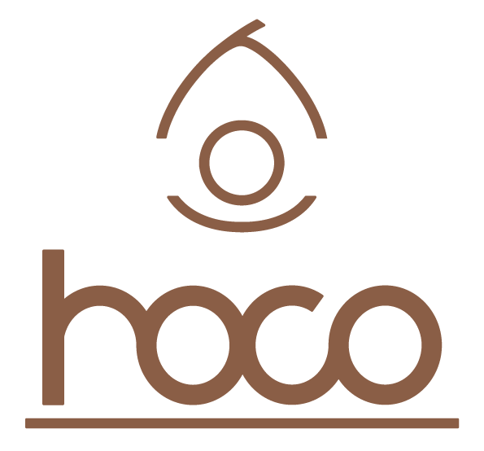
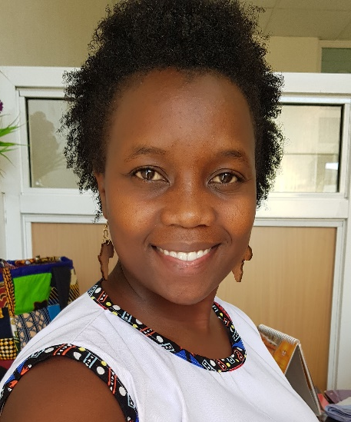



HOCO Dynamics
Sheila Koech
Ecologist, Innovator, Entrepreneur (26 yrs old)
With the poverty rate currently standing at 75% in Kilifi county, housing problem is just one of the many problems faced by the people of this county.
What inspired the start of this business?
Poor housing conditions in Kilifi County, Kenya
Readily available raw materials
The need to mitigate climate change

Slide 3
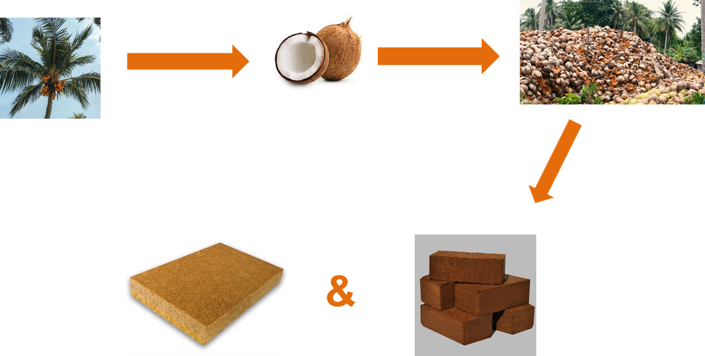
What is the nature of the business?
How?
Private Liability Company
(Social Entrepreneurship)
Main products:
(i) Coco-blocks
(ii) Coco-boards
Coco-panels
Coco-blocks

Slide 4
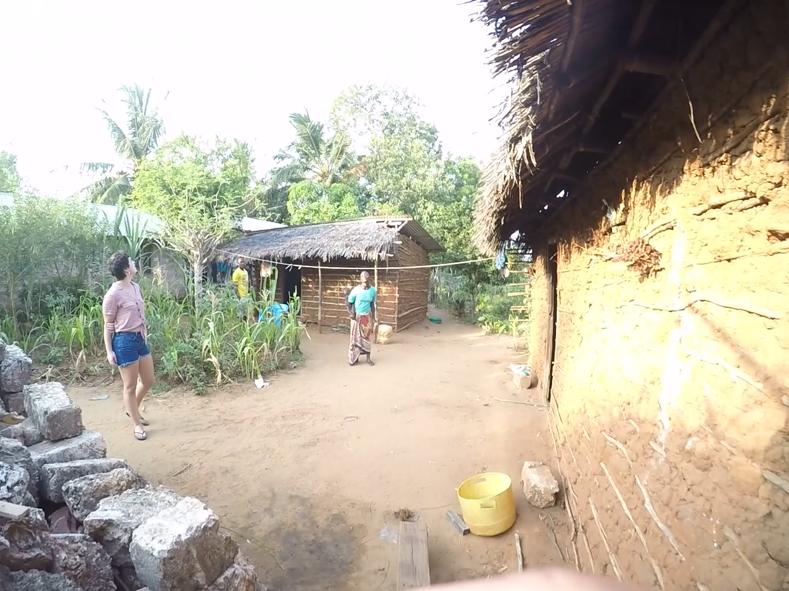
What customer needs are being addressed
Poor housing
Waste management
Poverty
Climate Change
Kenya is the 3rd largest producer of coconuts in Africa,
20,000 MT of waste is produced annually (UNEP, 2018)

Slide 5
How has the business impacted on other enterprises owned by young women?
The business is at its product development stage, and is yet to make any major impacts
Once we start production, we will provide direct employment to:
Up to 30 small-scale women farmers
More than 400 indirect job opportunities

Slide 6




How viable and implementable is the solution being proposed?
Viability:
Problem: Poor housing, expensive building materials, & poor coconut waste disposal
Opportunity: Readily available cheap raw materials
Solution: Eco-friendly, & affordable blocks and boards/panels
Implementation:
Cheap local labour, strong professional team, & grants
Partnership and Current funding
Revenue sources:
Business to Business (B2B)
Business to Consumer (B2C)
Grants

Slide 7
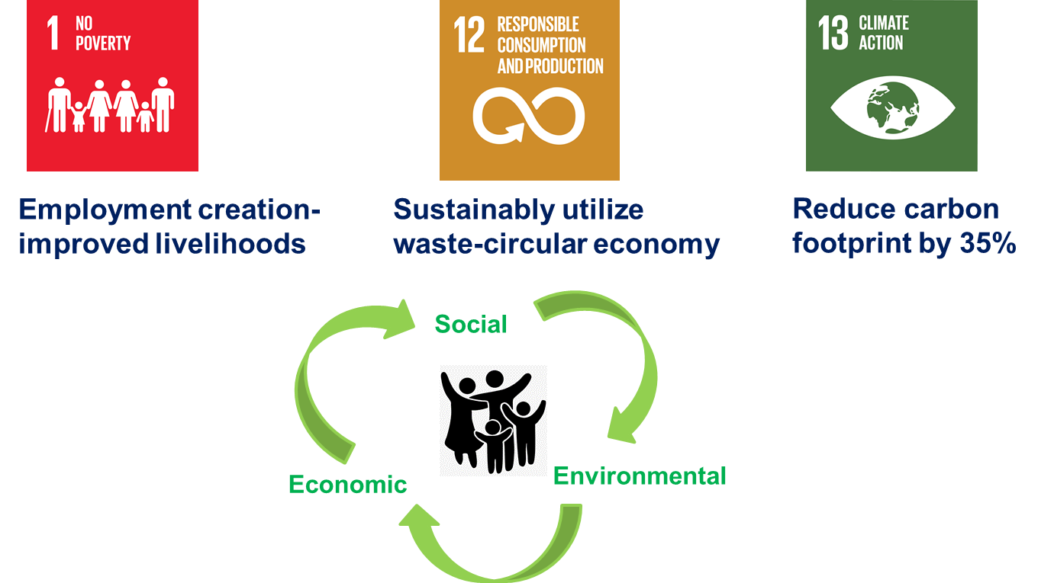
What makes the business unique?
Our Impact:

Slide 8
Use of ICT to promote economic and employment opportunities for young women?
Empowerment and training of women will be done both virtually and physically
We have extensively utilized the social media to look and apply for funding opportunities for women
We intend to create a website for marketing of our products (hire an ICT expert)

Slide 9
How have you managed the impact of the COVID-19 pandemic?
We have utilized this period to do:
Market research and virtual meetings working on our project
Product development with one key partner (KIRDI)
Applying for seed capital and scouting for production machinery

Slide 10
Anything else you would like to add
At HOCO we believe in sustainable production and consumption, and at most times, the solution to our problems lies right before our eyes.
If given the right support, the youth can play a huge role in creating sustainable change in construction and the built environment.
Thank you

