Slide 1







Logo goes here
LEARNING
AND SHARING
SUMMIT 2025
Story of Change
Matabeleland AIDS Council, Zimbabwe, Bulawayo,
February 2025
Viola Mupezani
Women’s Voice and Leadership Learning and Sharing Summit 2025

Slide 2
SYNOPSIS
The change that has occurred.
From a rural district in Zimbabwe with most of the villages quite far from the clinics or main hospital. Bulilima’ s huge number of Adolescent Girls and Young Women (AGYW) now can access SRHR services in their own villages from our Mobile Clinic. This has seen a huge decrease in unwanted pregnancies. Giving them a better control of their lives to better their livelihoods and fight poverty. In addition to this the district can now better manage;
Issues of cultural dynamics on SRHR – by having friendly youth services, safe spaces, Myths and misconceptions on SRHR demystified.
Issues of GI/GBV cases – ie Child marriages, sexual abuse, unequal power dynamics
There is now safe spaces, SRHR Champions, Mentors and Gender inclusive dialogues on SRHR issues, as well as awareness on drug and substance abuse which affect mental health and well being.
Women’s Voice and Leadership Learning and Sharing Summit 2025

Slide 3
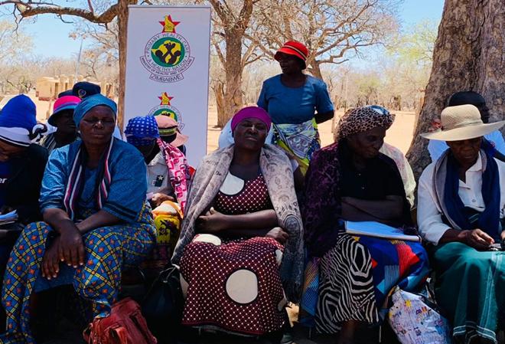
OBJECTIVES
To provided safe spaces from which AGYWs could access SRHR services and information. (i.e FP, PrEP, HTS, STI etc)
To enhance SRHR service uptake by provision of a mobile clinic which reduce distances AGWYs had to walk to find to closest health facility.
To raise awareness, increase knowledge and create safe, efficient and timely support systems to victims of GBV.
To identify and enhance norms that promote gender equality.
To identify other issues that affect the AGWYs and come up with mitigatory measures.
To find effective means that appeal to young people, which we can use cascade the information on SRHR, GBV, and Gender Equality
Photo
Women’s Voice and Leadership Learning and Sharing Summit 2025

Slide 4
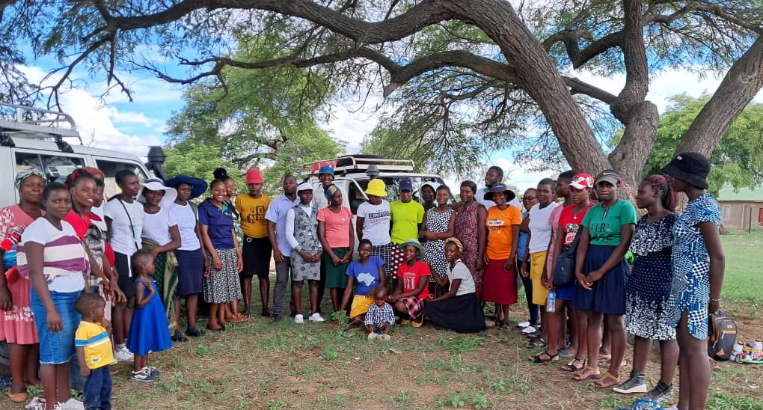
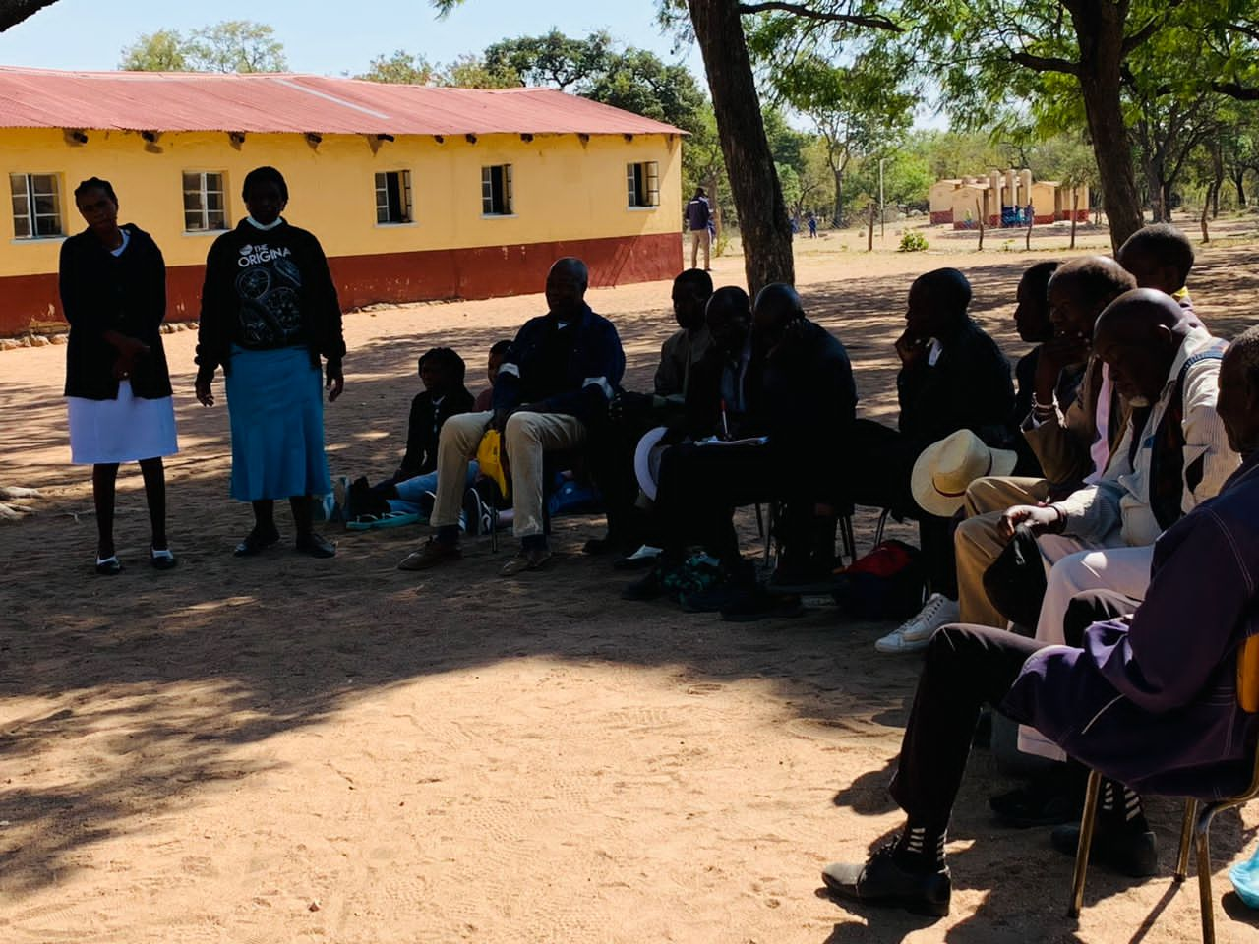
ACTIVITIES
Clinical Services (Mobile Clinics)
HTS
PrEP provision.
Contraceptives service provision.
STI screening and treatment
Distribution of menstrual cups and re-usable pads
Trainings and Advocacy
Community visioning and awareness on SRHR and Gender Inclusiveness.
Re-usable Pads trainings.
Mentorship of Ambassadors and SRHR Champions.
Career guidance.
Continuous Improvement & Learning
Conduct Dialogues with Leaders, AGYWs and all concerned.
Design indicators and data collection tools that assist in continuous monitoring and evaluation of our program.
Photo
Women’s Voice and Leadership Learning and Sharing Summit 2025

Slide 5
Contribution to change
Advocating for norms that promote gender equality.
Engaged and included community leaders and gate keepers to serve as custodians of the project.
Provision of SRHR services to AGYWs and the community at large.
Capacity building for AGYW and Community leaders on SRHR
Partnered with relevant government ministries
Women’s Voice and Leadership Learning and Sharing Summit 2025

Slide 6
Population Group this change most closely related to
Category | Women | Men | Total | % Women
Direct beneficiaries | 300 | 50 | 350 | 86%
Indirect beneficiaries (e.g. through other networks) | 900 | 150 | 1050 | 86%
Online beneficiaries (e.g. website access, mailing lists, scholarly articles) | 1500 | 700 | 2200 | 68%
Total | 2700 | 900 | 3600 | 75%
Women’s Voice and Leadership Learning and Sharing Summit 2025

Slide 7
Significance of change
The understanding on Gender equality issues by the community leaders may influence policy making and increase chances of a better future for the girl child.
Reduced GBV incidence and an increase in the GBV reported cases fosters healthier relationships in the families.
Increased uptake of SRHR services ie Family planning, HIV testing and PrEP is allowing families to take control full control of their lives thereby improving livelihoods and reducing poverty.
Through the program the beneficiaries continue to have a strengthened resilience towards challenges that they come across.
Women’s Voice and Leadership Learning and Sharing Summit 2025

Slide 8
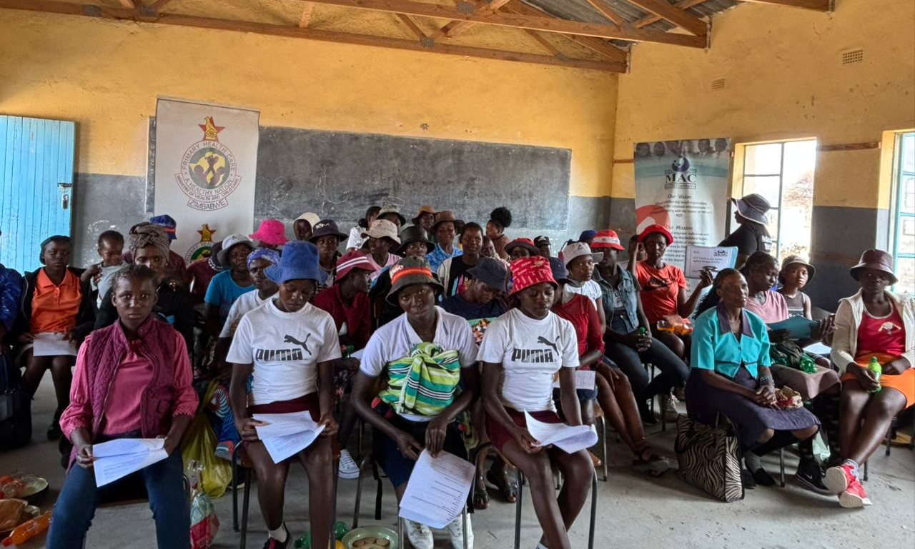
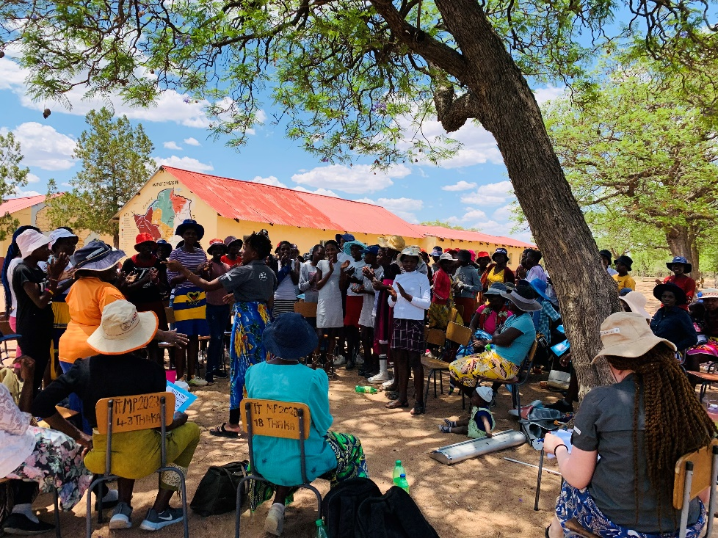
RESULTS
A significant increase in the number of people who attend our health talks and uptake services like family planning, HIV Testing and PrEP, from our mobile clinic.
High attendance and positive feedback from the community leaders, peer to peer and male engagement dialogues on SRHR, GBV & Gender Equality
Positive change in help and health seeking behaviours in AGWYs, leading to reduced teenage and unwanted pregnancies.
Include evidence here – photos/clippings
Women’s Voice and Leadership Learning and Sharing Summit 2025

Slide 9
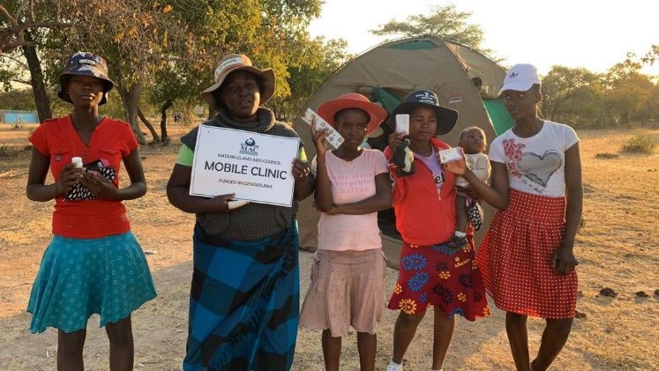
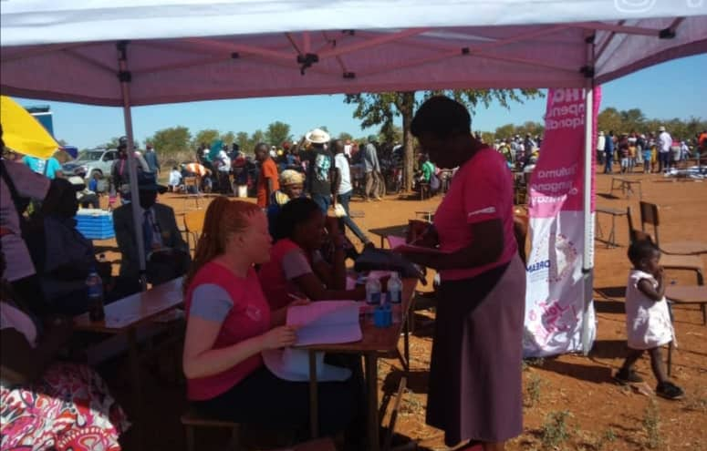
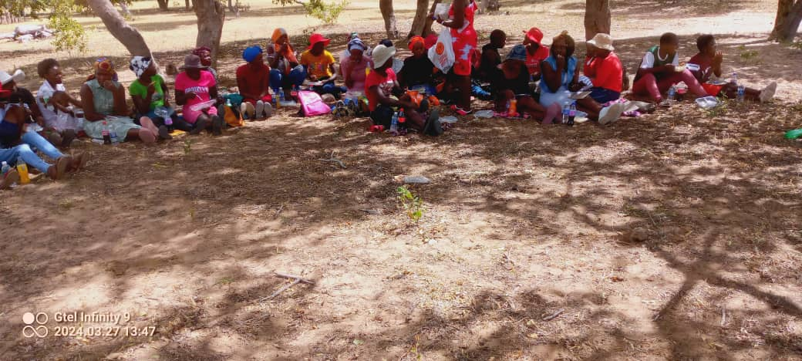
Evidence
Facility registers for Family planning, PrEP, HTS and STI.
Mobile clinic service provision reports and photos
Testimonials from community leaders and AGWYs
Reduced GBV occurrences and an increase in the GBV cases reported
A significant increase in the chances and opportunities afforded to the girl child.
The appointment of 5 GBV champions in the community to offer safe and immediate help to victims.
M&E support visits, verifications and tracking reports
Include evidence here – photos/clippings
Women’s Voice and Leadership Learning and Sharing Summit 2025

Slide 10
CHALLENGES AND LESSONS LEARNT
Main challenges encountered during the project implementation:
Reaching Key and Vulnerable Populations including People with Disabilities.
Stigma and discrimination on GBV, SRHR and Gender Equality issues.
Drugs and substance abuse
Overcoming Challenges
Offered private and confidential moonlight services to reach Key and Vulnerable groups at their convenience
Continued creation of safe spaces to eliminate stigma and discrimination and promote uptake of SRHR services for all
Engaged community leaders, gatekeepers and parents on issues of GBV, SRHR & Gender Equality.
Collaborated with government ministries to ensure support and sustainability of such programmes
Raised awareness on negative effects of substance abuse.
Women’s Voice and Leadership Learning and Sharing Summit 2025

Slide 11
CHALLENGES AND LESSONS LEARNT
Lessons learnt from the project:
That it is crucial to engage the community at large in SRHR for AGYW to promote understanding and a buy in to ensure sustainability and access to AGWYs as we implement the project
That it is important to collaborate with relevant government ministries to ensure support and sustainability of the project
That it is important to have safe spaces and private spaces for confidential services provision as this is essential in reaching Key and Vulnerable Populations
That community based approach is effective in promoting uptake of SRHR, GBV and Gender Equality programs
That most young people spend most of their time on social media.
Women’s Voice and Leadership Learning and Sharing Summit 2025

Slide 12
CHALLENGES AND LESSONS LEARNT
How will the lessons learned be applied?
Engage Community Leaders in SRHR for AGYW to promote buy in and ensure sustainability
Strengthening collaboration with government ministries to ensure sustainability
Expanding private and confidential moonlight services to increase access to SRHR, services
Scaling up community based approaches to reach more AGYW and Key and Vulnerable groups
Start providing SRHR, GBV and Gender Equality service on social media platforms.
Accelerate drug and substance abuse awareness.
Women’s Voice and Leadership Learning and Sharing Summit 2025

Slide 13
SUSTAINABILITY AND REPLICATION
How can the work be sustained/kept going?
Identifying and securing sustainable funding source
Partnering with local organisations to reach more communities and populations
Using data to inform program decisions and improvements
Sharing results and lessons learnt with stakeholders and partners
Building a diverse and skilled service provision team
Setting up local structures that can support the community on SRHR, GBV and Gender Equality issues right in the communities.
How can the work be cascaded to other organisations?
Exchange programs.
Partnerships for layering of services.
Collaborating with relevant government ministries.
Making the model flexible to suit different settings since communities differ.
Encouraging other organisations that work with young people to include SRHR,GBV AND Gender Equality issues in their programming as well as drug and substance abuse issues.
Women’s Voice and Leadership Learning and Sharing Summit 2025

Slide 14
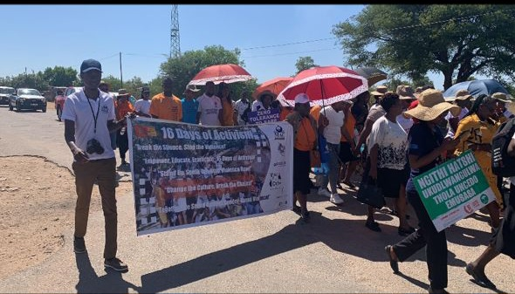
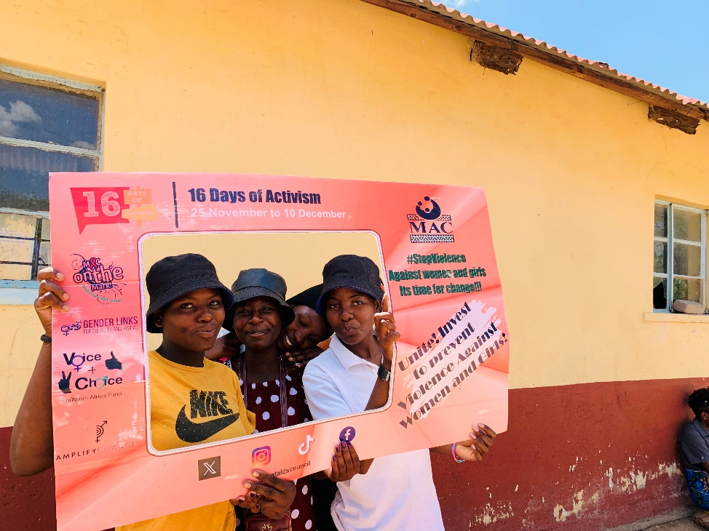
NEXT STEPS
Expanding to new communities and reaching more AGYW and Key and Vulnerable populations and those with disabilities.
Strengthening partnerships with relevant government ministries and other organisations.
Training and capacitate service providers and community health workers on SRHR, GBV, Gender Equality, Drugs and Substance abuse.
Avail SRHR, GBV, Gender Equality and Drug and Substance Abuse information on social media, through the use of WhatsApp Chatbots, Facebook, Tiktok etc
Women’s Voice and Leadership Learning and Sharing Summit 2025

