Slide 1







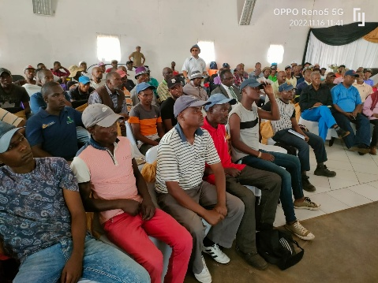
LEARNING
AND SHARING
SUMMIT 2025
Story of Change Template
(South Africa, Johannesburg, 02/025 and Carren
Women’s Voice and Leadership Learning and Sharing Summit 2025

Slide 2
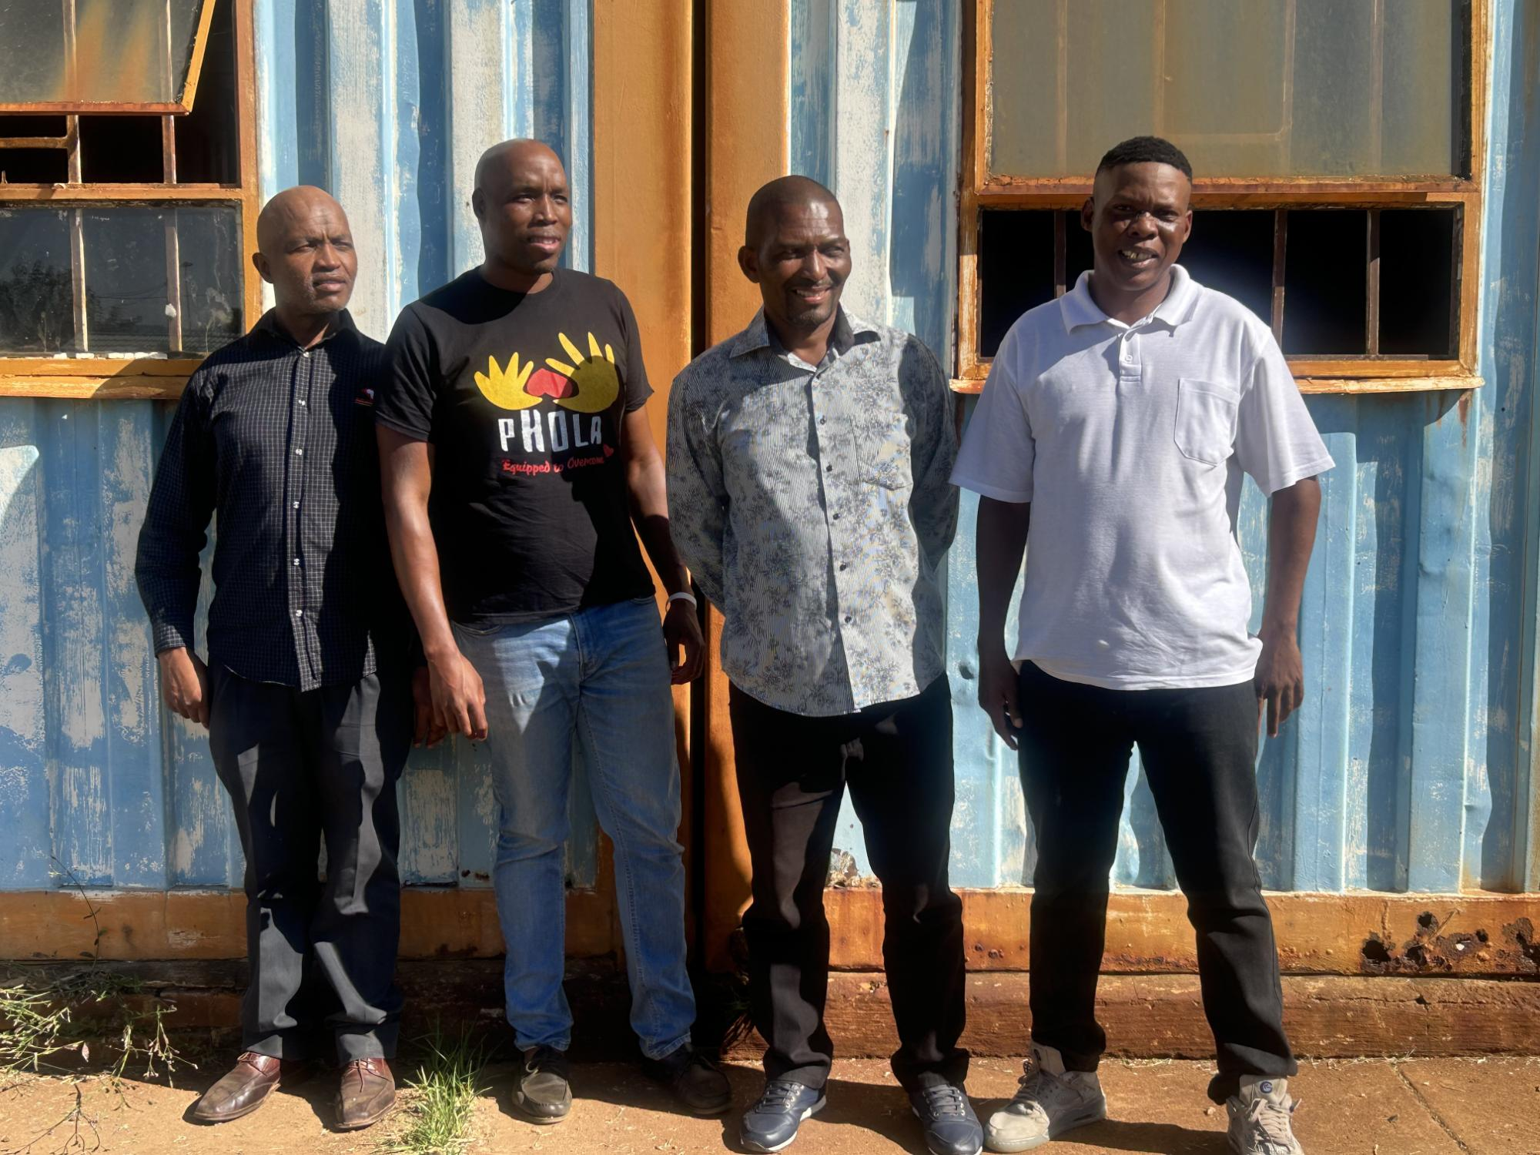
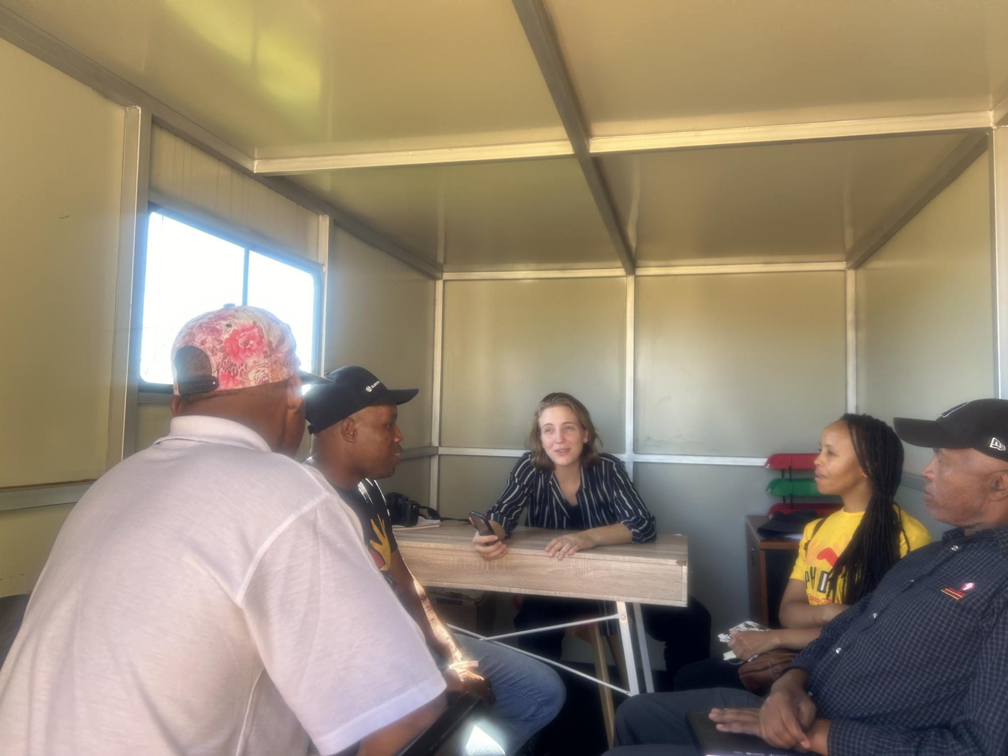
SYNOPSIS
O.U.T.T.R.A.G.E.D is a collective narrative therapy framework that facilitates conversation with men and boys for the prevention of violence and GBV specifically. The framework is for awareness raising, concept development, behaviour change and the development of personal agency among men and boys to support them to become community champions and agents of social justice in the prevention of GBV.
Change that has occurred.
During the period of 2023-2025,Phola has reached 629 men and boys with the eleven-session O.U.T.T.R.A.G.E.D. intervention. The intervention was carried out at Orange Farm Police station, old multi purpose, development centre in Protea Glen, Matholesville, Soweto, Cosmo City, Zandspruit and Tembisa. All beneficiaries who completed the eleven- session intervention was supported to conduct GBV awareness initiatives and reach at least thirty (30) other men in their respective communities. The aim of the project was for men and boys who have completed the intervention to reach an additional 2400 men and boys.
O.U.T.T.R.A.G.E.D. champions surpassed the above target and managed to reach over 15 000 men and boys in their communities with various GBV awareness raising initiatives via social media, in schools, churches, and communities. Soccer tournaments were used by men in Mathollesvile, several men were interviewed in radio stations about their GBV awareness raising initiatives.
Photo
Women’s Voice and Leadership Learning and Sharing Summit 2025

Slide 3
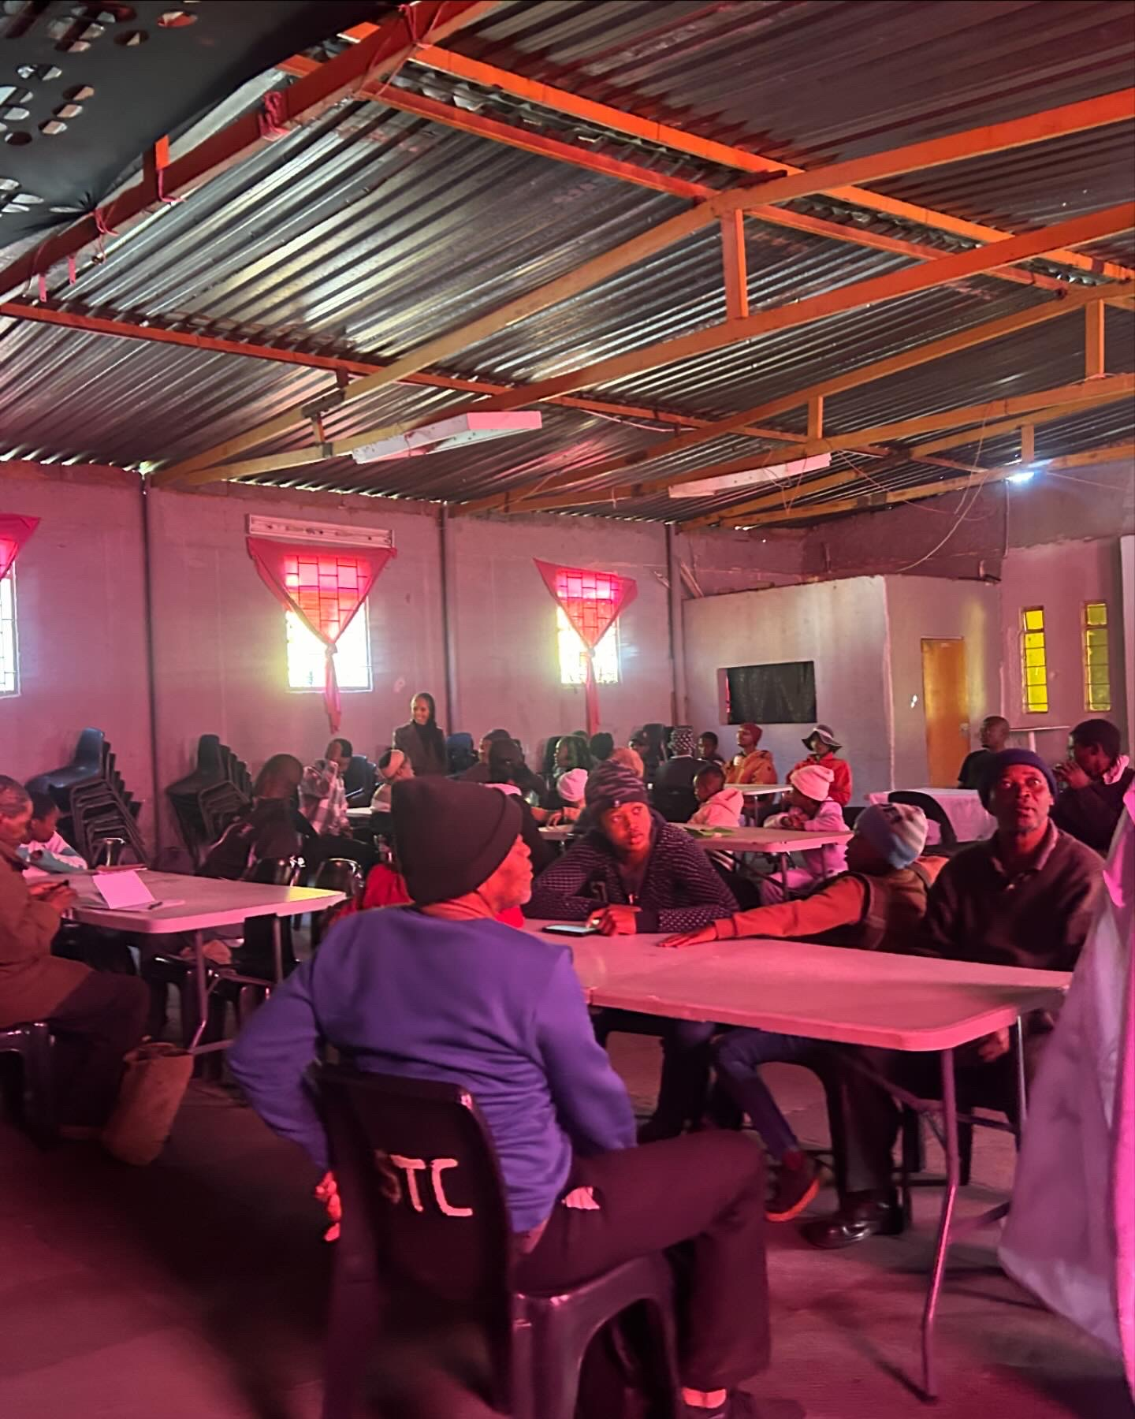
OBJECTIVES
The project set out to do the following:
To change harmful gender attitudes among men and boys that perpetuate GBV
To decrease symptoms of clinical depression among eighty (80) men and boys at risk and those who use violence in their relationships with others
To increase awareness of the hazards of GBV among men and boys
To contribute towards movement building for the prevention for GBV
To work with men and boys as partners in the prevention of GBV
To promote gender equality and promote inclusivity
Photo
Women’s Voice and Leadership Learning and Sharing Summit 2025

Slide 4
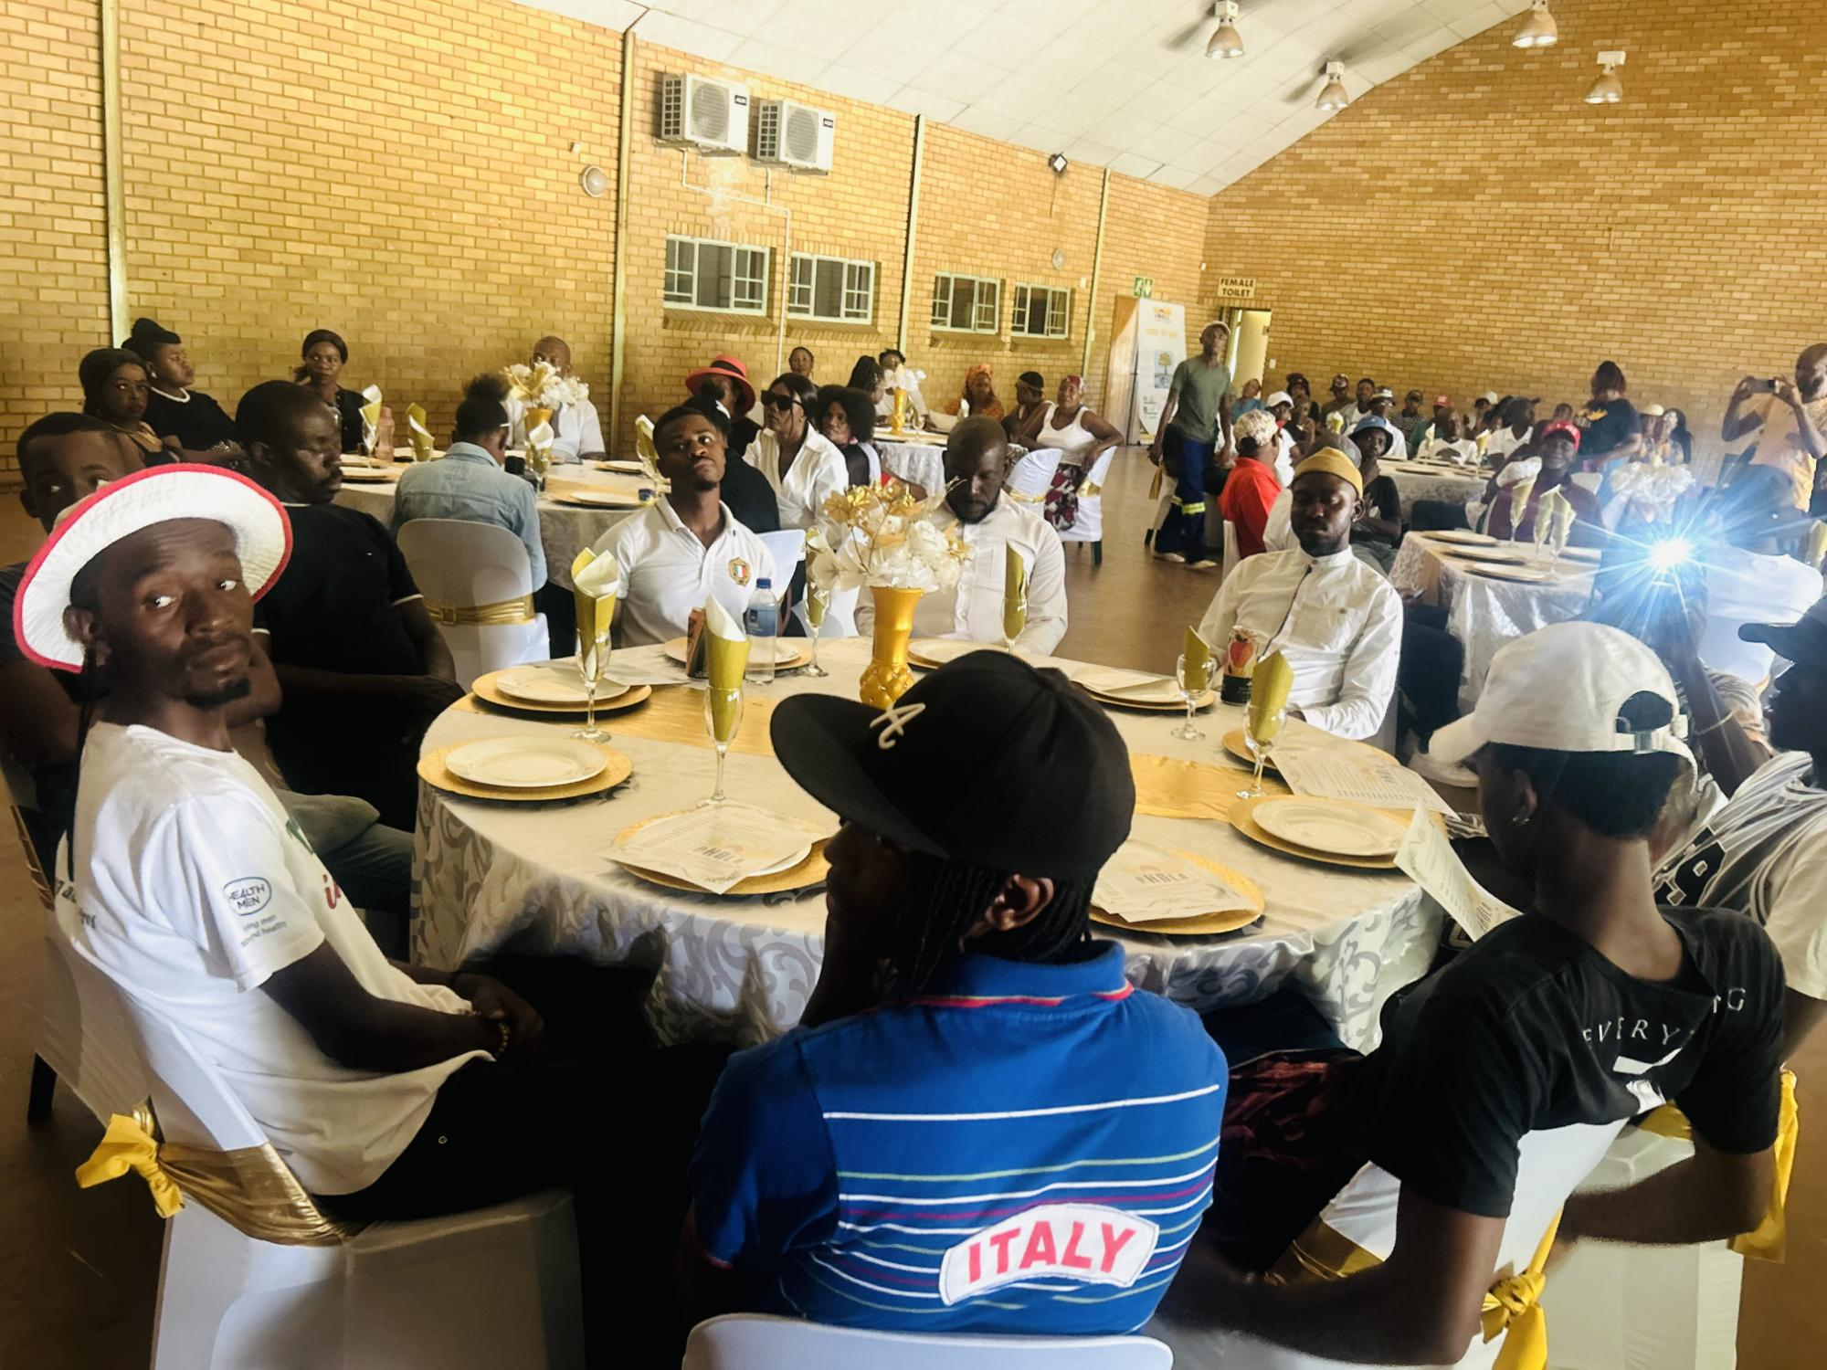
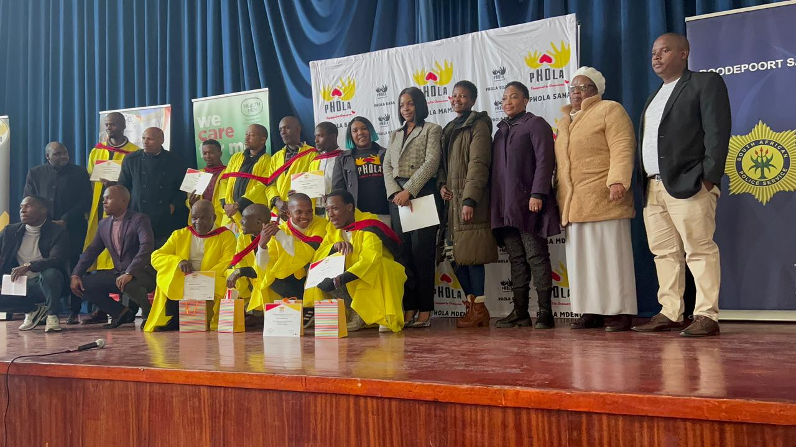
ACTIVITIES
Please provide a description of the evidence or verification including any supporting documents you may have.
629 pre-post assessments on depression using the PHQ-9 for adults and adolescents
Phola use the WHO endorsed Patient Health Questionnaire (PHQ-9) to assess symptoms of clinical depression among children, adolescents and adults. Six hundred and twenty-nine (629) men and boys completed PHQ-9 questionnaire pre-post the intervention.
629 Gender attitude survey questionnaires for men and boys both pre and post the intervention
Phola uses a gender attitude survey with seven questions
Videos, photos, as well as session registers
During the intervention and the advocacy work, videos and pictures are captured. Session/awareness register are filled in as well
Social media content
Phola social media platforms shares and update on the work being done in communities, including upcoming events
Drivers of change forms
After completing the O.U.T.T.R.A.G.E.D. intervention, men filled in the drivers of change template on voluntary basis
Community testimonies
Communities are witnessing the change happening in their communities through the O.U.T.T.R.A.G.E.D champions
Photo
Women’s Voice and Leadership Learning and Sharing Summit 2025

Slide 5
ACTIVITIES
What evidence or means of verification do you have for this change?
629 pre-post assessments on depression using the PHQ-9 for adults and adolescents
629 Gender attitude survey questionnaires for men and boys both pre and post the intervention
Videos, photos, as well as session registers
Social media content
Drivers of change forms
Community testimonies
Please provide a description of the evidence or verification including any supporting documents you may have.
Case study
John (fake name), a man who struggled with anger and depression throughout his life, attended the O.U.T.T.R.A.G.E.D. session and experienced a profound transformation. Previously, his rage affected both his family and colleagues, and as a member of the Community Police Forum, he had resorted to using violence to punish offenders, driven by past childhood trauma. After participating in the session, John learned to manage his anger, control his emotions, and heal from his past. He is now a changed man, able to smile with his family and colleagues, no longer abusing his power or feeling depressed.
Photo
Women’s Voice and Leadership Learning and Sharing Summit 2025

Slide 6
Contribution to change
What contribution did your organisation make to this change?
Please describe the advocacy work and actions taken by your organization that have contributed to this change.
Phola's Advocacy Work:Phola facilitated eleven (11) sessions with men and boys in schools and communities to raise awareness on GBV and challenge harmful masculinity. The total reach through the intervention was 629 men and boys.
Men’s Forums: In Orange Farm, men formed the Khoroni Men's Forum and were supported to be recognized in local stakeholder forums. The organization provided them with materials such as flyers, pamphlets, banners, and gazebos.
Community Champions: In Matholesvile after completing the intervention, men travelled to Eastern Cape, Phola supported men to raise GBV awareness with leaders and decision-makers. Over 400 people were reached. Around Region C, Matholesvile champions developed partnerships with various stakeholders to champion the prevention of violence in their communities.
Ongoing Advocacy: Champions continue to influence their communities, providing advice and leadership on GBV. In Matholesvile, the O.U.T.T.R.A.G.E.D champions have become the go-to people for advice. In Diepsloot, men are raising awarenesses in malls, clinis and churches within their communities.
Soccer Tournament: In October 2024, a soccer tournament was launched to engage youth and raise GBV awareness. Over 500 men and boys were reached through the awareness.
School Programs: Psychosocial clubs were created in schools, with boys leading efforts to protect girls and challenge toxic masculinity and create safe spaces for young boys.
Women’s Voice and Leadership Learning and Sharing Summit 2025

Slide 7
Population Group this change most closely related to
Category | Women | Men | Total | % Women
Direct beneficiaries | 26 | 629 | 655
Indirect beneficiaries (e.g. through other networks) | 220 | 2000 | 2220
Online beneficiaries (e.g. website access, mailing lists, scholarly articles) | 5220 | 7476 | 12696
Total | 5466 | 10105 | 15571
Women’s Voice and Leadership Learning and Sharing Summit 2025

Slide 8
Significance of change
What is the significance of the change?
Please provide further information on what this change means for the movement and its goals and what effect this change may have on the next steps in this area of work.
The O.U.T.T.R.A.G.E.D men in Matholesvile have become a go-to for men and boys in their community. The men have become the go to people when violence incidents occur in their community. They help to settle disputes and refer cases to the police. In a recent incident they calmed a dangerous situation where a man intended to kill his wife and his four children after his wife decided to leave him. Matholesville men are saving lives in their communities.
The O.U.T.T.R.A.G.E.D methodology has proven to be powerful in transforming harmful attitudes that perpertuate violence GBV and promoting positive behavioral change. The Khoroni men’s forum during an event after sharing their powerful testimonies of O.U.T.T.R.A.G.E.D. they attracted the Orange Farm Police Stations commanders. Through the Khoroni champions, Phola was asked to come and facilitate the intervention with all males starting from the lower ranks. The champions are leaving footprints for the organization’s recognition.
The notorious boys previously in gangs are now championing the schools raising awareness in to their fellow schools mates. The formation of Psychosocial clubs in schools where boys share their grieviences and receive support from their fellow brothers.
Women’s Voice and Leadership Learning and Sharing Summit 2025

Slide 9
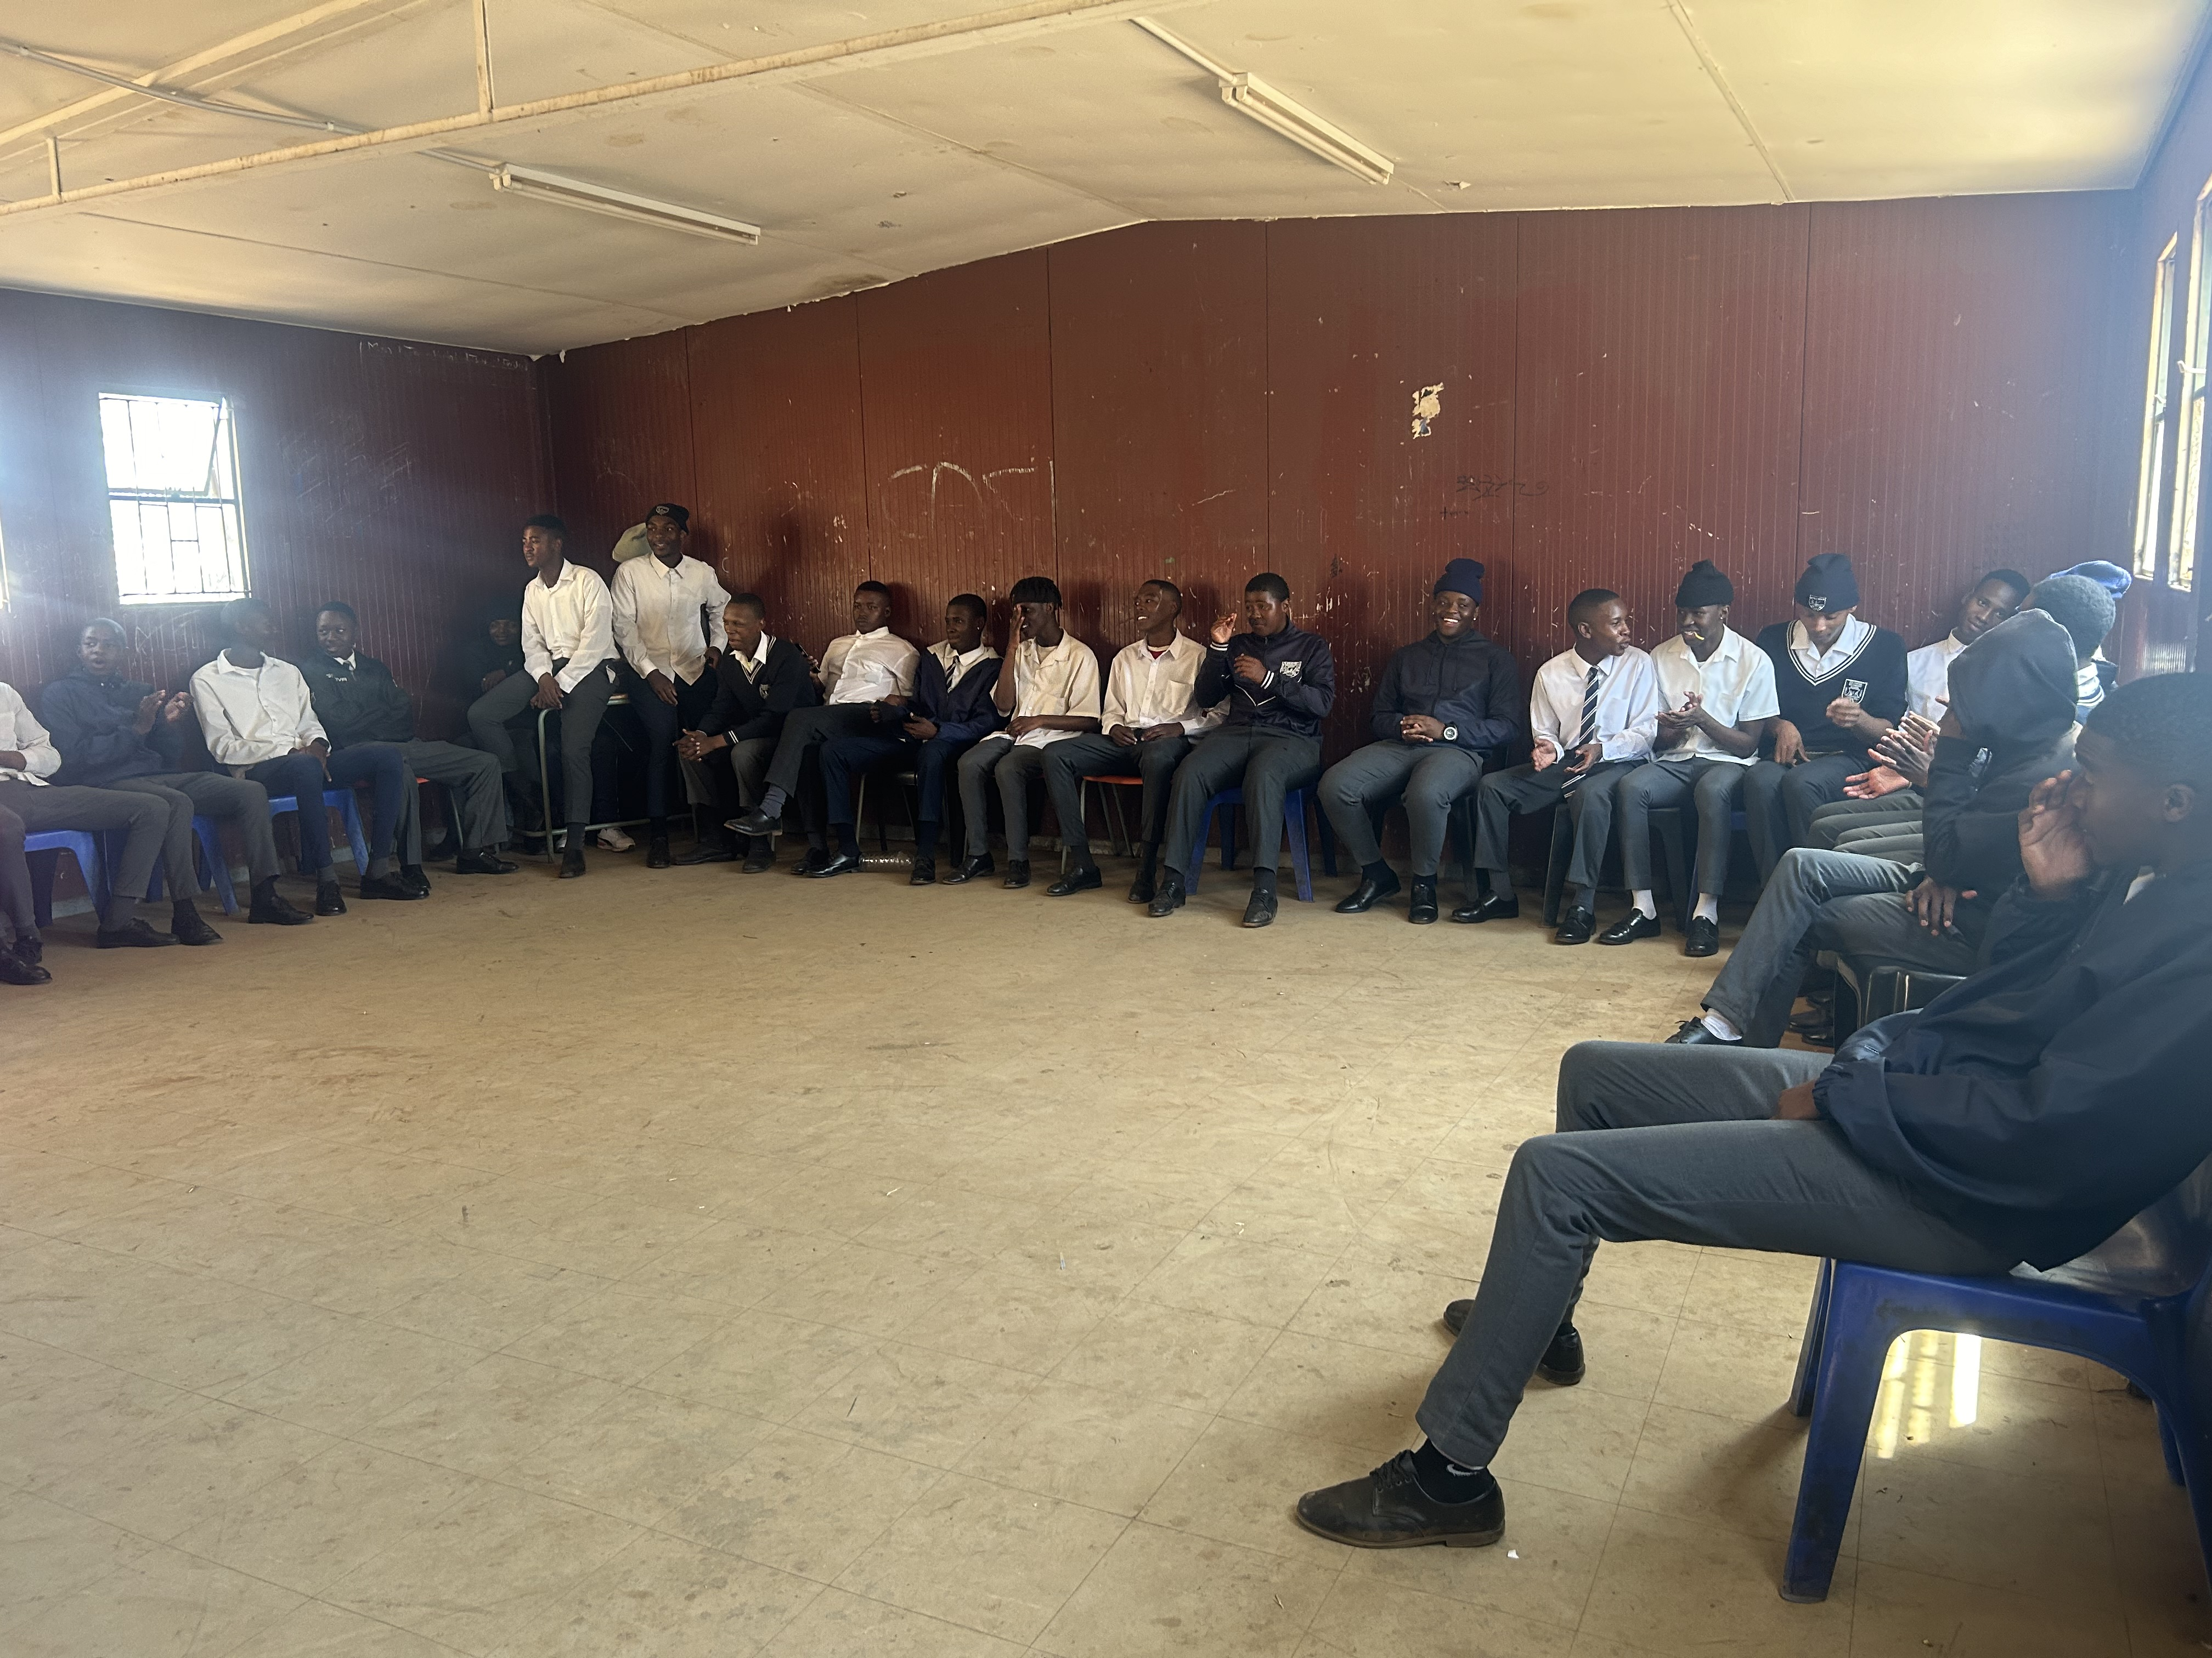
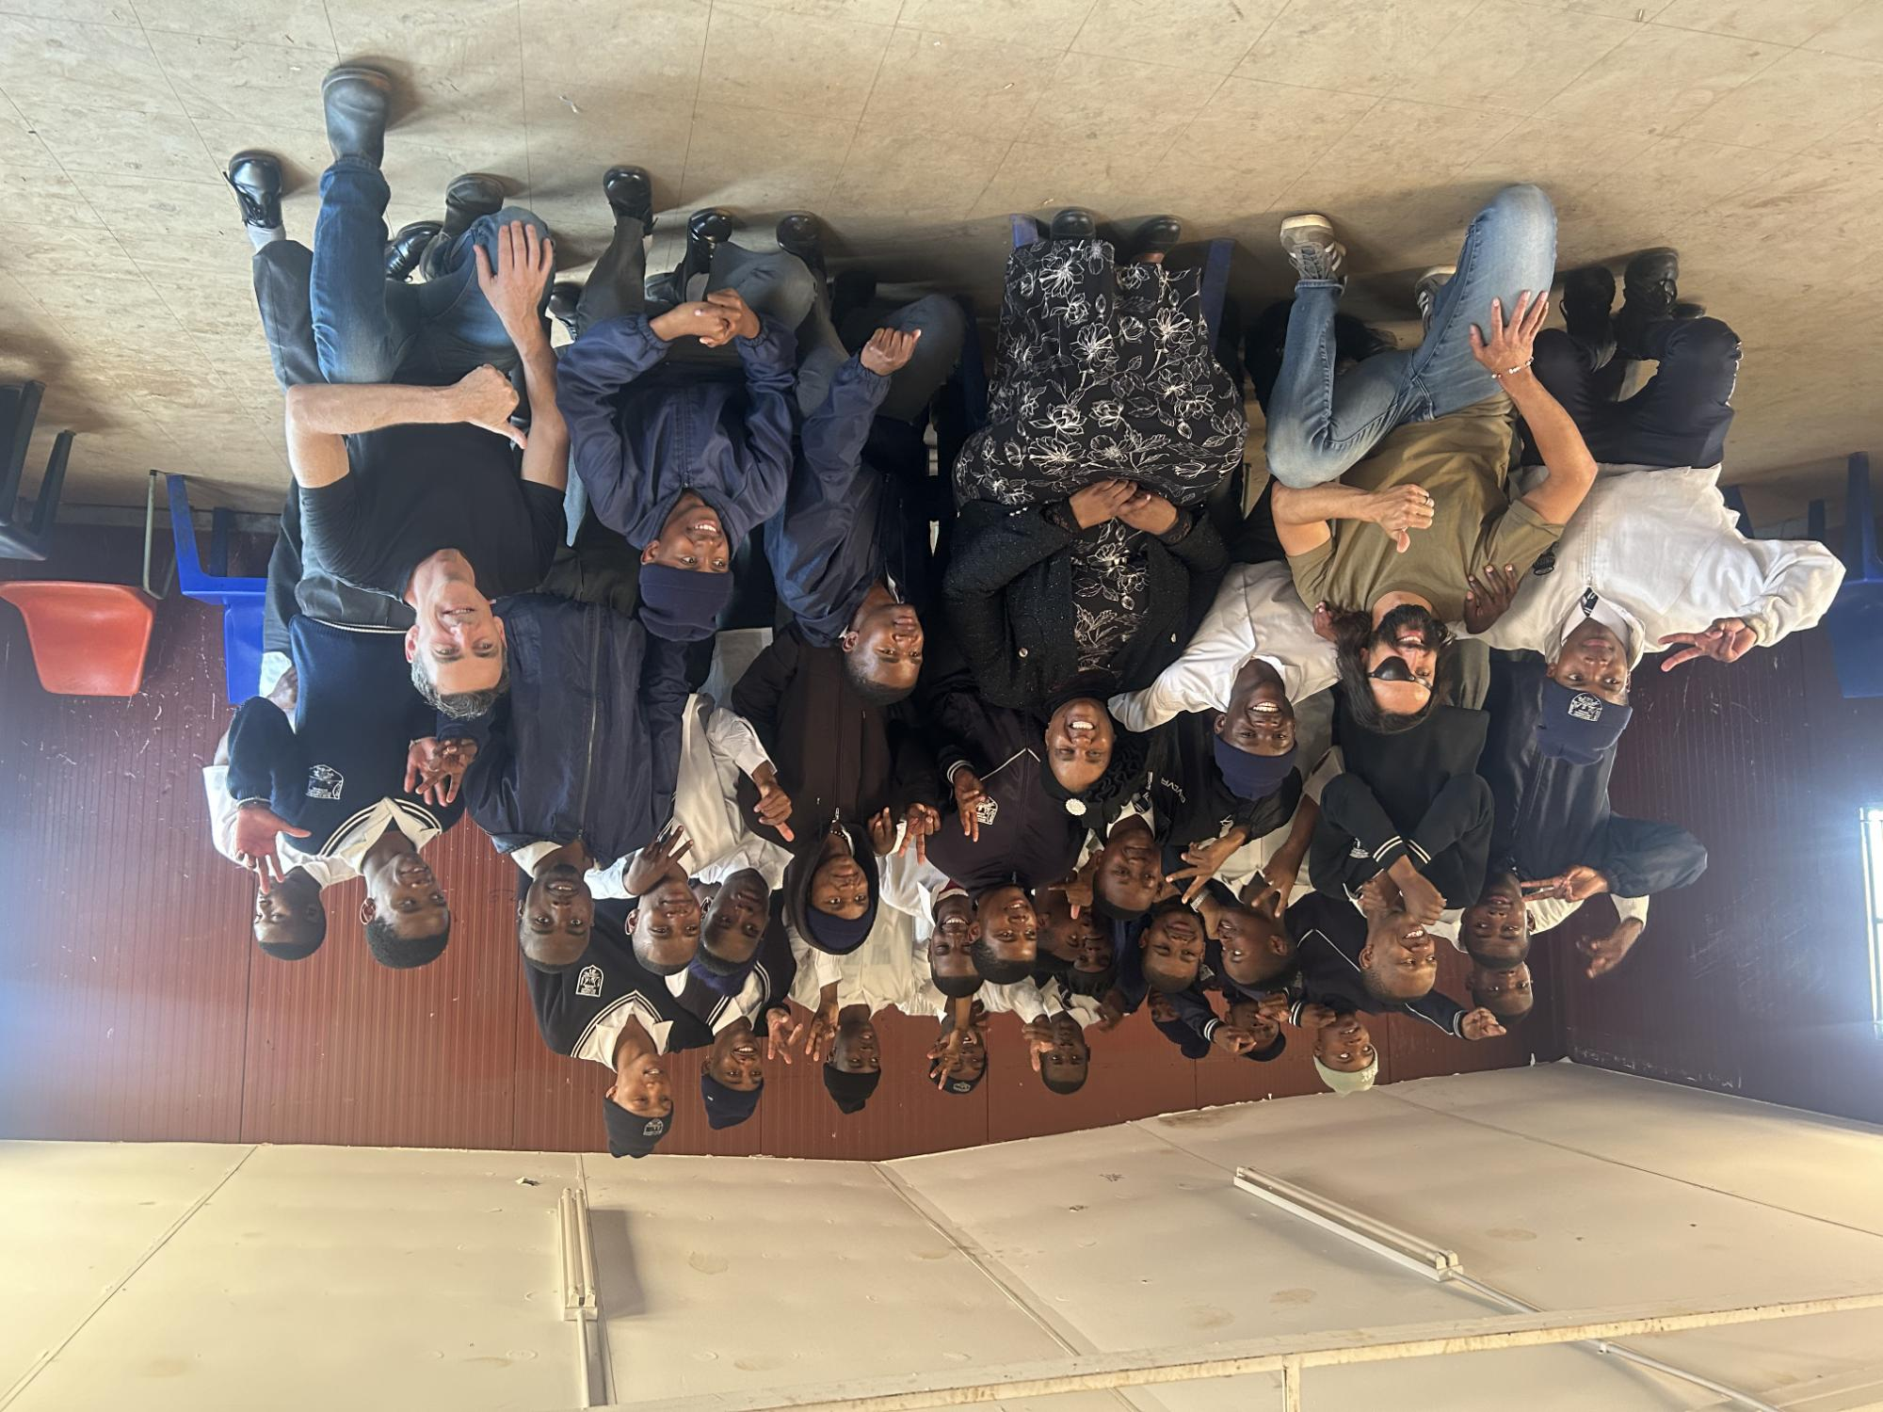
Evidence
    The slides below show results from Depression scores
    and the Gender attitude measures
Include evidence here – photos/clippings
Women’s Voice and Leadership Learning and Sharing Summit 2025

Slide 10
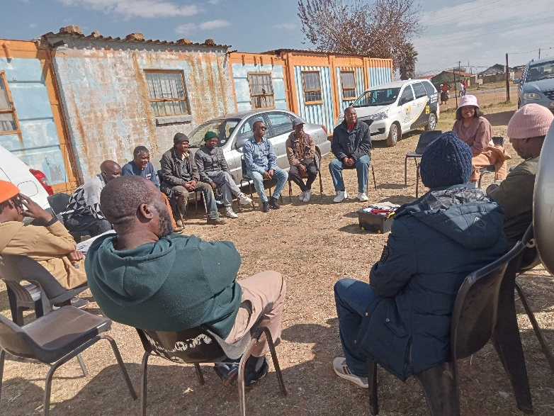
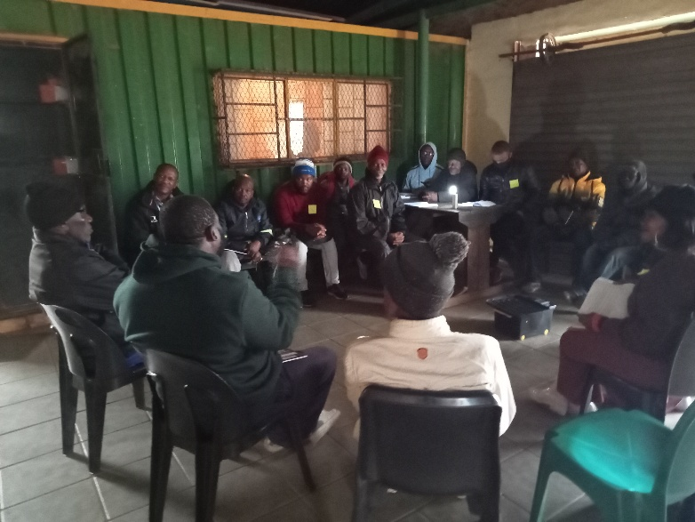
RESULTS
Please share some of your results for example:
Change in gender attitudes
To evaluate the gender attitudes of boys, we used a structured questionnaire comprising seven questions. For this report, three questions were analysed. The learners were asked to indicate their level of agreement with each statement, choosing from the following options: Strongly Agree, Agree, Neutral, Disagree, or Strongly Disagree. We administered the questionnaire to participants from both primary and secondary schools, with the aim of comparing gender attitudes before and after completing our interventions. This comparative analysis enabled us to identify potential shifts in attitudes and assess the effectiveness of our program.
The findings from our assessment of gender attitudes are presented below, highlighting the differences in responses between primary and secondary school learners. These results provide valuable insights into the impact of our interventions on promoting positive gender attitudes among boys and girls based on four questions:
Women’s Voice and Leadership Learning and Sharing Summit 2025

Slide 11
It is acceptable for a man to hit a woman if she deserves it:
At Bokamoso Secondary School, we used a sample of 30 learners, 15 boys from grade 11E and 15 girls from grade 11E. These were the findings:
Boys:
At Pre-Assessment
Three (3) boys had a "Strongly Disagree" attitude towards this question. There is a clear increase in the number of boys who strongly disagree after the post assessment, indicating a shift towards stronger rejection on hitting women.
Three (3) boys were neutral
Pre-Assessment, 9 boys strongly agreed with the statement about hitting women
At Post assessment
Ten (10) boys strongly disagreed.
One (1) boy was neutral
Four (4) boys strongly agreed with the statement.
The shifts made in the boys’ responses show evidence of attitude and behavior change. This suggests that the O.U.T.T.R.A.G.E.D intervention has influenced boys’ perspectives, leading to a reduced acceptance of violence against women. At pre-assessment, 20% of the boys strongly disagreed with the statement while at post assessment, 67% of the boys strongly disagreed. These results reflect a shift in boys' gender attitudes from a neutral or acceptance viewpoint to a strong rejection of violence against women. These changes provide a strong sense that the O.U.T.T.R.A.G.E.D intervention helped to shift harmful attitudes amongst boys at Bokamoso Secondary School.

Slide 12
It bothers me when a boy acts like a girl.
At Tembisa SOS, we used a sample of thirty (30) learners, fifteen (15) boys and fifteen (15) girls to discuss ‘if it bothers them when a boy acts like a girl’ pre and post assessments and these were the findings:
Boys: A sample of fifteen (15) boys from grade 6A was used
At pre-assessment:
Two (2) boys strongly disagreed
One (1) boy was neutral
Twelve (12) boys strongly agreed
At post-assessment:
Twelve (12) boys strongly disagreed
One (1) boy was neutral
Two (2) boys strongly agreed
These results indicate a shift in the boy’s attitude, suggesting that more boys found certain gender attitudes objectionable post-assessment. Only 13% boys strongly disagreed with the statement ‘it bothers me when a boy acts like a girl’ while at post-assessment, 80% boys strongly disagreed. The data shows a significant shift in boys' gender attitudes from strong agreement to strong disagreement with being homophobic. This suggests that the O.U.T.T.R.A.G.E.D intervention helped in educating the boys about different gender identities and being open to everyone, thus, they disregarded their strong resentments of people who act like boys or vice versa.

Slide 13
A man should make important decisions alone.
At Endulweni Primary School, we used a sample of sixty (60) learners, thirty (30) boys and thirty (30) girls in grade 6A to establish their attitudes towards other genders and these were the findings:
Boys: A sample of thirty (30) boys from grade 6A was used.
At pre-assessment:
Six (6) strongly disagree
Fourteen (14) were neutral
Ten (10) strongly agree
At post-assessment:
Sixteen (16) strongly disagree
Ten (10) are neutral
Four (4) strongly disagree
At pre-assessment, 20% of the sample strongly disagree while at post-assessment, 53% of the sample strongly disagree. The significant increase in "strongly disagree" responses alongside the decrease in "strongly agree" indicate that the O.U.T.T.R.A.G.E.D intervention had a strong influence on how the boys perceive about decision-making, leading to a more critical perspective on certain gender norms or messages.

Slide 14
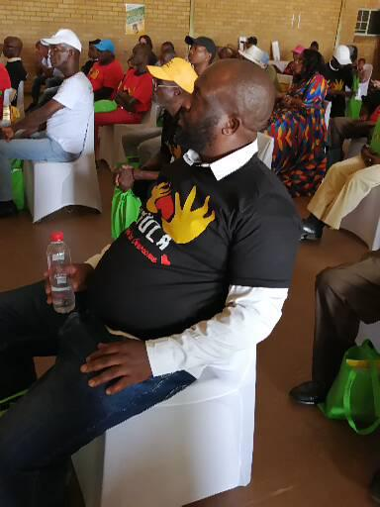
O.U.T.T.R.A.G.E.D. has increased safety in schools as learners do not Thoughts of suicide
At pre-assessment, ninety-four (94) boys had suicide thoughts whilst at the end of the post-assessment the number reduced to twenty-one (21). This means 73 boys who were suicidal at pre-assessment had no suicide thoughts at the end of the O.U.T.T.R.A.G.E.D intervention. The reduction of suicide thought was 78% for the boys. Boys had a high suicide reduction rate.
Suicide Attempt
At pre-assessment, two hundred and twelve girls (212) had attempted to end their lives. At post assessment the number was reduced to fifty-nine (59). One hundred and fifty-three (153) children who had previously attempted suicide had no plans to do so by the end of the intervention. There was a 72% reduction.
At pre-assessment, seventy-four (74) boys attempted suicide, but this number reduced to twenty-one (21) at post assessment. This means fifty-three (53) boys who had previously attempted suicide had no such intentions at the end of the intervention. There was a 72% reduction.
The O.U.T.T.R.A.G.E.D. intervention has had a significant impact on reducing both suicidal thoughts and suicide attempts.
Sixty-seven (67) men were assessed using the gender attitude survey. The results of the assessments show that:
More participants are rejecting patriarchal beliefs than those who support
them.

Slide 15
CHALLENGES AND LESSONS LEARNT
What have been the main challenges? How have these challenges been overcome?
The O.U.T.T.R.A.G.E.D program was initially funded for 80 men. The team experienced unexpected demands due to the popularity of the intervention. The men in communities found the sessions engaging and invited friends and family members to attend. This increased the number of people who attended the sessions. This caused challenges including budget constraints on the project.
The ever-increasing costs of fuel and program materials continues to be a challenge.
High rates of poverty and unemployment of project beneficiaries affects retention as men find themselves conflicted; “should I attend a session or go and look for a piece job”.
The majority of .O.U.T.T.R.A.G.E.D. champions are unemployed and Phola has been requested to provide food parcels for participants. This was never budgeted for and the organization has to find means to meet such a request
Community work creates a lot of expectations, project participants sometimes expect Phola to meet all their needs
Women’s Voice and Leadership Learning and Sharing Summit 2025

Slide 16
CHALLENGES AND LESSONS LEARNT
What lessons have been learned?
Men who have perpetrated violence against women and girls and others can transform and become agents of social change in the prevention of GBV.
Community champions require support and income strengthening initiatives so that they remain effective in their efforts to bring change in communities
Family involvement and support is critical in supporting men’s efforts to change and become champions of GBV prevention in their communities
They are several structural drivers of GBV that push men to perpetrate violence including unemployment, feeling disrespected, and unheard, shame, pressure, cultural norms and religious beliefs.
Working with boys presents a lot of opportunities to transform young people’s mindsets and ensure they grow up to value and respect gender equality
Women can facilitate men’s groups
Men in communities are hungry and eager to have safe spaces to talk about their challenges and distress
Men also suffer serious violence and abuse and therefore GBV prevention programs needs to cater for all genders
Women’s Voice and Leadership Learning and Sharing Summit 2025

Slide 17
CHALLENGES AND LESSONS LEARNT
How will the lessons learned be applied?
Phola continue to increase its fundraising efforts
We have established a social enterprise to provide mental health services to corporates at a nominal fee
Phola is engaged in efforts to support O.U.T.T.R.A.G.E.D. champions with income strengthening initiatives. We have asked men to come up with project proposals for the initiatives that they can develop for income strengthening. We have identified partners to train the men on entrepreneurship skills should we receive funding to do this work
The Youth@work partnership has helped with meeting staff salaries and increased the workforce of the organization. Phola will continue to pursue such partnerships as we grow and expand our reach
Women’s Voice and Leadership Learning and Sharing Summit 2025

Slide 18
SUSTAINABILITY AND REPLICATION
How can the work be sustained/kept going?
How can the work be cascaded to other organisations?
Phola is committed to sustaining its work by increasing fundraising efforts and establishing a social enterprise. This will provide ongoing support for community champions, empowering them to continue their advocacy and awareness initiatives. By securing sustainable funding, Phola aims to ensure long-term impact and growth in its programs, enabling champions to keep driving positive change in their communities and promoting gender-based violence awareness.
Through its partnership with the Youth@Work program, Phola secures funding to cover staff salaries and expand its workforce. This collaboration enhances the organization's capacity, allowing it to better support its community initiatives and increase its overall impact.
Phola’s work can be cascaded to other organizations by sharing best practices, offering training and mentorship, and promoting collaboration through partnerships. By establishing a network of community champions and providing resources, Phola can help replicate its successful initiatives in other regions.
Women’s Voice and Leadership Learning and Sharing Summit 2025

Slide 19
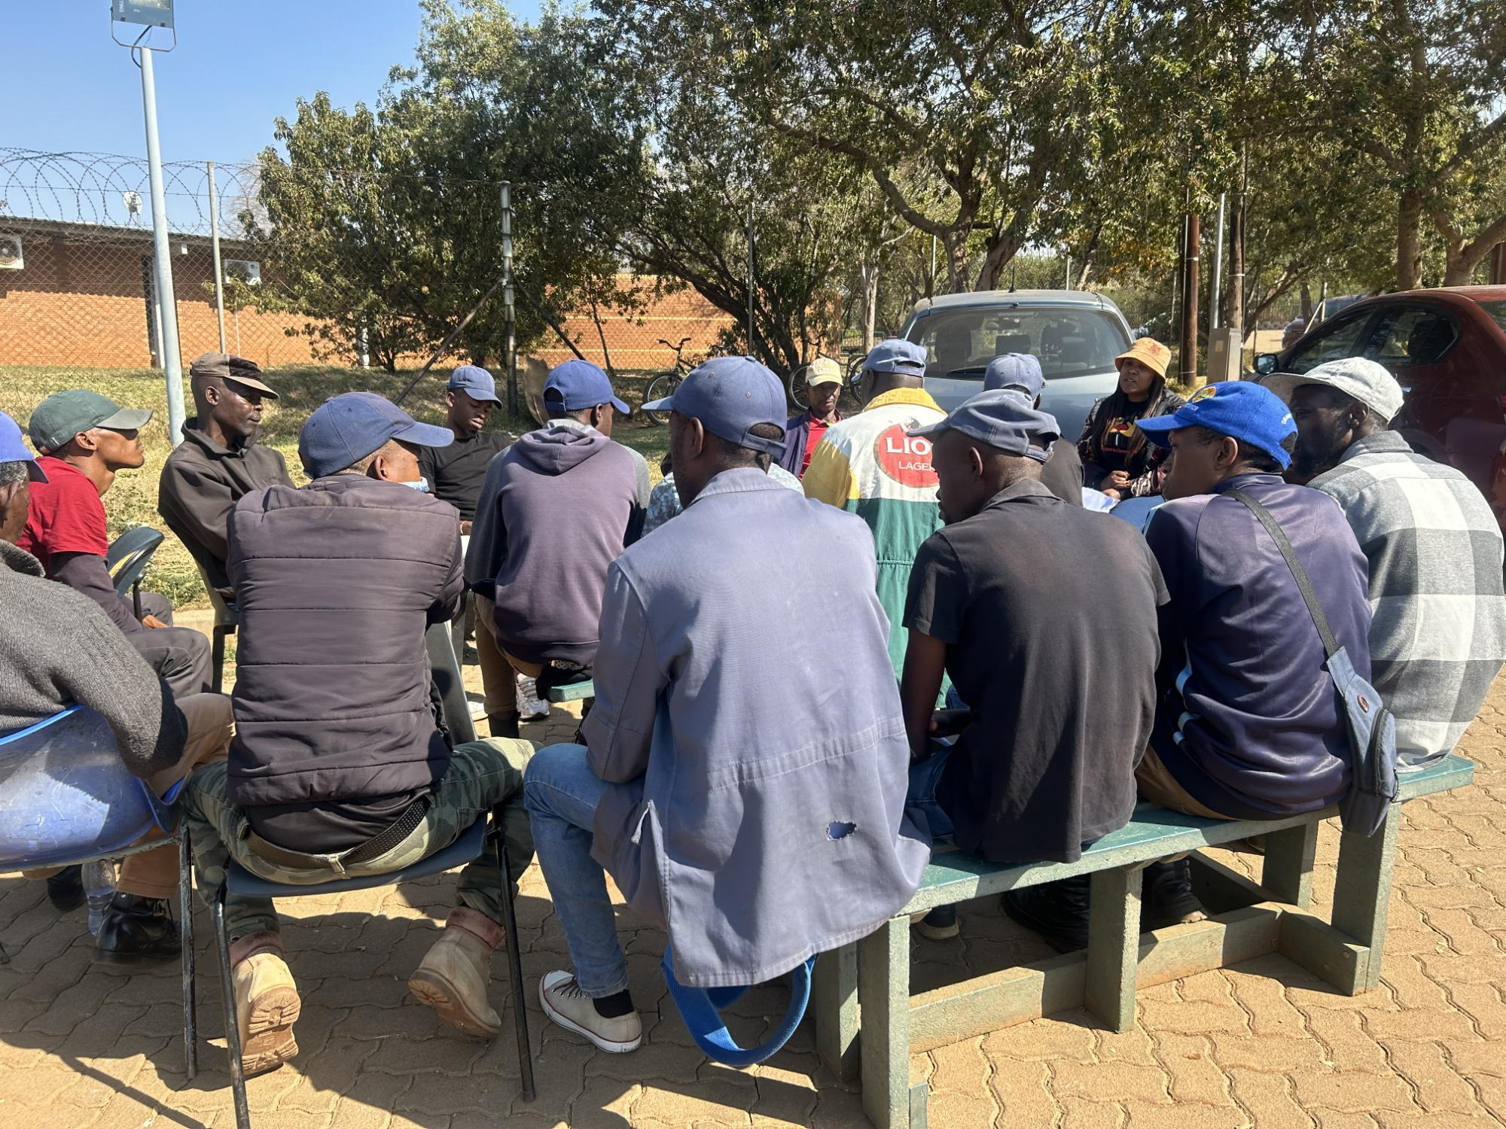
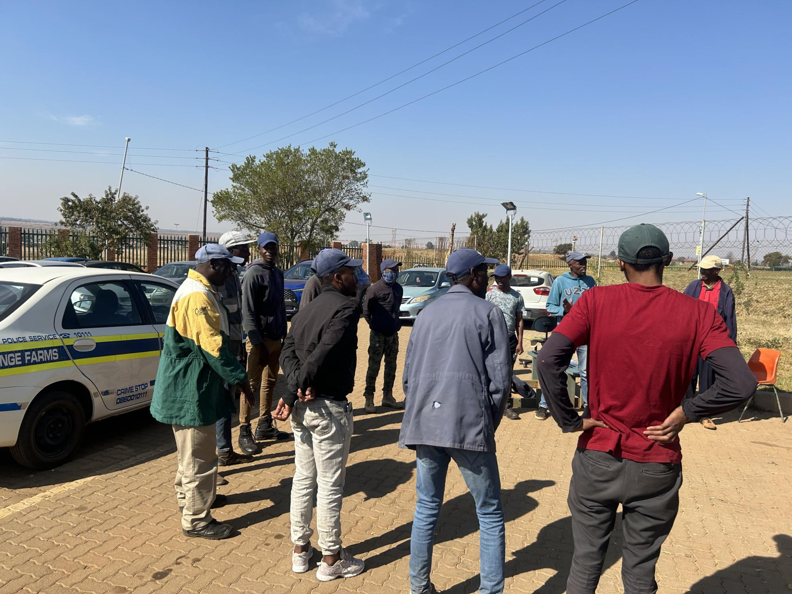
NEXT STEPS
What are the key priorities going forward?
Key priorities going forward include; securing sustainable funding
Expanding community champion programs for example soccer matches, and skills development programs etc
Strengthening partnerships with organizations/stakeholders that offer enterprenuer programs
Increasing awareness on gender-based violence, and replicating successful initiatives in other regions to ensure long-term impact and broader reach.
Include evidence here – photos/clippings
Women’s Voice and Leadership Learning and Sharing Summit 2025

