Slide 1







LEARNING
AND SHARING
SUMMIT 2026
WOMEN LEADERSHIP SOCIAL EMPOWERMENT
Empowering voices, fostering collaboration, and building a future where every youth member and community thrives—together, we can create lasting change.
Women’s Voice and Leadership Learning and Sharing Summit 2026

Slide 2
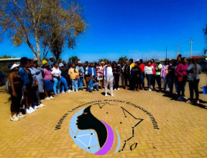
Summary
Objective:
To reduce Gender-Based Violence (GBV) and promote economic empowerment among women and youth in Ekurhuleni.
Target Groups:
Women and girls, men and boys aged 10-35.
Key Outcomes:
30% reduction in reported GBV incidents.
50% increase in participants accessing economic opportunities.
Improved mental health and well-being of GBV survivors.
Voice and Choice Learning and Sharing Summit 2026

Slide 3
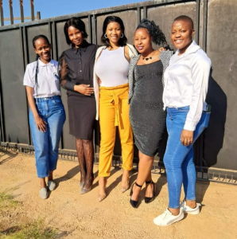
Initiatives and strategies
To foster a culture of collaboration among diverse groups, we will host regular community workshops that bring together local NGOs, community leaders, and residents, creating a space for dialogue and trust-building. We will establish a platform for marginalized individuals to share their stories related to GBV and economic empowerment,
We will establish a coalition of local organizations and stakeholders, including the Department of Social Development and local CBOs, meeting quarterly to align our goals and strategies for a unified advocacy approach. To unify efforts, we will organize joint awareness campaigns and community events, such as marches and workshops, co-hosted with partners like the Daveyton SAPS to enhance visibility.
Voice and Choice Learning and Sharing Summit 2026

Slide 4
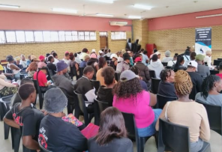
Governance & Resource Allocation
To ensure active participation and decision-making from all members, we will implement inclusive processes that value all voices, conduct regular feedback sessions to gather community input, create working groups focused on specific issues to empower participants, and provide training on advocacy and leadership skills
For equitable resource distribution, we will develop a transparent allocation framework based on need and impact, ensure equitable access to funding and support services, regularly assess resource distribution to address disparities and foster partnerships that prioritize shared goals and mutual benefit.
Voice and Choice Learning and Sharing Summit 2026

Slide 5
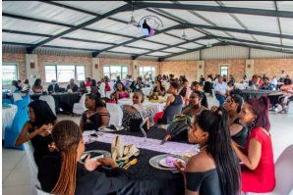
Inclusive Leadership & Coordination
To strengthen our advocacy efforts, we will collaborate with experts in GBV prevention and economic empowerment, utilize networks like Facebook, Twitter, and Instagram to amplify our advocacy messages, engage with academic institutions for research support, and build relationships with policymakers to influence legislation
we will develop a unified campaign plan with clear objectives, utilize social media and traditional media for outreach, organize community events in local parks and community centers to raise awareness, and continuously monitor and evaluate campaign effectiveness to adapt our strategies as needed.
Voice and Choice Learning and Sharing Summit 2026

Slide 6
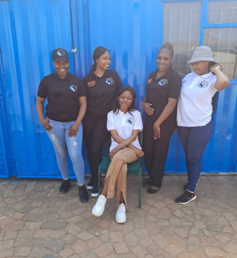
Connecting & Community-Building
Foster
Foster open communication and trust among partners.
Recognize and celebrate
Recognize and celebrate collective achievements to strengthen bonds.
Provide
Provide opportunities for networking and collaboration.
Engage in
Engage in joint training and capacity-building initiatives.
Voice and Choice Learning and Sharing Summit 2026

Slide 7
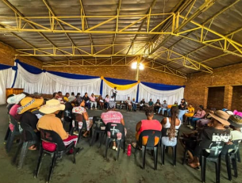
Linking & Learning
To build and sustain relationships within the advocacy community, we will foster open communication and trust among partners, recognize and celebrate collective achievements to strengthen bonds, provide opportunities for networking and collaboration, and engage in joint training and capacity-building initiatives.
To facilitate mentoring and peer exchanges, we will establish a mentorship program pairing experienced advocates with newcomers, organize regular convenings to share experiences and best practices, create online forums for ongoing discussions and resource sharing, and encourage peer exchanges to foster learning and collaboration.
Voice and Choice Learning and Sharing Summit 2026

Slide 8
NEXT STEPS
Strengthen community engagement and participation in advocacy.
Expand partnerships to enhance resource sharing and collaboration.
Focus on sustainability by developing long-term funding strategies.
Continue to raise awareness about GBV and economic empowerment through targeted campaigns.
Women’s Voice and Leadership Learning and Sharing Summit 2026

