Slide 1


Voice and Choice Summit 2026 Change Strategies-Movement Building Category
Rainbow Justice in Namibia:
Empowerment through LGBTIQ legal literacy
Voice and Choice Summit 2026 \ Voice and Choice Summit 2026

Slide 2
Name | Sophia DeLuca
Designation | Gender Research and Advocacy Project, Intern
Organisation | Legal Assistance Centre
Country | Namibia
Sub Category | Legal empowerment and access to justice
Summary | Our project addresses: significant gaps in legal knowledge around LGBTIQ rights in Namibia. Target groups: LGBTIQ and non-LGBTIQ communities and key service providers. Key strategy: leverage interactive trainings tailored towards audience groups, empower individuals with the tools to seek and provide justice free from discrimination.
Voice and Choice Summit 2026 \ Voice and Choice Summit 2026

Slide 3
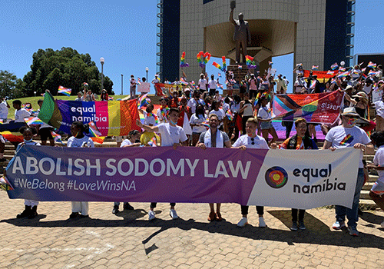
Background: A contradictory legal environment
Namibia's Constitution affirms the right to equality and dignity for all (Section 10).
In 2024: High Court ruled that the colonial-era laws criminalising same-sex intimacy between two consenting males were unconstitutional.
Government appealed to Supreme Court.
Laws still exist that exclude LGBTIQ individuals–like Combatting of Domestic Violence Act.
Voice and Choice Summit 2026 \ Voice and Choice Summit 2026

Slide 4
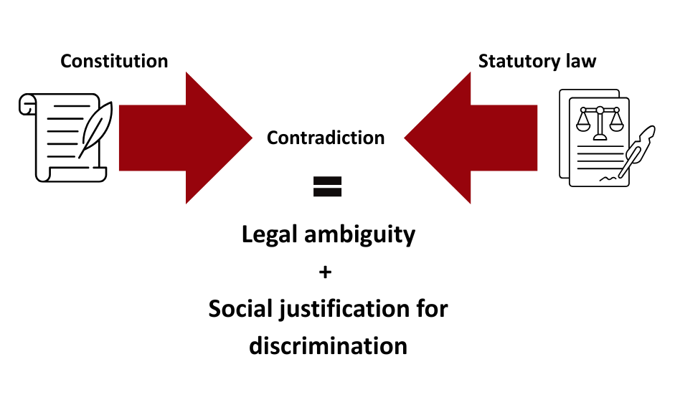
Background: A contradictory legal environment
This is deepened by limited knowledge about legal protections among the general public and service providers.
Voice and Choice Summit 2026 \ Voice and Choice Summit 2026

Slide 5
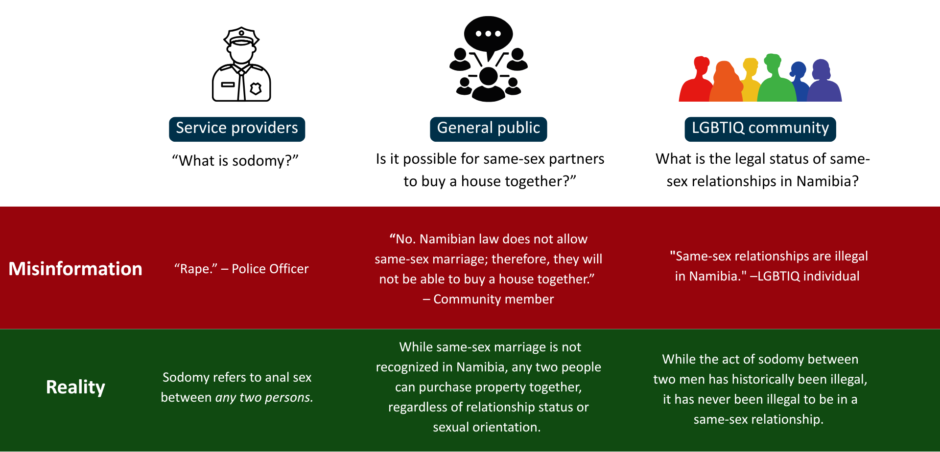
Background: Misinformation
Voice and Choice Summit 2026 \ Voice and Choice Summit 2026

Slide 6
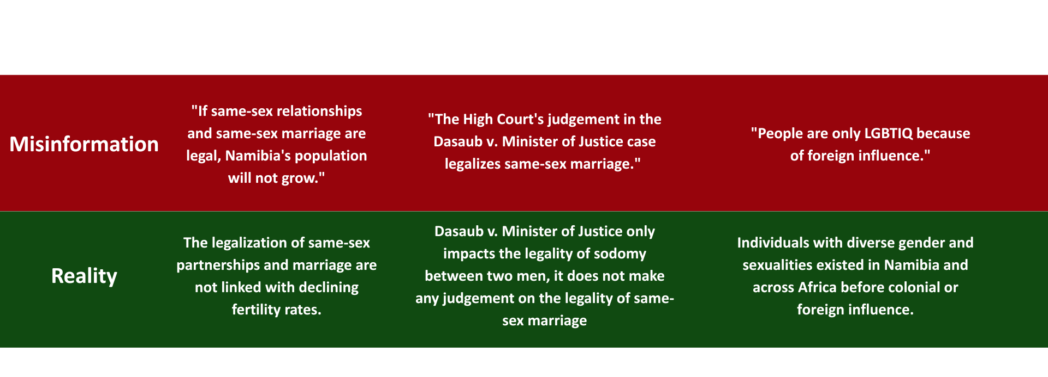
Background: Misinformation
Voice and Choice Summit 2026 \ Voice and Choice Summit 2026

Slide 7
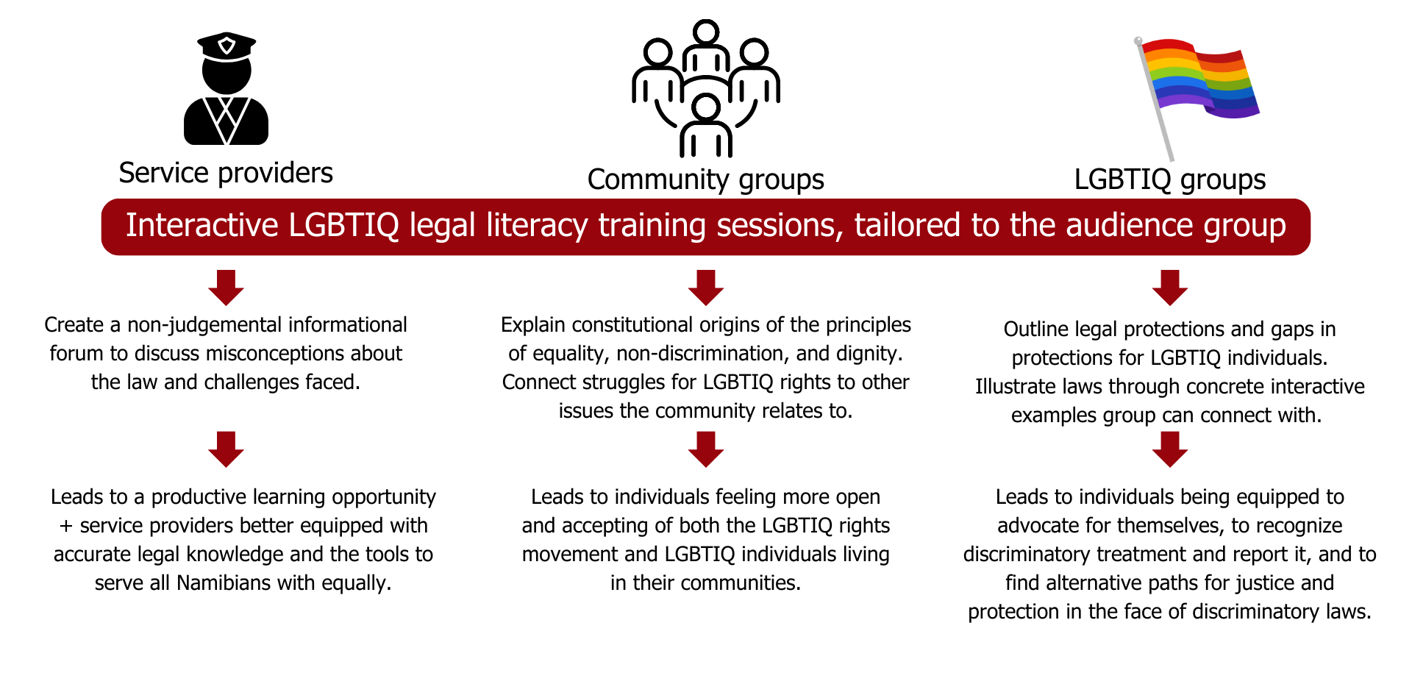
Theory of Change
Voice and Choice Summit 2026 \ Voice and Choice Summit 2026

Slide 8
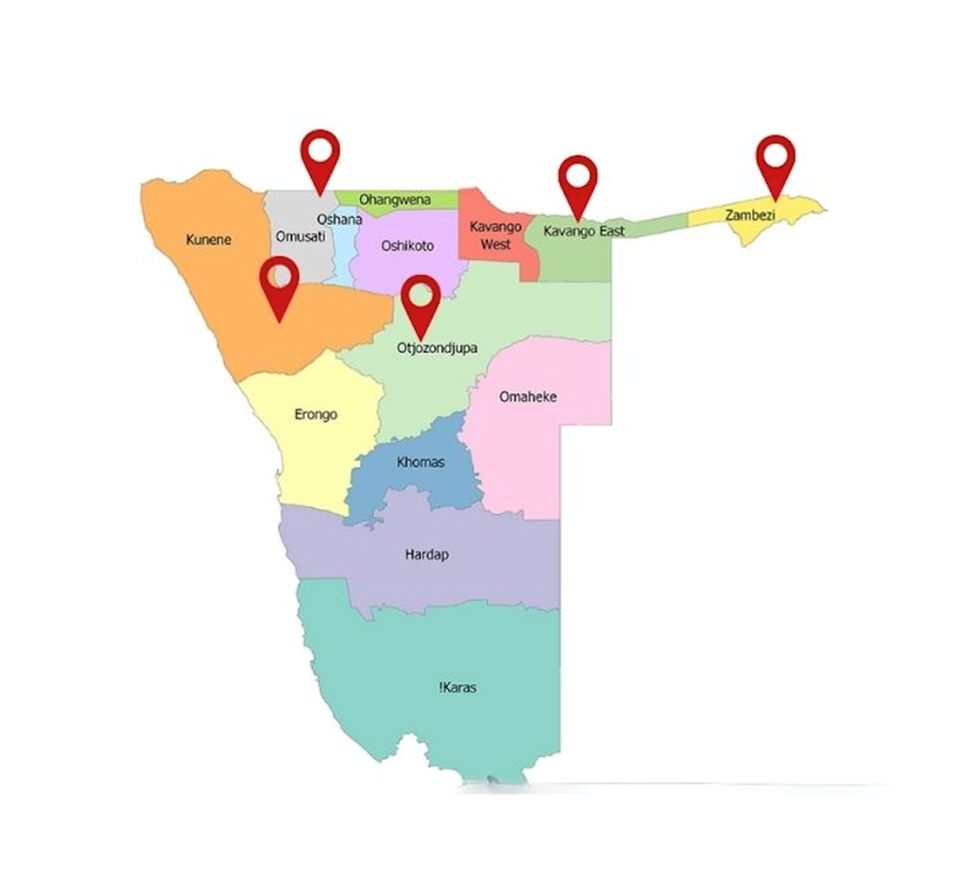

Reach
423 individuals reached
30+ service providers
35+ LGBTIQ individuals
5 regions
9 training sessions
3 community forums

Slide 9
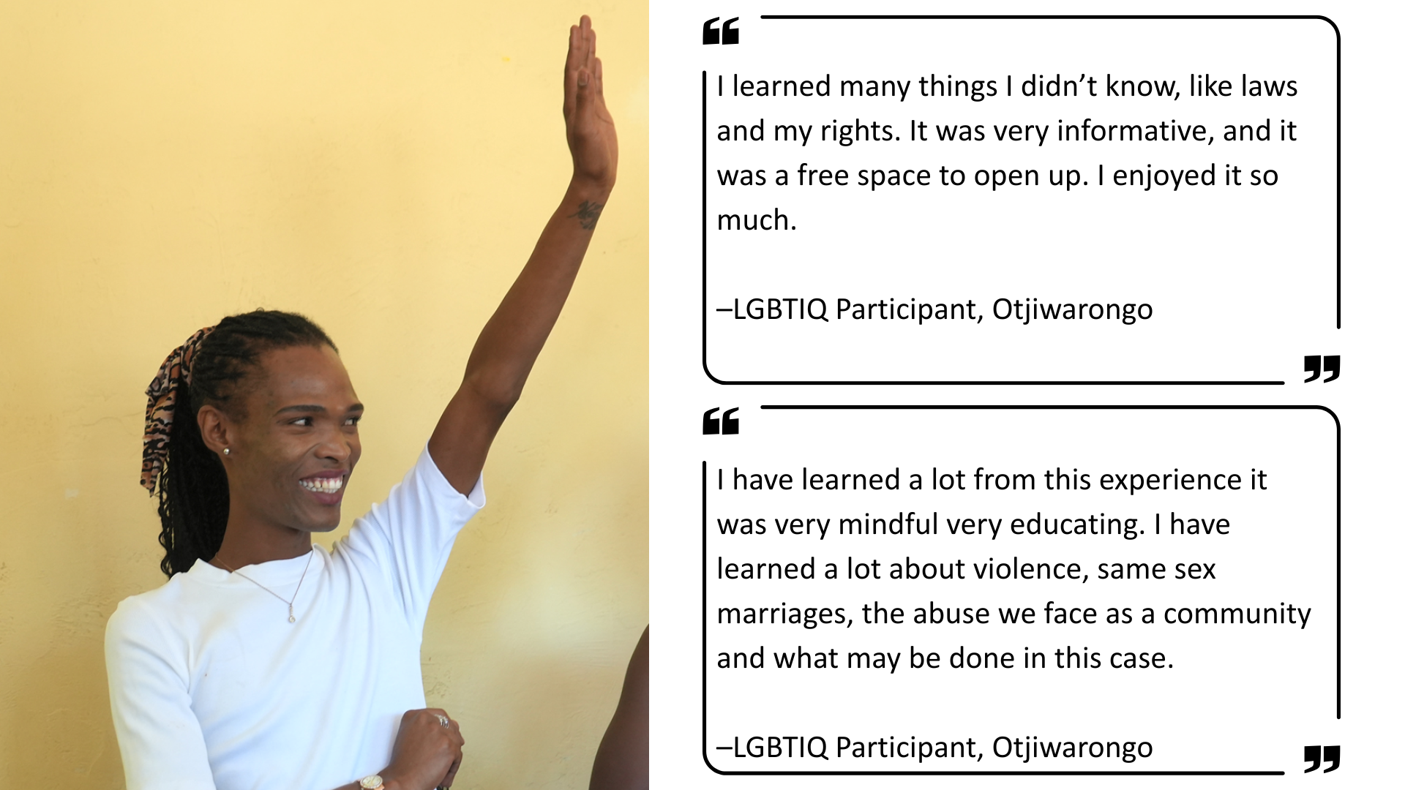
Feedback from LGBTIQ communities
Voice and Choice Summit 2026 \ Voice and Choice Summit 2026

Slide 10
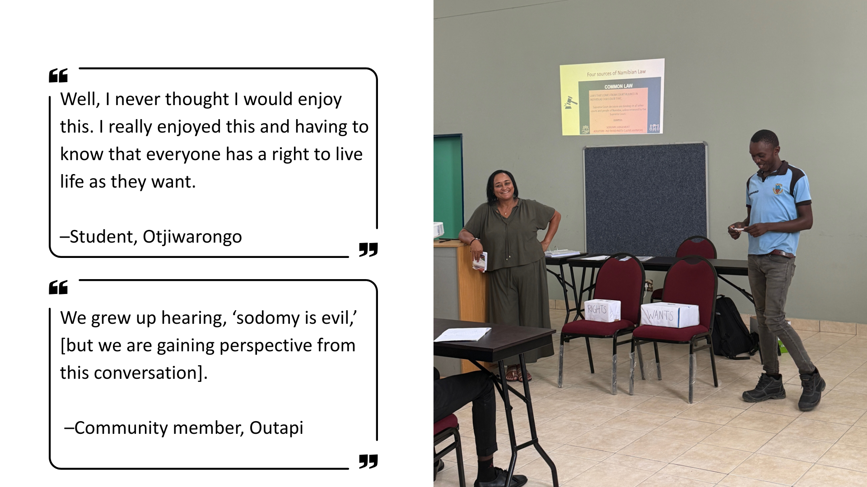
Community feedback
Voice and Choice Summit 2026 \ Voice and Choice Summit 2026

Slide 11
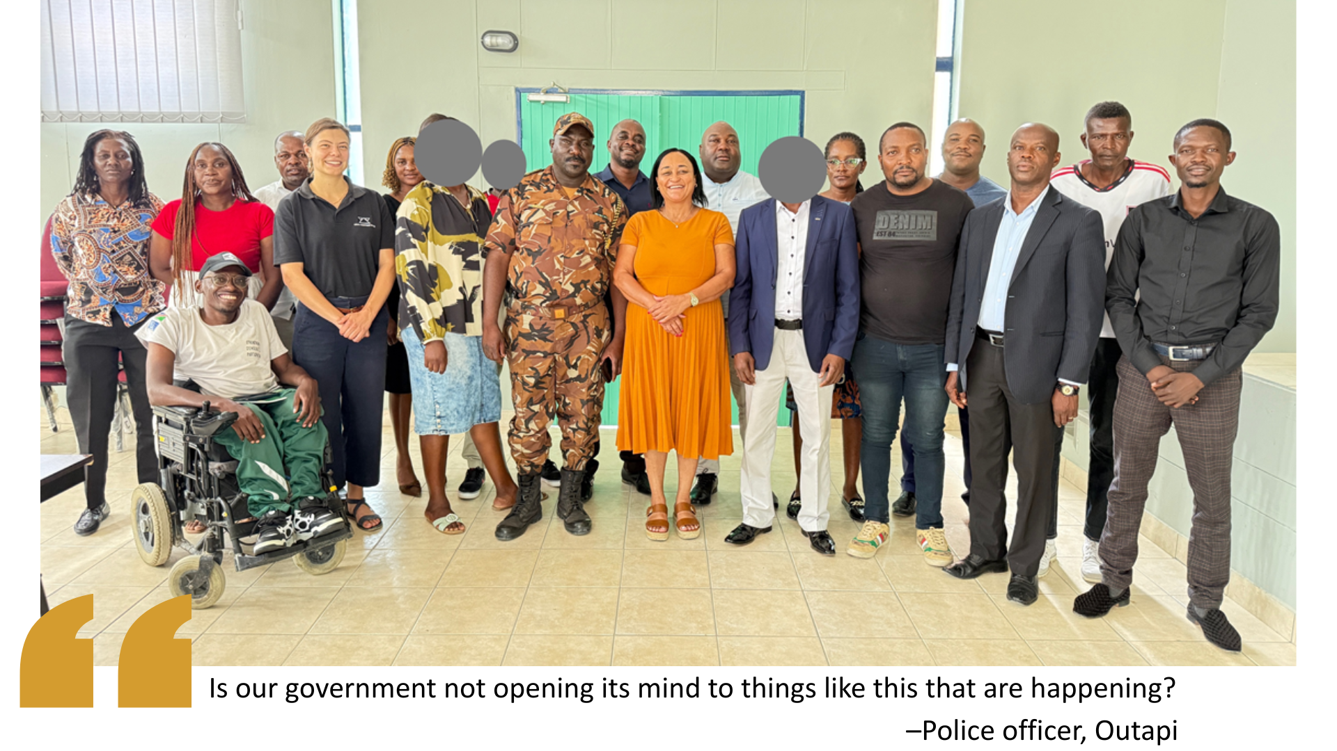
Service Providers
Voice and Choice Summit 2026 \ Voice and Choice Summit 2026

Slide 12
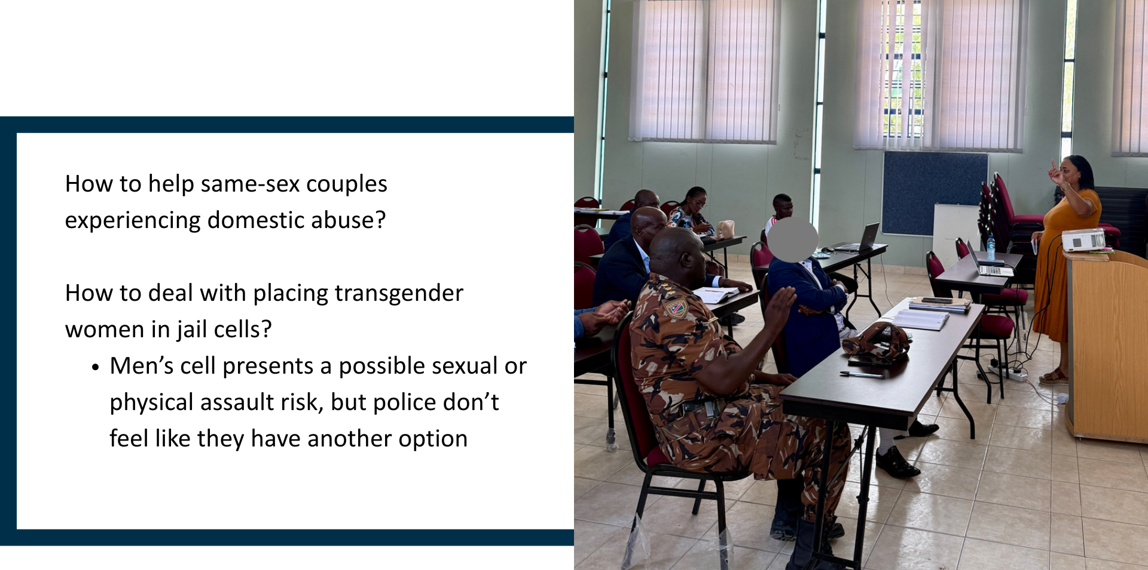
Service Providers: challenges
Voice and Choice Summit 2026 \ Voice and Choice Summit 2026

Slide 13
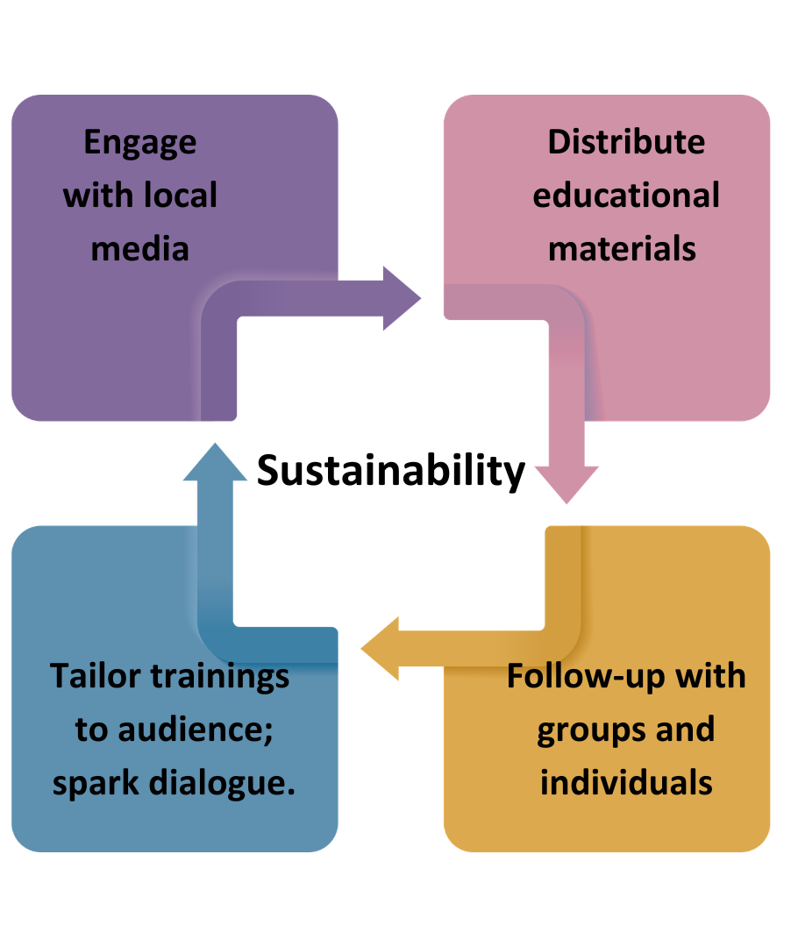
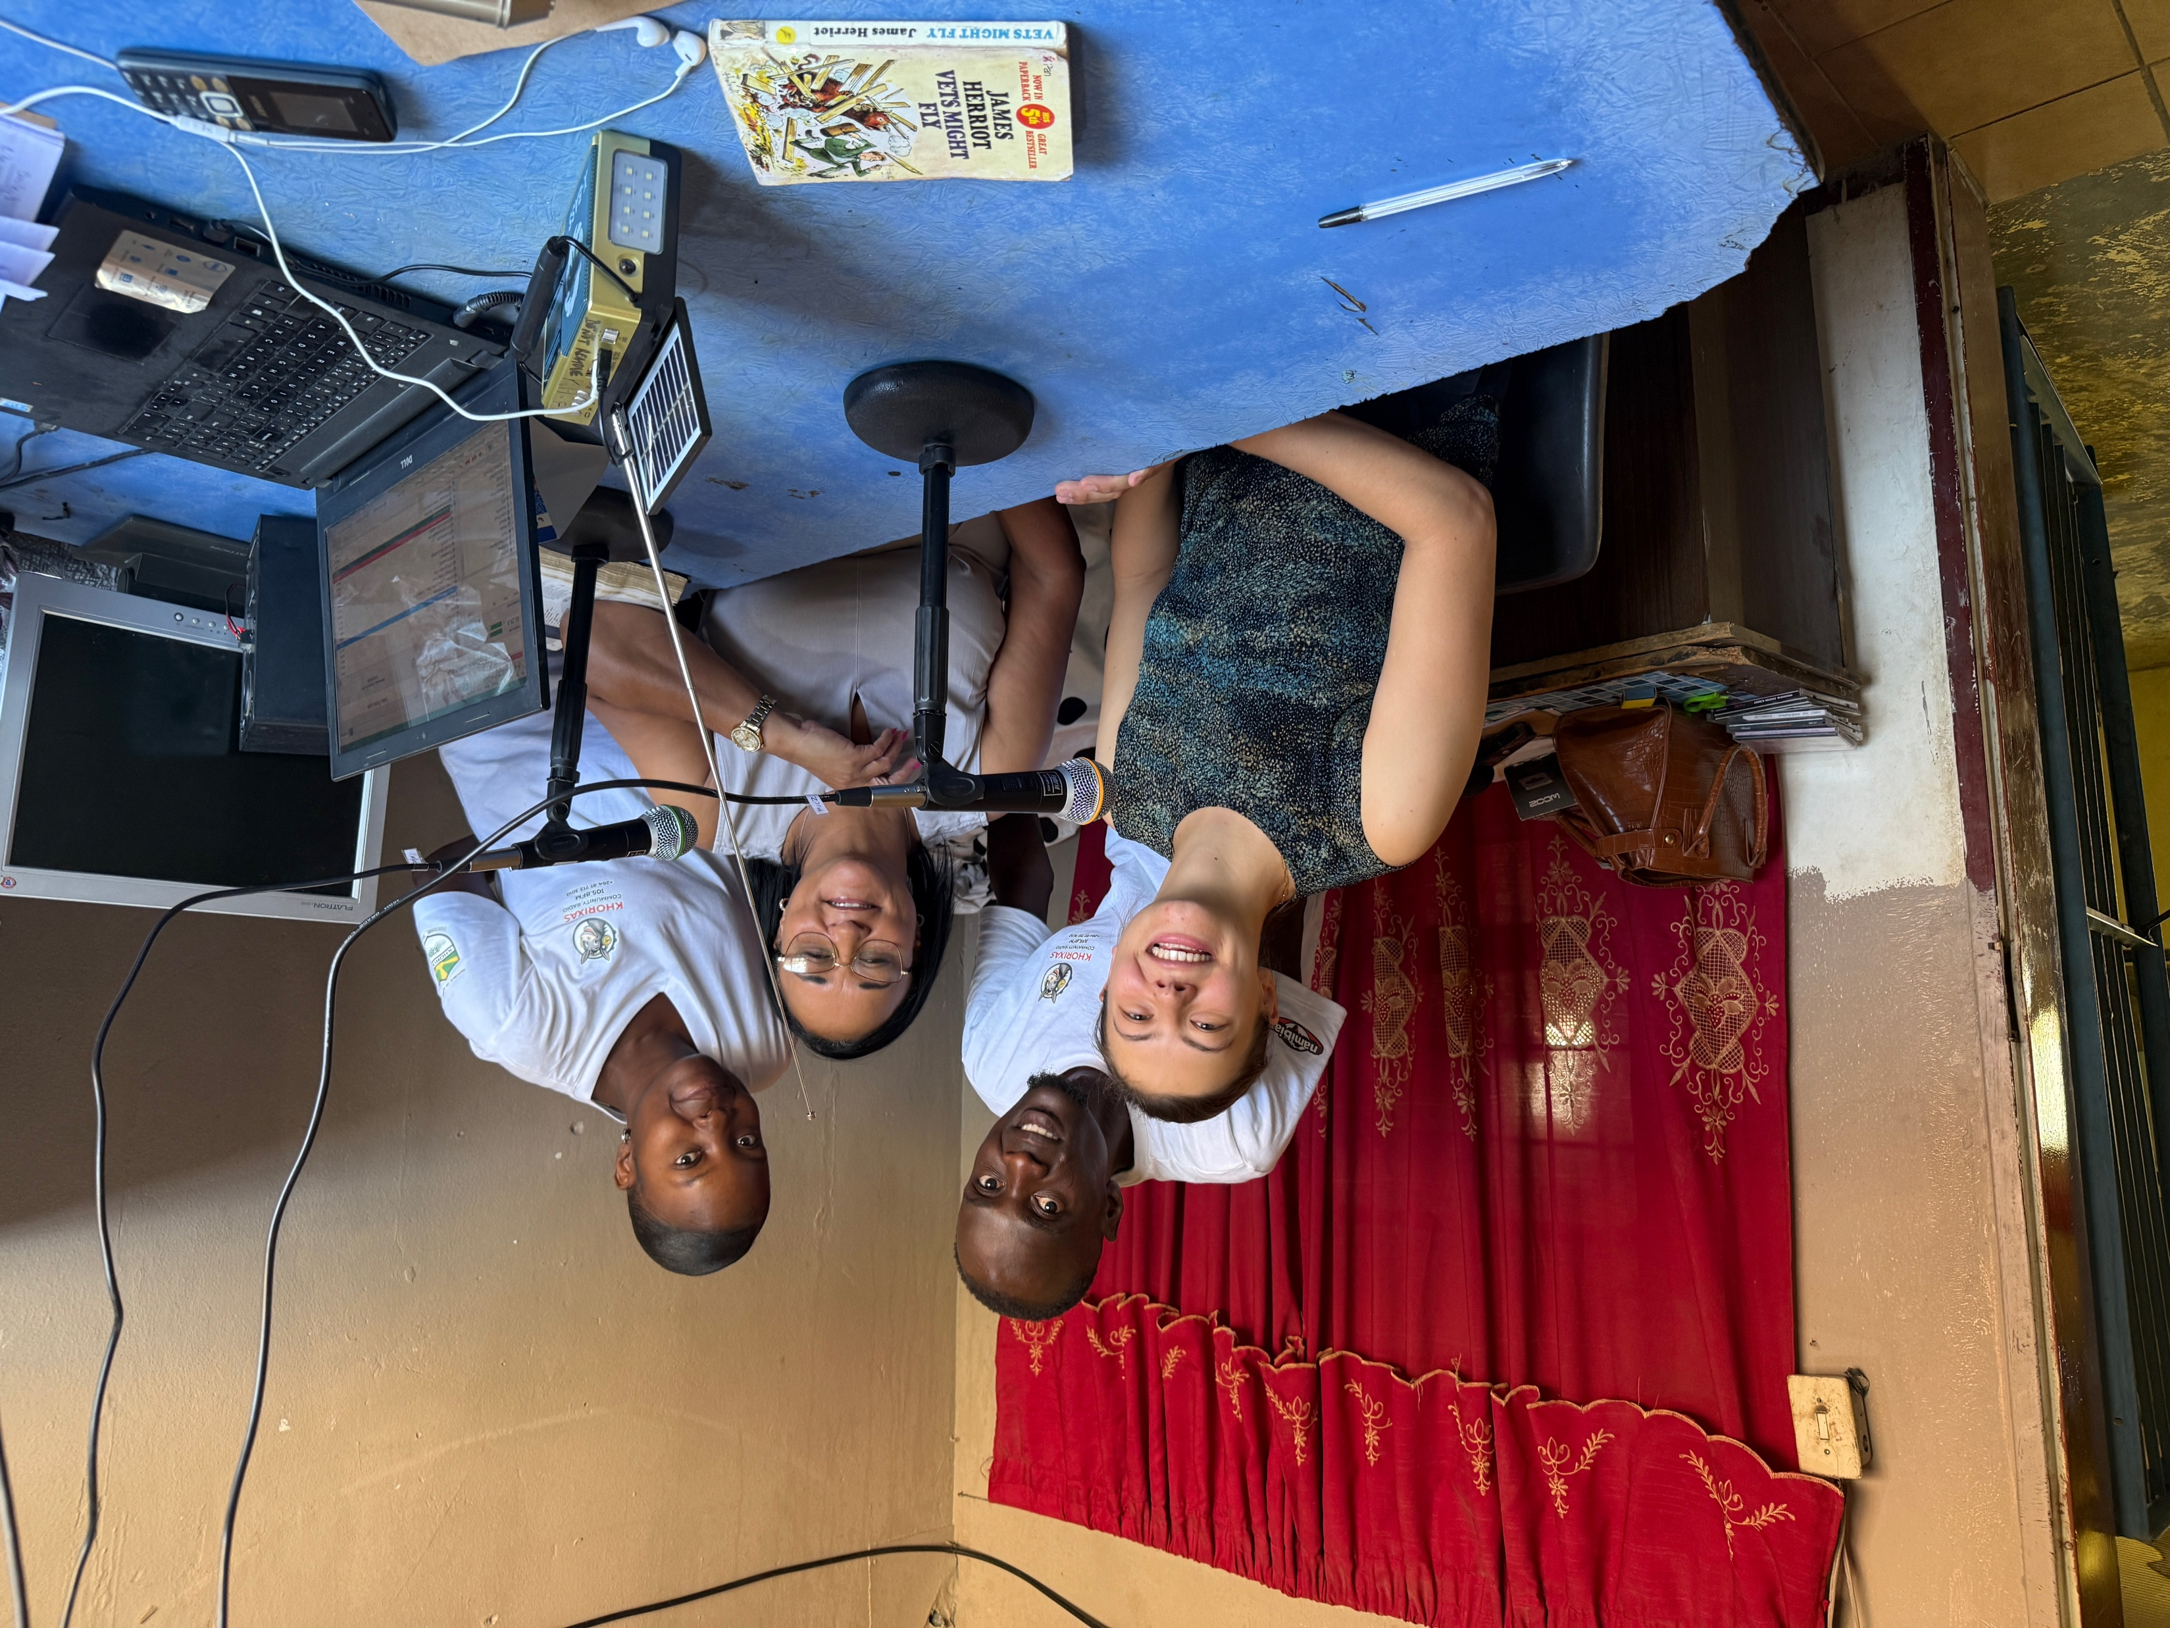
Voice and Choice Summit 2026 \ Voice and Choice Summit 2026

Slide 14
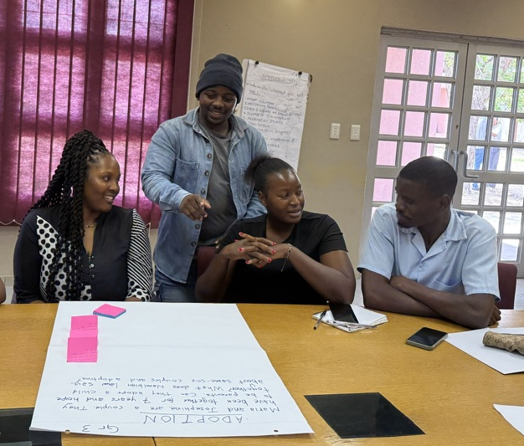
Challenges & Lessons learnt
Challenges & mitigation
Cultural barriers to discussions:
“Beliefs about these issues originate from the systems we grow up in.”
Being gay is “evil”
If you want change, start with the traditional leaders.
Different knowledge starting places:
What do words we use mean?
i.e. “sodomy”
Voice and Choice Summit 2026 \ Voice and Choice Summit 2026

Slide 15
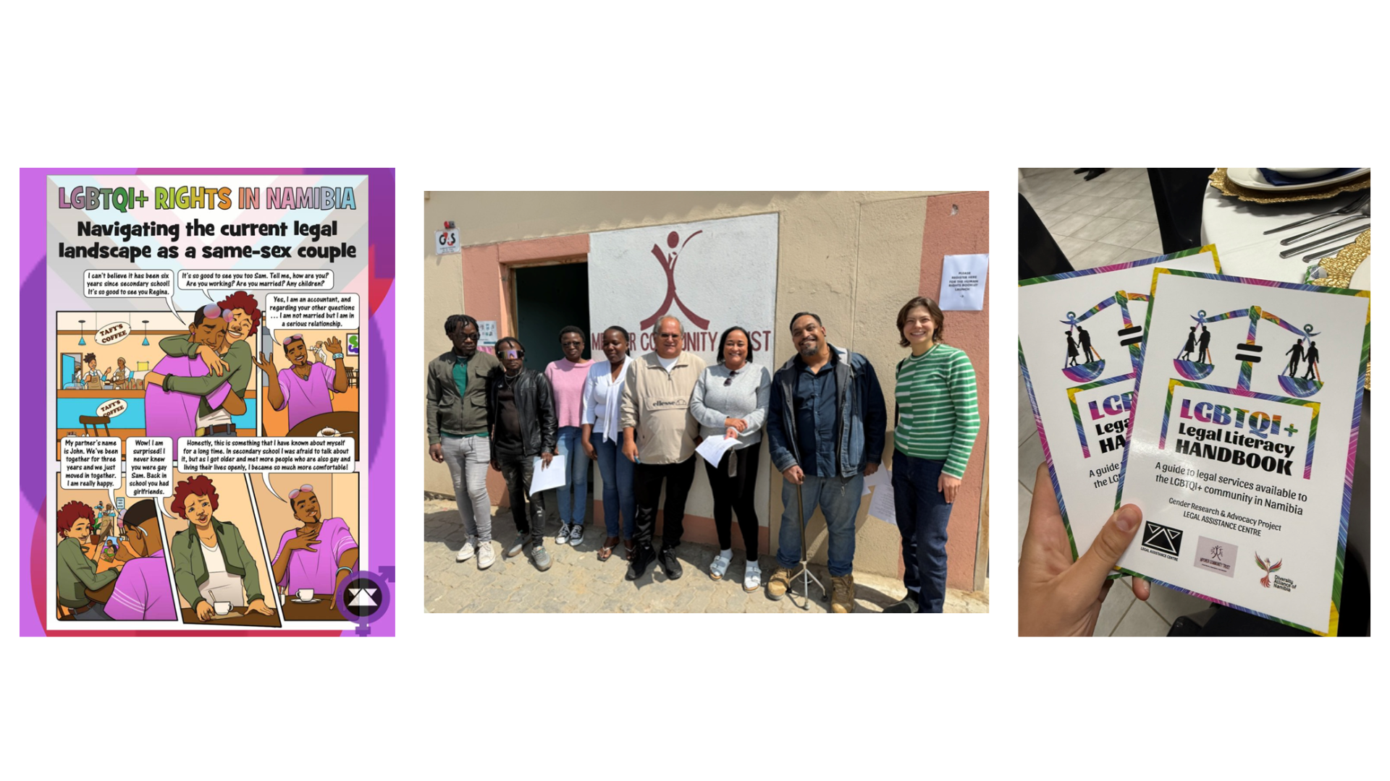
Next Steps
Education
Movement building
Research
Voice and Choice Summit 2026 \ Voice and Choice Summit 2026

Slide 16
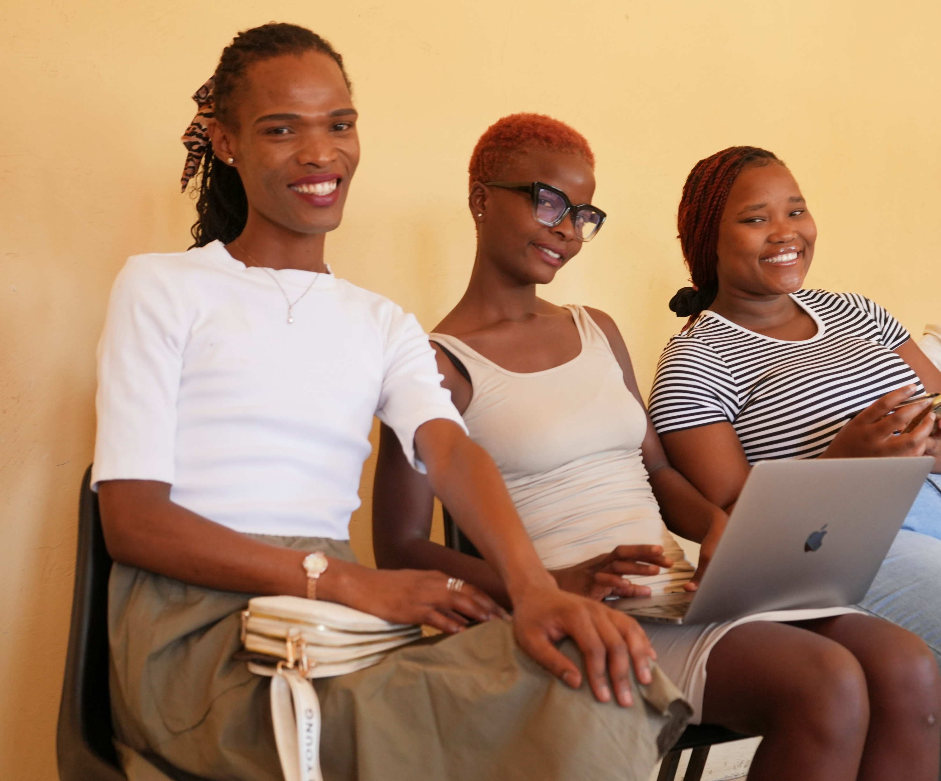
Thank you to…
The Marang Southern Africa LGBTIQ+ Fund Leadership
Fellow Namibian grantees
Community partners who have made these trainings possible
Participants who have approached these conversations with open minds and a readiness to learn
Voice and Choice Summit 2026 \ Voice and Choice Summit 2026

