Slide 1
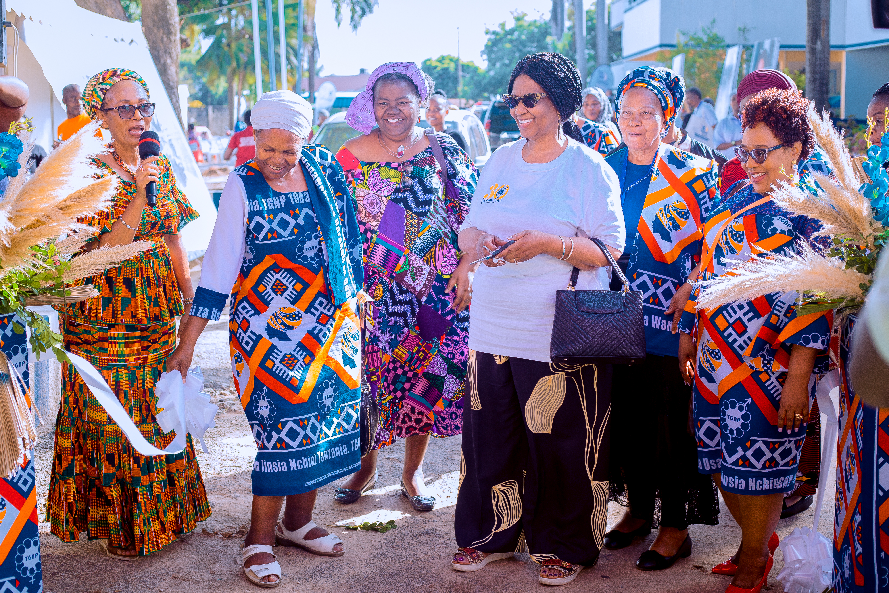


30+ Years of Legacy in Advancing Gender Equality across Grassroot Movements in Tanzania
COUNTRY: TANZANIA
LOCATION: DAR ES SALAAM
DATE: 27-02-2026
PRESENTER: FLORAH PETER NDABA
Voice and Choice Summit 2026 \ Voice and Choice Summit 2026

Slide 2
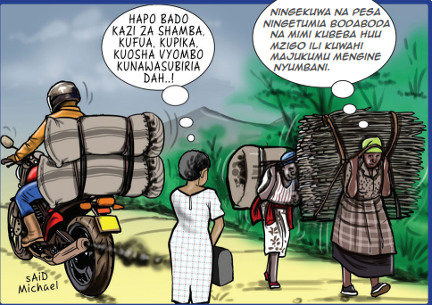
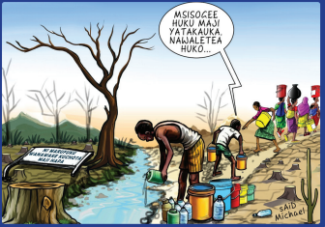
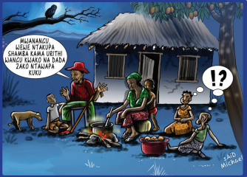
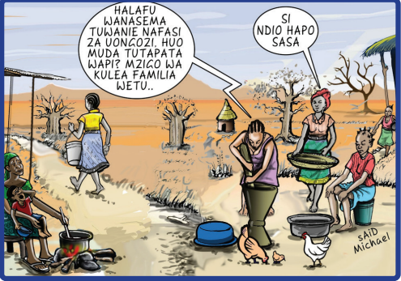
Background
Key objectives
To create a common platform to voice gender issues
What was the situation before
Consistent inadequate provision of social services at the local level
Consistent occurrence of Gender Based Violence
Lack of male allyship in the transformative movement's agenda
Low number of Women in Decision Making positions
Lack of inclusion of marginalized groups i.e. People with disabilities, girls from poor families
Insufficient Gender responsive Planning and Budgeting
Care burden/economy
Voice and Choice Summit 2026 \ Voice and Choice Summit 2026

Slide 3
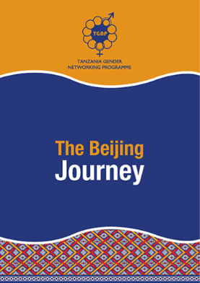
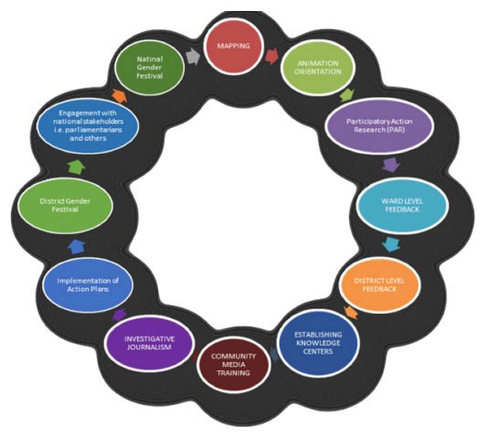
Background
Who is the organization behind
Tanzania Gender Networking Programme
Where is the approach being implemented?
24 Regions, 99 wards in Tanzania (Kigoma, Kilimanjaro, Arusha, Manyara, Mara, Lindi, Tanga, Mtwara, Unguja, Pemba, Morogoro, Dodoma, Ruvuma, Rukwa, Njombe, Songwe, Mbeya, Dar es Salaam, Singida, Mtwara, Iringa, Shinyanga, Pwani and Tabora)
Who was most affected by the problem and how?
Women (Young, Adult, Elderly, Young mothers, with disabilities, girls).
The most vulnerable group according to data
Community (Family, society, government, generations, Traditional and Faith leaders)
The burden bearers of the effects of inequalities
What issue(s) were addressed?
Adequate social services at the local level
Gender Based Violence
Women’s participation in Decision Making
Gender responsive Planning and Budgeting
Women Economic Empowerment
Voice and Choice Summit 2026 \ Voice and Choice Summit 2026

Slide 4
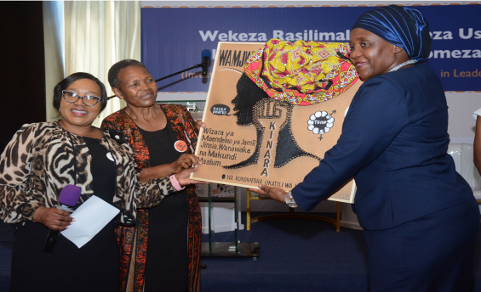
Change
• What activities or actions brought about the change?
Participatory Action Research (PAR) that generates evidence for policy engagement at local and national level
Policy analyses, budget analyses, and social analysis to inform public debate and strategic policy engagement.
Producing publications and other IEC materials Grassroots organizing for collective voice and action
Lobbying and advocacy for gender-responsive policies, budgets, structures, plans, and programmes at local level and national
Coordinating forums for movement building such as: Gender Festivals, Gender Development Seminar Series (GDSS), Safe Spaces, Community parliaments and Community dialogues.
• Who led and participated in bringing about the change.
The Community/Citizens, Local and Central Government, Like minded organizations, Artists, Activists, Faith based and Traditional leaders
Voice and Choice Summit 2026 \ Voice and Choice Summit 2026

Slide 5
The change
• The change was, when and where it happened
At Community level: Mindset and Behavior change, Awareness and Agency, Social Cohesion
At Local Government level: Gender Responsive planning and budgeting, Institutional strengthening, Inclusive governance
At Central Government level: Policy and legislative reforms, Resource allocation, Data and Accountability
Like-Minded Organizations: Stronger coordination, Programmatic innovation, Collective advocacy
Artists and Culture Influencers: Norm shifting through creative expression, Public awareness, Social dialogue
Faith-based and Traditional leaders: Legitimization of Change, Community Mediation, Norm transformation from within
• Was the change positive or negative?
Positive
• Who benefited, and in what way?
Women (Young, Adult, Elderly, Young mothers, with disabilities, girls) and Men (boys, young, poor men, with disabilities).
• What is the situation now?
Improved and increased access to social services at local level through collective voices and actions
Improved support in prevention and responding to gender-based violence with collaboration of the local government
Increased male engagement in the agenda
Increased number of women in leadership positions Improved gender responsive planning and budgeting processes
Voice and Choice Summit 2026 \ Voice and Choice Summit 2026

Slide 6
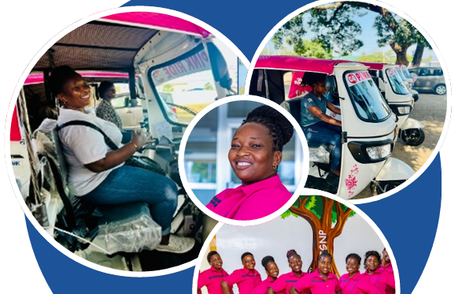
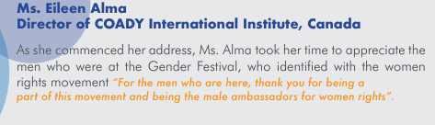

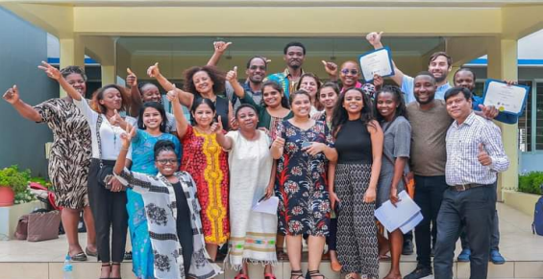
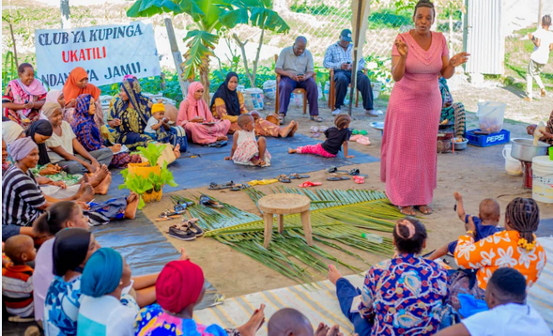

The change
Voice and Choice Summit 2026 \ Voice and Choice Summit 2026

Slide 7
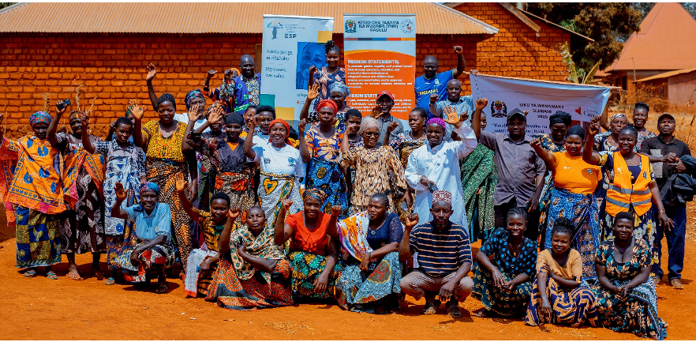
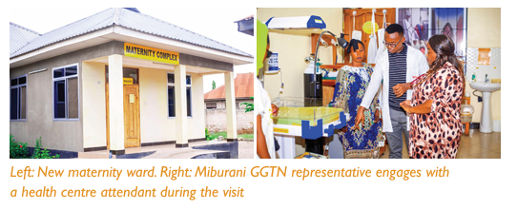
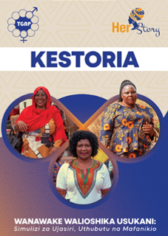
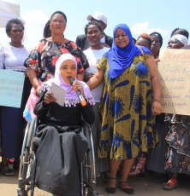

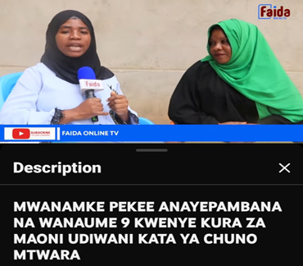
The change
Voice and Choice Summit 2026 \ Voice and Choice Summit 2026

Slide 8
Significance of Change
What this change means for the movement and its goals
Reduction in gender inequality gaps
Improved Service Delivery
Enhanced Accountability systems
Sustainable, institutional and social transformation
What effect this change may have on the next steps in this area of work.
Institutionalize Gender-Responsive Budgeting (GRB) in planning cycles
Develop tailored programming based on emerging data trends
Strengthen social accountability mechanisms
Expand creative advocacy through media and arts sectors
Voice and Choice Summit 2026 \ Voice and Choice Summit 2026

Slide 9
Sustainability
What sustainability measures were put in place for the work?
Use of two-Tier Approach to Engage with Policies
Monitoring Implementation of Gender Commitments at National, Regional and International
Influence Gender Responsive Policy and Budget Analyses
Organize and Coordinate Transformative Feminist Movement Platforms and forums
Promoting Collective Advocacy and Activism
Expand Intensive Movement Building Cycle and Knowledge Centers
How do you intend to sustain the work or scale up?
KRA
Knowledge, Research & Analyses
TCB
Training & Capacity Building
AMB
Activism & Movement Building
Voice and Choice Summit 2026 \ Voice and Choice Summit 2026

Slide 10
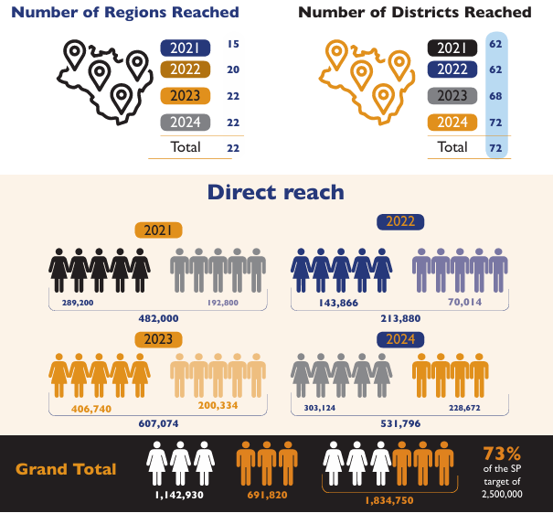
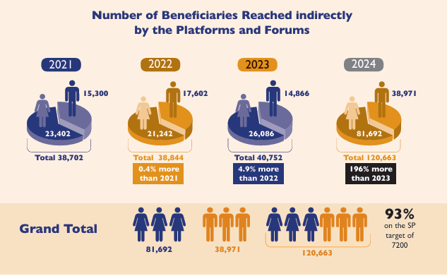
Beneficiaries (2021 – 2024)
Voice and Choice Summit 2026 \ Voice and Choice Summit 2026

Slide 11
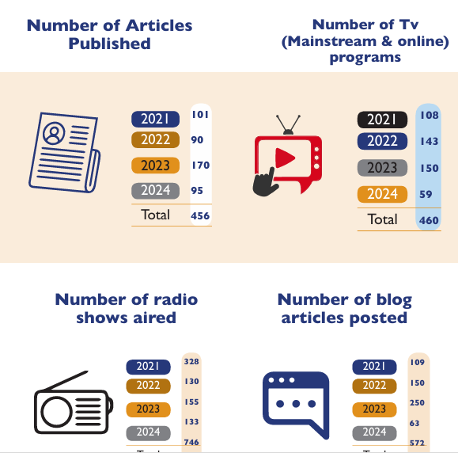
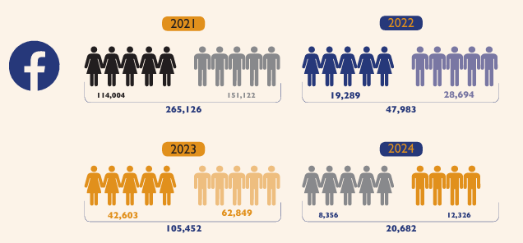
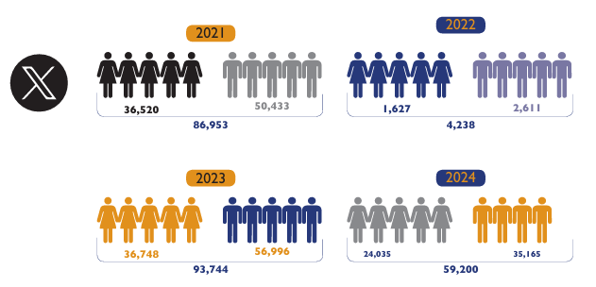
Beneficiaries (2021 – 2024)
Voice and Choice Summit 2026 \ Voice and Choice Summit 2026

Slide 12
Challenges & Lessons learnt
Challenges & mitigation
Political Context
Inadequate political will to advance GEWE in the country prevents the allocation of resources and the disbursement of funds in the country’s national budget.
Women participation in election is still in a corner stone as the interventions don’t match the pace.
Social Context
There has been an increase in violations of human and women’s rights, including abductions, beatings, sexual violence and murders where silence is at its loudest form
Access to social services is still an essential need as there is lack of a wholistic approach in mitigating these needs
Economic Context
The cost of living for an average Tanzania has increased compared to the available opportunities for direct or indirect employments
Climate Context
Increase gender crisis on the unforeseen climatic changes that disrupts the normal ways of leaving especially for women and girls
What lessons have you learnt?
Grassroots Movements Sustain Change
Legal Reform Alone Is Not Enough
Norms and Power Structures Matter More Than Awareness
Economic Empowerment Is Transformative—But Requires Structural Support
Data Drives Accountability
Intersectionality Cannot Be Ignored
Political Will Determines Speed of Progress
Progress Is Reversible
Voice and Choice Summit 2026 \ Voice and Choice Summit 2026

Slide 13
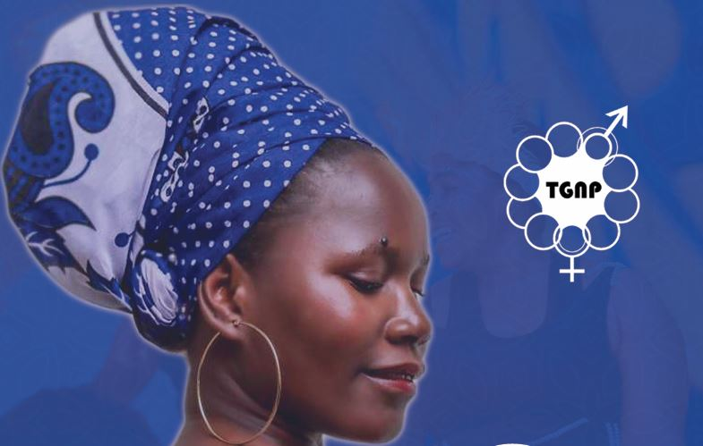

Next Steps
Change is possible
Change is Uneven
Change requires system thinking, not isolated interventions
Voice and Choice Summit 2026 \ Voice and Choice Summit 2026

