Slide 1


Voice and Choice Summit 2026-Change Strategies Category (Communication and Outreach)
Cameroon: EndTaxOnPad237 digital advocacy and outreach campaign
March 2026
Gender Links , Johannesburg, South Africa .
By Nkengafack Eucharia
Voice and Choice Summit 2026 \ Voice and Choice Summit 2026

Slide 2
Background
.
Who is the organisation behind the strategy? The Cameroon: EndTaxOnPad237 digital advocacy and outreach campaign is a change strategy co-led by Nkengafack Eucharia, a WOSSO fellow, YLOs and activists in Cameroon.
Where are you based / Where is the strategy being implemented? It is implemented nationally through digital platforms, community level engagements.
Who was most affected by the problem and how? Women and girls.
Evidence:
WATCH
Voice and Choice Summit 2026 \ Voice and Choice Summit 2026
Notes:
51.1% of women living below the poverty line makes dignified menstruation unattainable,deepening economic dependency and harmful coping mechanisms.

Slide 3
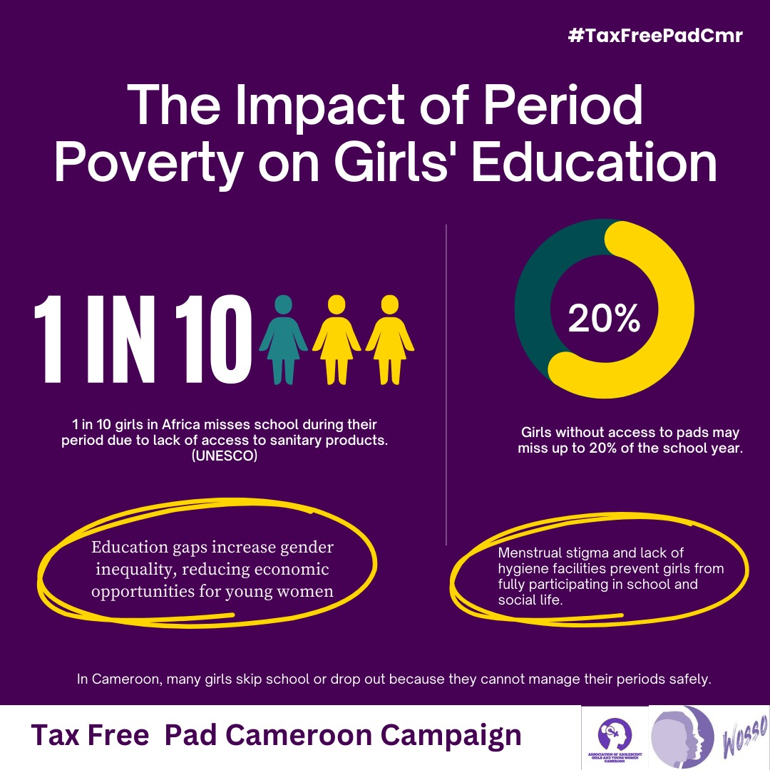
Background Cont...
.
What issue(s) did the strategy address? It tackled the intersecting areas of period poverty like taxes and high cost of sanitary pads, stigma and inequalities by reframing menstrual health as a human rights and social justice issue rather than a personal concern for women and girls
What were the key objectives of the strategy? TO challenge menstraul injustice, shift public narratives, engage key stakeholders and amplify women’s and girls’ voices through ethical communication
Evidence: Include Photos or videos
Voice and Choice Summit 2026 \ Voice and Choice Summit 2026

Slide 4
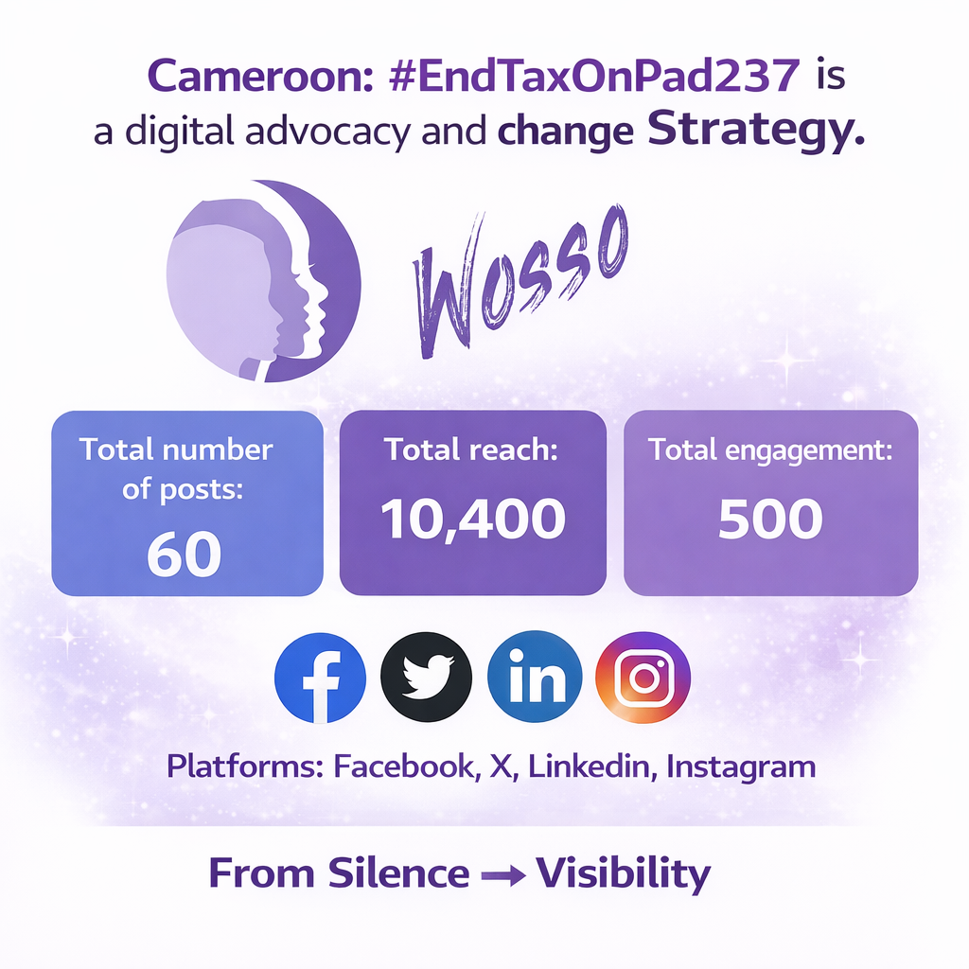
Change
How did the change come about? Digital advocacacy and community engagemnet
What activities or actions brought about the change? (advocacy and campaigning), cross-platfrom aplification and centreing community voices.
How do know there has been a change? Increased public awareness, normalised menstraul health convesrations, increased pressure for policy reform . Community dialogues .
Voice and Choice Summit 2026 \ Voice and Choice Summit 2026
Notes:
Campaign caused leaders to start speaking about menstrual health in their different policy spaces. Youth-led organizations joined the campaign and commenced brainstorming on menstrual justice projects

Slide 5
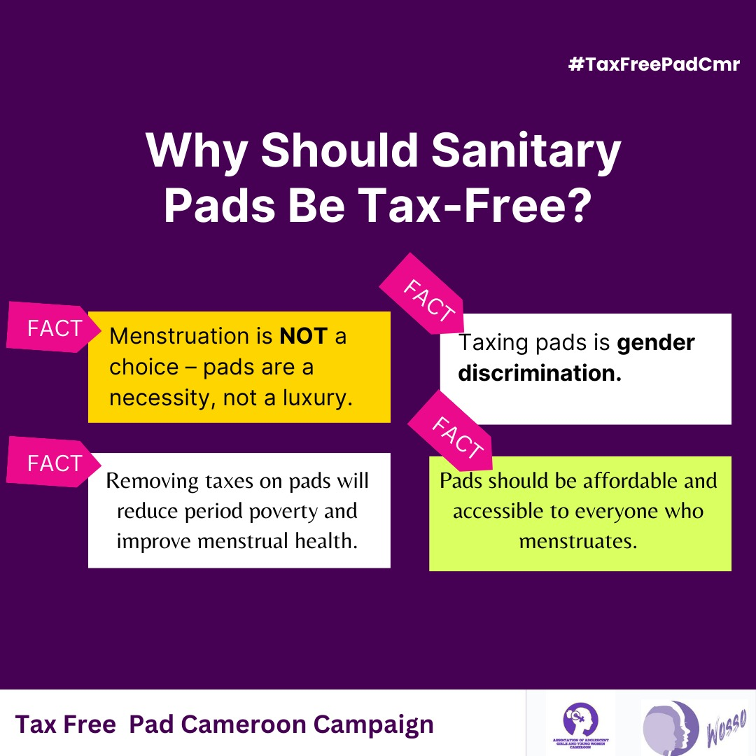
Change Cont..
What was the situation before the strategy? Discussions about menstruation were sidelined. Period poverty was normalized. Decision-makers had limited understanding. Advocacy was fragmented, youth voices and women were marginalised.
What is the situation now? Today, youths are leading the advocacy, women’s voices are valued. Menstrual health is framed as a dignity and gender justice priority rather than a women and girls issue
Voice and Choice Summit 2026 \ Voice and Choice Summit 2026

Slide 6

The Change
Describe the change that has occurred
• Describe what the change was, when and where it happened : The change occurred during #EndTaxOnPad237 digital advocacy and outreach campaign in Cameroon through coordinated online advocacy and offline community dialogues.
• Was the change positive or negative?The change has been strongly positive.Menstrual health is framed as an issue of dignity.
• Who benefited, and in what way? The WOSSO Fellow , Women and girls, YLOs, Youths , Policy stakeholders.
Evidence: Include Photos or videos
Voice and Choice Summit 2026 \ Voice and Choice Summit 2026
Notes:
Wosso Fellow gained exposure, internal conferences, media intervoews at G20, consultatncy opportunity . Started her own initaitve . Women and girls: gained safer spaces to share experiences and increased visibility in advocacy spaces.Youth advocates: strengthened leadership skills and transitioned from participants to community mobilizers (including a young woman who evolved into an advocate after sharing her story).Youth-led organizations: developed funded menstrual justice projects now being implemented in communities.Policy stakeholders: gained greater awareness of the lived realities of menstrual poverty.
-Leaders had limited exposure to the lived realities of women and girls.Youth and women’s voices had minimal influence in policy conversations.Menstrual health discussions were often stigmatized or kept private.

Slide 7
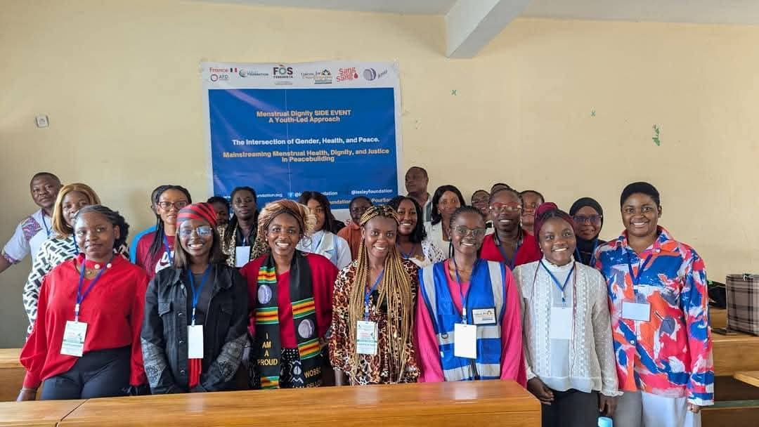
The Change cont..
• What was the situation before the project? Menstrual poverty was largely normalized and rarely questioned.Taxes on sanitary pads were not widely discussed.
• What is the situation now? Leaders are actively discussing the need to waive taxes on sanitary pads.Community dialogues have sparked policy-level conversations.Peer educators now use a structured Menstrual Health Justice and Dignity (MHJD) manual. and toolkit to sustain momentum.
Evidence: Include Photos or videos
Voice and Choice Summit 2026 \ Voice and Choice Summit 2026
Notes:
Wosso Fellow gained exposure, internal conferences, media intervoews at G20, consultatncy opportunity . Started her own initaitve . Women and girls: gained safer spaces to share experiences and increased visibility in advocacy spaces.Youth advocates: strengthened leadership skills and transitioned from participants to community mobilizers (including a young woman who evolved into an advocate after sharing her story).Youth-led organizations: developed funded menstrual justice projects now being implemented in communities.Policy stakeholders: gained greater awareness of the lived realities of menstrual poverty.
-Leaders had limited exposure to the lived realities of women and girls.Youth and women’s voices had minimal influence in policy conversations.Menstrual health discussions were often stigmatized or kept private.

Slide 8

The Change cont..
• Testimonials
“I decided to join menstrual health advocacy and now I am an advocate because I noticed many girls are going through the same challenges I am facing. Also, the prices of pads are increasing. People have different feelings during menstruation. They are valid.’’ Cynthia
“For me, talking about menstruation isn’t seeking attention. It is reclaiming dignity. And until every girl can manage her period with confidence, safety, and pride, this work will continue. “ Mercy
Evidence: Include Photos or videos
Voice and Choice Summit 2026 \ Voice and Choice Summit 2026
Notes:
Wosso Fellow gained exposure, internal conferences, media intervoews at G20, consultatncy opportunity . Started her own initaitve . Women and girls: gained safer spaces to share experiences and increased visibility in advocacy spaces.Youth advocates: strengthened leadership skills and transitioned from participants to community mobilizers (including a young woman who evolved into an advocate after sharing her story).Youth-led organizations: developed funded menstrual justice projects now being implemented in communities.Policy stakeholders: gained greater awareness of the lived realities of menstrual poverty.
-Leaders had limited exposure to the lived realities of women and girls.Youth and women’s voices had minimal influence in policy conversations.Menstrual health discussions were often stigmatized or kept private.

Slide 9
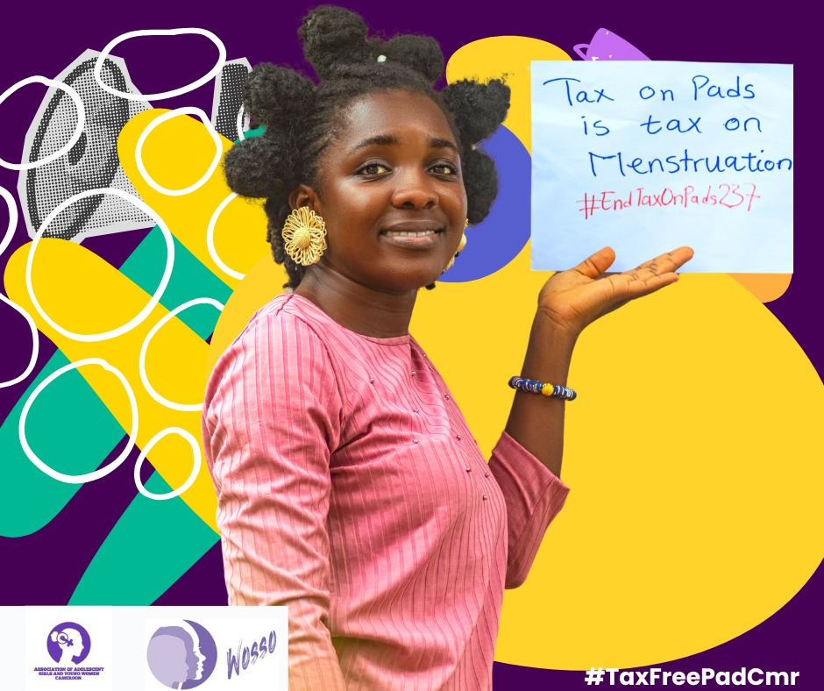
Significance/ Impact
What is the significance of the change?
Please provide further information on what this change means for the movement and its goals and what effect this change may have on the next steps in this area of work.
Legitimizing Menstrual Justice as a Policy Issue:Shifted menstrual health from a stigmatized private matter to a recognized issue of gender justice and public policy in Cameroon.Positioned dignity and taxation as interconnected structural concerns.
Evidence: Include Photos or videos
Voice and Choice Summit 2026 \ Voice and Choice Summit 2026

Slide 10
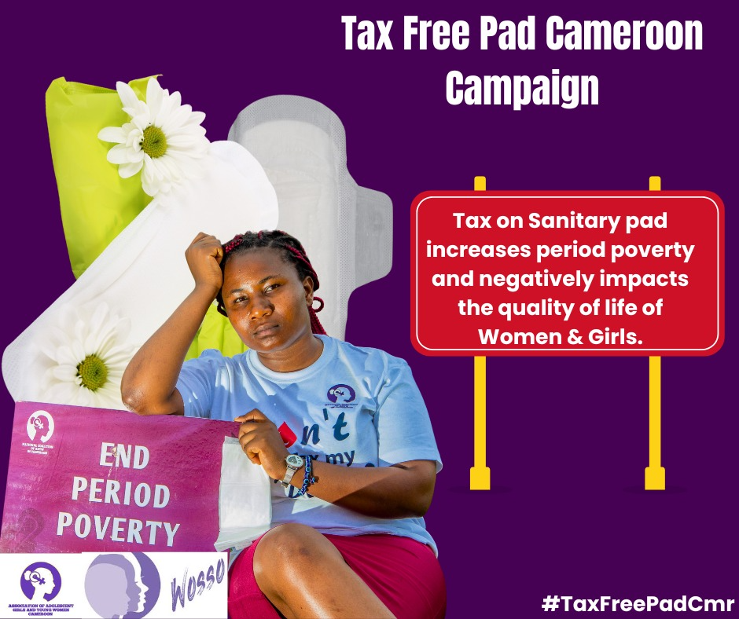
Significance/ Impact cont..
Redefining Women and Girls as Agents of Change:Moved from a “beneficiary” narrative to one centered on agency and lived expertise.
Building a Sustained Constituency for Change: Growth of peer educators using the Menstrual Health Justice and Dignity (MHJD) Manual.Creation of a shared advocacy toolkit enabling coordinated, long-term engagement.
Evidence: Include Photos or videos
See Toolkit
Voice and Choice Summit 2026 \ Voice and Choice Summit 2026
Notes:
Women and girls actively shaped advocacy messaging and.Emergence of community advocates demonstrates leadership development within the movemen

Slide 11
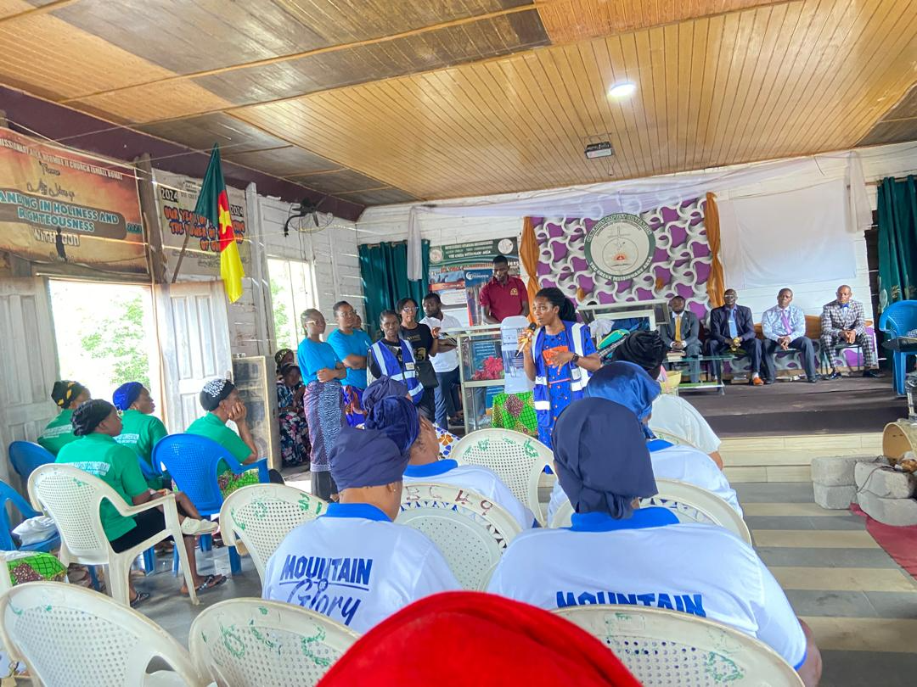
Sustainability
How will the change be sustained or scaled up? Community Ownership;Peer educators and emerging women advocates continue leading menstrual health education and challenging stigma at grassroots level.
Reusable Advocacy Tools:The Menstrual Health Justice & Dignity (MHJD) Manual and digital advocacy toolkit can be adapted and reused by youth groups, civil society, and educators.
Evidence: Include Photos or videos
Voice and Choice Summit 2026 \ Voice and Choice Summit 2026

Slide 12
Sustainability cont..
Institutional Continuity:Voices for Transformation Initiative.
Policy and Movement Integration:By embedding menstrual justice within broader gender equality and social justice work, the issue remains relevant and positioned for continued policy engagement.
Evidence: Include Photos or videos
Visit :
Voice and Choice Summit 2026 \ Voice and Choice Summit 2026

Slide 13
Challenges & Lessons learnt
Challenges & mitigation
Persistent Stigma and Cultural Taboos:Menstruation is still treated as shame. This is mitigated through ethical storytelling and community conversations.
Limited Political Will & Policy Resistance mitigated through coalitions, advocacy.
Funding gaps call for a need to diversify funding options.
What lessons have you learnt?
Silence Can Be Shifted Through Strategic Storytelling
When lived experiences are shared ethically, stigma reduces and public understanding deepens.
Digital + Grassroots = Stronger Impact
Community Ownership ensures Sustainability
.
Voice and Choice Summit 2026 \ Voice and Choice Summit 2026
Notes:
Funding Gaps & Resource Constraints:Menstrual justice initiatives are underfunded, especially youth-led and grassroots efforts :Diversify funding sources (crowdfunding, grants, partnerships). reusable toolkits and manuals to reduce repeated costs.Integrate menstrual health into broader health and gender program

Slide 14
Challenges & Lessons learnt
Challenges & mitigation
Fragmented Advocacy Efforts: Civil society actions may be uncoordinated, leading to duplicated efforts and reduced impact.Develop shared messaging frameworks and advocacy toolkits.Establish coordination and promote structured digital campaigns aligned with grassroots action.
What lessons have you learnt?
Tools Strengthen Movements: Developing structured manuals and toolkits makes advocacy coordinated, replicable, and scalable.
Policy Change Requires Evidence and Coalition Building.
Framing Matters: Positioning menstrual health as dignity, justice, and economic equityelevates it to a policy issue.
Voice and Choice Summit 2026 \ Voice and Choice Summit 2026
Notes:
Policy Change Requires Evidence and Coalition Building:Decision-makers respond better when advocacy is supported by data, economic framing, and collective voices.

Slide 15
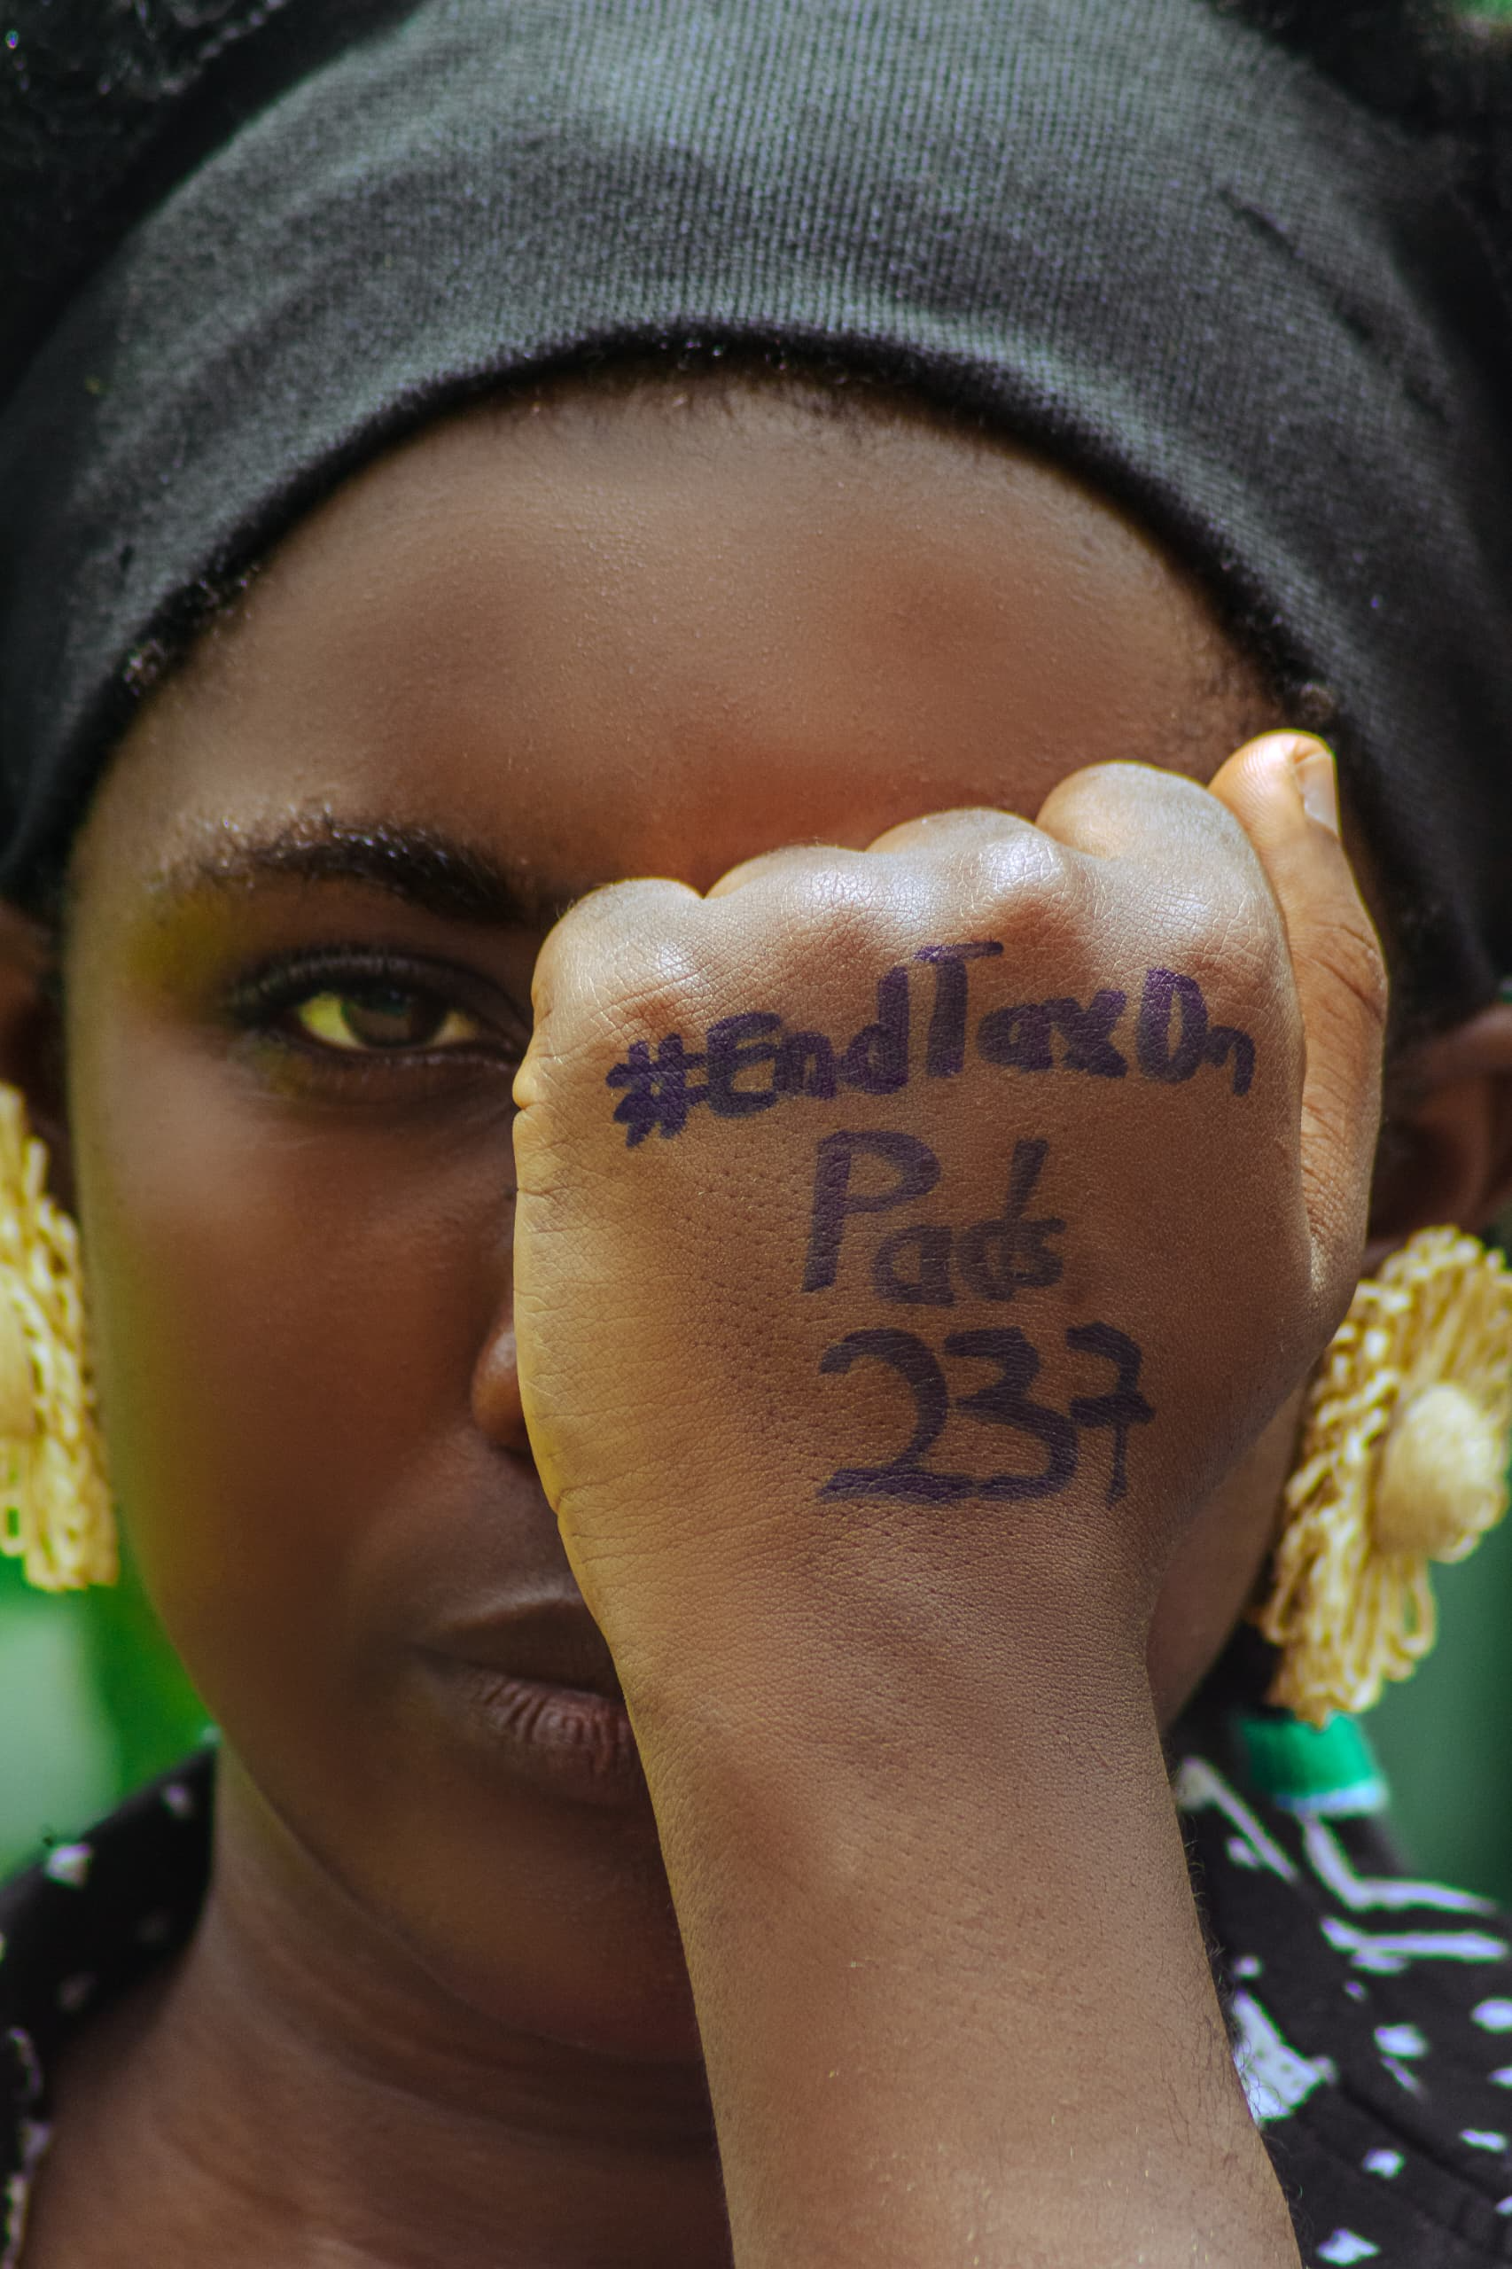
Next Steps
What are your plans?
Sustained Policy Engagement
Strengthening Collective Action
Reframing the National Agenda
Voice and Choice Summit 2026 \ Voice and Choice Summit 2026
Notes:
Sustained Policy Engagement:Increased readiness for structured dialogue with policymakers on tax reform.Momentum supports continued legislative advocacy grounded in community evidence.
Strengthening Collective Action:Opportunity to expand the coalition of youth-led and grassroots actors.Tools developed during the campaign enable scalable, coordinated advocacy.
Reframing the National Agenda:Sets the foundation for positioning menstrual equity as a non-negotiable component of gender equality and social justice work in Cameroon.Encourages integration of menstrual justice into broader development and economic policy conversations.

