Slide 1
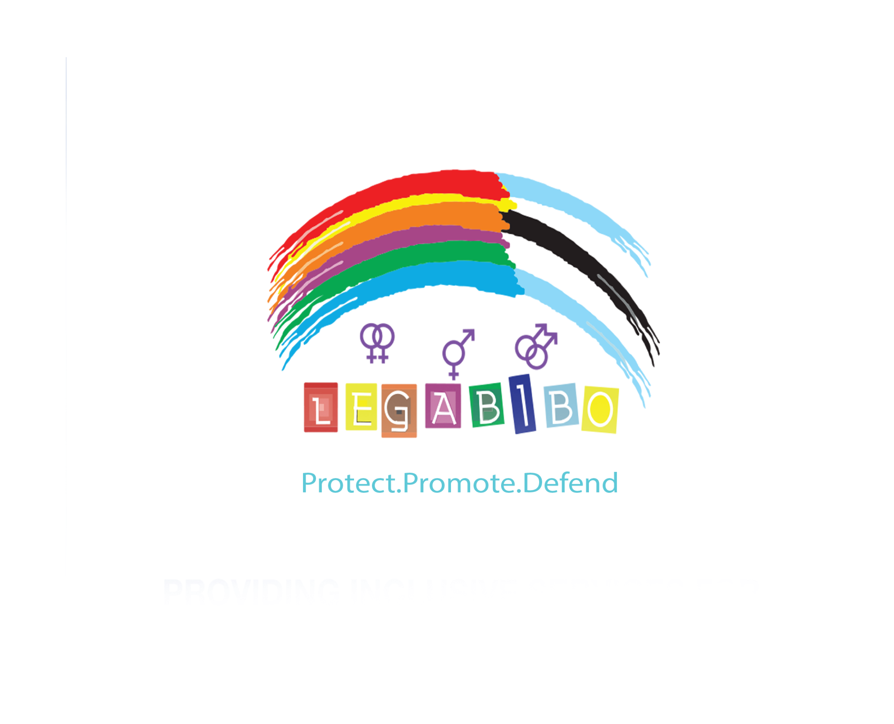

Voice and Choice
Summit 2026-Change Strategies-Strategic Litigation Category
Botswana: From Incremental Gains to Rights Realisation
Voice and Choice Summit 2026 \ Voice and Choice Summit 2026

Slide 2
Synopsis– brief overview what this is about
Name | Laone van Vuuren
Designation | Head of Policy & Legal Advocacy
Organisation | LEGABIBO
Country | Botswana
Category | Change Strategies
Summary | LEGABIBO’s change strategy focuses on advancing human rights for LGBTIQ people in Botswana through incremental gains, engaging with communities, leaders on multiple levels that lays foundation for strategic litigation, policy advocacy and institutional engagement.
Voice and Choice Summit 2026 \ Voice and Choice Summit 2026
Notes:
Our approach moves beyond individual court victories. It combines:
• legal empowerment and documentation of violations
• strategic engagement with national institutions
• participation in international human rights mechanisms
• community mobilisation and leadership development
Through programmes such as Living Free, Living Well and Letsema Le Tsweletse, LGBTIQ communities are increasingly engaging the state as organised rights-holders shaping law, policy and accountability frameworks.

Slide 3

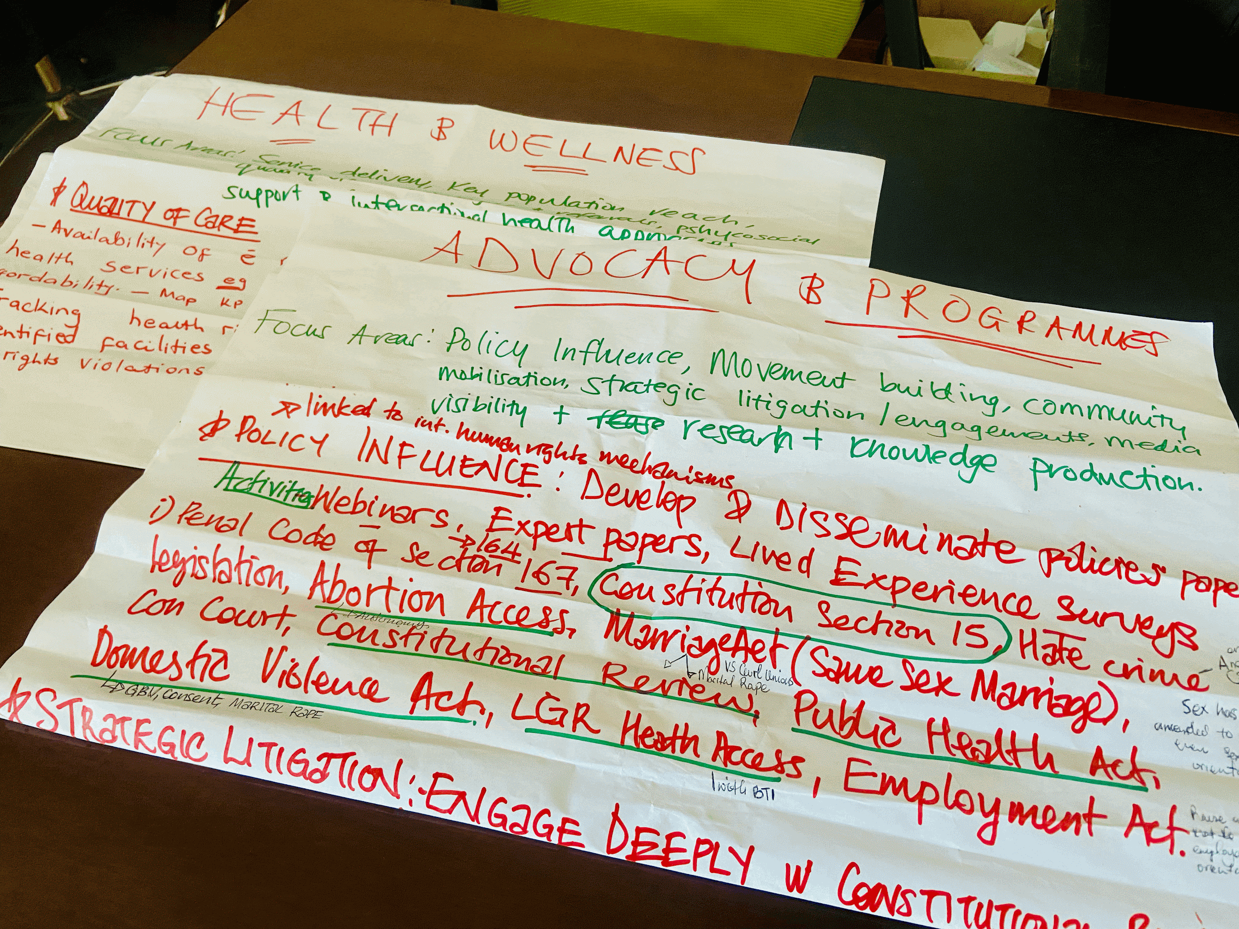
Background
Despite progressive court rulings, legal recognition has not automatically translated into lived equality and inclusion for LGBTIQ people in Botswana.
Many queer people continue to face:
discrimination in healthcare and employment
barriers to gender-affirming healthcare
exclusion from their families
violence and hate-motivated crimes
These occur in a broader context of shrinking civic and global backlash against gender and sexual rights.
Voice and Choice Summit 2026 \ Voice and Choice Summit 2026
Notes:
LEGABIBO therefore adopted an incremental gains strategy developed over more than a decade. Instead of pursuing isolated victories, the organisation prioritised:
• building community readiness
• strengthening alliances
• engaging institutions
• documenting lived realities
The goal is to embed LGBTIQ equality within legal systems, public institutions and human rights processes, creating durable and sustainable change.

Slide 4
Actions
LEGABIBO works through a multi-layered strategy combining advocacy, institutional engagement and strategic litigation
A multi-layered strategy combining, community engagement and advocacy, institutional engagement and strategic litigation.
Engaging communities and allies from local to national
Training first responders - healthcare, law enforcement etc. on SOGIESC inclusion in services
Participating in the CHRSNAP technical working group
Documenting rights violations through the Living Free, Living Well Programme - Mokgosi
Providing legal referrals and psychosocial support to affected individuals
Supporting strategic litigation to advance constitutional protections for LGBTIQ people - registration, LGR, decrim
Contributing to CEDAW shadow reports and African Commission processes
Voice and Choice Summit 2026 \ Voice and Choice Summit 2026
Notes:
LEGABIBO implemented a multi-layered strategy combining litigation, advocacy and institutional engagement.
CHRSNAP - Comprehensive Human Rights Strategy and National Action Plan

Slide 5
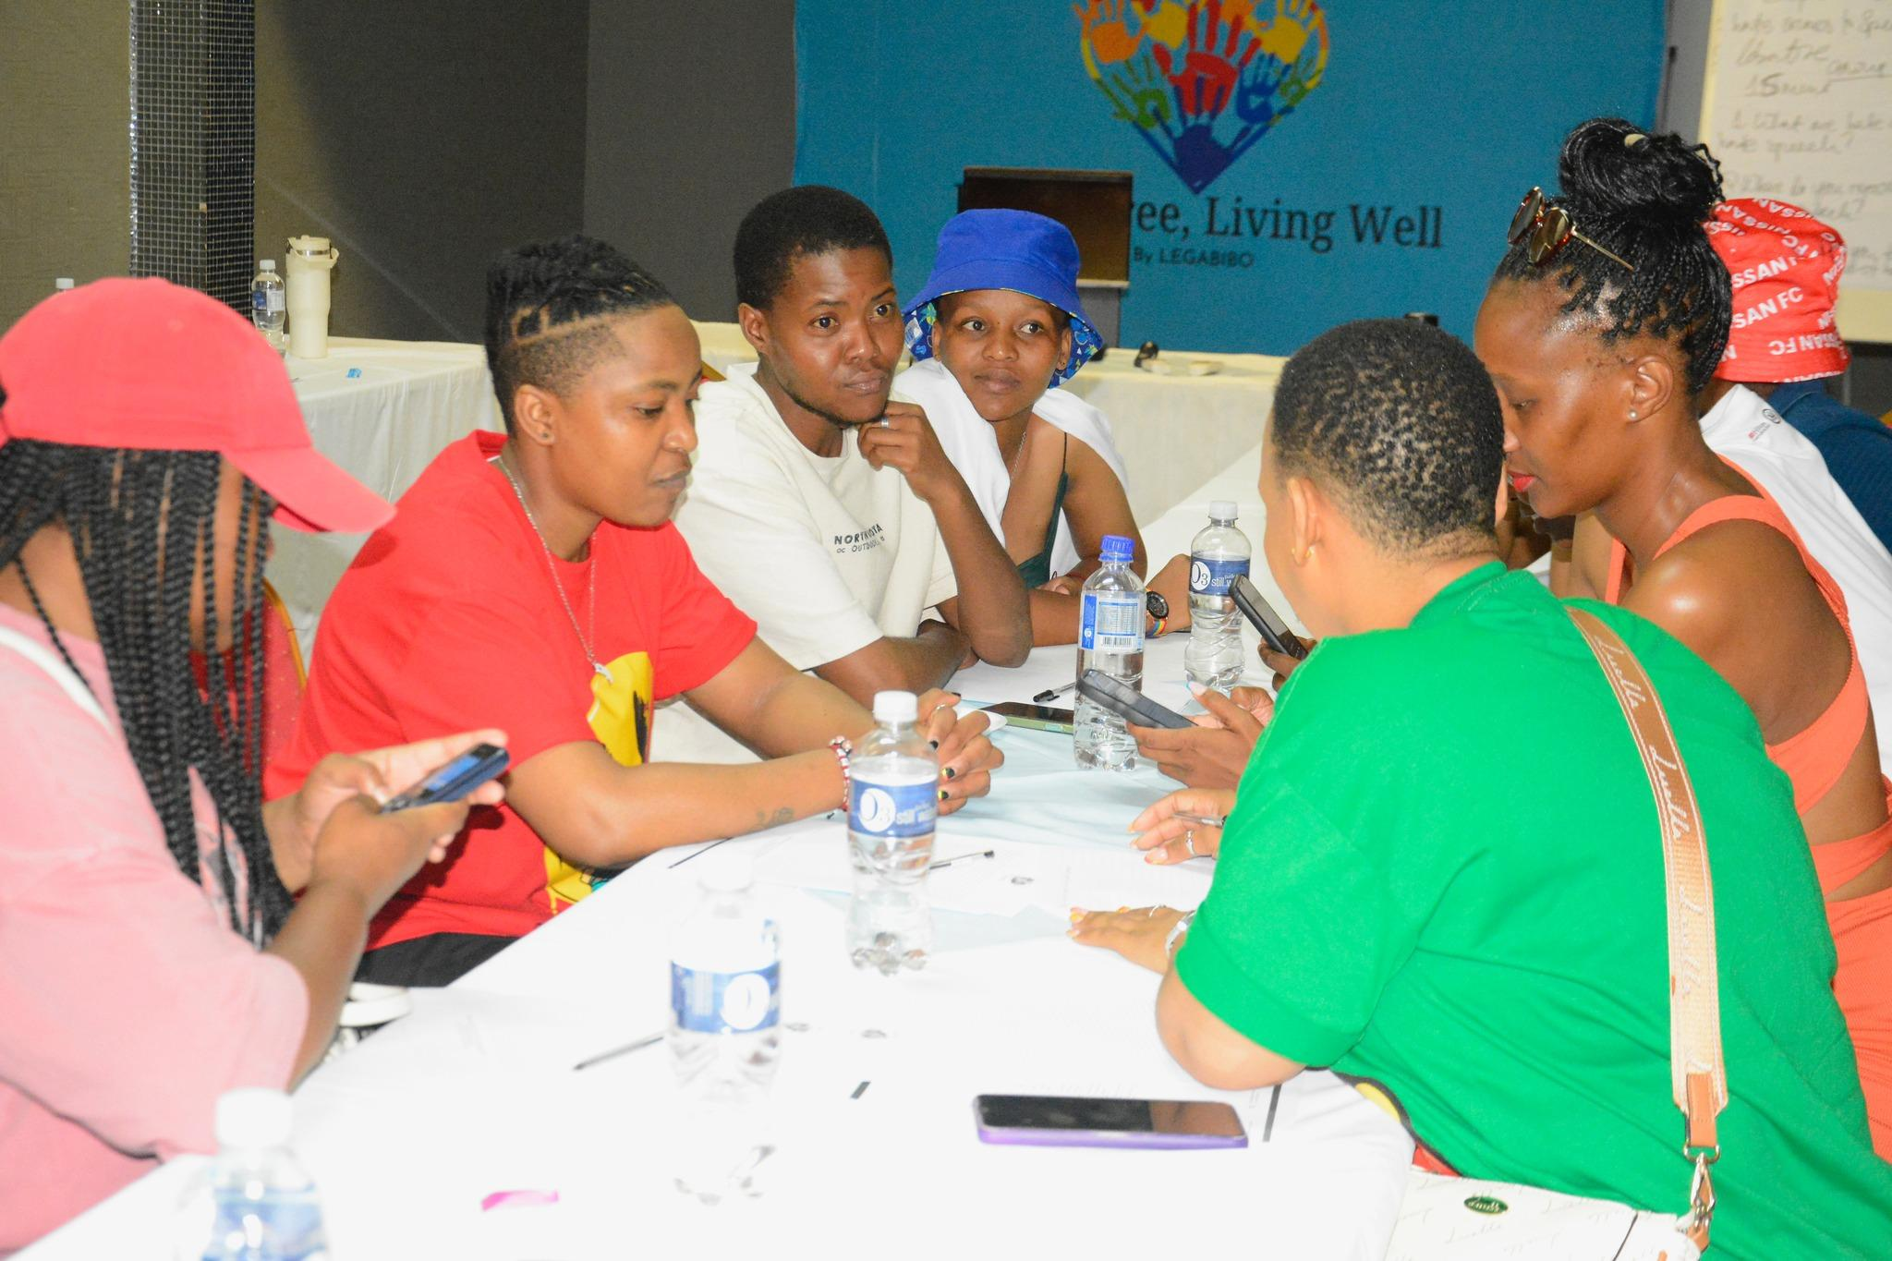
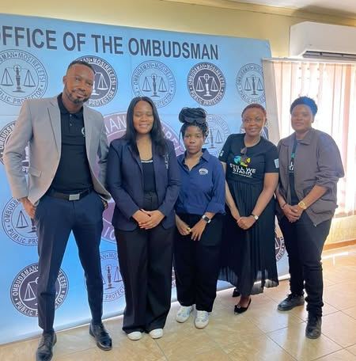
Actions
Through these, LEGABIBO moves LGBTIQ concerns from informal advocacy to documented state obligations
Voice and Choice Summit 2026 \ Voice and Choice Summit 2026
Notes:
LEGABIBO implemented a multi-layered strategy combining litigation, advocacy and institutional engagement.
CHRSNAP - Comprehensive Human Rights Strategy and National Action Plan

Slide 6
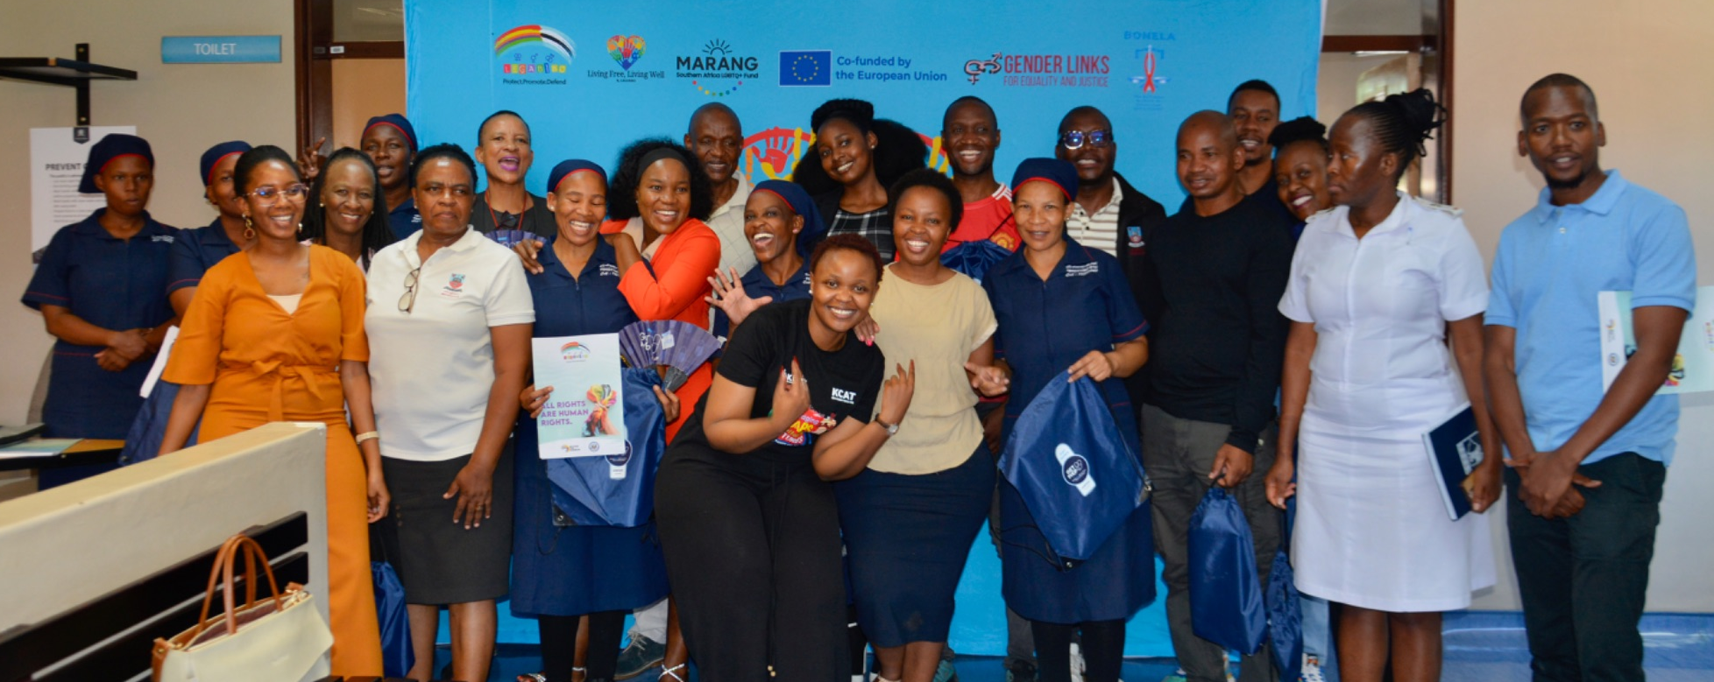
Actions
Through these, LEGABIBO moves LGBTIQ concerns from informal advocacy to documented state obligations
Voice and Choice Summit 2026 \ Voice and Choice Summit 2026
Notes:
LEGABIBO implemented a multi-layered strategy combining litigation, advocacy and institutional engagement.
CHRSNAP - Comprehensive Human Rights Strategy and National Action Plan

Slide 7
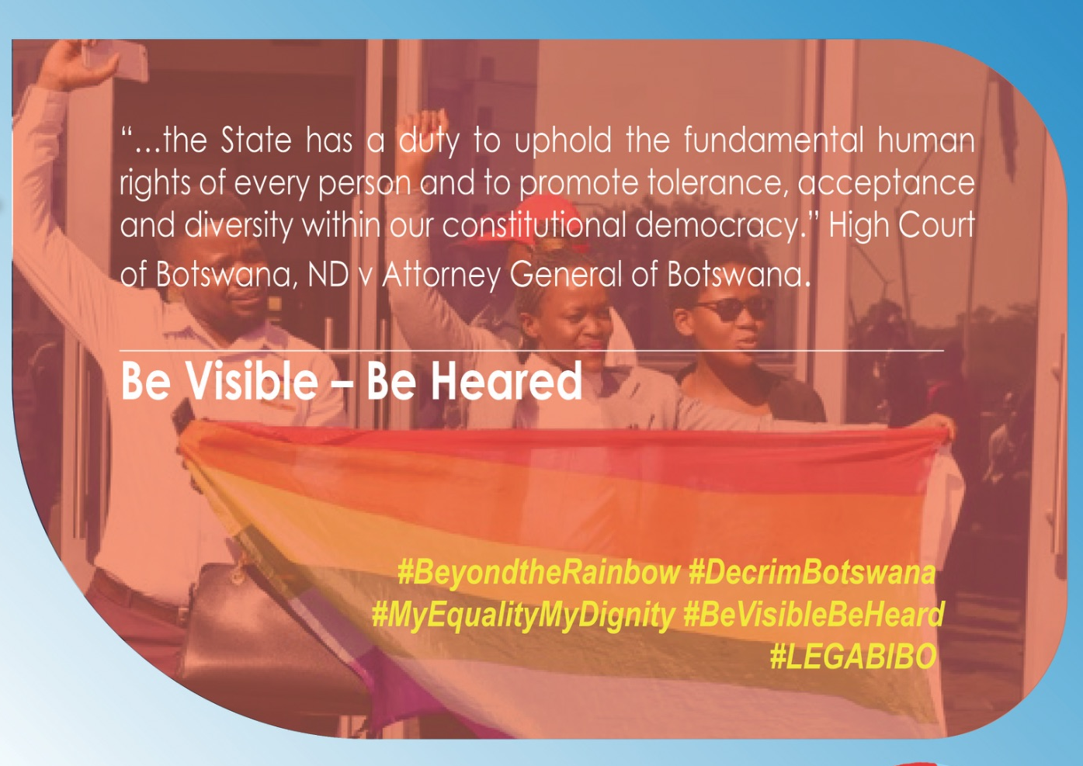
Impact
This strategy has LGBTIQ advocacy in Botswana from reactive to activism to sustained systems engagement
Key changes include:
• LGBTIQ organisations contributing to national human rights planning through CHRSNAP
• Inclusion of intersex protections in the 2024 Constitutional Review Committee recommendations
• Increased reporting of human rights violations by community members
• Greater engagement between LGBTIQ communities and state institutions
• Access to gender-affirming healthcare through referrals and advocacy with providers
Evidence: Include Photos or videos
Voice and Choice Summit 2026 \ Voice and Choice Summit 2026
Notes:
These developments demonstrate a shift where human rights of LGBTIQ people are increasingly treated as legitimate governance and human rights issues, rather than marginal concerns.

Slide 8
Challenges & Lessons learnt
Advancing human rights for LGBTIQ people in Botswana remains complex and contested. Strategic patience and community leadership remain critical to sustainable progress.
Key challenges:
• rising backlash and hate-motivated violence
• shrinking funding for human rights organisations
• slow policy reform processes - LGR by self-determination for eg.
• ongoing stigma in healthcare and public institutions
Lessons Learned:
• Legal victories must be supported by community mobilisation and institutional engagement
• Incremental change can produce long-term structural shifts
• International human rights mechanisms strengthen national accountability
• Protecting the safety and agency of affected individuals must remain central
Voice and Choice Summit 2026 \ Voice and Choice Summit 2026

Slide 9
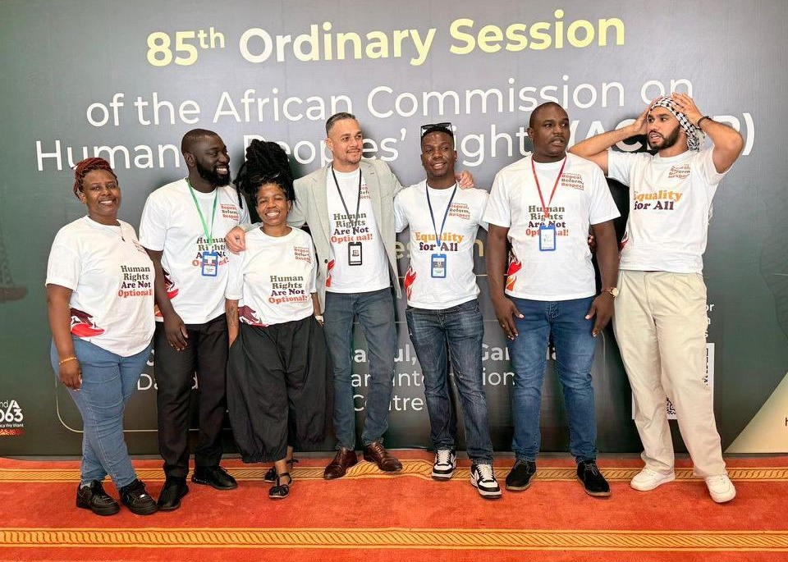
Sustainability
The change LEGABIBO has achieved is sustained through institutionalisation, collective leadership and evidence-based advocacy.
Key sustainability strategies include:
• Leadership development through engagements with PFLAG and Dikgosi
• Continued documentation of violations under Living Free, Living Well - Mokgosi
• Integration of LGBTIQ concerns into CHRSNAP and national human rights planning
• Engagement with CEDAW and the African Commission on Human and Peoples’ Rights
• Coalition building with civil society and community organisations
Voice and Choice Summit 2026 \ Voice and Choice Summit 2026
Notes:
Leadership development through engagements with PFLAG and Dikgosi in Letsema Le Tsweletse.
By embedding LGBTIQ rights within institutions, policy frameworks and accountability mechanisms, the movement becomes less dependent on individual campaigns or cases.

Slide 10
Next Steps
Next Phase focus: Deepening institutional accountability and Expanding legal protections.
Upcoming priorities include:
• strengthening legal empowerment and community reporting mechanisms
• continuing advocacy for legal gender recognition by self-determination
• continued engagement in the implementation of CHRSNAP
• expanding healthcare inclusion initiatives beyond HIV/AIDS
• building stronger regional and international advocacy alliances
The long-term goal is to ensure that LGBTIQ equality is embedded within Botswana’s democratic and human rights institutions.
Voice and Choice Summit 2026 \ Voice and Choice Summit 2026

