Slide 1


Voice and Choice Summit 2026-Change Strategies-Communications and Outreach Category
Title/Name of Change Strategy
South Afica:Protect & Educate:GBVF/SRHR Initiatitive
Presenter: Matshego Pitse
Voice and Choice Summit 2026 \ Voice and Choice Summit 2026

Slide 2
Synopsis– brief overview what this is about
Name | Matshego Pitse
Designation | Director
Organisation | Moswen NGO
Country | South Africa
Category | Story of Change
Summary | The programme is about embedding GBVF prevention and SRHR promotion into everyday systems, ensuring that change is sustained, scalable, and community-driven in order prevent violence, promote rights, and strengthen support systems across schools, health facilities, and communities.
Voice and Choice Summit 2026 \ Voice and Choice Summit 2026

Slide 3
Background(problem, actions, change, evidence)
Briefly describe the context or problem the Change Strategy set out to address.
Who is the organisation behind the strategy?
Moswen NGO
Where are you based / Where is the strategy being implemented?
Northern Cape province, Kimberley
Who was most affected by the problem and how?
Young people, women, parents and vulnerable groups
Evidence: Include Photos or videos
Voice and Choice Summit 2026 \ Voice and Choice Summit 2026

Slide 4
....Continuation.......
What issue(s) did the strategy address?
Creating safer schools, informed communities, and supportive health systems where individuals—especially women, children, and vulnerable groups—can live free from violence and make informed decisions about their health.
What were the key objectives of the strategy?
Increase knowledge and life skills among learners to make informed, safe decisions, reduce incidents of gender-based violence through awareness and early intervention, strengthen collaboration between schools, communities, and health facilities for effective referral and response systems and promote gender equality, respect, and human rights.

Slide 5
...........Continuation.....
Problem: The programme addresses high levels of gender-based violence (GBV), limited access to comprehensive sexual and reproductive health (SRH) information, and weak referral systems affecting learners, community members, and vulnerable groups — including LGBTQI+ individuals.
Action: To address the identified challenges, the GBVF/SRHR programme implemented coordinated actions across schools, communities, and health facilities.
Change: Overall, the change reflects a movement from silence, stigma, and vulnerability toward awareness, protection, inclusion, and strengthened support systems for all.

Slide 6
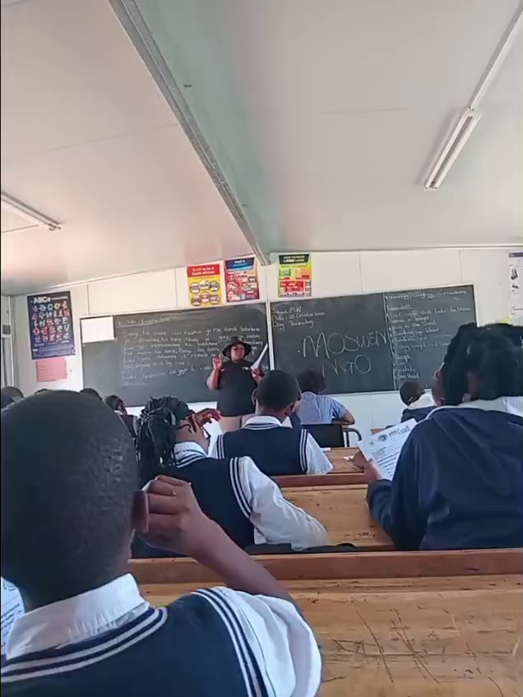
......Continuation...........In-school programme

Slide 7
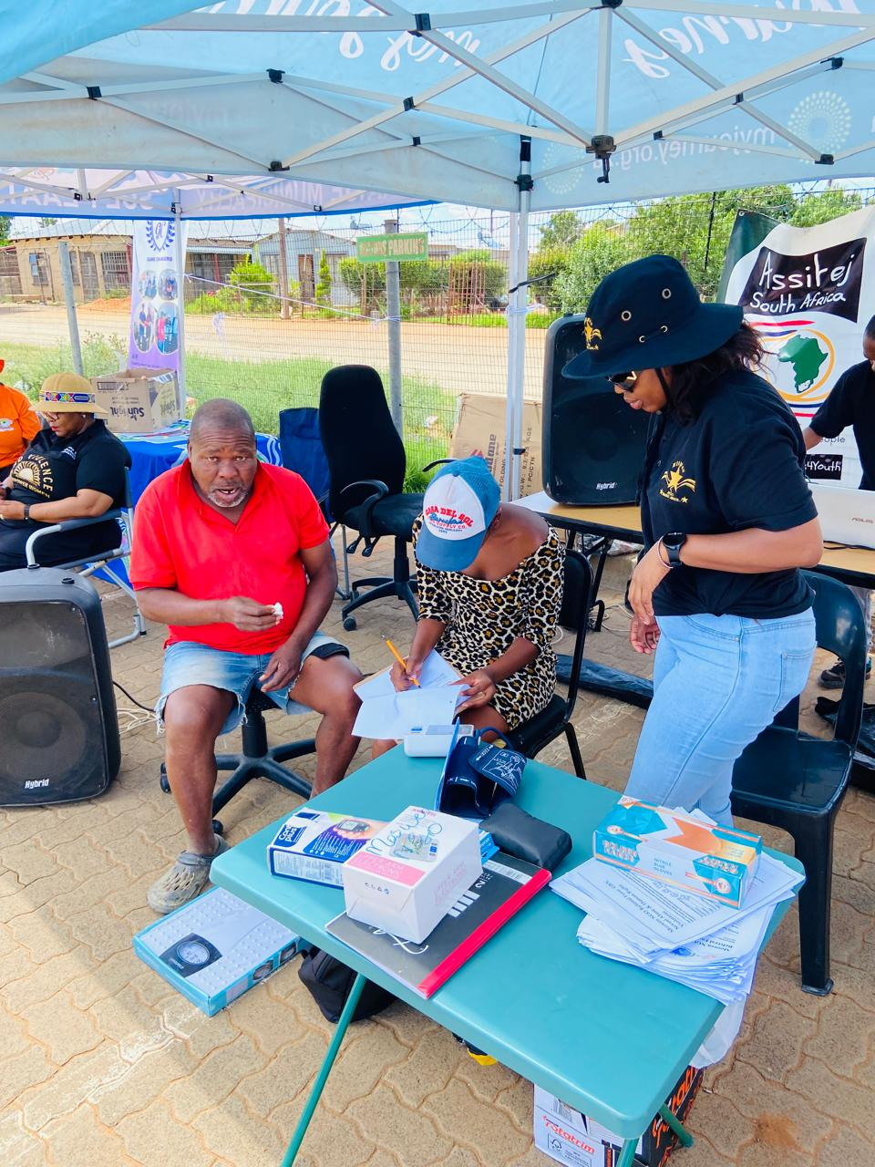
16 Days Activation programme

Slide 8
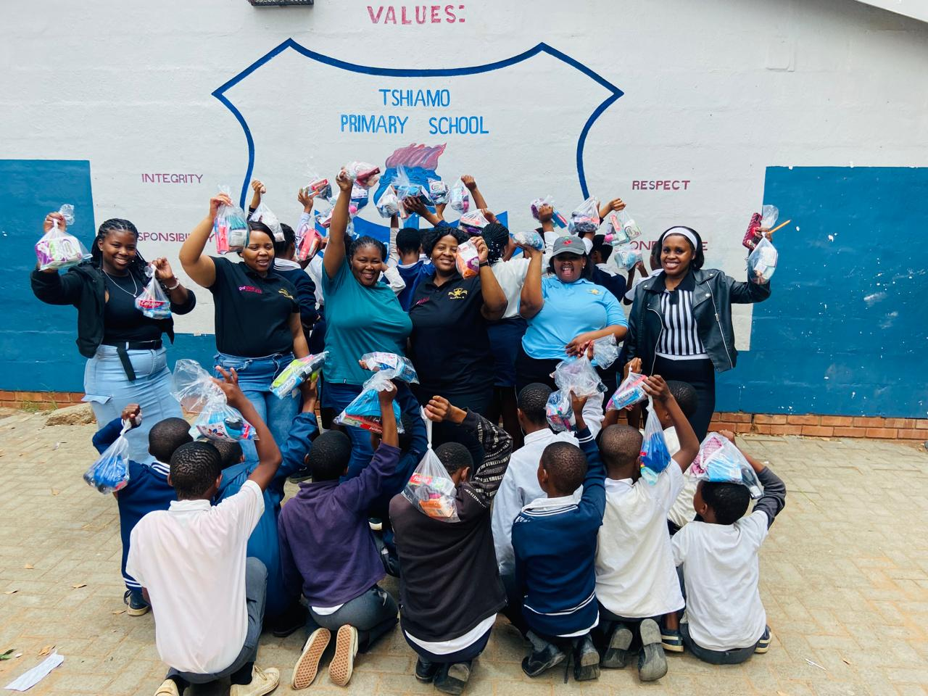
Peer Educator conducting door to door

Slide 9
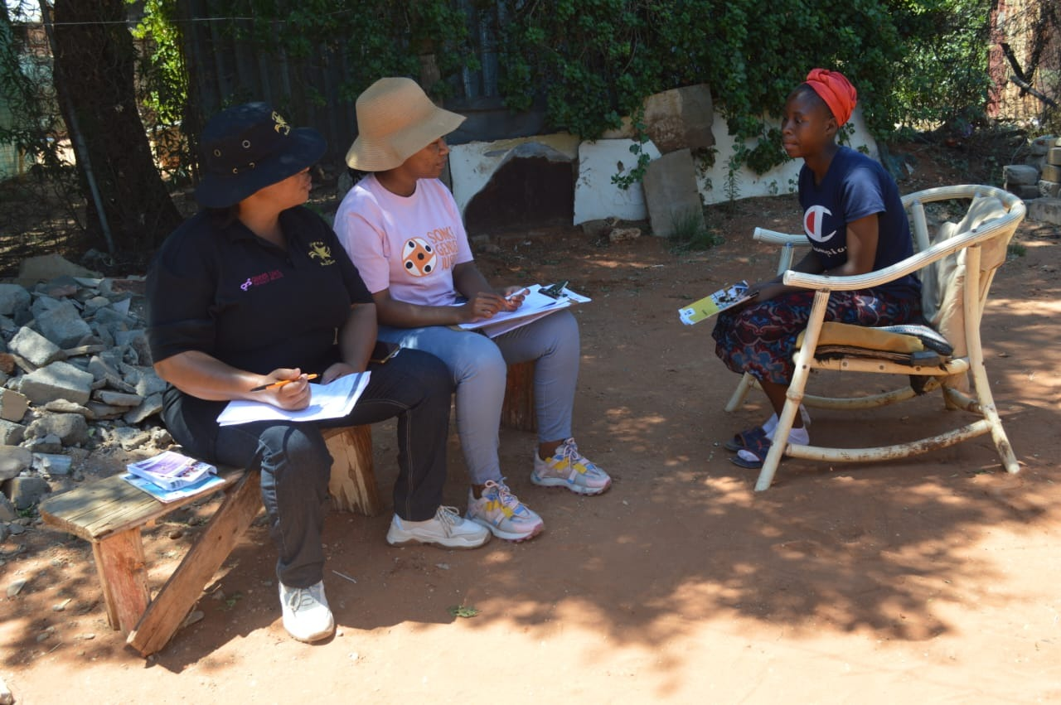
Follow-up on referral case - door to door

Slide 10
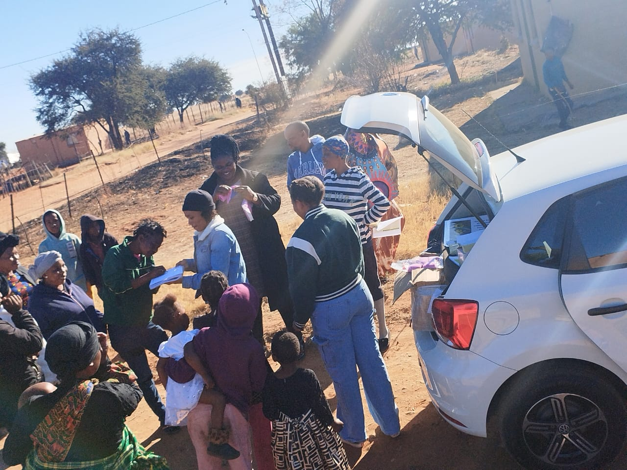
Campaign held in Platfontein

Slide 11
Followers | Before WVL/Marang | Current
Facebook | 35 | 129
Twitter | 0 | 0
Tik-Tok | 0 | 9
YouTube | 0 | 0
Instagram | 60 | 75
Please provide a concrete example of your post
For us to have followers on social media is more than just numbers—it’s about building influence, credibility, and community around our advocacy work.

Slide 12
Likes | Before WVL/Marang | Current
Facebook | 30 | 34
Twitter | 0 | 0
Tik-Tok | 0 | 8
YouTube | 0 | 0
Instagram | 0 | 3
Please provide a concrete example of your post
Signal of resonance: A like shows that your message connects with people—it’s a quick form of validation.

Slide 13
Impressions | Before WVL/Marang | Current
Facebook | 9 | 25
Twitter | 0 | 0
Tik-Tok | 0 | 59
YouTube | 0 | 0
Instagram | 0 | 12
Please provide a concrete example of your post
Impressions are a crucial metric because they show how many times your content has been displayed, regardless of whether people liked, commented, or shared it.

Slide 14
Sustainability
How will the change be sustained or scaled up?
By Institutionalizing the program, build local capacity, and foster community ownership.
How did you foster a culture of continuous learning and best practice sharing within the movement?
Thriving to see learning been seen as collective, ongoing, and celebrated—not a one-off event.
How did you generate and utilise evidence to assess the impact and effectiveness of advocacy efforts within your movement?
By generating evidence systematically, transperancy in sharing and used strategically to refine advocacy and prove its impact.
Evidence: Include Photos or videos
Voice and Choice Summit 2026 \ Voice and Choice Summit 2026

Slide 15
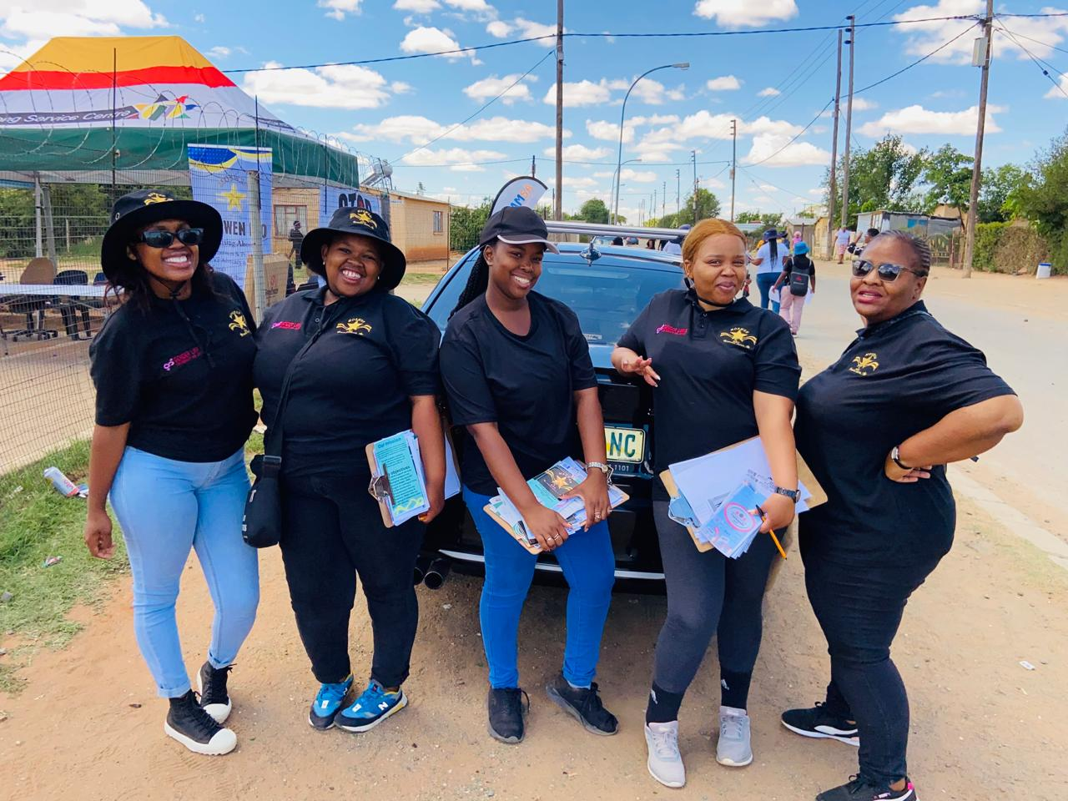
Community Workers holding POEs

Slide 16
Beneficiaries
 | Number of participants
Female – Direct beneficiaries | 109
Male – Direct beneficiaries | 111
Female – Indirect beneficiaries (e.g. through other networks) | 276
Male – Indirect beneficiaries (e.g. through other networks) | 95
Female – Online beneficiaries (e.g. website access, mailing lists, scholarly articles) | 0
Male – Online beneficiaries (e.g. website access, mailing lists, scholarly articles) | 0
Total | 591
Voice and Choice Summit 2026 \ Voice and Choice Summit 2026

Slide 17
Challenges & Lessons learnt
Challenges
Resource constraints: Limited funding and staff to sustain programs.
Resistance to change: Cultural norms, stigma, and entrenched gender inequalities slows acceptance.
Capacity gaps: Teachers, Community Workers, and community leaders lack training.
Weak monitoring systems: Difficulty in collecting reliable data to demonstrate impact.
Policy-practice gap: Strong policies exist but are not consistently implemented at grassroots level.
What lessons have you learnt?
Evidence matters: Data and lived experiences are powerful in influencing policy and practice.
Advocacy is stronger when backed by credible evidence.
Community ownership is essential: Programs thrive when communities see themselves as co-creators rather than passive beneficiaries.
Integration prevents fragmentation: Aligning schools, health facilities, and community structures ensures consistency and avoids duplication.
Capacity is not a one-off: Continuous training, mentorship, and peer learning are necessary to keep momentum and confidence alive.
Voice and Choice Summit 2026 \ Voice and Choice Summit 2026

Slide 18
Challenges & Lessons learnt
Mitigations
Diversified funding: Secure government, donor, and community contributions to reduce reliance on a single source.
Community engagement: Work with traditional leaders, parents, and youth to shift norms and build ownership.
Integrated platforms: Establish cross-sector task teams to align schools, clinics, and community initiatives.
Capacity building: Provide ongoing training, mentorship, and peer support networks.
Robust M&E systems: Use digital tools, participatory monitoring, and partnerships with research institutions.
Policy advocacy: Push for accountability mechanisms that ensure policies are translated into practice.
Wellbeing support: Offer psychosocial support, recognition, and safe spaces for activists and service providers.
What lessons have you learnt?
Wellbeing of advocates matters: Burnout is real—support systems, recognition, and psychosocial care are critical for sustainability.
Flexibility is key: Contexts change, and strategies must adapt. What works in one community may need tailoring in another.
Partnerships amplify impact: Collaboration across sectors—government, NGOs, schools, clinics, and traditional leaders—creates stronger, more resilient movements.
Communication drives change: Storytelling, campaigns, and peer-led dialogues help shift norms faster than top-down messaging.
Voice and Choice Summit 2026 \ Voice and Choice Summit 2026

Slide 19
Next Steps
What are your plans?
The ultimate plan is to create a self-sustaining ecosystem where schools, health facilities, and communities reinforce each other.
Advocacy should bot just become a campaign, but a way of life—embedded in everyday practices, supported by evidence, and driven by people themselves.
Voice and Choice Summit 2026 \ Voice and Choice Summit 2026

