Slide 1


Voice and Choice Summit 2026-Change Strategies- Policy change & Movement Building Category
South Africa: Institutionalising Court-Based GBV Survivor Support
Incema Court Placement Model
S. Ndlovu
Voice and Choice Summit 2026 \ Voice and Choice Summit 2026

Slide 2
Synopsis– brief overview what this is about
Name | Senzekile Ndlovu
Designation | Psycho Social Manager
Organisation | Incema NPO
Country | South Africa
Sub Category | POLICY Change Strategies and movement building
Summary | This presentation outlines how Incema institutionalised court-based psychosocial support in response to rising GBV and domestic violence cases in Plessislaer, Pietermaritzburg. From a rapid response intervention in 2022 to a formally adopted Terms of Reference in 2025, this model is now recognised as a best practice system for survivor navigation of the court process. This project is implemented in alignment with the South African National Strategic Plan on Gender-Based Violence and Femicide (NSP GBVF), particularly Pillar 4 (Response, Care, Support and Healing) Pillar 5( access to justice system) Pillar 6 (Research and Information Management). This project addresses the urgent need for trauma-informed, coordinated, and timely psychosocial support for survivors navigating legal processes.
Voice and Choice Summit 2026 \ Voice and Choice Summit 2026

Slide 3

Background: Problem
• Plessislaer identified as a GBV hotspot
• Police station ranked among Top 20 for reported GBV crimes
• Cases falling through the cracks
• High case withdrawals
• Dysfunctional coordination systems
• Survivors lacked information & psychosocial support
Voice and Choice Summit 2026 \ Voice and Choice Summit 2026

Slide 4
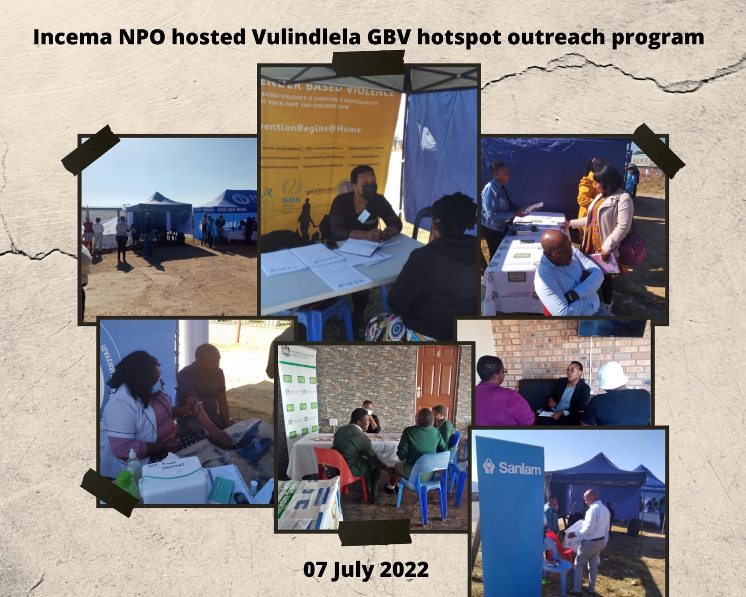
Background: ActionTaken – GBV Hotspot project
Roundtable of key stakeholders convened
• Community outreach programmes initiated
• Psycho-social support integrated into outreach
• Incema led court placement strategy
• Social workers placed in court on 7 February 2022
• Funded through WVL 1 Rapid Response Grant
Voice and Choice Summit 2026 \ Voice and Choice Summit 2026

Slide 5
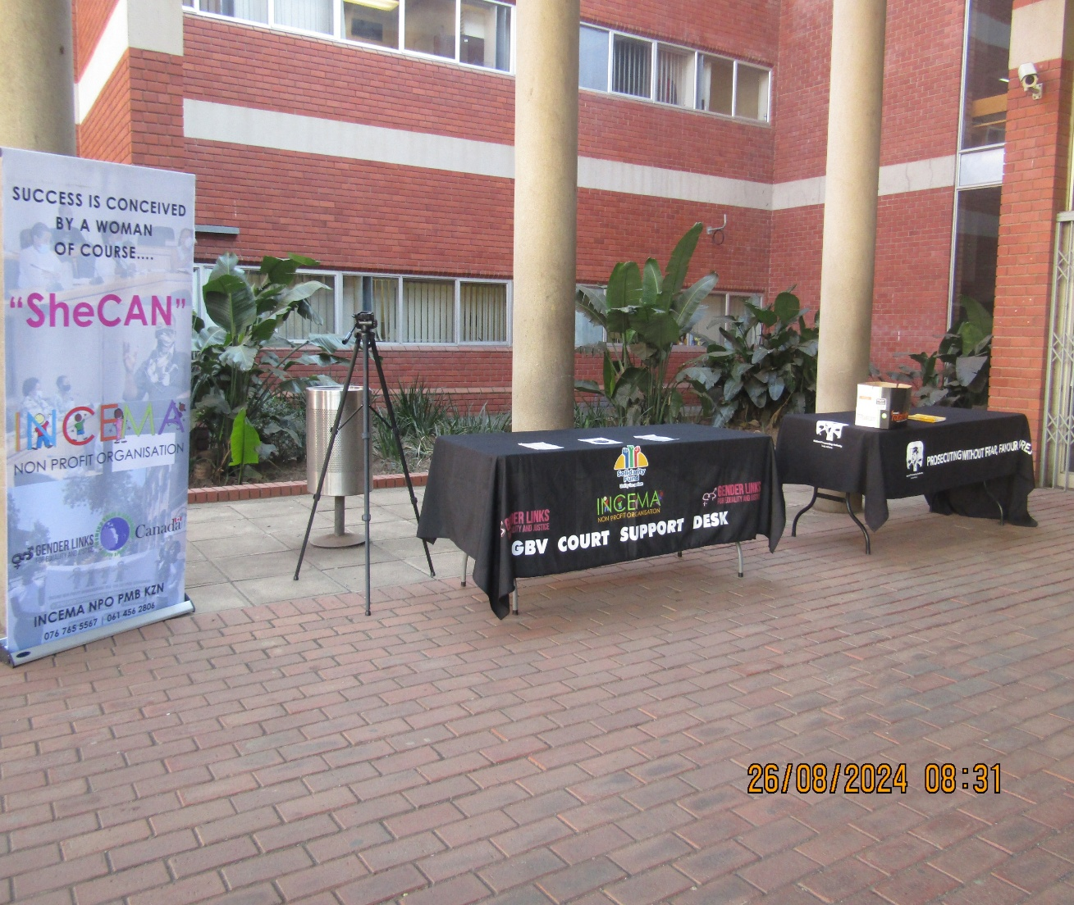
Background: The Change – Court Placement Model
• Social workers available inside Pietermaritzburg Magistrate Court
• Immediate trauma-informed support
• Survivor walk-in access
• Collaboration with Lifeline & NPA
• Introduction of GBV Referral & Notification System
• Prosecutors notify social workers upon case enrolment
Voice and Choice Summit 2026 \ Voice and Choice Summit 2026

Slide 6
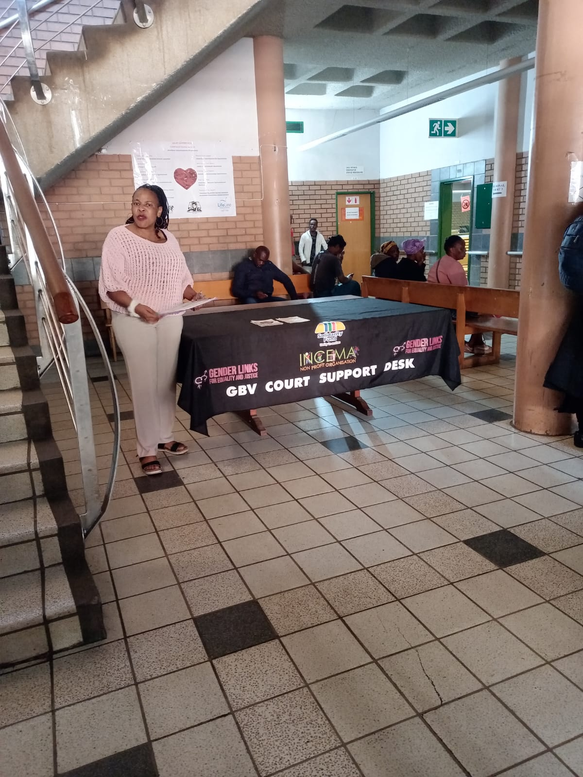
Change: Evidence of Impact
• Reduced trauma symptoms & anxiety among complainants
• Increased survivor confidence & emotional regulation
• Improved case navigation & informed decision-making
• Better monitoring of withdrawals & dropouts
• Strengthened Batho Pele-aligned service delivery
• Alignment with National Strategic Plan on GBVF (Pillars 2, 5, 6)
Voice and Choice Summit 2026 \ Voice and Choice Summit 2026

Slide 7
Change: Institutional- December 2025
• Terms of Reference signed by Incema, Lifeline & NPA
• Incema confirmed as Lead Partner
• Formal adoption of court placement system
• Defined stakeholder roles & responsibilities
• Standardised referral & notification protocol
• Data tracking & quarterly stakeholder reviews
Service availability and accessibility.
This program brought the public and government department together and in conversation, on community needs instead of top down, this influencing policy change, and better practice of Batho Pele Principles
Emotional healing: reduced trauma symptoms and anxiety
Victims, were able to feel worthy and gained confidence, better management of emotions and coping mechanisms
Empowerment: making informed decisions about their lives
Support networks, ie. by knowing they can walk-in to the Social workers office inside court any day.
Practical changes: improved access to resources, ability to build healthier relationships
Contemplation on life changes ie new goals
And ongoing psychosocial support.
Voice and Choice Summit 2026 \ Voice and Choice Summit 2026

Slide 8
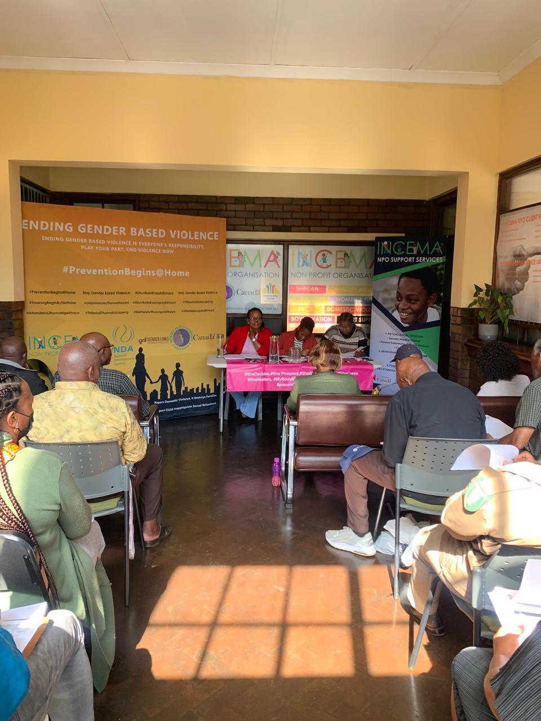
Sustainability strategy
• Diversified funding post-WVL 1
• Strong stakeholder coalition
• Resource sharing mechanisms
• Ongoing community engagement
• Monitoring & evaluation framework
• Cultural sensitivity & survivor-centred approach
Voice and Choice Summit 2026 \ Voice and Choice Summit 2026

Slide 9
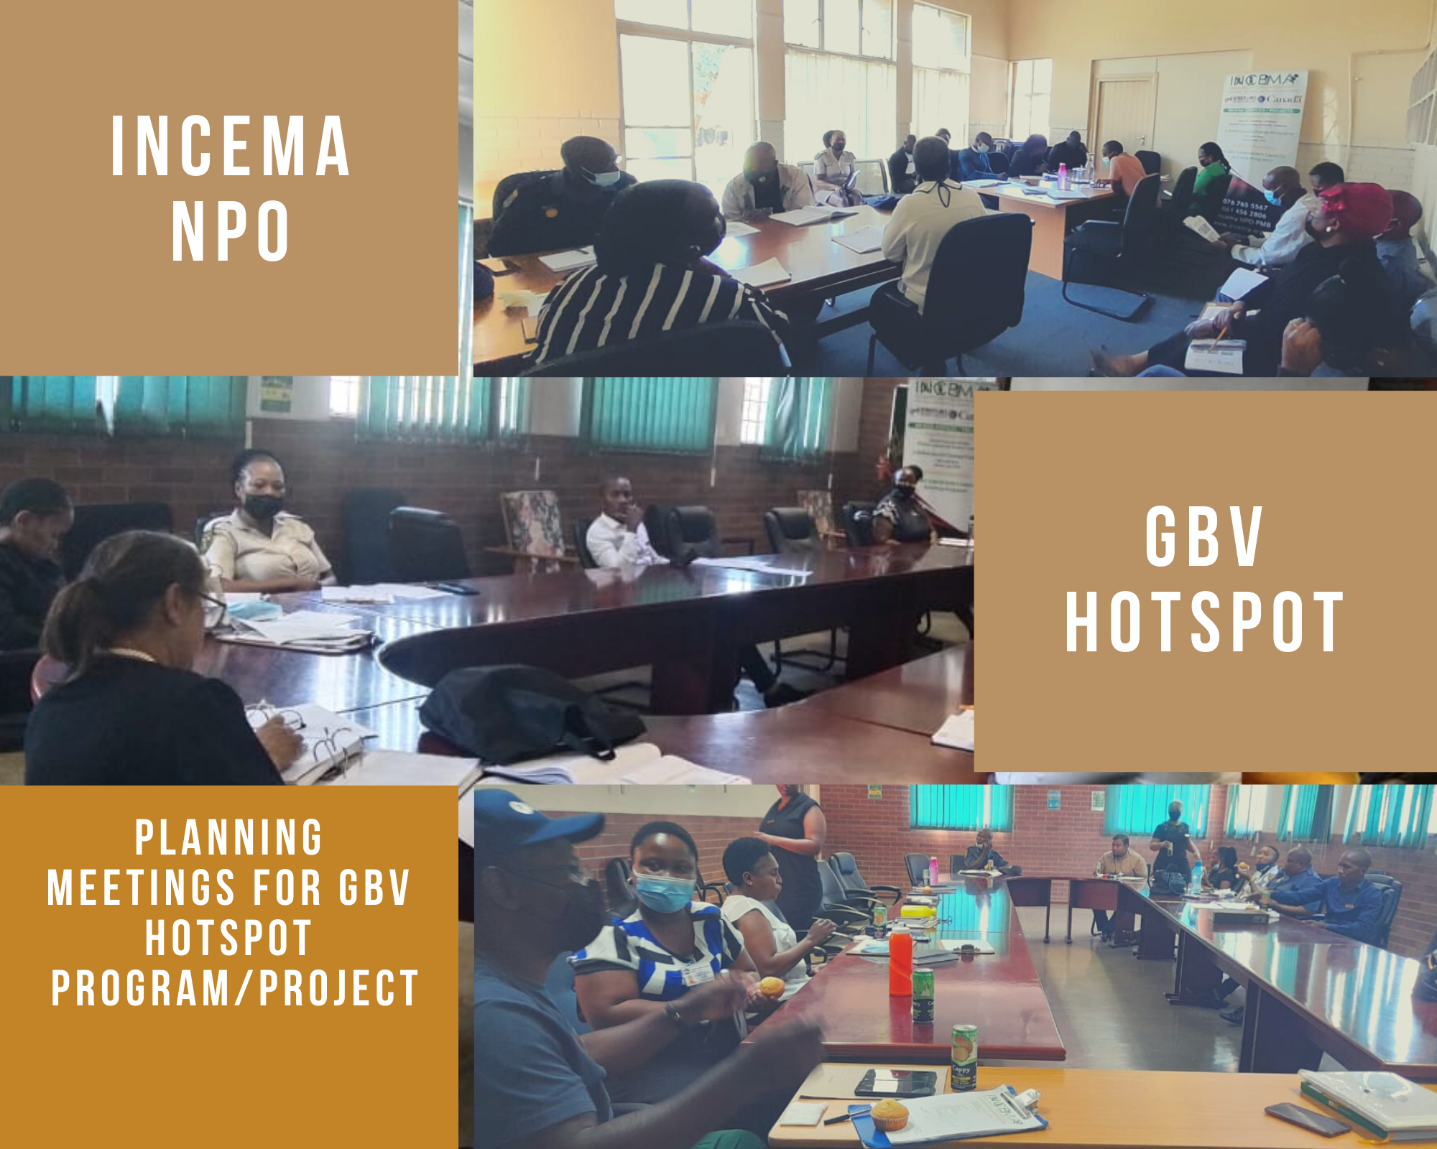
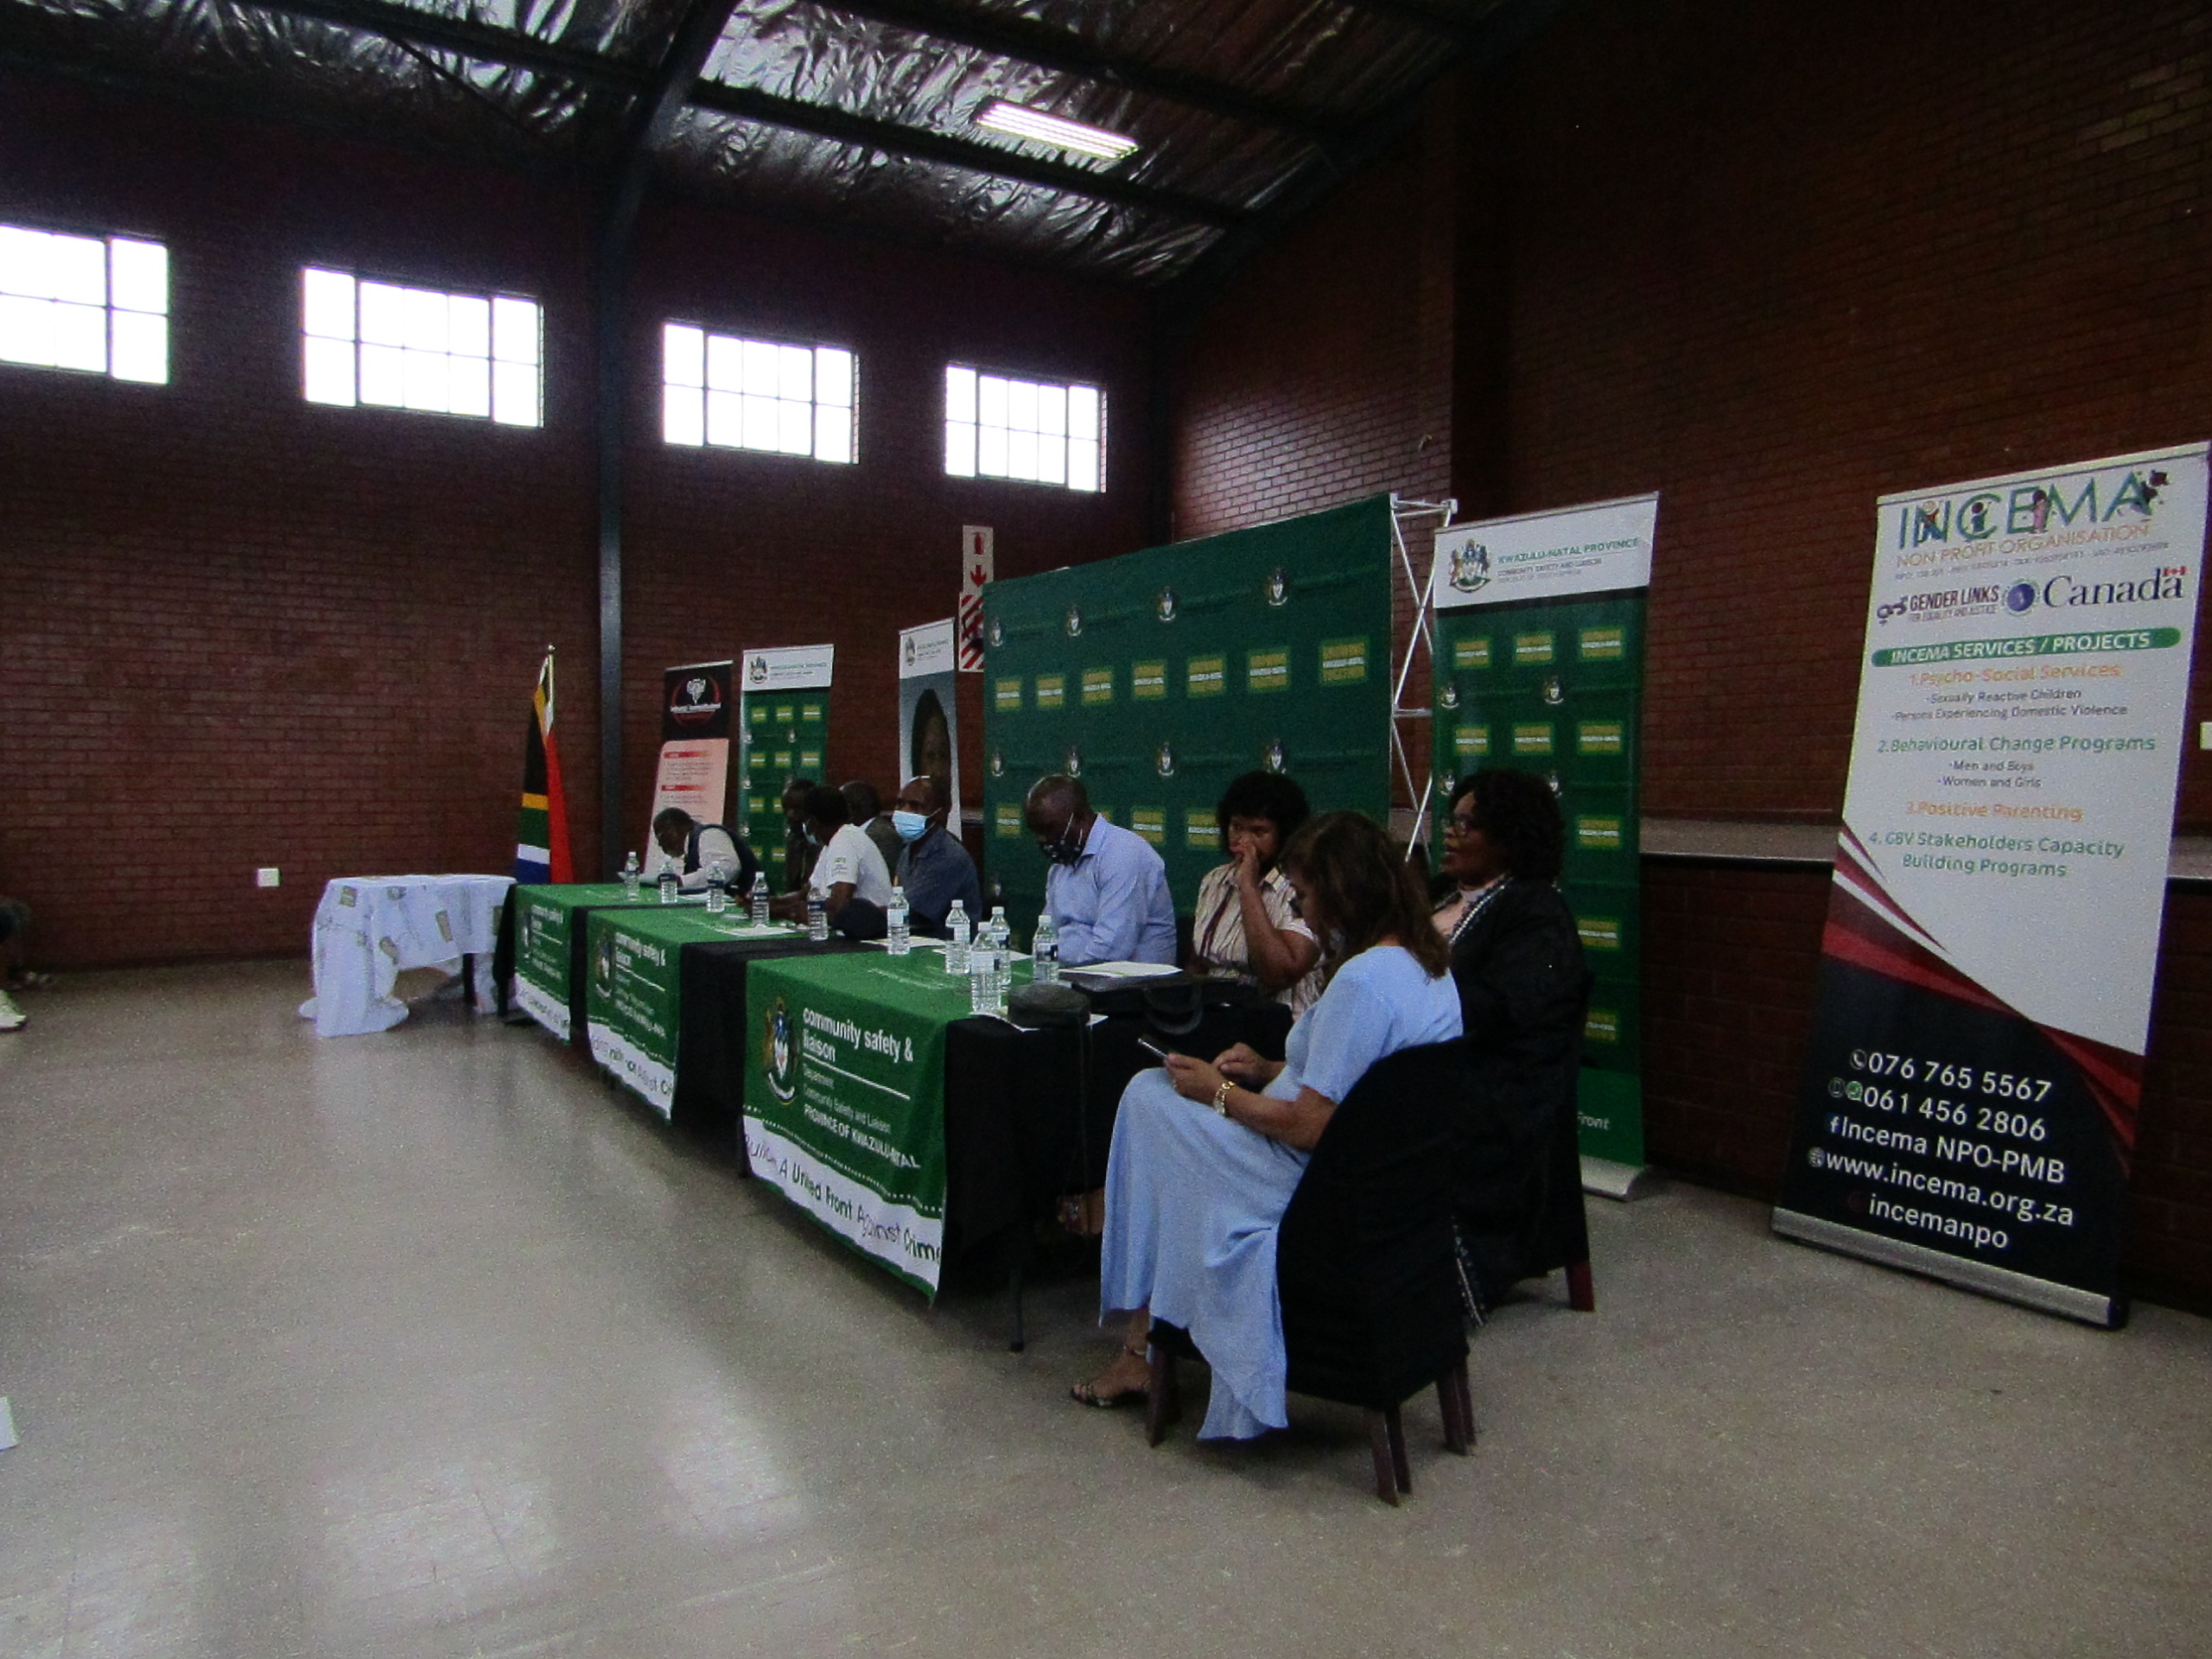
Sustainability
Funding application : GBVF1
Funding application: Community Chest
Funding application : WVL 2
Decentralisation of services
Formed partnerships and Relations
Voice and Choice Summit 2026 \ Voice and Choice Summit 2026

Slide 10
Challenges & Lessons learnt
Challenges:
• Lengthy court processes
• Economic dependency on perpetrators
• Family pressure & fear of retaliation
• Limited funding & staff shortages
Lessons Learnt
• Economic empowerment linked to protection
• Behaviour change is long-term
• Men & boys inclusion strengthens impact
• Staff wellbeing affects service quality
Voice and Choice Summit 2026 \ Voice and Choice Summit 2026

Slide 11
Next Steps
What are • Replicate model in Umgungundlovu courts:
- Howick
- Impendle
- Camperdown
• Strengthen data-informed advocacy
• Influence district-level policy adoption
• Expand survivor economic empowerment linkages
• Develop sustainability through The Long Term model: Cross subsidization and wellness programs ( Annual Hiking)
Voice and Choice Summit 2026 \ Voice and Choice Summit 2026

Slide 12
In closing: Why this matters
This model moves beyond project-based intervention.
It institutionalises survivor-centred justice support, reduces case attrition, and strengthens trust in the justice system.
Incema’s court placement model demonstrates how civil society can influence systemic change through partnership, evidence, and persistence.
Voice and Choice Summit 2026 \ Voice and Choice Summit 2026

