Slide 1

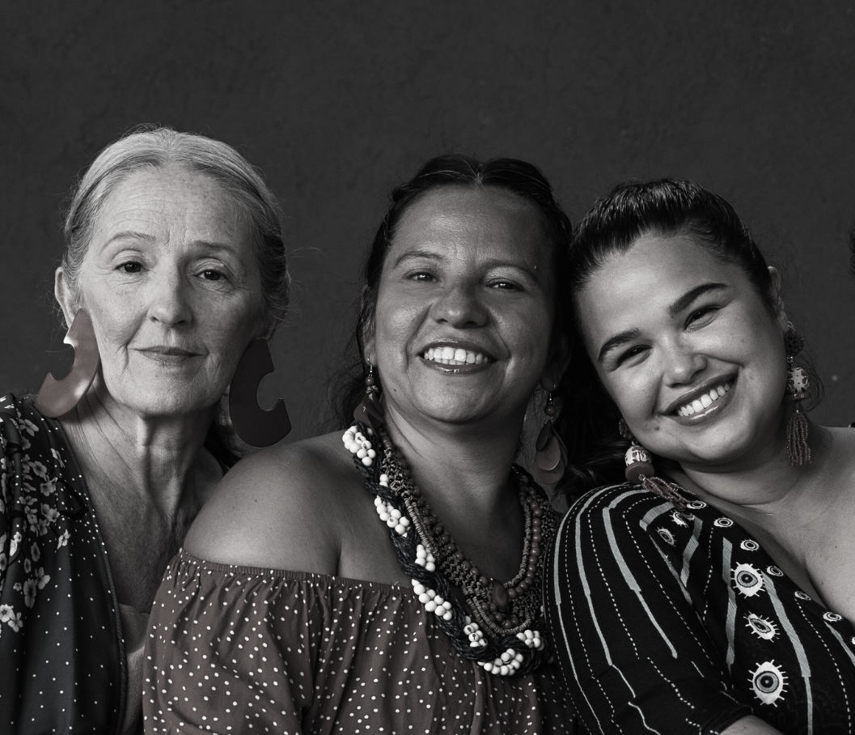

Voice and Choice Summit 2026: Communications & Reach
South Africa: The 1000 Women Chatbot – A Digital Lifeline for Change
The 1000 Women
24 Hour Chatbot

Slide 2

Inspire. Educate. Equip. Empower.
1000 Women Trust is a registered Women's Rights Organisation operating in South Africa dedicated to raising awareness about gender-based violence and femicide (GBVF) while providing capacity building to GBV Community Organisations.
Our network serves as a vigilant watchdog over government and society, with a specific focus on addressing gender-based violence (GBV) and femicide along with their underlying causes. Since its establishment in 2003, our organisation has remained steadfast in advocating for the rights and safety of women in South Africa.
Capacity Building lies at the core of our mission. Our training is even more accessible as we are using WhatsApp technology that enables more people to participate. We offer free training programmes: :
Trauma Support Volunteer Training,
Anti-Bullying Training Programme,
GBV & Substance Abuse Awareness Training,
GBV Life Coach Training (Basic Counselling)
Talking to Boys (Men’s Programme)
First Responder Training
Support Group Training
Who we are

Slide 3
Our strategy in developing the 1000 Women Trust Chatbot was rooted in accessibility, safety, and empowerment.
We chose WhatsApp as the platform because it is widely used, familiar, and discreet, ensuring that women—even in rural or marginalised communities—could reach support without barriers.
The chatbot was designed through collaboration with survivors, community organisations, and experts, ensuring that its content reflects real needs and lived experiences.
Our Strategy

Slide 4

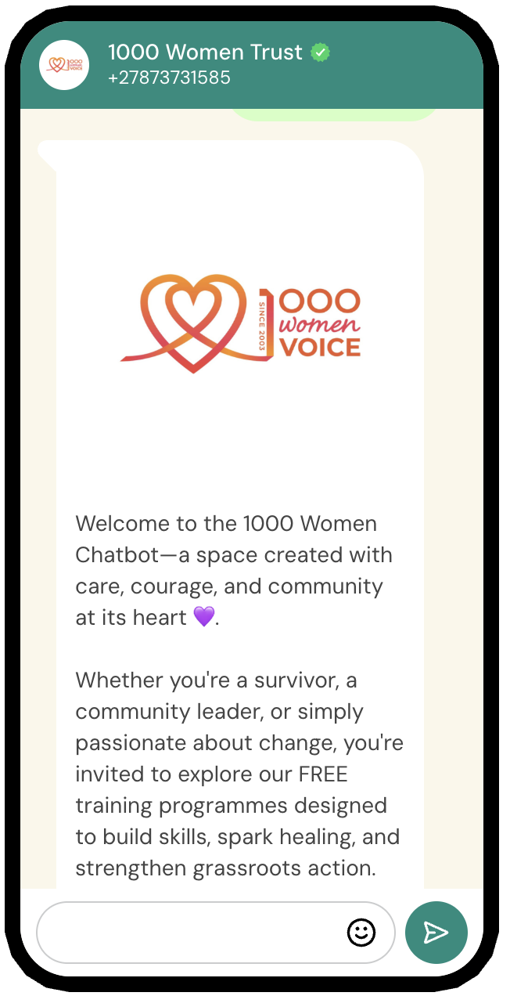
1000 Women: 24hr CHATBOT
Immediate, Always-On Support
Women & children often face crises at night or in isolated moments when traditional services are unavailable. A 24/7 chatbot ensures help is accessible at any time, reducing the risk of women being left without support when they need it most.
Scalable Reach across Communities
Why a Chatbot?
WhatsApp is widely used across South Africa and beyond, including in rural and underserved areas. A chatbot leverages this existing platform to reach thousands of women simultaneously, breaking barriers of distance, cost, and limited human resources.
Safety and Confidentiality
Many survivors fear stigma, retaliation, or judgment. WhatsApp provides a discreet, familiar, and private channel where women can seek information and guidance without exposing themselves to further danger.

Slide 5
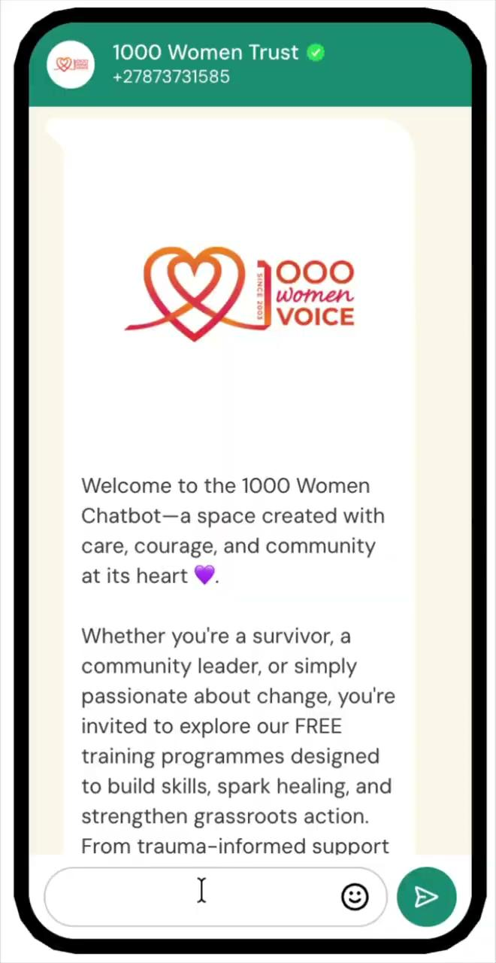


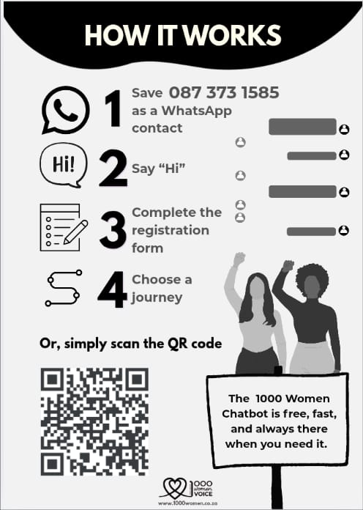
How it Works
Access to
GBV Info ( GBV Legislation, Protocols, Shelters, Case Study material etc.
Training Courses ( Trauma Support & Anti Bully )
Help and Research ( Tell your story, Report and incident, Join GBV warrior network etc)

Slide 6


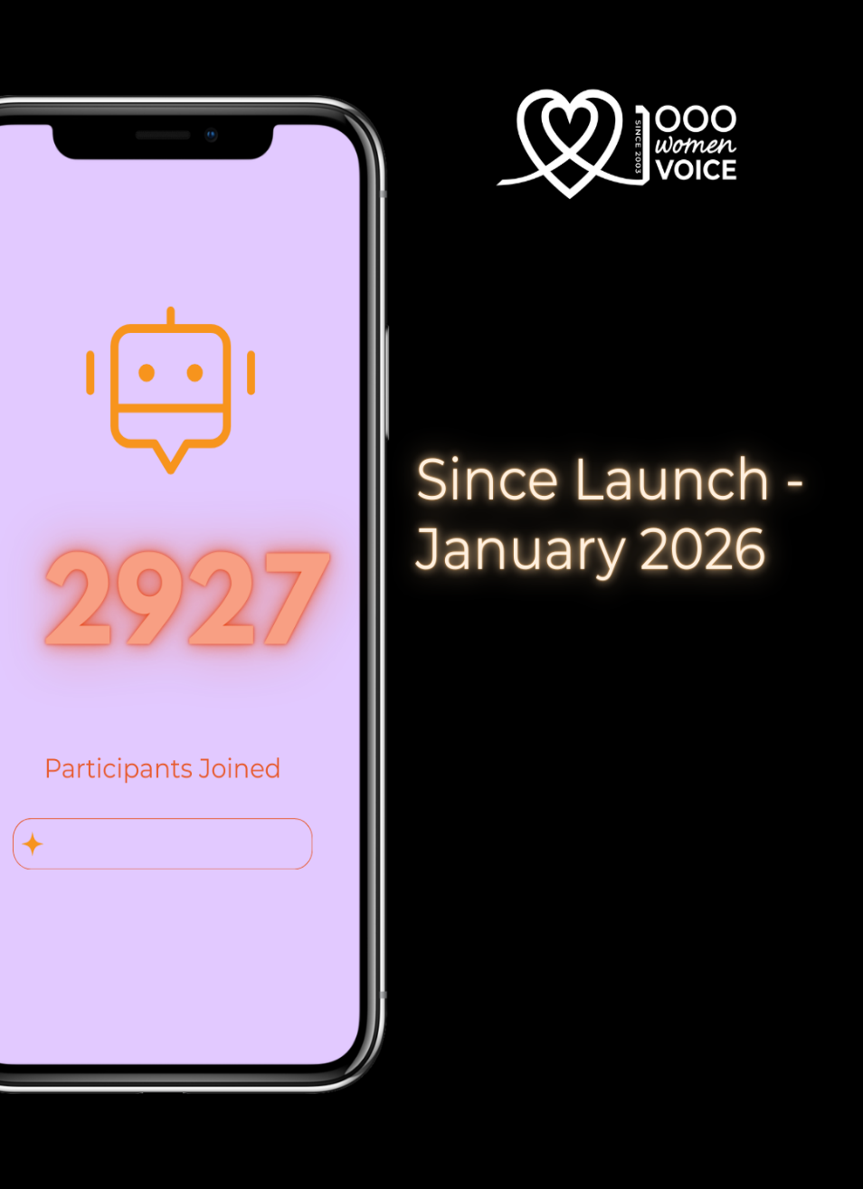


Post Launch figures
Since Launching the CHATBOT on 26 January 2026
Educate
Skills Training
South African
Women/Girls
Inspire
Survivor Stories
99,6%
89%
Empower & Equip GBV info and Resources

Slide 7
Continuous Content Updates - Regularly updating information, training materials, and referral pathways will keep the chatbot relevant and responsive to evolving needs.
Capacity Building – Training Community Leaders, volunteers and organizations to use and promote the chatbot will embed it into local support structures, making it a trusted tool at grassroots level.
Technology Expansion - Scaling up by integrating new features (e.g., multilingual support, AI‑driven insights, expanded referral databases) will allow the chatbot to reach more diverse communities.
Data Driven insights – Using anonymised data collected through the chatbot to identify trends and gaps.
Sustainability through awareness - Ongoing awareness drives will ensure women know about the chatbot, trust it, and use it, creating a cycle of demand and impact that sustains the initiative.
Next Steps

Slide 8
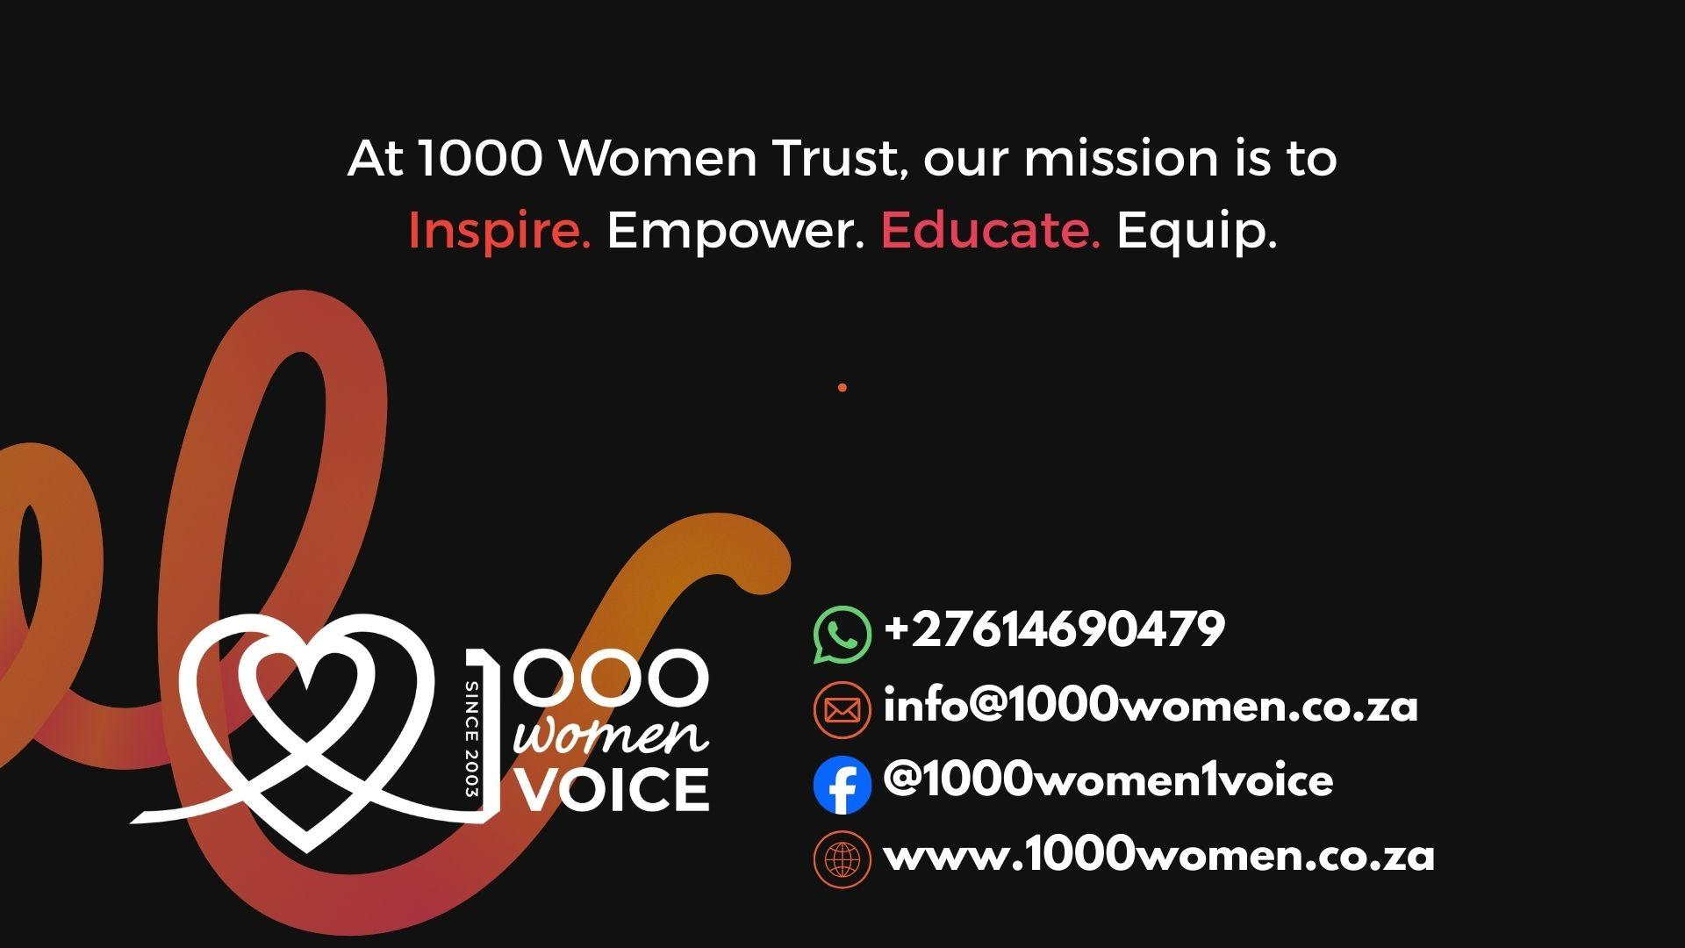
Thank you
#1000Women1Voice

