Slide 1


Gender Links
SUNRISE CAMPAIGN
TRAINING OF TRAINERS PROGRAMME

Slide 2
PURPOSE OF TOT
draw on the success and results of a pilot programme rolled out and largely funded by gender links (gl) to expand the programme within local government
Ideally integrate programme into the gender action plans and economic development aims of local governments
Create long term sustainability as a model for achieving the aims of loCal government to;
  Reduce gbv
  Promote the Economic empowerment of women (eew) at a local level

Slide 3
New model for challenging GBV and economically empowering women
ANCHORED IN LOCAL GOVERNMENT
LIFE SKILLS AND ENTREPRENEURSHIP
Local level Action Plans to end GBV
Links through councils to LED plans and opportunities
Entrepreneurship training for survivors of GBV
GBV SURVIVORS
LIFE SKILLS
ENTERPIRSE SKILLS
MENTORSHIP
ACCESS TO FINANCE
Unique model

Slide 4
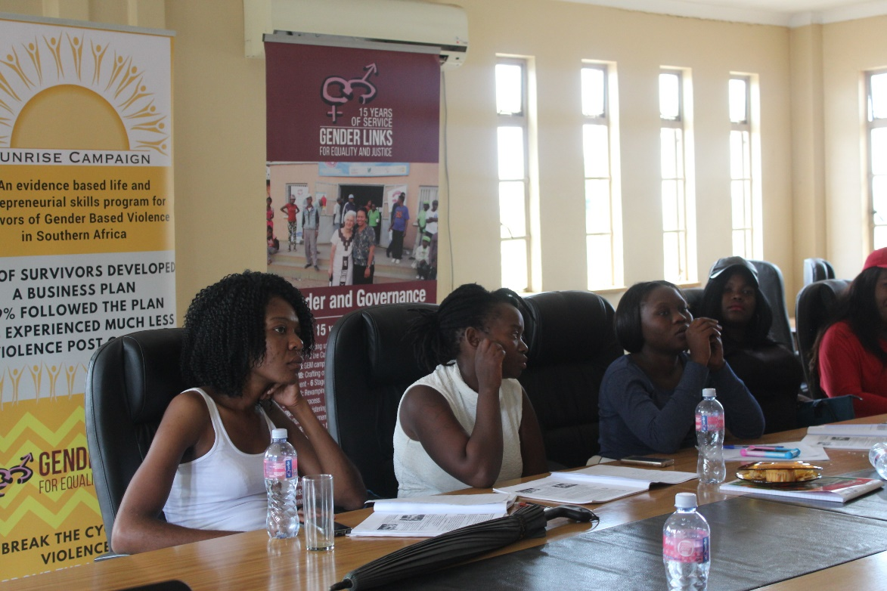
Target Groups
Women who have experienced gender based violence (GBV)
18 years or older – 50% under 35 years
Referred from an institution that can offer ongoing support
Unemployed or self employed
WANT TO BE IN BUSINESS

Slide 5
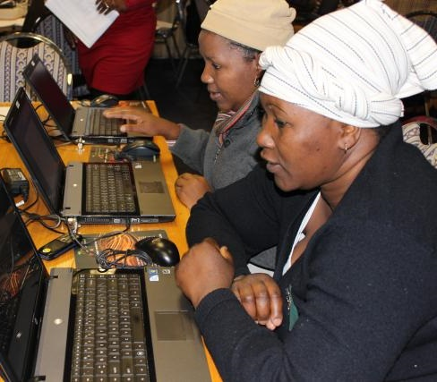
Programme summary
Life skills including confidence and self-esteem building, writing; public speaking; decision making.
Introduction to basic entrepreneurship skills for planning a business
IT as a tool with basic computer skills training
Develop business plans
Follow up
Link up with resources

Slide 6
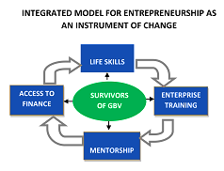
The aims of the programme
Provide a framework for the development of potentially sustainable entrepreneurship opportunities for survivors of gender based violence (GBV)
Integrated model of life skills preparation, business development skills training, mentorship opportunities and access to finance.
Mainstream participants in local economic development
To increase women’s agency and independence, socially, emotionally and economically
To provide them with the tools to realize their
economic potential as entrepreneurs
Introduce women to alternatives to staying in
situations where they experience GBV
Break the stereotypes of women in business
Connect women with information, services and
resources to enhance their ability to succeed

Slide 7
SUMMARY OF RESULTS - Business outcomes
91% completed a business plan
79% followed through on the plan
48% indicated starting a new business
41% opened a banking account
29% increased the size of their business
28% employed staff

Slide 8
CHANGES IN GBV EXPERIENCES

Slide 9
Income before and after project

Slide 10
WHY HAVE WE WORKED WITH COE’S
Government closest to the people
Already have plans for local economic empowerment and gender empowerment
have resources to support the women in different ways
Have the influence to mobilise support from the community around them
Able to make significant change at local level
Can influence the broader agenda in their countries

Slide 11
Envisaged process
Meet with council
COE arranges their own logisitcs
Conduct TOT
Discuss handing over the programme
Sign an agreement
Ask COE to select trainees
Provide COE with supporting documents
Arrange venue
Report and upload information.
Follow up with GFPs for plans to roll

Slide 12
Tot programme
Familiarise participants with history and outcomes of the programme
Understanding the roles and responsibilities of facilitators
Go through manuals and content
Mentorship
Monitoring and evaluation to measure change
Promote interest and buy in
The way forward

