Slide 1

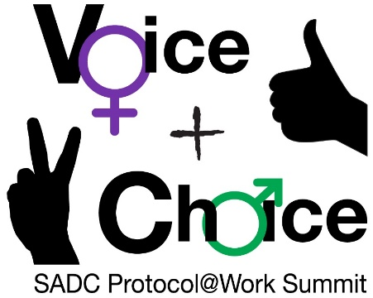





LEARNING
AND SHARING
SUMMIT 2025
VCSA Joint Campaigns
(Tanzania, Dar es salaam, .2025 and Shadrack J. Msuya)
Women’s Voice and Leadership Learning and Sharing Summit 2025

Slide 2
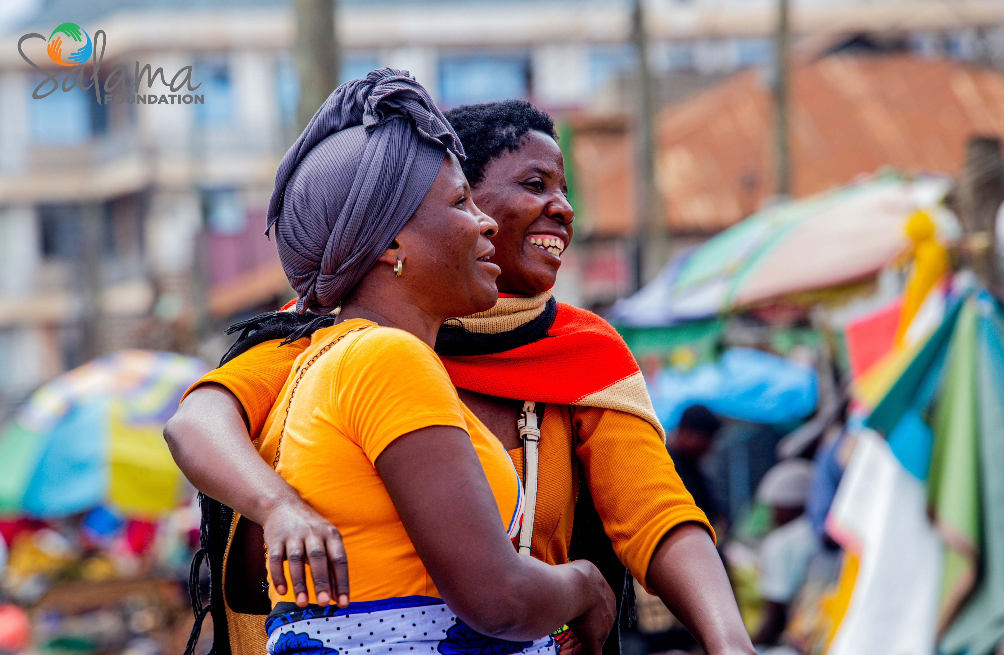
Summary
The 16-day period between November 25 and December 10 holds significant commemorative dates, including International Women Human Rights Defenders Day (November 29), World AIDS Day (December 1), and the Montreal Massacre Anniversary (December 6). These dates emphasize the connection between GBV and human rights violations.
In Tanzania, Salama Foundation, in collaboration with the GBV MKUKI Coalition, the government adopts a national theme each year to inspire action on pressing GBV issues. The 2024 campaign prioritized grassroots activism; ensuring community voices play a central role in creating solutions to end GBV.
Voice and Choice Learning and Sharing Summit 2025

Slide 3
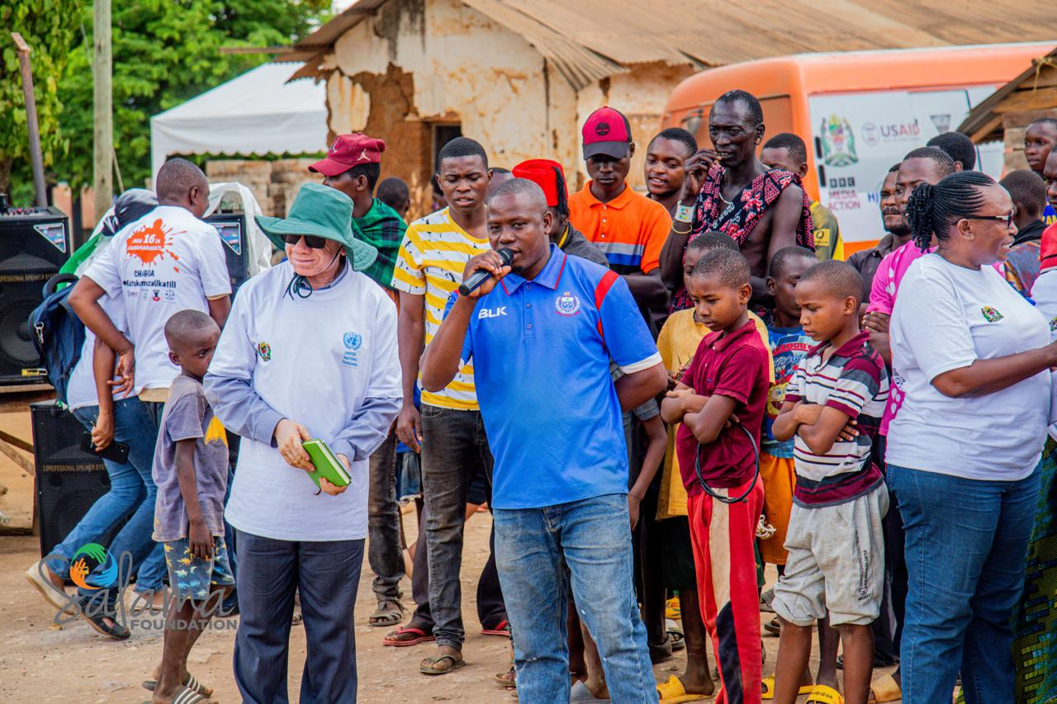
Count...
The campaign targets a broad audience, including men, women, boys, girls, social groups, CBOs, CSOs, NGOs, private sector players, policymakers, and development partners.
It aims;
1. To inspire community-led initiatives and drive national-level policy engagement,
2. Emphasizing long-term strategies to eradicate GBV.Unfriendly health services and poor utilization of available SRHS

Slide 4
Dates and themes of your joint campaign/s
 | Date | Theme
1 | 21rd Oct | Awareness raising through integrated social media and digital platforms
2 | 21th Oct -31th Oct | Community radio & TV interviews on GBV prevention among young mothers
3 | 25thNov-10thDec | Caravan for change to prevent GBV in Tanzania
4 | 28thNov | Train keystakeholders on sexual harrassment and GBV
Voice and Choice Learning and Sharing Summit 2025

Slide 5
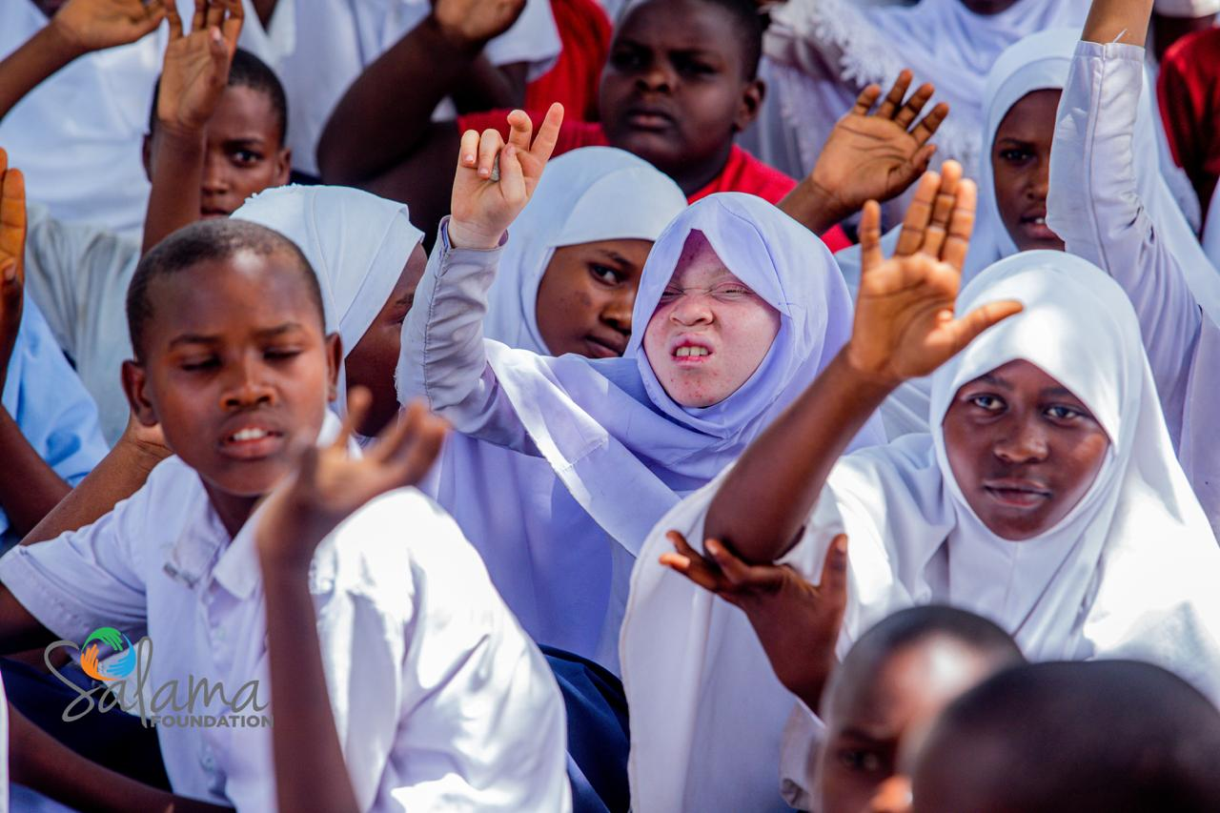
Initiatives (How did your initiative contribute to building stronger and more inclusive movements.)
Caravan Route Initiative and Community Outreach; reached 13 regions, including Pwani, Mbeya, Songwe, Rukwa, Ruvuma, Mara, Morogoro, Dodoma, Singida, Kigoma, Simiyu, and Shinyanga. This initiative raised awareness about GBV and SRHR services, reaching 1,985,907 people, including 659,451 men, 1,323,938 women, and 2,518 youth and children. Community engagement efforts continue to ensure that the momentum against GBV remains strong.
2. Engaging Boda Boda Riders; Boda boda riders (motorcycle taxi operators) were engaged in open dialogues Over 800 riders participated. Their involvement served as a model for sustained behavioral change and helps spread awareness in their communities.
Voice and Choice Learning and Sharing Summit 2025

Slide 6
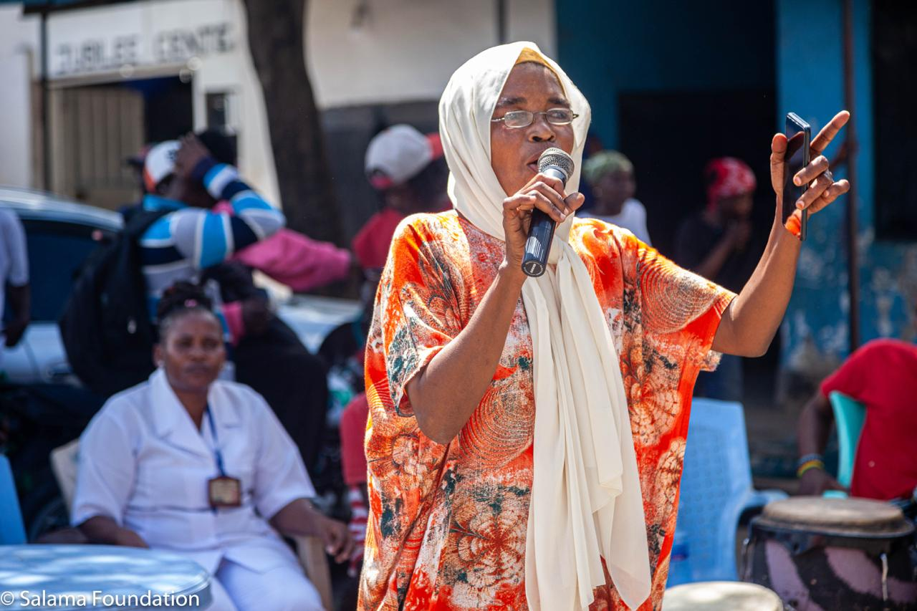
Count...
2. Mobile Health Clinics; provided critical SRHR services in underserved regions, reaching young mothers, adolescents, and the general public. Services included HIV testing, family planning, and counseling on STIs, menstrual health, pregnancy, and GBV prevention. These clinics have reduced travel time to health centers by 40%, making SRHR services more accessible.
3. Media Campaigns: By leveraging digital platforms, traditional radios, TV, and social media, the foundation bridges the gap between the community and the government. This fosters development and ensures that diverse voices are heard, which is crucial for inclusivity.
4. Through outreach, edutainment programs, open dialogues, and other activities, the foundation directly involves the community. This ensures that grassroots-level activities addressing gender-based violence (GBV), gender equality, and sexual and reproductive health and rights (SRHR) are sustainable and impactful.

Slide 7
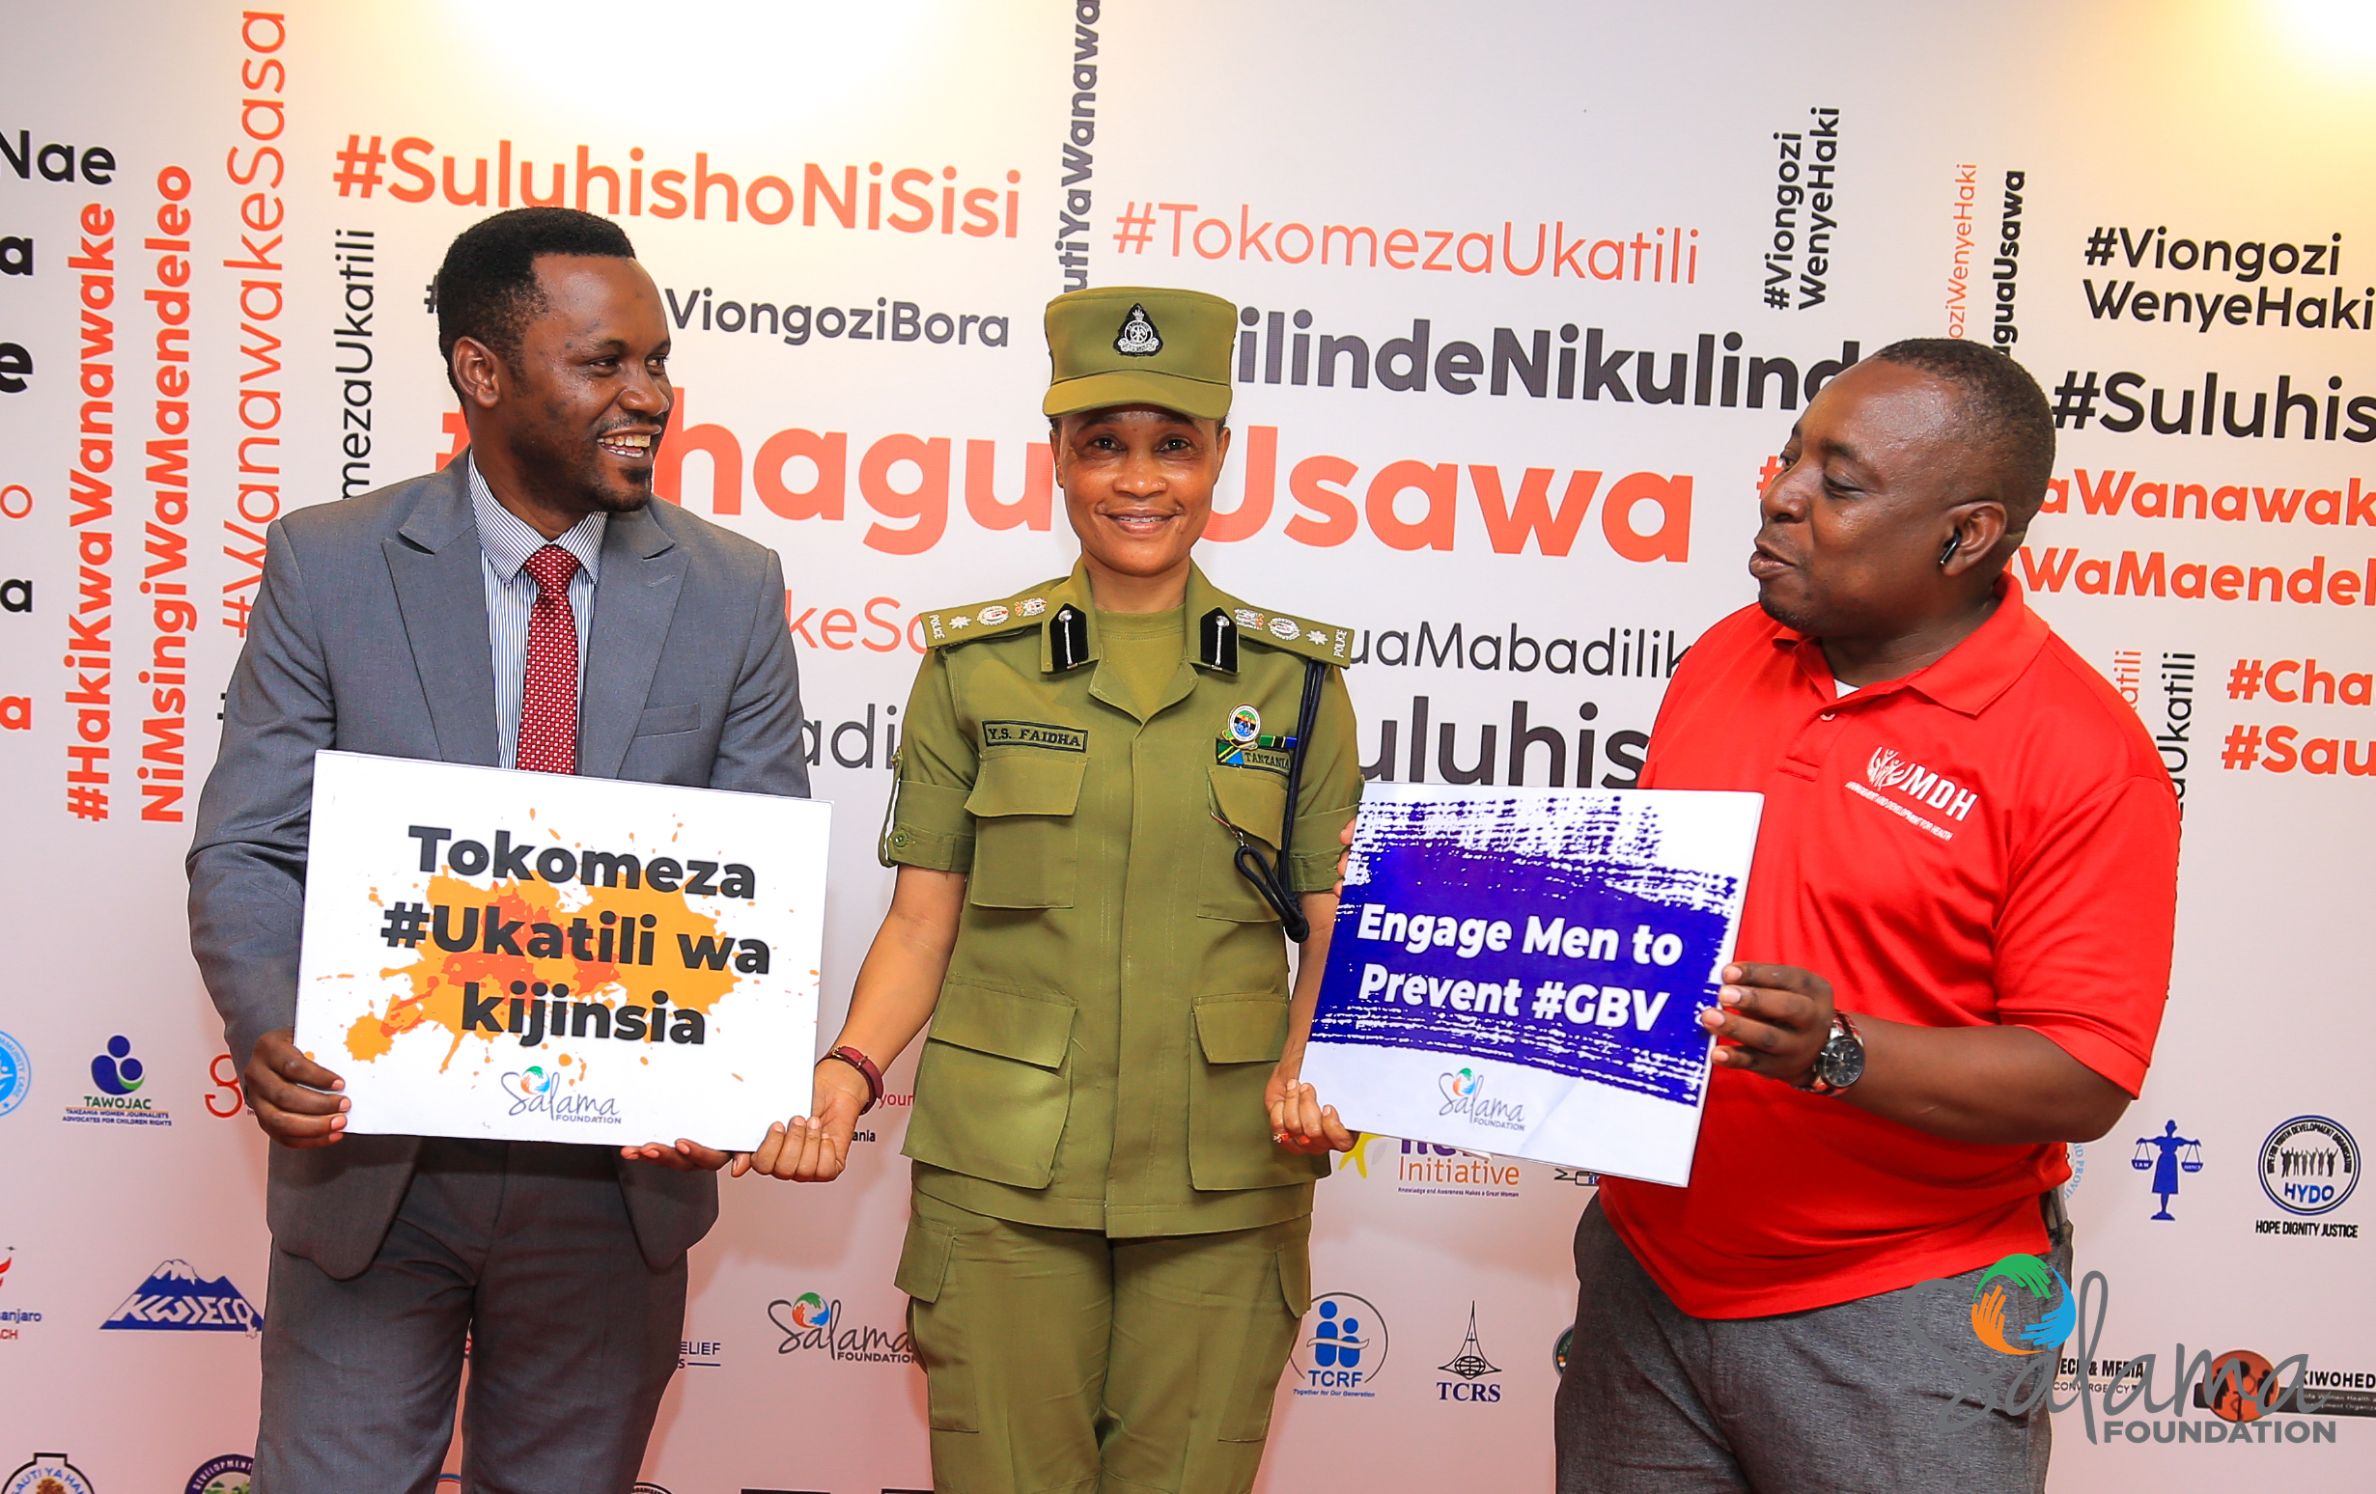
Count...
5. Police Involvement in GBV Prevention; 250 police officers were deployed to raise awareness about GBV in various regions. They played a key role in supporting survivors and will continue to receive training to enhance their capacity in handling GBV cases.
6. 16 Days of Activism and Public Engagement; We mobilized men to participate in a marathon in Dar es Salaam, promoting male involvement in preventing GBV. Public engagement efforts included distributing flyers, creating interactive photo booths, and leveraging social media platforms. The campaign reached over 21 million people, continuing to raise awareness about GBV.

Slide 8

What strategies did you use to strengthen collaboration and solidarity within your network?
Effective collaboration and communication; We ensure within the team and members in our project was essential to ensure that all partners are at the same page and the resource allocated accordingly (Teamwork and readiness contributed to the achievement and completion of planned interventions within given time)
Regular meetings both online and physical; We conducted meetings with representatives and be able to share their experience and challenges they face for better building up during activity delivery and enable to meet project implementation of strengthening the work of coalition and meet the goal.

Slide 9
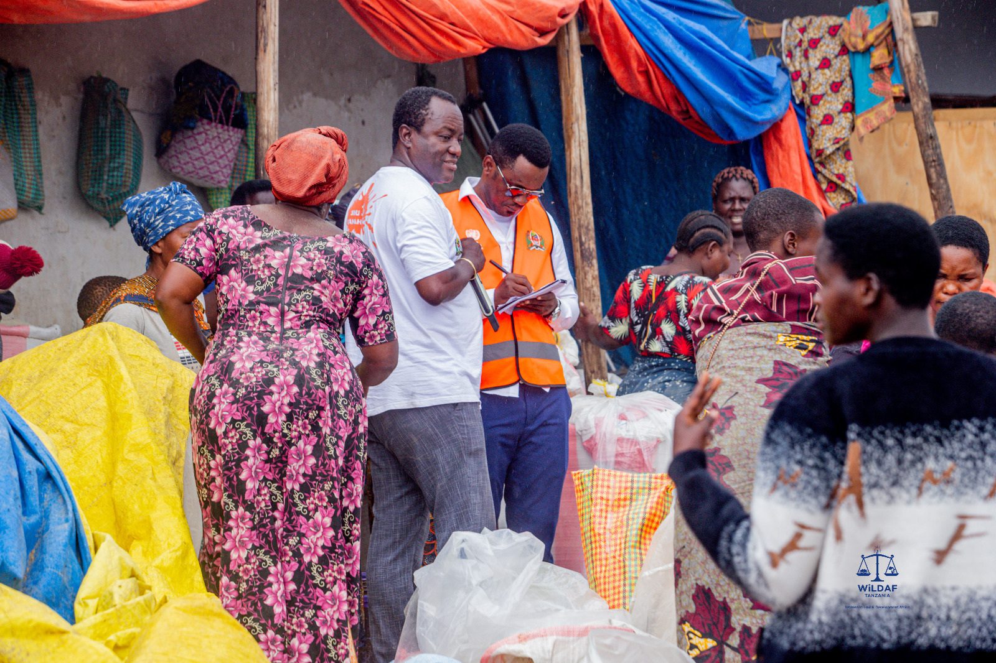
Governance:
1. Effective and Transparent Governance: SoYoMo governance structure is effective and transparent are key in our network fostering trust and inclusivity, which are necessary for active participation from all members.
2. Well-Defined Roles and Responsibilities: In the network each members have well-defined roles and responsibilities in the network from the MoU ensures that everyone knows their part in the decision-making process.
3. Regular Meetings and Core Values: We conduct regular meetings for observation of the core values, practices, and providing proper coaching when necessary
4. Practice of Core Values: We do outlook the practice of the core values if well observed and maintained. It helps to ensure that the network's foundational principles are upheld. These has created a culture of inclusivity and respect, which has essential for active participation from all members.
Voice and Choice Learning and Sharing Summit 2025

Slide 10
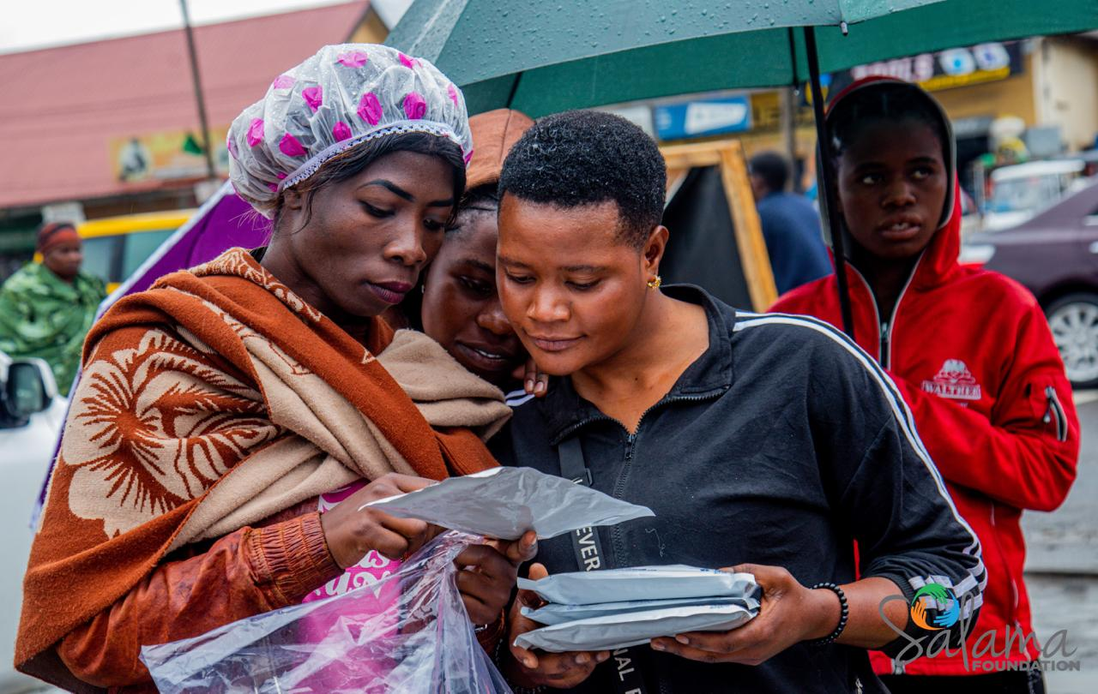
Resource Allocation:
We distributed resources based on the specific needs and capacities of each partner organization, ensuring that smaller or less-resourced partners received adequate support to promote equit
We established transparent resource allocation framework guided by MoU, to ensure fair distrubution and long term sustainability
We support resources distribution proportionally, according with the size, scope, and impact of each partner’s activities.

Slide 11
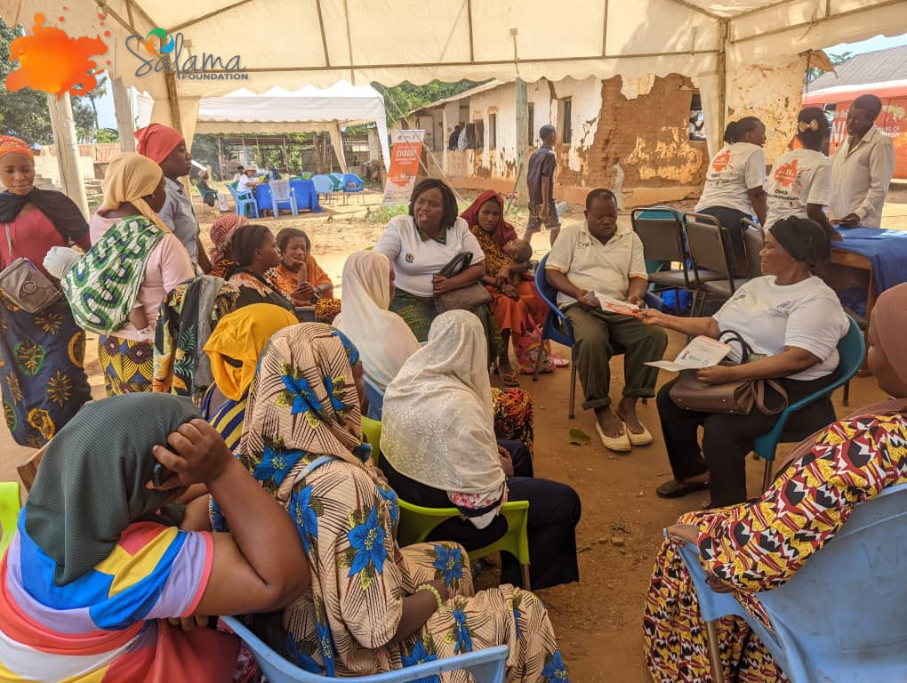
Inclusive Leadership & Coordination: How did you leverage expertise and diverse connections to strengthen advocacy efforts?
We collaborated with technical experts from the Ministry of Health to design evidence-based advocacy strategies for improving healthcare access.
By partnering with the local governmnet, Ministry of Education, community development , we incorporated educational expertise into our campaigns, ensuring that our messaging was tailored to different audiences.
The diverse connections we established through regional outreach programs allowed us to gather grassroots insights, which informed our advocacy strategies and made them more effective.
Voice and Choice Learning and Sharing Summit 2025

Slide 12
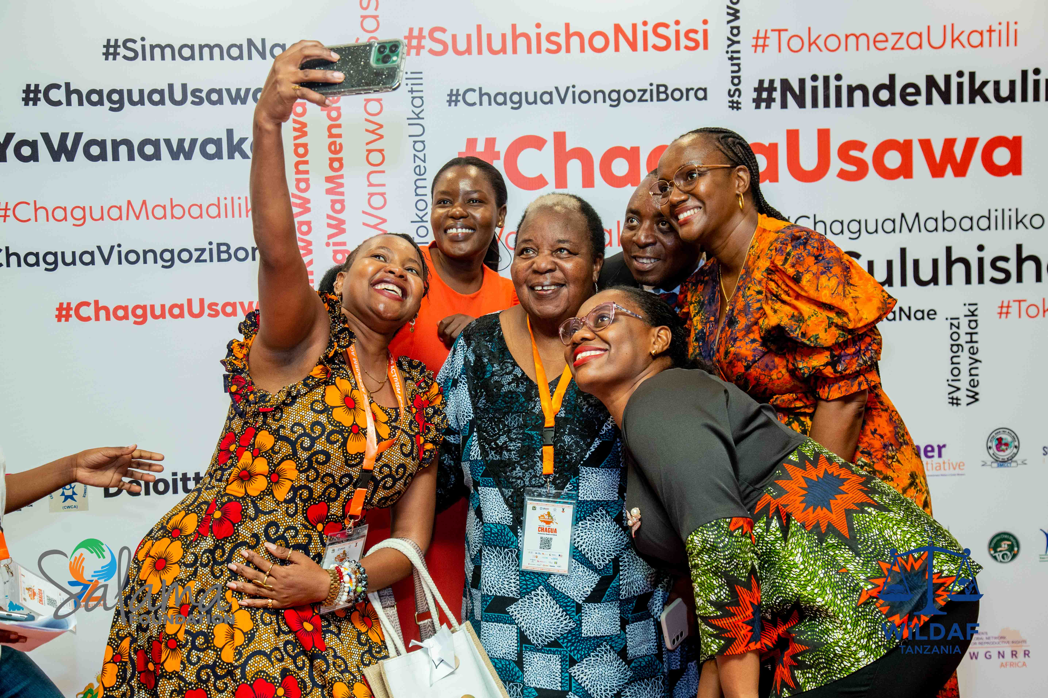
What strategies did you implement to coordinate campaigning across multiple organizations?
Collaborative structure; We formulated steering committie from different organization in assigning roles and responsibilities for leveraging organization strengths.
Shared Vision and Goals; Developed a unified missions and clear objectives that aligns with the all organization partners including; development of content creation, developing of the messages, hash tags, activities etc.
Regular communication; We held weekly, and monthly check-ins for the progress of the preparation from different departments
Joint plan and resource sharing; able to collectively be with campaign strategies and timelines for supporting throughout campaigns as well as pooled resources such expertise running the social media contents for great impact

Slide 13
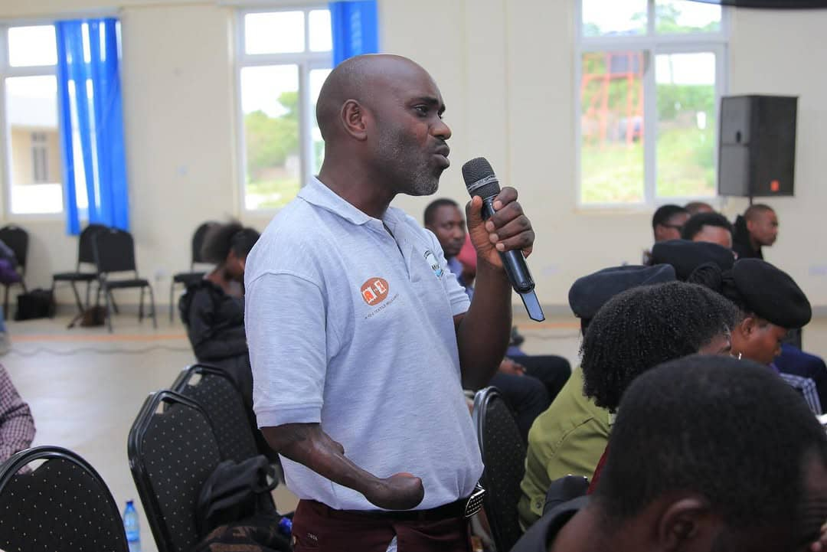
Connecting: What approaches did you use to build and sustain relationships?
We maintain consistent communication with stakeholders through regular meeting, email, and updates.
Involving community members and partners in decision-making processes, to ensure their voice are being heard and shape our intiatives
We created shared goal with our partners, aligning our efforts in ensuring that we all work towards same objectives
Provision of the training, resources, and mentorship to our partners, empowers them in contributing effective movement.
Our engagement with the community that we organize such as; open dialogue, outreach activities, and edutainment builds trust with them and fosters a sense of project owning
Additionaly, we share progess reports, challenges, and success with our partners and the community that help us to maintain transparency.
Voice and Choice Learning and Sharing Summit 2025

Slide 14
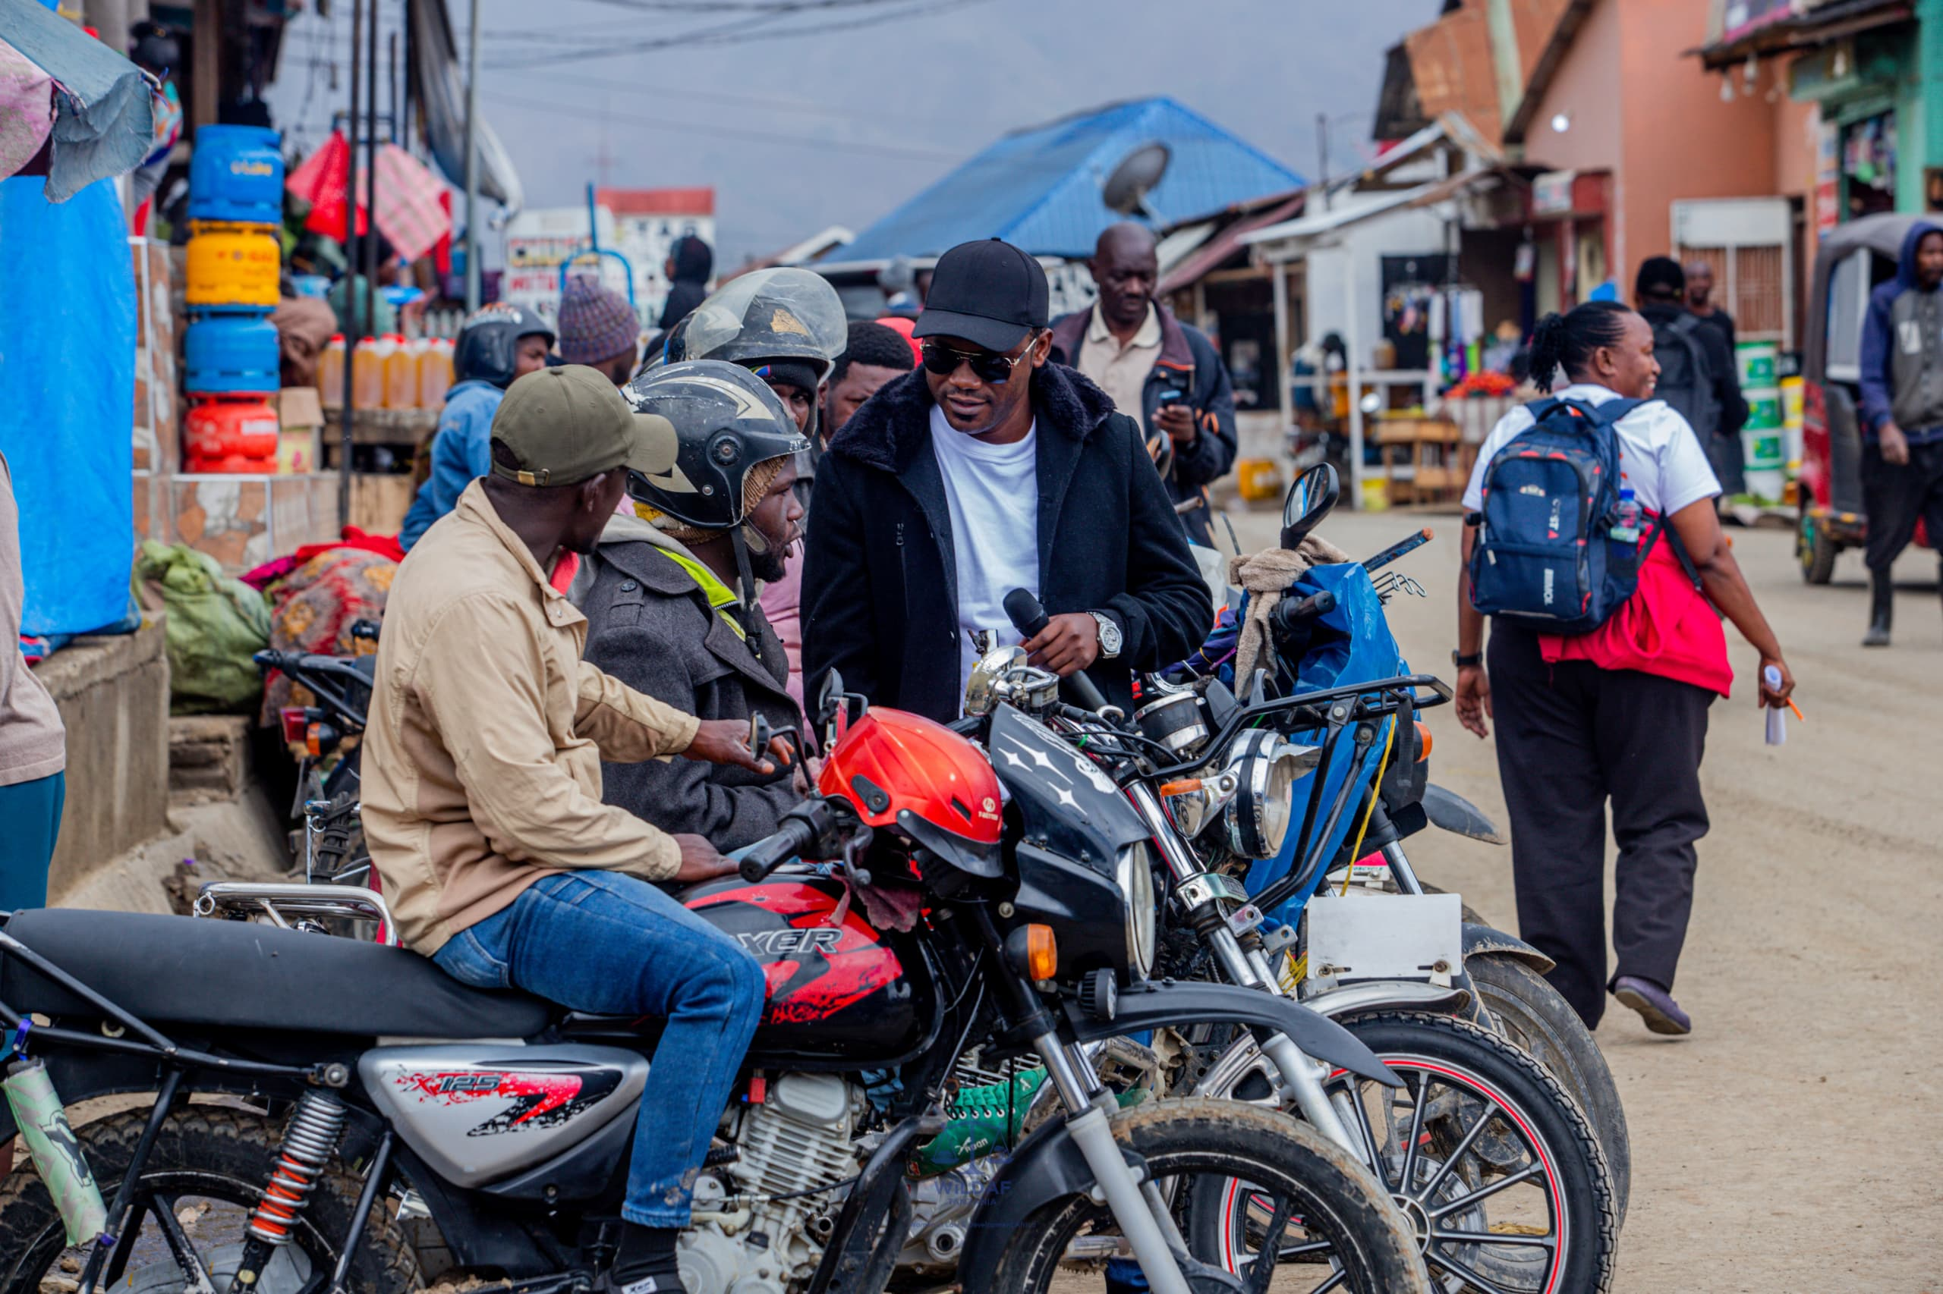
Community-Building: How did you facilitate mentoring, convening, and peer exchanges among professional advocates and emerging leaders?
We facilitated open dialogues with the community groups including boda boda, young mother, adolescents, in school and out of school adolecents share their experiences, challenges, and best practices.
We conducted workshops and training sessions focused on the SRHR key issues, GBV, and HIV as well as strategic planning.
We use social media platforms as safe space to connect community groups and professionals to share information about SRH and HIV and where to actual get friendly health services from their area. In addition, the platform is being used to experience GBV challenges.

Slide 15
Linking & Learning: How did you foster a culture of continuous learning and best practice sharing within the movement?
Knowledge sharing platforms; whatsapp channels, whatsapp group, instagram, twitter. All this we use as online platform where members can share education materials for exchanging learning
Learning Events and Workshops; We usual organize events such as workshops, open dialogues, and trainings on SRHR, and GBV to foster opportunities for partcipants to share their experience.
Safe space; salama foundation faciltates peer to peer learning creating safe space in groups example school clubs to discuss challenges, share solutions, and learn from each other.
Documentation of best practices; it is salama foundation behaviour to document successful intiatives and case studies creating the best practices that are shared in the movement.
Collaborative aprojects and joint intiatives: we facilitated project by bringing together diverse groups within the movement to work on a shared goal. that provided hand on learning experience in real-time.
Voice and Choice Learning and Sharing Summit 2025

Slide 16
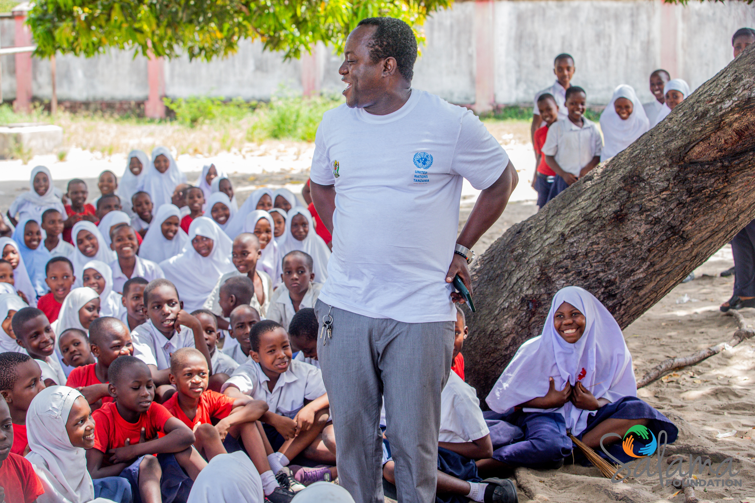
How did you generate and utilise evidence to assess the impact and effectiveness of advocacy efforts within your movement?
We conducted Baseline and endline assessments allowed us to track progress and quantify changes over time.
We developed specific KPIs, such as policy changes achieved and levels of community engagement, to measure success.
Regular stakeholder feedback ensured that our assessments were grounded in the experiences of those directly affected by our advocacy.
We documented case studies and success stories to highlight tangible outcomes and analyzed the collected data to identify trends and areas for improvement.
The findings were compiled into comprehensive reports and used to adapt our strategies in real-time.
Additionally, the evidence generated was also utilised to strengthen our advocacy messages, demonstrate impact to funders and policymakers, and build credibility with stakeholders.

Slide 17
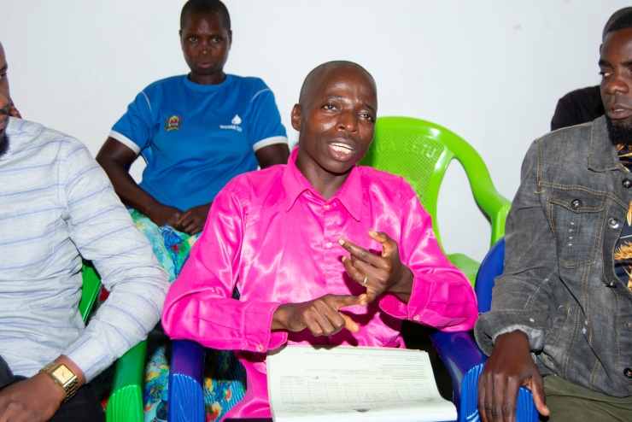
Beneficiary qoutation: Eliutha’s Healthcare Provider
"Previously, our youngsters were unwilling to discuss topics such as sexual health and contraception publicly. But today, thanks to Eliutha's efforts, they feel more emboldened to seek knowledge and assistance. He has provided a secure space for them to address questions and access previously unavailable information."

Slide 18
NEXT STEPS
What will be your key priorities moving forward
Our top priority going ahead will be to increase and strengthen our influence while maintaining inclusivity and sustainability. By focusing on policy issues and utilizing data from previous campaigns to promote systemic change, we want to strengthen our advocacy efforts. Our primary goal will be to increase our influence by forming strategic alliances with more governmental bodies, civil society groups, and the commercial sector.
Additionally, we will make investments to empower our staff and the movement's up-and-coming leaders. Our efforts will stay rooted in the needs of the people we serve if we improve community participation through outreach activities and participatory decision-making. We will also use innovation and digital platforms to improve our advocacy work and strengthen our systems for monitoring, evaluating, and learning.
Women’s Voice and Leadership Learning and Sharing Summit 2025

Slide 19
THANK YOU...

