Slide 1







LEARNING AND SHARING SUMMIT
2025
Organisational Growth South Africa, Cape Town
Presented by : Kwenzokuhle S. Khoza

Slide 2

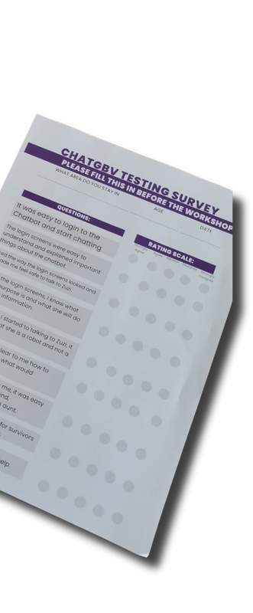



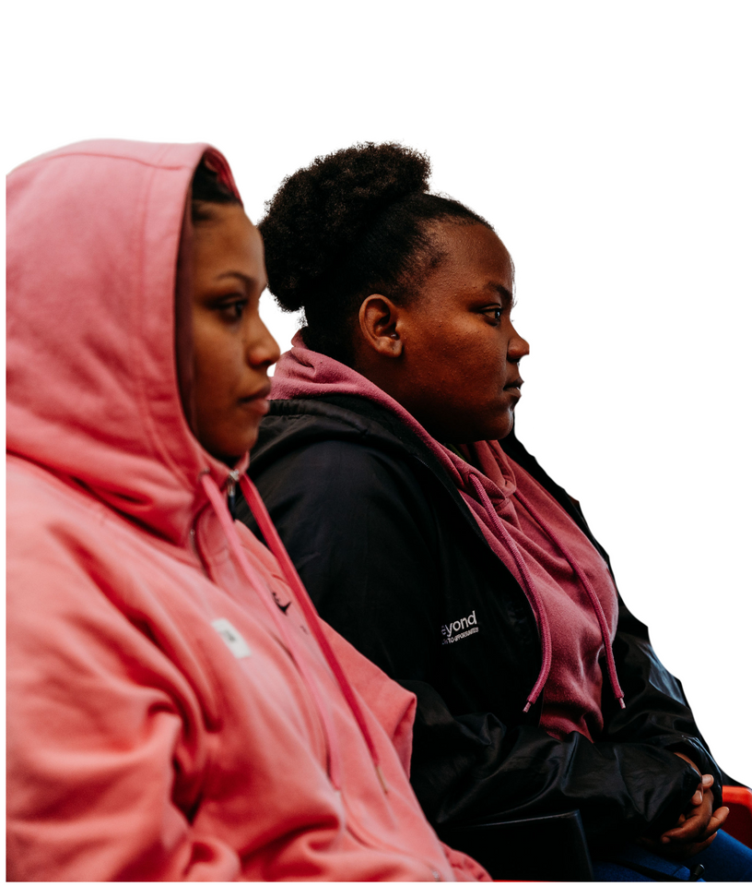


Gender Rights in Tech (GRIT): A brief background
Founded in 2021 after the murder of the founder’s 19-year-old, pregnant family member (victim of femicide).
Solution: Created Kwanele (now GRIT)—a tech-driven platform for accessible justice.
Focus: Supporting underprivileged communities with simple, effective solutions.
Core value: Co-creation ensures solutions truly serve those in need.

Slide 3
GRIT before VCSA
Organizational Compliance & Governance Overview
1. Did you have any policies?
Yes, GRIT has a comprehensive set of policies in place, including:
Child Protection Policy Anti-Bribery Policy Sexual Harassment Policy Whistleblowing Policy Finance Policy
Code of Conduct HR Policy
Ethical Community Engagement Policy Procurement Policy
Feminist Disciplinary Policy
Monitoring, Evaluation, Research & Learning (MERL) Policy
Were you VAT registered? Yes.
Were you registered for SARS? Yes.
Did you have a governance/board in place?
Yes, GRIT operates under a fully female-led board, ensuring leadership representation aligns with our feminist values and mission.
Did you have a finance system in place?
Yes, we utilize Xero as our financial management system.
Did you make any institutional changes?
Yes, we underwent a rebranding process, changing our name from Kwanele to GRIT, to better reflect our evolving mission and impact.

Slide 4

Registrations
Before VCSA grant
SARS registered GRIT was registered
GRIT has 3 bank Accounts
After VCSA grant
SARS
Public Benefit Organisation (PBO) Status

Slide 5
Strategic Positioning
Before VCSA grant After VCSA grant
Vision, Mission, and Core Values were already established, guiding our work in gender justice and technology.
Initial Theory of Change was formulated, outlining how our interventions contribute to systemic change.
Strategic Framework was in place, setting our priorities and key focus areas.
Mission and Vision Statements provided clarity on our long-term goals and commitment to access to justice. Core Values were defined, emphasizing feminism, accountability, innovation, and survivor-centered approaches.
Legitimacy of Our Work was grounded in early partnerships, grassroots engagement, and community- driven solutions.
Board Strategy Session was conducted to realign our mission, vision, and values with our evolving work.
Comprehensive Rebranding was undertaken, transitioning from Kwanele to GRIT to better reflect our impact and approach.
Strategic Refinement ensured our organizational direction remained relevant and responsive to emerging challenges.
Mission and Values Review reinforced our commitment to feminist leadership, accountability, and ethical AI for justice.
Strengthened Governance with board alignment, ensuring sustainable growth and long-term impact.
Women’s Voice and Leadership Learning and Sharing Summit 2025

Slide 6
Mission, Values, Vision

Slide 7
Governance
Before VCSA grant– Governance Structures
During the VCSA Grant – Strengthening Governance
Board in Place – A fully female-led board was already established, ensuring leadership representation aligned with feminist values.
Application of Democratic Rule – Decision-making was inclusive, participatory, and guided by feminist principles of shared leadership.
Transparent Governance – The board provided oversight, ensuring accountability and ethical leadership Commitment to Feminist Governance – Leadership structures emphasized collective decision-making, power-sharing, and survivor-centered approaches.
Established Advisory Committees to enhance decision-making: Youth Advisory Committee – Centering young voices.
Tech Committee – Guiding AI and digital safety.
Sex Worker Advisory Committee – Ensuring inclusivity. Strengthened Board Engagement with clearer governance structures.
Integrated Community-Led Decision-Making into strategy. Enhanced Feminist Governance through participatory leadership.
Improved Transparency & Accountability with structured feedback loops.
Expanded Stakeholder Representation to ensure lived experiences shape our work.

Slide 8
PROGRAMME OF ACTION
Before VCSA grant– Planning & Reporting
During & After VCSA Grant – Strengthened Planning & Reporting
Comprehensive Implementation Strategy developed, integrating lessons from global AI and digital safety standards. Enhanced Reporting & Documentation with structured frameworks to track progress, AI ethics, and survivor experiences.
Refined Best Practices for safe online spaces, now backed by research and user-driven insights.
Standardized Data Collection & Impact Measurement to improve program accountability and scaling potential.
Institutionalized Learning through a knowledge-sharing system, ensuring insights drive continuous improvement.
Early Implementation Planning focused on Zuzi’s development as a safe AI-driven chatbot.
Limited Documentation Processes with informal tracking of learnings and challenges.
Initial Best Practices for building safe online spaces
were identified but not fully structured.
Reporting Systems existed but lacked consistency in tracking impact and AI safety measures.

Slide 9
INSTITUTIONAL EFFECTIVENESS
During & After VCSA Grant – Institutional Effectiveness
Before VCSA Grant – Institutional Effectiveness
Human Resources Growth – Expanded team of 9 full time staff with specialized roles in AI ethics, community engagement, and program management.
Improved Physical Resources – Upgraded workspace, tech equipment, and infrastructure for operational efficiency.
Enhanced Electronic Systems – Adopted Xero for financial management, strengthened cybersecurity, and integrated AI-driven data collection tools.
Formalized Admin & Finance Routines – Strengthened compliance, internal controls, and audit-ready financial processes, ensuring transparency and accountability.
Human Resources – Three staff members
Physical Resources – Basic infrastructure in place but limited access to essential tools for scaling operations. Electronic Resources – Early adoption of digital tools but lacked robust systems for automation and data security.
Administrative & Financial Routines – Basic financial processes existed but lacked formalized structures for audits and compliance.

Slide 10








SUSTAINABILITY AND DIVERSIFICATION
Before VCSA Grant – Sustainability & Diversification
During & After VCSA Grant – Strengthened Sustainability & Diversification
Enhanced Financial Policies & Procedures – Strengthened budgeting, compliance, and financial oversight to ensure long-term stability.
Diverse Funding Base – Expanded from two main donors to six funders and three corporate partners, reducing reliance on a single funding stream.
Secured Long-Term Funding – Successfully obtained two years of funding from the Gates Foundation, providing greater financial security.
Developed a Social Enterprise Model – Launched fee-based services to diversify funding beyond traditional grants, ensuring sustainability.
Financial Policies & Procedures – Basic financial management in place but lacked formalized sustainability planning.
Value for Money – Limited funding base with only two main donors, creating financial vulnerability.
Restricted Growth – Dependent on grants, with no structured strategy for long-term sustainability.
NPC: 2021/70992808 | 286-451NPO

Slide 11
Anti-corruption/Fraud Policy
Before VCSA Grant – Anti-Corruption & Fraud Policy
During & After VCSA Grant – Strengthened Anti-Corruption & Fraud Policy
Expanded & Strengthened Policy – Fully revised and expanded the Anti-Corruption & Fraud Policy to align with best practices.
Clear Enforcement Mechanisms – Established detailed procedures for investigating fraud and corruption cases. Formalized Whistleblower Protection – Implemented a secure and anonymous reporting system for staff and stakeholders.
Compliance Training – Introduced anti-fraud and ethics training to build a culture of integrity and accountability. Stronger Financial Oversight – Strengthened internal controls and auditing procedures to prevent and detect fraudulent activities.
Basic Policy in Place – Had an initial anti-corruption and fraud policy, but it was limited in scope and lacked clear enforcement mechanisms.
General Ethical Guidelines – Basic provisions for financial transparency and accountability, but no structured reporting system for fraud detection.
No Formal Whistleblower Mechanism – No dedicated, confidential reporting channels for concerns related to corruption or fraud.

Slide 12
Sexual Harassment Policy
Before VCSA Grant – Sexual Harassment Policy
During & After VCSA Grant – Strengthened Sexual Harassment Policy
Expanded & Strengthened Policy – Fully revised to align with feminist, survivor-centered principles, ensuring a zero- tolerance approach.
Clear Enforcement & Accountability – Strengthened investigation procedures, ensuring timely and fair resolution of reported cases.
Formalized Training & Awareness – Implemented internal training for staff, ensuring all team members understand their rights and responsibilities.
Whistleblower & Survivor Protection – Established confidential reporting mechanisms to ensure survivors feel safe to report harassment.
Training Other Organizations – Now offering external training to other NPOs, community organizations, and corporate partners, expanding impact beyond GRIT.
Basic Policy in Place – Had a Sexual Harassment Policy, but it was limited in scope and not fully integrated into organizational culture.
Internal Reporting Mechanism – Reporting procedures existed but lacked clear survivor-centered guidelines and enforcement mechanisms.
No External Engagement – Policy was focused on internal compliance, with no outreach to support other organizations.
Limited Staff Training – Awareness existed, but structured training was not regularly provided to staff and partners.

Slide 13
Monitoring and Evaluation Systems
Before VCSA Grant – Monitoring & Evaluation Systems
Basic Tracking in Place – Had informal methods for monitoring program outcomes, but lacked a structured, feminist-aligned MERL framework.
Limited Key Performance Indicators (KPIs) – Some performance measures existed but were not consistently tracked or standardized.
Minimal Surveys & Feedback Mechanisms – Collected anecdotal feedback but lacked systematic evaluations from beneficiaries and stakeholders.
Transparency Gaps – Reporting was primarily internally focused, with limited external accountability measures.
During & After VCSA Grant – Strengthened Monitoring & Evaluation Systems
Implemented MERL Framework – Developed a feminist-aligned Monitoring, Evaluation, Research, and Learning (MERL) process, embedding accountability and continuous learning.
Established KPIs – Defined and integrated clear Key Performance Indicators to measure program effectiveness and impact.
Expanded Surveys & Feedback Systems – Added structured feedback loops, user surveys, and evaluations, ensuring stakeholder voices guide decision-making.
Increased Transparency – Strengthened data collection, reporting, and external accountability, making impact assessments more rigorous and visible.
Feminist-Aligned Approach – Ensured equitable, survivor-centered, and participatory evaluation methods, reinforcing inclusive and ethical data collection.

Slide 14
Other policies/systems
Before VCSA Grant – Other Policies & Systems
During & After VCSA Grant – Strengthened Policies & Systems
Implemented Menstrual Leave Policy – Introduced 2 days of menstrual leave per cycle for all employees (permanent and temporary), recognizing the physical and emotional challenges of menstruation.
This leave is separate from sick or annual leave and does not accumulate.
Formalized Gender Equality Policy – Strengthened GRIT’s commitment to gender equality, ensuring all policies actively prevent, address, and eradicate gender-based discrimination and violence within the organization and the communities we serve.
Enhanced Employee Well-Being Measures – Instituted policies supporting survivor-centered approaches, promoting workplace equity and holistic employee wellness.
Strengthened Inclusivity Frameworks – Ensured gender-sensitive policies and feminist leadership structures guide decision-making, fostering a safer, more equitable work environment.
Institutionalized Feminist Governance – Embedded gender justice, inclusion, and trauma-informed practices into all aspects of operations, reinforcing GRIT’s mission beyond external programming.
Foundational Policies in Place – Had key policies such as HR, Finance, Whistleblowing, Anti-Bribery, and Ethical Community Engagement but lacked specific policies on gender equality and employee well-being. Basic Gender Commitments – While feminist principles guided GRIT’s work, there was no formalized Gender Equality Policy embedded into internal structures.
No Menstrual Leave Policy – Employee wellness considerations existed but lacked explicit support for menstrual health as part of workplace policies.
Limited Formal Inclusion Measures – While GRIT was committed to inclusivity, structured frameworks to support marginalized employees and survivors were not in place.

Slide 15
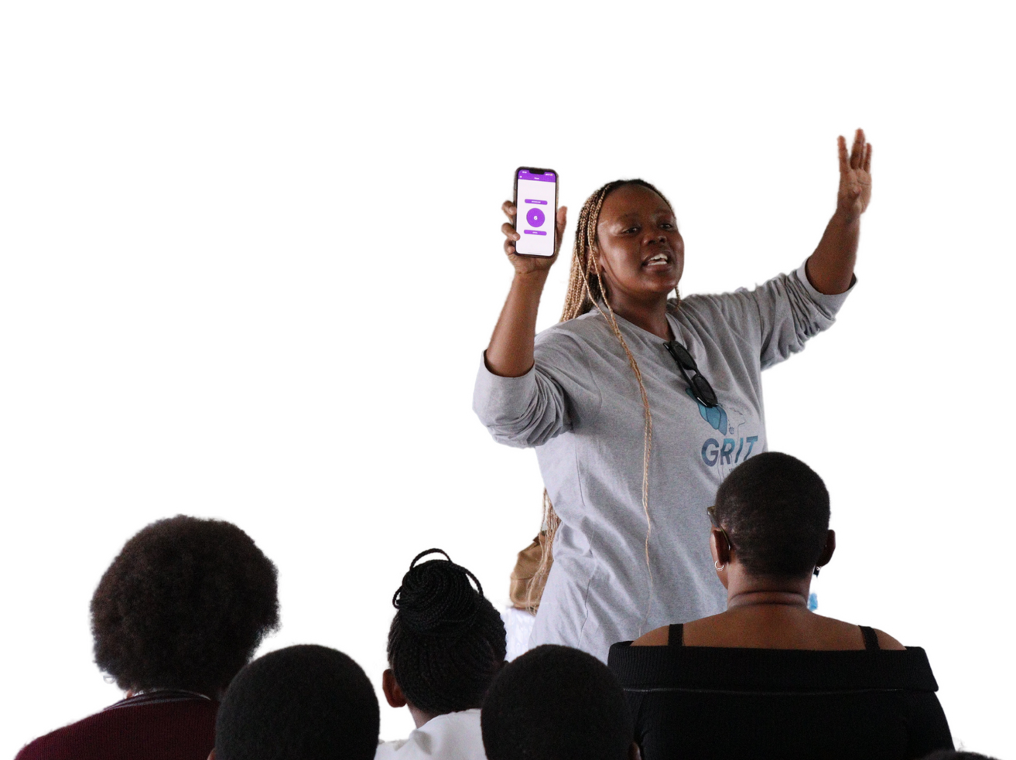


Capacity during VCSA-SA grant
How VCSA-SA’s Capacity-Building Support Benefited GRIT
Strengthened Operations & Impact – VCSA-SA’s support helped refine our strategies for growth and advocacy.
Valuable Insights & Networking – Attending VCSA-SA summits provided access to best practices, key stakeholders, and funders, expanding our influence.
Improved Financial & Narrative Reporting – Mentorship helped enhance financial management, grant reporting, and impact communication.
Expanded SRHR Advocacy – Joining the Safe Abortion Alliance of South Africa connected us with key SRHR organizations across the SADC region.
Increased Collaboration – Strengthened partnerships and advocacy efforts to improve access to safe abortion services.
Greater Financial Accountability – Enhanced budgeting, reporting, and compliance, ensuring transparency in funding use.
Alignment with Global Movements – Deepened GRIT’s integration into global SRHR and GBV advocacy efforts, amplifying our impact.
92808 | 286-451NPO

Slide 16
Challenges
Funding & Financial Sustainability
Challenge: Initially relied on only two major donors, limiting financial stability and flexibility.
Solution: Expanded funding base to six funders and three
corporate partners, secured two years of Gates Foundation funding, and developed a social enterprise model to diversify revenue.
Staff Capacity & Workload
Challenge: Growing demands on staff, especially in key areas like grant writing, donor relationships, and program execution.
Solution: Strengthened HR structure, added advisory committees,
and improved internal capacity-building to streamline operations and prevent burnout. Grew team from 3 to 9.
Resistance to Technology in GBV Spaces
Challenge: Failure to take AI and tech-based solutions seriously in addressing GBV, leading to skepticism from some stakeholders.
Solution: Increased advocacy, positioned GRIT as a leader in
ethical AI, won second place in Mozilla’s Responsible AI Challenge, and published research on tech-facilitated GBV.
Stigma & Resistance from Stakeholders
Challenge: Working across provinces meant facing varying levels of stigma around SRHR and digital rights, with some local stakeholders hesitant to engage.
Solution: Built stronger local partnerships, trained
community-based advocates, and integrated survivor-led approaches to gain trust.
Rebranding & Trust Rebuild Challenge: Challenge: The transition from Kwanele to GRIT led to temporary loss of trust and recognition among funders and partners.
Solution: Launched a clear communications strategy, held stakeholder briefings, and emphasized continuity of mission and impact to reinforce trust.

Slide 17
Lesson learned on institutional growth
Small, United Team = Big Impact
A shared vision drives growth, even with limited resources.
Applied: Foster innovation and teamwork.
Right Funders = Faster Growth
Funders who mentor accelerate impact. Applied: Prioritize mission-aligned, strategic partners.
Adaptability in Tech is Key
Rapid changes require constant updates and user focus.
Applied: Gather feedback, integrate AI ethics, and stay agile.
Networks Strengthen Impact
Collaborations expand influence and advocacy. Applied: Build strategic partnerships in SRHR & GBV spaces.
Resilience & Innovation Drive Sustainability
Growth comes with challenges; innovation keeps us ahead.
Applied: Diversify funding, invest in impactful tech, and stay adaptable.

Slide 18
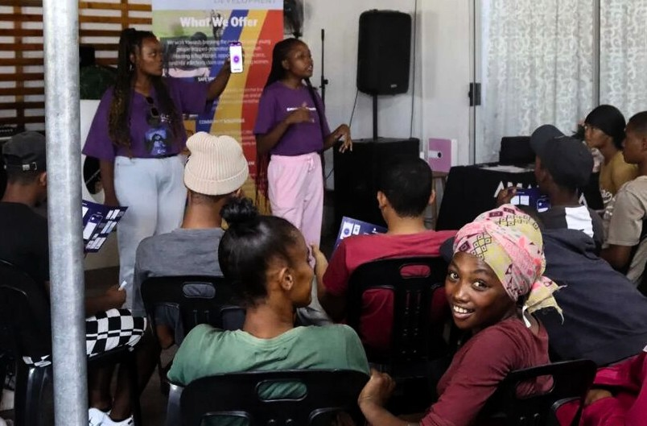

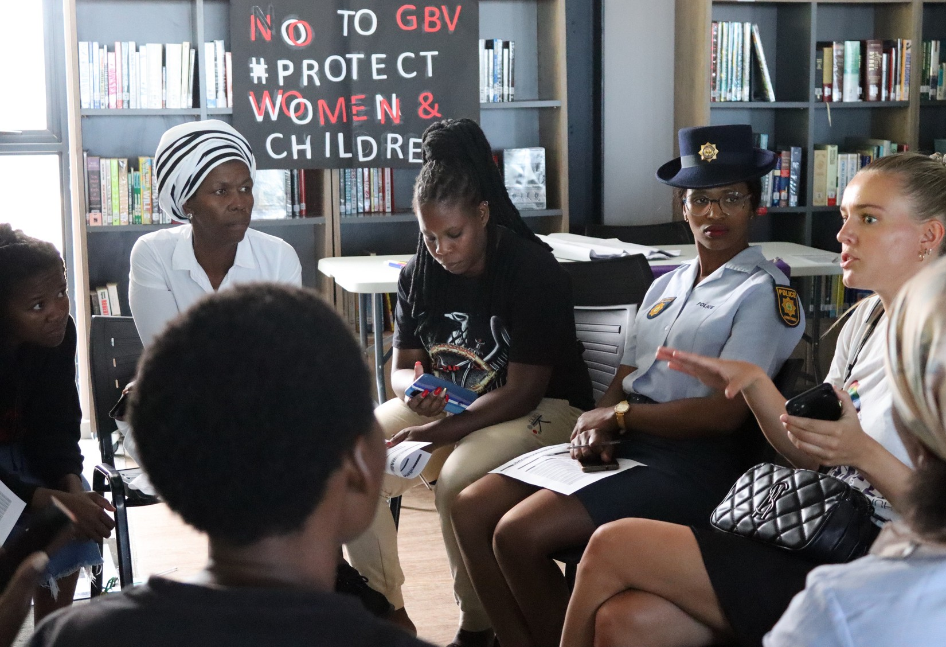
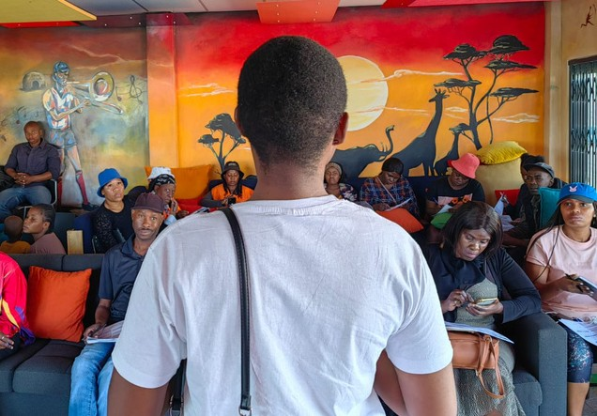
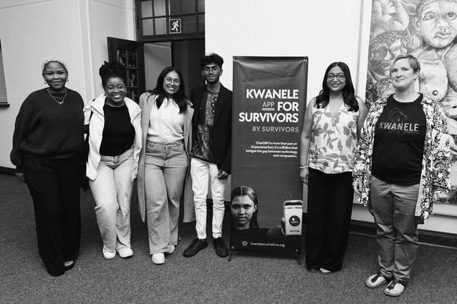

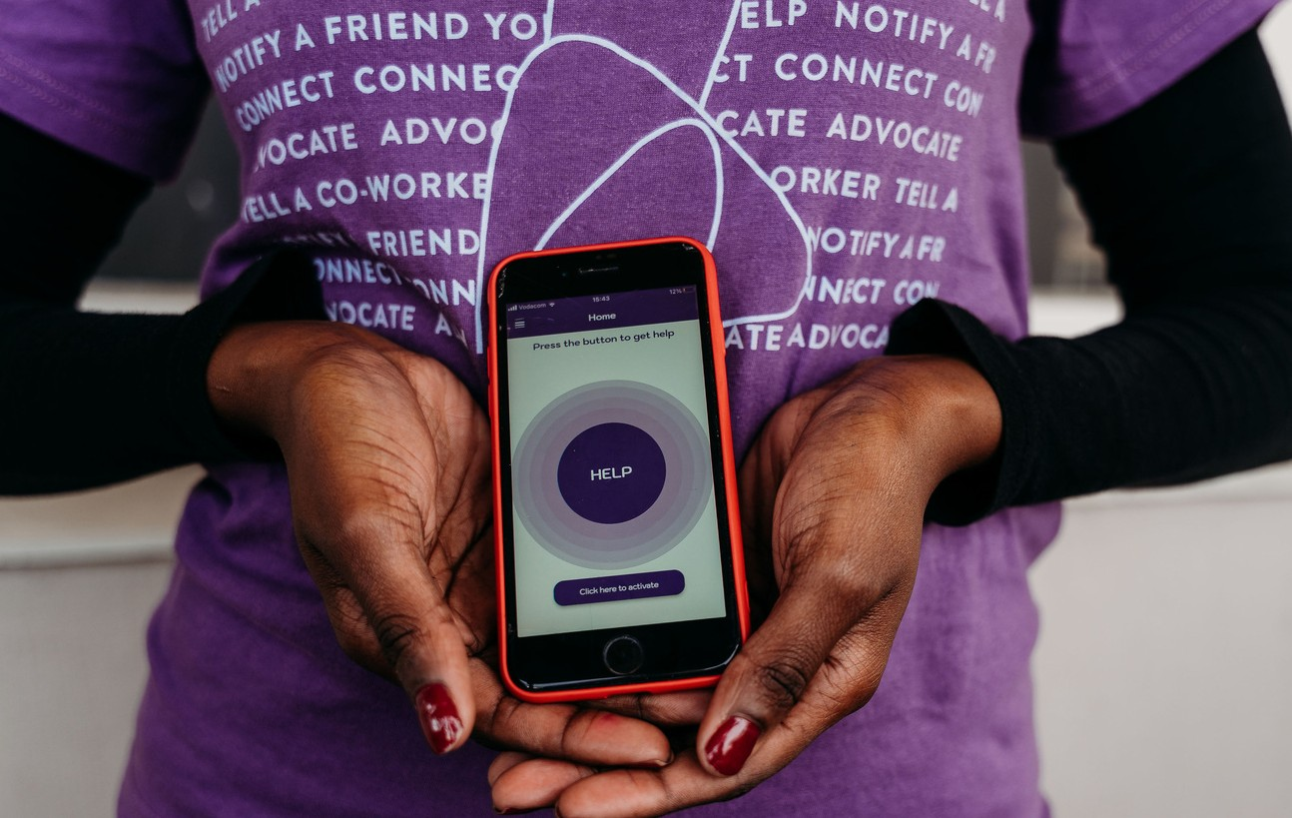

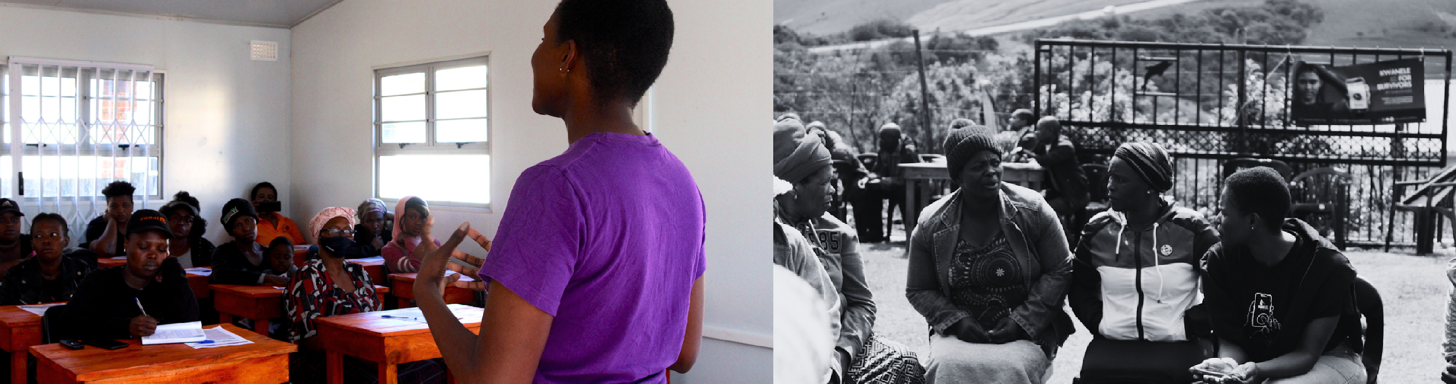


Slide 19

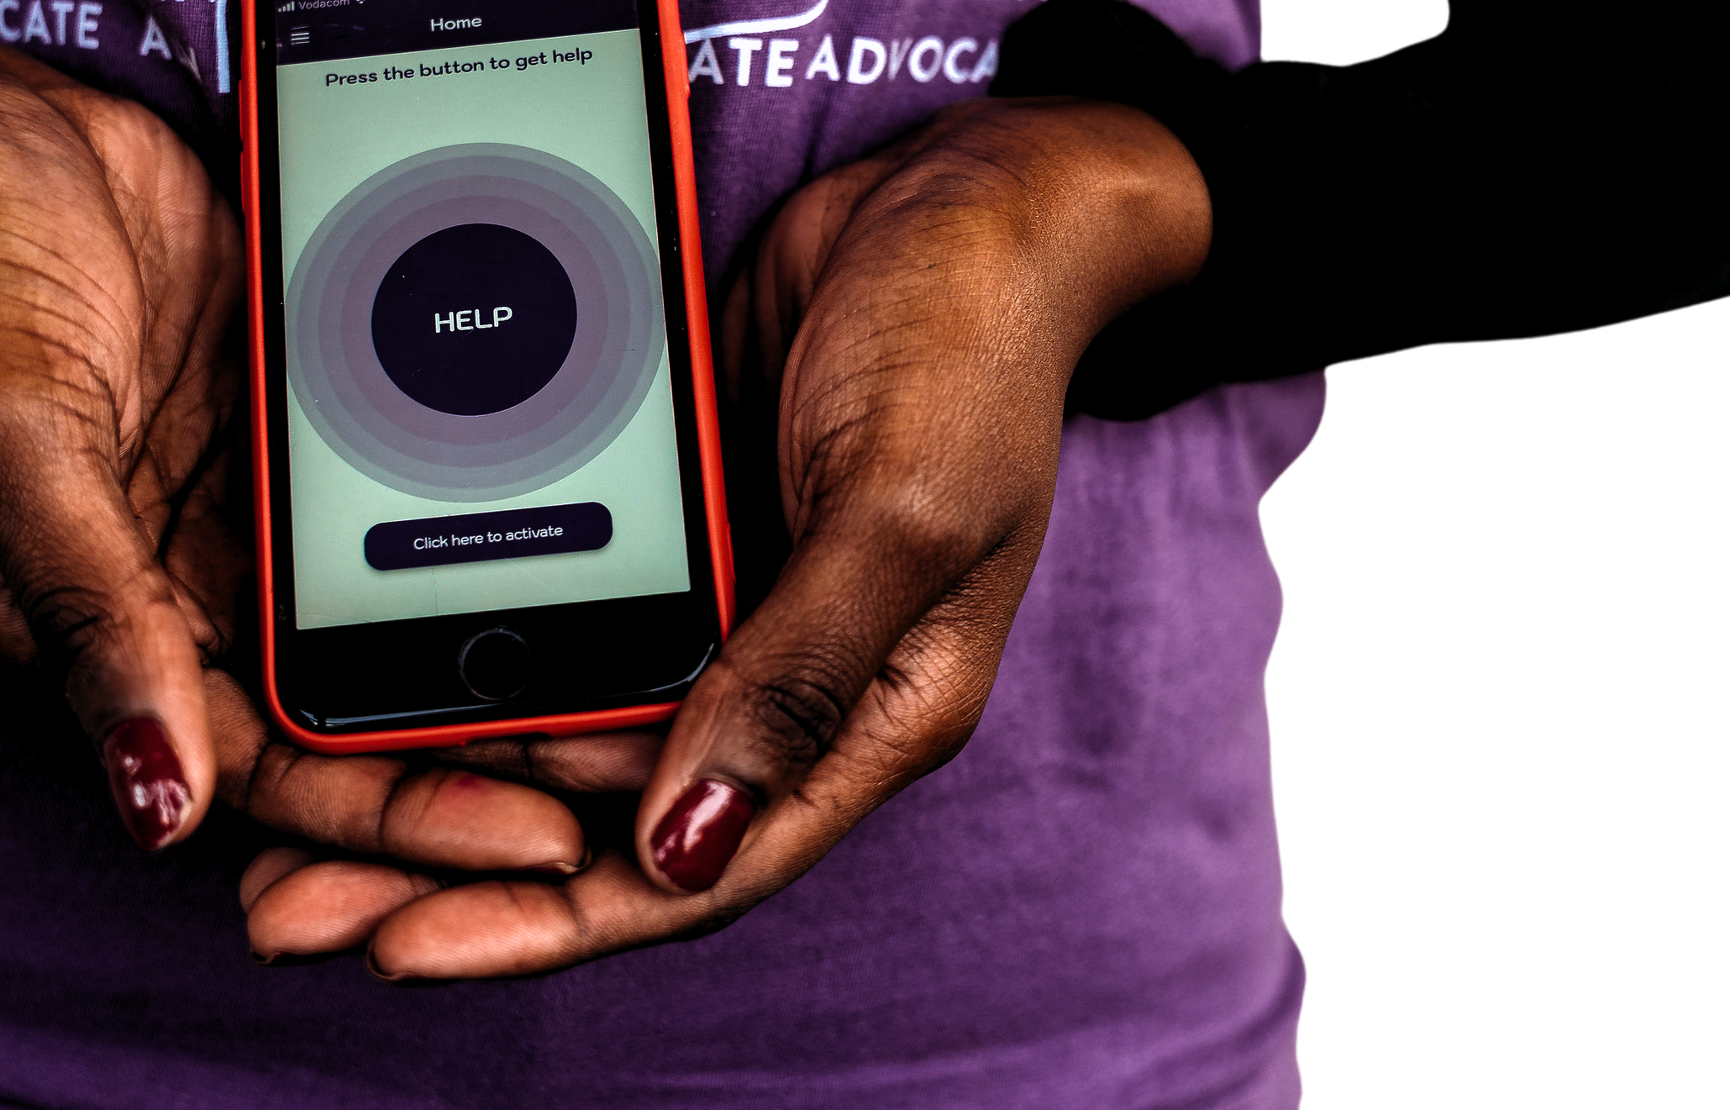


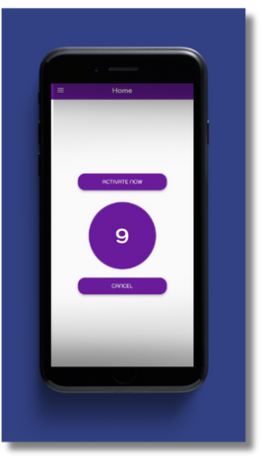
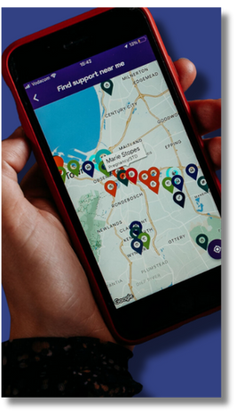
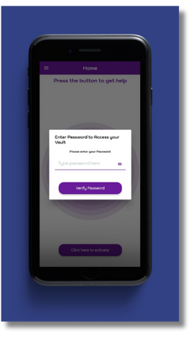
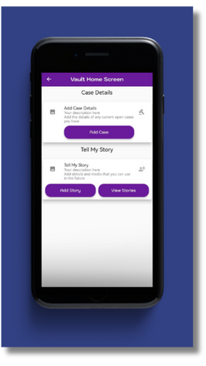
Download our immediate reporting, safety and
evidence-storing app, GRIT.
Need legal advice or general support? Reach out and
message us via our Whatsapp line at 072 737 8819.
shamryn@grit-gbv.org |
www.grit-gbv.org

