Slide 1




Organizational Growth
Hilda Stuart Dadu- National Coordinator
Coalition for Women Human Rights Defenders Tanzania)
(TEMPLATE – add pictures and/or videos to personalise your presentation)
Voice and Choice Learning and Sharing Summit 2023

Slide 2
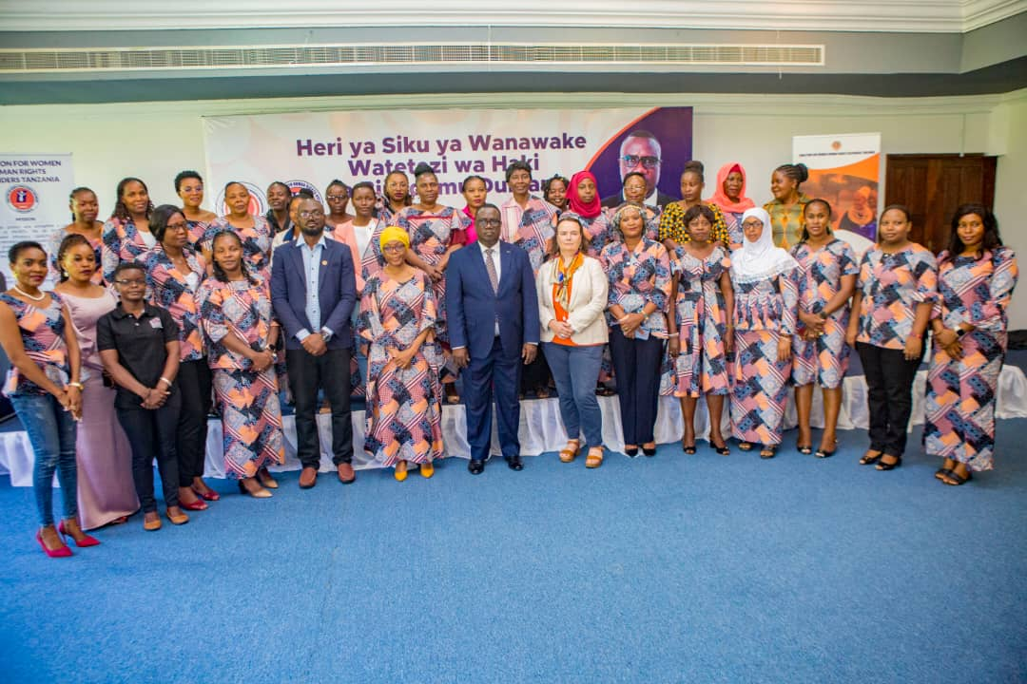
Summary
Coalition for WHRDs TZ is a leading Women Human Rights Defenders Protection Network registered in 2019 under Non-governmental organization Legislation of 2002.
Its head office is in Dar es Salaam Tanzania.
The Coalition was established to strengthen movement of Women Human Rights Defenders in Tanzania.
Started with 8 women human rights defenders organizations in 2029, the Coalition is now having more than 100 institutional members in Tanzania Mainland and Zanzibar
Voice and Choice Learning and Sharing Summit 2023

Slide 3
Organisational Acore Card
 | Baseline score | Latest score
Overall score
Strategic Positioning Score | 5 | 8
Governance Score | 6 | 9
Partnerships and Target Groups Score | 4 | 8
Programme of Action Score | 5 | 9
Institutional Effectiveness Score | 5 | 8
Sustainability and Diversification Score | 4 | 8
Voice and Choice Learning and Sharing Summit 2023

Slide 4
Areas of improvement
 | 1 | 2 | 3 | 4 | 5 | 6 | 7 | 8 | 9 | 10
Better financial policies and practice |  |  |  |  |  |  |  | X
Better governance |  |  |  |  |  |  |  |  | X
Better legal compliance |  |  |  |  |  |  |  |  | X
Fund raising skills |  |  |  |  |  |  | X
Report writing skills |  |  |  |  |  |  |  | X
Voice and Choice Learning and Sharing Summit 2023

Slide 5
 | 1 | 2 | 3 | 4 | 5 | 6 | 7 | 8 | 9 | 10
Monitoring and evaluation skills |  |  |  |  |  |  | X
Lobbying and advocacy skills |  |  |  |  |  |  |  | X
Networking skills |  |  |  |  |  |  |  | X
Communication skills (media, social media) |  |  |  |  |  |  |  | X
Presenting skills |  |  |  |  |  |  | X
Use of IT eg to organise online events |  |  |  |  |  |  |  |  | X
Voice and Choice Learning and Sharing Summit 2023

Slide 6
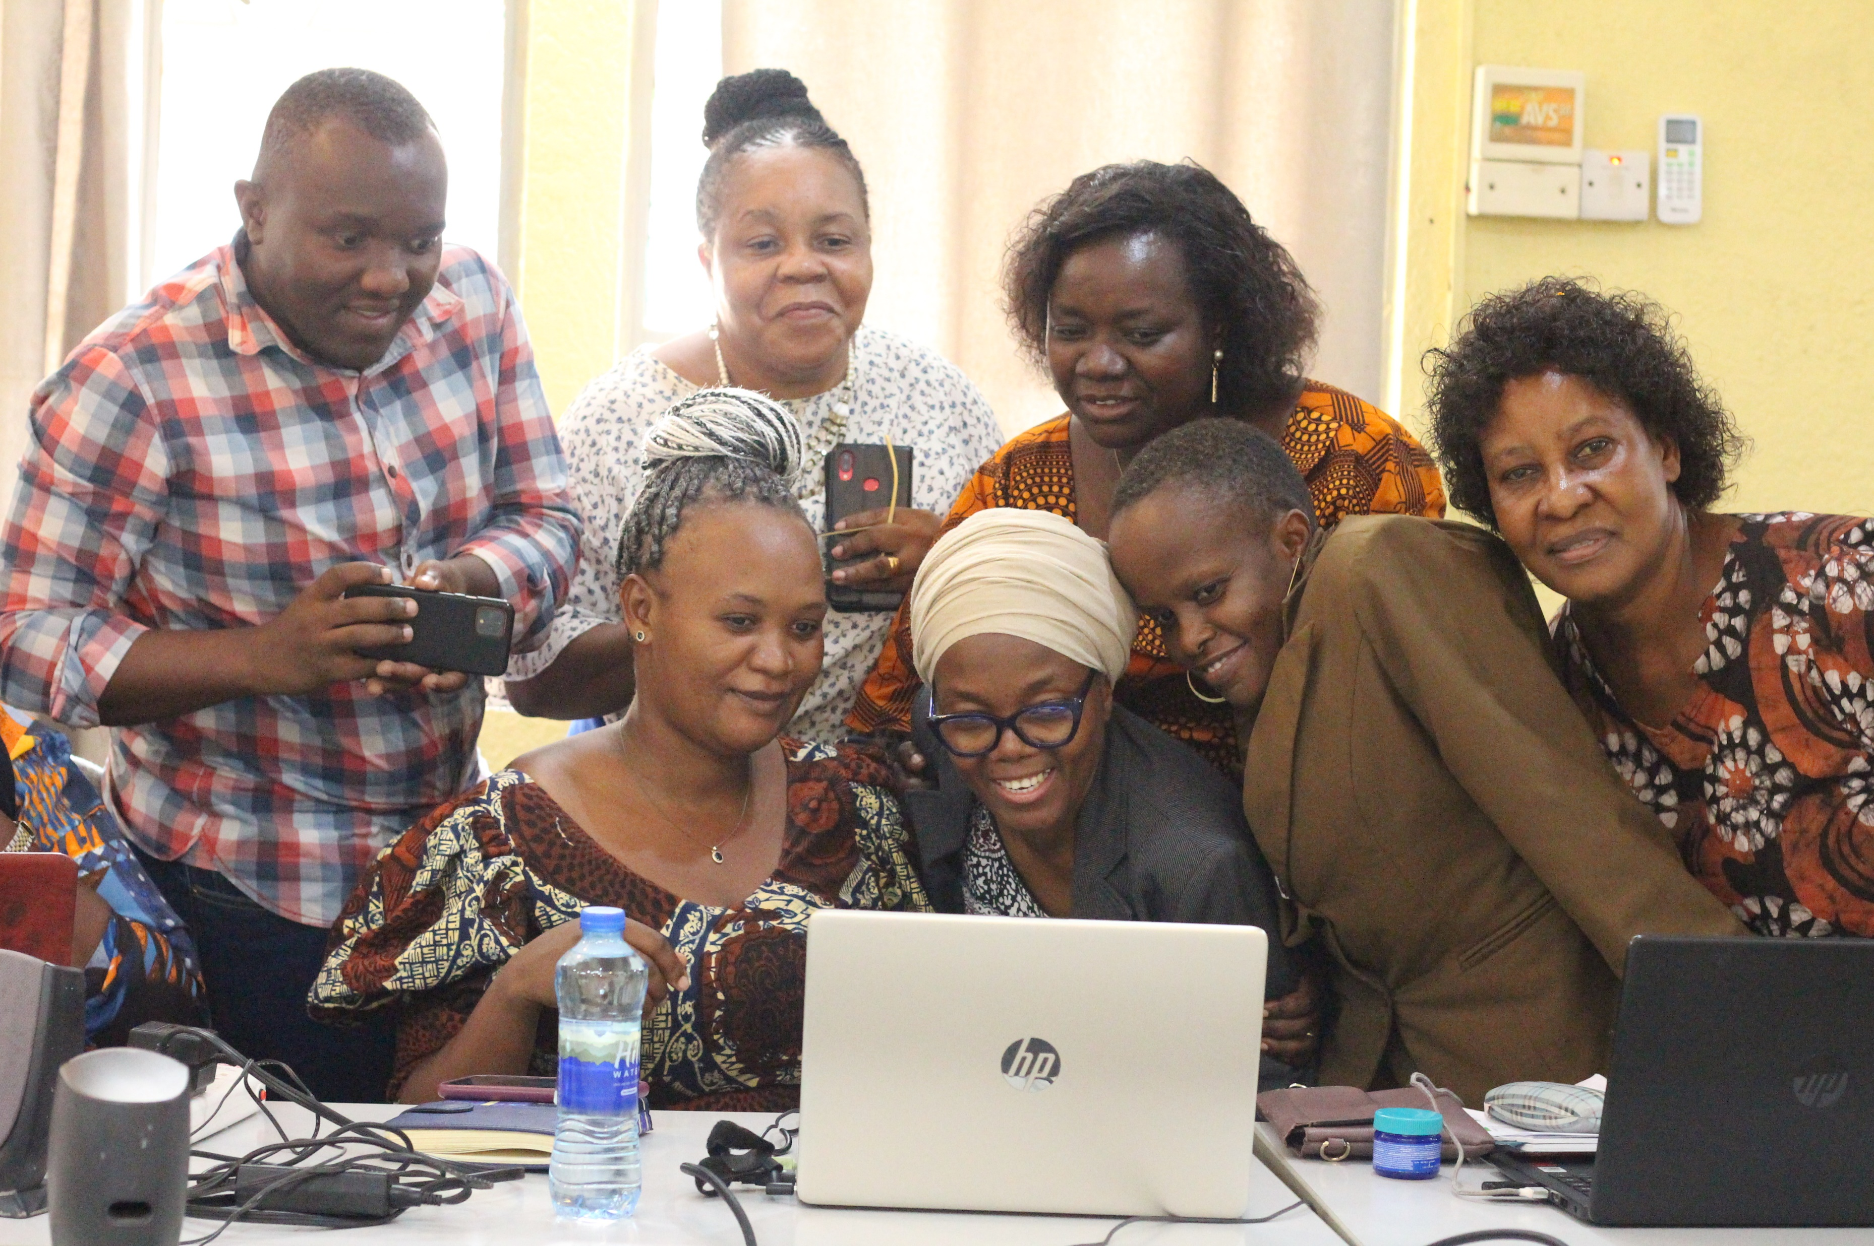
At least three examples of organizational growth
Better policies and practice
Coalition developed Anti-Corruption /Fraud Policy to ensure financial management without fraud or corruption.
The policy was essential for setting control within finance department, procurement as well as programming for enhanced accountability, transparency and efficiency
The Coalition strengthened its procurement practices, eg. Ensuring costs comparison analysis in all procurement
It also developed Safeguarding Policy essential for promotion of gender equality and the rights of vulnerable groups
Voice and Choice Learning and Sharing Summit 2023

Slide 7
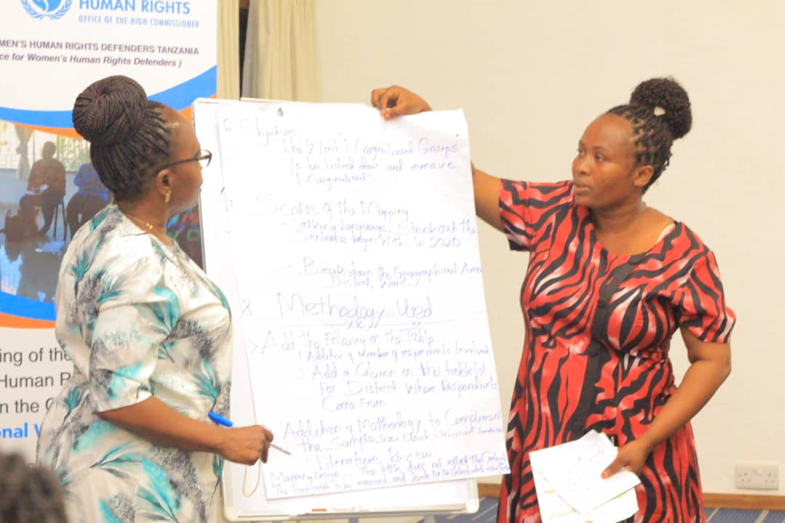
At least three examples of organizational growth
Monitoring and Evaluation Systems
The Coalition developed M&E Plan
The Plan had guided M&E work within organization, not only for the GL/Amplify Change Project, but also for other projects
It is now a must to conduct field monitoring visits to document good practices and lessons learned for all projects
M&E Plan has improved monitoring, documentation and reporting within the Coalition
M$E has added to the key documents required by donors when submitting projects write-up
Voice and Choice Learning and Sharing Summit 2023

Slide 8
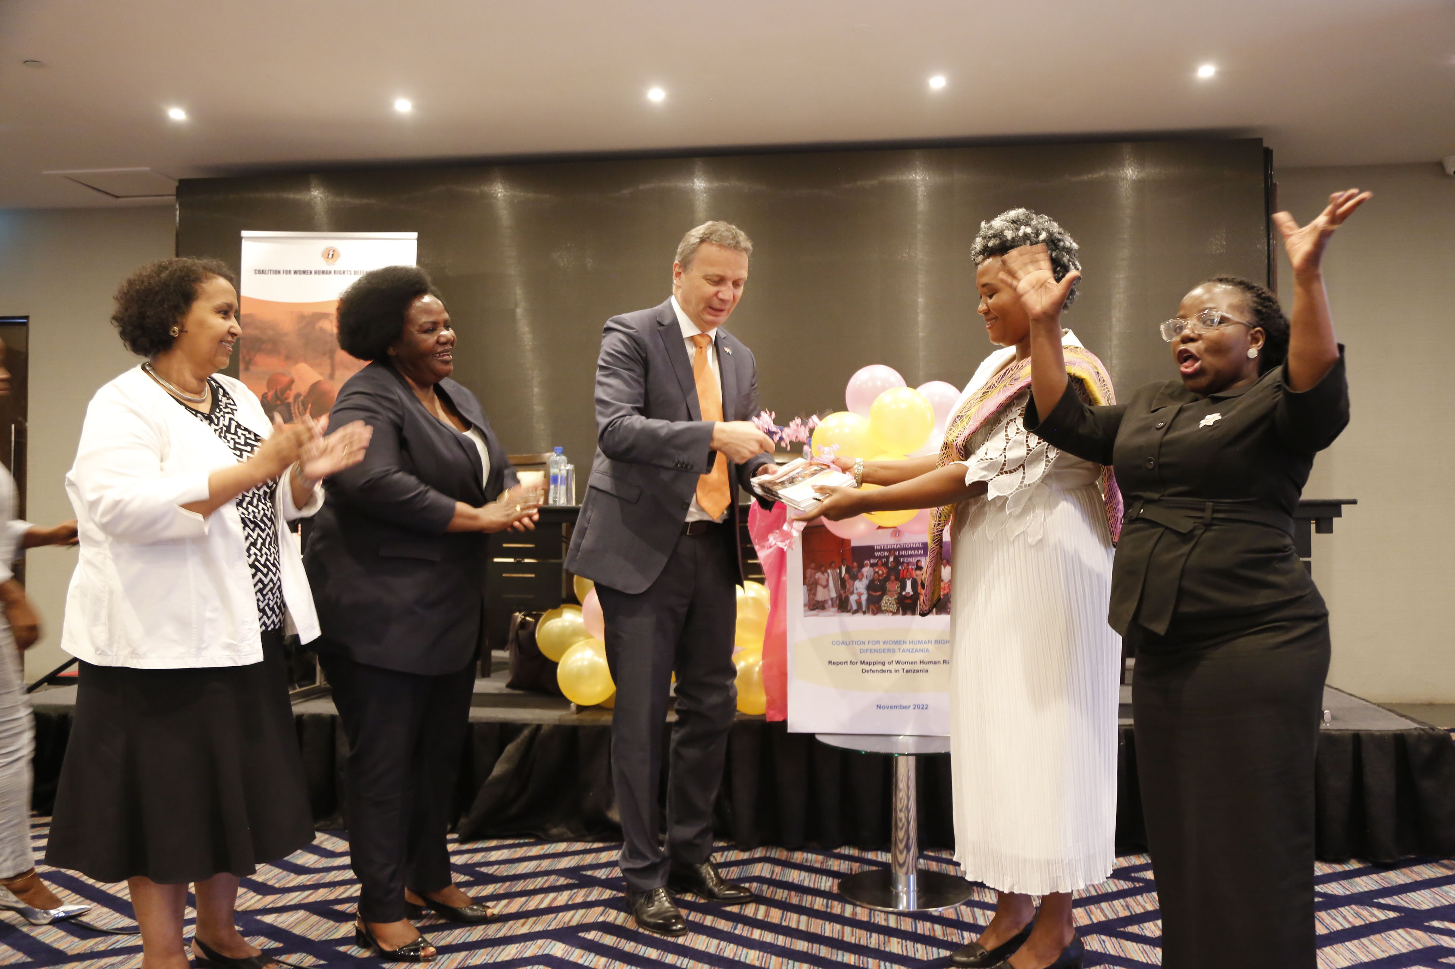
At least three examples of organizational growth
Fund Raising
The Coalition has been transformed in terms of Resource mobilisation and diversification.
With only three grants, GL/AC being the largest grant, after two years, the Coalition has secured 8 grants, with two grants larger than GL/AC grant.
The amount of funds raised has increased 5 times compared to the audited report submitted during GL/AC grant application proposal
This has contributed to growth in terms of office operation as well as programming ensuring sustainability and staff retention
Voice and Choice Learning and Sharing Summit 2023

Slide 9
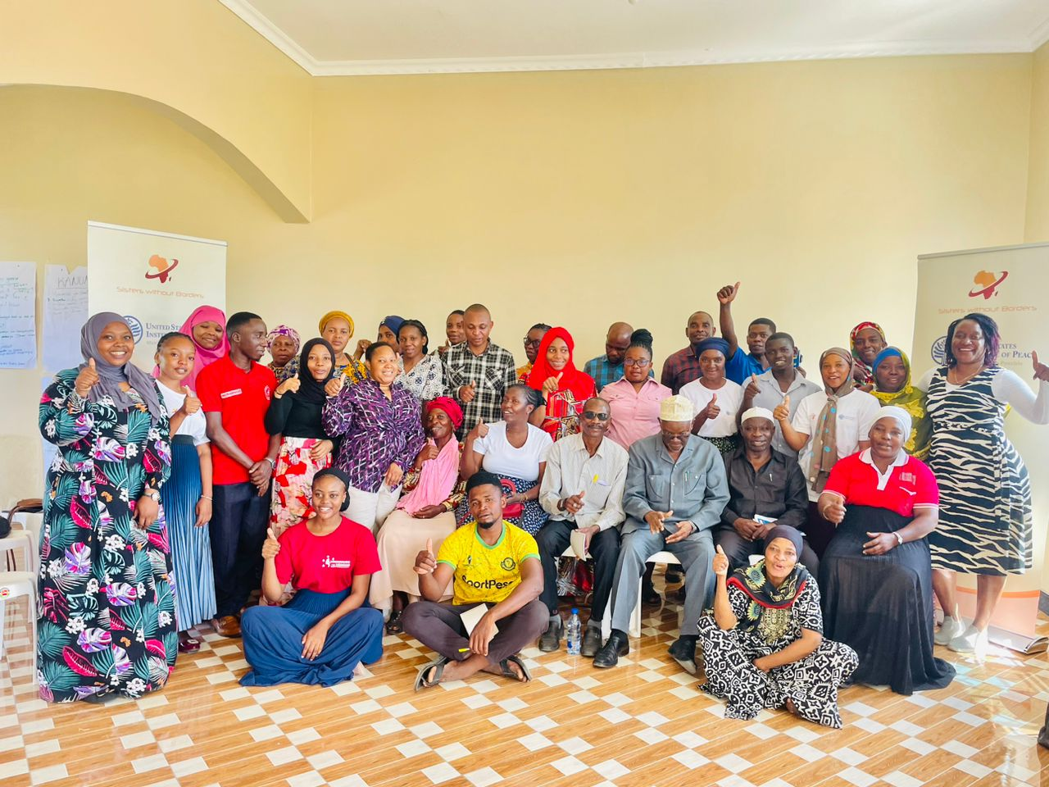
How VCSAF has contributed to growth
This growth happened during implementation of the VCSAF two-year grant.
The grant put it mandatory for the Coalition to have Safeguarding, Anti Corruption/Anti Fraud and Monitoring and Evaluation Policies
Gender Links guided the development of two policies – Safeguarding and Anti Corruption/Anti Fraud Policies
Through networking strengthened through VCSAF project, Coalition secured in-kind support to develop M&E and Learning Plan
Voice and Choice Learning and Sharing Summit 2023

Slide 10
How VCSAF has contributed to growth
VCSAF grant increased threshold that Coalition could get from other development partners
VCSAF training on communication increased benefits from using social media such as Face Book, Twitter and Instagram.
This enhanced Coalition’s using of Social Media as fundraising tools by tagging all potential development partners.
This has increased visibility and Coalitions’ work to be known beyond, making some development partners seek partnership with Coalition and eventually funding.
Voice and Choice Learning and Sharing Summit 2023

Slide 11
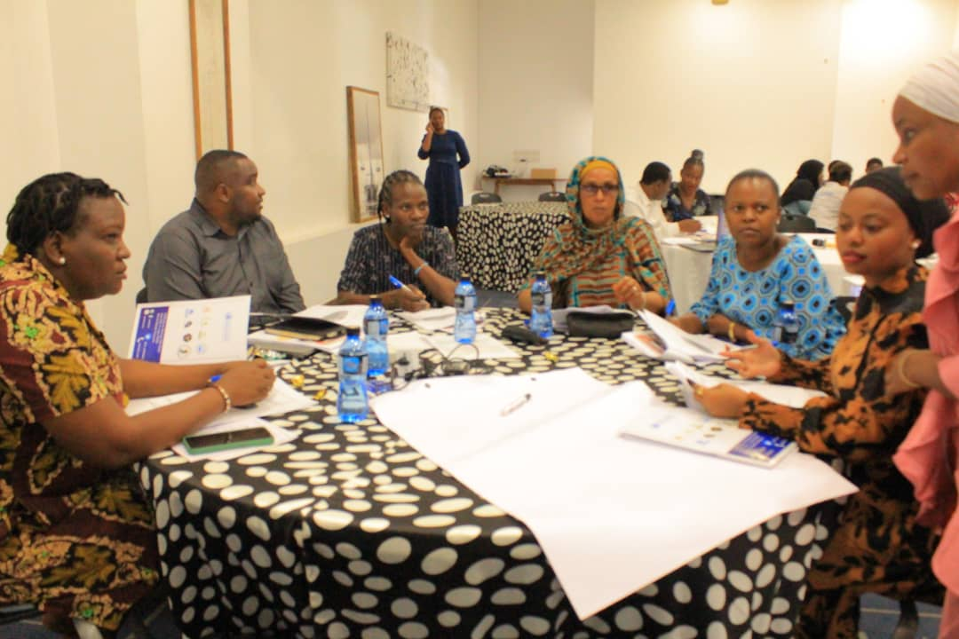
Additional funds raised
The Coalition has raised additional funds from other development partners to support women human rights defenders movement around SRHR
It has raised funds from Ireland Embassy in Tanzania
It is now part of a consortium in East Africa collaborating with 4 organizations on the anticipated AmplifyChange SRHR project
Voice and Choice Learning and Sharing Summit 2023

Slide 12
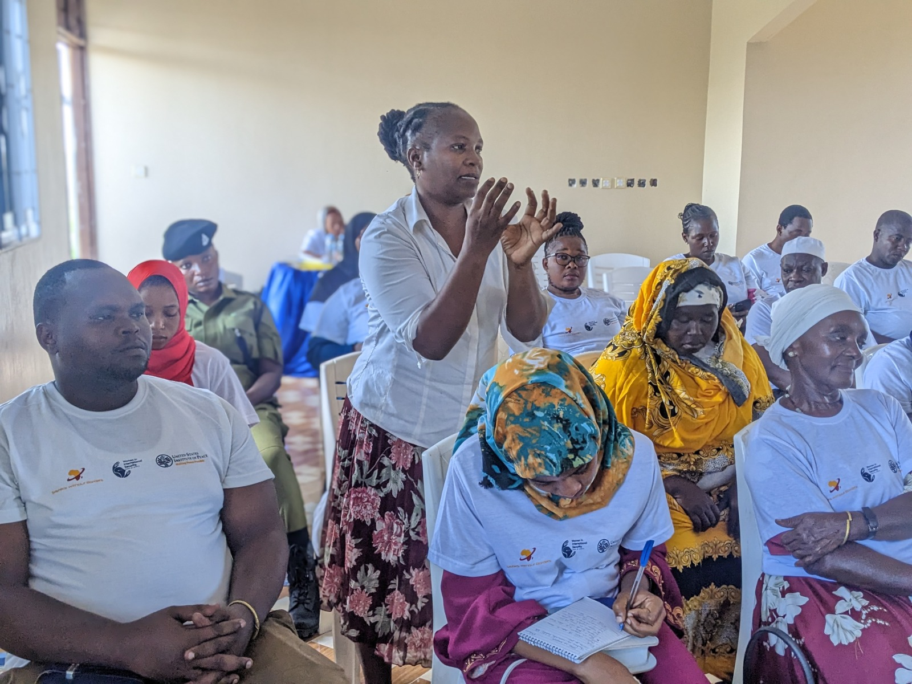
In-kind support
The Coalition Received in-kind support to develop M & E and Learning Plan
The Coalition obtained in-kind support to develop Board Charter
The organization obtained in-kind support to conduct Mid-Term Evaluation of its Strategic Plan
Voice and Choice Learning and Sharing Summit 2023

Slide 13
Please quantify the in-kind support received:
Type of support | # of units | Cost per unit | Total
Develop M & E and Learning Plan | 1 | USD 5,000 | 5,000
Develop Board Charter | 1 | USD 5,000 | 5,000
Conduct Md-Term Evaluation of its Strategic Plan | 1 | USD 8,000 | 8,000
Voice and Choice Learning and Sharing Summit 2023

Slide 14
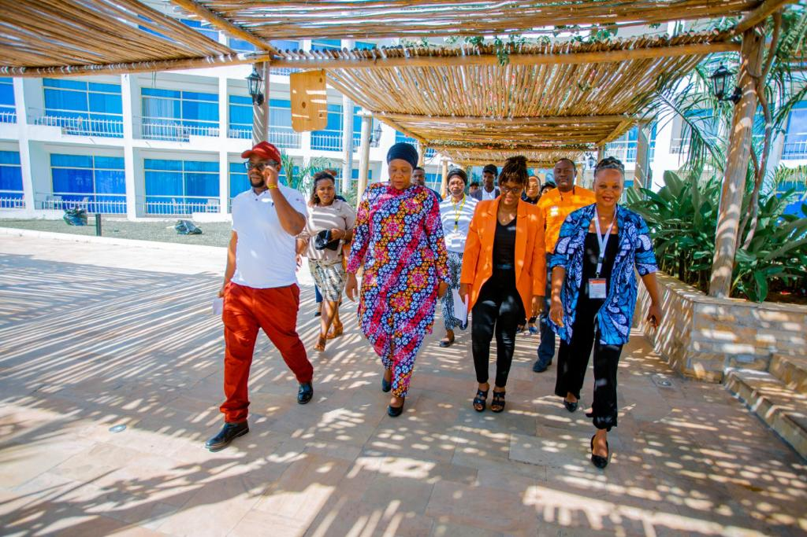
Next steps
Increase fundraising efforts to ensure members of the community are reached with SRHR messages for awareness creation and attitude change
Enhance advocacy efforts on legal transformation using international mechanisms such as UPR
Voice and Choice Learning and Sharing Summit 2023

