Slide 1







LEARNING
AND SHARING
SUMMIT 2025
(South Africa, Polokwane, Monama Maburwana)
Women’s Voice and Leadership Learning and Sharing Summit 2025

Slide 2
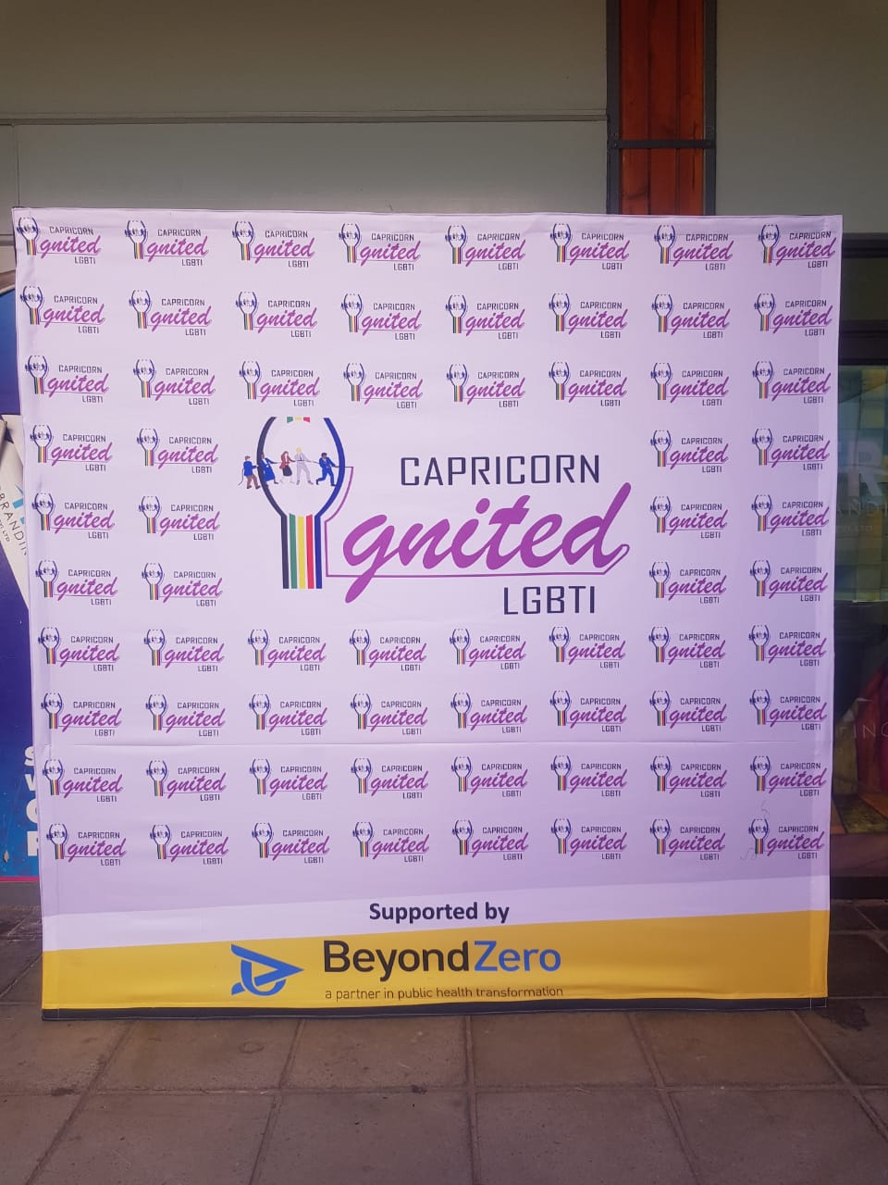
Summary
Capricorn Ignited LGBTI (CIL) is an Organization conceptualized through the feminist lens to advocate for LGBTIQ+ rights in Limpopo Province, looking closely to the understanding and the belief in full social, economic and political equality for LGBTIQ+.
CIL is formed with the clear intention of building strategic partnerships and movements that use training and dialogues as a key platform for critical engagement and mobilization, capacity development, reframing of perceptions and advocacy interventions across Limpopo Province.
Add photo or video
Voice and Choice Learning and Sharing Summit 2025

Slide 3
Dates and themes of joint campaign/s
 | Date | Theme
1 | 17-05-2023 | IDAHOBIT Webinar (CIL and Lesotho Master of Healing Foundation Lesotho)
2 | 05-08-2023 16-07-2024 | LGBTIQ+ Advocacy through Cinema and Dialogue: Kasi to Kasi Queer Film Festival (Zebediela and University of Limpopo)
3 | 26-10-2024 | Mopani, Vhembe, Waterberg and Capricorn Pride Campaigns
4 | 27-08-2024 | SDR and Parents Dialogue: Community GBVF and Health Workers –Sensitization at Matlala and Mamabolo Areas
5 | 27-07-2024 | Human Rights Visibility and Awareness Marches and Dialogues (Lebowakgomo and Matlala)
Voice and Choice Learning and Sharing Summit 2025

Slide 4
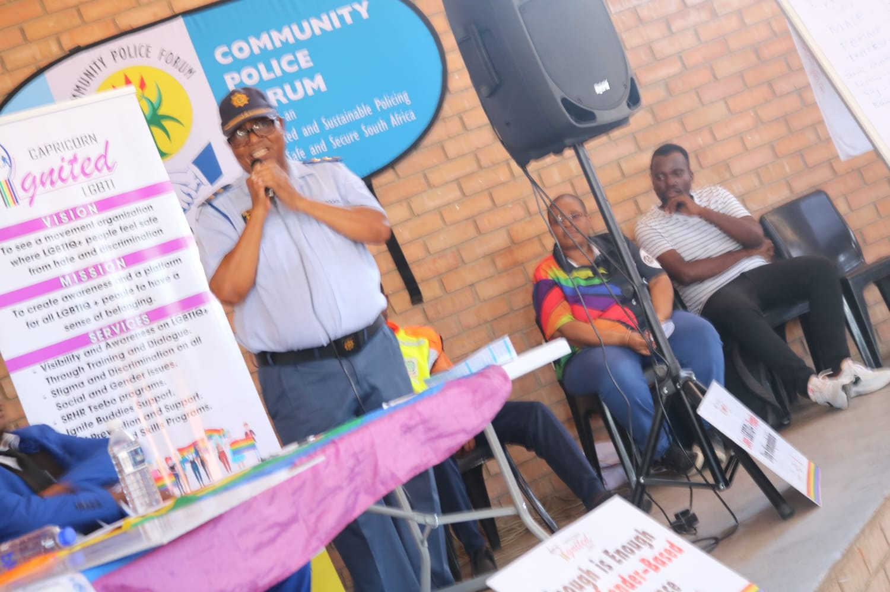
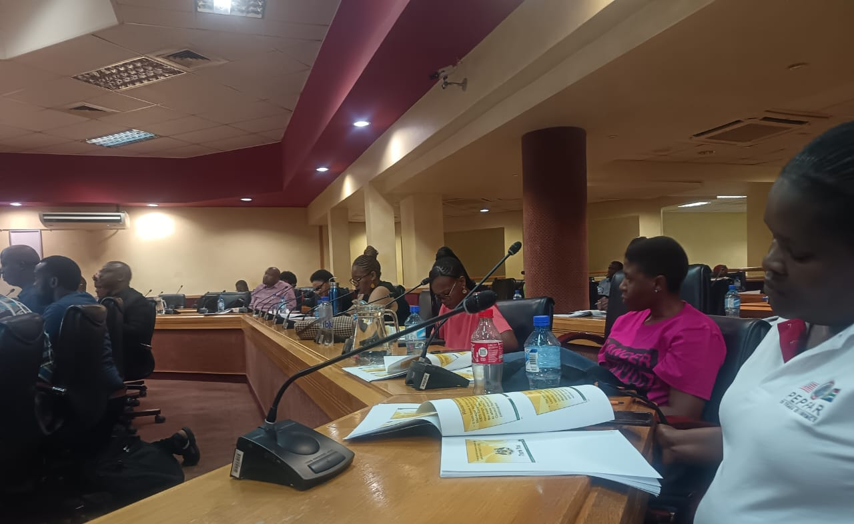
Initiatives and Strategies
Collaborations and Partnerships in Activities in different communities increased our access to more communities.
Affiliation in different Municipalities, Departments and Civil Society Forums has amplified our visibility.
Add photo or video
Voice and Choice Learning and Sharing Summit 2025

Slide 5
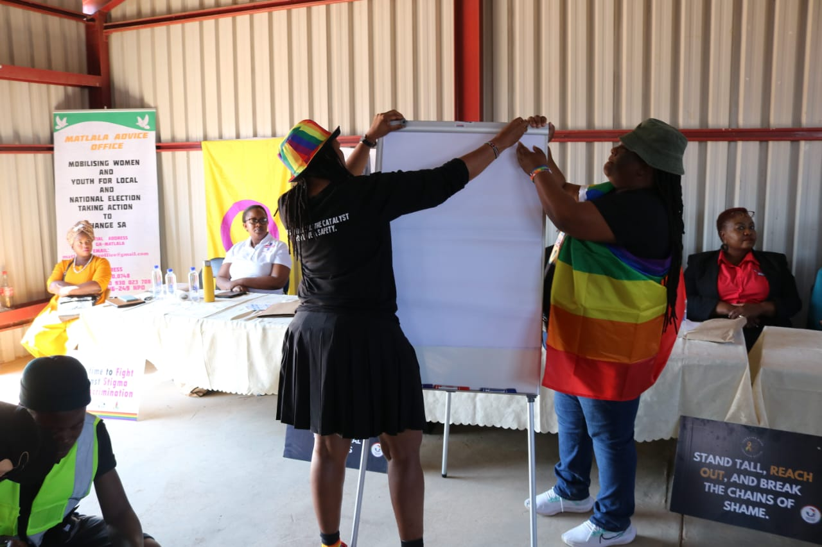
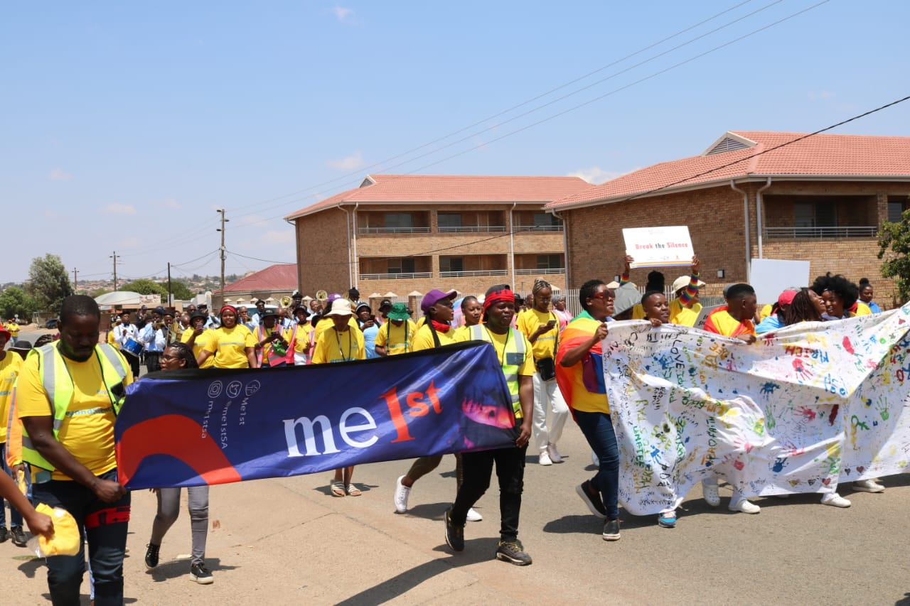
Governance & Resource Allocation
Management and Volunteers collectively held plenary meetings preparing for activities, and involvement of stakeholders for shared responsibilities.
Partnership of different stakeholders with resources during events has assisted the organization and the movement in making events possible and successful. Dividing resources like Transport, Catering and other logistics.
Add photo or video
Voice and Choice Learning and Sharing Summit 2025

Slide 6
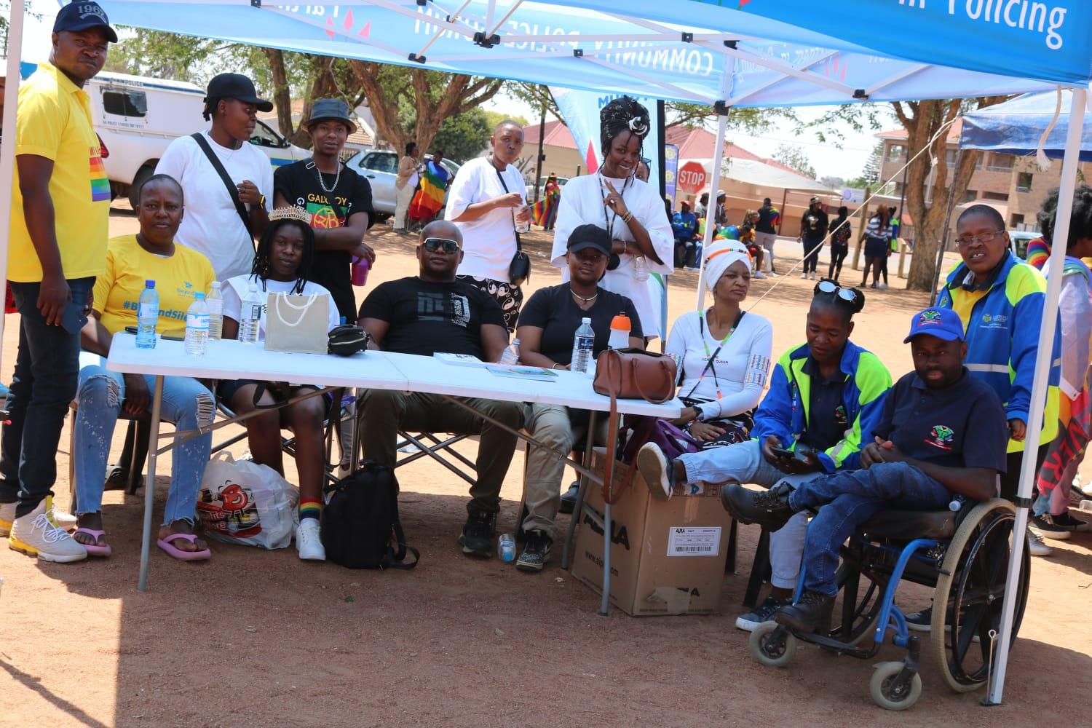
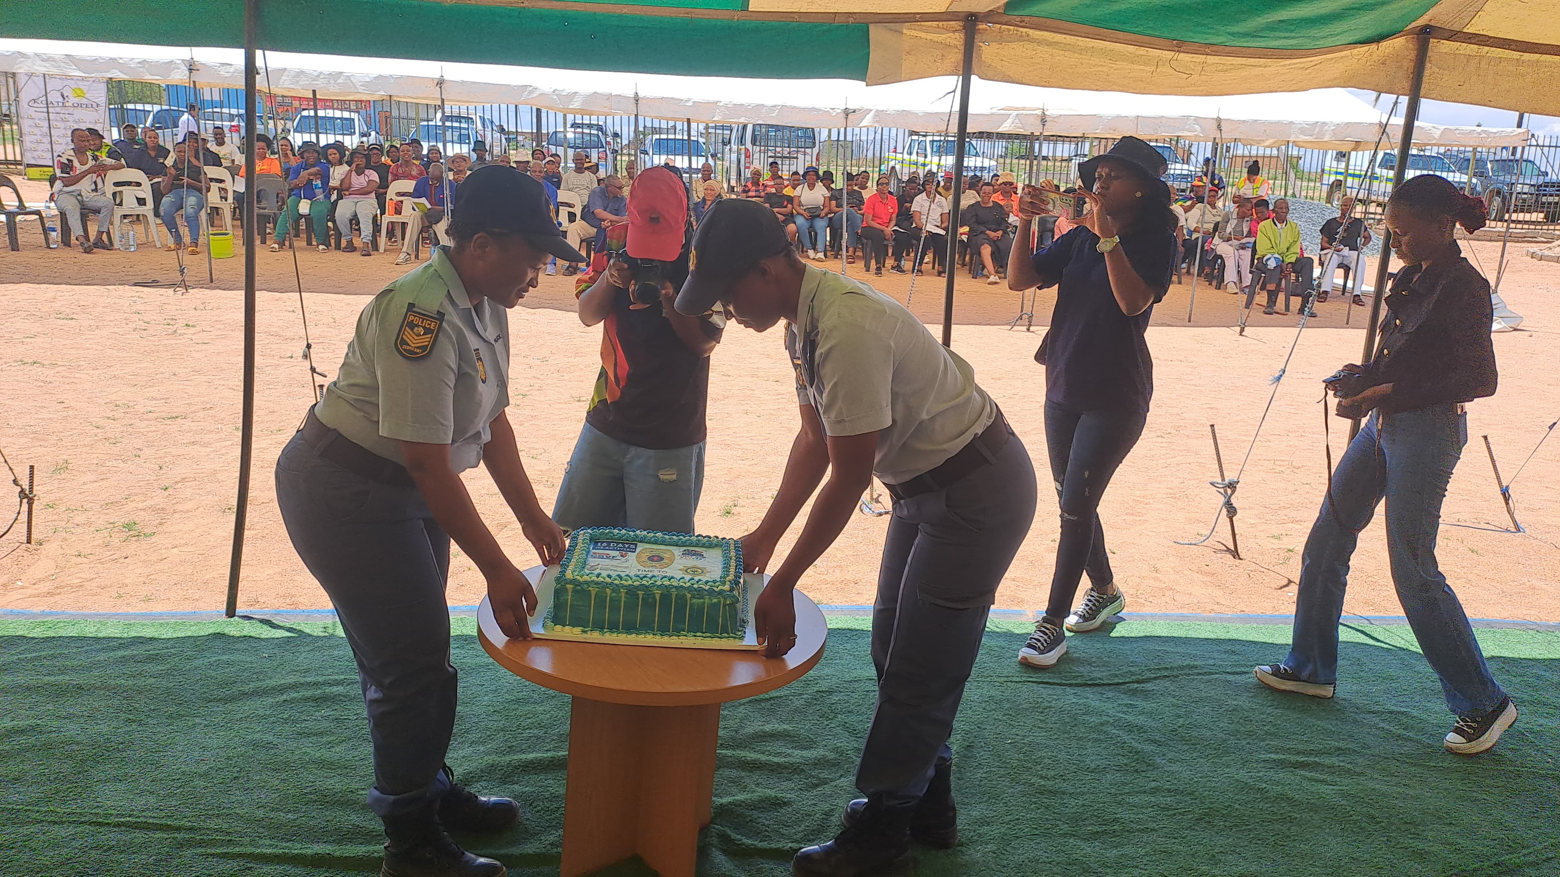
Inclusive Leadership & Coordination
Involvement of Leadership from Key Sectors during the initial phase strengthens Collaborations. Local Organizing Committees have been established in different police clusters.
Plenary meetings inclusive of stakeholders, delegation of tasks and responsibilities, and community mobilizations.
Add photo or video
Voice and Choice Learning and Sharing Summit 2025

Slide 7
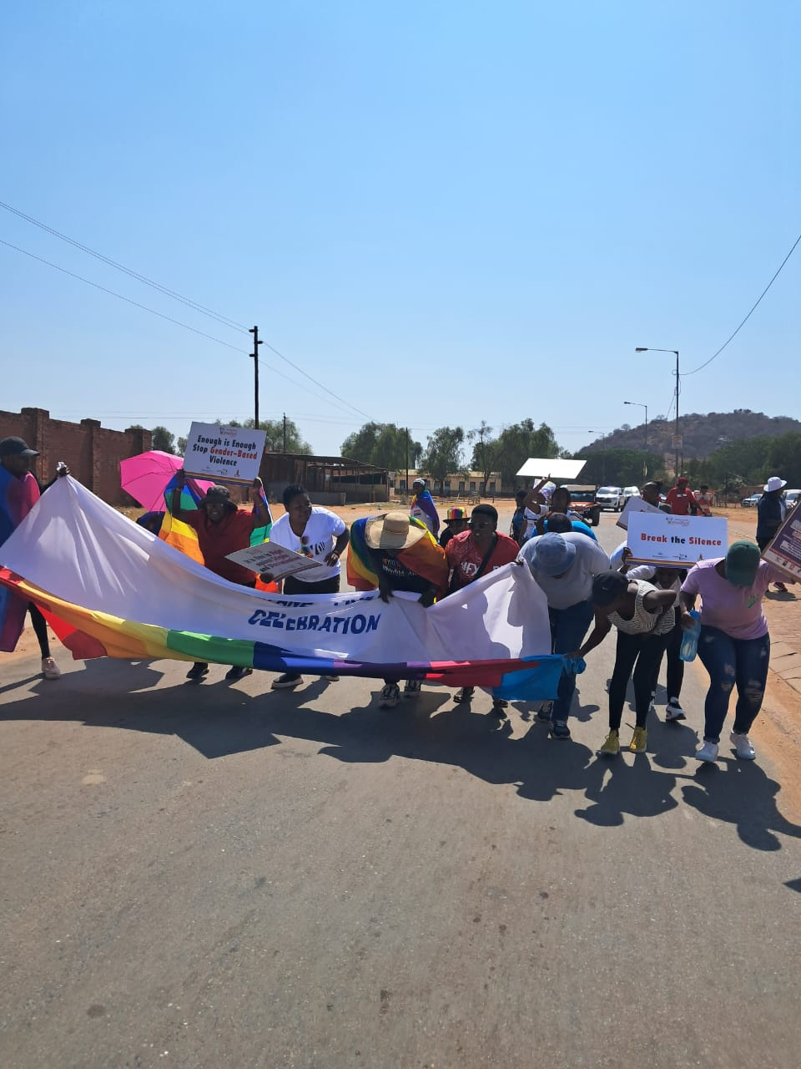
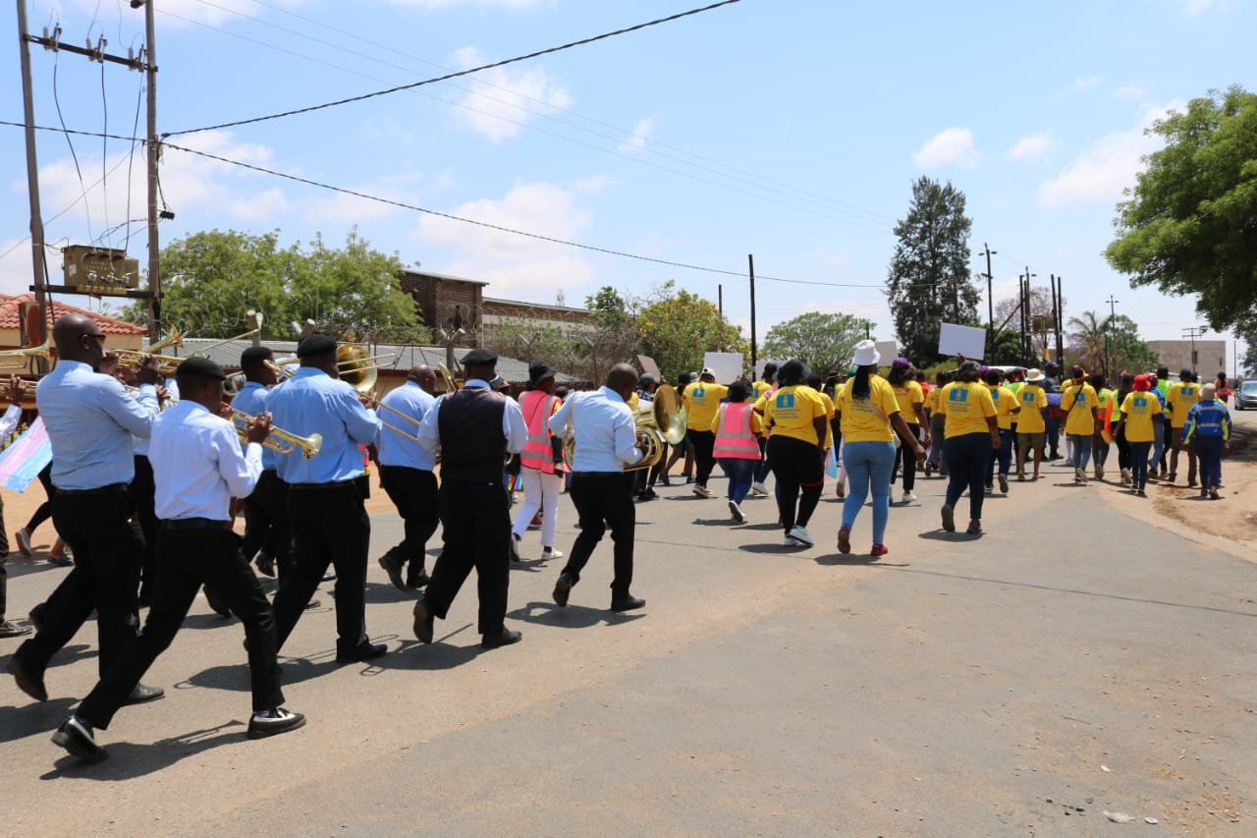
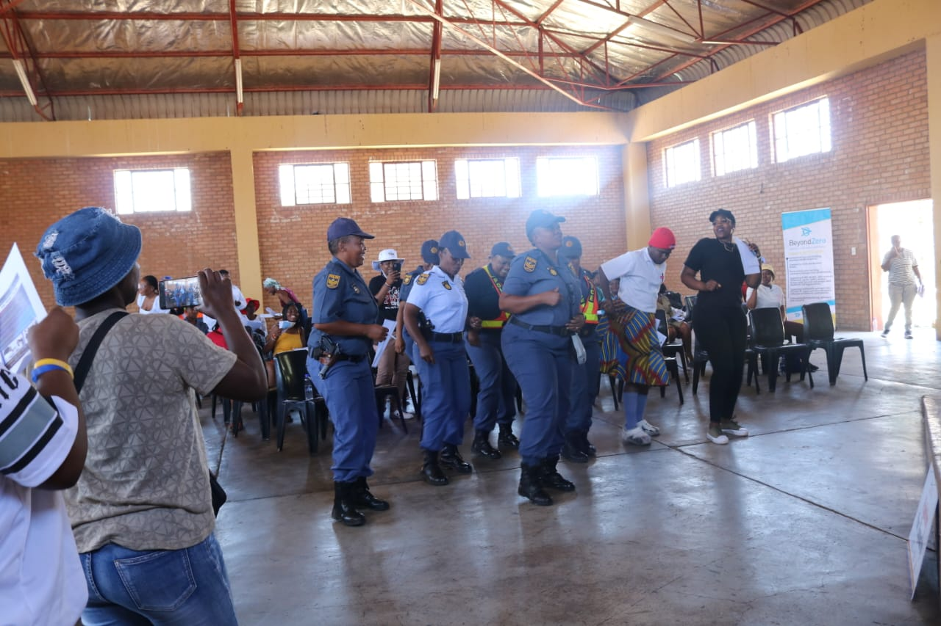
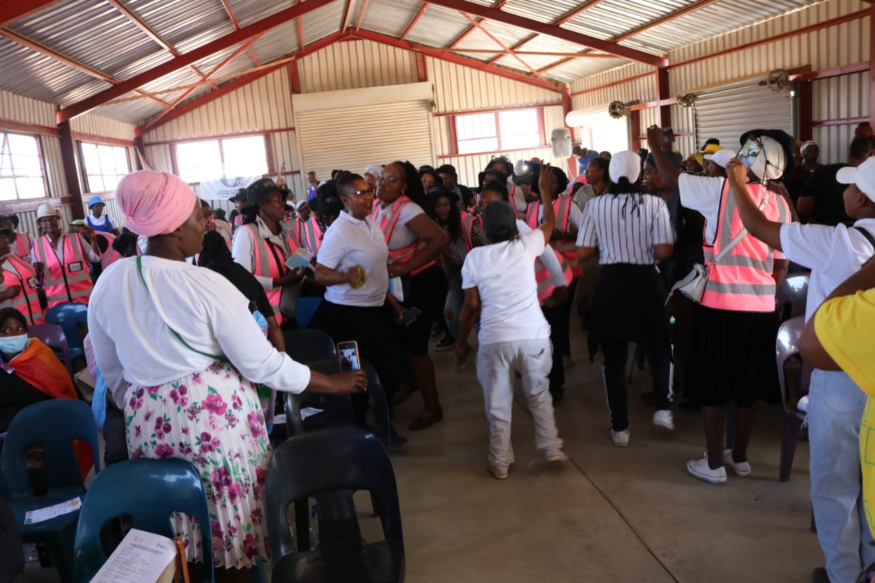
Connecting & Community-Building
Established Communication Systems through WhatsApp groups, Local Organizing Committees and Forums to sustain networking.
Partnership and Support on activities focusing on: GBVF, Human Rights, SRHR, HIV/AIDS Prevention, Community Safety and Gender Issues. The component of LGBTIQ+ sessions in these activities has increased demand of our services.
Add photo or video
Voice and Choice Learning and Sharing Summit 2025

Slide 8
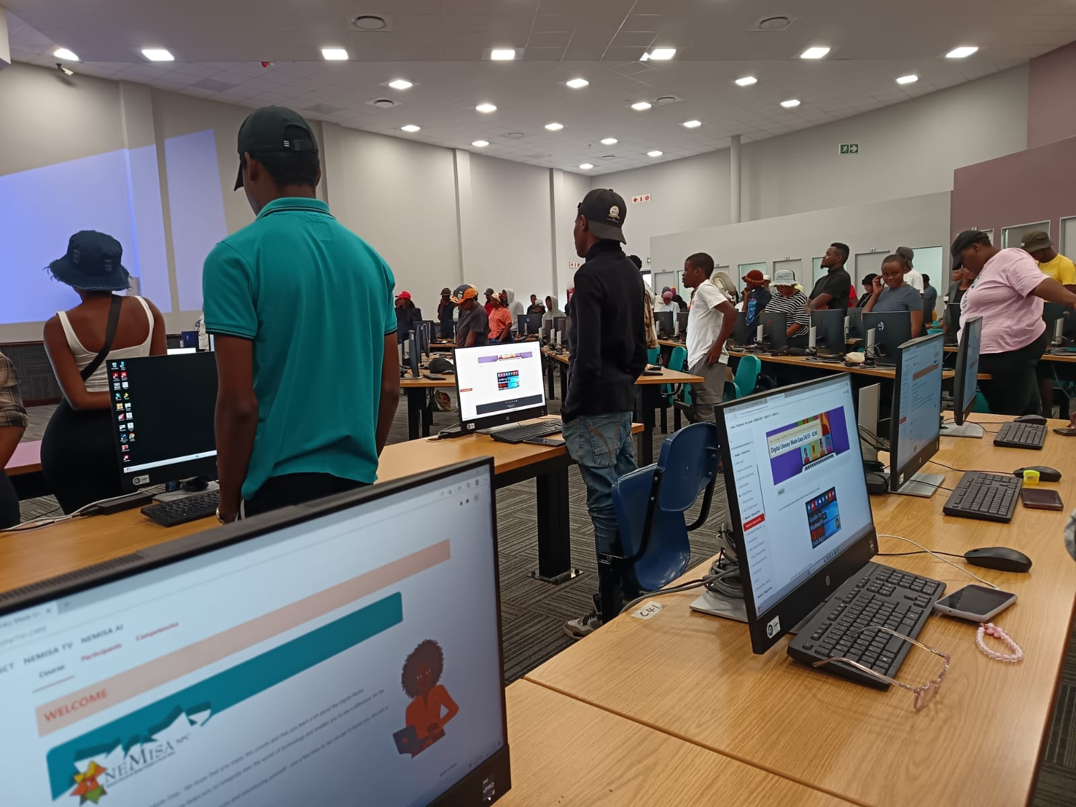
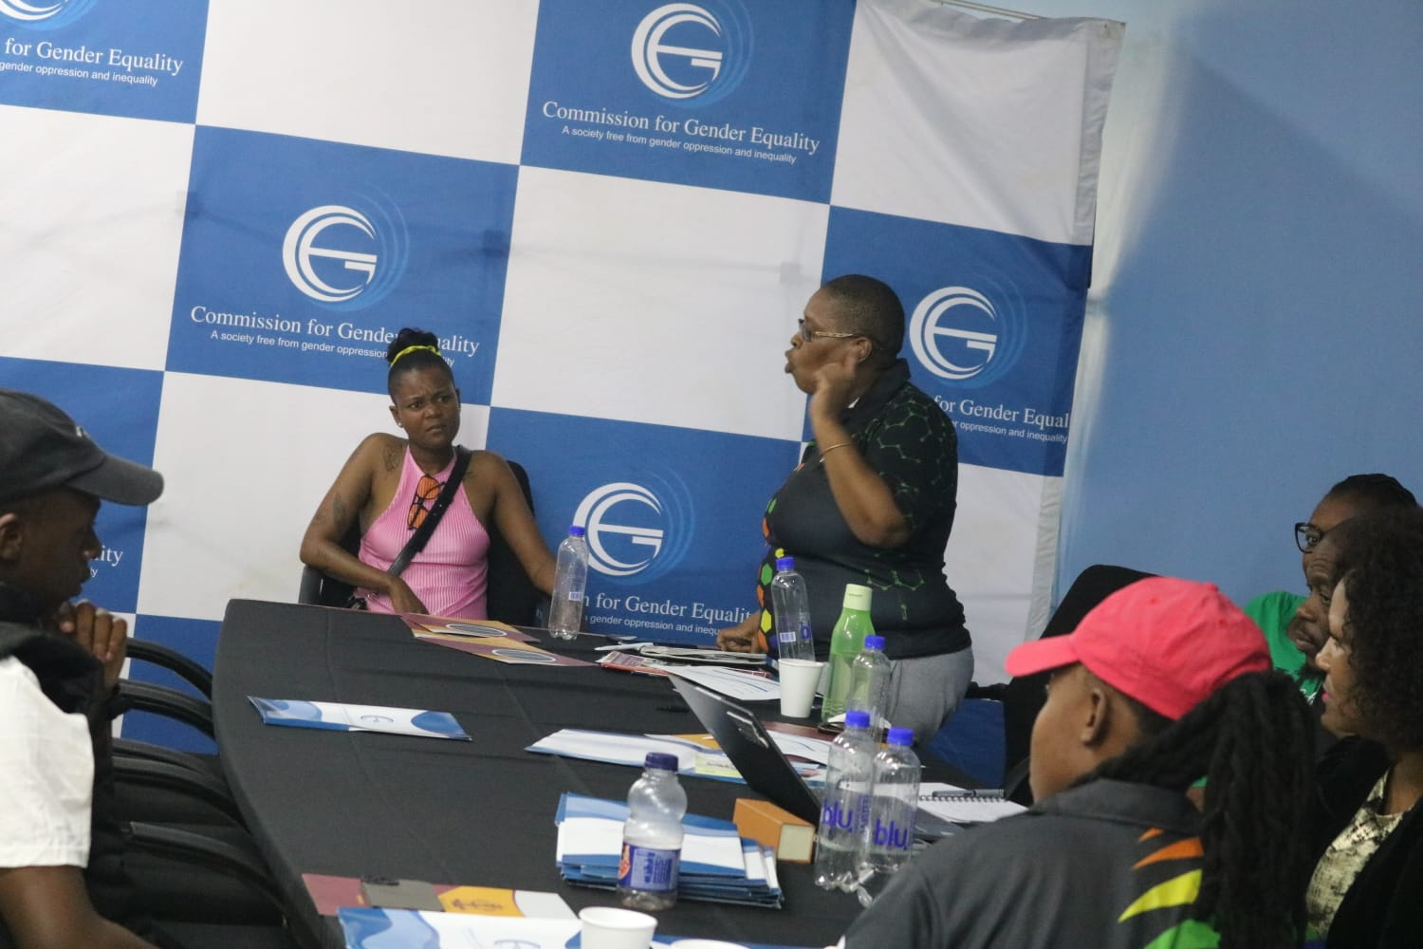
Linking & Learning
Continuous Training sessions on Human Rights for LGBTIQ+ people in communities, capacitating members to advocate in their local areas, and linking them with stakeholders.
Documenting LGBTIQ+ Human Rights cases and referring survivors to relevant services like psychosocial support and legal assistance. Established Human Rights Violations Support group and conduct wellness sessions.
Add photo or video
Voice and Choice Learning and Sharing Summit 2025

Slide 9
NEXT STEPS
Maintain engagements with different stakeholders.
Train more local LGBTIQ+ people to understand SOGIESC and be able to advocate in local areas.
Develop more Simplified Information Material to distribute in communities.
Raise more funds to ensure sustainability of LGBTIQ+ Sector movement in the Province.
Thank You
Women’s Voice and Leadership Learning and Sharing Summit 2025

