Slide 1





Healing the Healers:
VOICE AND CHOICE SUMMIT
2026
Strengthening the GBV Response Movement Through Trauma-Informed Care
Organisational Development
Category
Presented by:
Segametsi Ditlhale

Slide 2

Table of Contents
1
5
Synopsis
Changes in policies
2
6
Background
Significance/Impact
3
7
ODS baseline scores
Challenges & lessons learnt
4
8
Change (How did change come about)
Sustainability
9
Future Goals
GBVF Responders
are the
spine of
the work

Slide 3
  Synopsis
The Mental Wellness Initiative (MWI) delivers trauma-informed mental wellness programmes designed specifically for frontline responders in the gender-based violence (GBV) sector. Responders, including volunteers, survivor-practitioners, counsellors, and activists, carry the emotional burden of supporting survivors while often receiving little support themselves.
MWI’s programme provides a structured healing framework that combines trauma literacy, emotional regulation, and embodied healing practices. Through a four-part workshop series, participants learn practical tools to manage stress, process secondary trauma, and strengthen their resilience while continuing their critical work in communities.
By centering the wellbeing of caregivers, the programme strengthens the broader GBV response system. Supporting frontline workers improved survivor care, organisational stability, and the long-term sustainability of community-led responses to gender-based violence.

Slide 4
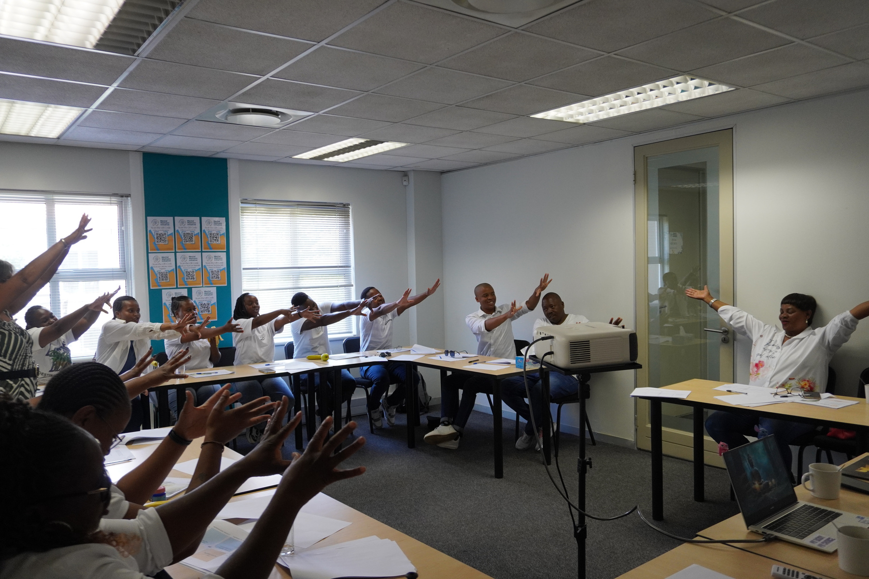
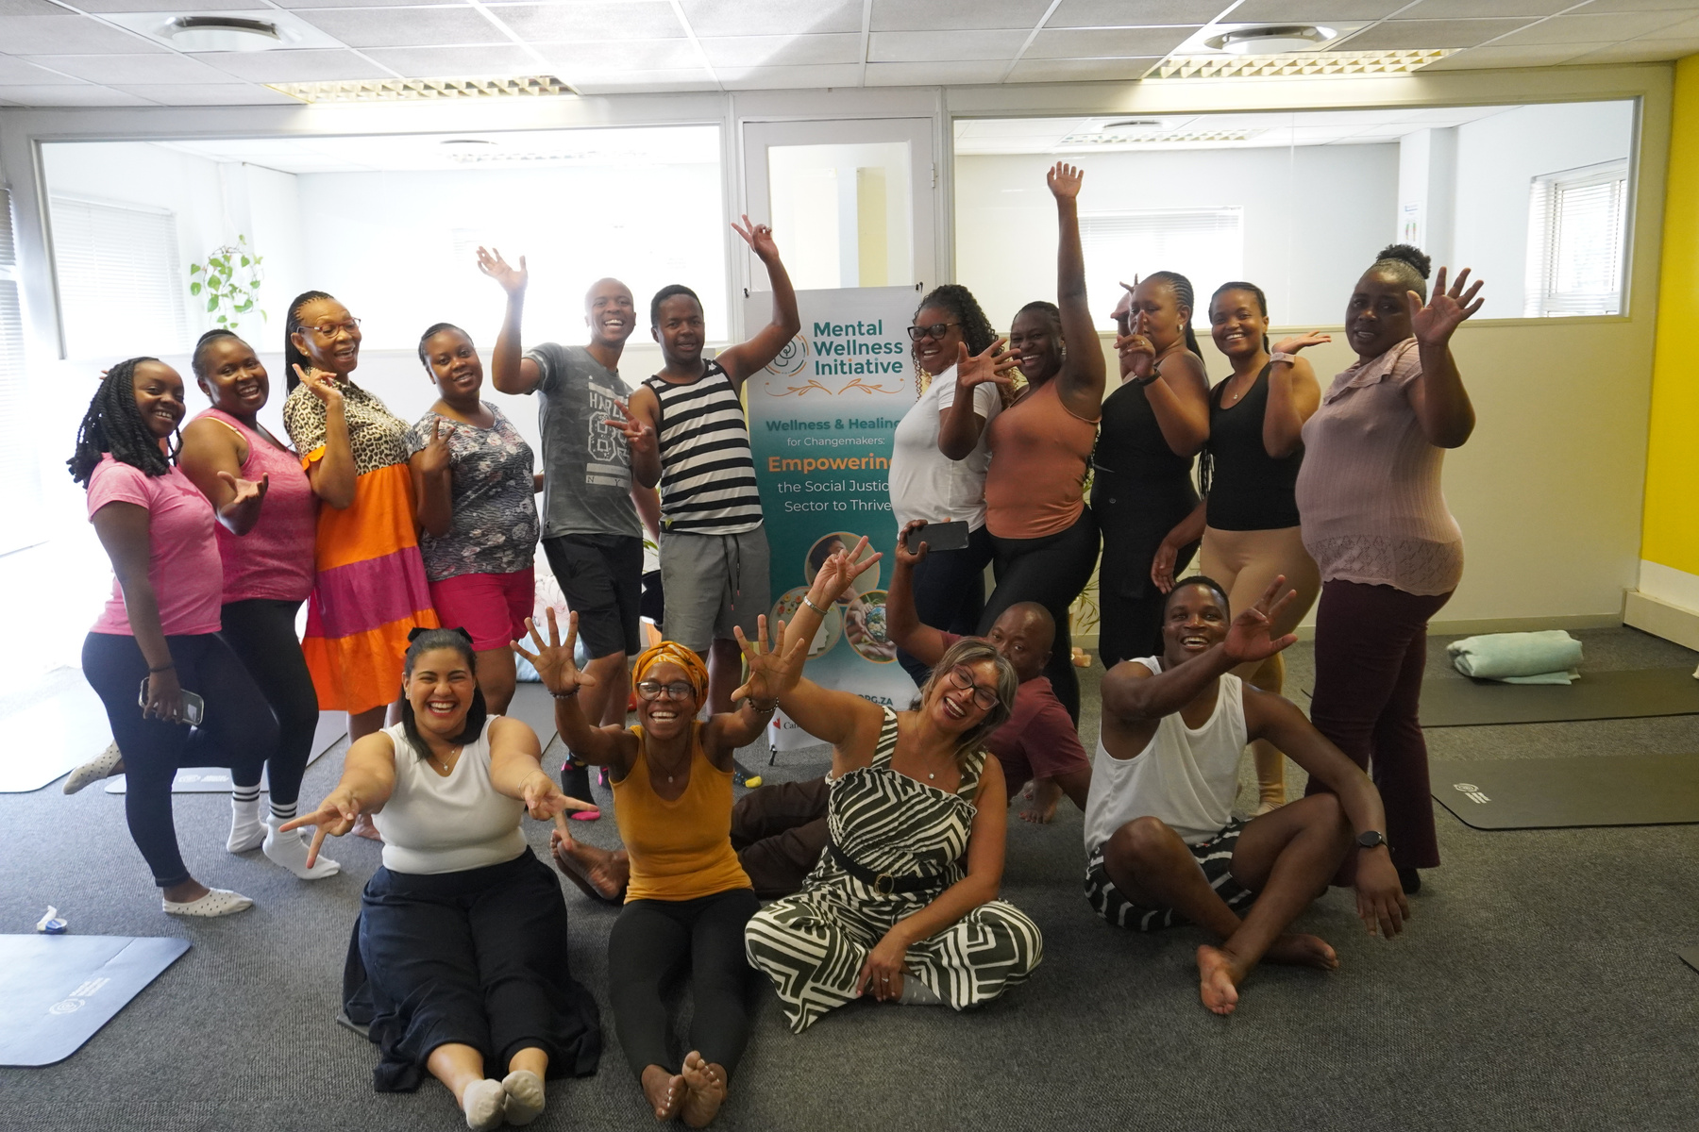
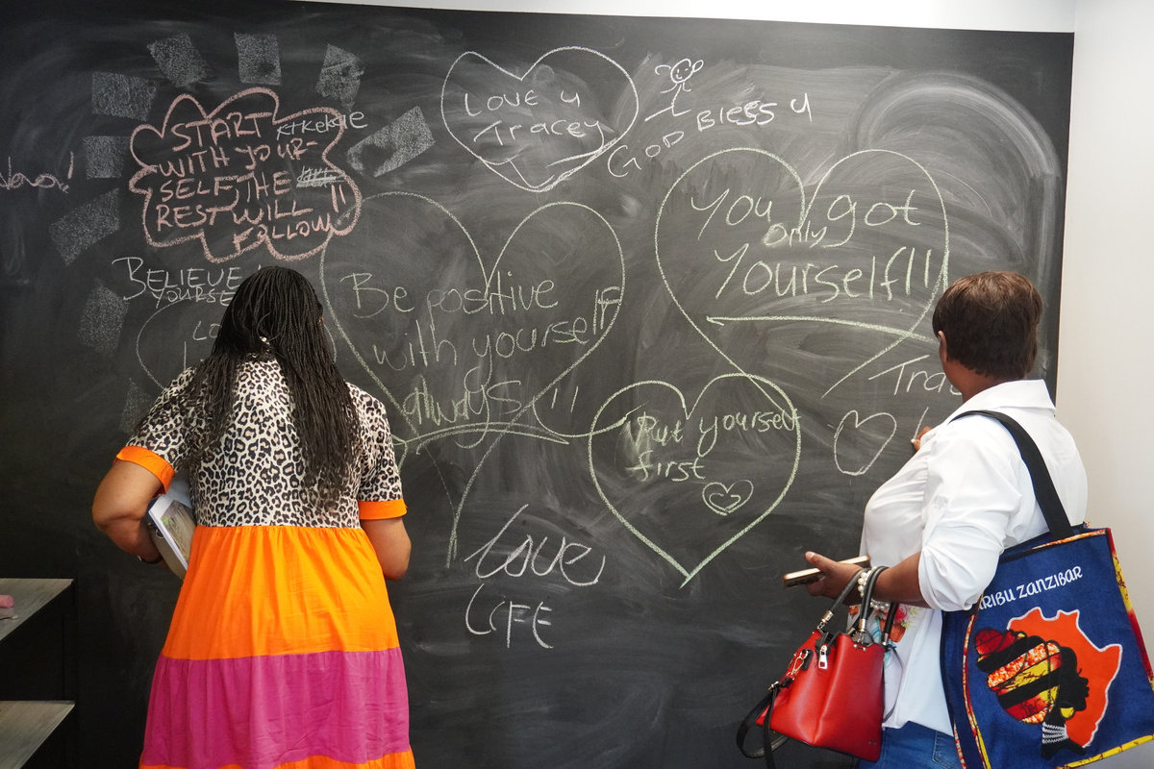
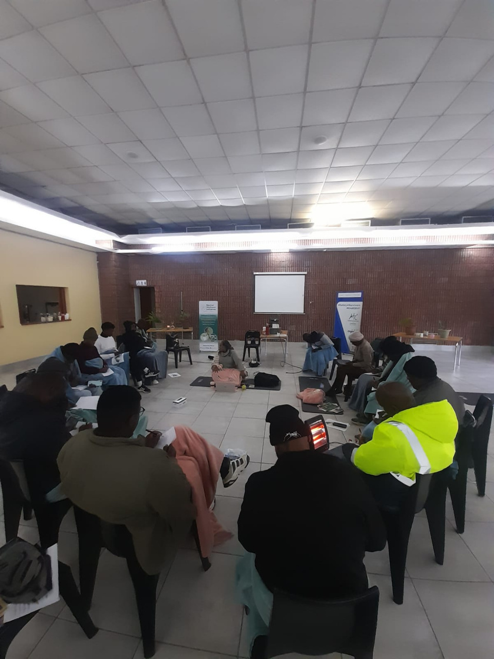
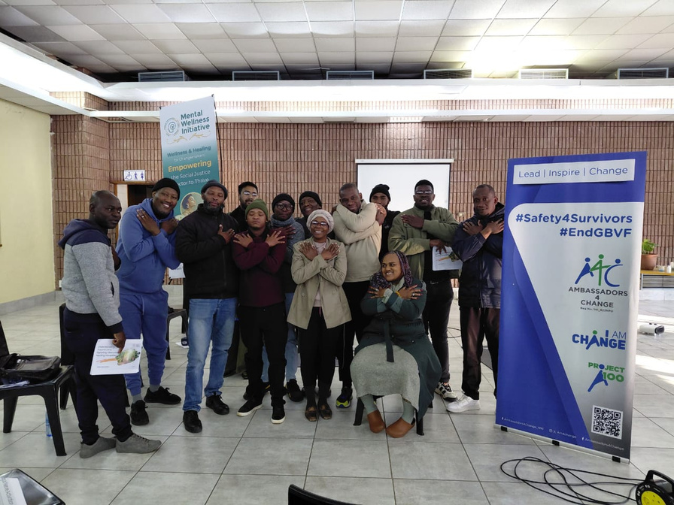
  Our participants
Workshops at MWI Office with Participants
Mental wellness workshop with Ambassadors of change NPO in Mafikeng - Hosting Men’s forum.

Slide 5
  Background
The Problem: A sector wide challenge
Burnout, compassion fatigue and staff turnover are high
Without support, the efficacy of the sector is undermined
GBV responders work under massive strain
Our Action: Trauma Informed Care
4 part trauma recovery and self regulation programme
trauma literacy, emotional regulation tools, somatic practices (breathwork, meditation, yoga, TRE). Integration into daily work.
2 part train the trainer: Applications for community work
Outcomes: Strengthened individual and organisational resilience, strengthed community wellness

Slide 6
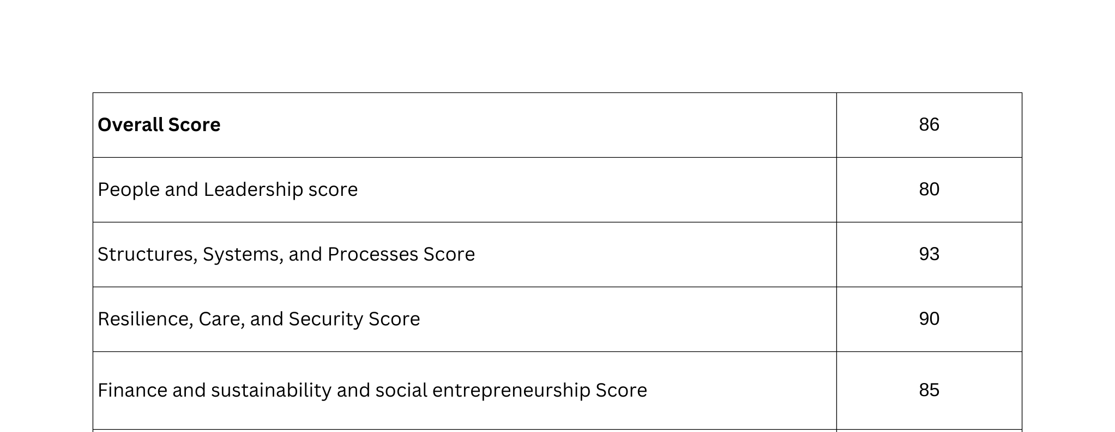

  ODS Baseline Score

Slide 7


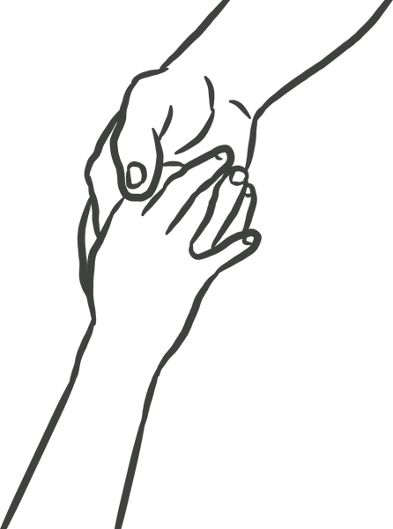

  How did change come about?
Theory and practice of being trauma aware and trauma informed
Embodied stress management and self regulation practices
Applying the practices with self and community

Slide 8
  How did change come about?
Evidence of Change
  Participants reported feeling more emotionally equipped to manage difficult cases, communicate more effectively with survivors, and support one another within their organisations.
  Many organisations began integrating trauma-informed practices, including peer support conversations, grounding exercises before meetings, and improved emotional awareness when responding to survivors.
  As frontline workers became more regulated and confident, their ability to support survivors and community members improved. This strengthened the quality and sustainability of community-based GBV response
This shift demonstrates how supporting caregivers strengthens the organisations that sustain community responses to GBV.
NGO teams began supporting one another through peer conversations
Organisations expressed strong interest in continued trauma-informed training
Frontline workers reported greater emotional regulation and resilience
Participants reported feeling more confident handling difficult cases

Slide 9
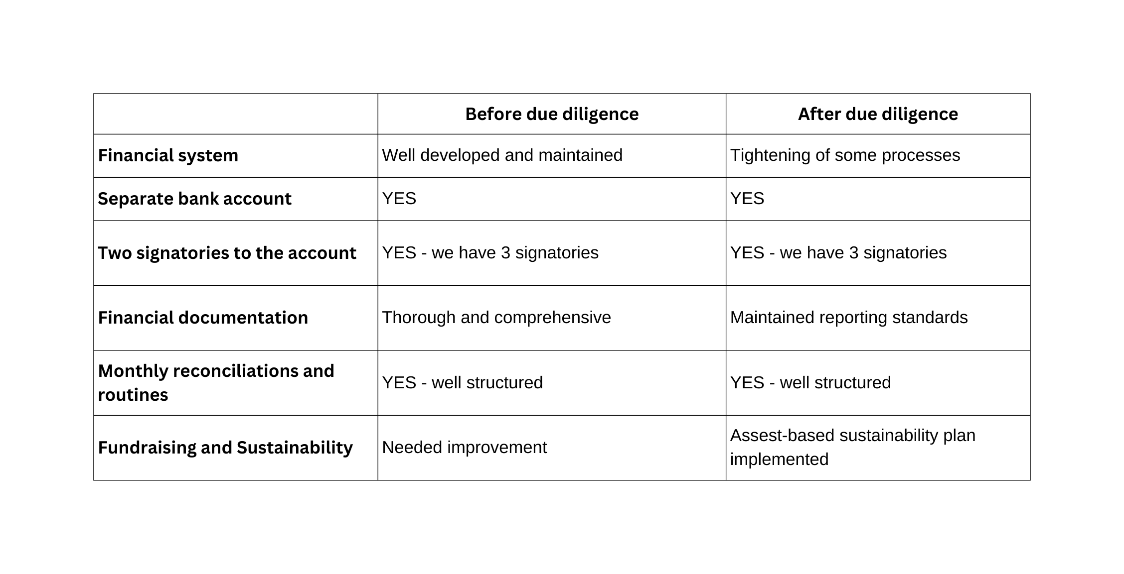
  Changes in Policy
What has changed in the following areas since working with Gender Links:

Slide 10
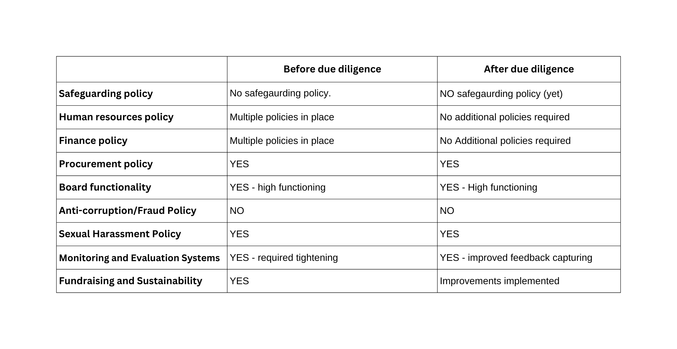
  Changes in Policy
What has changed in the following areas since working with Gender Links:

Slide 11


  Impact
Participant Voices
For the first time, I understand why my body reacts the way it does after hearing so many painful stories. Now I have tools to ground myself.
I realised I have been carrying other people’s trauma for years. Learning how to release that weight has changed how I approach my work.
These sessions helped our team speak openly about stress and support each other instead of pretending we are fine.”
230+ frontline responders supported
Reach into 4 provinces
21 organisations strengthened

Slide 12
  Impact
Individual Level:
  Improved emotional regulation
  Reduced burnout symptoms
  Increased trauma awareness
  Strengthened confidence in case management
Organisational Level:
  Improved staff retention
  Healthier team dynamics
  Better survivor engagement
  Increased resilience among frontline workers
Movement Level:
  Destigmatisation of mental health in GBV spaces
  Emergence of community facilitators
  This intervention strengthens the sustainability of the GBV movement by supporting those who carry its heaviest burden.

Slide 13
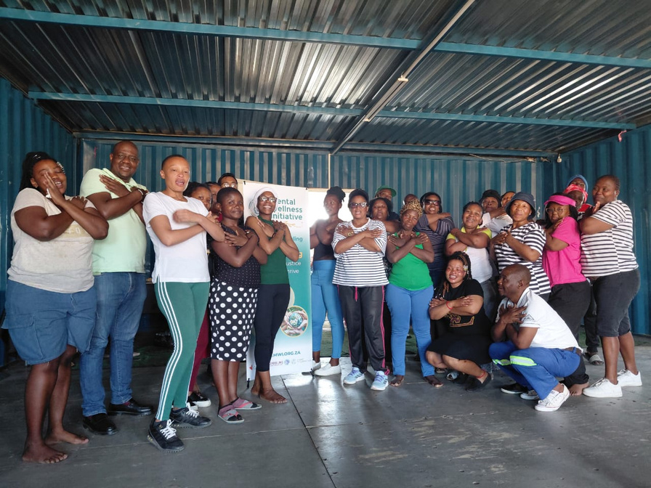
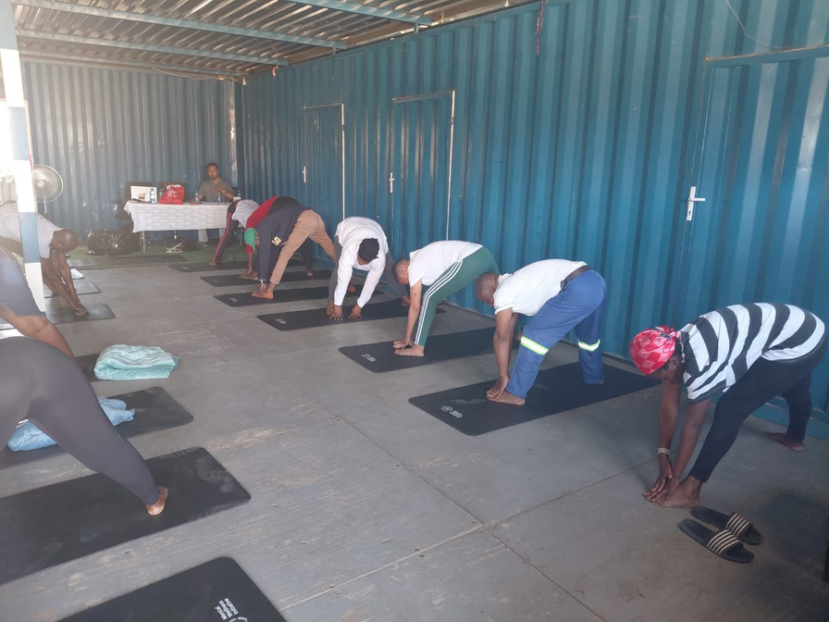
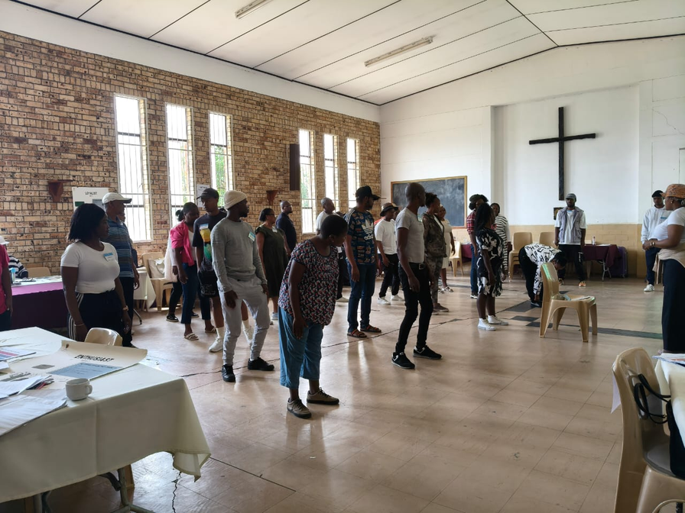
  Impact Images
Trauma release session with Meloding community, Free States
Hare-foleng Sechaba programme - Community healing programme in Virginia, Welkom.
Community healing workshops

Slide 14
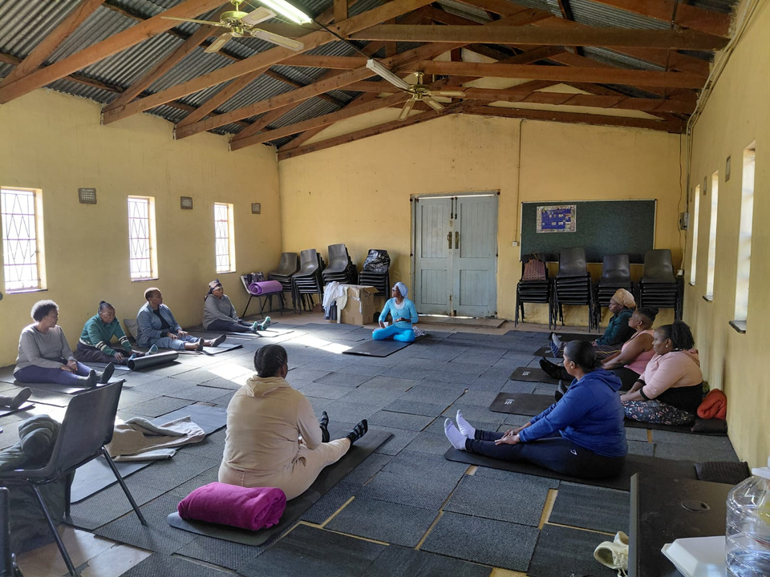
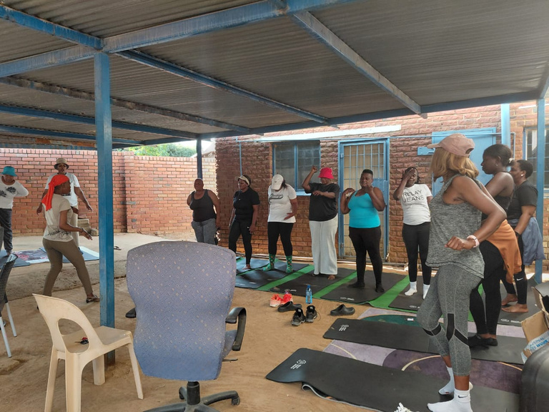
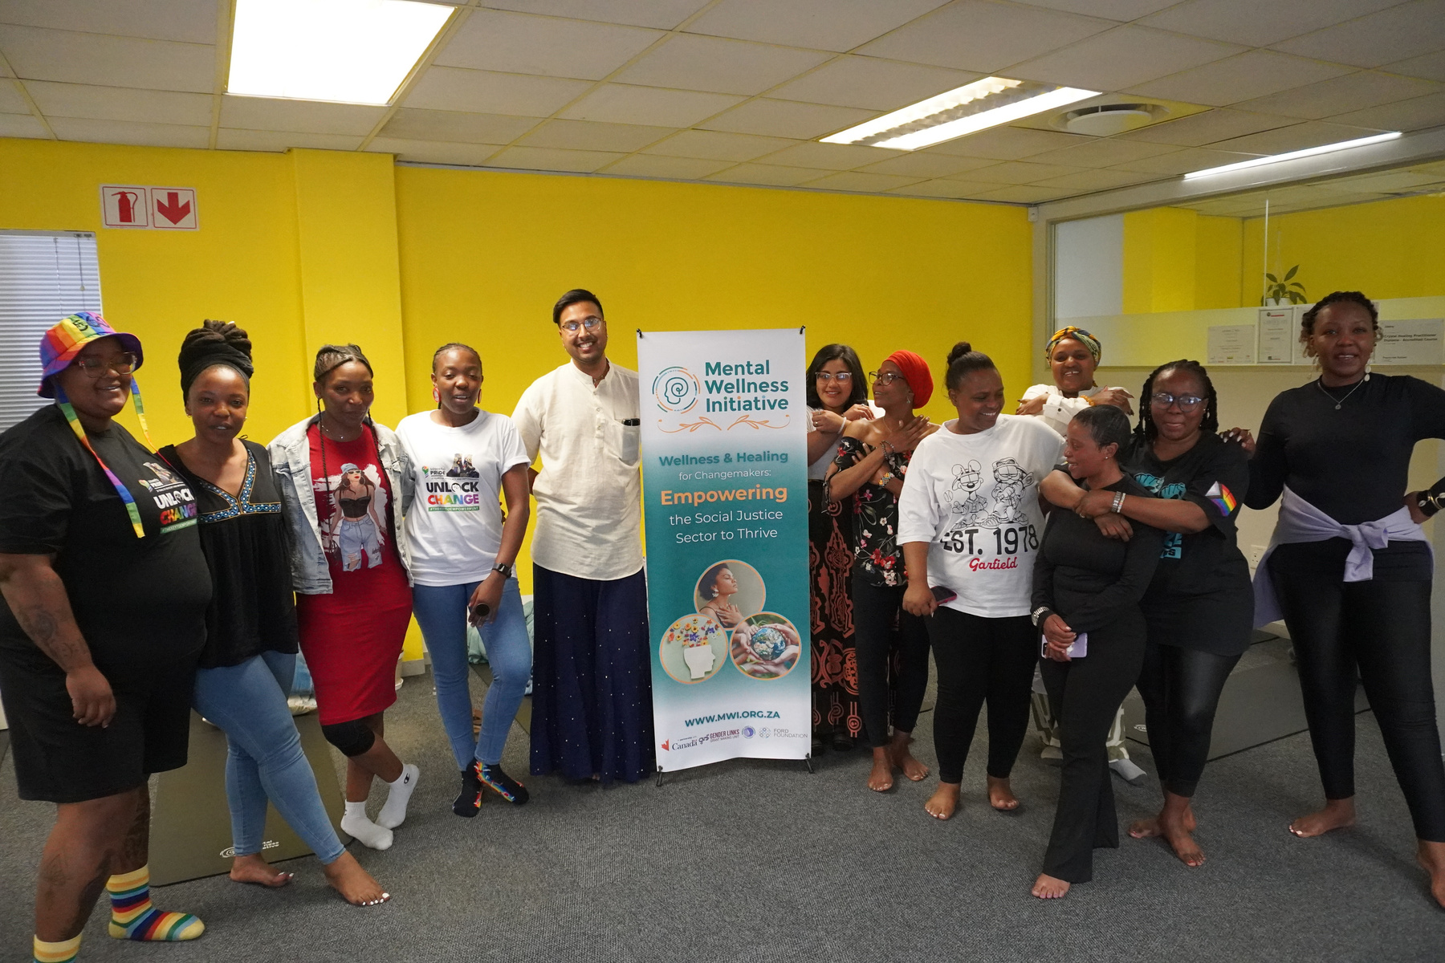
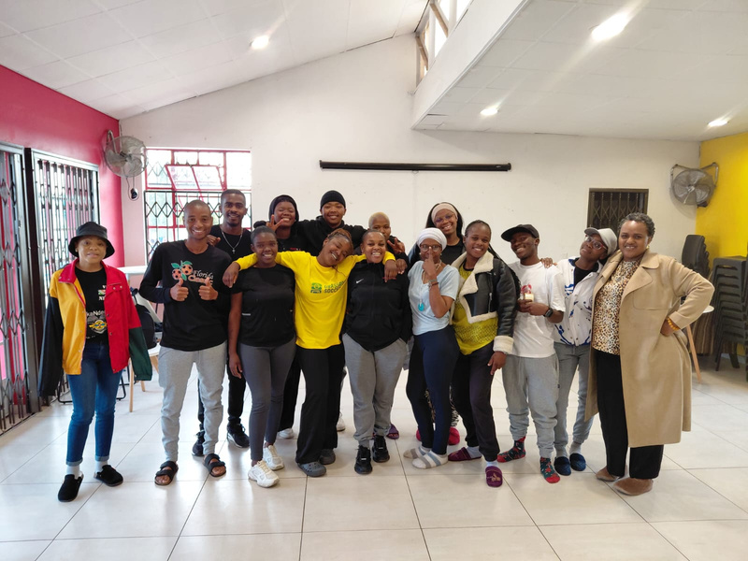
  Impact Images
Vuka-enough NPO is
based in Hammanskraal, they work with frontline workers within GBV space and Elderly people
Workshops with Grassroots soccer organisation, we haev a trauma recovery coaching programme with the youth.

Slide 15
  Challenges and lessons
Key Challenges:
  Scale constrained by available funding
  Participants struggling with transport costs
  High demand exceeding available resources
  Emotional intensity of sessions requiring careful facilitation
Lessons Learned:
  Mental wellness is foundational to effective GBV work
  Community-based responders deeply value safe healing spaces
  Somatic practices are powerful in low-resource settings
  Sustainable change requires long-term engagement
  The need for this programme is greater than initially anticipated.
  Facilitation team need direct containment after sessions

Slide 16
  Sustainability
Sustainability is supported through:
  Daily integration of healing tools into participant practice
  Ongoing relationships with partner organisations
  Development of a train-the-trainer model
  Strengthened internal planning and M&E systems
  Cross-department collaboration (programmes, finance, communications)
  Participants are now applying tools independently, creating peer-led healing spaces within their organisations.

Slide 17
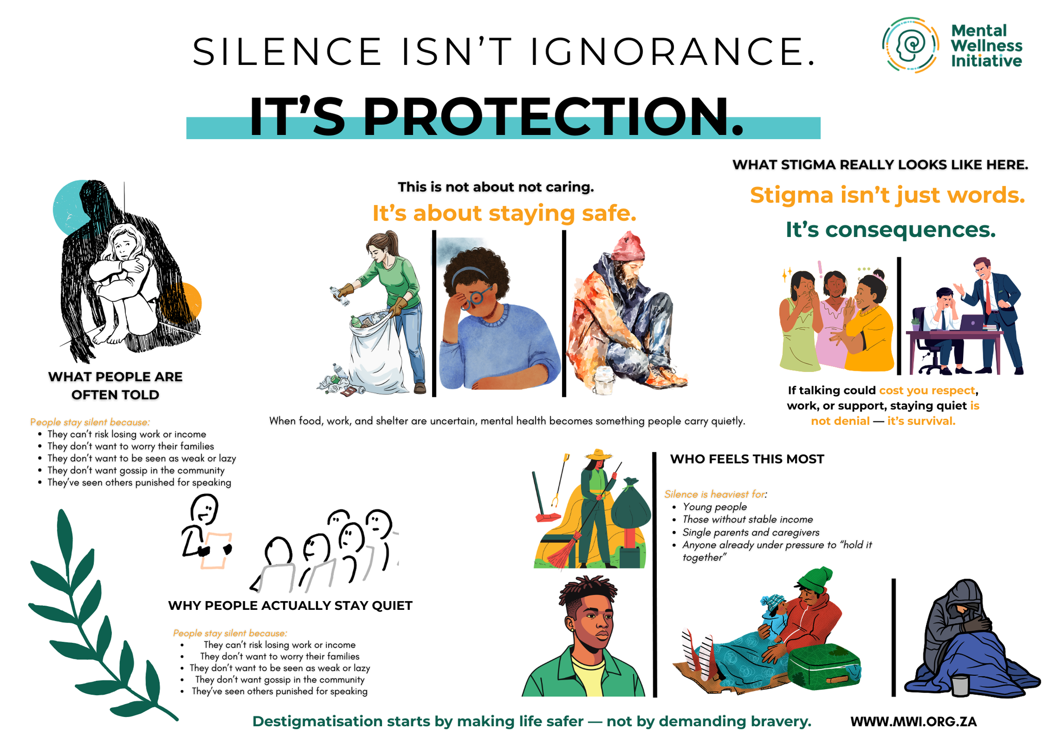
  Destigmatisation Campaign

Slide 18
  Goals for the Future
With continued support, MWI aims to:
  Expand reach to additional provinces
  Train community facilitators
  Reach 500+ frontline workers annually
  Institutionalise trauma-informed practice within GBV - responsive organisations
  Strengthen monitoring and evidence systems
  Advocate for mental wellness as core to GBV response policy
  The long-term goal is to build a decentralised, community-owned healing ecosystem within the GBV sector.
Supporting GBVF responders transforms communities.
When frontline workers are supported, survivors receive better care, organisations grow stronger, and the movement for gender justice becomes sustainable.

Slide 19

Get in touch with us
Segametsi Ditlhale
Community Engagement and Programmes Manager +27 81 513 1318
segametsid@mwi.org.za
www.mwi.org.za

