Slide 1







LEARNING
AND SHARING
SUMMIT 2025
Communications and reach
(South Africa, Johannesburg, 5 March 2025)
Women’s Voice and Leadership Learning and Sharing Summit 2025

Slide 2
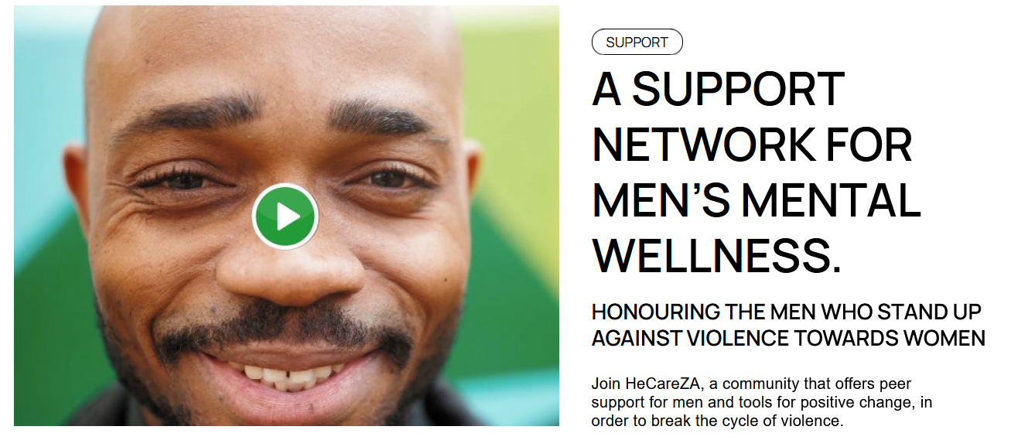
Planned objective
What key insights or results are anticipated for RWVL’s social media visibility?
Quarterly research deliverables to increase social media visibility by:
  Driving engagement on owned channels and accounts, supported by media releases
  Hosting webinars and interviews focused on each research report.
Social media visibility bolstered by addressing hurdles to participation identified through beneficiary feedback (i.e. data costs or peer group stigma), unlocking amplified reach and engagement
In person trainees to participate virtually and activate contact networks, scaling reach and deepening impact.
Women’s Voice and Leadership Learning and Sharing Summit 2025
Notes:
Renewed Women’s Voice and Leadership (RWVL).

Slide 3
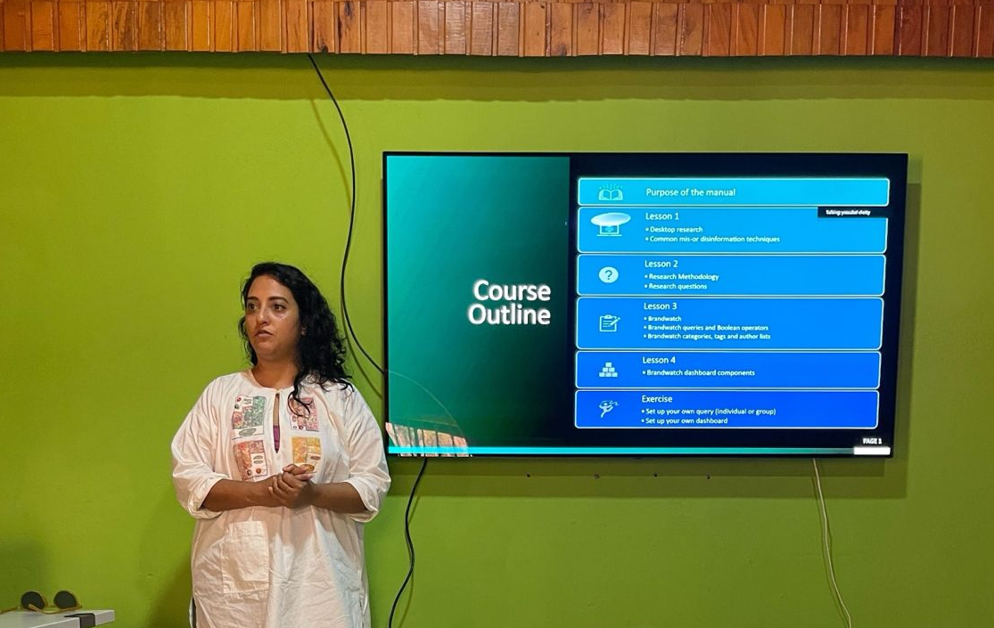

PARTNERS AND NETWORKS
Do you plan to work with other VCSA grantees? If so, which ones?
The CABC has a strong network in place with civil society and citizens and intends on expanding it exponentially by partnering with mission-aligned organisations including VCSA grantees particularly grassroots organisation partners to assist in facilitating in-person training.
We look forward to collaborating with any VCSA grantee interested in further developing the digital aspects of their work. Whether through accessing tech tools, leveraging research assets or in maximising social media content for reach and impact.
Women’s Voice and Leadership Learning and Sharing Summit 2025

Slide 4
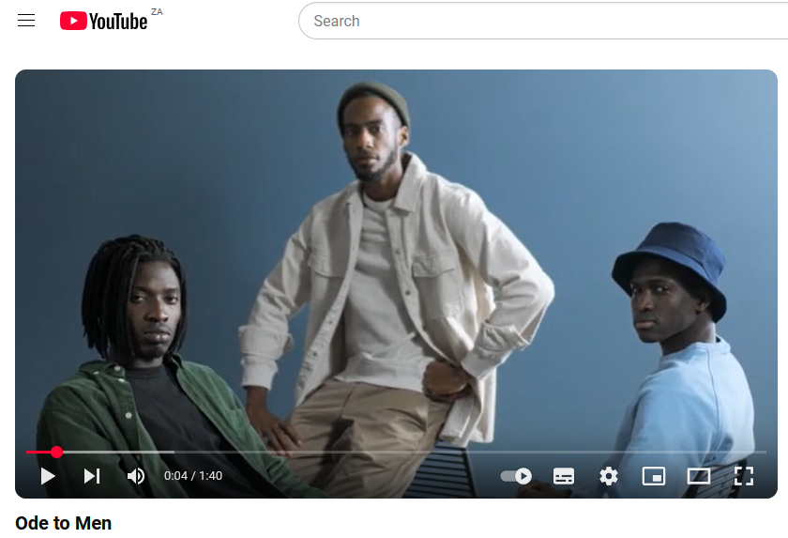
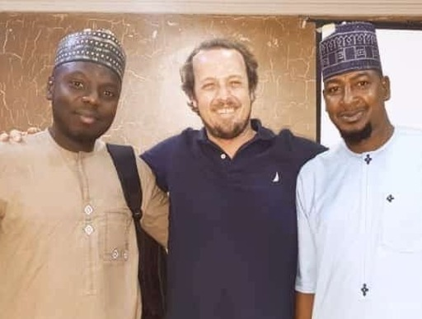
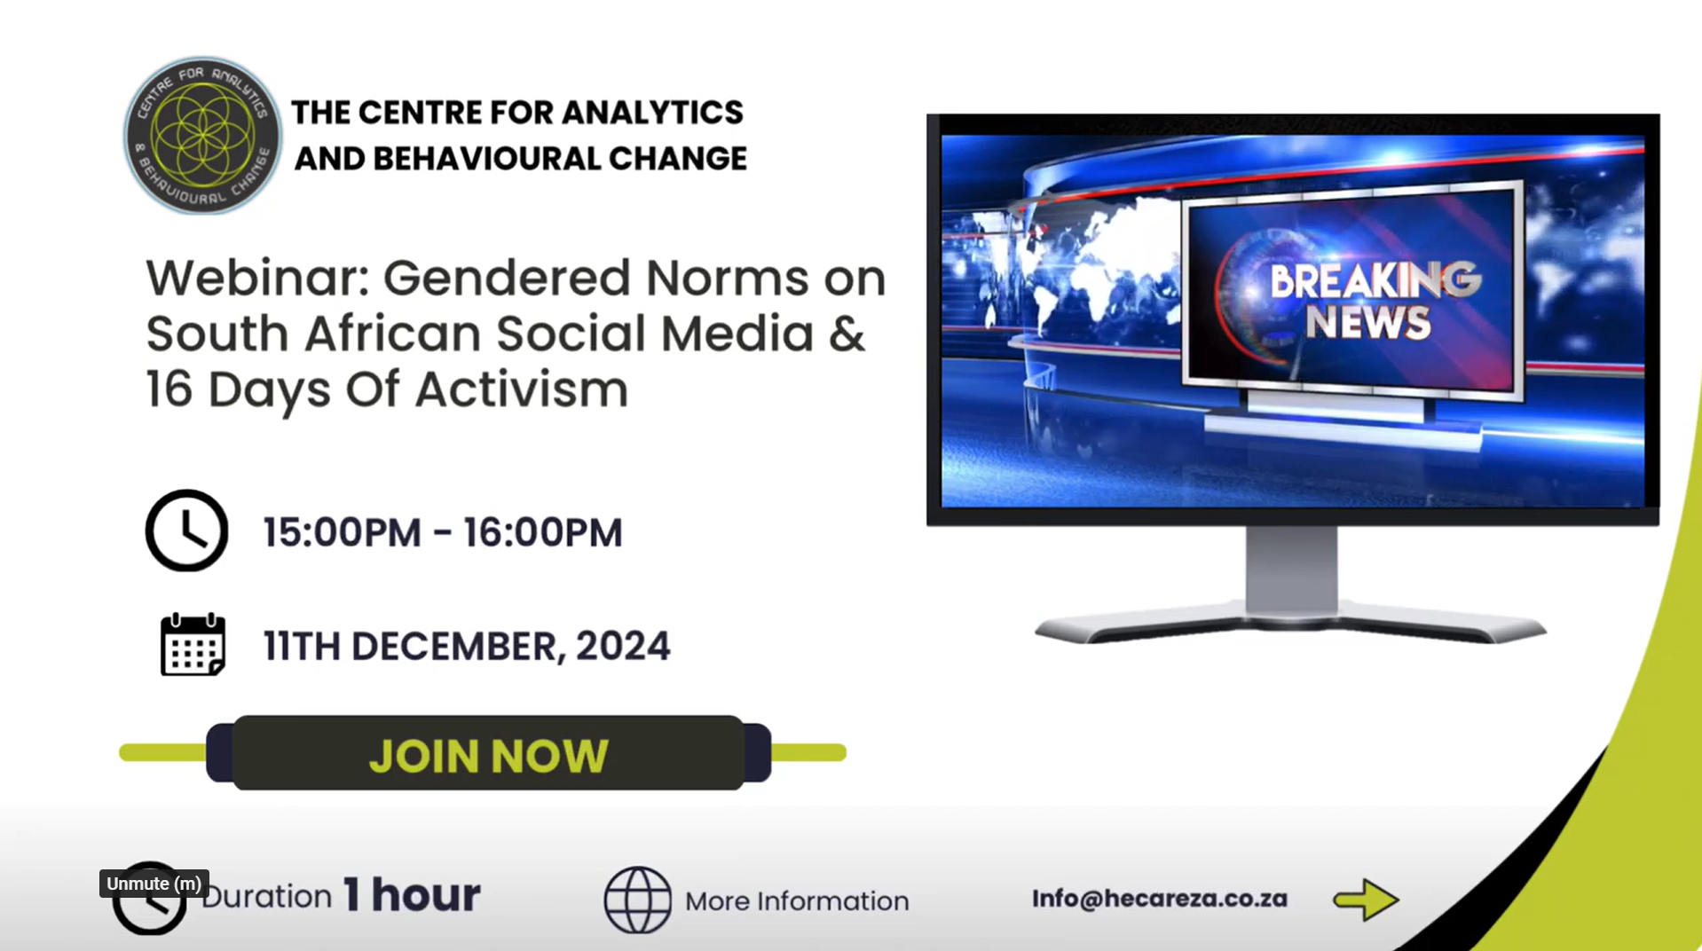
Will you build networks or alliances through your social media activities? If so, with whom?
The CABC intends on building and scaling our online training and current networks as well as explore avenues to remove access to barriers to participation to our online training such as data costs. We will leverage expertise in digital marketing to make training effective, accessible and engaging. Participants will be encouraged to recommend the program to friends and family, further building and expanding our networks.
Women’s Voice and Leadership Learning and Sharing Summit 2025

Slide 5
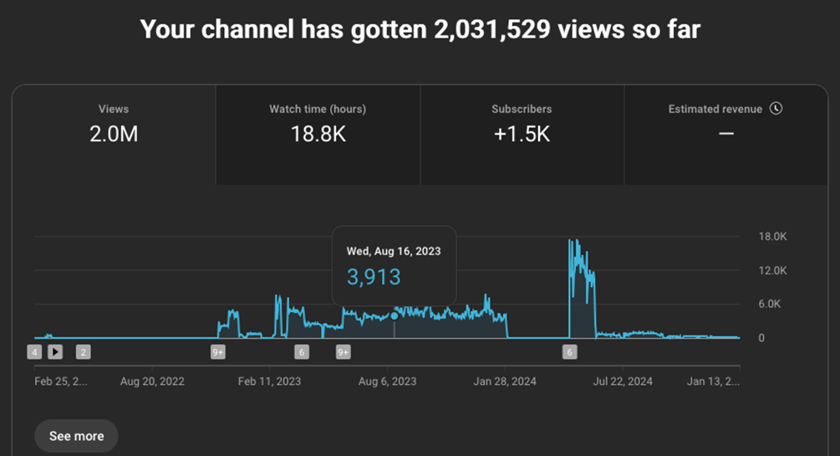
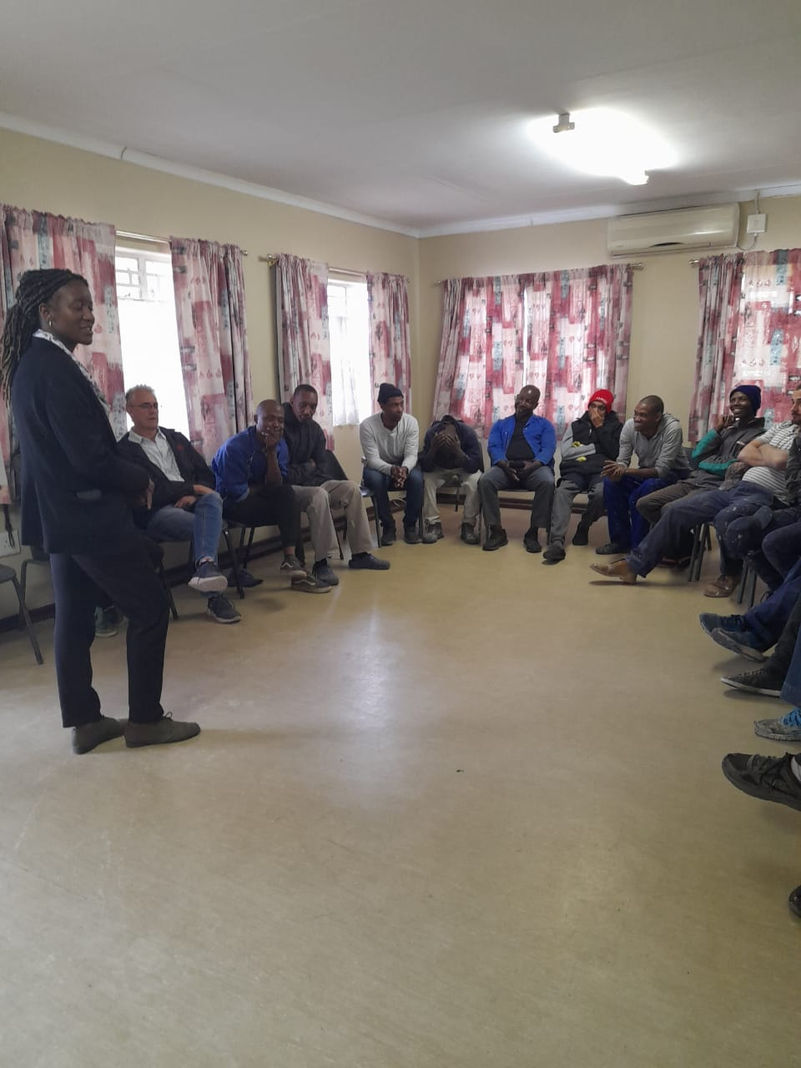
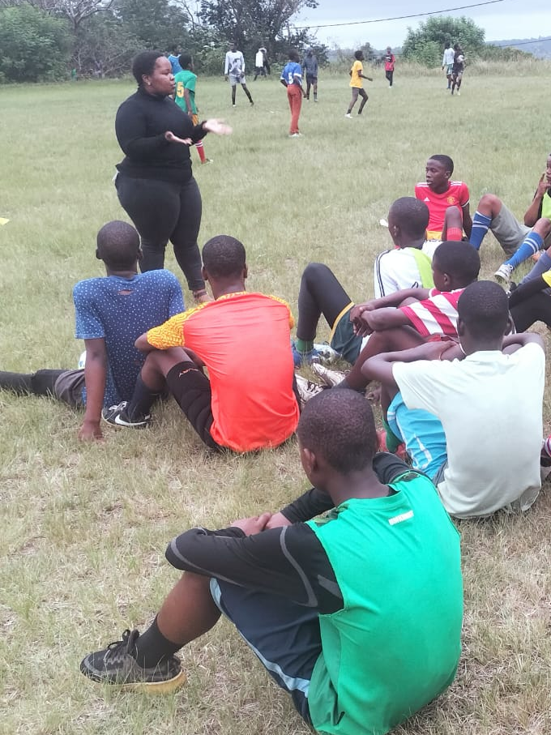
Expected Impact
What impact do you expect your social media activities to have?
We know structural inequality exists and is perpetuated digitally, our goal is to:
Increase nuanced online Gender Equality conversations reaching men and boys at scale
Connect individuals to organisations offering support and projects that aim to empower men to effect change
Increase participation from male allies in support of HeCareZA project and equality, both in person and online
Better prepare young South Africans to navigate harmful and gendered online spaces
Women’s Voice and Leadership Learning and Sharing Summit 2025

Slide 6
Followers | Before RWVL (Current) | Current (Projected)
Whatsapp group (HeCareZA) | 130 | 30% Increase
Facebook (CareZA Social) | +- 23 000 | 30% Increase
X (CABC) | 339 | 15% Increase
YouTube (CABC) | 39 | 50% Increase
Instagram (WeCareZA) | 391 | 50% Increase
Likes | Before RWVL (Current) | Current (Projected)
Facebook | +-23 000 | 50% Increase
X | +-138 | 50% Increase
YouTube | 25 | 15% Increase
Instagram | 524 (*Interactions) | 50% Increase
Women’s Voice and Leadership Learning and Sharing Summit 2025

Slide 7
Impressions (Reach) | Before RWVL | Current
Whatsapp group | +-3 members p/m | 70% Increase
Facebook | +- 2 800 000 | 50% Increase
X | 66 105 | 30% Increase
YouTube | 9,976 | 50% Increase
Instagram | +-149 400 | 40% Increase
Women’s Voice and Leadership Learning and Sharing Summit 2025

Slide 8
Anticipated Challenges
What challenges do you anticipate facing? How do you plan to overcome them?
  Online Training
    Data costs involved for participants to attend online training
    Retention of participants
  Offline Training
    Digital Literacy: The level of technological literacy of participants
    Cultural, religious, social or personal values that may conflict or lead to non-cooperation
What lessons do you expect to learn?
  Support Mechanisms: How to support individuals in continuing to apply the skills they’ve learnt
  Digital Literacy: Which igital literacy skills required to maximize efficacy of the training
  Cultural Context: Understanding the importance cultural contexts and nuance and addressing TFGBV
How do you plan to apply the lessons learned?
  Improving future training to account for lessons learned such as support mechanisms and digital literacy
  Adjusting content to account for different cultural contexts while maintaining the integrity and core outcome of training
  Fostering stronger and effective grassroots networks and iteratively improving to extend reach and deepen engagement
Women’s Voice and Leadership Learning and Sharing Summit 2025

Slide 9
NEXT STEPS
What will be your key priorities moving forward
  Develop and Design training manual
  Recruit interns
  Partnering with organisations for learning-exchange, cross-cutting interventions and areas for collaboration
  Identify key groups/organisations for training
  Publish TFGBV Research Report setting the groundwork for training.
Work plan
Women’s Voice and Leadership Learning and Sharing Summit 2025

