Slide 1
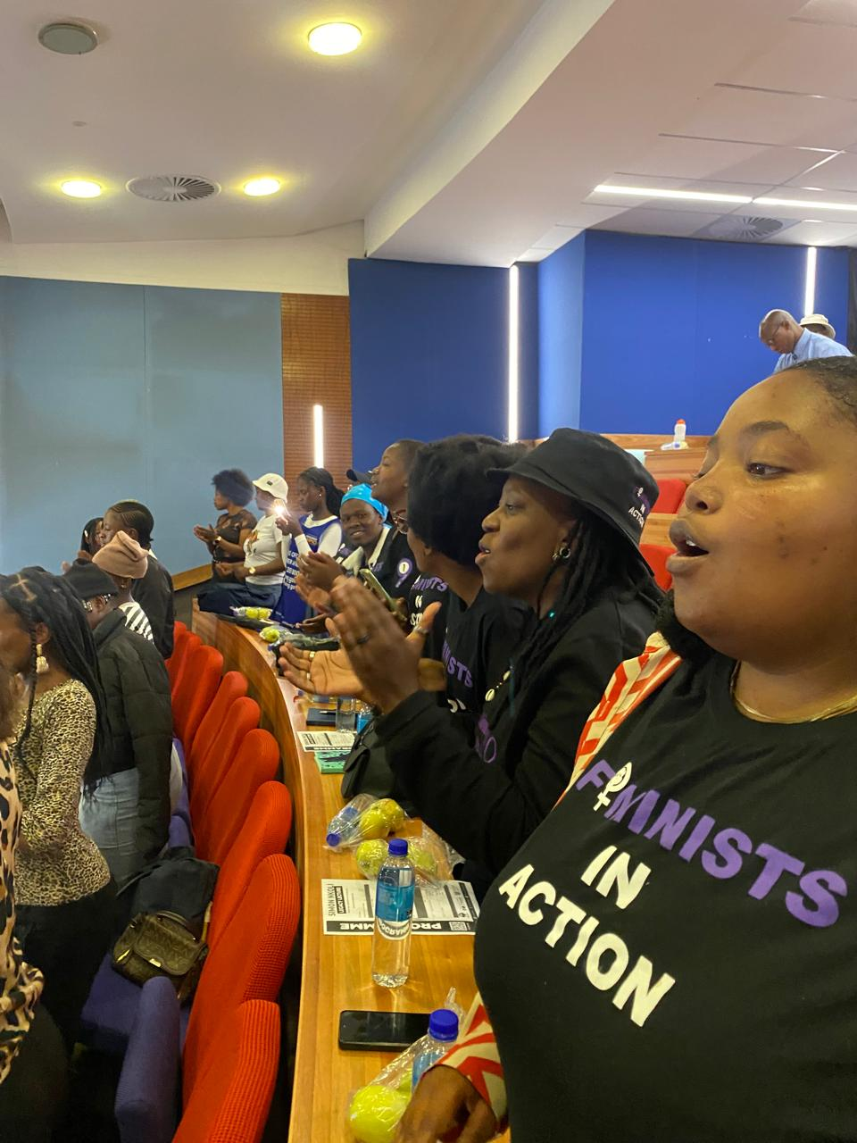


Voice and Choice​
Summit 2026-Story of Change Category
South Africa: Feminist Political Education Strengthens Inclusive GBVF Leadership
Boitumelo Tefo
One in Nine Campaign | RWVL/WOSSO Fellow
Voice and Choice Summit 2026 \ Voice and Choice Summit 2026

Slide 2
Synopsis– brief overview what this is about
Name | Boitumelo Tefo
Designation | Programmes Administrator Assisstant
Organisation | One in Nine Campaign
Country | South Africa
Category | Story of Change
Summary | This story highlights how feminist political education and inclusive advocacy strengthened leadership and advanced intersectional GBVF responses in South Africa, demonstrated through the transformation and impact of activist Thabsie Mabezane and Pearl Xakoshe
Voice and Choice Summit 2026 \ Voice and Choice Summit 2026

Slide 3
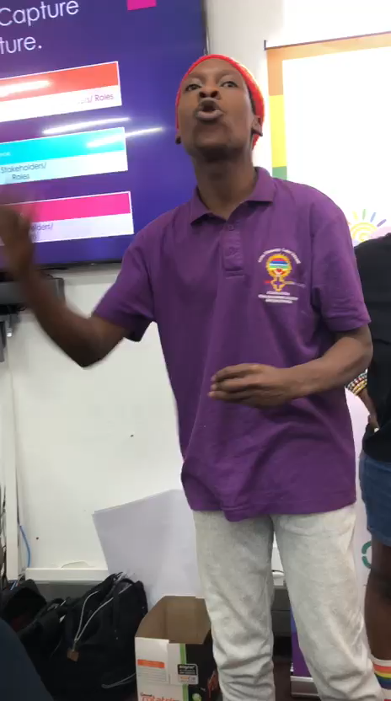
Background(problem, actions, change, evidence)
Context
South Africa faces a severe gender-based violence crisis.
The Gap
Marginalised survivors particularly LBTQI+ persons remain excluded from GBVF policy, shelters, and protection systems.
My Action
Developed and implemented an intersectional feminist advocacy plan focused on political education, inclusive policy engagement, and narrative shifting.
The Change
Leaders like Thabsie Mabezane strengthened their systems analysis, shifted from reactive activism to strategic feminist leadership, and influenced more inclusive GBVF responses.
Voice and Choice Summit 2026 \ Voice and Choice Summit 2026

Slide 4
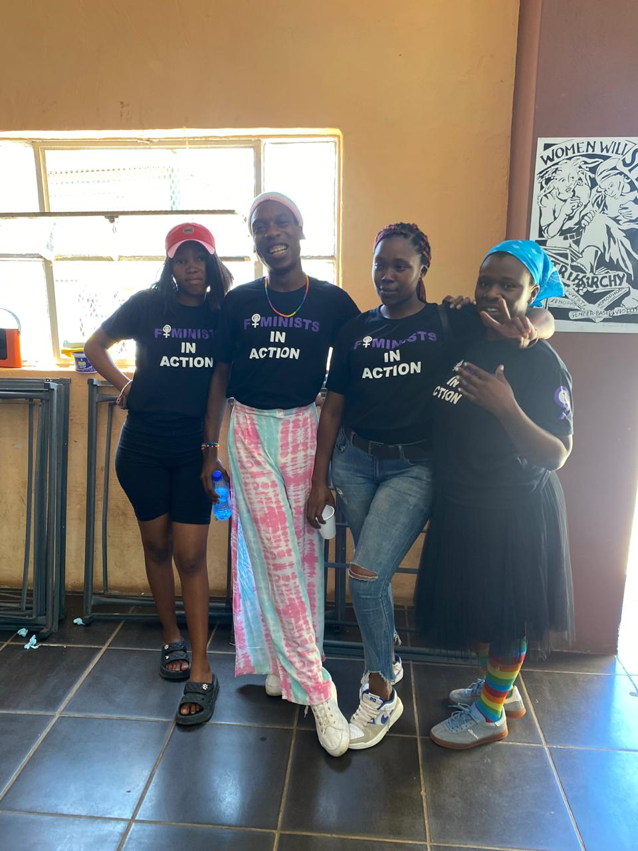
Background
Project Context & Foundation
Context / Problem
South Africa’s GBVF response often excludes LBTQI+ survivors from policy design, shelters, and social protection systems.
Key Objectives
• Centre marginalised survivors in GBVF advocacy
• Strengthen intersectional feminist leadership
• Influence inclusive shelter and policy frameworks
• Shift national GBVF narratives
Situation Before
GBVF responses were largely reactive, with limited intersectional systems analysis and inconsistent inclusion of LBTQI+ persons.
Organisation Behind the Project
One in Nine Campaign's feminist movement-building and political education.
Voice and Choice Summit 2026 \ Voice and Choice Summit 2026

Slide 5
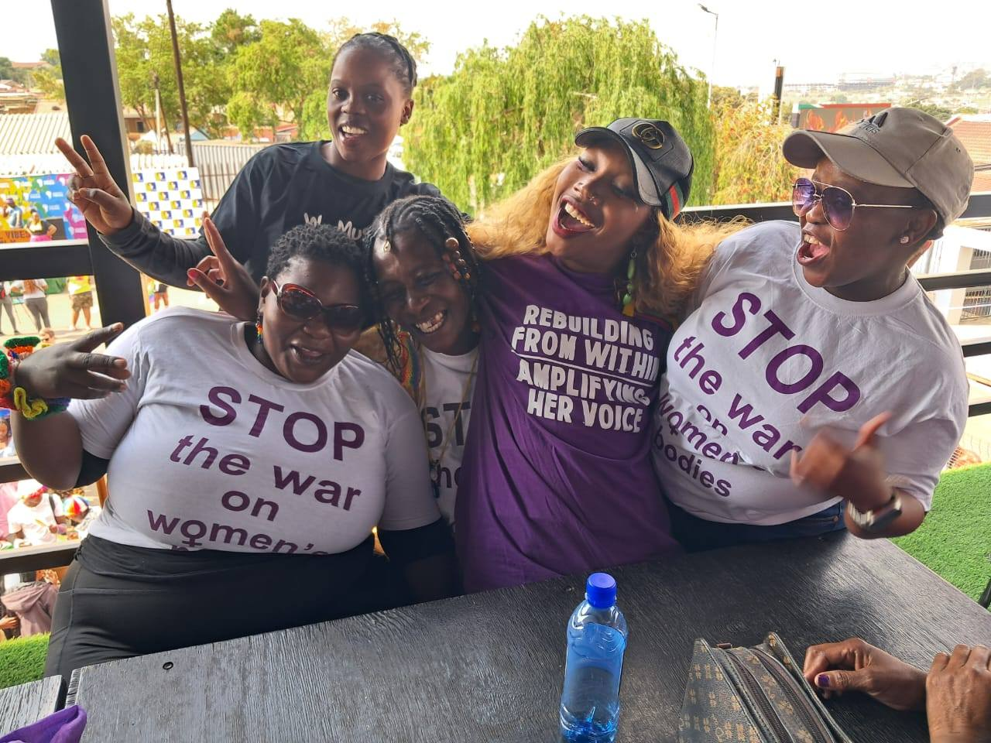
Context
Location
South Africa, Gauteng in the Vaal community with advocacy engagement at community levels.
Who Was Most Affected
LBTQI+ survivors of gender-based violence and displacement particularly focusing on lesbian, bisexual, transgender, and gender-diverse persons excluded from shelters and protection systems.
How They Were Affected
• Denied or unsafe shelter access
• Exclusion/ lack of urgency within GBVF policy enforcement
• Stigma and discrimination in response systems
• Limited recognition within social protection frameworks
Issues Addressed
• Structural exclusion in GBVF responses
• Lack of intersectional feminist systems analysis
• Invisibility of marginalised survivors in policy and practice
Voice and Choice Summit 2026 \ Voice and Choice Summit 2026

Slide 6
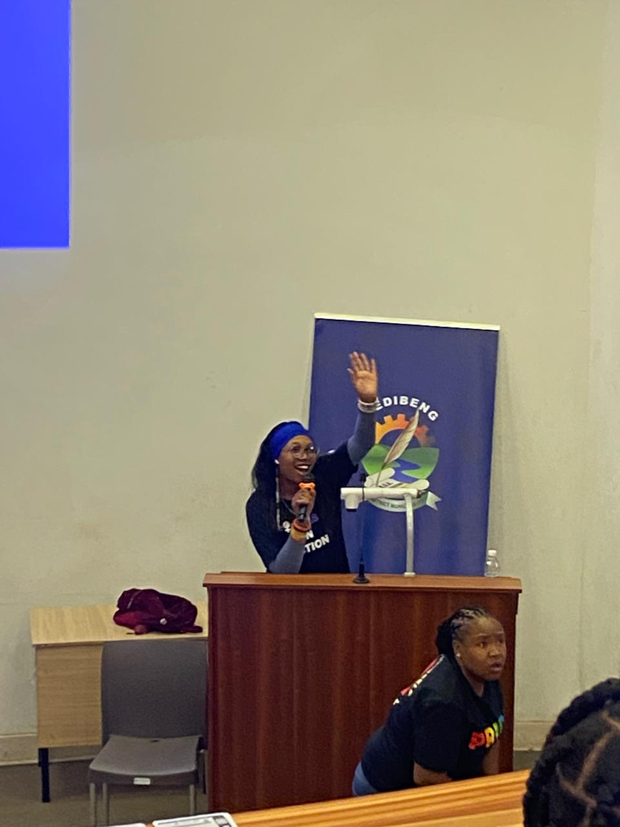
Actions
How the Change Came About
Activities & Actions
• Structured feminist political education sessions
• Intersectional systems analysis workshop
• Healing-centred leadership dialogue
• Arts-based advocacy and narrative shifting
• Policy engagement on inclusive shelter frameworks
Leadership & Participation
• Led by Boitumelo Tefo through her advocacy model
• Implemented within One in Nine Campaign spaces
• Actively engaged by Thabsie Mabezane, Pearl Xakoshe and other LBTQ participant and co-creators
• Supported by One in Nine Campaign
Voice and Choice Summit 2026 \ Voice and Choice Summit 2026

Slide 7
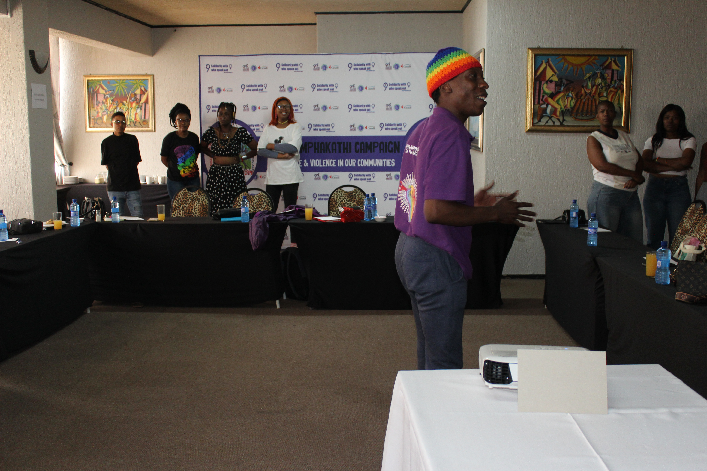
The change – impact
What Changed
Strengthened intersectional feminist leadership and increased inclusion of LBTQI+ survivors within GBVF advocacy and policy engagement.
When & Where
During structured feminist political education processes within One in Nine Campaign spaces in South Africa with ripple effects into community and national policy spaces.
Nature of the Change
Positive and transformative.
Who Benefited & How
• Thabsie Mabezane — strengthened systems leadership and policy engagement
• Community members — more inclusive GBVF dialogue
• Marginalised survivors — greater visibility in advocacy spaces
Situation Now
Intersectional analysis informs advocacy practice, inclusive policy conversations have strengthened, and leadership capacity has expanded beyond individual activism into systems change.
Voice and Choice Summit 2026 \ Voice and Choice Summit 2026

Slide 8
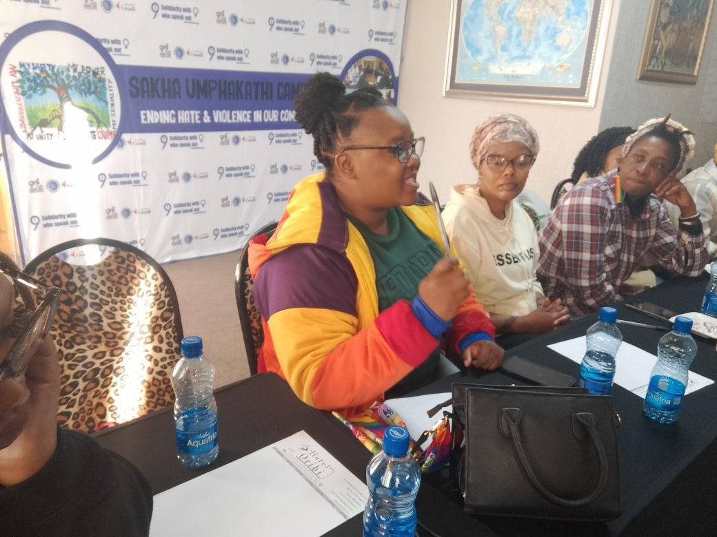
Significance of the Change
What This Change Means for the Movement
• Demonstrates that intersectional feminist political education produces systems-level leadership
• Strengthens inclusion of LBTQI+ survivors within GBVF advocacy
• Reinforces that justice must be structurally transformative — not symbolic
Effect on Next Steps
• Scaling structured feminist political education models
• Deepening inclusive policy engagement on shelters and protection systems
• Mentoring emerging feminist leaders
• Expanding cross-movement collaboration across African contexts
Voice and Choice Summit 2026 \ Voice and Choice Summit 2026

Slide 9
Beneficiaries
 | Number of participants
Female – Direct beneficiaries | 110
Male – Direct beneficiaries | 45
Female – Indirect beneficiaries (e.g. through other networks) | 700+
Male – Indirect beneficiaries (e.g. through other networks) | 350+
Female – Online beneficiaries (e.g. website access, mailing lists, scholarly articles) | 1905
Male – Online beneficiaries (e.g. website access, mailing lists, scholarly articles) | 290
Total | 3400+
Voice and Choice Summit 2026 \ Voice and Choice Summit 2026

Slide 10
Challenges & Lessons learnt
Challenges & mitigation
Key Challenges
• Resistance to trans-inclusive feminist frameworks
• Institutional slow pace in policy reform
• Limited resources for sustained political education
• Emotional fatigue within GBVF movement spaces
Mitigation Strategies
• Strengthened intersectional feminist grounding to address resistance
• Built strategic relationships within policy spaces
• Integrated arts-based and healing-centred approaches to sustain engagement
• Leveraged movement partnerships for collective support
Lessons
• Intersectional feminist political education is essential for sustainable movement leadership.
• Inclusive GBVF responses must intentionally centre marginalised survivors to be effective.
• Arts, healing, and storytelling are powerful tools for shifting narratives and sustaining activism.
• Collective leadership strengthens movements and ensures long-term systemic change.
Voice and Choice Summit 2026 \ Voice and Choice Summit 2026

Slide 11
Sustainability
Sustainability Measures
• Continued feminist political education within movement spaces
• Strengthened networks between activists, community organisations, and policy actors
• Integration of arts-based advocacy to sustain engagement and narrative change
Scaling the Work
• Expand inclusive GBVF advocacy to broader community and national platforms
• Mentor and support emerging feminist leaders
• Share tools and political education models across African activist spaces
• Strengthen policy engagement for inclusive shelter and protection systems
Voice and Choice Summit 2026 \ Voice and Choice Summit 2026

Slide 12
Next Steps
Continue
Continue community dialogues with young women and girls on Gender, Sexuality, SRHR, and GBV.
Strengthen
Strengthen partnerships with civil society organisations and community leaders.
Use
Use digital platforms and storytelling to expand access to information and amplify youth voices.
Document
Document impact and lived experiences to inform advocacy and future programming.
Advocate
Advocate for youth-inclusive policies and survivor-centred GBV responses.
Support
Support young women and girls to become peer educators and community advocates.
Voice and Choice Summit 2026 \ Voice and Choice Summit 2026

