Slide 1


Attitudes towards Women’s Political Participation in Southern Africa
November 2024

Slide 2

What is the attitudes towards Women’s Political Participation in Southern Africa Scale?
15 question survey to gauge attitudes towards women’s political participation
Gender Links developed this survey to better understand different attitudes towards women’s political participation
Includes questions on traditional gender roles and leadership perceptions, barriers and challenges to political participation, support for gender equality and recognition of women’s impact, and media representation and public perception in relation to women’s political participation
Gathered comprehensive insights from a total of 20,959 respondents across 16 countries
The survey covered 16 countries in Southern Africa, including South Africa, Mozambique, Madagascar, the Democratic Republic of the Congo (DRC), Angola, Tanzania, Malawi, Zimbabwe, Zambia, the Comoros Islands, Botswana, Lesotho, Eswatini, Namibia, Mauritius, and Seychelles

Slide 3
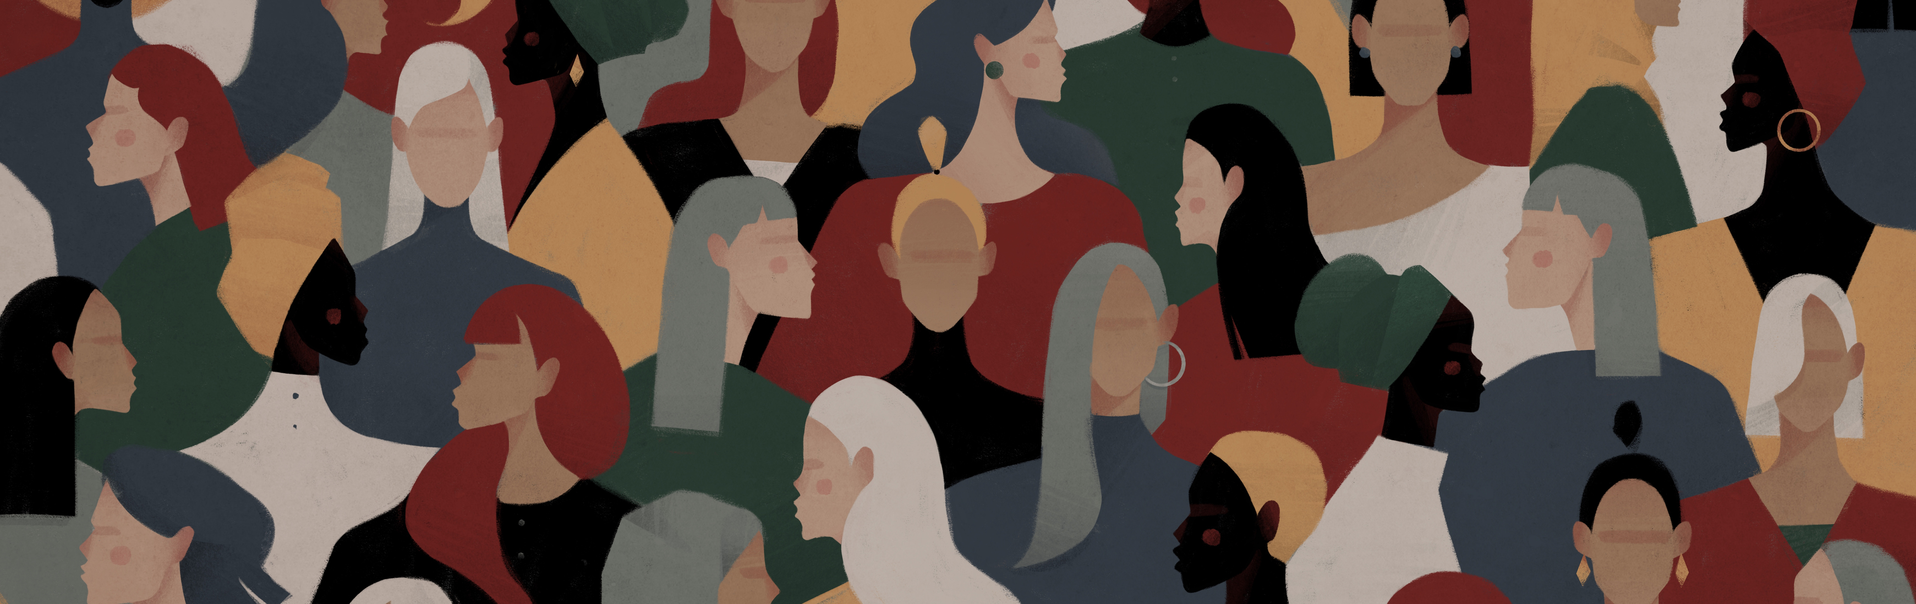
sample

Slide 4
sample
Total sample | 20,959
Living with a disability | 7%
Notes:
The “Attitudes toward Women’s Political Participation in Southern Africa” survey gathered comprehensive insights from a total of 20,959 respondents across 16 countries.
The survey sample was relatively balanced across gender, with 54.8% female respondents, 45% male, and a small minority (0.2%) identifying as another sex or gender identity.
The age distribution was also diverse: the largest age group, 26-40 years, comprised 33% of respondents, followed by 18-25-year-olds at 23%, and the 41-50 age group at 21%. Older age groups, 51-60 and 60+, represented 11% and 6% of the sample, respectively, while respondents under 18 accounted for 6%.
Education levels varied, with 41% having tertiary education, 30% secondary school, 13% vocational education, 9% adult literacy, and 8% primary school education. Additionally, 7% of respondents indicated living with a disability, with the majority experiencing physical or sensory impairments.

Slide 5
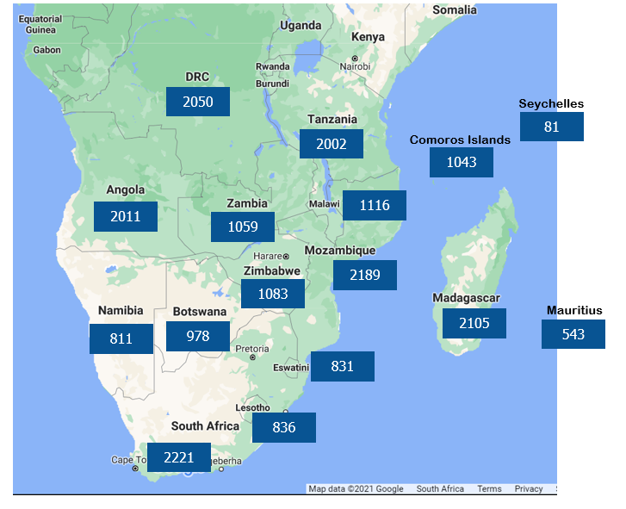
sample
Total sample | 20,959
South Africa had the highest number of responses at 2,221, followed closely by Mozambique with 2,189 and Madagascar with 2,105.
The Democratic Republic of the Congo (DRC) and Angola also had significant participation, with 2,050 and 2,011 entries, respectively.
In contrast, smaller island nations like Seychelles recorded fewer responses, with 81 entries, while Mauritius had 543.
Notes:
The “Attitudes toward Women’s Political Participation in Southern Africa” survey gathered comprehensive insights from a total of 20,959 respondents across 16 countries.

Slide 6
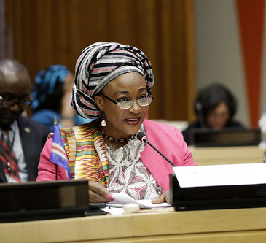
Overall attitudes toward women's political participation

Slide 7
Overall scores
The overall average score of 63 indicates a generally positive attitude toward women's political participation in Southern Africa. This average suggests that while there is substantial support for gender equality in politics, there are still areas where attitudes could be improved.
Average score | 63
On average, women have a more positive view, scoring 66 out of 100, with scores ranging from a minimum of 18 to a maximum of 100.
Men, on the other hand, have a slightly lower average score of 60, with a broader range spanning from 0 to 100, indicating more variability in their attitudes.
Respondents who identify as another sex or gender identity show the highest average score of 67, with a narrower range from 33 to 100, suggesting a generally more supportive stance.

Slide 8
Most encouraging findings
Encouragingly, the survey revealed broad recognition of the value of women in politics. 70% of respondents agreed that “Having women in politics makes a positive difference to society,” reflecting a societal shift toward gender inclusivity.
There was also an acknowledgement of the challenges women in politics experience, with 66% of respondents agreeing that “Women in politics experience more gender-based violence compared to men”.
Furthermore, there is substantial agreement (65%) on the necessity of legislated quotas for women in politics to achieve gender balance.
70%
Agreed or strongly agreed with the statement:
Women in politics experience more gender-based violence compared to men
65%
Agreed or strongly agreed with the statement:
Having women in politics makes a positive difference to society
Agreed or strongly agreed with the statement:
It is necessary to have legislated quotas for women in politics to bring about gender balance
66%

Slide 9
Areas in need of focus
46%
Agreed or strongly agreed with the statement:
Women do not have the same chance of being elected to political office as men
59%
The survey reveals that 43% agree that “Women do not have the same chance of being elected to political office as men” and 46% believe that “Political parties are more likely to nominate women for seats in which they are less likely to win.”
These responses highlight structural and institutional barriers that require policy reforms and efforts to create a level playing field for women in politics.
59% feel that “The media is often unfair in its coverage of women in politics,” suggesting the need for media accountability and training to ensure fair and unbiased reporting.
Agreed or strongly agreed with the statement:
Political parties are more likely to nominate women for seats in which they are less likely to win
Agreed or strongly agreed with the statement:
The media is often unfair in its coverage of women in politics
43%

Slide 10
Agreement with each statement
 | Agreed or Strongly Agreed
Having women in politics makes a positive difference to society​​ | 70%
Politicians should be treated the same whether they are male or female​​ | 69%
Women in politics experience more gender based violence compared to men​​ | 66%
It is necessary to have legislated quotas for women in politics to bring about gender balance​​ | 65%
​Female politicians are threatened and insulted on social media more than male politicians​ | 62%
If there was a choice between a female and a male politician with the same experience, the sex of the politician makes no difference​​ | 60%
The media is often unfair in its coverage of women in politics​​ | 59%
Women generally have less resources for political campaigns​​ | 58%
The media is more interested in how women in politics dress and look than is the case with men in politics​​ | 58%
Political parties are more likely to nominate women candidates for seats in which they are less likely to win than is the case for men​​ | 46%
Women do not have the same chance of being elected to political office as men​​ | 43%
A woman needs permission from her family to take part in politics​​ | 38%
Men are better political leaders than women​​ | 35%
Women should take care of the home not venture into politics​​ | 20%
Women have no interest politics | 18%

Slide 11
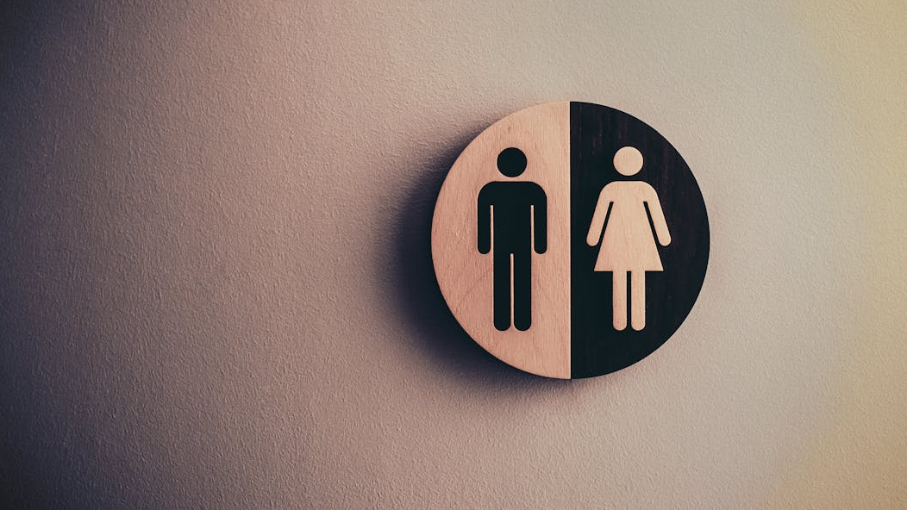
attitudes toward women's political participation by sex

Slide 12
Main differences by sex
Female
15%
Male
26%
Female
30%
Male
41%
Female
70%
Male
59%
Agreed or strongly agreed with the statement:
Women should take care of the home, not venture into politics
Agreed or strongly agreed with the statement:
Men are better political leaders than women
Agreed or strongly agreed with the statement:
It is necessary to have legislated quotas for women in politics to bring about gender balance
The perception of male leadership superiority also remains an issue. 41% of men believe that “Men are better political leaders than women,” compared to 30% of women. This difference highlights a gender gap in the perception of leadership capabilities, emphasizing the need for continued efforts to showcase and promote successful female leadership examples.
While 70% of women felt that “It is necessary to have legislated quotas for women in politics to bring about gender balance,” only 59% of men felt the same.
Some traditional and gender-biased attitudes persist, especially among men. 26% of men believe that “Women should take care of the home, not venture into politics,” while only 15% of women share this view.

Slide 13
Agreement with each statement by sex
 | Agreed or Strongly Agreed
 | Female | Male
Women have no interest politics | 15% | 22%
Women should take care of the home not venture into politics | 15% | 26%
Women do not have the same chance of being elected to political office as men | 43% | 43%
A woman needs permission from her family to take part in politics | 34% | 42%
Political parties are more likely to nominate women candidates for seats in which they are less likely to win than is the case for men | 49% | 44%
Men are better political leaders than women | 30% | 41%
Politicians should be treated the same whether they are male or female | 70% | 67%
If there was a choice between a female and a male politician with the same experience, the sex of the politician makes no difference​ | 63% | 57%
It is necessary to have legislated quotas for women in politics to bring about gender balance | 70% | 59%
Having women in politics makes a positive difference to society | 74% | 66%
Women generally have less resources for political campaigns | 61% | 54%
Women in politics experience more gender-based violence compared to men | 69% | 61%
The media is more interested in how women in politics dress and look than is the case with men in politics | 61% | 54%
The media is often unfair in its coverage of women in politics | 63% | 55%
Female politicians are threatened and insulted on social media more than male politicians | 65% | 59%

Slide 14
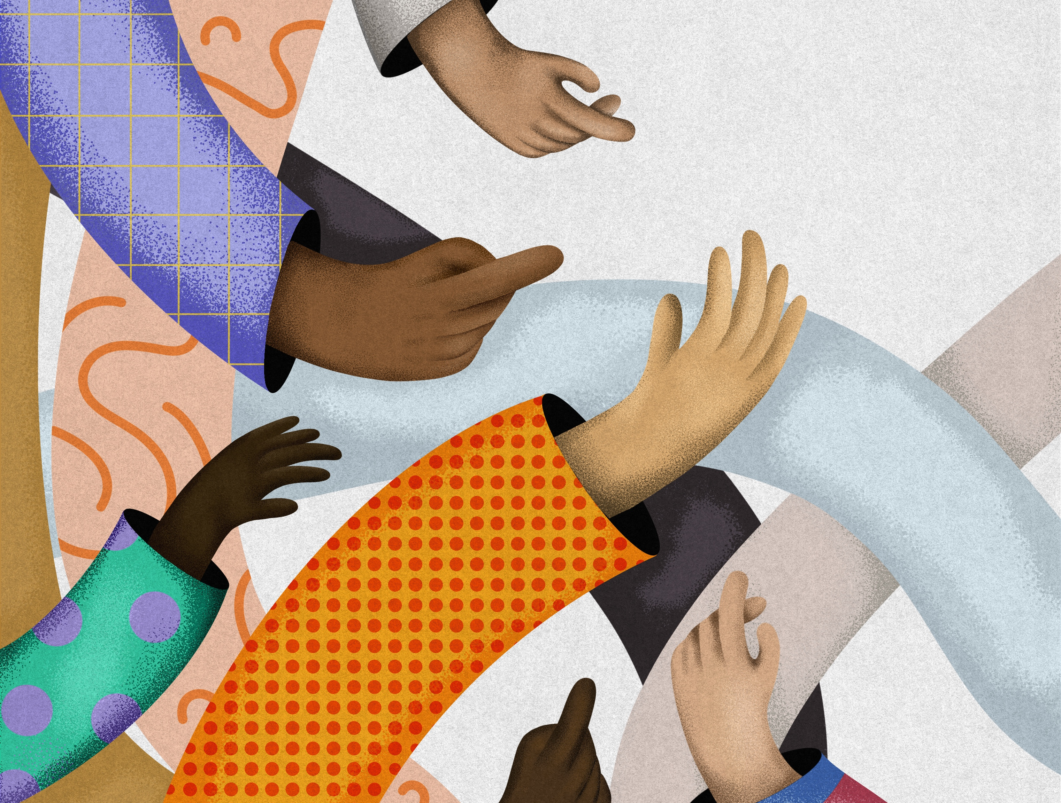
attitudes toward women's political participation by AGE GROUP

Slide 15
Overall scores by age group
Respondents aged 41-50 show the most supportive attitudes, with an average score of 65.
The 51-60 age group follows closely with a score of 64, indicating strong support as well.
Both the 26-40 and 60+ age groups have an average score of 63, reflecting moderately positive views.
Respondents aged 18-25 have a slightly lower score of 62, suggesting a somewhat less favourable but still supportive attitude.
The youngest group, those under 18, scored the lowest at 59, indicating that younger respondents may have more traditional or less developed views on women's roles in politics.
Overall, support tends to be highest among those aged 41-60, with slight declines in both younger and older groups.

Slide 16

attitudes toward women's political participation by level of education

Slide 17
Overall scores by level of education
The survey results indicate a clear relationship between education level and support for women’s political participation.
Respondents with tertiary education have the highest average score of 66, suggesting that higher educational attainment is associated with more supportive attitudes toward gender equality in politics.
Those with secondary school education score slightly lower at 62, followed by individuals who completed adult literacy programs, who have an average score of 61.
Respondents with primary school education and vocational education have the lowest scores, both at 59, indicating less favourable views compared to those with higher educational qualifications.
These findings highlight that individuals with higher levels of education are generally more supportive of women’s involvement in politics, while those with lower levels of education may hold more traditional or less progressive views.

Slide 18
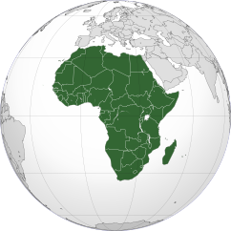
attitudes toward women's political participation by country

Slide 19
Results by country
The wide range of scores across these countries illustrates the diverse landscape of gender attitudes in Southern Africa. The high scores in Mozambique, Zimbabwe, and Botswana are promising, indicating that progress is being made in certain areas. However, the lower scores in countries like Lesotho, Namibia, and Angola highlight the persistent need for gender-sensitive policies, increased representation of women in politics, and awareness campaigns to challenge traditional gender norms.
The findings underscore the importance of a tailored approach to promoting gender equality in politics. In countries with higher scores, efforts should continue to sustain and build on existing support. In contrast, nations with lower scores may benefit from interventions such as education initiatives, leadership training for women, and advocacy efforts aimed at shifting cultural attitudes and creating more inclusive political environments.

Slide 20
conclusion
The survey on attitudes toward women’s political participation in Southern Africa provides a comprehensive look at the region's progress and remaining challenges.
With 20,959 responses collected across 16 countries, the survey highlights a general trend toward supporting gender equality in politics, but it also reveals significant areas needing improvement.
Women generally show more supportive attitudes than men, with notable gender-based differences in views on leadership and gender roles.
The data also emphasize disparities across educational levels and age groups, with higher educational attainment correlating with greater support for women’s political involvement.
Geographical variation is pronounced, with Mozambique, Zimbabwe, and Botswana displaying the highest levels of support, while Lesotho, Namibia, and Angola lag behind.
To foster a more inclusive political environment, targeted efforts such as policy reforms, educational initiatives, and media accountability are essential to address persistent barriers and traditional biases.
Overall, the findings call for sustained and tailored interventions to advance women’s political representation and create equitable opportunities for all.

