Slide 1
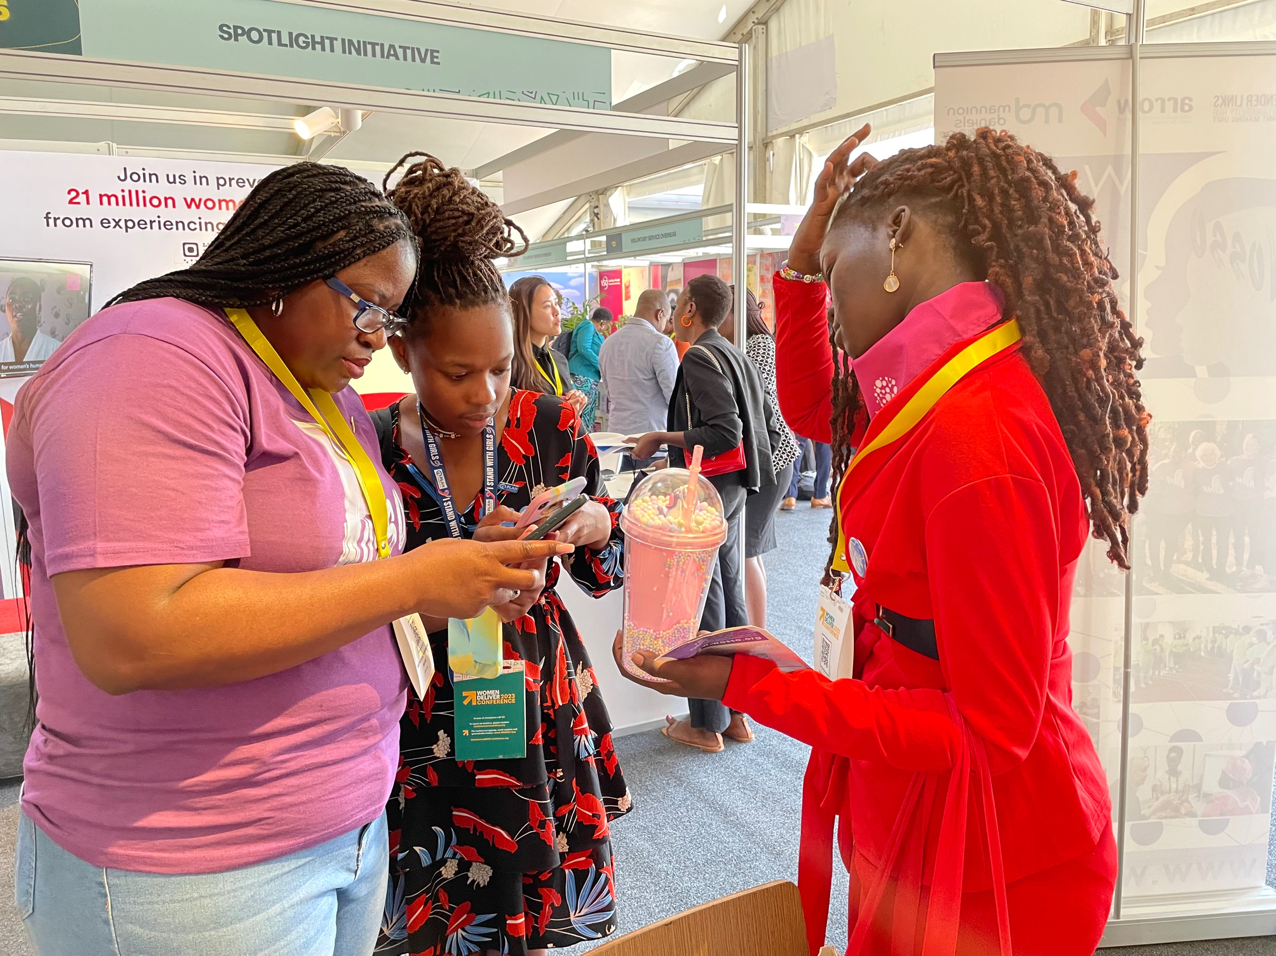

GL Strategy 2026-2030
Presented by: Tabetha Kanengoni

Slide 2




No looking back as we are carrying on!
Backlash
Push forward

Slide 3
RECAP: GL’s Vision and Goals; 2020-2025
Vision | An inclusive, equal and just society in which women and girls in all their diversities exercise their voice and choice in accordance with the Southern African Development Community (SADC) Protocol on Gender and Development and related regional, continental and global instruments.
What: Women and girls’ rights (Outcome areas) | Women and girls exercise #VoicandChoice over their bodies through the full attainment of Sexual and Reproductive Health for all. | Women and girls exercise equal and effective #VoiceandChoice in the public sphere through their participation in politics and decision-making. |  | Women exercise equal #Voice as citizens in and through the media. | Women exercise #VoiceandChoice through increased agency and economic power to prevent gender-based violence and take control of their lives. |  | Halt the destruction of the planet through innovative links between gender and climate justice in our work and practice.
How: Pathways to change | Build a strong Southern African women’s movement advocating for #VoiceandChoice and holding government to account for global, African and regional commitments. |  | Grant making to strengthen the ability of community based organisations and networks to work with women and girls to claim their rights and exercise #VoiceandChoice. |  |  | Communicating results through mainstream and social media using multi-media formats to reach beneficiaries and strengthen advocacy and lobbying efforts.
Where: Sites for change | Global and continental: Realise the provisions in the global and continental instruments to achieve gender equality and equity at a regional, national, local and individual level. | Regional: Contribute to an inclusive, equal and just society in the public and private space in accordance with the SADC Protocol on Gender and Development. |  | National: Strong women’s rights movements hold governments accountable for their gender commitments. | Local: Gender-responsive local governance and community-based organisations enhancing women’s and girl’s #VoiceandChoice. |  | Individual: Strengthening individuals’ self-confidence and knowledge to act as Drivers of Change for gender equality.
Foundation: Institutional effectiveness (Foundational Pillars) | A strong and sustainable organisation that includes a fundraising unit, grantmaking and, income-generating capabilities. | A robust and transparent system and processes for planning, monitoring, evaluation, learning, innovation, knowledge management and sharing |  | Improved institutional efficiency and effectiveness by making IT work for gender justice. | Investing in people, engaged, capable staff, partners, and associates with the motivation, facilities and tools to deliver high quality work. |  | Good governance and sound financial management, strong, continuously updated policies and practices overseen by a diverse, compliant and accountable governance structure that result in zero tolerance for corruption as well as Value for Money.

Slide 4
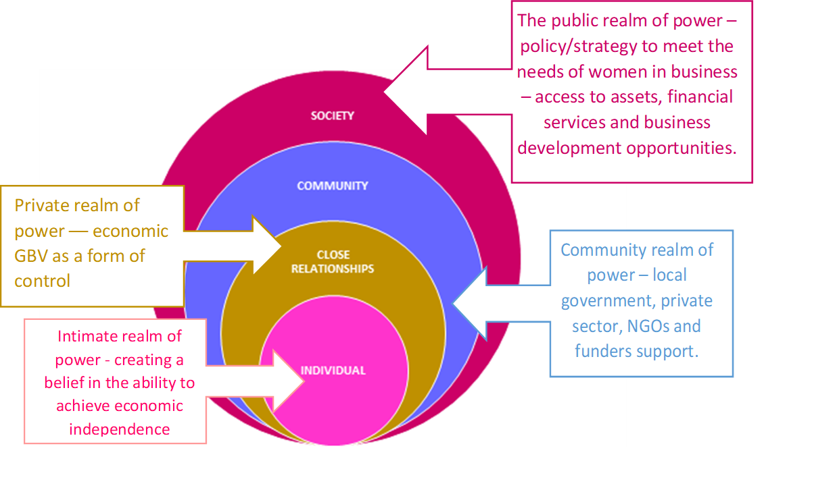
GL Theory of Change
Developed in 2012 (DFID PPA Gender Learning Partnership). Collaborative.
Updated in 2015

Slide 5
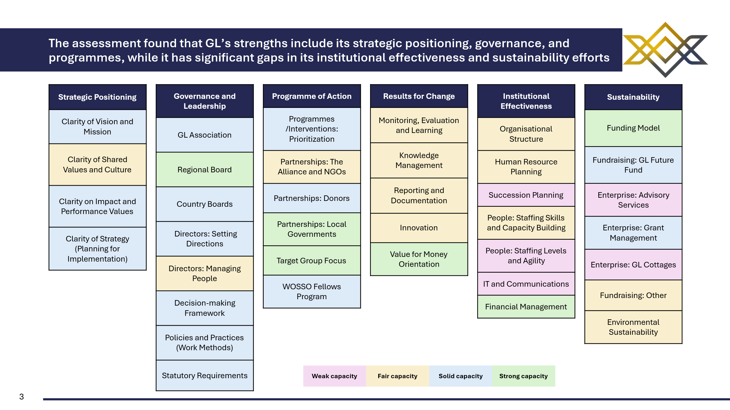
Where we are: Organisational Assessment

Slide 6
Looking forward (2026-2030) Strategic Positioning
RENEWED VISION:
Gender Links (GL) envisions an inclusive, equal and just society for women and girls in all their diversity.
MISSION:
Gender Links champions gender equality and justice through research, advocacy, linking and learning, movement and institution building in Southern Africa and beyond.
Challenges | Strengths | Opportunities
Limited integration between strategic intent and implementation planning. | Clear vision, mission, and performance framework. | Strengthen evidence-based planning and communication of impact.
Shared organisational values not consistently internalised across all regions. | Strong clarity on impact and performance values. | Reinforce shared culture and collective purpose through participatory strategy renewal.

Slide 7
Strategic Positioning: Targets and Indicators
Specific Goals | Targets | Indicators
Overall Goal: Strengthen Gender Links’ strategic coherence, visibility, and impact orientation across all programmes.
Refresh and align vision, mission, and values with the 2030 Agenda. | 2026–2030 Strategy finalised and launched by Q2 2026. | Approved strategic framework document.
Embed performance metrics into annual planning. | All country offices using performance scorecards by 2027. | Annual performance dashboards.
Strengthen internal communications around shared values. | Cross-regional dialogues held quarterly by 2026. | Staff survey shows improved alignment with shared values.
The Axum assessment confirms that Gender Links has strong strategic clarity. Our 2026–2030 Strategy will integrate implementation planning, reinforce shared values, and link performance indicators directly to impact.

Slide 8
Governance and Leadership
Specific Goals | Targets | Indicators
Overall Goal :Strengthen governance systems and leadership capacity to enhance accountability and strategic direction.
Strengthen regional and country board effectiveness. | Annual board performance reviews starting 2026. | Board performance reports.
Improve decision-making transparency. | Online governance portal launched by 2027. | Portal usage analytics.
Build directors’ management and leadership capacity. | 100% of directors complete annual leadership training. | Training completion records.
Governance is a pillar of Gender Links’ resilience. The 2030 Strategy will enhance leadership development, modernise decision-making, and ensure stronger accountability across boards and country offices.

Slide 9
Programme of Action: Opportunities
Challenges | Strengths | Opportunities
Programme prioritisation not always consistent across countries. | Strong partnerships with NGOs, donors, and local governments. | Streamline programmes to align with regional and global priorities.
Gaps in emerging thematic advocacy areas. | Clear target group focus and impactful interventions. | Leverage digital innovation and expand regional synergies.

Slide 10
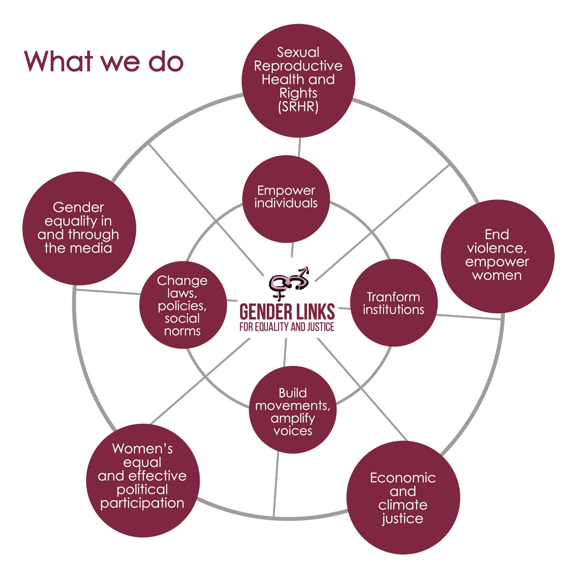

Slide 11
Programme of Action: Targets and Indicators
Specific Goals | Targets | Indicators
Overall Goal: Strengthen programme coherence, partnerships, and regional advocacy for greater impact.
Enhance coordination of partnerships across regions. | All partnership MoUs reviewed annually. | Partnership register updated annually.
Align programme strategic goals. | 90% of programmes linked to SDG indicators by 2028. | Programme alignment report.
Strengthen advocacy and thematic focus. | Regional advocacy frameworks completed by 2026. | Framework implementation progress reports.

Slide 12
Towards Impact and Change
Programmes
Design and implement interventions across Gender Links’ six focus areas.
Generate knowledge, case studies, and lived experiences.
Provide the foundation for monitoring, learning, and storytelling.
MEL (Monitoring, Evaluation & Learning)
Tracks progress and impact of programmes.
Produces evidence, data, and lessons learned.
Feeds insights back into programme design and advocacy.
Comms
Translates programme results and MEL evidence into accessible stories, campaigns, and advocacy messages.
Amplifies voices of beneficiaries, partners, and movements.
Engages media, policymakers, and donors to influence change.
Programmes
Comms
Impact and Change
MEL

Slide 13
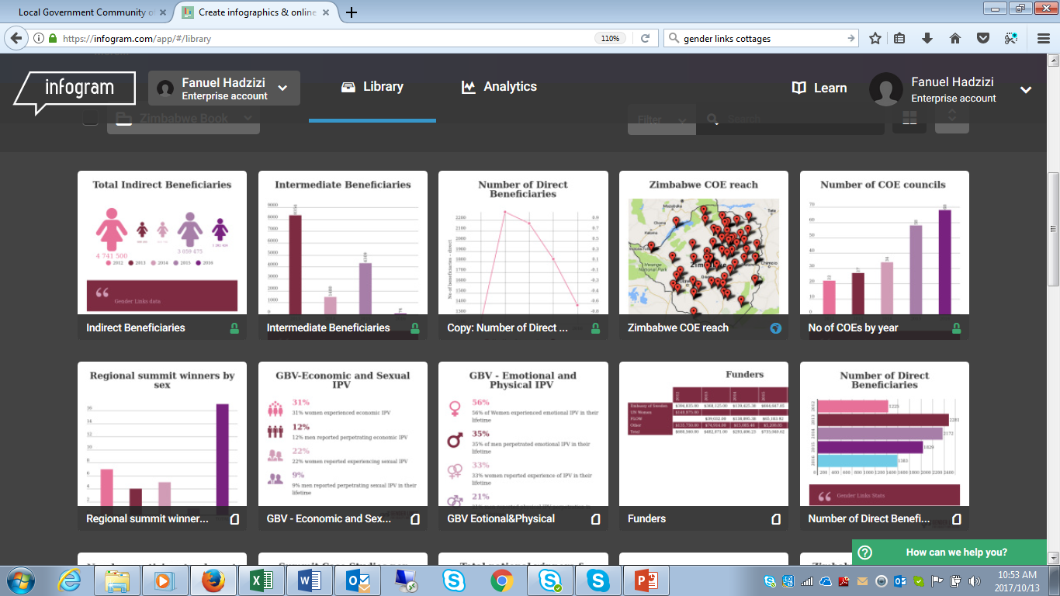
Results for Change
Monitoring | Evaluation | Learning | Innovation | Knowledge Management | Communicating Results

Slide 14
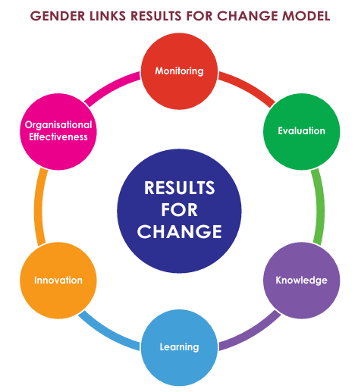

Slide 15
Opportunities, Outputs and Indicators
Challenges | Strengths | Opportunities
Inconsistent monitoring and learning systems across regions. | Established culture of evaluation and reporting. | Modernise MEL systems for real-time learning and adaptation.
Limited focus on innovation and value-for-money assessment. | Strong documentation and knowledge-sharing foundation. | Develop innovation labs and strengthen results-based learning.
Output | Indicators
Training and advocacy initiatives delivered | # workshops; # participants disaggregated by sex, age, disability
Knowledge products produced | # barometers, briefs, dashboards, podcasts
Partner capacity strengthened | # partners trained in MEL; % partners using MEL data in decision-making

Slide 16
Institutional Effectiveness: Succession Planning
GL Board
DRH
Country Directors
Corporate Services (Finance, HR, IT)
GMU
Special Advisor
GLS/ GLC
WOSSO
Regional programmes

Slide 17

Successor Model
GL Board
DRH
Zimbabwe
Madagascar
GL Services
Grants and fellowships
Lesotho
Director of Programs
Regional Programmes
MEL
Communications
Finance, Governance and IT
HR
Mauritius
Give GL Services dedicated focus

Slide 18





Sustainability

Slide 19


Sustainability: Opportunities
Challenges | Strengths | Opportunities
Unstructured approach - absence of a formalised growth strategy hinders its ability to develop and expand its service offerings proactively Capacity constraints: The advisory team is small, with only two full-time associate staff. Weaknesses in research and programme support coordination: Programme support needs are variable and can be unplanned. Under-monetised Intellectual Property (IP): No structured packages developed into commercial offerings that can be systematically marketed and sold. Management: Currently, pipeline management primarily focuses on responding to immediate opportunities as they arise, with minimal proactive strategies or tools in place to systematically identify and pursue new business development initiatives. | Gender Links has strong credibility in gender integration Established GL Future Fund and enterprise portfolio. Pivoting capacity: from Sustainability Hub to GL Services | Develop a GTAS Business Plan: Define target markets, price points, core offerings, and sales targets based on a thorough assessment of market demand. Build a high-level annual unit plan to define the type of work, topics, and funders the advisory team aims to pursue based on market demand. This would enable the team to have a sense of direction, prioritise efforts, track progress, and be proactive. Leverage the GL Academy: Expand the catalogue of premium courses; offer bundled deals where training leads to advisory services (e.g., "Train-the-Trainer" followed by implementation support). Diversify client base and income streams: Forge alliances with management consultancies, universities, and private sector networks to co-deliver services and access new client bases and income streams. Gender Links Cottages – A lot of renovations have taken place at the cottages since the Axum report was submitted. A new spa has opened, new website, the reception area was renovated, new furniture for the dining room, facelift work. For the first time, the cottages had a ZAR 1million profit in August 2025.
Environmental sustainability not fully mainstreamed. | Proven enterprise experience (Advisory Services, Cottages, Grant Management). | Integrate environmental principles into organisational policies.

Slide 20
Sustainability: Objectives and Indicators
Goal: To establish GL as the premier pan-African centre of excellence for gender integration services, leveraging our unparalleled expertise to drive sustainable revenue growth, amplify our impact, and ensure the long-term financial resilience of the organisation.
Objective | Key indicators
1. Strategic growth and market positioning: Transition GTAS from a reactive unit to a proactively managed, strategically aligned business line with a clear market position. | A 5-year GTAS business plan is developed and approved, with annual revenue targets. A comprehensive market analysis of gender integration services in Africa is completed. Annual revenue from GTAS increases by 25% year-on-year.
2. Product development and systematisation: Package GL's IP into scalable, tiered product offerings for different market segments, for example, governments, NGOs, and the private sector. | 3 new standardised service packages are developed, for example, "Gender Audit Plus," "GRB in Action" 5 flagship GL Academy courses are premium-certified and monetised A digital repository of all GTAS methodologies, proposals, and reports is created and maintained.
3. Operational excellence and capacity: Build a dedicated, skilled GTAS team with the capacity to deliver high-quality services and pursue new business. | A dedicated GTAS Manager and Business Development Officer are hired. 100% of GTAS staff receive annual upskilling in specialised areas. A streamlined process for project management, from pitching to delivery, is implemented.
4. Visibility and client engagement: Execute a targeted marketing and communications strategy to promote GTAS services and attract ideal clients. | A dedicated GTAS section is launched on the GL website, featuring client testimonials and case studies. GL participates in 2-3 key industry conferences or expos annually as a thought leader. A client relationship management (CRM) system is used to track leads and manage partnerships.

Slide 21
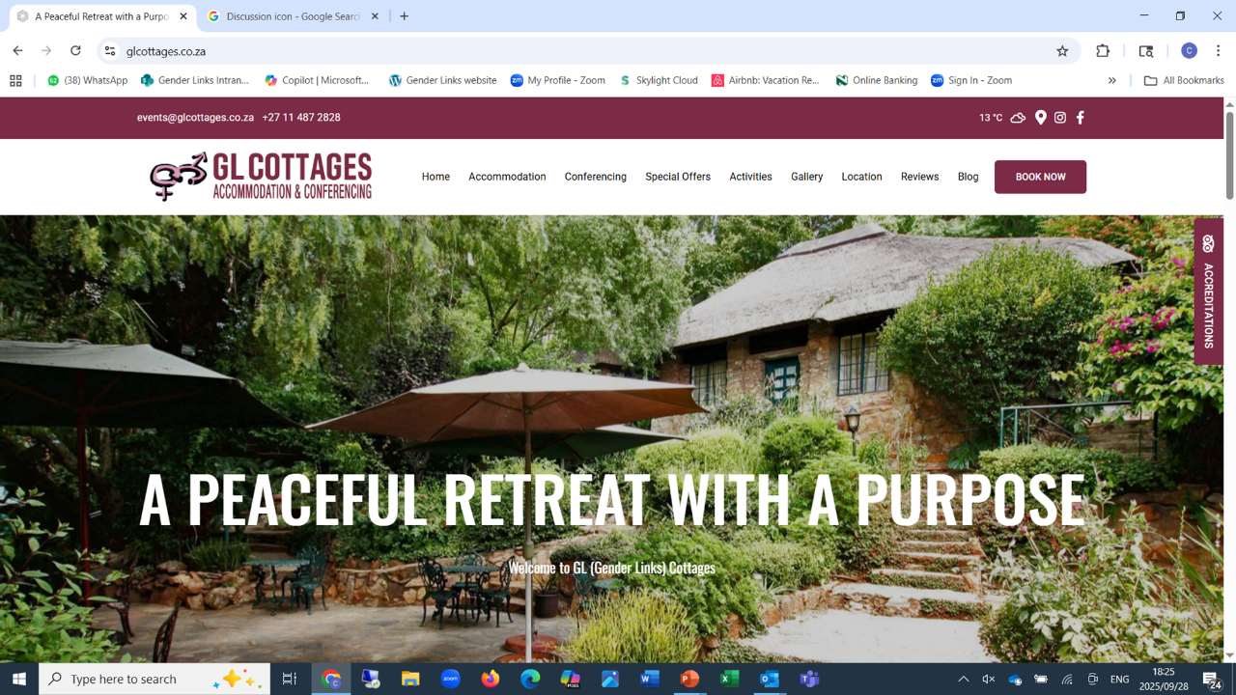

Slide 22
GLC Strategy 2026 -2030
Vision: The preferred guesthouse for business and leisure travellers, offering exceptional accommodation, conferencing, and dining experiences in a tranquil setting.
Mission: To provide warm, personalized hospitality in a serene environment, ensuring every guest feels at home while enjoying the comforts of modern accommodation while contributing to GLs long term sustainability; gender equality and justice.
Legal compliance
Market Penetration
Product Development
Digital Marketing
Operational Efficiency
Renovation of outdated rooms and facilities

Slide 23
Fund Raising Unit
Challenges | Strengths | Opportunities
Shrinking bilateral funding | Strong GL brand | Sub-granting
Middle income countries e.g. SA that do not qualify | Base from which funds can be dispersed in the region | Sub-granting
Foundations and high net-worth individuals – personality driven | GL has some relationships to draw on | WOSSO fellows; Sunrise campaign; GL@25 lend themselves to this model
Internal capacity, competing demands | GLO model shows that team work makes the dream work | Formalising the FRU – structure, incentives

Slide 24
FUND RAISING UNIT: 2026 – 2030
Goal: Sustainable and diverse funding pipelines at regional and country level to ensure business continuity.
Objectives | Key indicators
Establish a motivated, agile unit that scouts out opportunities and supports the various arms of GL in pursuing funding opportunities | Effective unit established Hybrid model recognising time and effort, but also rewarding success adopted
Increase GL funding by at least 5% per annum | % increase in funding, by unit and type of funder
Build capacity of staff and grantees to target their efforts more effectively | No of staff and grantees trained % able to successfully follow through on a proposal from start to finish

Slide 25

Harnessing AI for Gender Justice
A responsible path forward for Gender Links

Slide 26

Amplifying GL’s Programmatic Impact
How
Research and analysis - Rapid analysis; workshops, surveys, news monitoring) to identify emerging trends in GBV, economic exclusion, or WPP
Advocacy and communications - Draft and personalise communications, translations, social media, campaigns, outreach
Capacity building and knowledge Management
Monitoring & Evaluation - Automation, track indicators, freeing our staff for deeper, strategic review.
The AI Opportunity

Slide 27
Pathway – Towards AI Strategy, AI Policy
A Mission-aligned strategy, followed by a protective policy.
Develop GL AI Strategy (The Why & What)
Align AI use with GL's strategic goals. What do we want to achieve?
Draft GL AI Policy (The How & Guardrails)
Establish rules for ethical, secure, and responsible implementation.
A formal policy document (building on the AI policy elements already drafted at GL planning.
AI Training and Implementation
Rolling out tools and training to regional and country boards and staff, after strategy and policy are set.
Spell out use cases, value proposition, and required resources.

Slide 28

Moving Together, Responsibly
Endorse the principle of developing a formal AI Strategy and Policy for Gender Links.
AI Task Team –
Experimenting with Co-pilot,
Collaboration = GL Programmes, IT, HR, MEL, and the board to draft the strategy and Policy.
Learning from leaders -
Actively engaging with frameworks from partners like UN Women’s AI School
and focus on gender-responsive AI to ensure our approach is world-class and feminist.
Let’s build our AI Future together — Safely and Strategically.

Slide 29
Thank You!

