Slide 1



PROMOTING GENDER-INCLUSIVEE LOCAL ECONOMIC DEVELOPMENT IN SOUTH AFRICA
START UP ENTREPRENEURS
Radieta Enterprise
PARTICIPANT NAME: Alice Lieta
COUNCIL: Emfuleni
Please include photographs of the business!

Slide 2
MY EXPERIENCE DURING SUNRISE CAMPAIGN
Key lesson from Life Skill and Entrepreneurship training
Memorable moments(e.g. Mentorship, Group Work, Support etc.)
Lessons are:
Gender based violence
IT
Entrepreneurship
Moments are:
Group discussions were memorable
Team engagement was fun & enhanced self-love & confidence

Slide 3
HOW MY LIFE HAS CHANGED
Personal growth (confidence, independence, safety)
Family impact (children, relationships, community respect)
Income changes or lifestyle improvements
Personal Growth:
Learning gender based violence changed my perspective of live
After funding I became self dependent and less demanding from a man, also I have become more respected in my community, home, including friends and now I feel uplifted

Slide 4
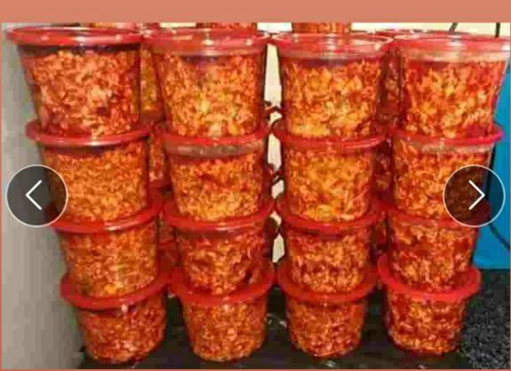
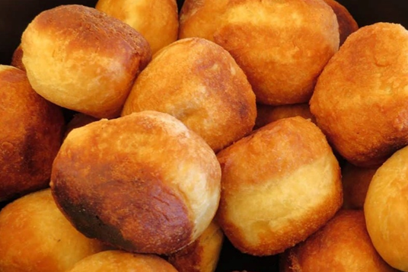
PLEASE DESCRIBE THE BUSINESS
Name of business and products/services offered
Achievements so far Challenges still faced and how they’re managed
Radieta Enterprise is a Tuck shop..Selling Clothes And Planting Crops
My busniness expanded im now selling fat cakes & atchara
Competition was a challenge so I got a different target market by adding new product & selling at different location. E.g Malls & Schools
Photo or video

Slide 5
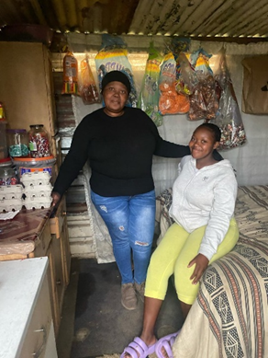
CUSTOMER BASE AND COMPETION?
My target market is educators,Malls,colleagues,and school,Churches and social media
Yes I increased the number of customers
by adding new product & selling at different location. E.g Malls & Schools
People who are selling the same product or similar product
I sell at a lessor price to get more customers and icrease foot traffic
Evidence

Slide 6
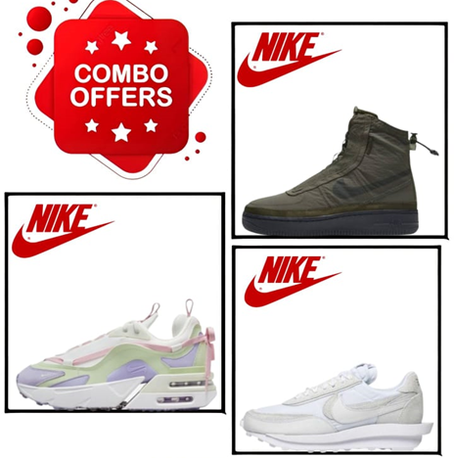
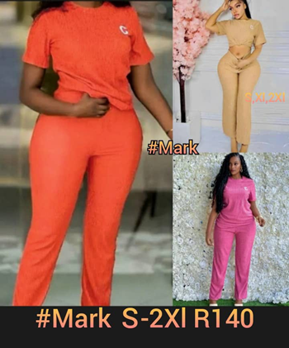
NEW PRODUCTS OR SERVICES?
Do you have any new business products or services?
yes
What new products are in the business?
Sneaker & Clothes
How are they performing compared to your initial products?
They’re performing well
How do you advertise/market your products?
By use of social media, word of mouth
Evidence

Slide 7
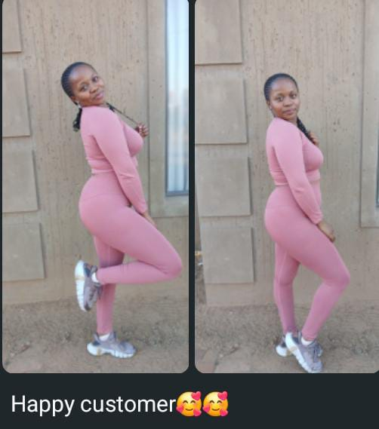
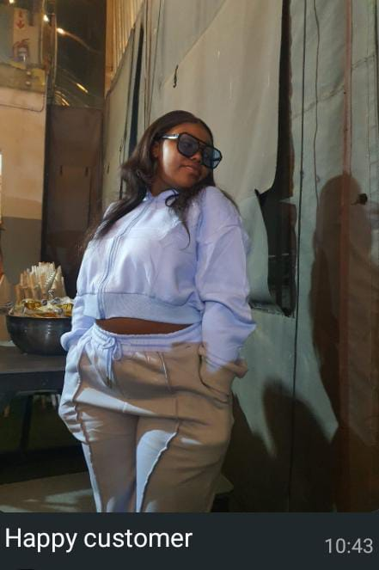
QUALITY AND PACKAGING
Are your customers happy with the quality of your products or services?
Yes
They appretiate the freshness, the quality of taste & cleanliness of my products
Do yo have u any branding available for your products?
No I have no branding
Have you changed the packaging or marketing of your business to attract more customers?
I hired an additional staff member to sell our products at a new location such as the taxi rank, where my competitors are out of reach
Evidence

Slide 8
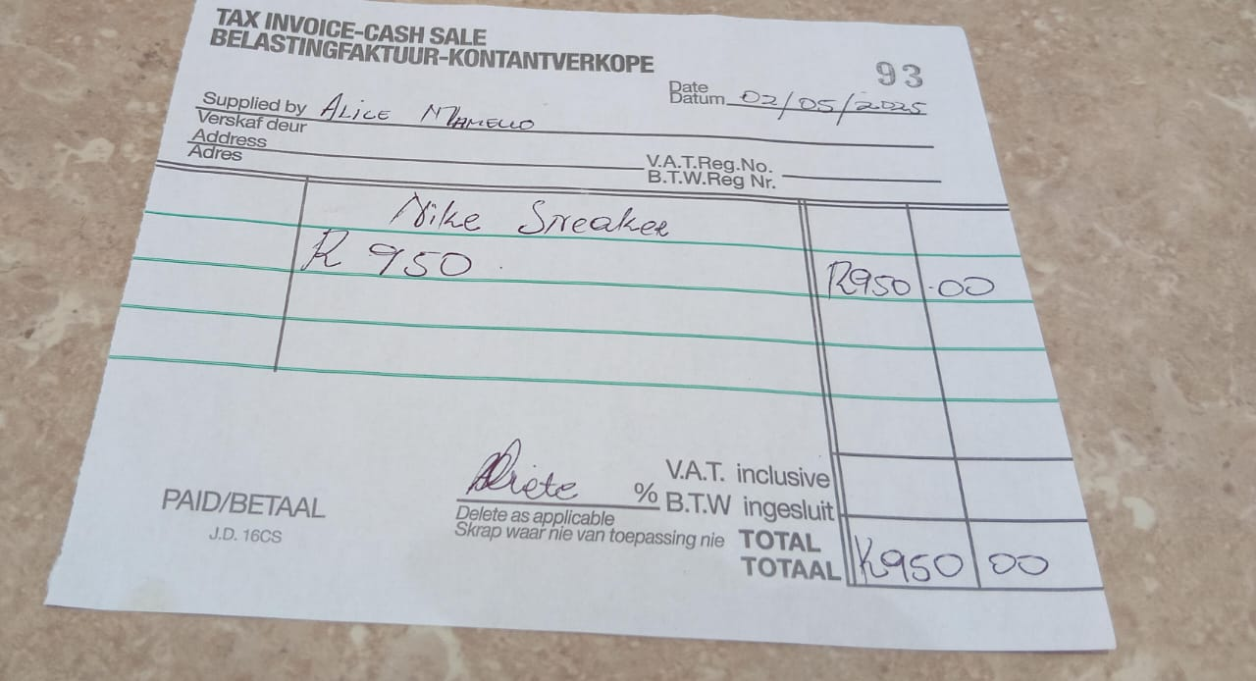
BUSINESS MANAGEMENT
Have you hired more staff? How many full-time and how many part-time?
Yes, I hired one on a part time basis
How do you manage your stock and check regularly? Please explain.
We use a receipt book for record keeping
Record every transaction
Package my stock securely to avoid shrinkage(damage or stolen goods)
Have you been able to price your products better so that you can earn a surplus from the business? Please explain.
No if I sell higher my competition will be selling lower & customers will go for a cheaper price on the same product
Evidence

Slide 9
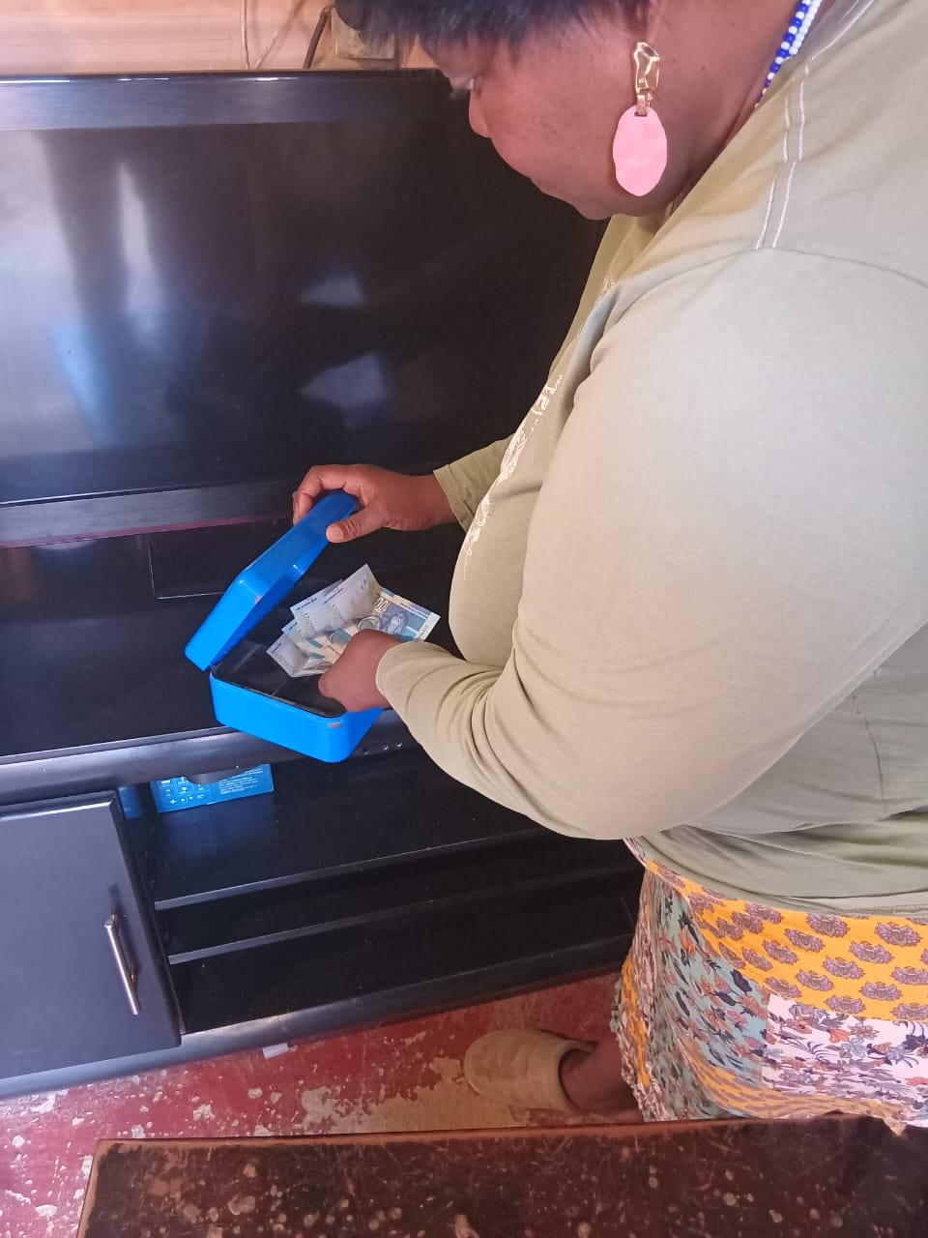
FINANCIAL MANAGEMENT
Do you have a record-keeping system in place?
Yes,
If yes, how is it helping you to manage your business?
We use Record book & recipt on each sale, helping us to keep track of money made in the business and profits made
Do you have a bank account for your business?
No, I use a safe
Evidence

Slide 10
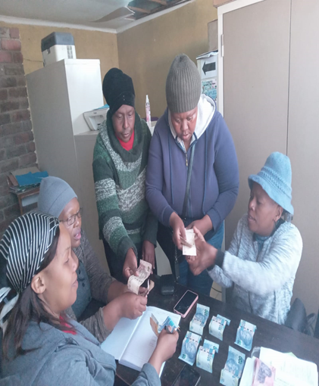
SAVINGS AND SELF SUFFICIENCY
Are you a member of a savings group?
Yes
Are you saving money? How much have you been able to save so far?
Yes, so far we have saved an amount of R 2000
Have you managed to increase household income?
Yes due to business success
Evidence

Slide 11
INCOME AND EXPENSES FOR THE BUSINESS FOR PAST THREE TO SIX MONTHS
INCOME
EXPENSES
ITEM | AMOUNT
SALES & PROFIT | R 20 000
TOTAL | R 20 000
ITEM | AMOUNT
STOCK | R 5 000
SALARY | R 2 000
TRANSPORT | R 1500
TOTAL | R 8 500

Slide 12
CHALLENGES
What challenges have you experienced in your business?
Competition
Businesses Copying my ideas
My stock used to get damaged because of incorrect packaging
How have you addressed these?
Yes I hired a new staff member to sell else where my competitors are out of reach

Slide 13
SUSTAINABILITY
How will you sustain your business?
My profit keeps my business going
Always try new marketing strategies to engage with new clients
I go out at night to sell food at local tarvens
What other sustainability measures are you putting in place for your business?
Adaptability to adapt to market changes, trends, and customer needs

Slide 14
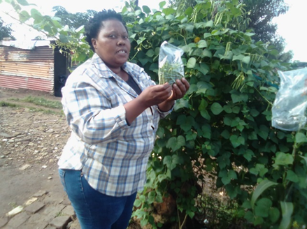
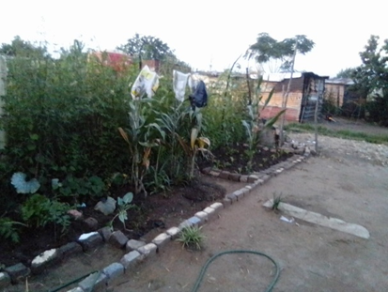
WHAT PLANS HAVE YOU MADE TO GROW YOUR BUSINESS IN THE NEXT 6 MONTHS?
In the next 6 months we will add a Meat, I want to open market selling vegetables, generate more money for the business
I will also purchase gas stove, a gas fridge and frying machine.
Evidence

Slide 15
ADDITIONAL INFORMATION?
What other changes have you experienced in your business? Explain
I have started earning more money
I have made more profit in my business
Do you have any additional information to share?
With my vegetable garden I sell green beans, tomatoes, spinach and corn. With these my business is making a good profit so I the near future I will be able to supply shops such as Spar and Shoprite
I was also able to donate R500 to help someone start a business of selling atchaar and also give money for transport

