Slide 1



PROMOTING GENDER-INCLUSIVEE LOCAL ECONOMIC DEVELOPMENT IN SOUTH AFRICA
START UP ENTREPRENEURS
NAME OF THE BUSINESS: BONTLE’S GLOW & GO BOUTIQUE
PARTICIPANT NAME: ANNA MGCOBO
COUNCIL: MIDVAAL
Please include photographs of the business!

Slide 2
MY EXPERIENCE DURING SUNRISE CAMPAIGN
Key lesson from Life Skill and Entrepreneurship training
I learned more about controlling my own emotions
Guiding my thoughts
Feel valuable and important as they really are.
Entrepreneurship
Business is for financial gain.
Customer Care is key in business
Financial Management is a priority
Memorable moments(e.g. Mentorship, Group Work, Support etc.)
Group work was good because we learned from one another.
I had support from our mentors guiding and advising us in business.
We also had support from our Municipality Midvaal

Slide 3
HOW MY LIFE HAS CHANGED
Personal growth (confidence, independence, safety)
I am now able to negotiate more confidently on my business terms and conditions.
I have overcome my fears regarding business losses and risks.
I’ve grown to develop my time management.
I prioritize my safety as well as of my customers.
Family impact (children, relationships, community respect)
The whole experience has had a great and positive impact on my children.
They are always learning new things from me day by day.
They will at least be able to look after themselves in future.
There is respect from community.
My relationship is now in my life. My partners is also helping in the business.
Income changes or lifestyle improvements
I have gained a bit of financial freedom.
I can afford things I couldn’t.
I can buy close to enough food for family in the house.
I have managed to buy a washing machine.
Bought a smart phone.

Slide 4
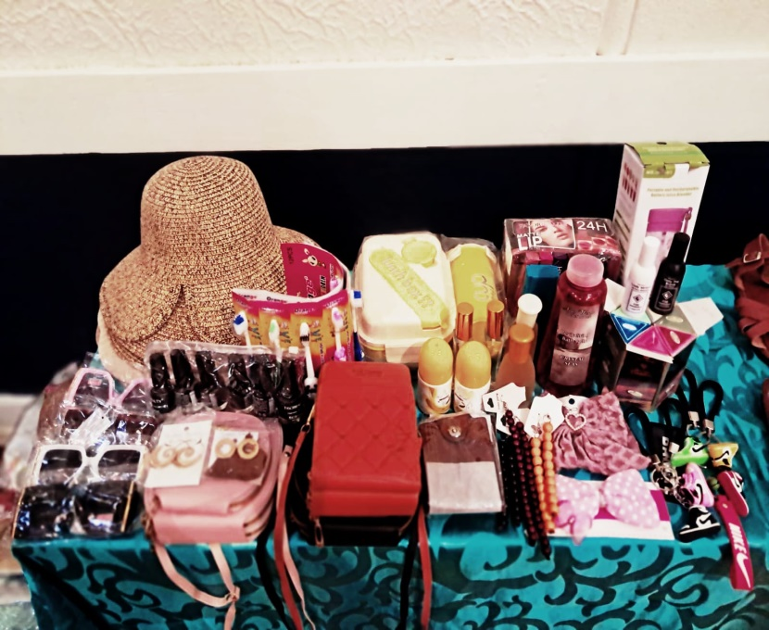
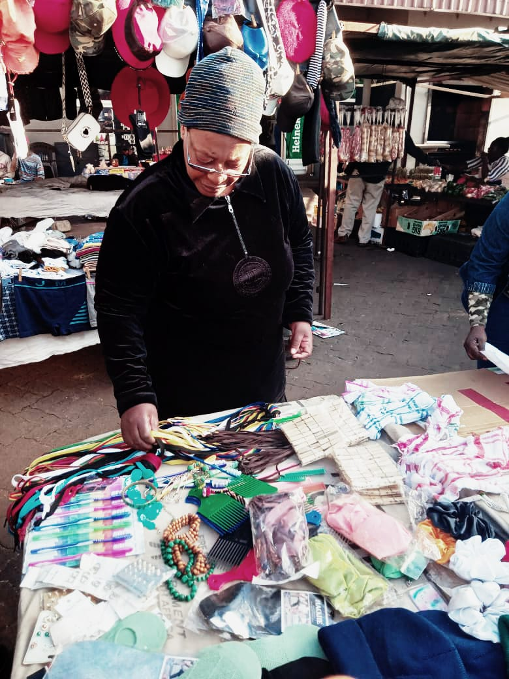
PLEASE DESCRIBE THE BUSINESS
Name of the Business
Bontle Glow & Go Boutique
Products/services offered
accessories,
make-up,
fragrances,
beauty products,hats and sunglasses.
Achievements so far Challenges still faced and how they’re managed
my business is growing, I am adding products every month end.
as a street vendor I face weather related issues like not being able to sell during rainfall and storms.
BONTLE GLO & GO BOUTIQUE

Slide 5
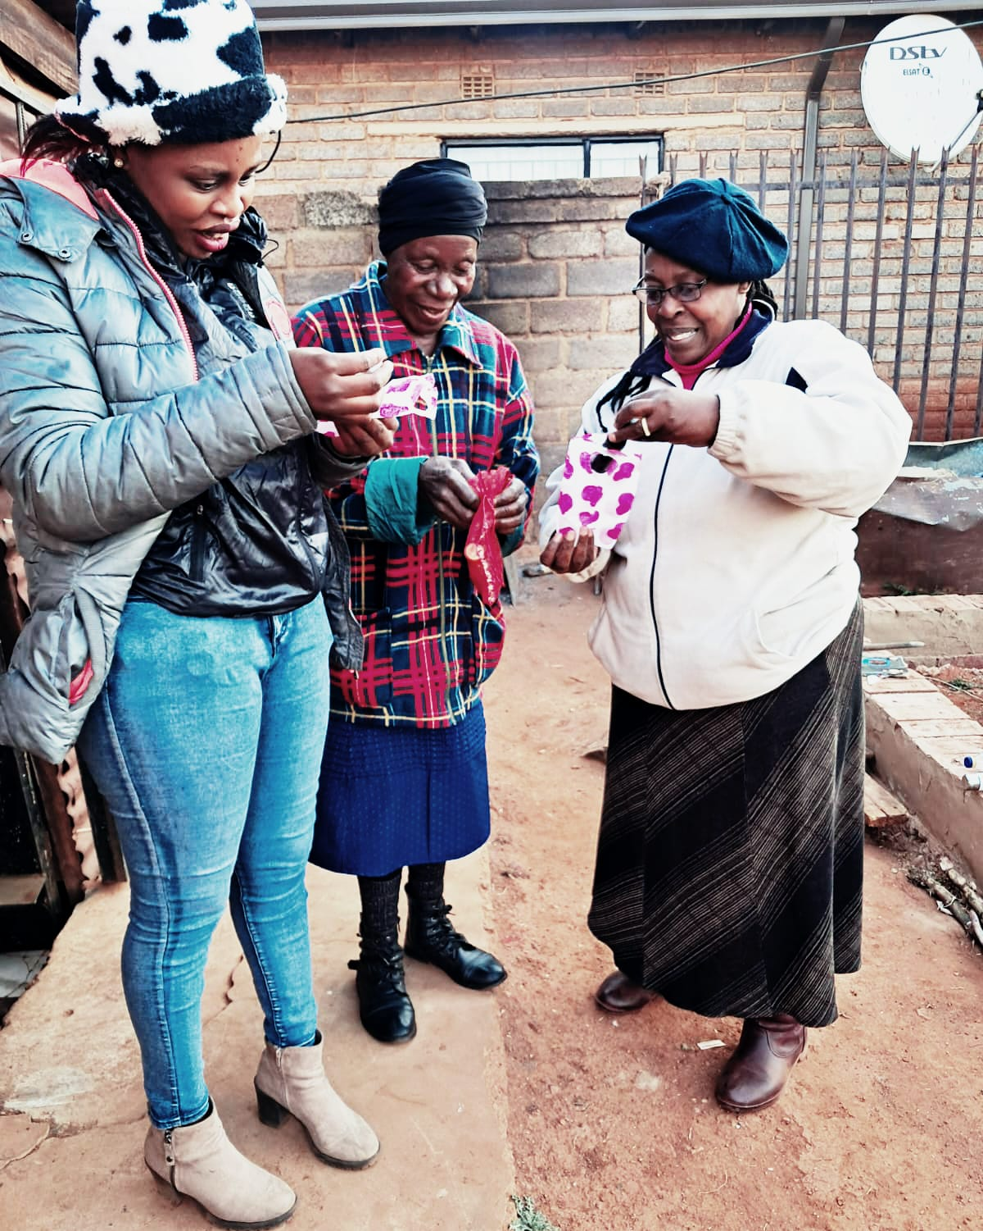
CUSTOMER BASE AND COMPETION?
Who are your customers?
my target market is women, school kids and outdoor enthusiasts.
Have you increased the number of customers since starting the LED Programme? Yes or No
yes
How did you do this?
I learned new marketing strategies and also offered samples and demonstration to showcase my products.
Who is your competition?
my competition is other street vendors who are selling identical or similar products.
How do you handle competition in your business?
I stay informed about market trends, customer preferences and competitor activity.
Evidence

Slide 6
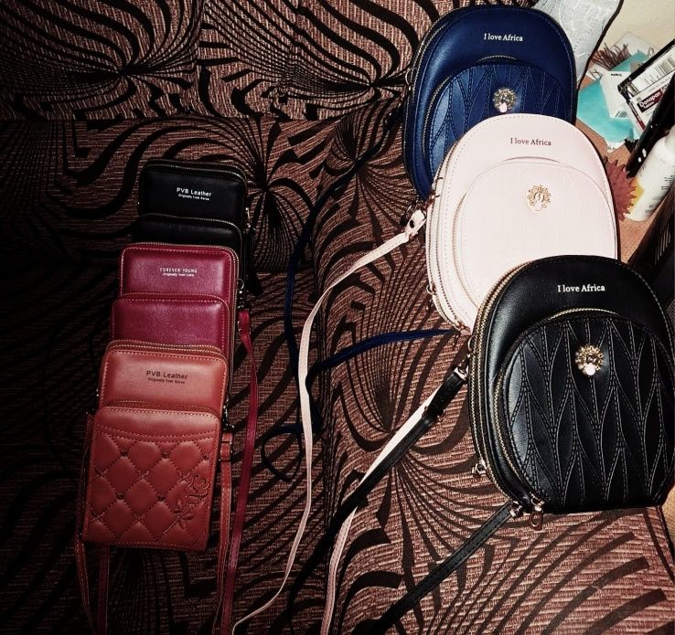
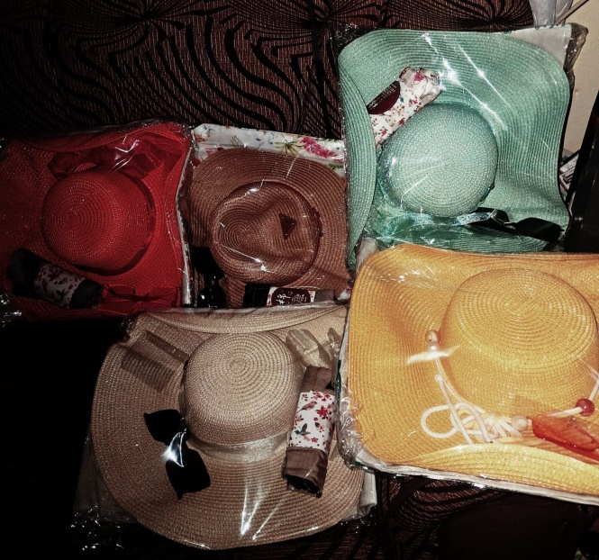
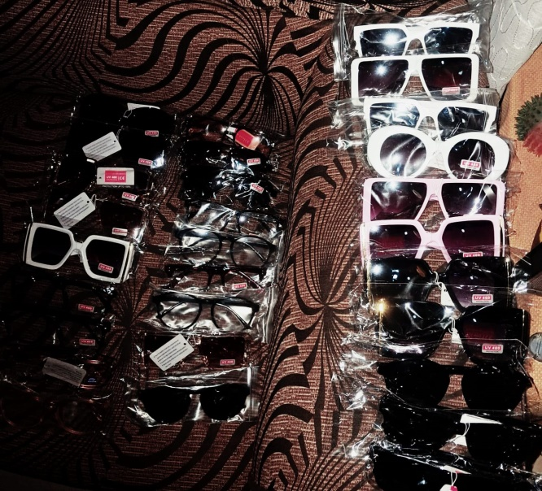
NEW PRODUCTS OR SERVICES?
Do you have any new business products or services?
summer-hats, sunglasses and handbag
knitting and crocheting hats,
How are they performing compared to your initial products?
Good
How do you advertise/market your products?
I encourage satisfied customers to share their experiences with others.
I also offer demonstrations to showcase my products feature’s and benefits

Slide 7
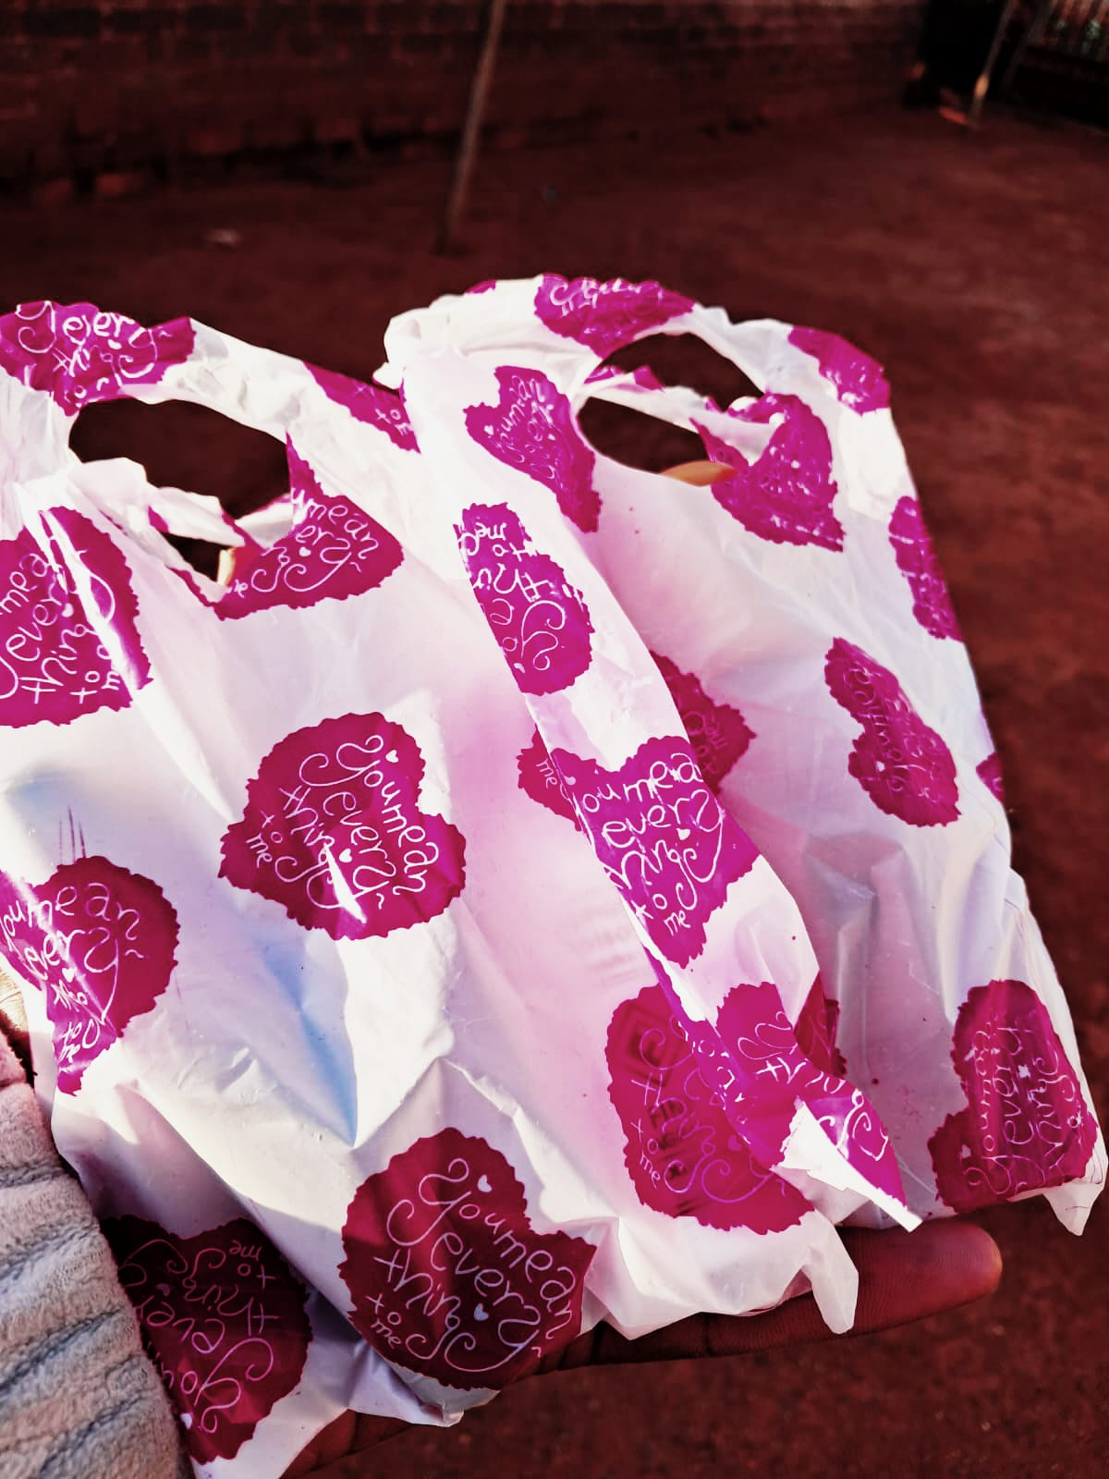
QUALITY AND PACKAGING
Are your customers happy with the quality of your products or services?
Yes
If you have answered yes please give more information.
I have repeated customers that make multiple purchases
Do you have any branding available for your products? Explain
Yes, socks for winter but expanding has been my main focus.
Have you changed the packaging or marketing of your business to attract more customers? Please explain.
Yes, I do door to door marketing strategies in order for me to attract new customers.
Evidence

Slide 8
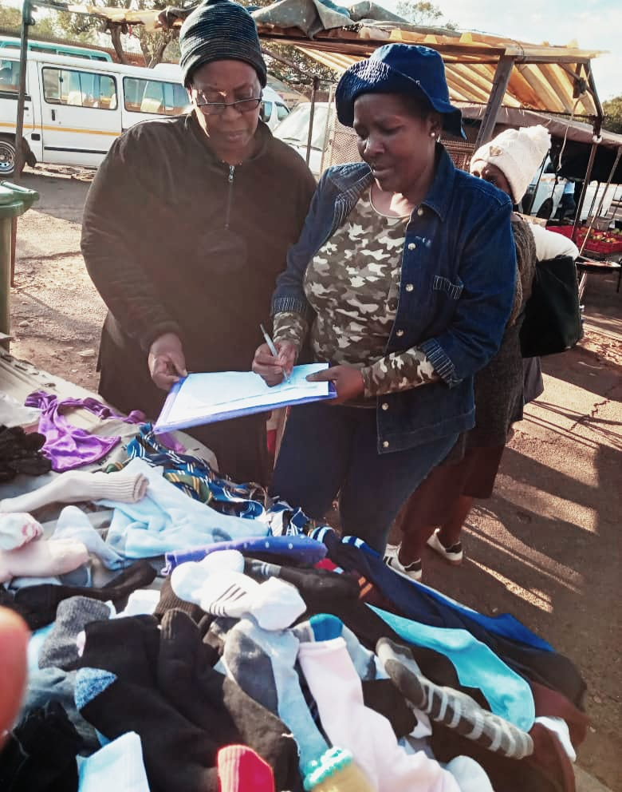
BUSINESS MANAGEMENT
Have you hired more staff? How many full-time and how many part-time?
I only have one staff member who works on weekends
How do you manage your stock and check regularly? Please explain.
I keep record of my stock levels, including the quantity of each product
Have you been able to price your products better so that you can earn a surplus from the business? Please explain.
Yes, I calculate the total cost of purchasing my products and adjust my prices based on changes in supply and demand.
Evidence

Slide 9
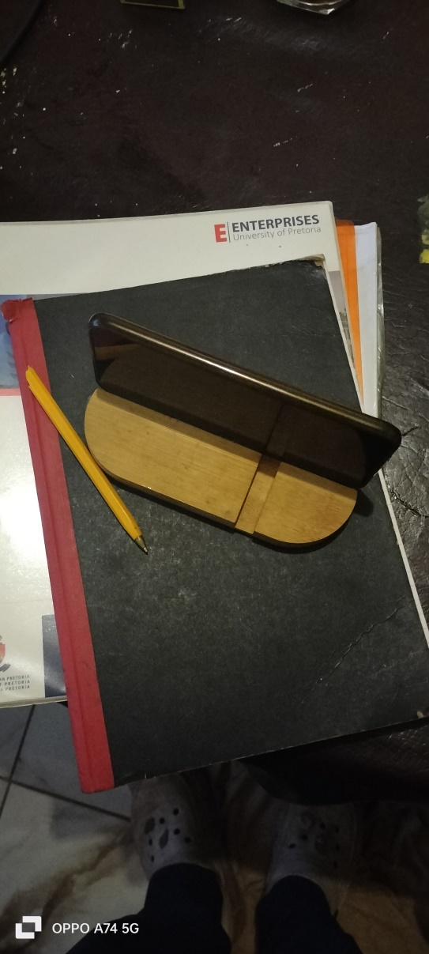
FINANCIAL MANAGEMENT
Do you have a record-keeping system in place? Explain.
Yes
If yes, how is it helping you to manage your business?
Record keeping helps me create and stick to a budget ensuring I’m allocating resources and finances efficiently.
Do you have a bank account for your business?
Yes

Slide 10
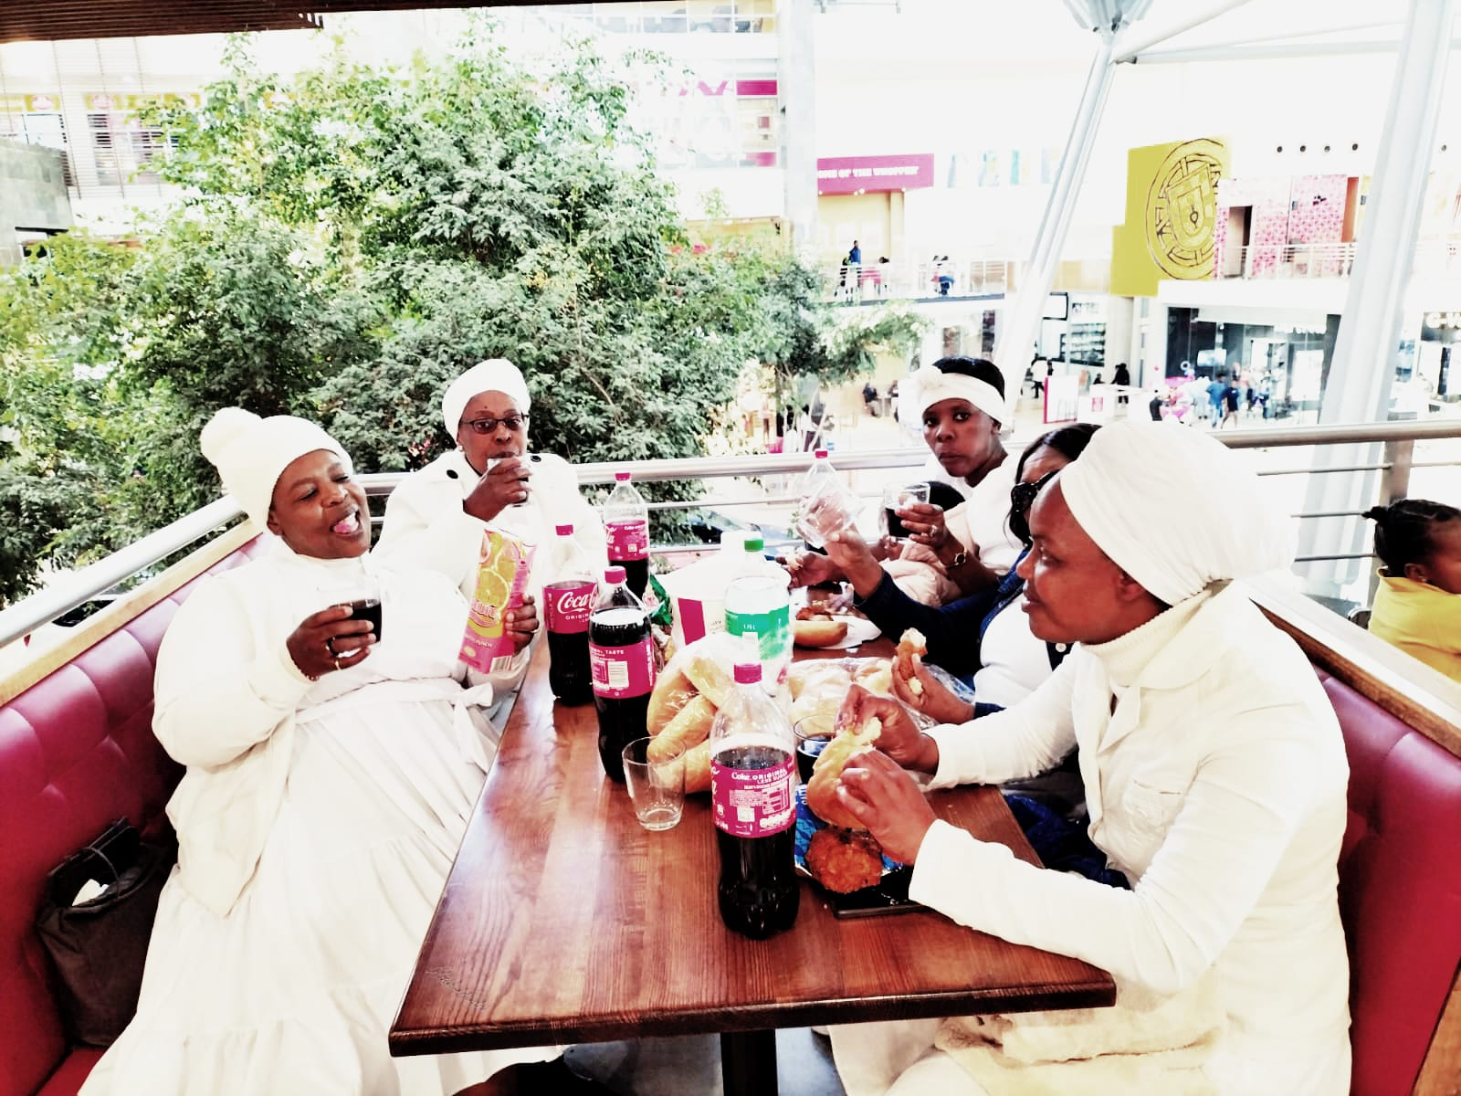
SAVINGS AND SELF SUFFICIENCY
Are you a member of a savings group?
Yes
Are you saving money? How much have you been able to save so far?
Yes, I save R250-R300 weekly which makes it plus minus a 1000 rand monthly
Have you managed to increase household income?
Yes
Evidence

Slide 11
INCOME AND EXPENSES FOR THE BUSINESS FOR PAST THREE TO SIX MONTHS
INCOME
EXPENSES
ITEM | AMOUNT
Sales | R28 000
TOTAL | R28 000
ITEM | AMOUNT
Stock | R12000
Salary | R3000
Transport | R1800
TOTAL | R16 800.

Slide 12
CHALLENGES
What challenges have you experienced in your business?
>I’m in a crowded space that has other street vendors which increases the competition bar high
>on rainy and dusty days I encounter minimal customers
>my income flactuates
How have you addressed these?
>my stuff member and I teamwork,when he’s shopkeeping I hawk around.

Slide 13
SUSTAINABILITY
How will you sustain your business?
>collect feedback to understand customers needs and improve my products or services, ensure that I have a stable cash flow in order to meet my financial obligations
What other sustainability measures are you putting in place for your business?
>I’ll always be on the lookout for new trends due to the mere fact that they sell quickly
>I’ll also utilize digital marketing channels such as social media and email marketing to reach my target audience

Slide 14
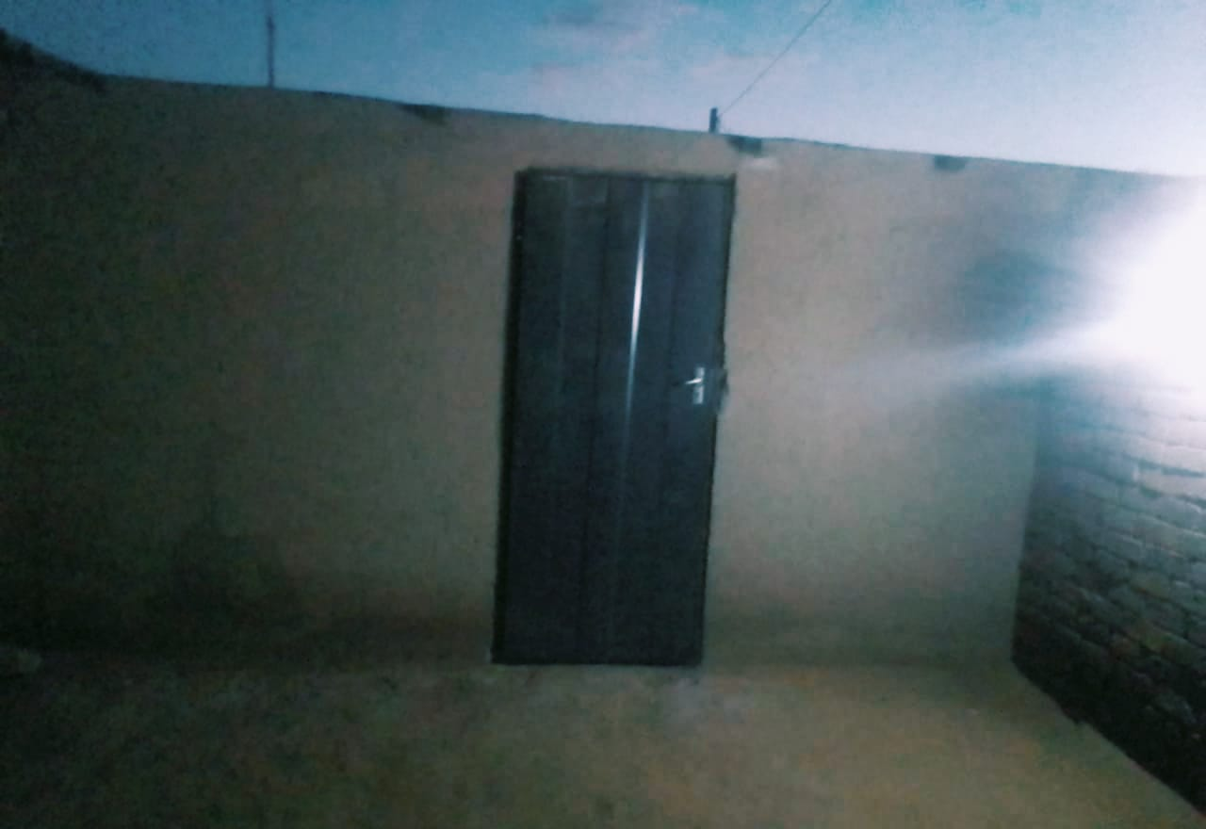
WHAT PLANS HAVE YOU MADE TO GROW YOUR BUSINESS IN THE NEXT 6 MONTHS?
The plans I have for my business is to finish building a suitable and secure place and also be able to expand in regards of stock. I’d also like to enhance customer engagement as well as brand visibility
Evidence

Slide 15
ADDITIONAL INFORMATION?
What other changes have you experienced in your business? Explain
I have to make sure that I personalise my products for my customers during public holidays like valentines, mother's day,etc.
Do you have any additional information to share?
Bontle's Glow & Go Boutique is not just a market stall but an inspiration that literally secured my future as a late bloomer and what excites me is that it caters for everyone women, men, LGBTQI+ and the youth.

