Slide 1

Voice and Choice Summit 2026-Leadership Category
Cameroon: Breaking the Silence: Empowering women and girls for a safe society
Cameroon, Bamenda-Fundong sub division,
Presented by
Akem Aurelia Njang on 4th March 2026
Voice and Choice Summit 2026 \ Voice and Choice Summit 2026

Slide 2
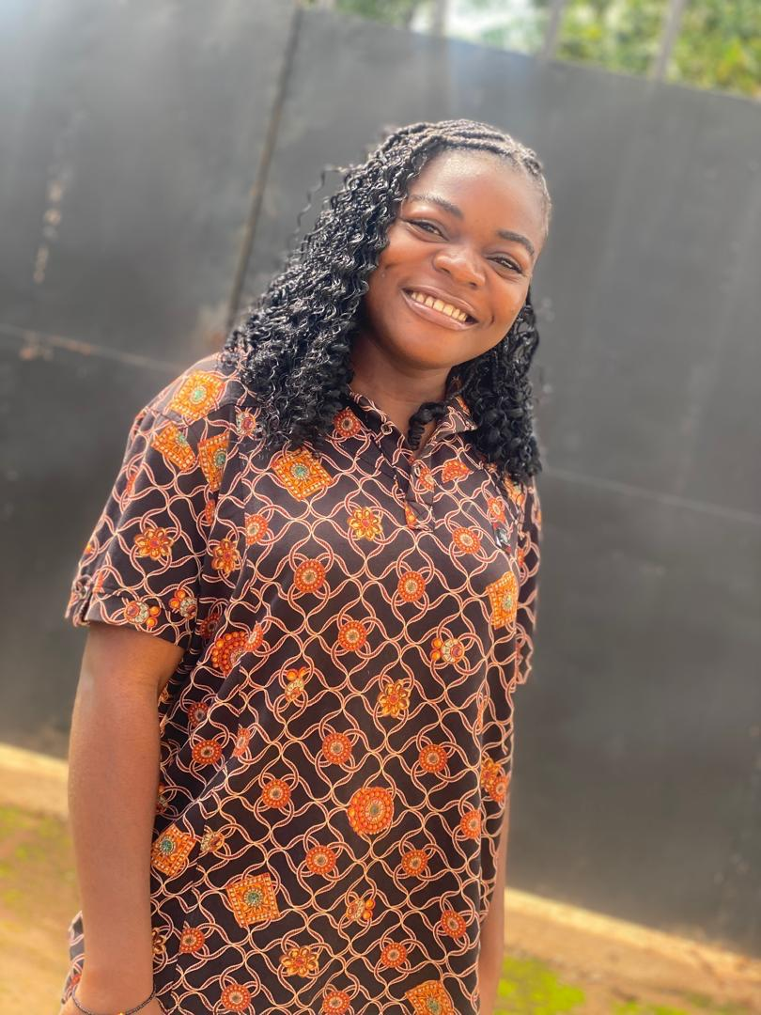
Background
I am Akem Aurelia Njang, a youth leader from the Northwest Region of Cameroon, a region deeply affected by the Anglophone crisis since 2016. I serve as a Program Officer at She can Excel, a youth parliamentarian, and the vice president of the Cameroon National Youth Council- Fundong Bureau.
Growing up in a rural community, I witnessed women and girls endure gender based violence in silence.
Aurelia the girl re-writing her story and that of many others
Voice and Choice Summit 2026 \ Voice and Choice Summit 2026

Slide 3
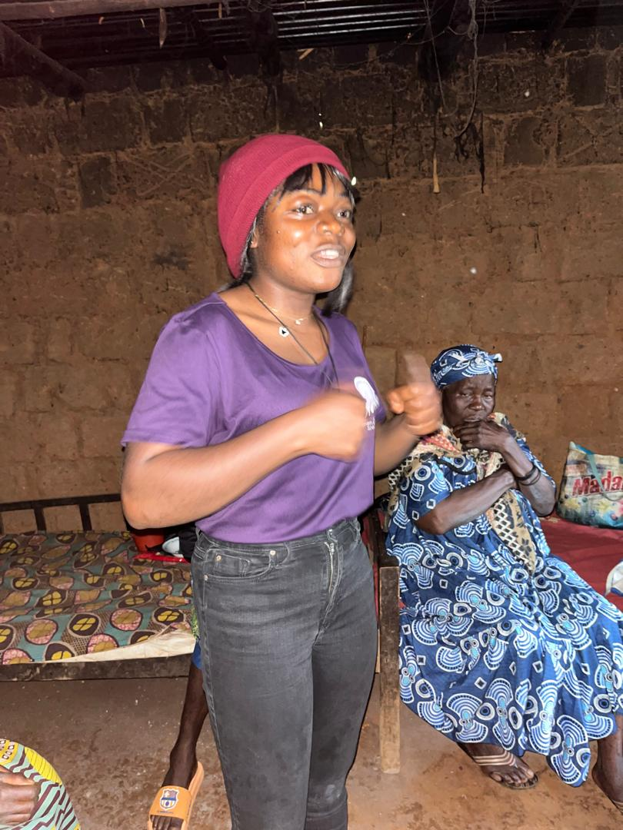
Background
Harmful cultural norms, conflict, economic dependence, and lack of safe reporting systems normalized abuse and prevented survivors from seeking help. Gender based violence was treated as a private matter rather than a human rights issue.
These experiences shaped my commitment to empowering women and young people to participate actively in leadership, peace building and sustainable development.
Reaching the communities that need it
Voice and Choice Summit 2026 \ Voice and Choice Summit 2026

Slide 4
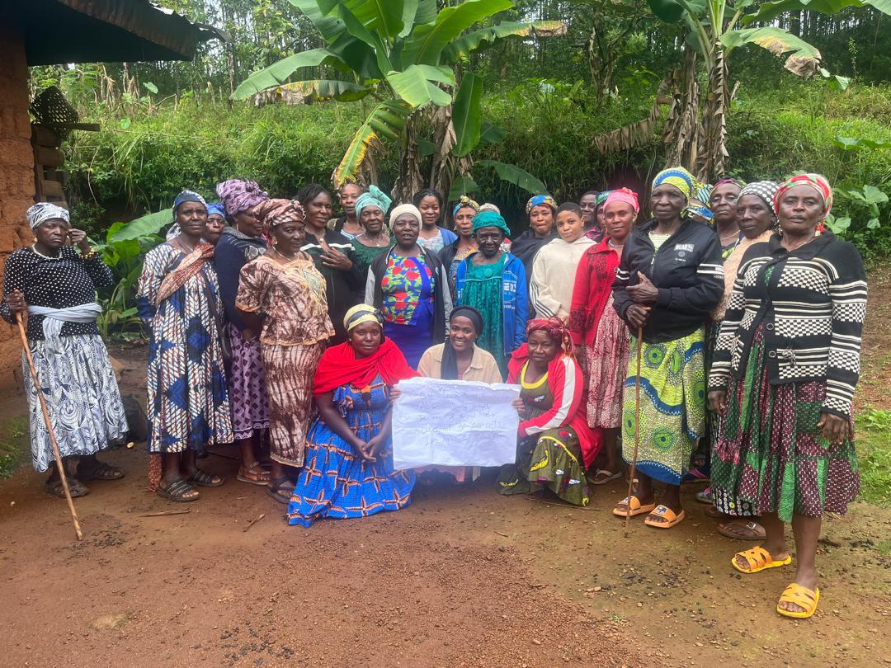
Change
In 2024,a baseline survey conducted at saint Bede’s college revealed that while many students recognized physical violence, less than half understood other forms of gender based violence.
With support from the Women of the South Consortium, I led community based interventions over 18 months that included:
GBV awareness workshops in schools and communities
Most can’t read but their participation tells a lot
Voice and Choice Summit 2026 \ Voice and Choice Summit 2026

Slide 5
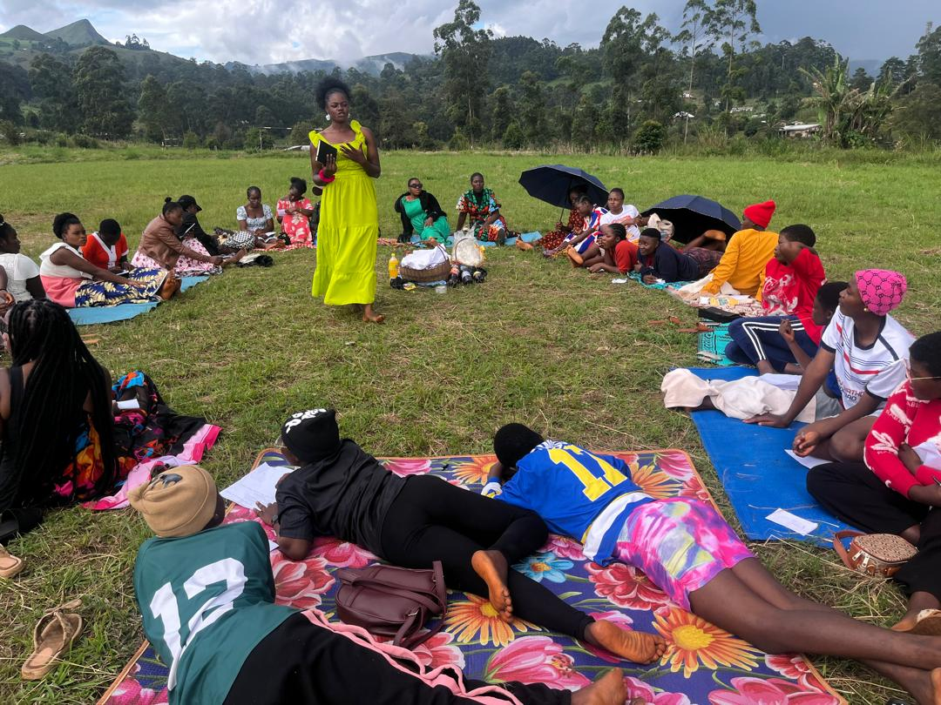
Change
Safe spaces for dialogue and survivor storytelling
Mentorship of young women into leadership roles
Engagement with youth groups, women’s groups and local leaders.
These actions helped break the culture of silence and encouraged open discussions on GBV, women’s rights and inclusion.
Safe is where they can be themselves
Voice and Choice Summit 2026 \ Voice and Choice Summit 2026

Slide 6
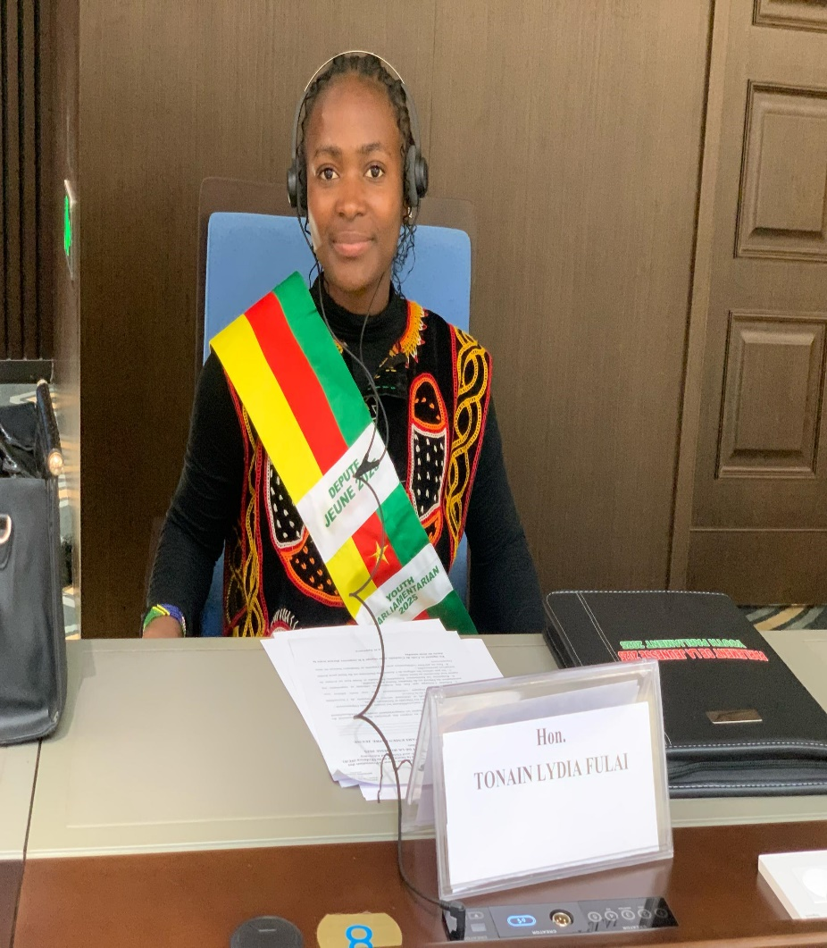
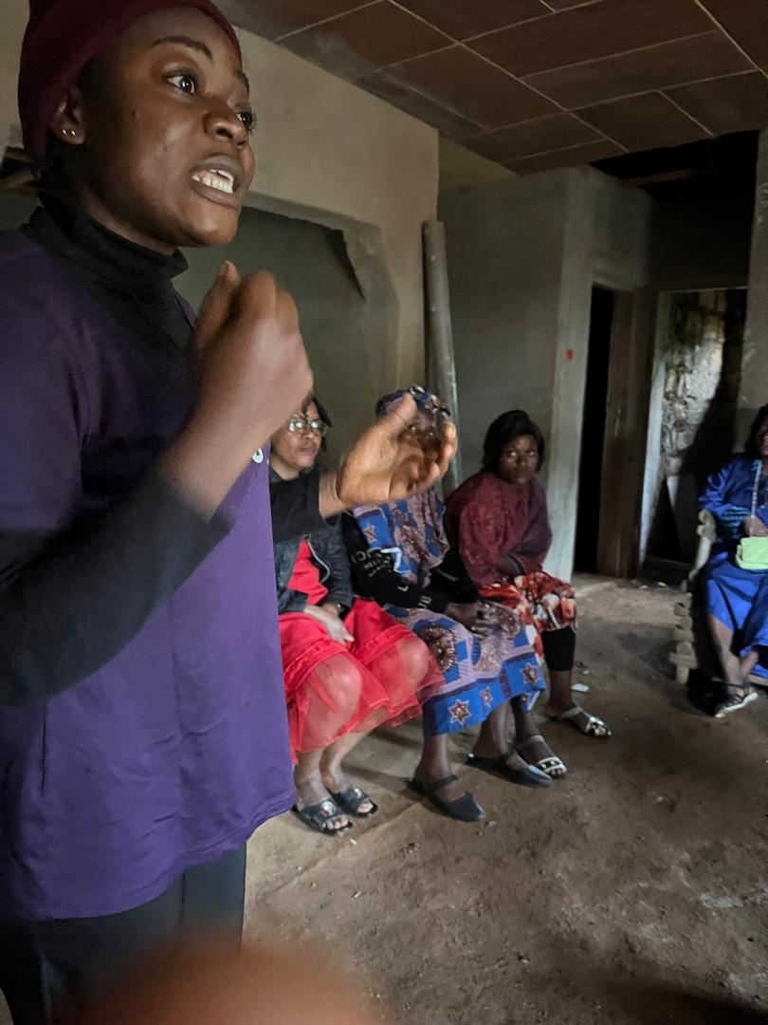
The change
Change has occurred primarily at the local level. With growing influence at the national level. Key changes include:
Over 15 cases of gender based violence identified and supported
Increased willingness among women and girls to speak openly about abuse
Greater participation of young women in decision making spaces
Mentorship of a female youth parliamentarian in my municipality
Community members now actively request workshops, and GBV discussions , once a taboo are happening openly. Contributions from these engagements were also captured in a national women and girls conference. Leading to the “Cameroon we want Declaration “ calling for an end to GBV
They want us to come back and include their girls
Voice and Choice Summit 2026 \ Voice and Choice Summit 2026

Slide 7
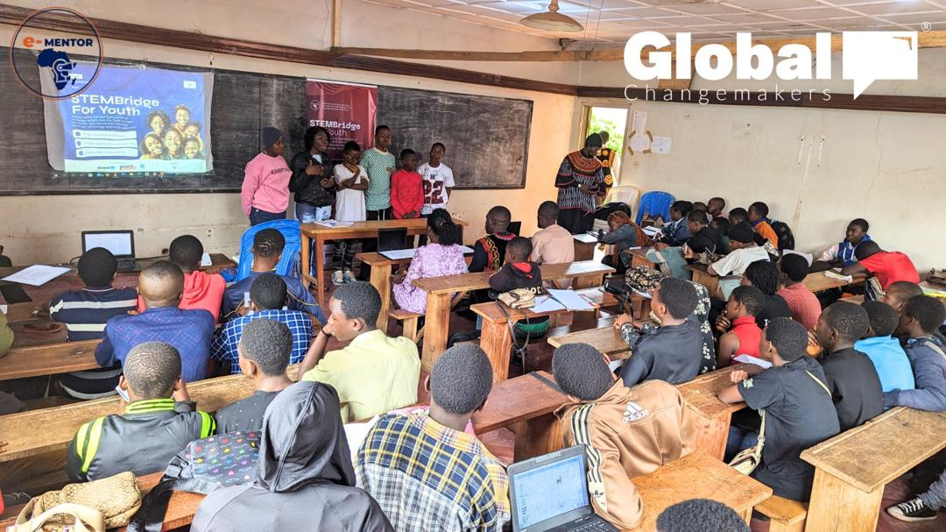
Sustainability
Sustainability is being ensured through:
Training and engaging youth leaders to continue community education
Establishing school-based clubs to institutionalize GBV awareness
Working with community leaders to integrate messages into local forums
Building partnerships with local organizations for long-term impact
By embedding the work within schools, youth structures, and community groups, the change continues beyond individual projects.
We are partnering with other organizations for greater reach
Voice and Choice Summit 2026 \ Voice and Choice Summit 2026

Slide 8
Challenges & Lessons learnt
Challenges & mitigation
Deep-rooted cultural silence around GBV
Fear of stigma and retaliation among survivors
Limited access to psychosocial and legal support services
LESSONS LEARNT
Trust building is essential for survivor engagement
Youth led and community based approaches are more effective
Creating safe spaces enables healing, leadership and long term change.
Voice and Choice Summit 2026 \ Voice and Choice Summit 2026

Slide 9
Next Steps
Moving forward, I plan to:
Expand GBV clubs in more schools
Strengthen referral pathways for survivors
Engage more youth and women leaders as community advocates
Advocate for policy reforms aligned with regional and international gender protocols
Engage men and boys in the discussions as allies to the fight against GBV
The goal is to scale this work across more communities and strengthen national advocacy for women’s rights and safety.
Voice and Choice Summit 2026 \ Voice and Choice Summit 2026

Slide 10
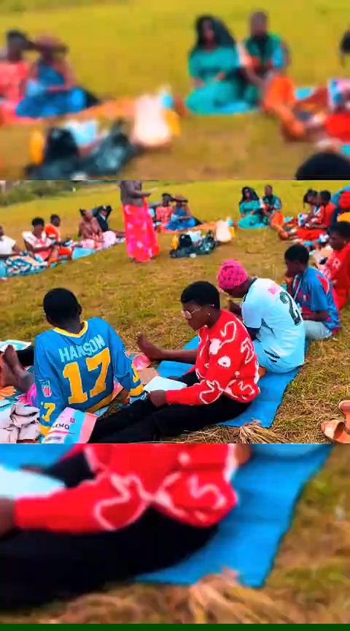
A video compiled from one of our activities THANK YOU FOR YOUR KEEN ATTENTION

