Slide 1

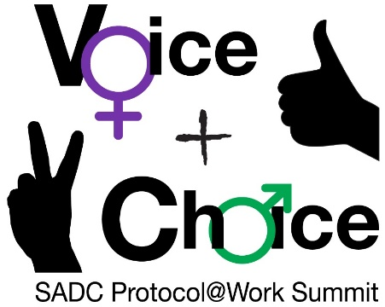





Logo goes here
LEARNING
AND SHARING
SUMMIT 2025
Country: Lesotho
Presenter: Matseliso Mokitimi
Women’s Voice and Leadership Learning and Sharing Summit 2025

Slide 2
About AGYW+ Foundation Lesotho
Adolescent Girls, Young Women and others (AGYW+) Foundation was started by coalition of Basotho AGYW who take great pride in their celebration of diversity and multicultural immersion and aspires to serve as policy influencers in Lesotho as well as gearing up for a lifetime of human rights activism in support of AGYW+ in Lesotho.
Vision
Envisions empowered AGYW living with dignity and contributing as equal partners in accessing SRHR services, health care, participating in socio-economic and political decision making whilst being free from violence and discrimination.
Mission
To empower and attain AGYW’s gender equality at all levels through advocating for their rights, eliminating discrimination against AGYW including GBV, advancing AGYW‘s capabilities, leadership skills, amplifying their voices and promoting AGYW participation in decision making platforms at the national and international level.

Slide 3
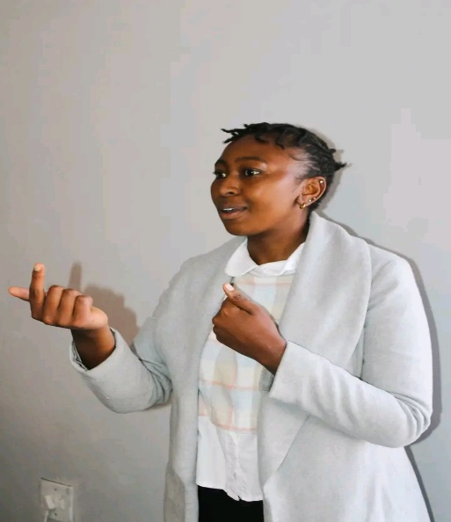
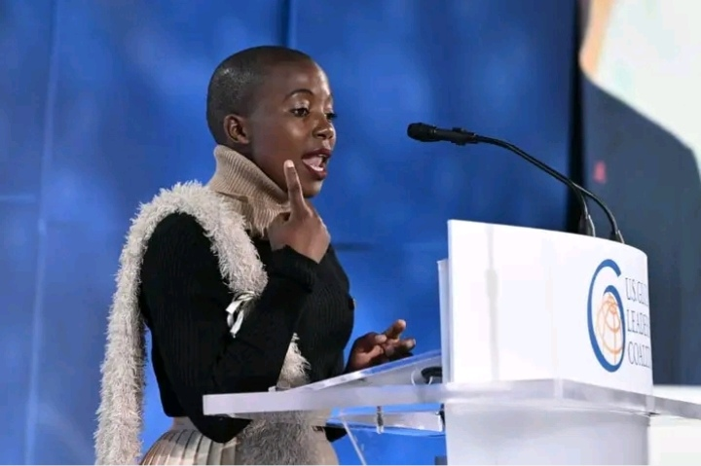
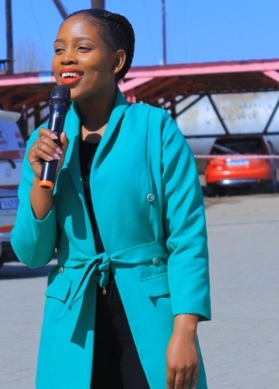
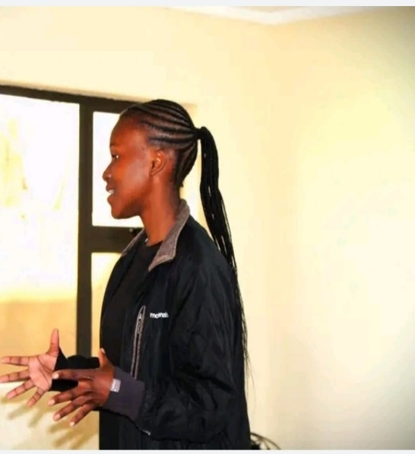
OBJECTIVES
Supported by VCSAF, Amplifying AGYW+ Voices project set out to:
Advocate for SRHR, gender equality, and AGYW participation in decision-making processes.
Strengthen networks and partnerships to improve AGYW+ access to health services.
🎯 Empower AGYW+ by:
Enhancing leadership capabilities
Advocating for SRHR and eliminating GBV
Promoting inclusive SRHR services and raising awareness on HIV prevention, GBV, and menstrual health
Photo
Women’s Voice and Leadership Learning and Sharing Summit 2025

Slide 4
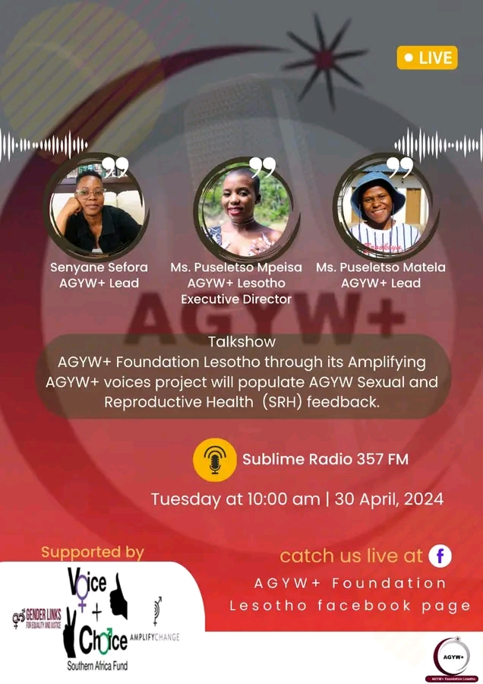
SYNOPSIS
Key Changes: ✅ Increased empowerment and active involvement of Adolescent Girls and Young Women (AGYW) in policy advocacy, SRHR, and gender equality in Lesotho.
Driving Force: 🚀 Since 2023, AGYW+ Foundation Lesotho's advocacy efforts have:
Raised awareness on AGYW+ rights, particularly in SRHR, GBV, and leadership development.
Strengthened AGYW participation in decision-making processes.
Strengthen networks and partnerships to improve AGYW access to health services.
Leadership & Support: 🚀 Led by AGYW+ Leads & Team Leaders in 8 communities Supported by Community Leaders, Parents & Implementing Partners
Photo
Women’s Voice and Leadership Learning and Sharing Summit 2025

Slide 5
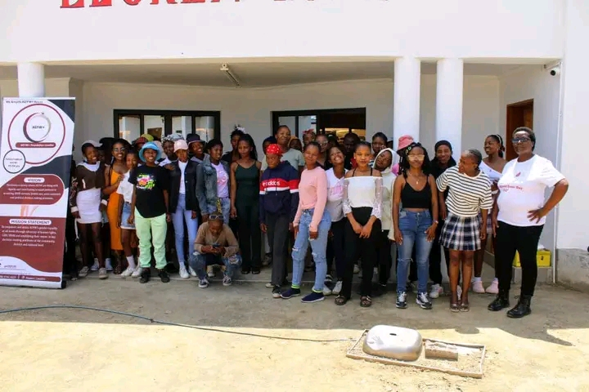
Activities and contribution to change
AGYW+ Foundation Lesotho has made significant contributions through SRHR advocacy, Capacity building, awareness campaigns and stakeholders engagement.
📌 Multiple activities and initiatives have driven change, including:
✅ SRHR Mobilization & Sensitization (418 AGYW)
✅ AGYW Leadership Training (36 AGYW) ✅ Represention in Advocacy Meetings (HIV Prevention Dialogue & Roadmap (NACYC), SRHR Advocacy meeting by ARASA, PEPFAR COP 23 meetings, SADC Regional meeting by UN Women to review regional commitments and strategies including SADC GBV strategy and advancing SRHR across the region): 29 AGYW ✅ Peer-to-Peer SRHR Sharing & Open Dialogues (86 AGYW) ✅ Engagements with Key Stakeholders (Parents, Community Policing, Child & Gender Protection Unit, Health facilities and service providers)
✅ Participation in a Social Innovation Lab by GIZ through Partnerships for Prevention (PfP) of GBV program. ✅ Campaigns & Events (16 Days of Activism, Day of African Child, Menstrual Hygiene Day)
Evidence of Change include documentation of program activities, including reports, media coverage, and testimonials from AGYW beneficiaries
Photo
Women’s Voice and Leadership Learning and Sharing Summit 2025

Slide 6
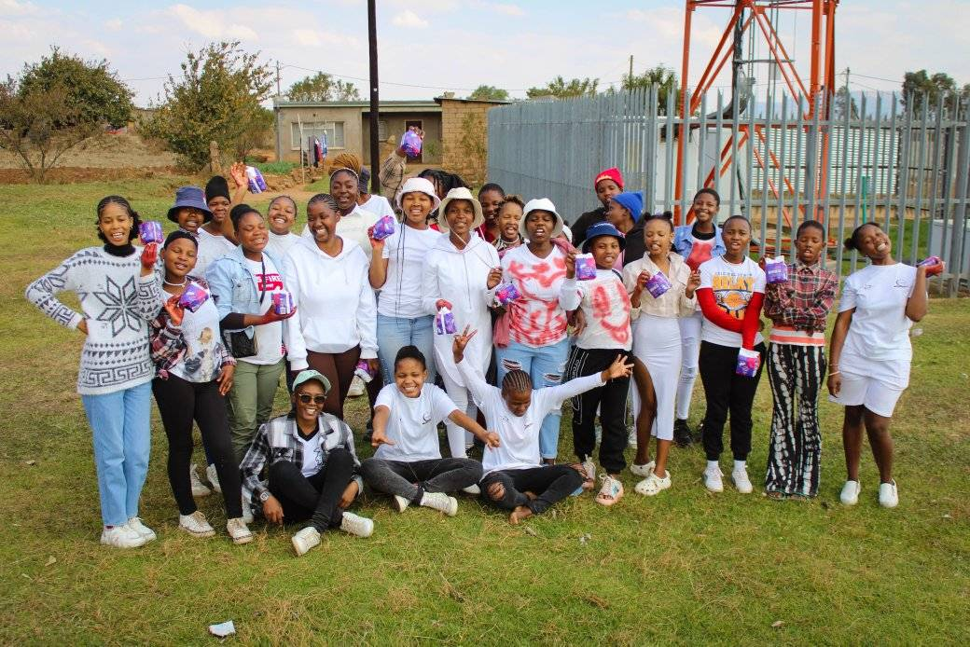
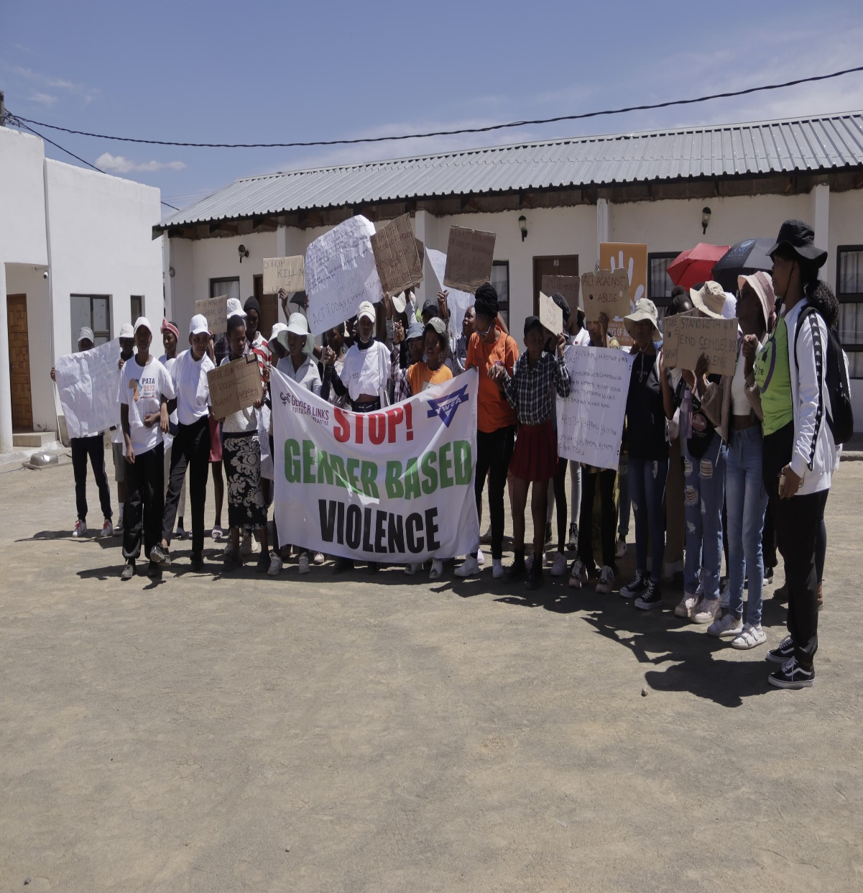
Awareness Campaigns
Menstrual Health Day
16 Days of Activism

Slide 7
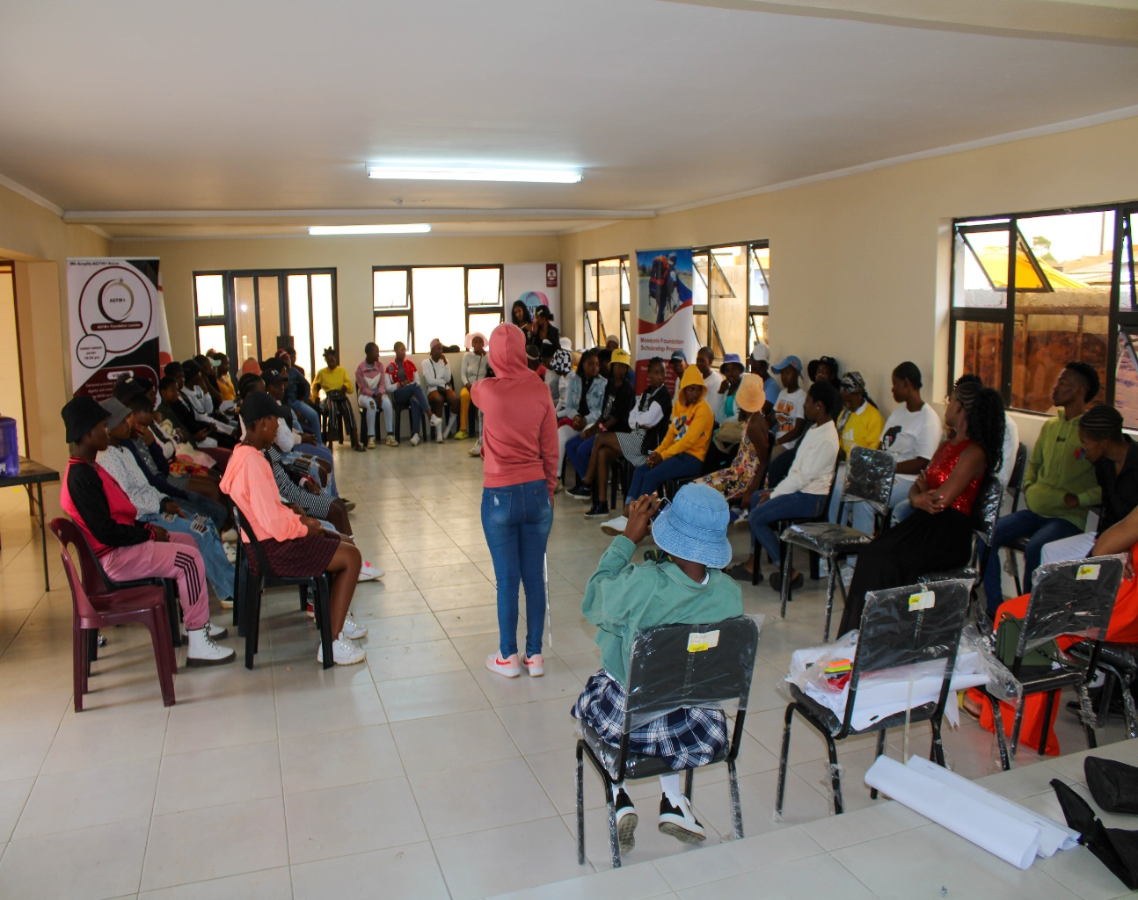
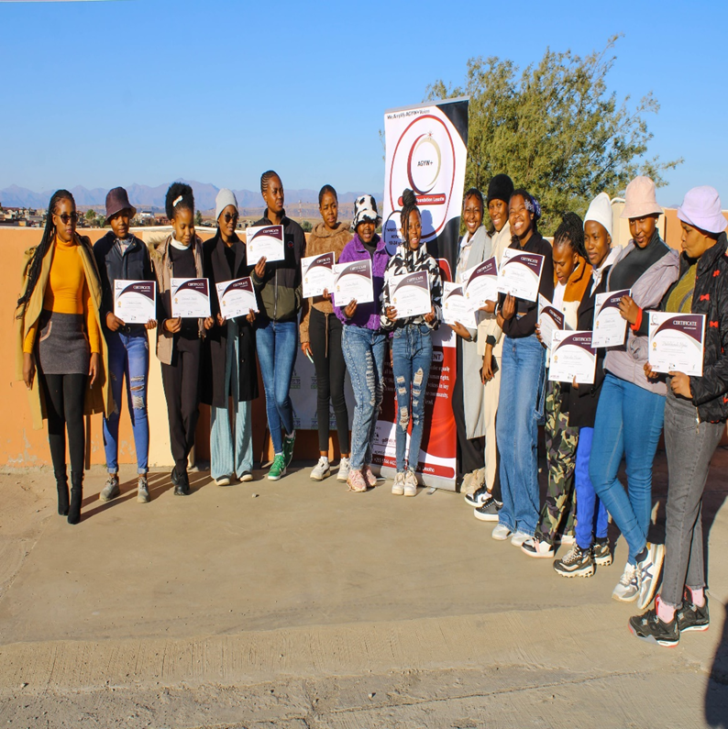
Open Dialogues and Trainings
Open dialogues and Sensitization on SRHR, GBV and Menstrual Health
Training of AGYW community team leaders on Advocacy, Communication and Public Speaking an Health Policy

Slide 8
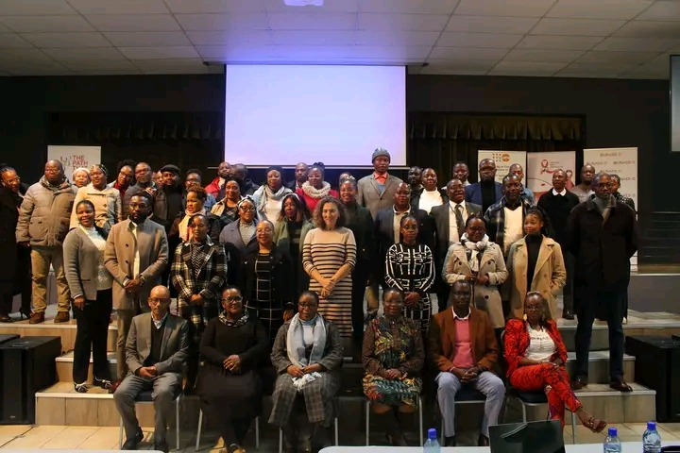
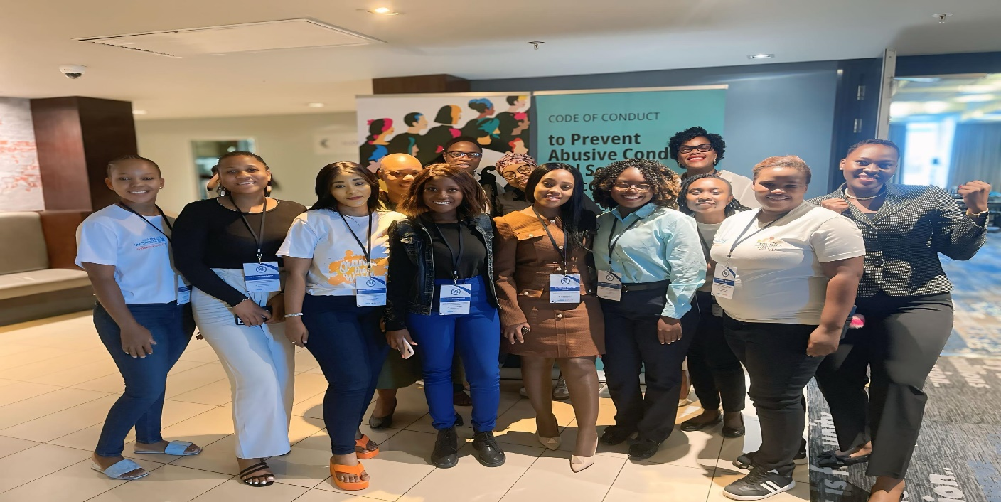
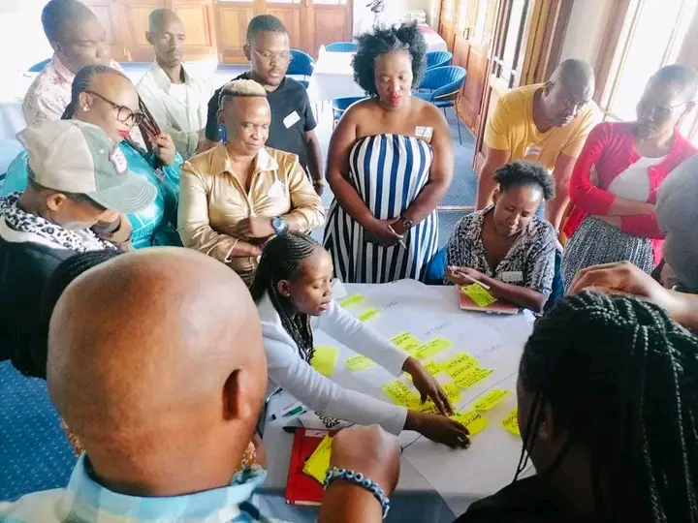
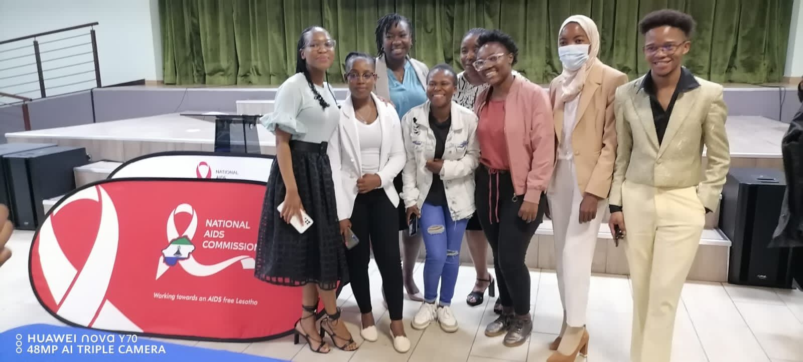
AGYW participation in decision making processes regarding their SRHR

Slide 9
Contribution to change
These activities and advocacy work have ensured that AGYW’s voices are heard and contributed to:
🔹 Strengthened GBV laws & enforcement using community engagement model during 16 Days of Activism event, focus group discussions and progress toward establishing community-led GBV prevention committee comprised of AGYW community team leaders, area chiefs, community policing units and other community leaders in the community of Ha Motemekoane and Ha Jimisi and Ha Bosofo.
🔹 Youth-Friendly Health Services: Influenced youth-centered spaces in clinics (e.g., Paki Health Center and Pshoalella Heatlth Facilities now offers Saturday HIV services and timely services (red-carpet treatment) to AGYW.
🔹 SRHR Education & Awareness: 418 AGYW+ empowered with knowledge on SRHR including HIV prevention, contraception, menstruation so that they make informed decisions about their SRH. Parents & community stakeholders and leaders were engaged on SRHR sensitization.
🔹 Improved Access to Healthcare: Expanded SRHR & HIV services for AGYW+ through partnerships with partners who implement DREAMS program and community-based health services and mobile clinics.
🔹 HIV Prevention Advocacy: Highlighted gaps in youth-focused HIV prevention with National AIDS Commission (NAC). Supported youth-centered policies & PrEP awareness.
Women’s Voice and Leadership Learning and Sharing Summit 2025

Slide 10
Population Group this change most closely related to
Category | Women | Men | Total | % Women
Direct beneficiaries | 418 | 0 | 418 | 100%
Indirect beneficiaries (e.g. through other networks) | 18 | 4 | 22 | 82%
Online beneficiaries: Facebook, Instagram and WhatsApp | 1556 | 51 | 1607 | 97%
Total | 1992 | 55 | 2047 | 97%
Women’s Voice and Leadership Learning and Sharing Summit 2025

Slide 11
Significance of change
AGYW+ are now active change agents in decision-making spaces (e.g., HIV Prevention Roadmap
AGYW have increased capacity in public speaking, advocacy, and SRHR education.
Changing Social Norms & Public Engagement:
Communities are more open to discussing SRHR, GBV, and gender equality.
Increased participation of parents, chiefs, and community policing units.
Women’s Voice and Leadership Learning and Sharing Summit 2025

Slide 12
Results
The results of the actions made has been:
AGYW Empowerment: AGYW+ are better equipped to advocate for their SRHR.
Public Participation: Increased involvement of adolescents and young women in decision-making spaces such as HIV Prevention road map processes and PEPFAR COP as well as community based GBV prevention forums.
Media Coverage: Enhanced visibility through national and international platforms such as National AIDS Commission Youth Consortium events with AGYW representatives. Events like radio talk shows and campaigns have increased media visibility for AGYW’s issues.
Capacity Building: Strengthened leadership skills among AGYW+ members: 20 AGYW+ from 8 communities have been empowered with skills in public speaking, advocacy, and SRHR education.
Changes in Gender Attitudes: Growing community support for gender equality and AGYW rights. Community members, community leaders, parents and community policing units are becoming more open to discussing SRHR, GBV, and women’s rights, leading to evolving attitudes.
Evidence: Reports, photos, social media engagement, feedback from beneficiaries
Women’s Voice and Leadership Learning and Sharing Summit 2025

Slide 13
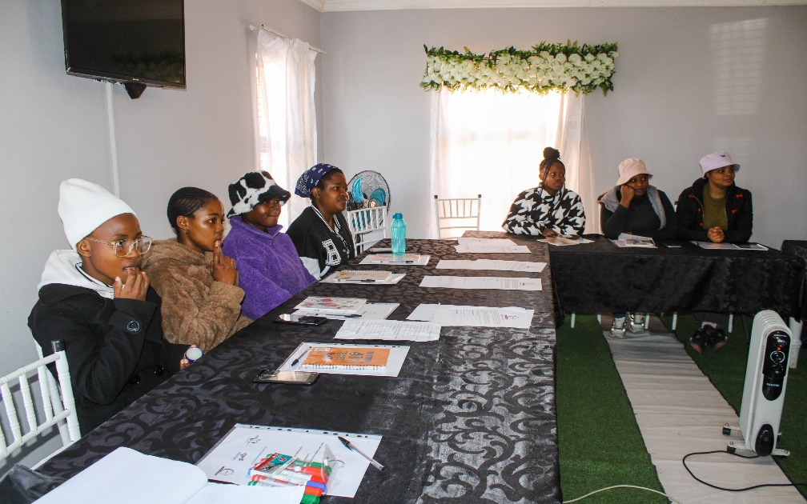
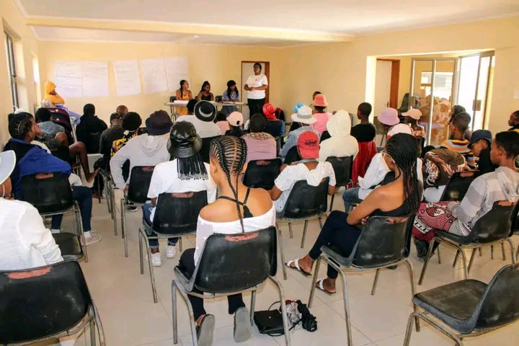
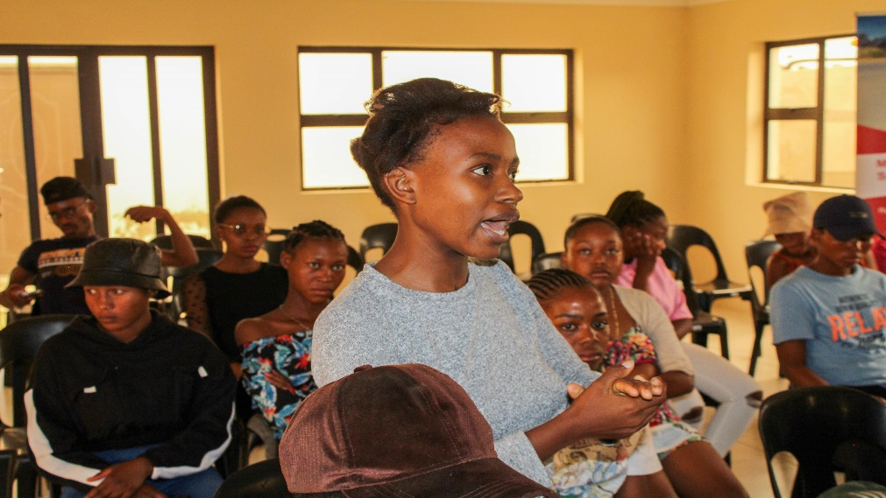
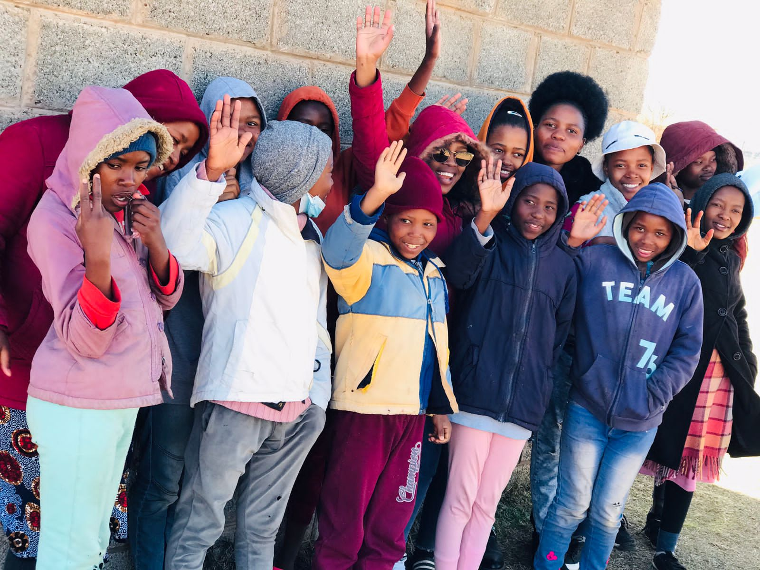
Evidence: Reports, photos, social media engagement, feedback from beneficiaries
Women’s Voice and Leadership Learning and Sharing Summit 2025

Slide 14
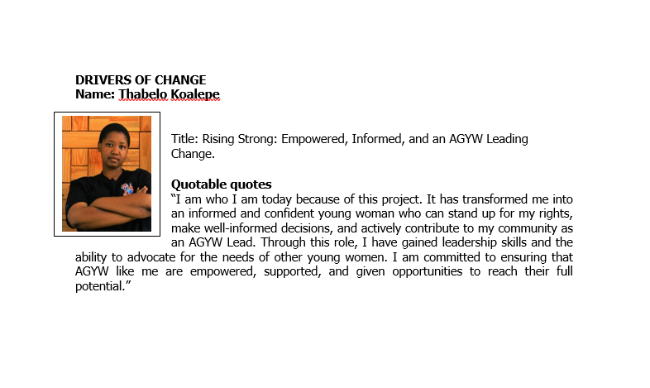
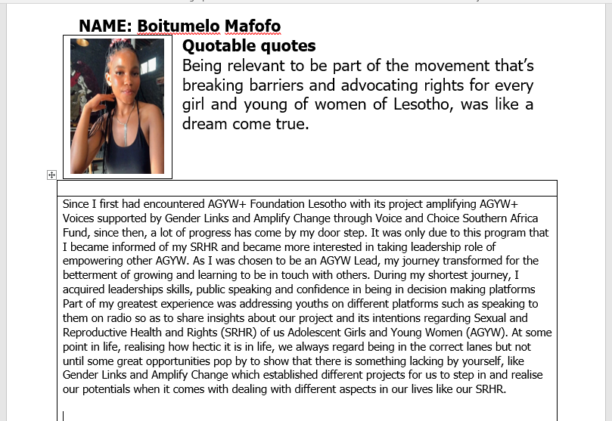
Cont.

Slide 15
CHALLENGES AND LESSONS LEARNT
Main challenges experienced include:
• Cultural and Religious Barriers: Resistance to SRHR and GBV discussions, especially in rural communities where there is lack of access to know advanced knowledge.
• Limited Access to Resources: Financial and logistical challenges in scaling programs.
• Stigma and Discrimination: Negative societal attitudes towards AGYW seeking SRHR services or discussing GBV.
These challenges have been overcome through:
• Community sensitization and involving community leaders and parents in SRHR discussions.
• Partnering with implementing partners like USAID DREAMS program targeting AGYW to leverage on resources for AGYW SRHR services.
• Continuously engaging AGYW and their communities through open dialogues and educational campaigns to break down stigma.
Women’s Voice and Leadership Learning and Sharing Summit 2025

Slide 16
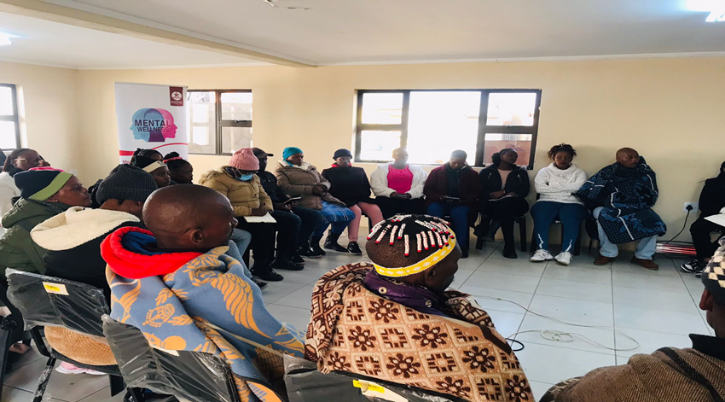
LESSONS LEARNT
Community engagement is essential to overcoming cultural and societal barriers.
Youth-led initiatives are powerful in addressing issues that directly affect young people.
Collaboration with other organizations enhances impact and reach, particularly when dealing with complex issues like SRHR and GBV.
Women’s Voice and Leadership Learning and Sharing Summit 2025

Slide 17
LESSONS LEARNT
The lessons will be applied by:
Continuing to engage community leaders and local stakeholders to ensure that interventions are culturally sensitive and widely accepted.
Focusing on further strengthening youth-led advocacy and leadership within the AGYW community.
Expanding partnerships to secure additional resources and amplify efforts.
Women’s Voice and Leadership Learning and Sharing Summit 2025

Slide 18
SUSTAINABILITY AND REPLICATION
These work can be sustained through:
Continued fundraising and partnership building to secure ongoing financial support.
Institutionalizing SRHR and leadership training programs for AGYW, ensuring they become part of the national decision making processes and community engagement strategies.
Establishing a strong AGYW network that can continue advocacy efforts beyond the current project.
Lobbying community support
The work can be cascaded by:
Sharing best practices and lessons learned with other organizations in the SRHR and youth empowerment sectors.
Creating a mentorship program where AGYW leaders can share their experiences with peers from other organizations
Encouraging and supporting community-led initiatives
Women’s Voice and Leadership Learning and Sharing Summit 2025

Slide 19
NEXT STEPS
Expansion of SRHR and GBV Advocacy: Continuing to push for stronger policies and support for AGYW.
Economic Empowerment: Developing more programs focused on economic independence for AGYW.
Leadership Development: Enhancing leadership opportunities for AGYW to ensure their representation at all levels of decision-making.
Improved Access to Healthcare: Advocating for youth-friendly healthcare services and removing barriers to SRHR access.
Improving partnerships with implementing partners like Bokamoso DREAMS project to ensure more resources and impact for AGYW.
Women’s Voice and Leadership Learning and Sharing Summit 2025

Slide 20


THA https://www.facebook.com/profile.php?id=100063904908103 https://www.instagram.com/agywplusfoundationlesotho?igsh=OGQ5ZDc2ODk2ZA== THANK YOU

