Slide 1



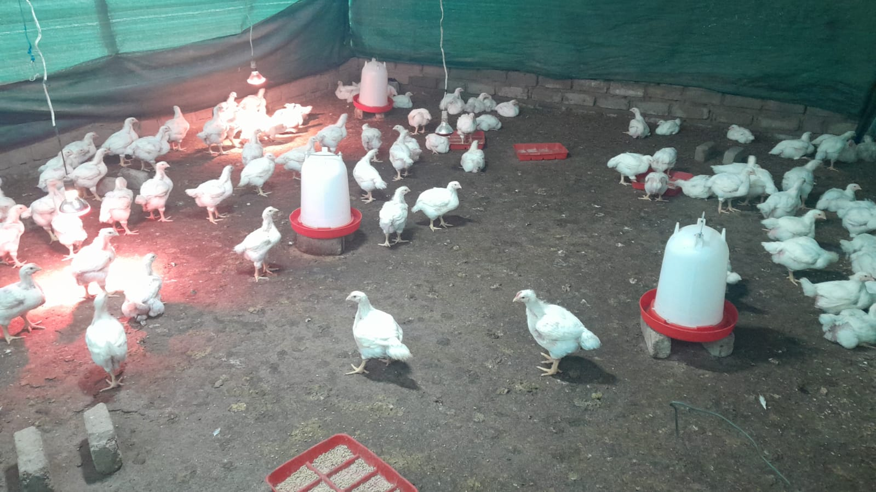
PROMOTING GENDER-INCLUSIVE LOCAL ECONOMIC DEVELOPMENT IN SOUTH AFRICA
ESTABLISHED ENTREPRENEURS
NAME OF THE BUSINESS: ADEL SPACE SHOP
PARTICIPANT NAME: ADALETH VALOYI
COUNCIL: TZANEEN
R100

Slide 2
MY EXPERIENCE DURING SUNRISE CAMPAIGN
Key lessons from Life Skills and Entrepreneurship training
Loving myself
Problem Solving
Business planning
Time management
Market and Sale
Memorable moments(e.g Mentorship, Group Work, Support etc)
Working together with love and respect during group work
My mentor encouraged me to manage my stock and control my anger towards my customers
Understanding more about business

Slide 3
HOW MY LIFE HAS CHANGED
Personal growth (confidence, independence, safety)
Goal – Setting and achieving when it comes to business because I am now my own boss.
Self awareness
Family impact (children, relationships, community respect)
My life start to be easy because I can afford to support my children so now it’s a happy family
I have freedom towards my relationships and wellbeing and happiness
Improve living environment
Income changes or lifestyle improvements

Slide 4
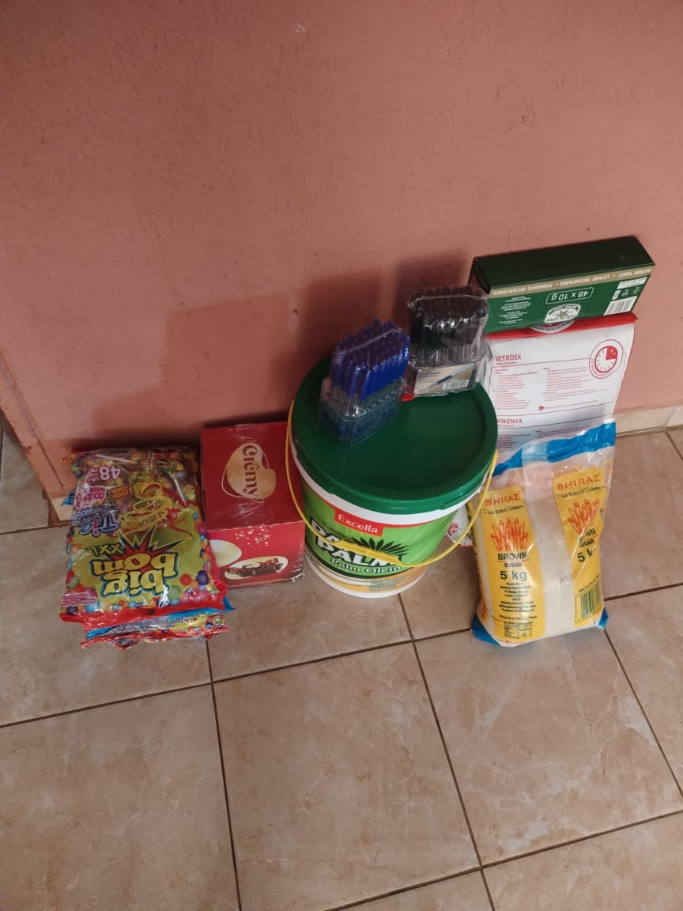
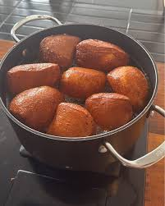
PLEASE DESCRIBE THE BUSINESS
Name of business: Adel Space Shop
Products/services offered
I am selling cream, pens, potatoes, tomatoes, eggs and making fats
Achievements so far Challenges still faced and how they’re managed
I achieve self control and making business with my specifications
Challenges with business is that some of my customers are staying far from my shop.
My achievement is to work hard so that my business can grow fast by going door-to-door, selling.
Photo or video

Slide 5
CUSTOMER BASE AND COMPETITION?
My customers are those that receive social grant and students.
Have you increased the number of customers since starting the LED Programme? Yes or No
How did you do this?
My competition are the shops nearby.
I make sure my market is clean and well packed.
I also give free snacks when my customers come with the young ones.

Slide 6
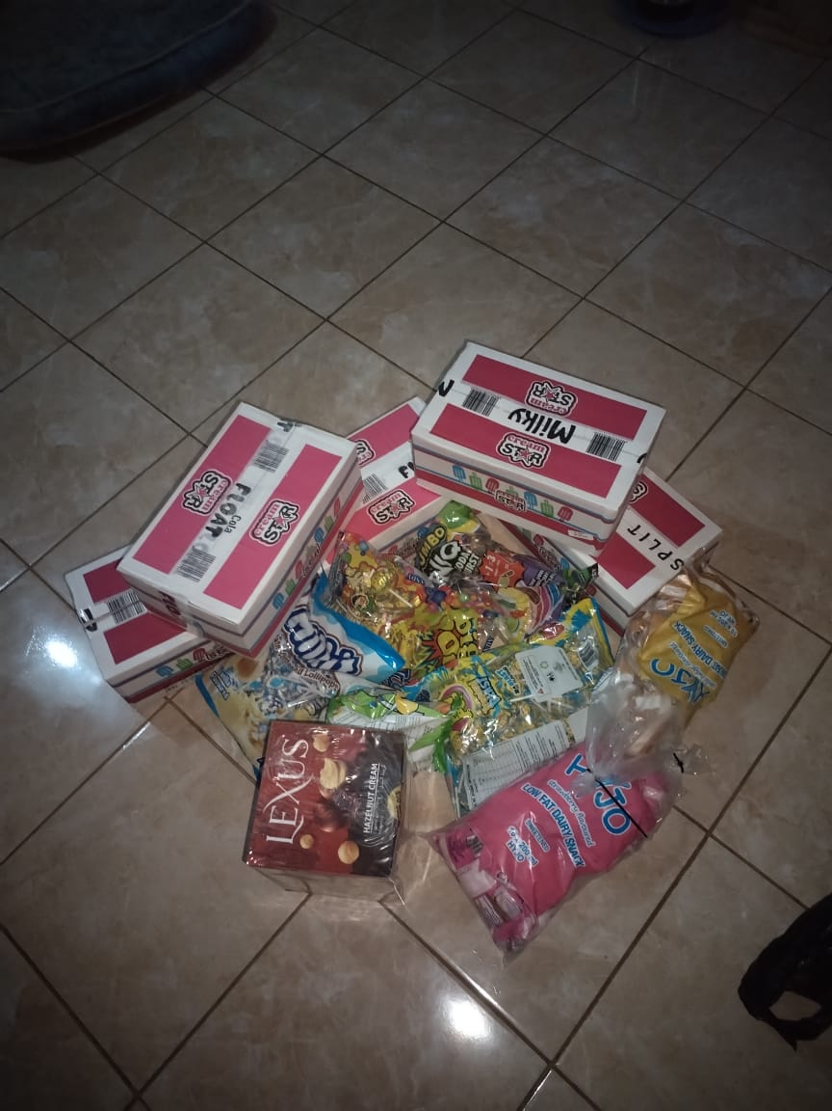
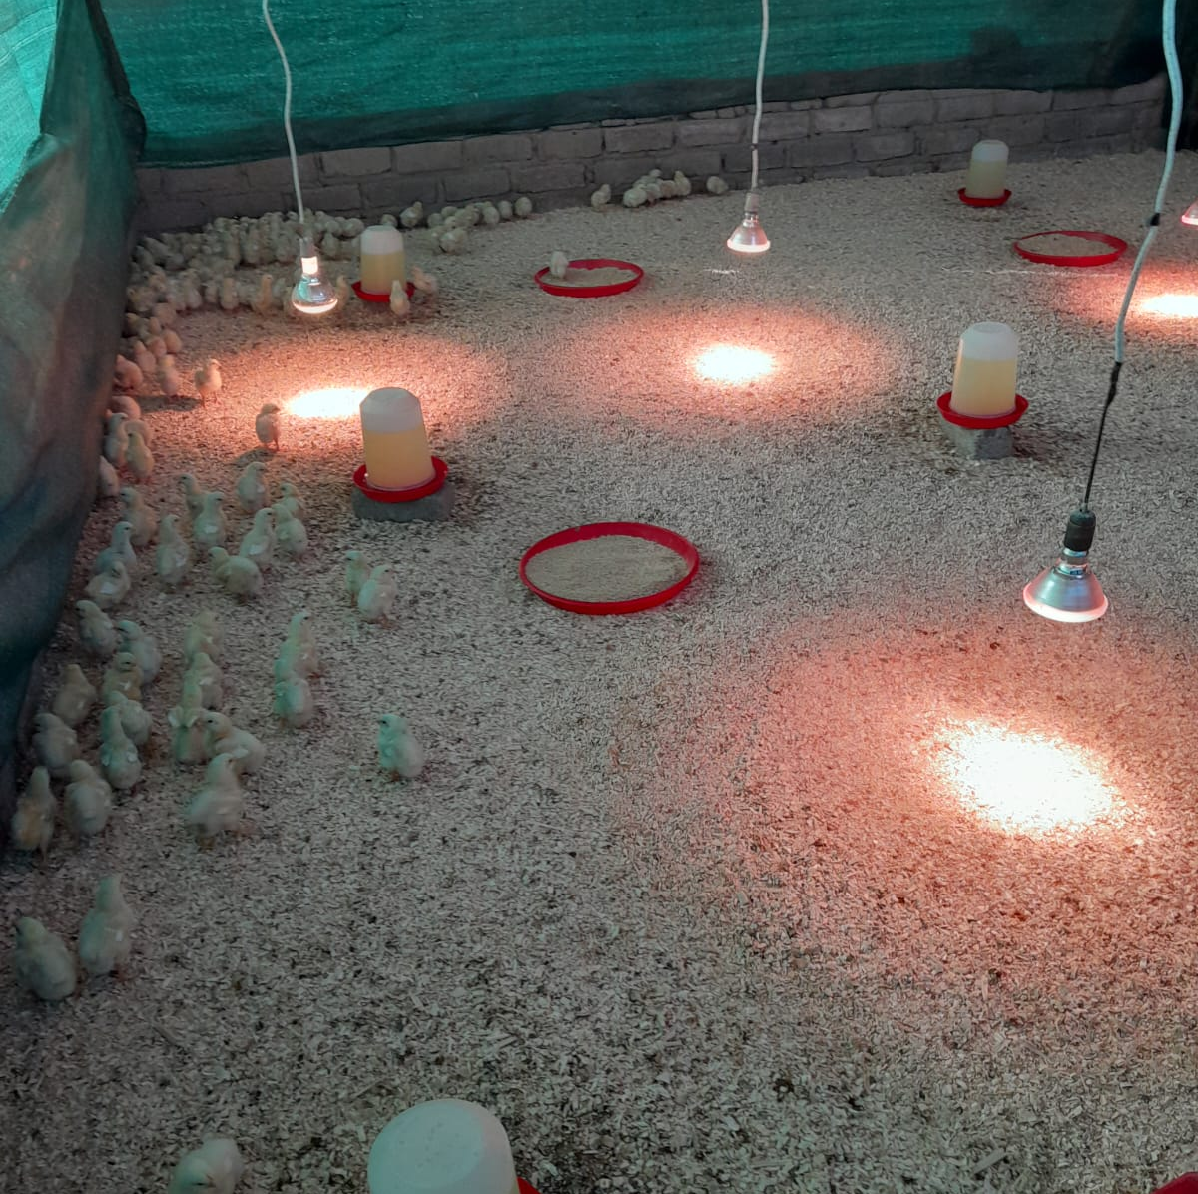
NEW PRODUCTS OR SERVICES?
Do you have any new business products or services?
What new products are in the business?
How are they performing compared to your initial products?
How do you advertise/market your products?
Evidence

Slide 7
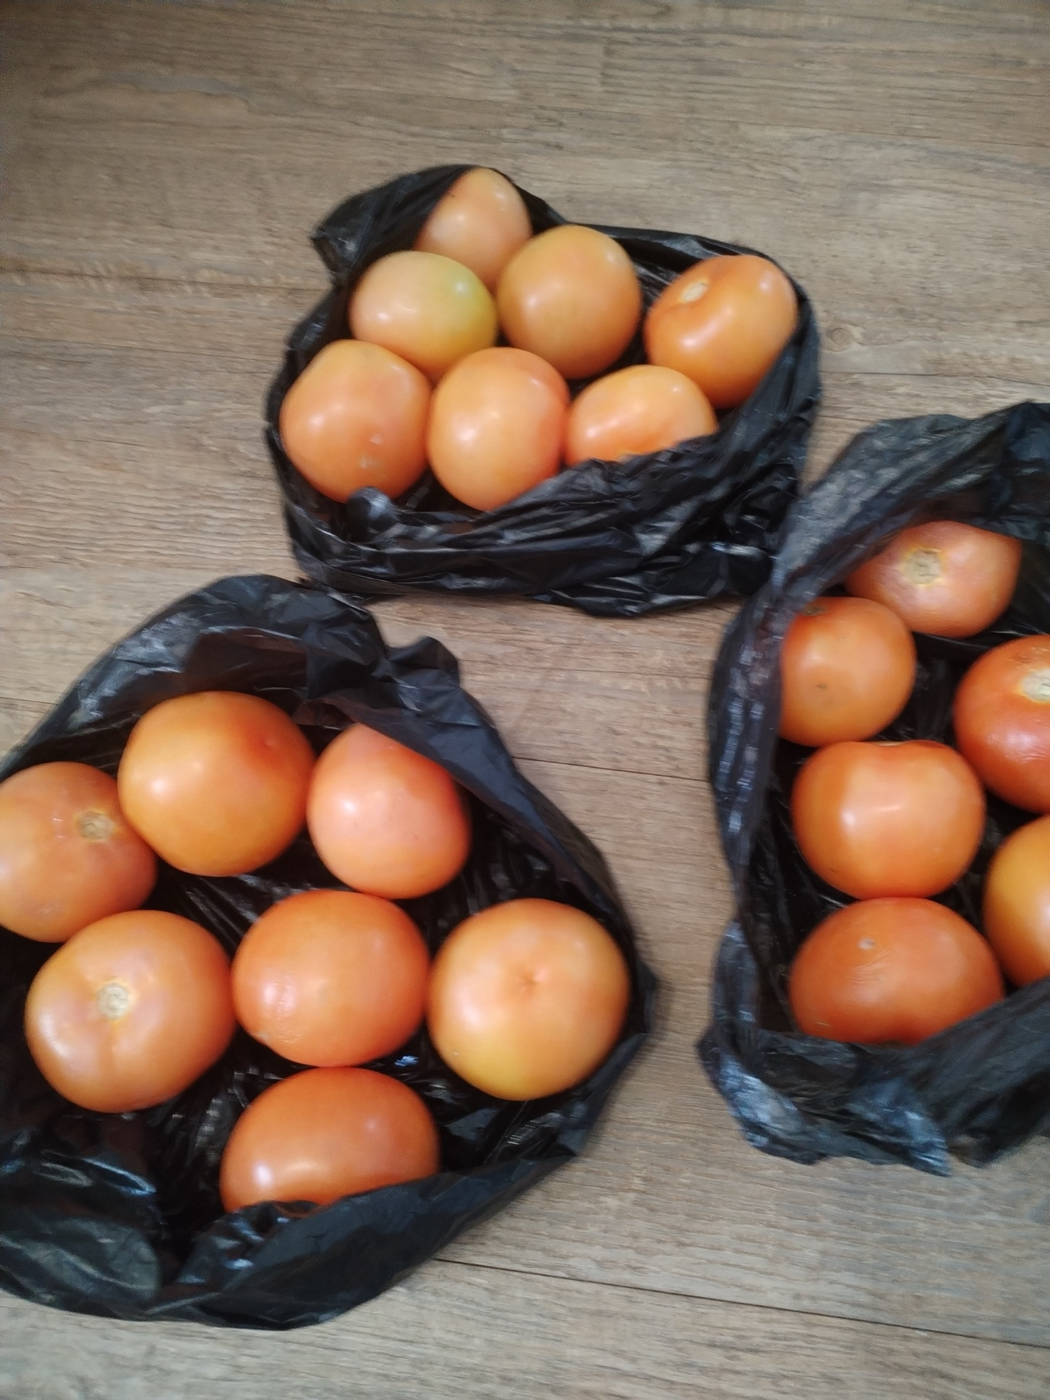
QUALITY AND PACKAGING
I use quality products and the packaging is also perfect. For example I use a plastic bag to package tomatoes.
Evidence

Slide 8
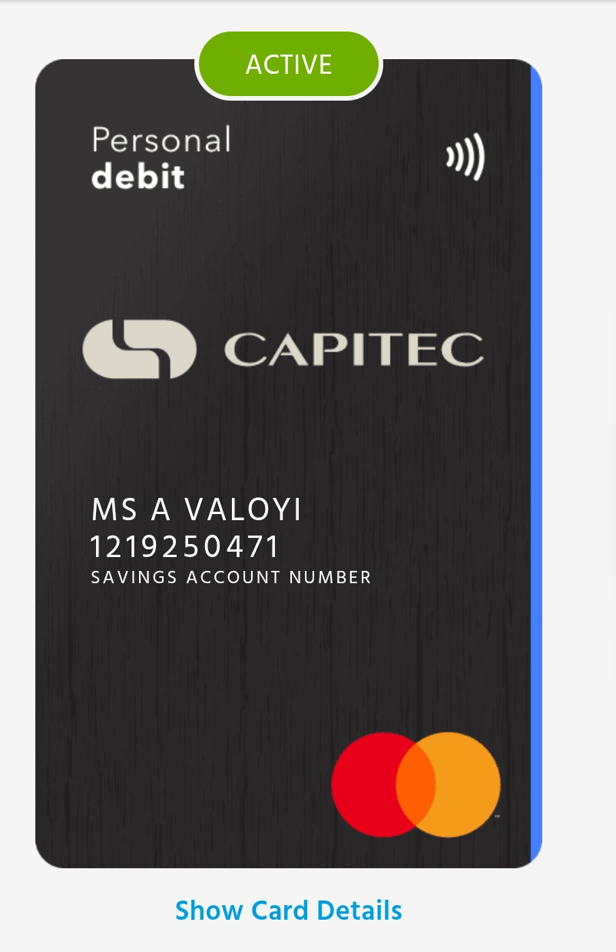
BUSINESS MANAGEMENT
When I come from buying my stock, I record my slips and stock that I bought.
My prices are always affordable.
I keep record of everything.
I manage my business by myself.
Evidence

Slide 9
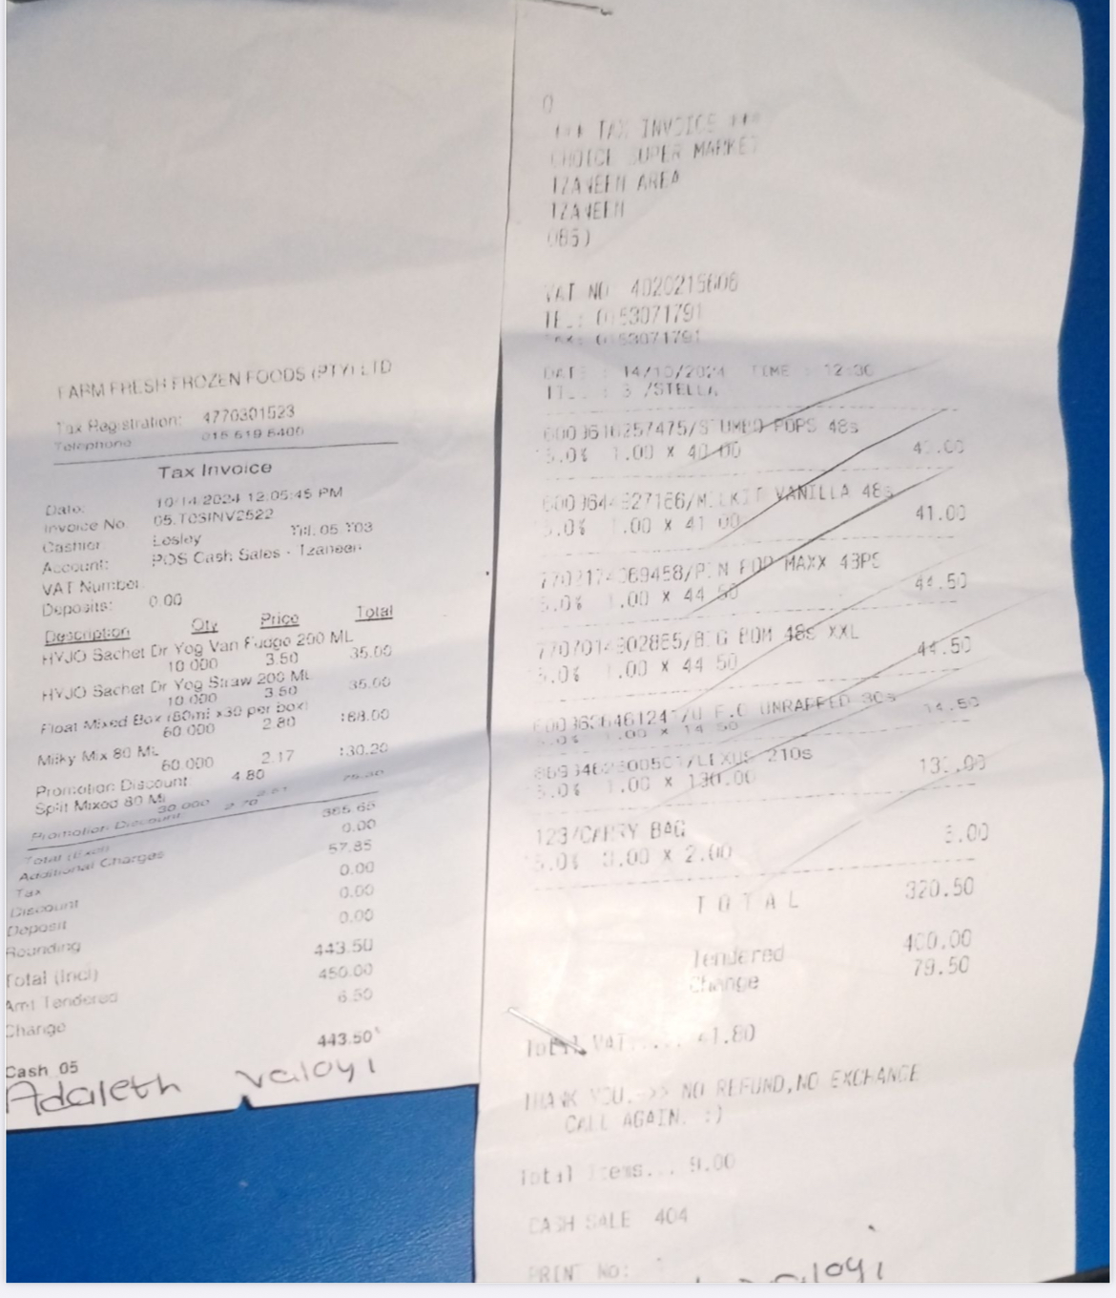
FINANCIAL MANAGEMENT
I do have a record keeping in place to help me track my business progress.
I am always time cautious.
I get income from child support grant and family.
I use my own bank account for my business.

Slide 10
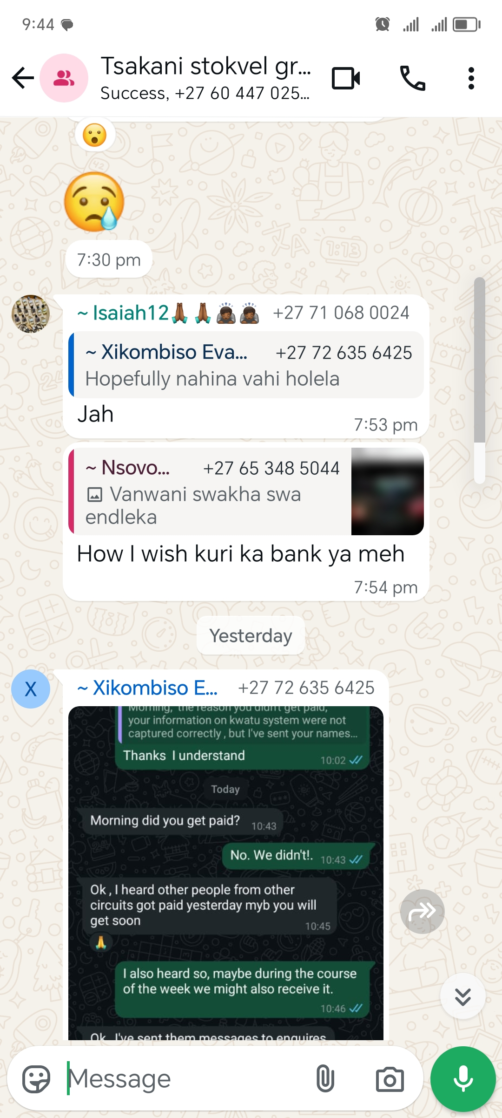
SAVINGS AND SELF SUFFICIENCY
I am a member of a saving club whereby I manage to save R1000 because every month each person contribute R200.
Evidence

Slide 11
INCOME AND EXPENSES FOR THE BUSINESS FOR PAST THREE TO SIX MONTHS
INCOME
EXPENSES
ITEM | AMOUNT
Profit | R15000
Child grant | R3360
TOTAL | R18360
ITEM | AMOUNT
Electricity | R3600
Stock | R6600
Transport | R324
TOTAL | R10524

Slide 12
CHALLENGES
The challenges that I am facing right now is selling the vegetables because they need transport and I have limited space and containers.
Some people buy on credit and don’t pay back.
If chicken die, there wont be a profit
It is difficult to bank the money for chicken because it is going back to buy chicken stuffs

Slide 13

SUSTAINABILITY
I should go where there are lot of people, for example the soccer tournaments.
I should do door-to-door
I should add new products
There is advertisement on the road for chicken sale.

Slide 14
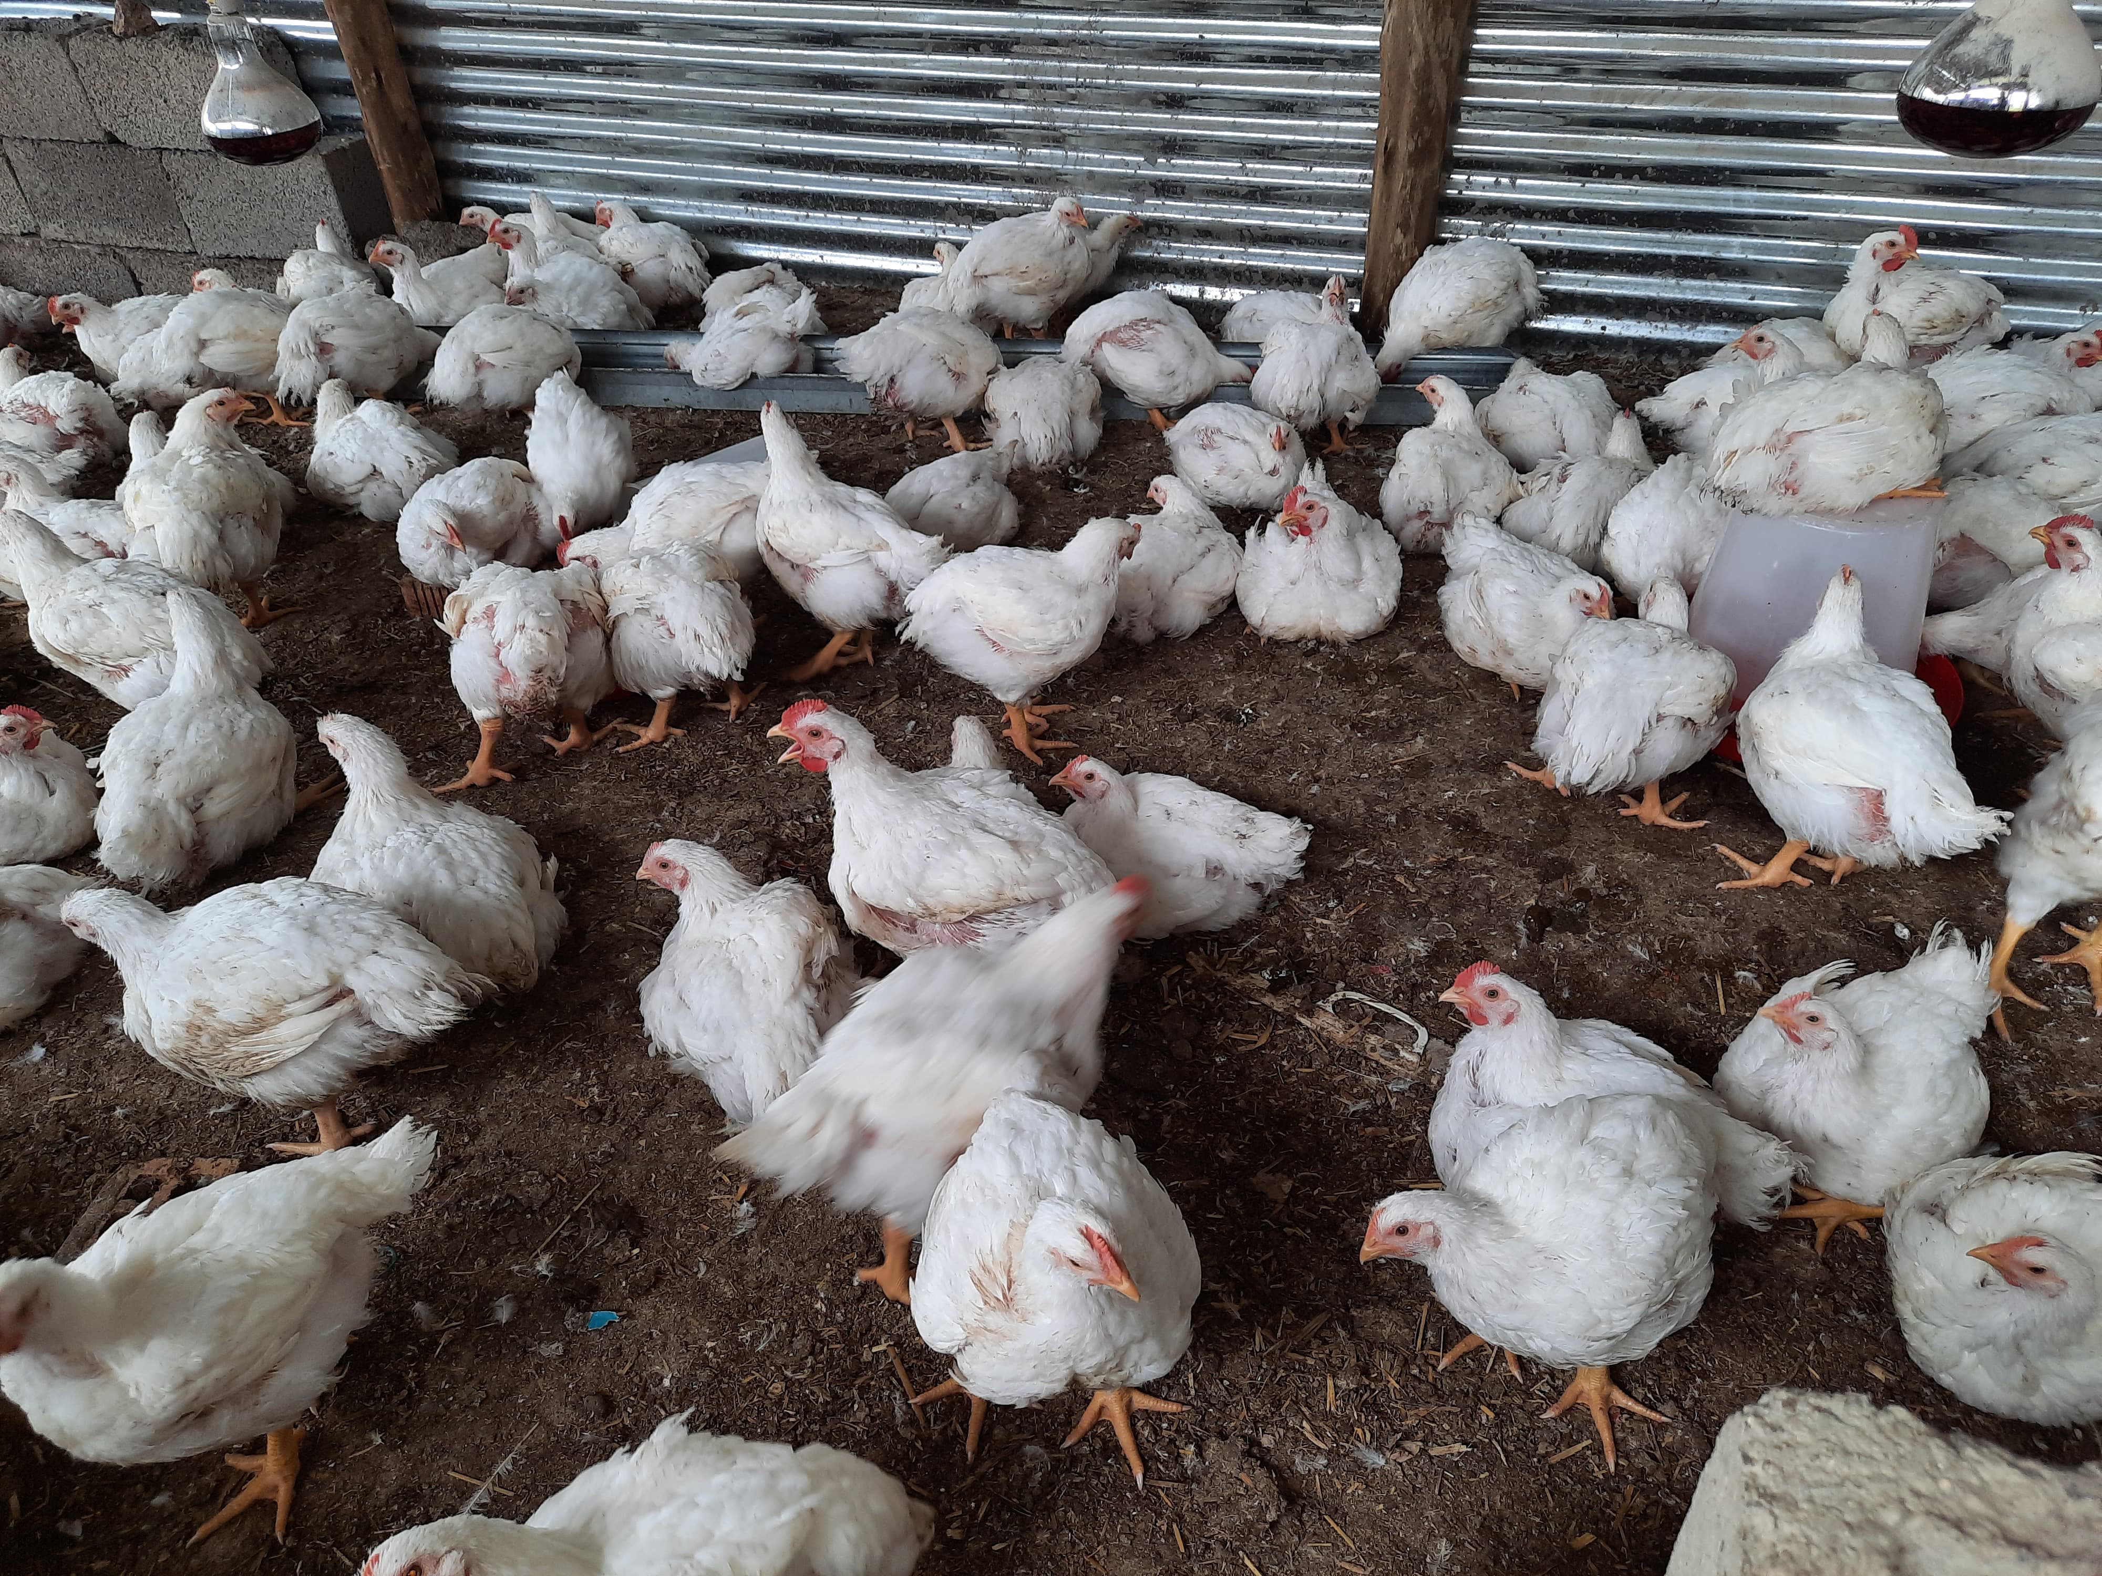
WHAT PLANS HAVE YOU MADE TO GROW YOUR BUSINESS IN THE NEXT 6 MONTHS?
I want to build a structure where I can put chickens.
I should meet new people.
I should build and sustain connection.
Evidence

Slide 15
ADDITIONAL INFORMATION?
I need support towards getting a transport and networking opportunities.

