Slide 1
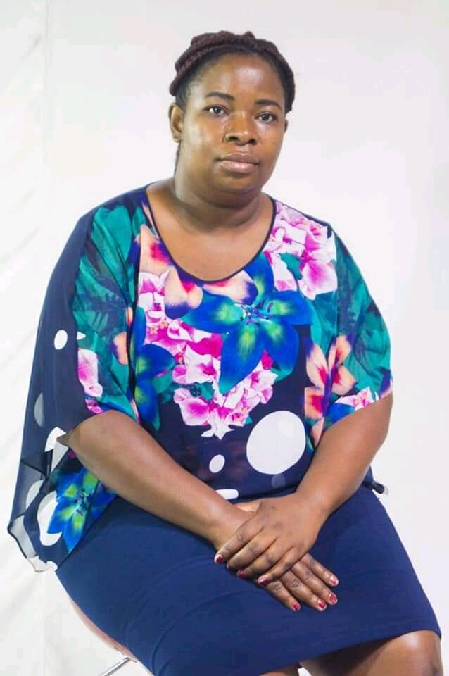
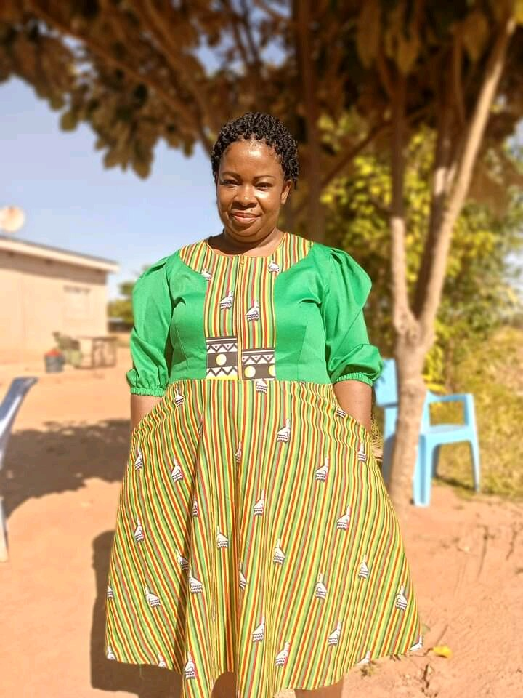





SADC PROTOCOL@WORK SUMMIT 2024
GENDER DRIVERS OF CHANGE
(ZIMBABWE, HARARE, 10 - 13 NOVEMBER, 2024;
COUNCILOR NETSAI MAKAMURE)
“Break the norm, defy the stereotype"

Slide 2
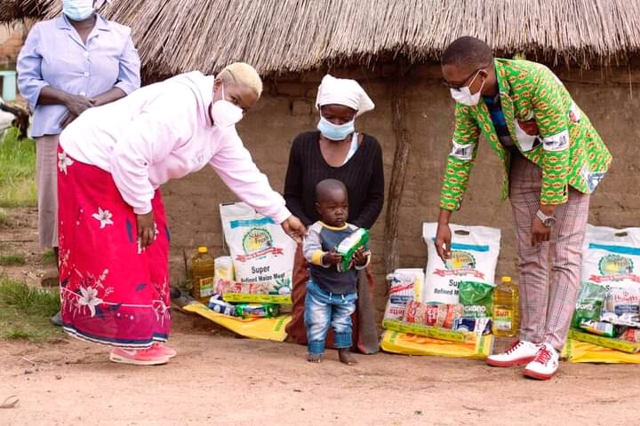
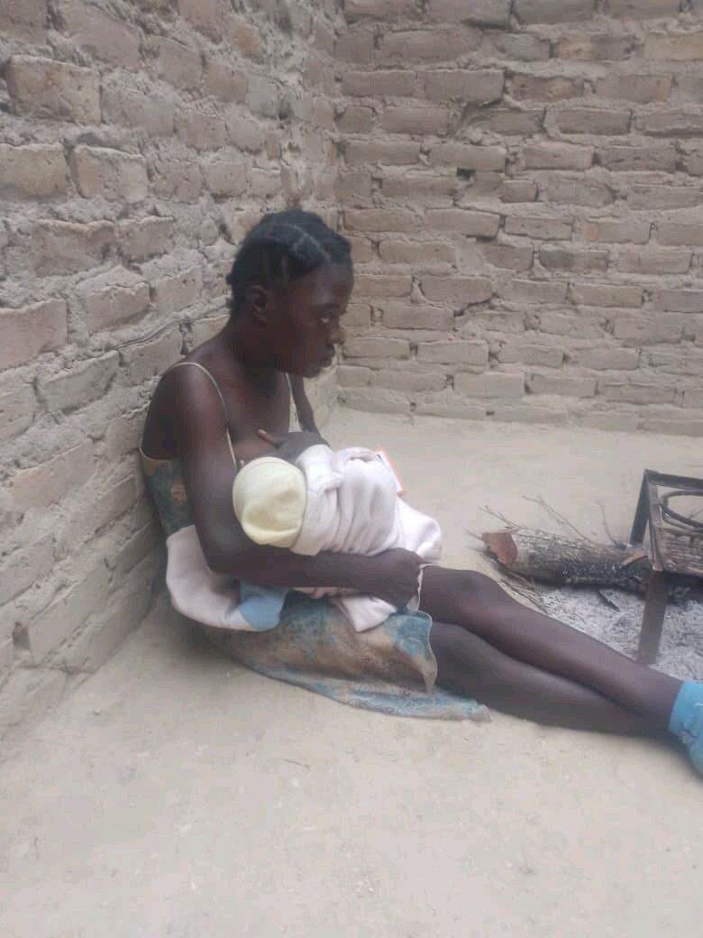

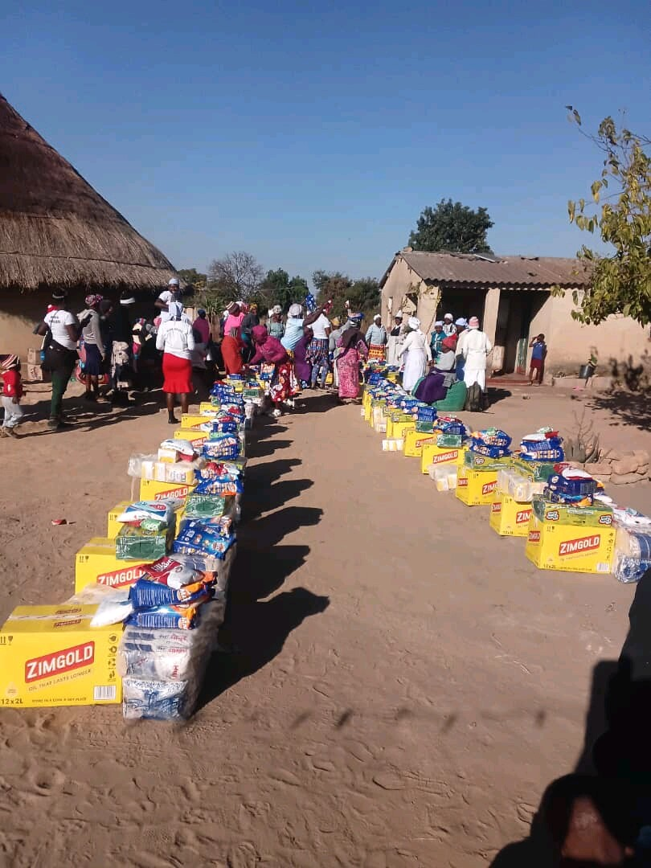

Quotable Quotes
“to create an inclusive and equitable society where gender equality is a reality, empowering individuals to reach their full potential and fostering a culture of mutual respect, understanding, and social justice.”
Evidence

Slide 3
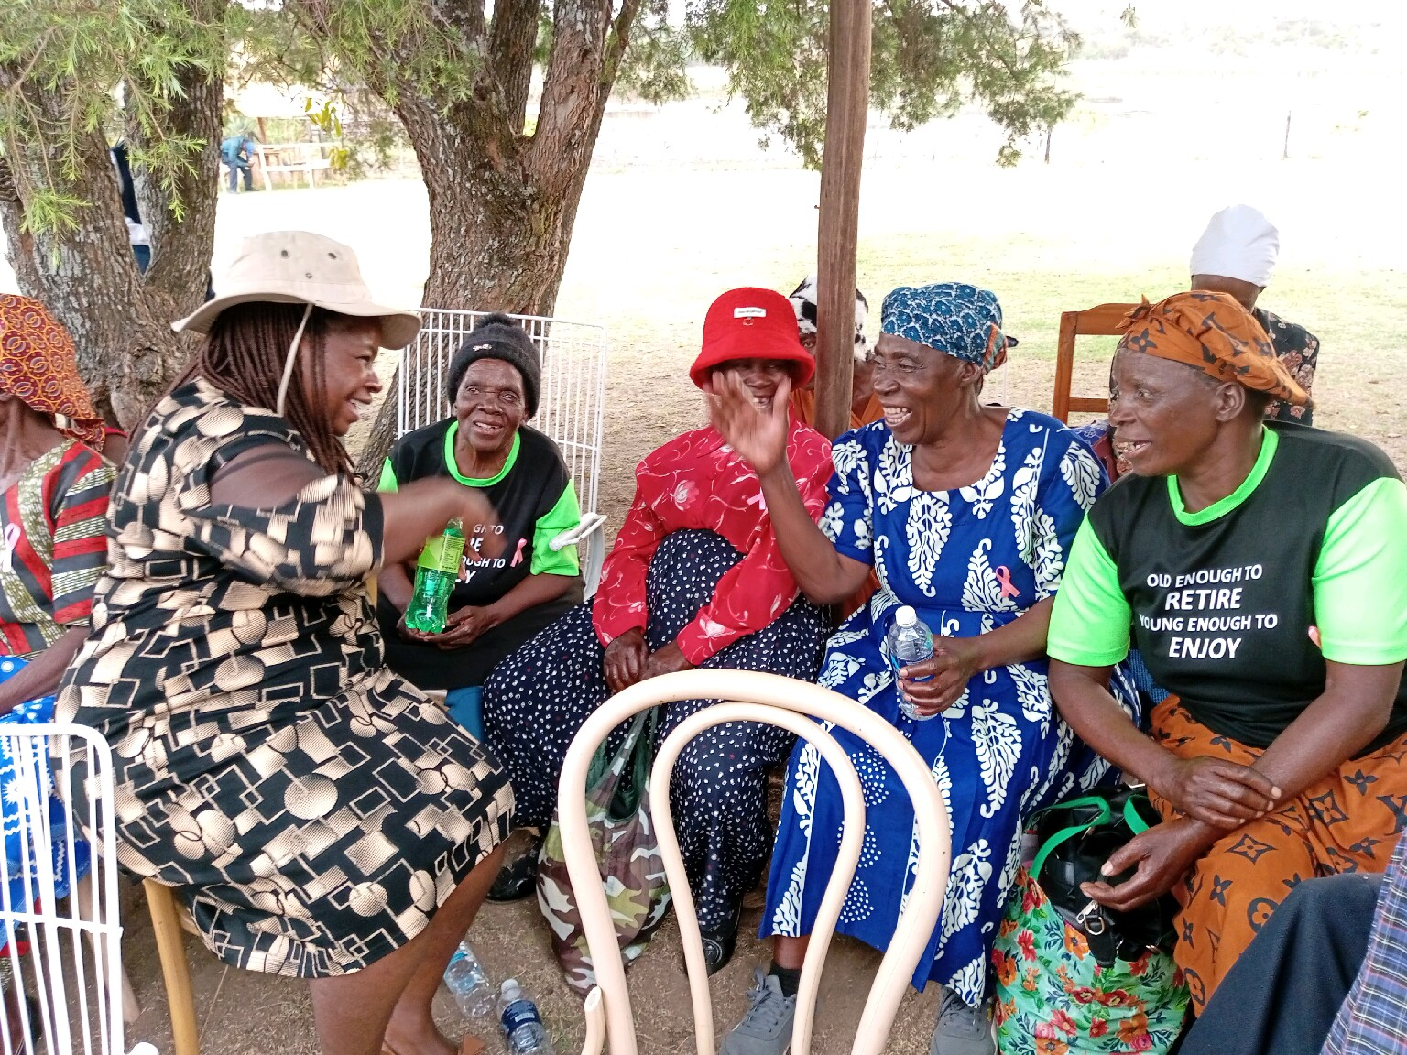
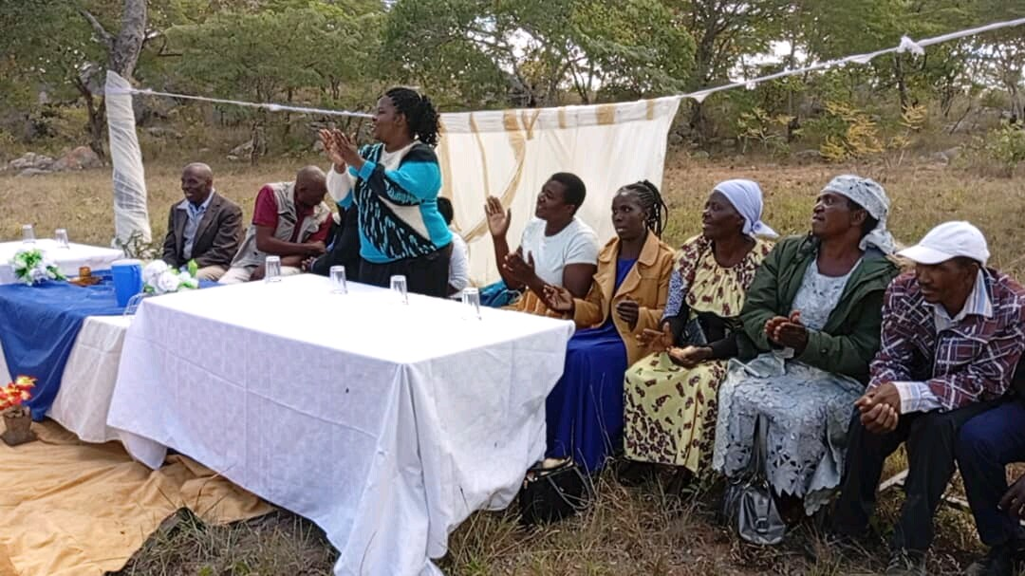
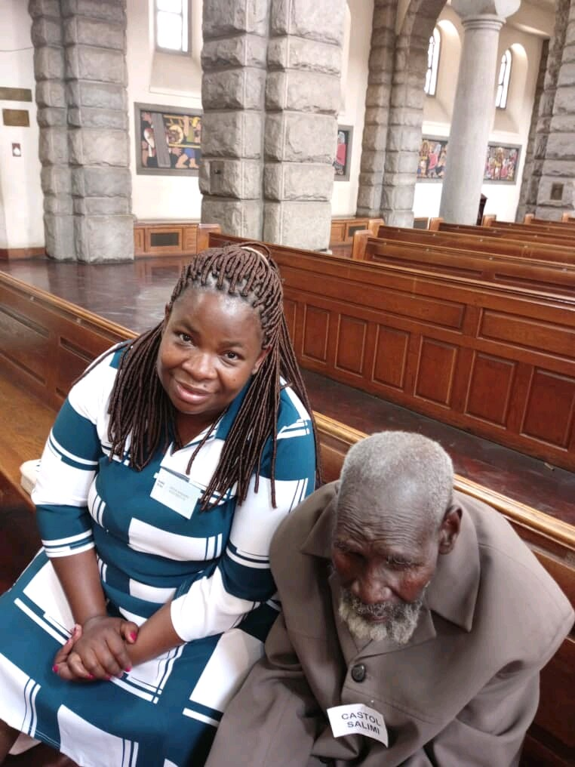
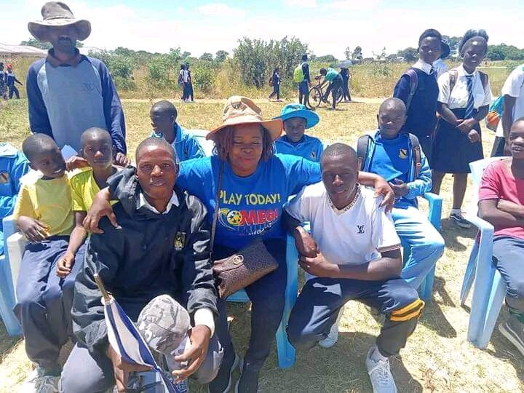

Quotable Quotes
I have been able to bridge generational gap
Empathy has become a new personality
Advocacy
Evidence

Slide 4
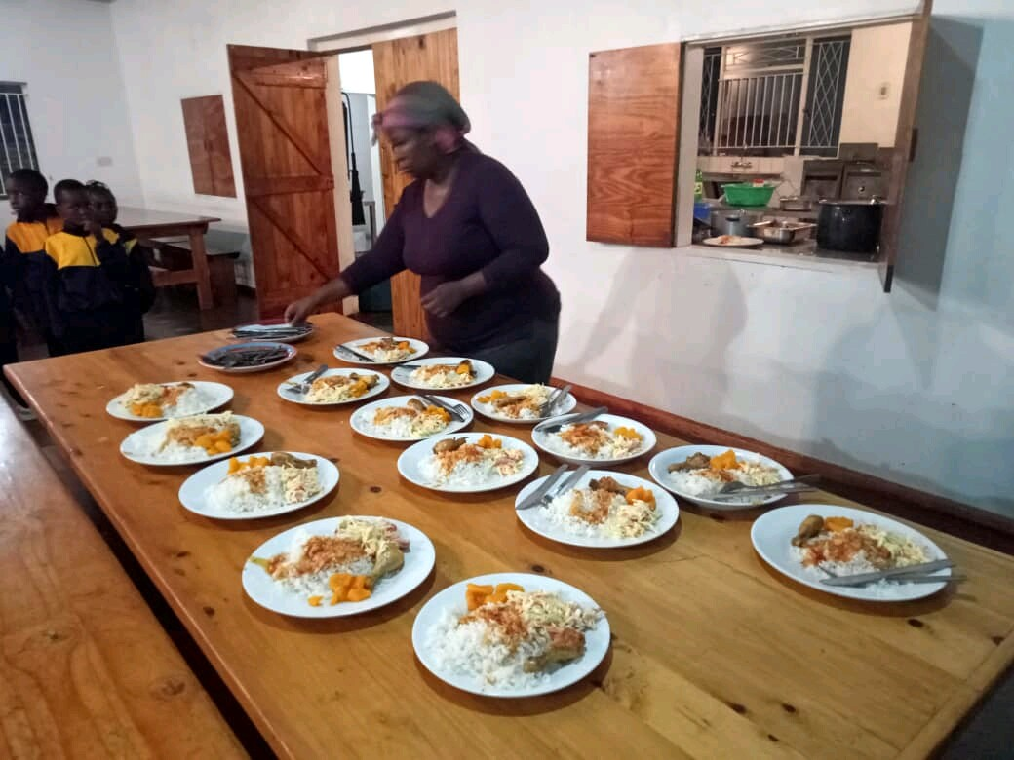
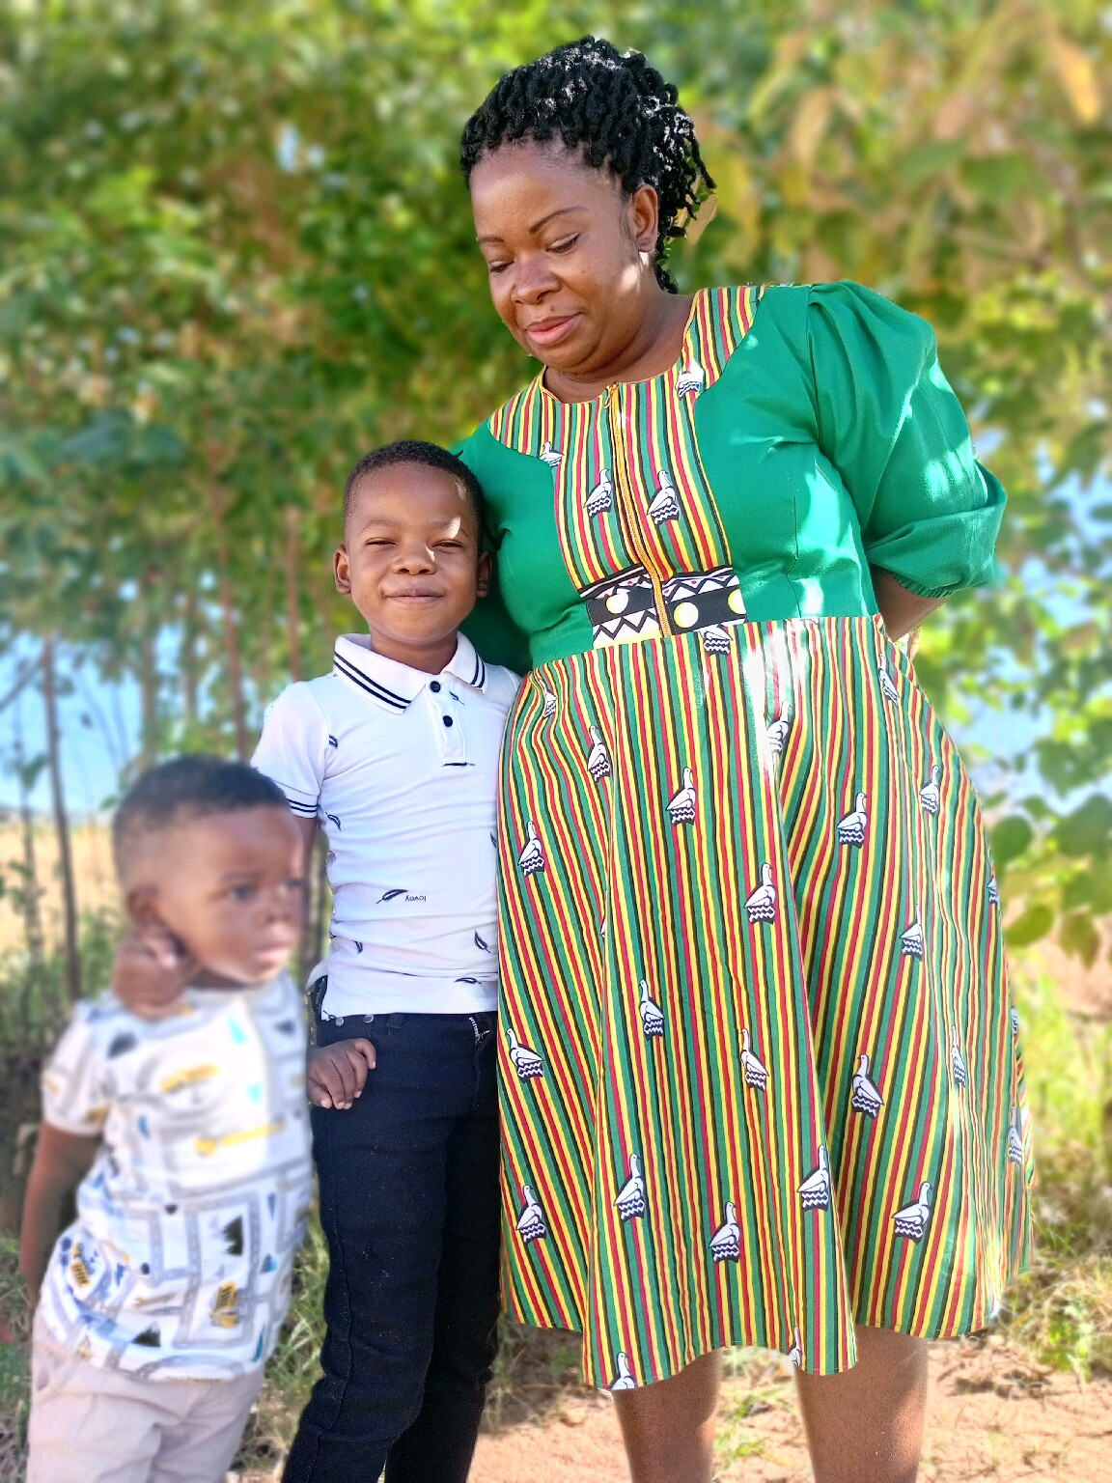
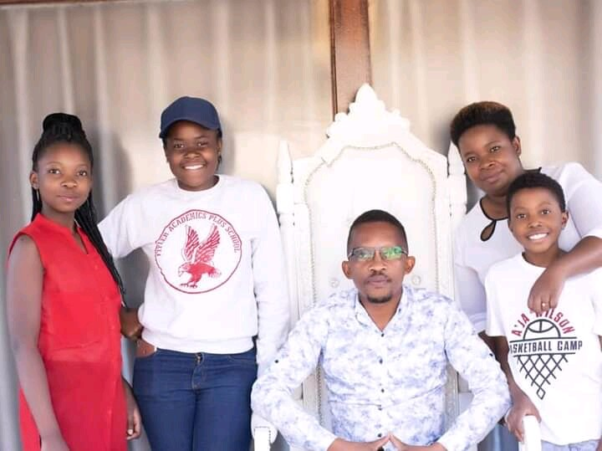
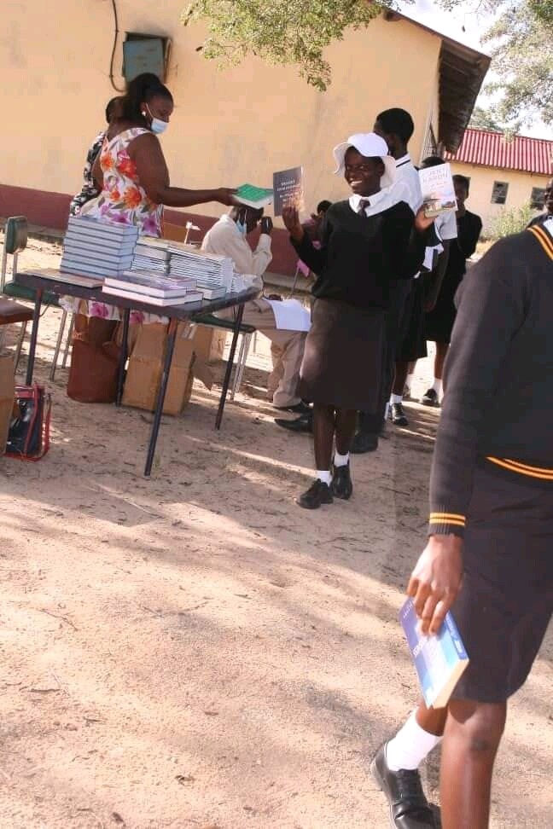
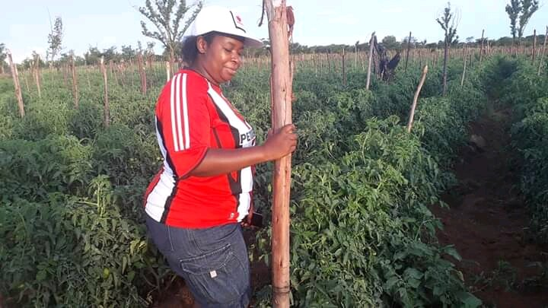
Experience as a leader
I am a Mother, I am a Wife, I am a Teacher, I am a Businesswoman, I am a Leader,
St Stanislous Primary and Secondary School headgirl and I may also add that I had a liking for public speaking.
Represented Masvingo Province in Youth Games, Zimbabwe Youth Council leadership Seminars
Secretary General of Masvingo Teachers College Student Body.
Founding and Current Chairperson of St Stanislous Old Student’s Association 2019

Slide 5
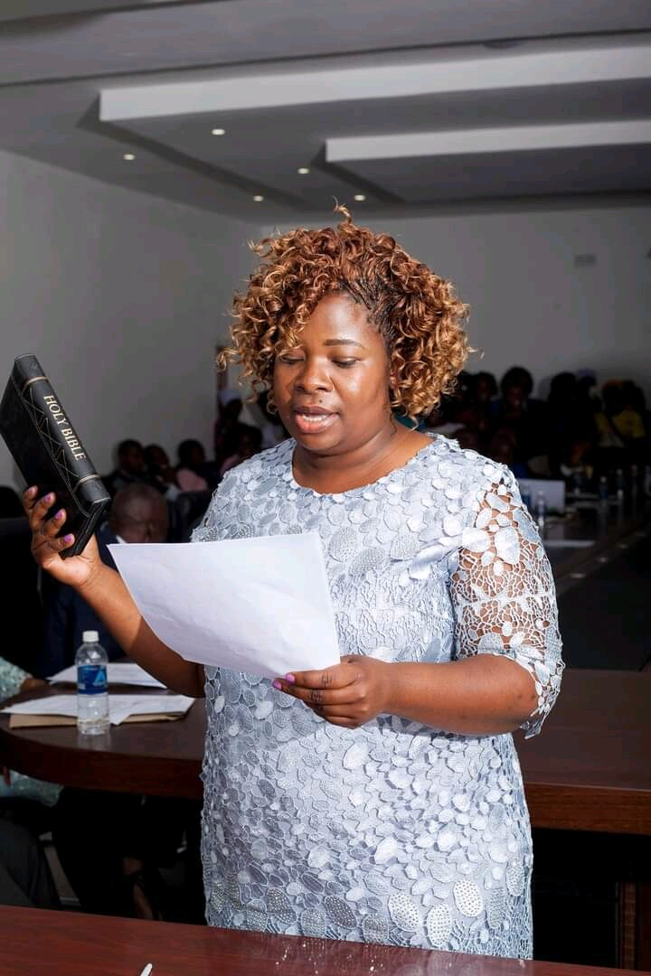
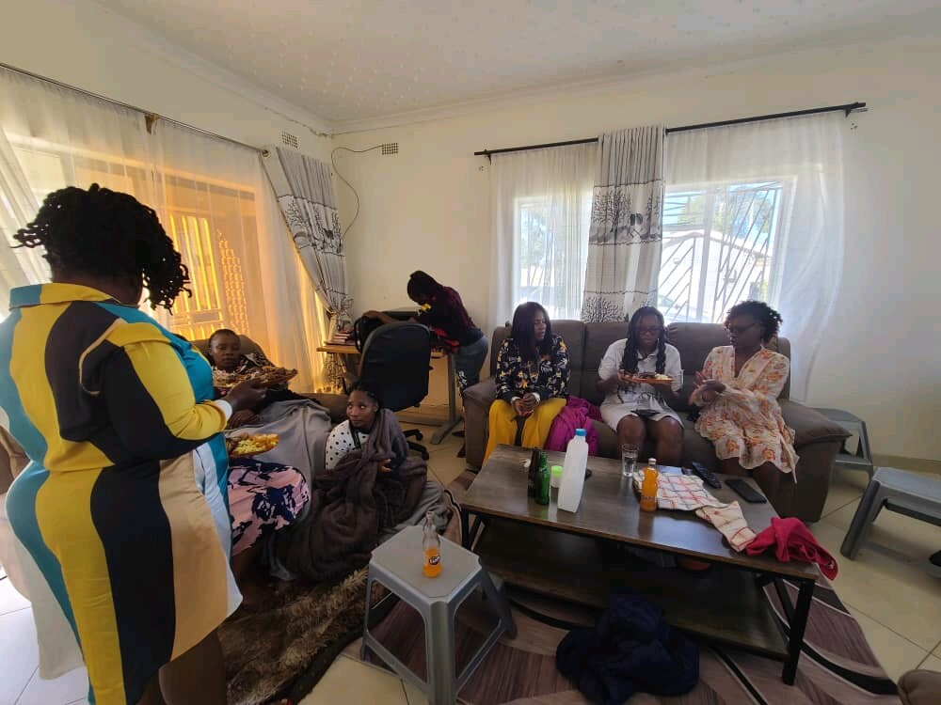
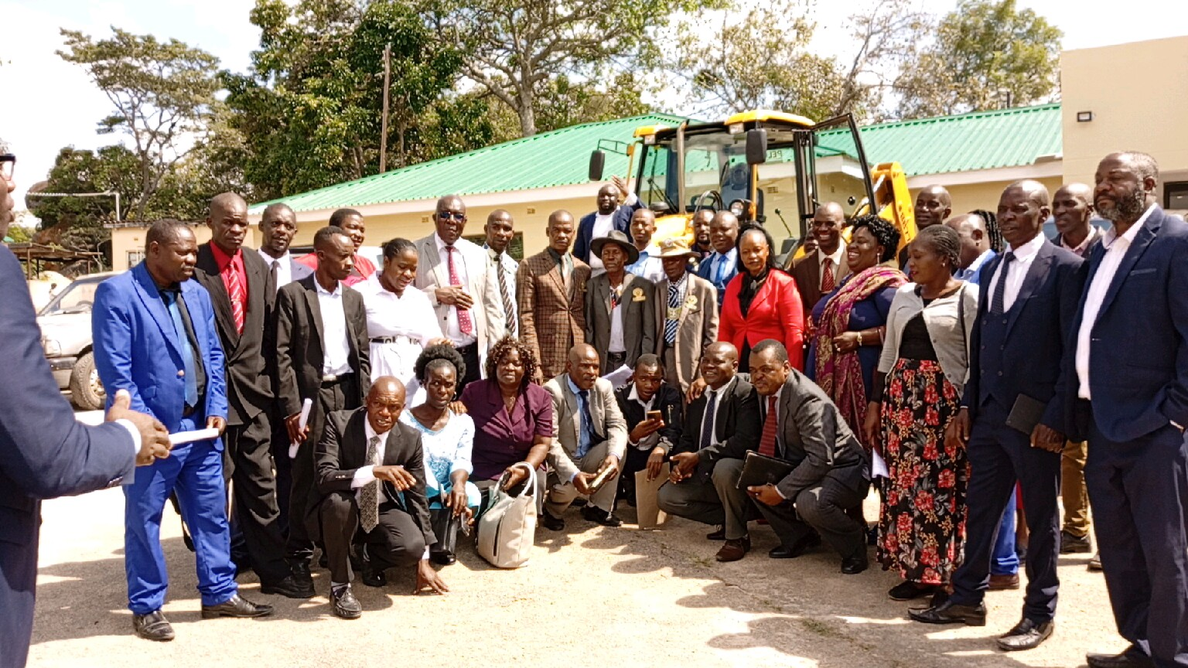
Experience as a leader
District Women League’s Secretary General
Founding and Current Chairperson of Serious Women in Business (SWIB), 2018
Marondera Rural District Council (MRDC) Councilor,
Vice Chairperson MRDC Gender Committee
Gender Champion MRDC
Vice Chairperson Women in Local Government Forum, Mashonaland East Chapter
Chairperson, Young Women of Africa (YWOA), Mashonaland East Chapter
Church Leader (AGAPE, charity department and Couple’s Group).
I lead Community Groups, Mikando and Choral.
Insert photo
“Break the norm, defy the stereotype"

Slide 6
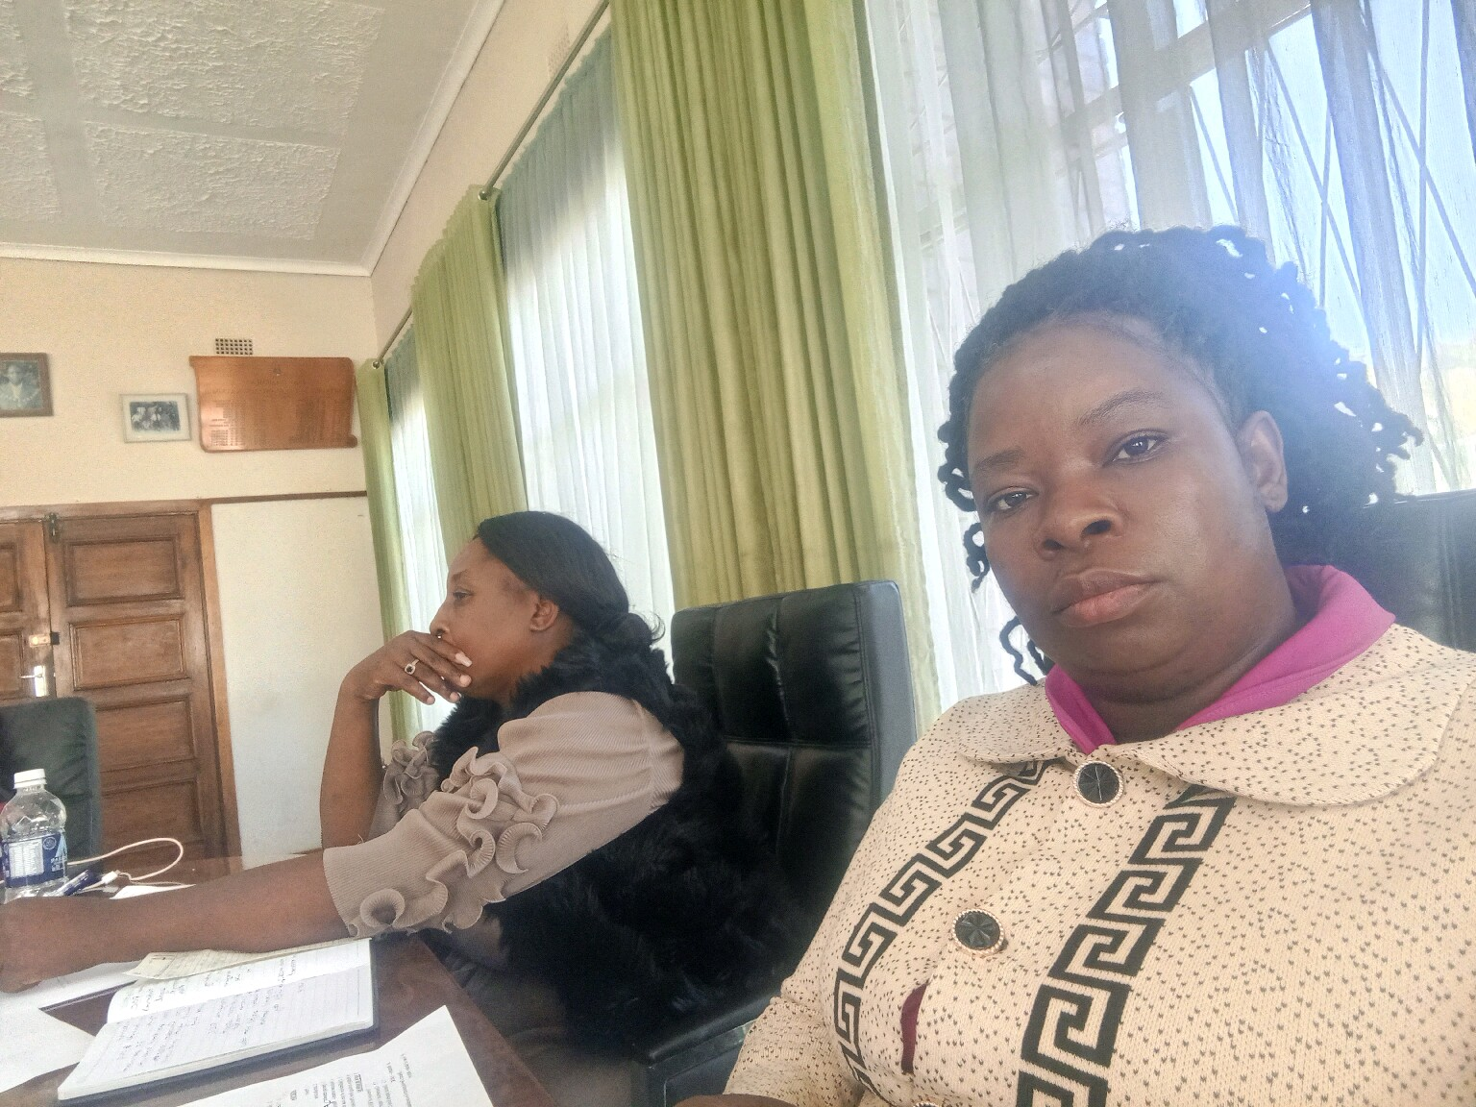
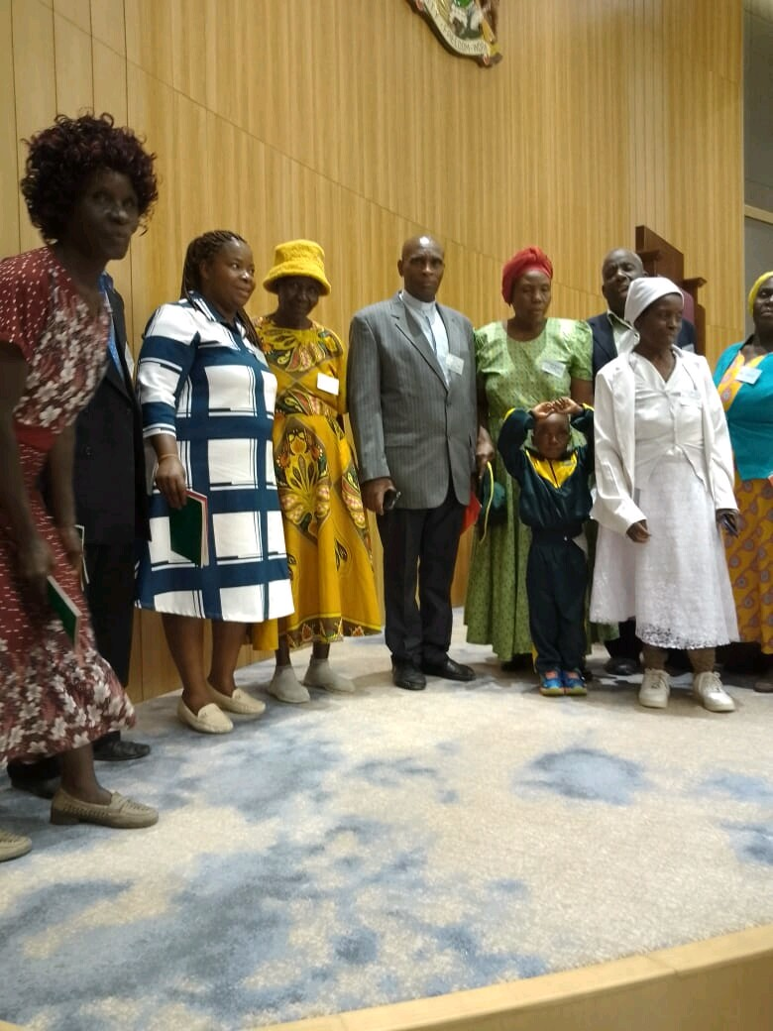
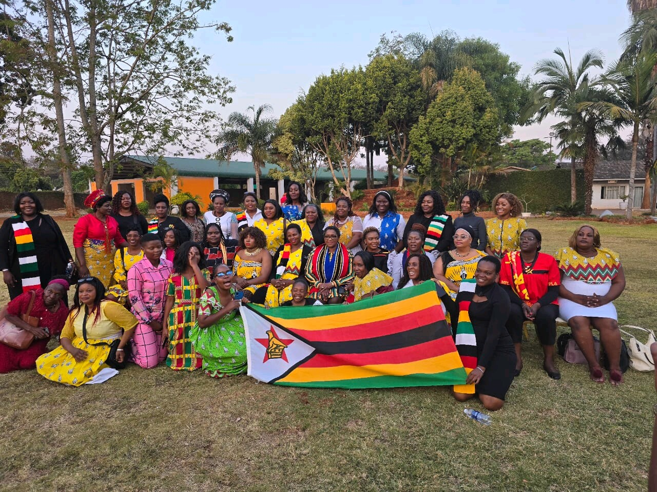
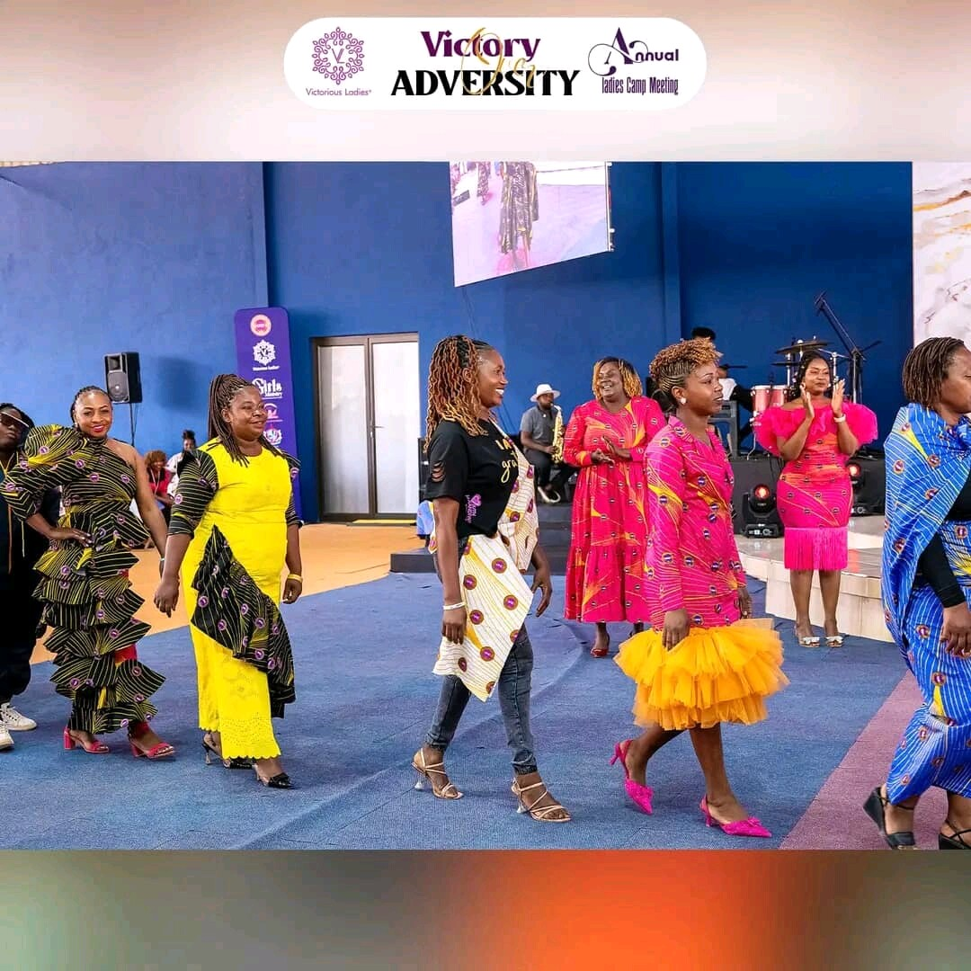
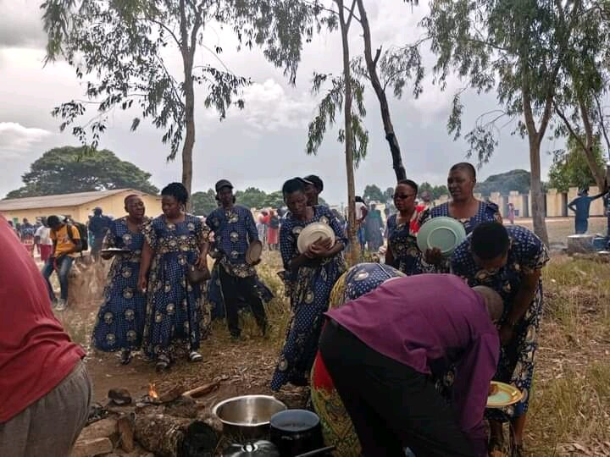
Experience as a leader
I qualify to be a leader in the sense that I have passion for social justice and equality;
Strong commitment to community development
Excellent communication and interpersonal skills
Ability to mobilise and empower others
Strategic thinking and problem solving skills
Emotional intelligence and empathy and understanding
Evidence

Slide 7
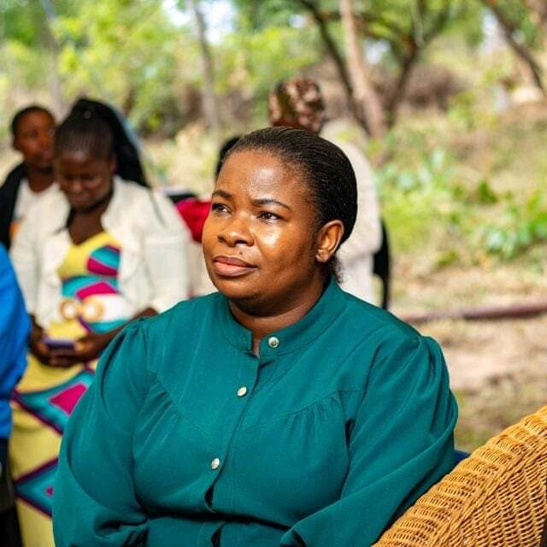
WHO IS THIS LEADER?
Detail
My name is Councillor Netsai Makamure
I represent women in Marondera Rural District Council
Empathy and Understanding makes me unique
I am innovative and able to think outside the box
Include Photos or videos

Slide 8
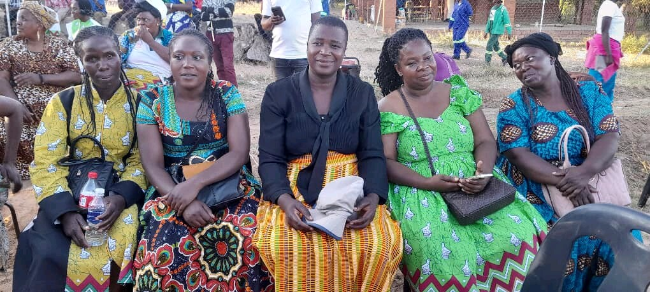
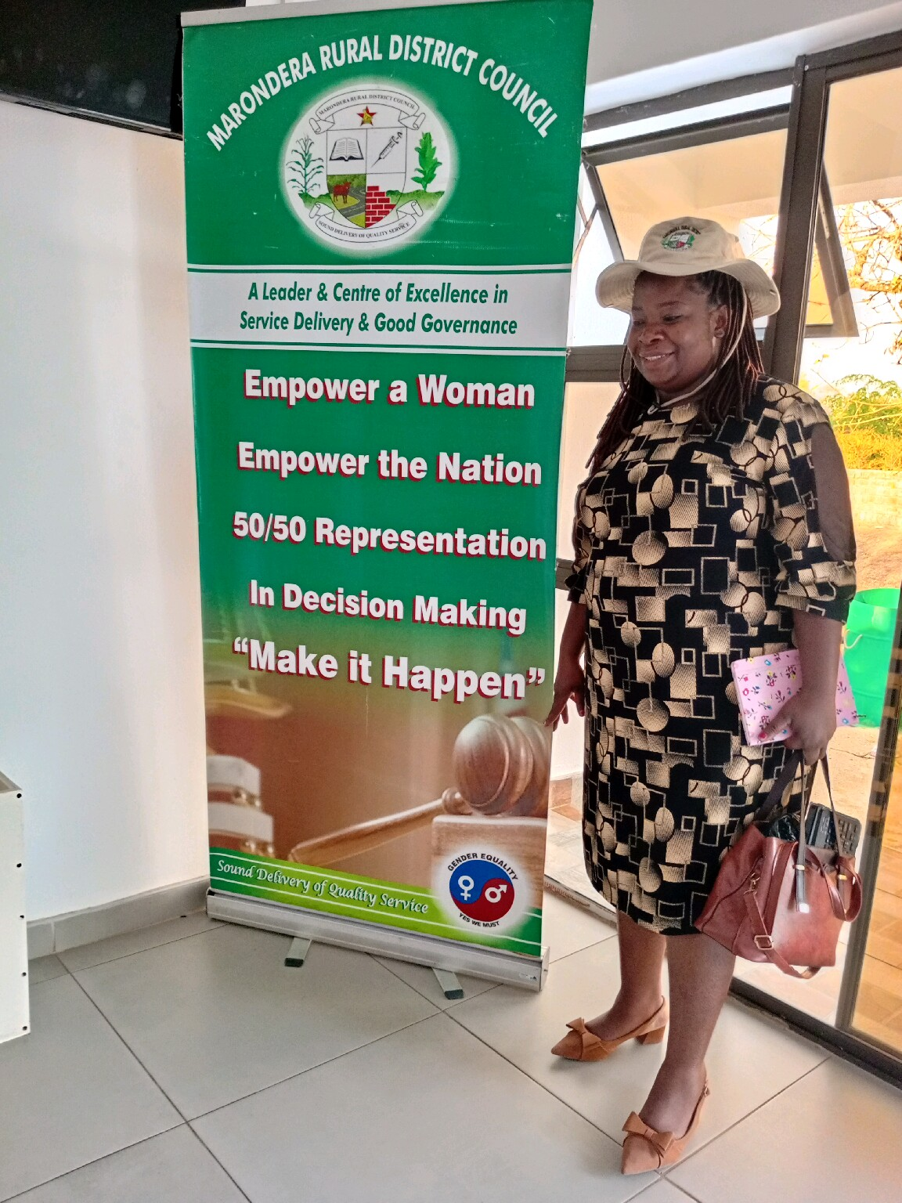
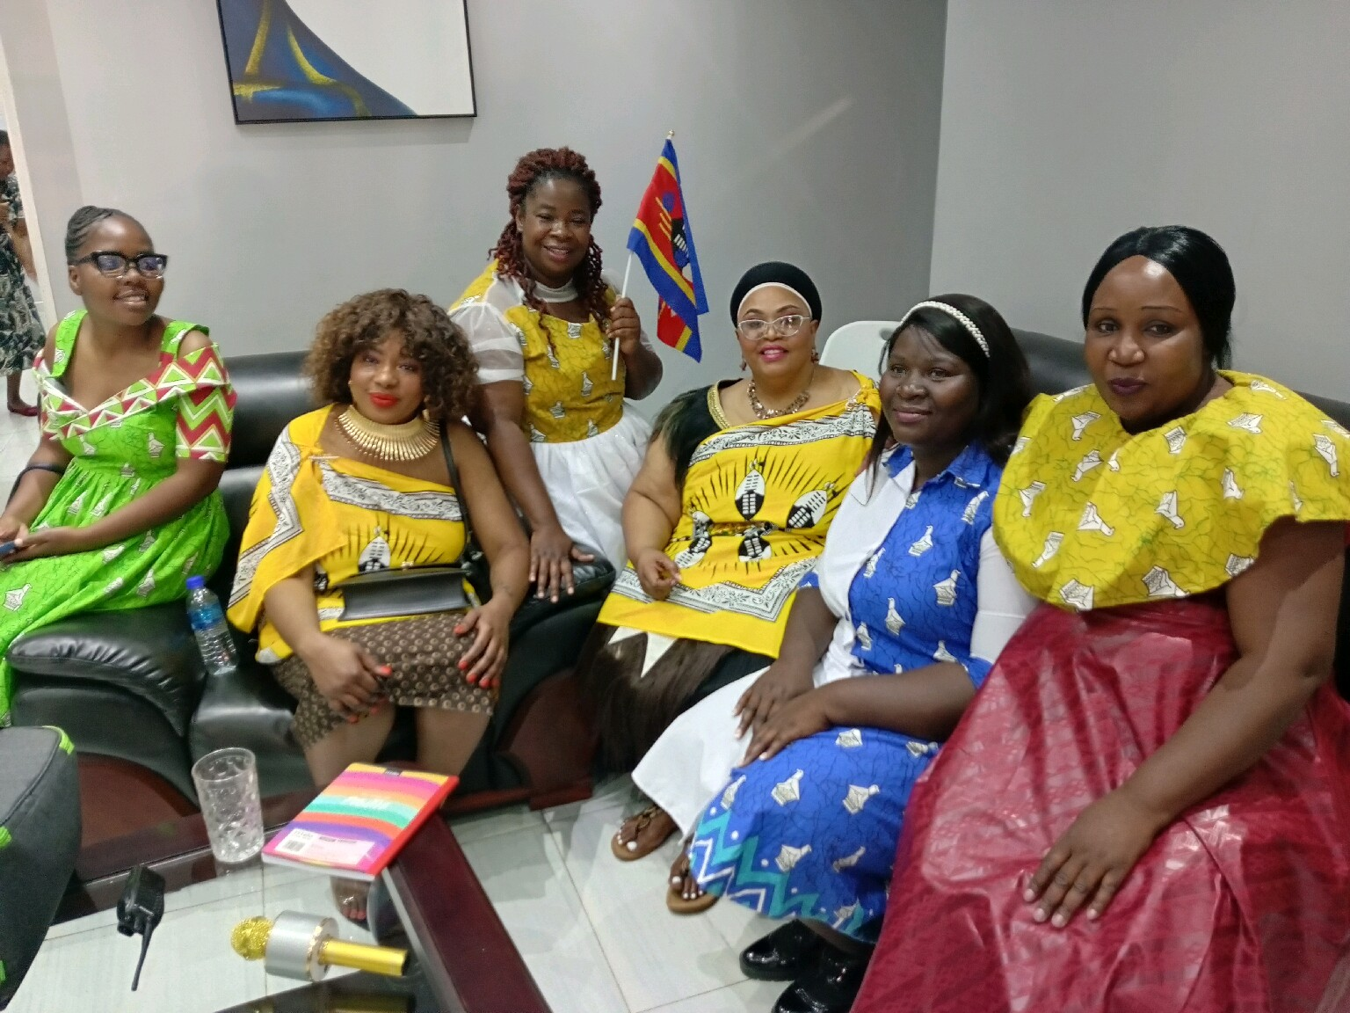
WHAT DRIVES YOU?
Detail
Vision
I envision a situation that makes it possible to create an inclusive and equitable society where gender equality is a reality, empowering individuals to reach their full potential and fostering a culture of mutual respect, understanding, and social justice

Slide 9


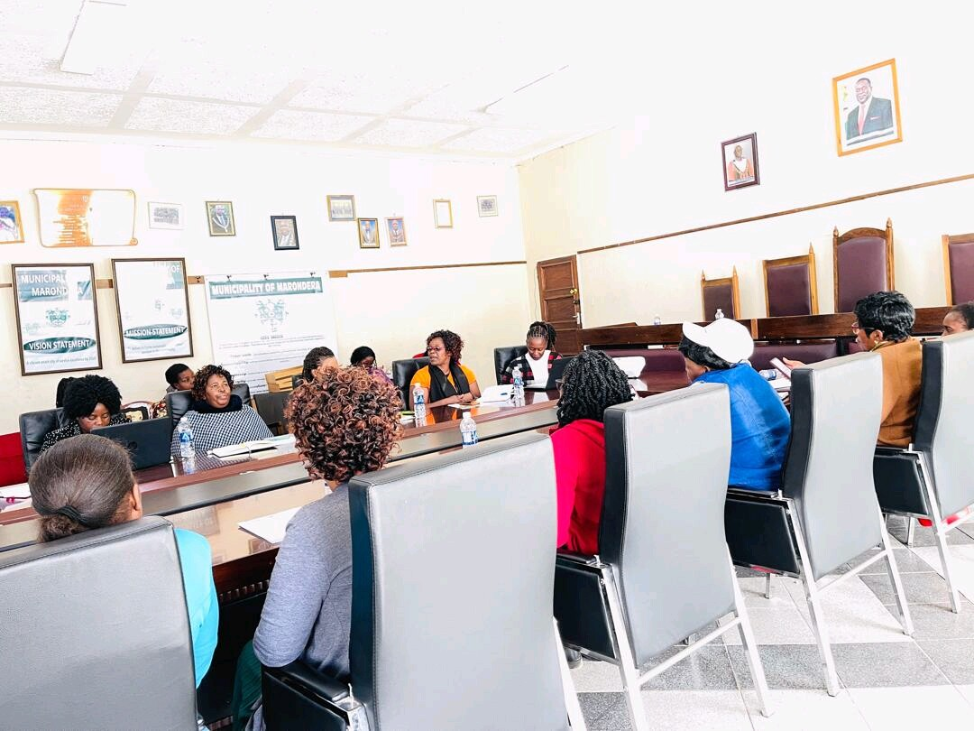
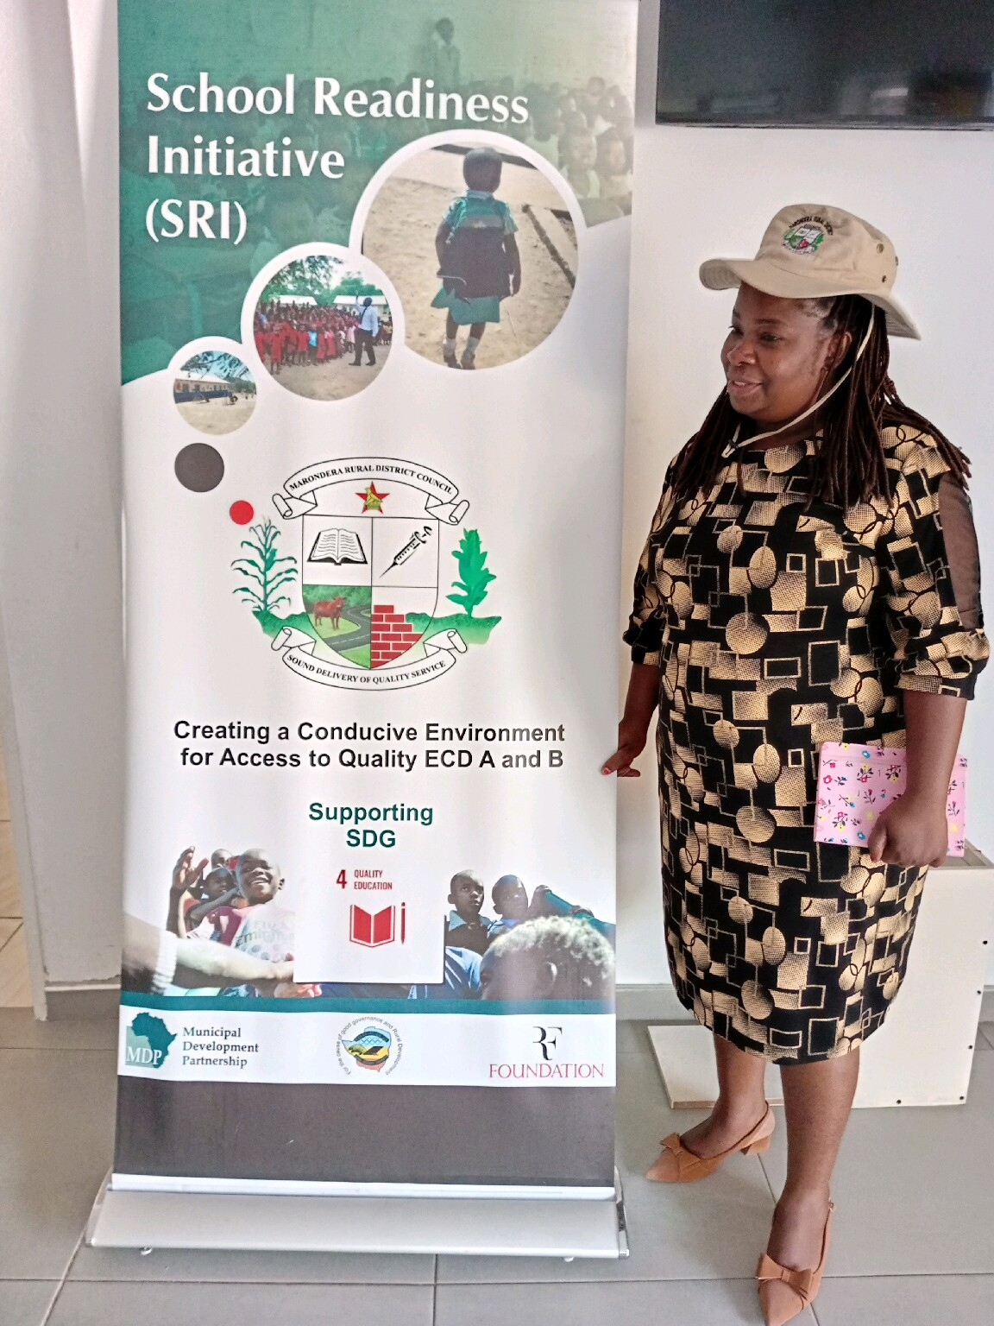
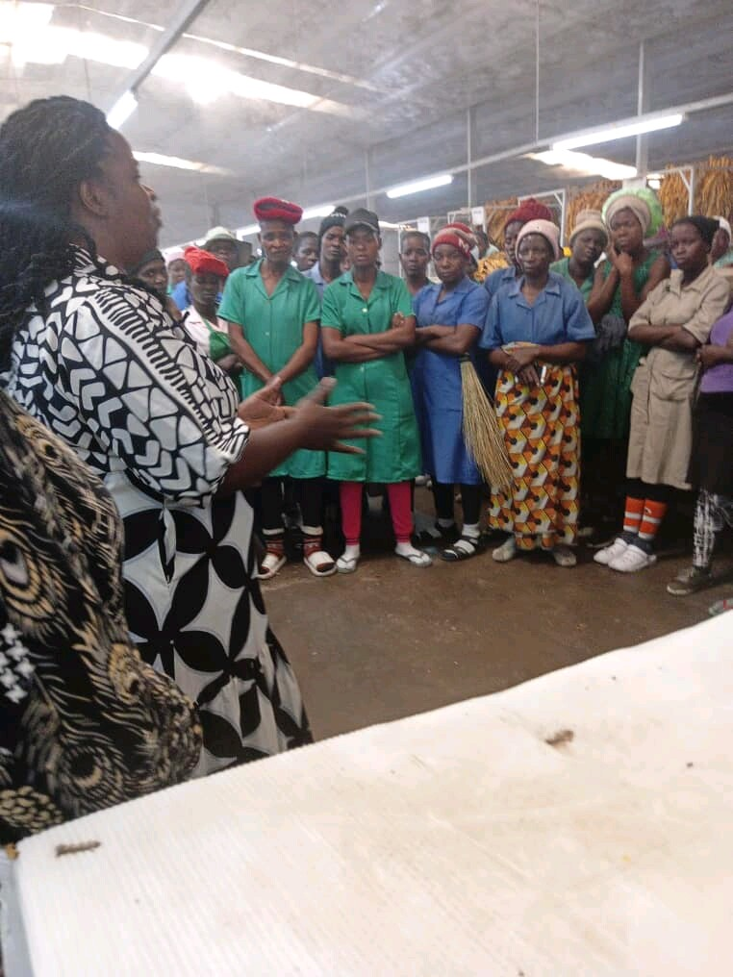
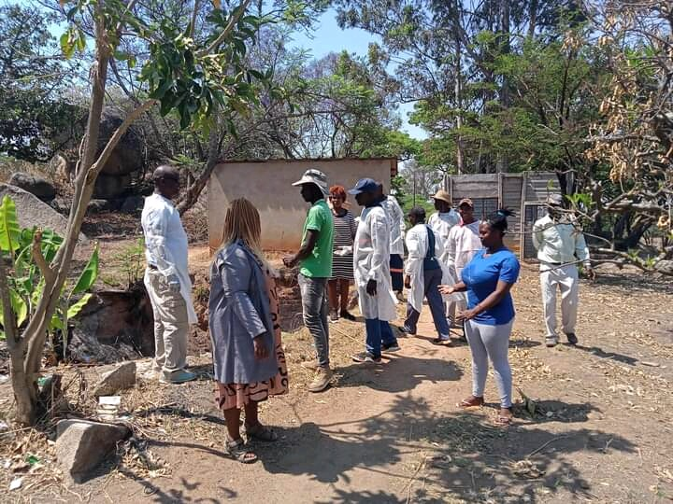
WHAT DRIVES YOU?
Detail
Objectives
Establish a gender-sensitive community framework.
Provide training and capacity-building programmes for over 2000 individuals.
Advocate for policy reforms addressing gender-based violence, domestic violence, child abuse, drug and substance abuse, sexual abuse and climate action
Include Photos or videos

Slide 10
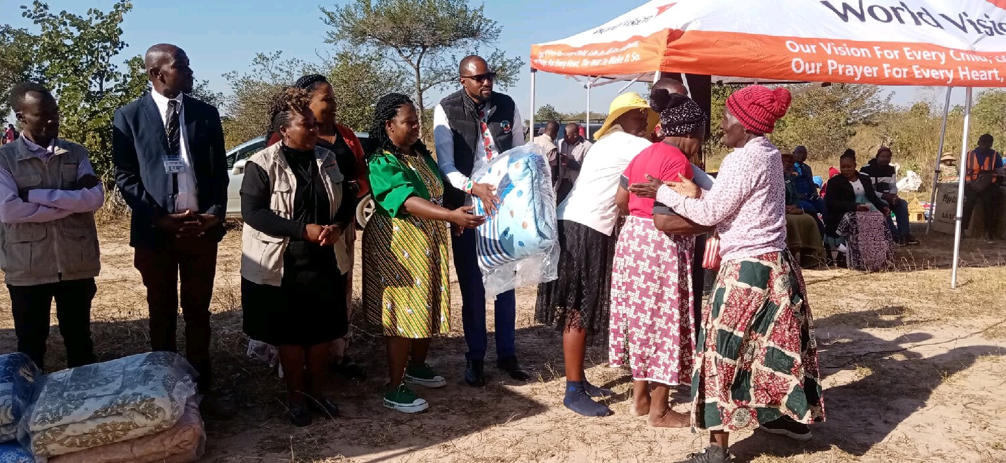
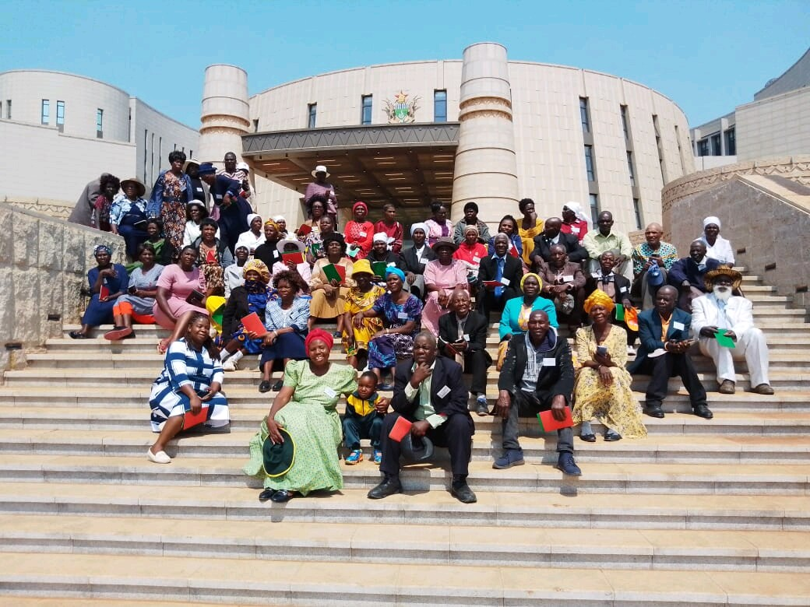
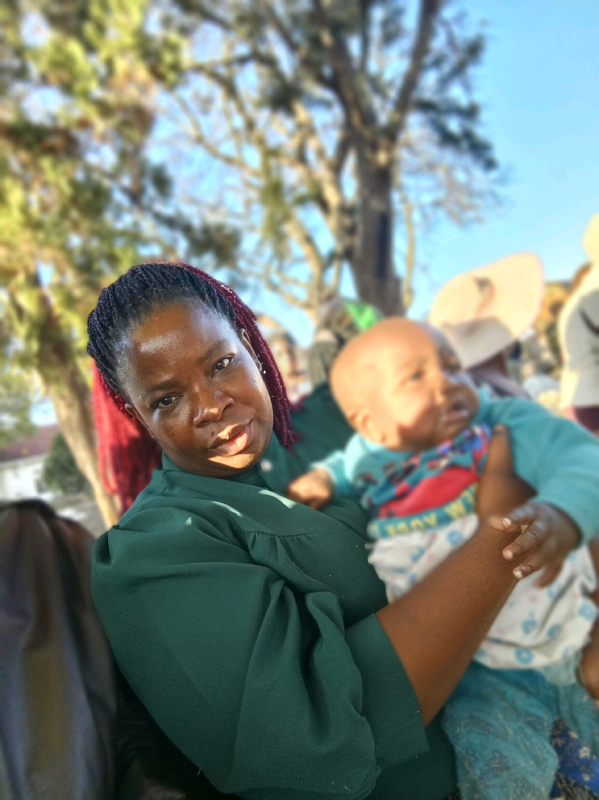
WHAT DRIVES YOU?
Detail
Objectives
and provision of social protection through safety nets for the elderly, women, orphans, youth and the physically challenged
Develop strategic partnerships with organisations promoting gender equality.
Launch initiatives supporting economic empowerment for rural and marginalised women.
Your commitment to gender equality
Include Photos or videos

Slide 11
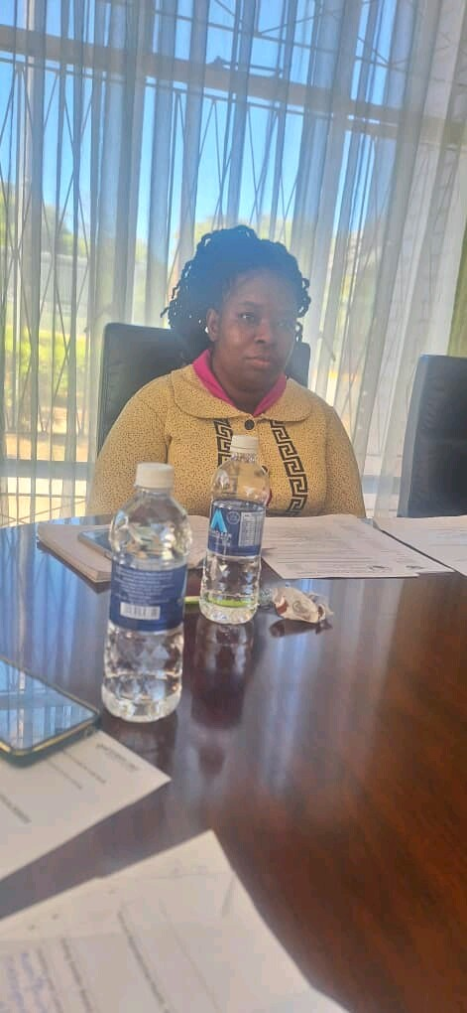
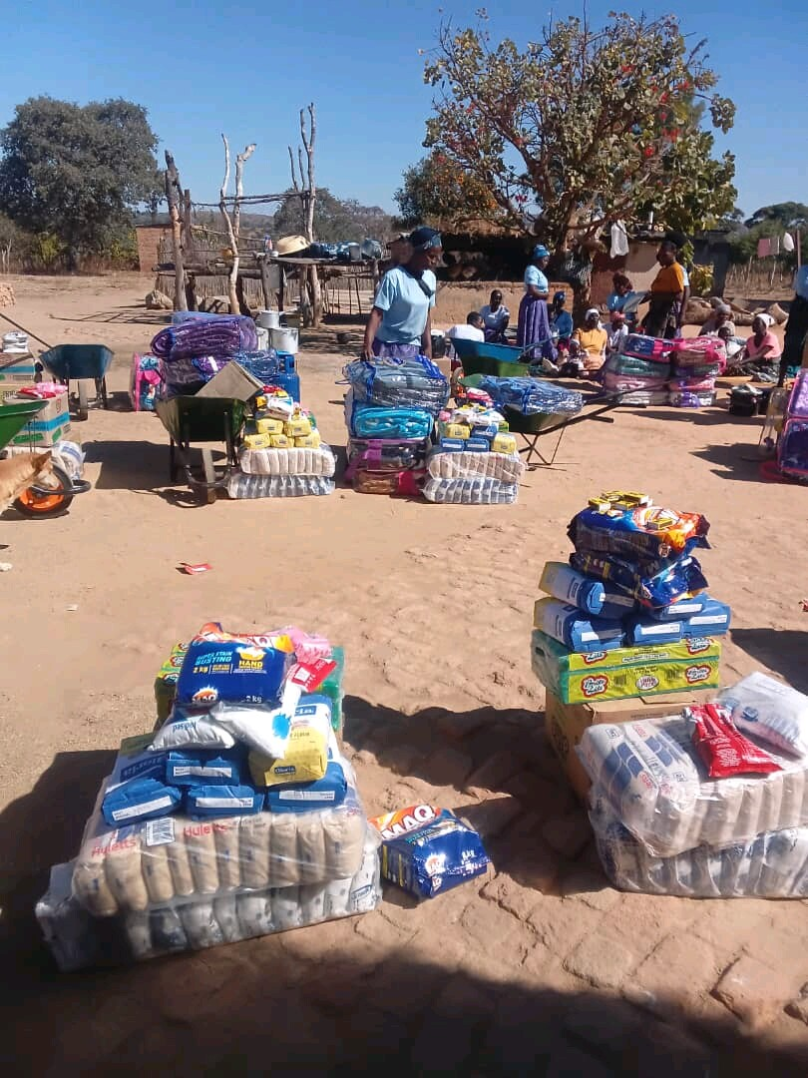
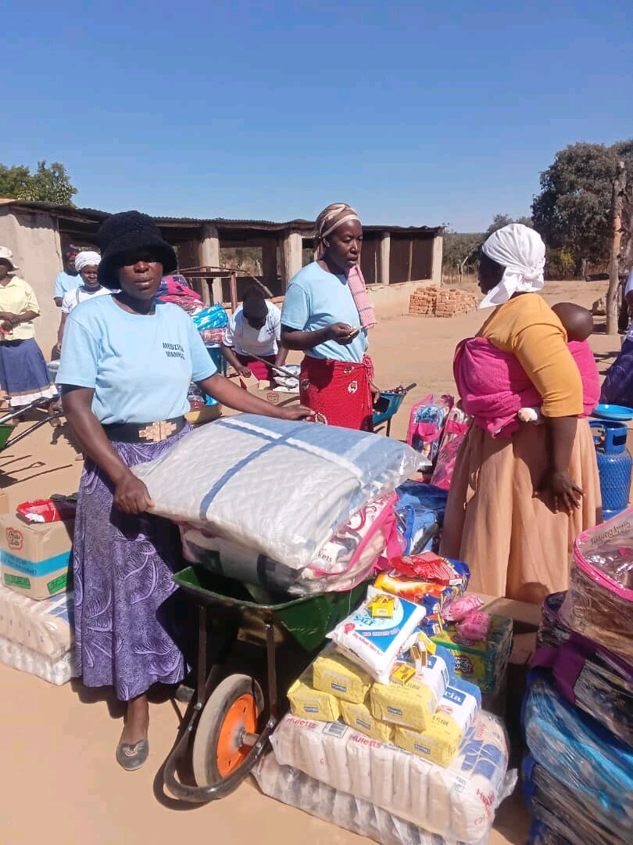
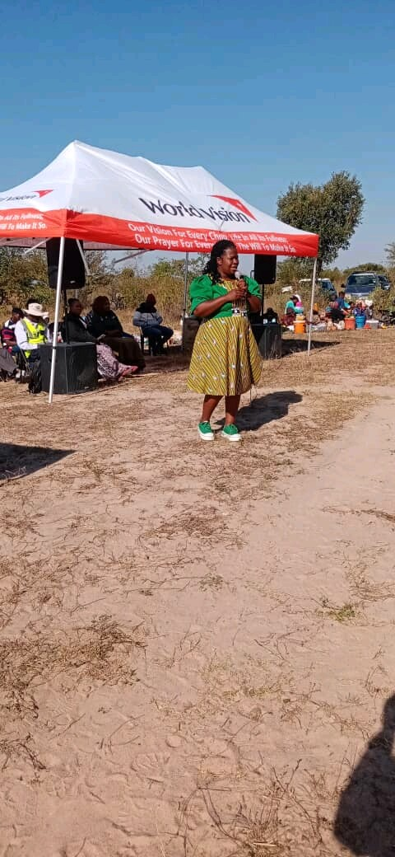
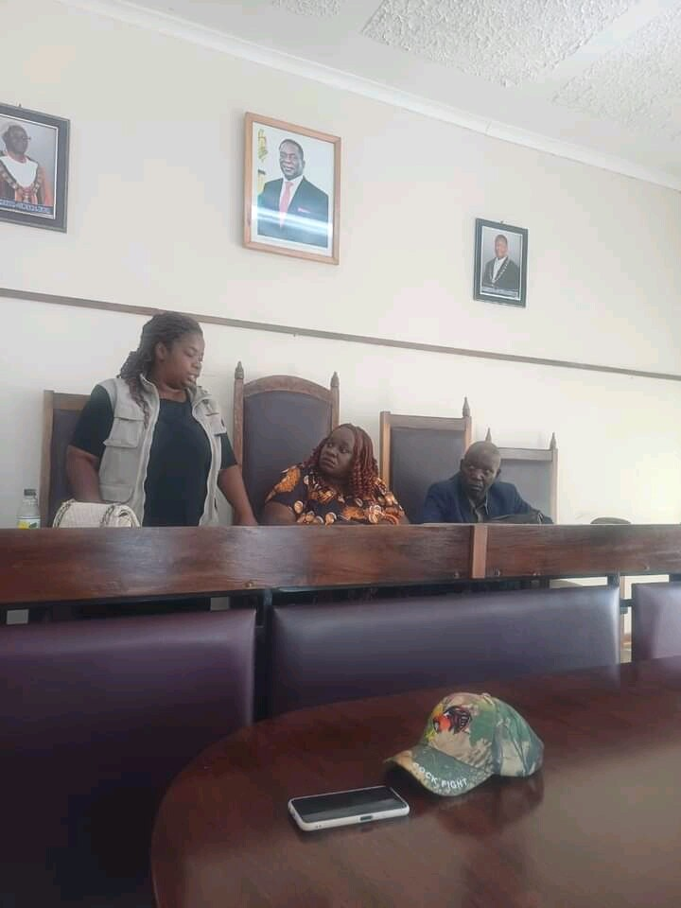
WHAT DO YOU DO?
Detail
Key Advocate for WASH (Water and Sanitation Hygiene) – SDG 6 Clean Water and Sanitation
Educate and Encourage women to effectively participate on matters that concern them, ECD Centres, Mothers Shelter, Clean Water and Renewable Energy
I have been encouraging, supporting and even participating in Mikando
Meal Day
Organising and Hosting Family Days
Supporting the needy such as the elderly
Include Photos or videos

Slide 12
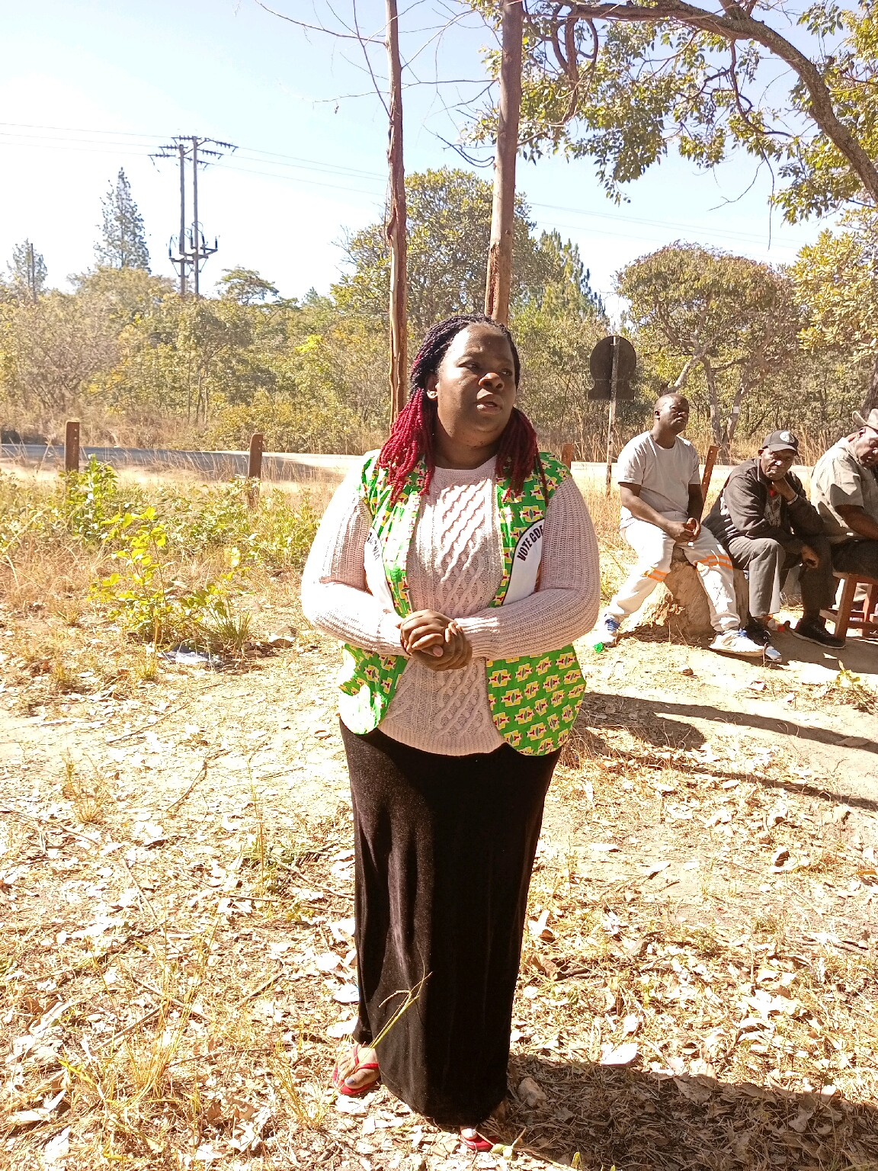
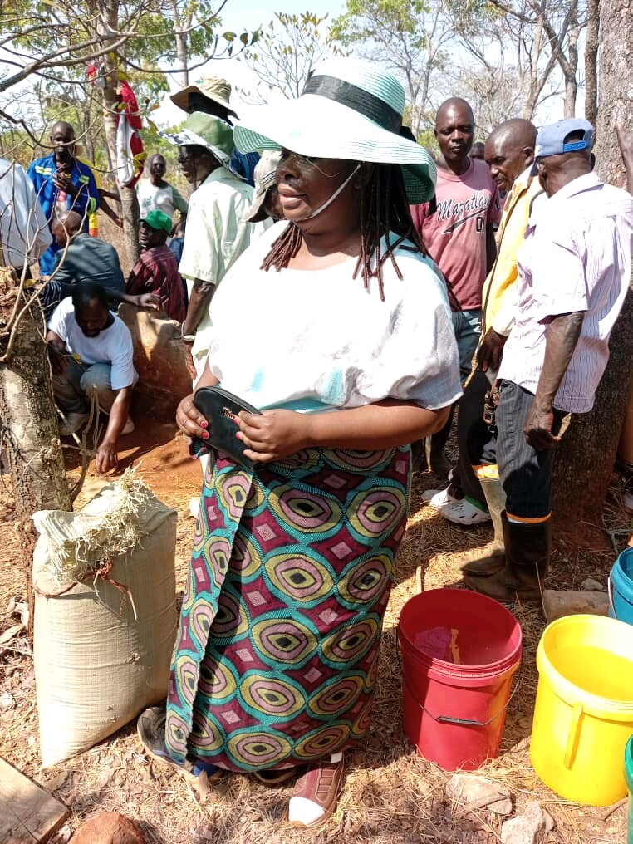


GENDER EQUALITY CHALLENGES
Balancing Community priorities as needs of the community are broader
Low attendance to meetings such as budget consultation
Illiteracy affect explaining the complexities of budget information effectively
Limited economic diversification and revenue streams
Gender Based and Domestic Violence have led to significant statistic on deaths in our Council Jurisdiction over the past year
Cultural, social norms and beliefs perpetuate inequality e.g. Madzibaba’s Case
Share videos/photos of evidence

Slide 13
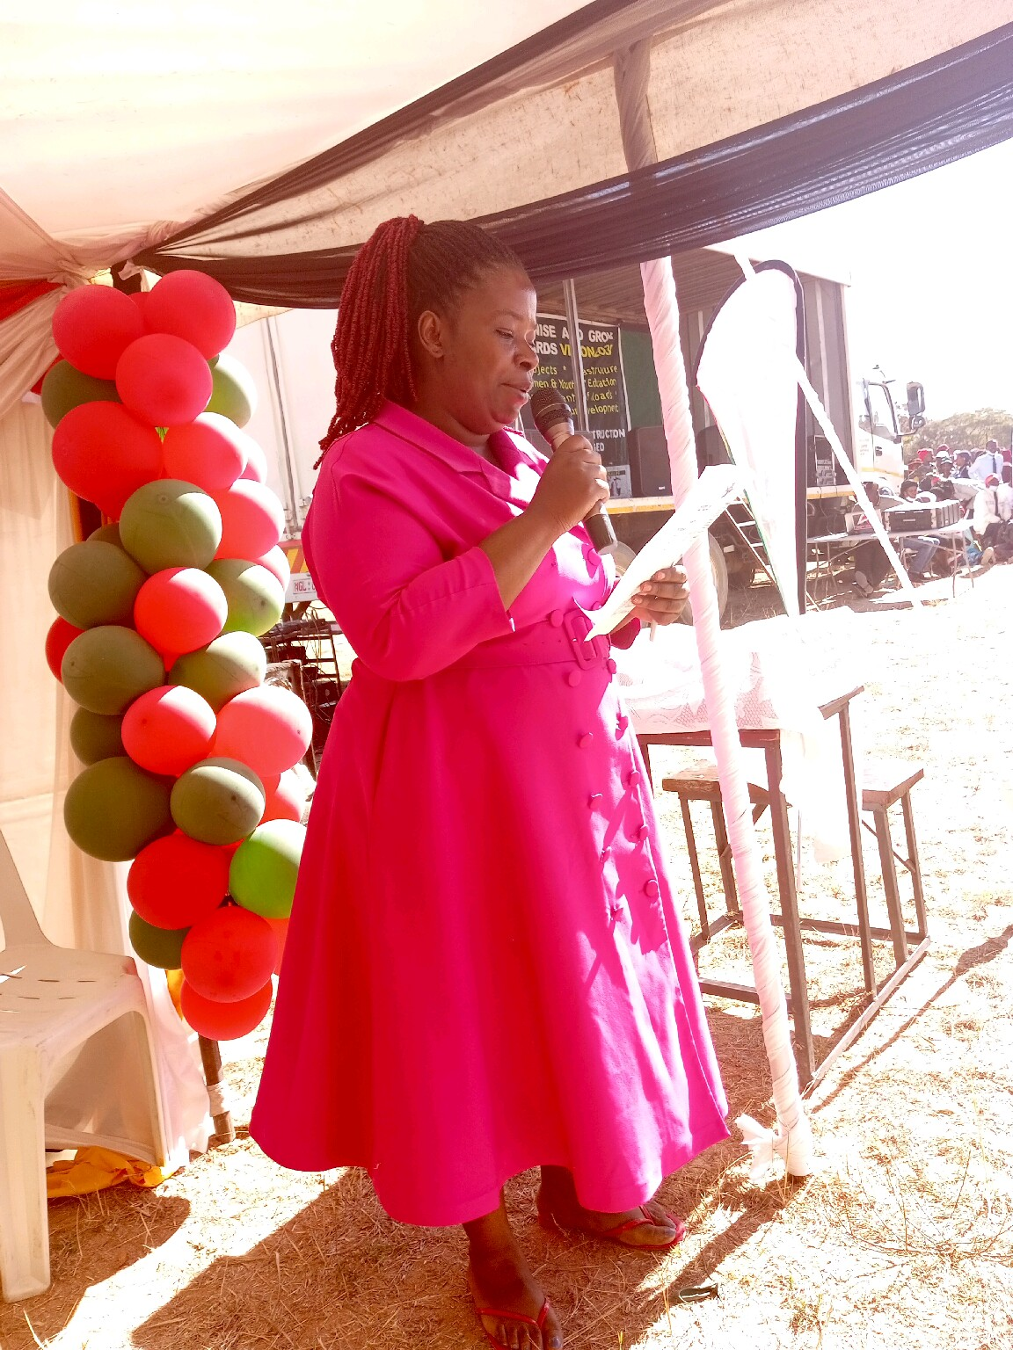
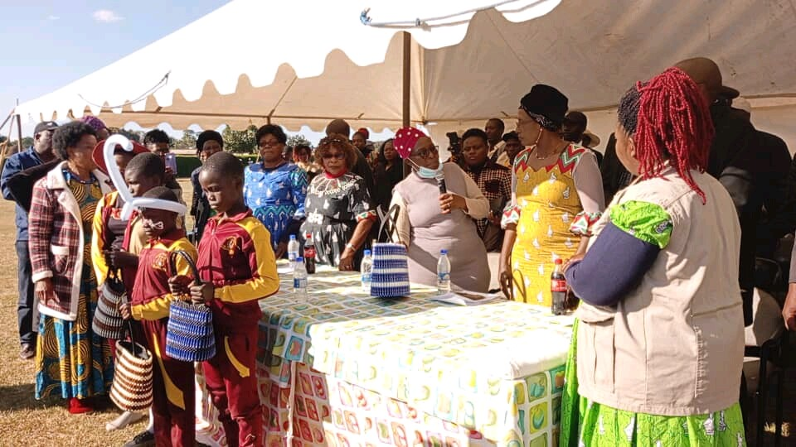
GENDER EQUALITY CHALLENGES
I have not used the cry baby approach but instead addressed the challenges as follows;
To address low attendance, I came up with the initiative to visit their workplaces to consult and advocate and educate on the pertinent issues;
Encourage them to attend through phone calls;
Community projects to promote economic participation;
Research and simplify information to make it understandable;
Organising awareness campaigns
During family days and many gatherings, we always sensitise issues to do with gender-mainstreaming and equality.
Share videos/photos of evidence

Slide 14
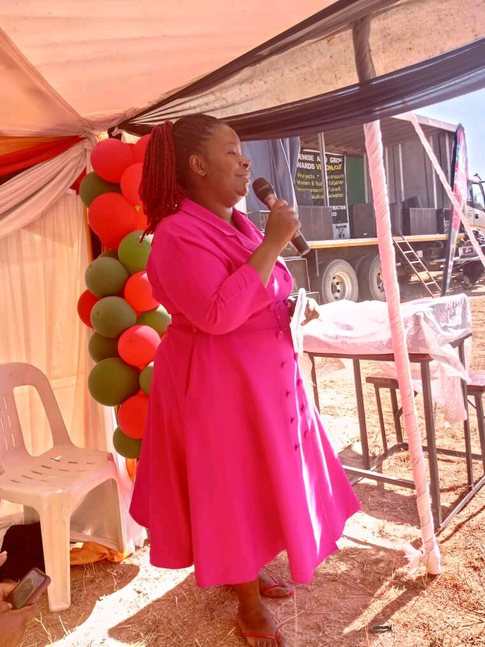
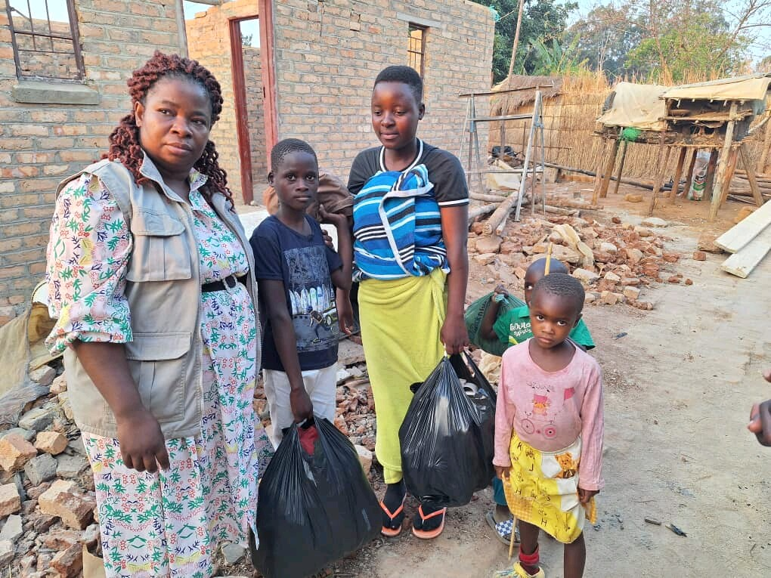
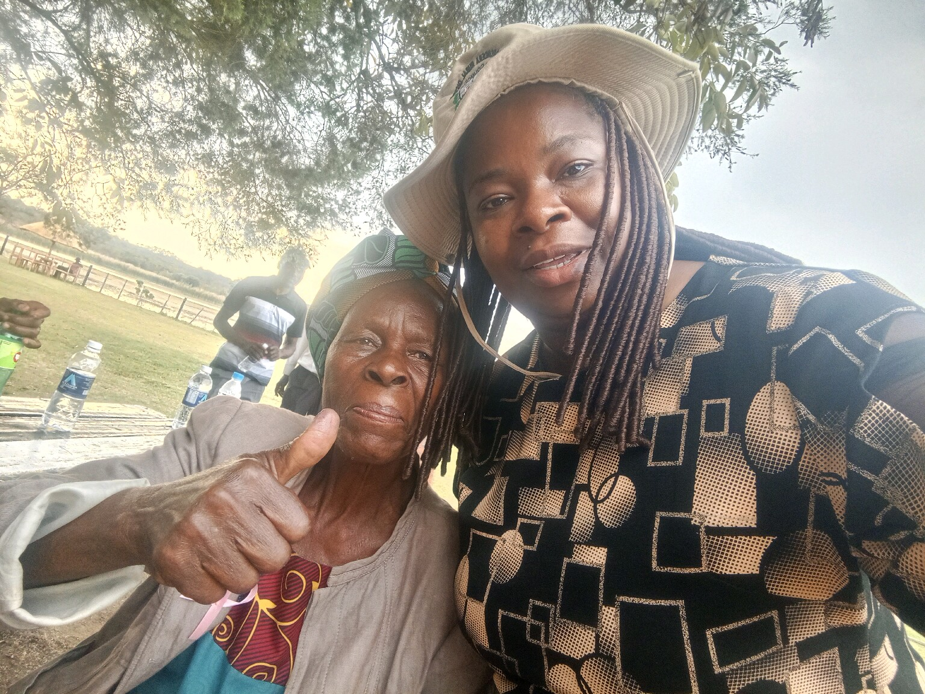
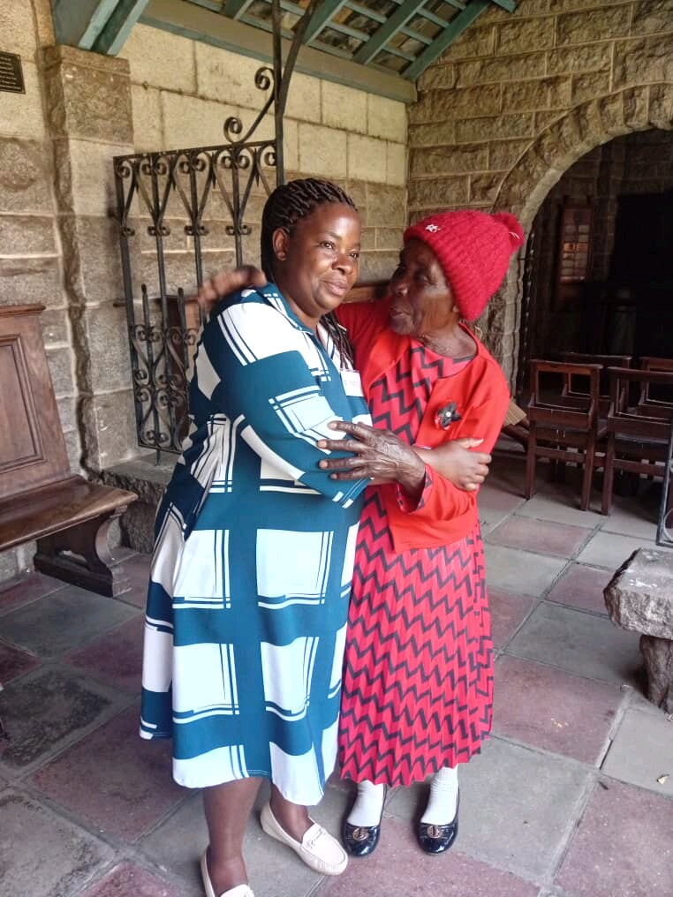
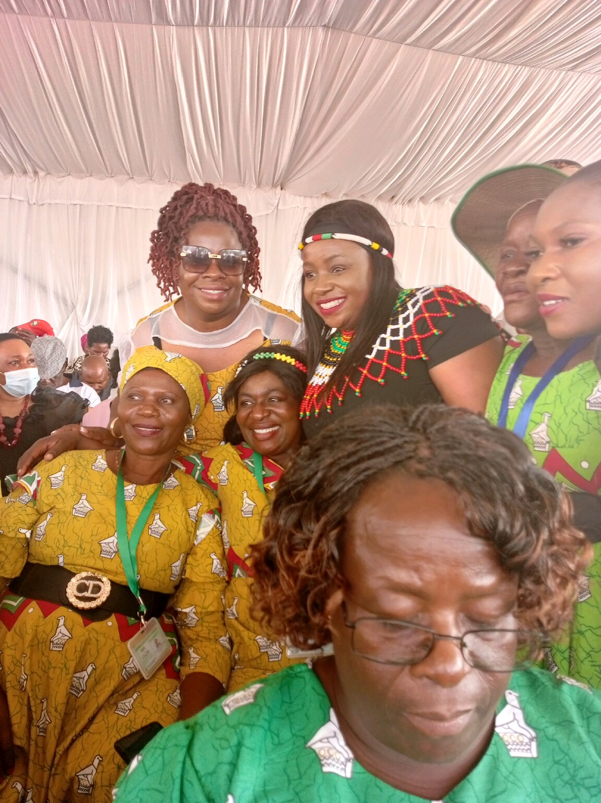
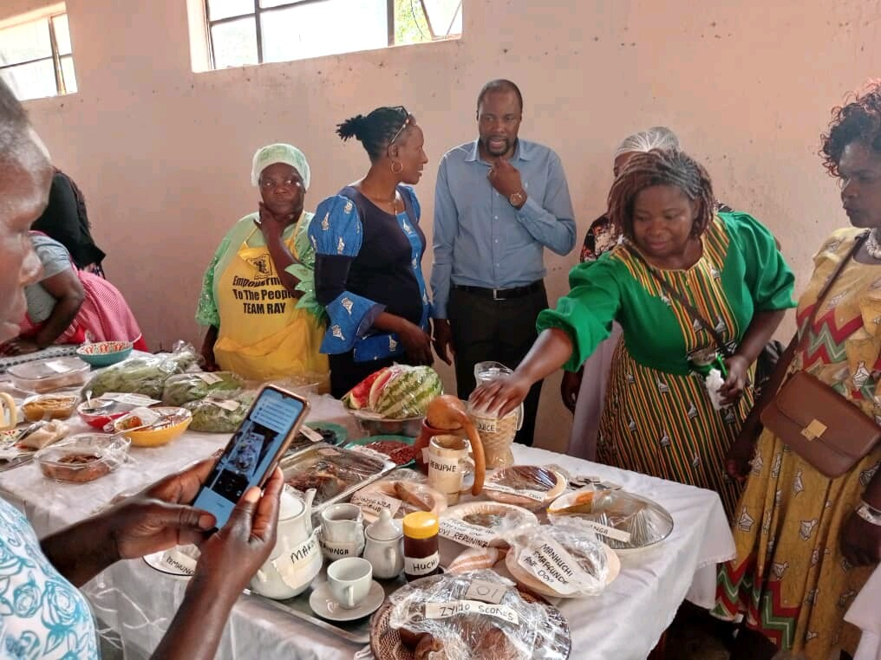
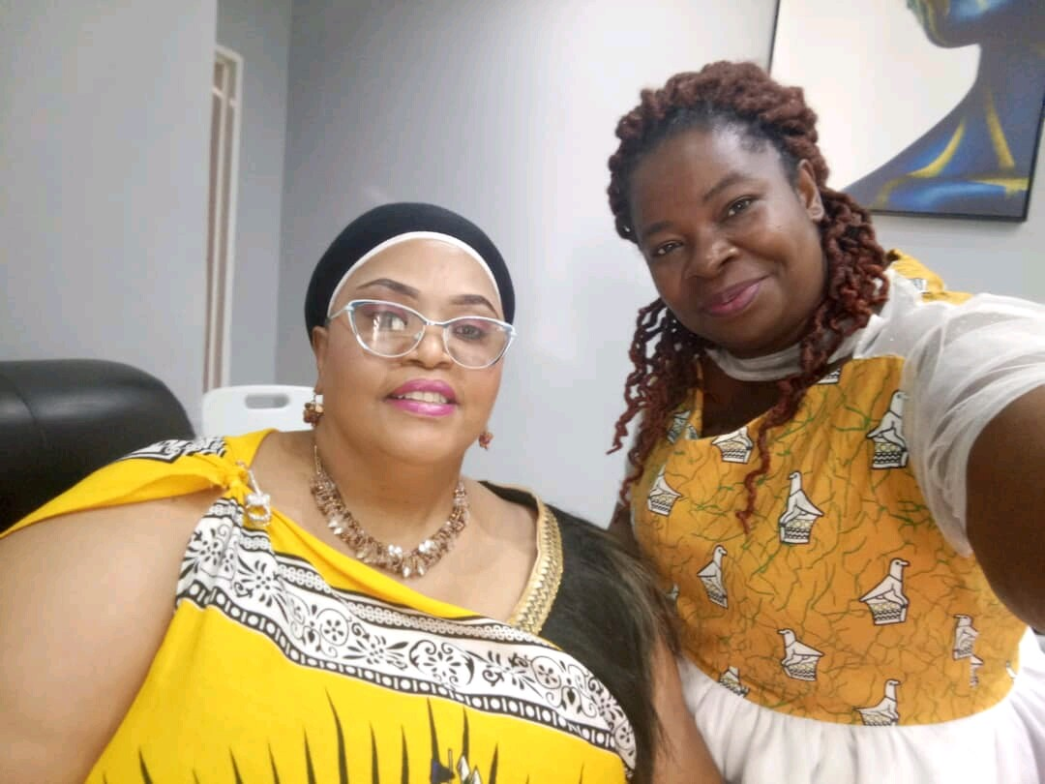
CHANGES AT INDIVIDUAL LEVEL
Influenced me to create relationships, from being an isolated person
to prioritise social impact
Increased connections through empathy and understanding
People’s harrowing experiences creates a conviction of wanting to do more
Becoming a confident and compelling public speaker
Include Photos or videos

Slide 15
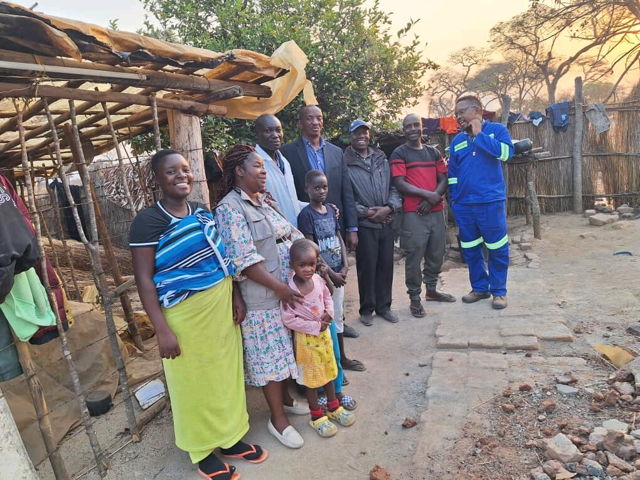


CHANGES AT THE HOUSEHOLD LEVEL
Appreciative of my husband
Can no longer find offense in petty issues
Significantly rekindled my intimacy and love life
Include Photos or videos

Slide 16



CHANGES AT THE INSTITUTIONAL LEVEL
Collaboration with colleagues in council, police, advocacy groups, Ministry of Women Affairs for Gender Sensitive Programmes
Advocated for retention of graduate trainees after falling pregnant
MRDC now has a Gender Committee and a Gender Champion
Junior Council now has a budgetary allocation
Include Photos or videos

Slide 17

CHANGES AT POLICY LEVEL
The review of Graduate Trainee Policy,
The review of Gender Policy
Advocacy and lobbying for social protection, through safety nets like ECD centres, Orphanages, Old People’s Homes;
Gender Committee,
Gender Champion,
Junior Council now has budgetary support;
I am still advocating for 50:50 representation in policy and decision making
Include Photos or videos

Slide 18



INFLUENCE AT COMMUNITY LEVEL
I have organized community forums i.e. family days and women’s days where awareness campaigns have been done
I have visited farm workers and educated them on the importance of participating on budget consultation meetings.
Include Photos or videos

Slide 19



Lessons Learnt
Learnt that if you empower a woman, you empower a community,
Old people require additional support
Education is key to the success of budget consultation and participation
Fighting poverty is key to eradicating Gender Based and Domestic Violence

Slide 20

NEXT STEPS
Mobilise resources for the establishment of old people’s homes and orphanages
Planning an award ceremony to celebrate the success of rural women
16 Days of Activism Against Gender Based Violence
Establishing Community Based Projects
Plan Community Based Workshop and Trainings on Budget Consultations
Use graphics and tables to illustratethe next steps.

