Slide 1




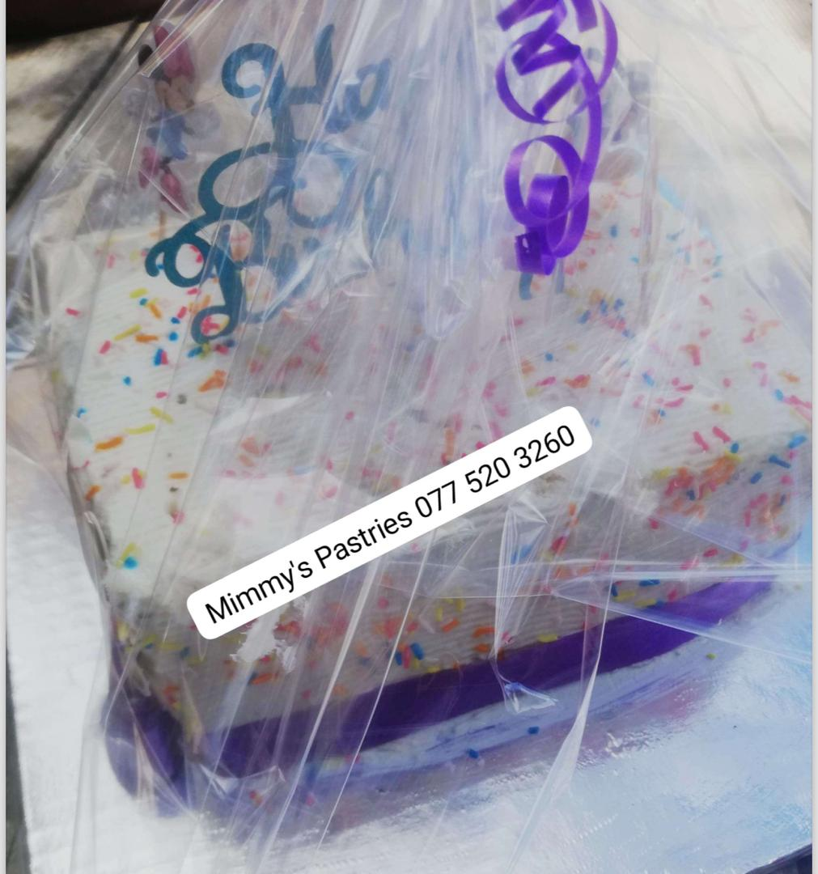
PROMOTING GENDER-INCLUSIVEE LOCAL ECONOMIC DEVELOPMENT IN ZIMBABWE
11-13 NOVEMBER 2024
Business name:
MIMMY’S PASTRIES
Participant name:
MIRTH KDIRI
Council:
MUREWA R.D.C.

Slide 2
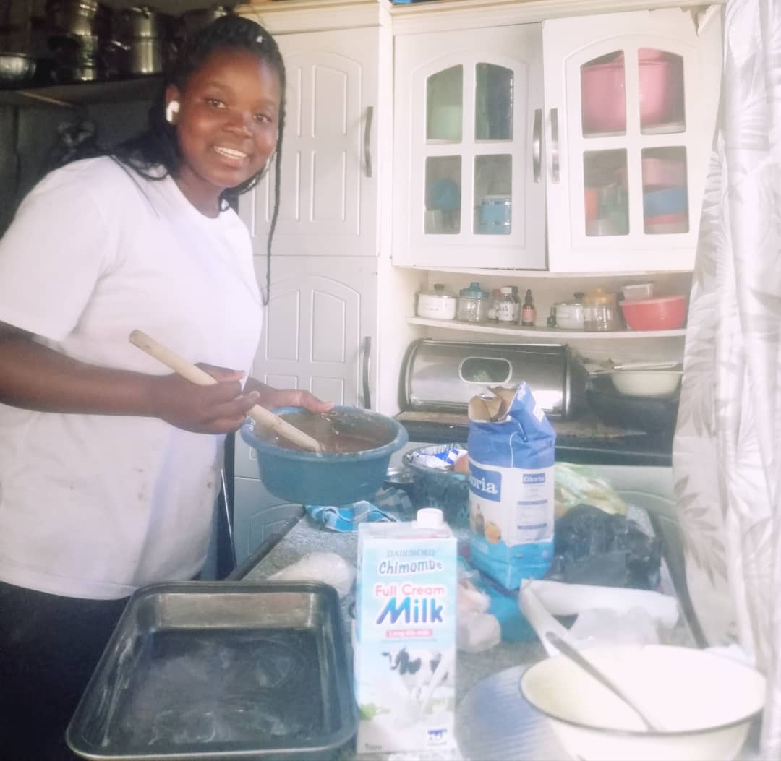
MY BUSINESS
I am a Pastry Chef
I focus on baking and selling pastries e.g. cakes, cup cakes, doughnuts, bread, buns etc

Slide 3
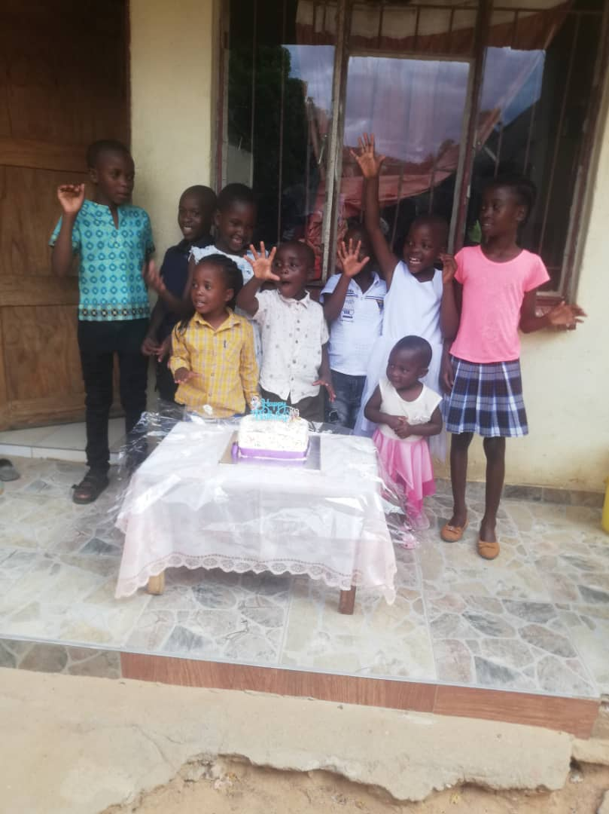
CUSTOMER BASE?
My Customers are the commnuty, neighbours and friends as well as local shops
My customers have increased since staring the LED Business. I have more orders from people in my group.
I give samples of my products and people like my pastries and they keep ordering

Slide 4
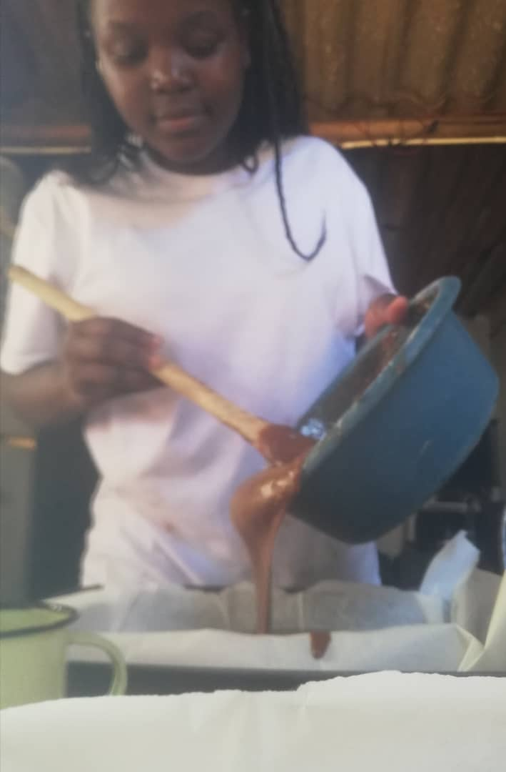
COMPETITION
The Local bakery is my competitors.
I handle competitions by giving promotions to my customers or discounts e.g. Buy a large cake and get free 5 cup cakes. I keep getting more customers.
I also do door to door deliveries.

Slide 5
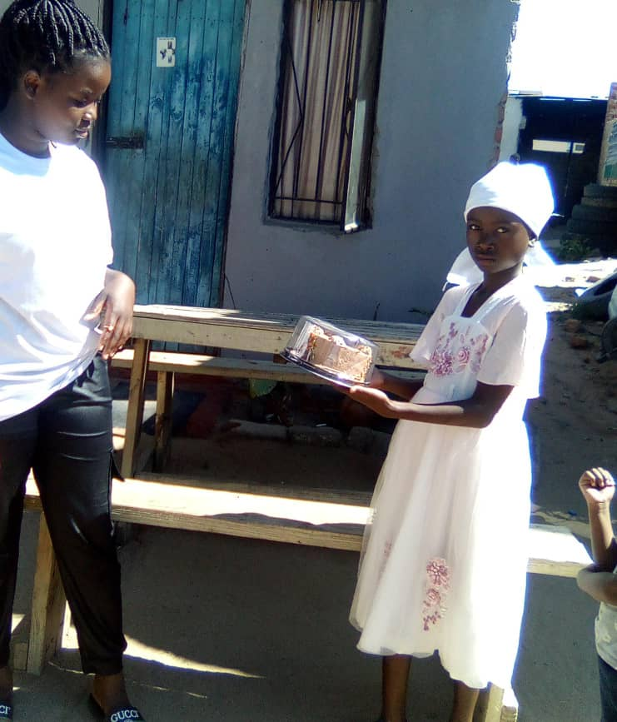
NEW PRODUCTS OR SERVICES?
I do not have new products, however, I do offer catering services.
I advertise through Social media platforms.

Slide 6
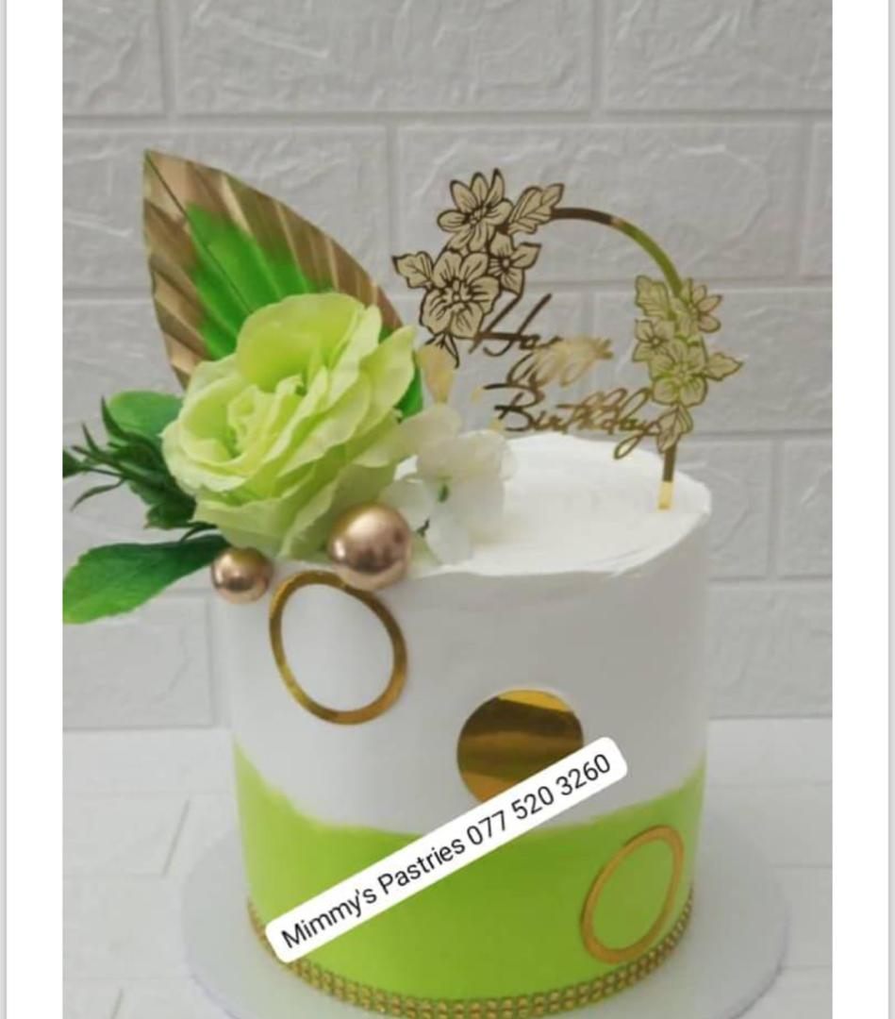
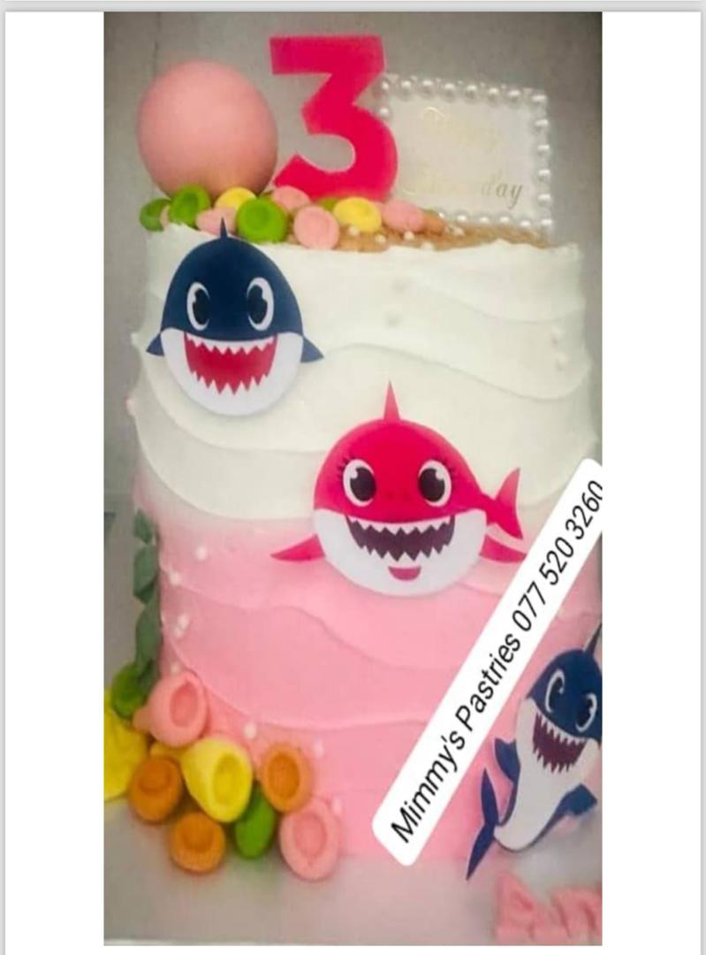
QUALITY AND PACKAGING
My customers are happy with quality of my products.
I have more referrals from them.
My products are branded Mimmie’s pastries.
For cakes, I have tried different packaging and customers like the packaging.

Slide 7
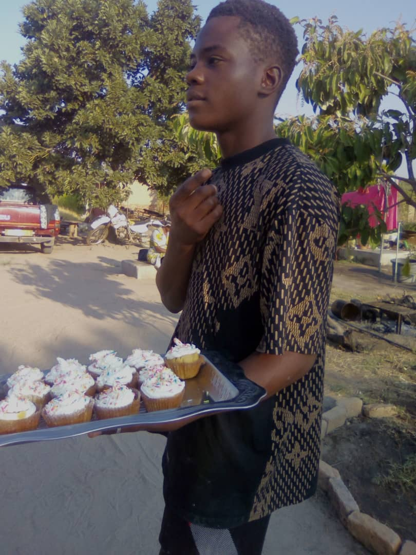
BUSINESS MANAGEMENT
I have one part time staff
I keep track of my stock every week.
I have managed to price my products well such that I realise profits. I check the cost of my inputs and put a mark up . Cost plus markup gives me the selling price. My mark up is 20 to 30% of the cost. The mark up represents my labour and creativity.

Slide 8
FINANCIAL MANAGEMENT
I do have record keeping in place for my credit and cash sales. .
This helps me to keep track of my finances and to follow up with my customers
Yes I have a bank account.

Slide 9
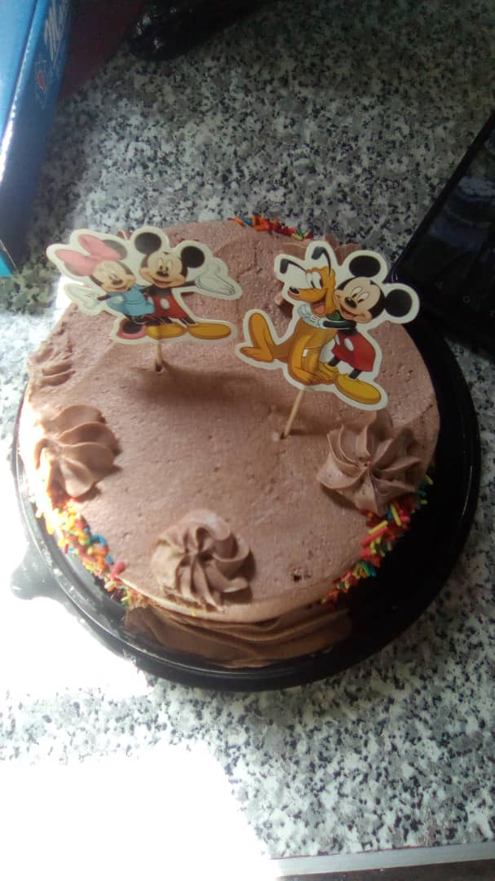
SAVINGS AND SELF SUFFICIENCY
Yes I am a member of a savings group.
Yes I am saving money. I have managed to save about US$500.
Yes as a youth I am helping my family.

Slide 10
INCOME AND EXPENSES FOR THE BUSINESS FOR THE PAST SIX MONTHS
Income
ITEM | AMOUNT
Sales-
CAKES | 100
COP CAKES | 60
MUFFINS | 40
PIES | 20
DÉCOR- CATERING | 80
SCONES | 70
BUNS | 20
DIGHNUTS | 50
CROISSANTS | 45
FRIED FRITAS, ROLLS, WRAPS, BISCUITS | 140
TOTAL | 615
Expenses
ITEM | AMOUNT
INGREDIENTS | 250
ALLOWANCE | 100
GAS | 30
AIRTIME | 5
PACKAGING | 30
TOTAL | 415

Slide 11
INCOME AND EXPENSES FOR THE BUSINESS FOR
NEXT SIX MONTHS
Income
Expenses
ITEM | AMOUNT
SALES | 1158
TOTAL | 1158
ITEM | AMOUNT
INGRIDIENTS, GAS, AIRTIMS | 580
ALLOWANCE | 120
PACKAGING | 60
TOTAL | 760

Slide 12
WHAT PLANS HAVE YOU MADE TO GROW YOUR BUSINESS IN THE NEXT 6 MONTHS?
I want to register my business as a private limited company.
I want to engage more part time personnel who sell products that give quick money e.g. doughnuts, pies, buns and cup cakes.
I want to supply retailers in Murewa

Slide 13
CHALLENGES
Delay in payments by some customers who buy on credit.
I now request for deposit from clients and they pay balance upon delivery.

Slide 14
SUSTAINABILITY
Recapitalizing the business, meaning I ensure that ingredients are always available.
To avoid misuse of funds.

Slide 15
ADDITIONAL INFORMATION?
As a young entrepreneur, I am learning new things everyday and I have the potential to grow my business.

Slide 16
THANK YOU

