Slide 1
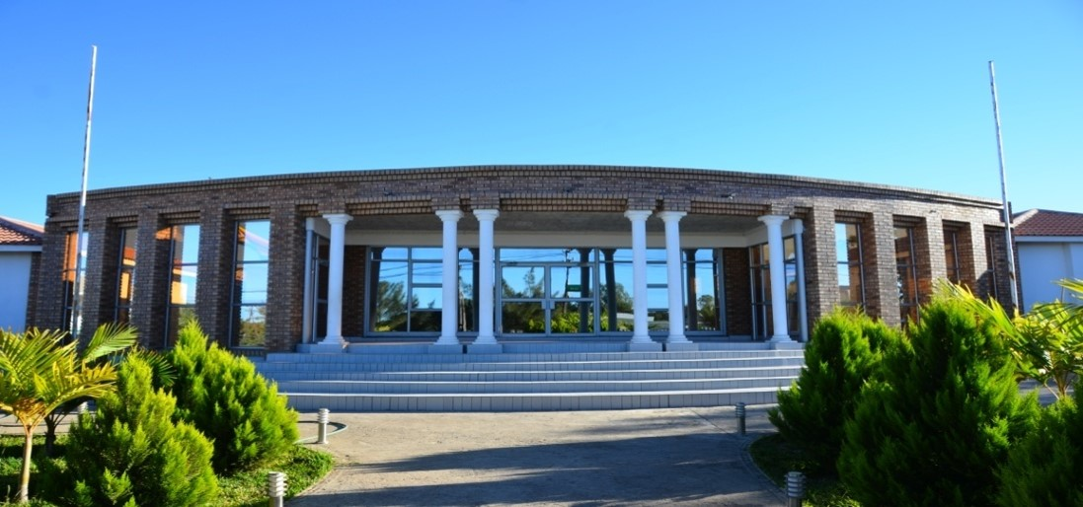





SADC PROTOCOL@WORK SUMMITS AND AWARDS
2024 INSTITUTIONAL COE
.
Zimbabwe, Beitbridge Municipality, November and Magic Shoko

Slide 2
OVERVIEW
COUNTRY | ZIMBABWE
COUNCIL | BEITBRIDGE MUNCIPALITY
GENDER CHAMPION | COUNCILLOR BRENDA MAWORERE
GENDER FOCAL PERSON | MAGIC MAKER SHOKO
MATEBELELAND SOUTH HUB COUNCIL
Latest score (year)
 | Women | Men | Total | % Women
Council | 4 | 4 | 8 | 50%
Management | 7 | 15 | 22 | 31%
Council staff overall | 91 | 317 | 408 | 22%
Population served
Key characteristics | The Municipality of Beitbridge houses the busiest border post in Sub-Saharan Africa with transit population of over 12000 per day and over 20000 during peak times. It experiences low rainfall and very high temperatures of about 42 degrees celcius.

Slide 3
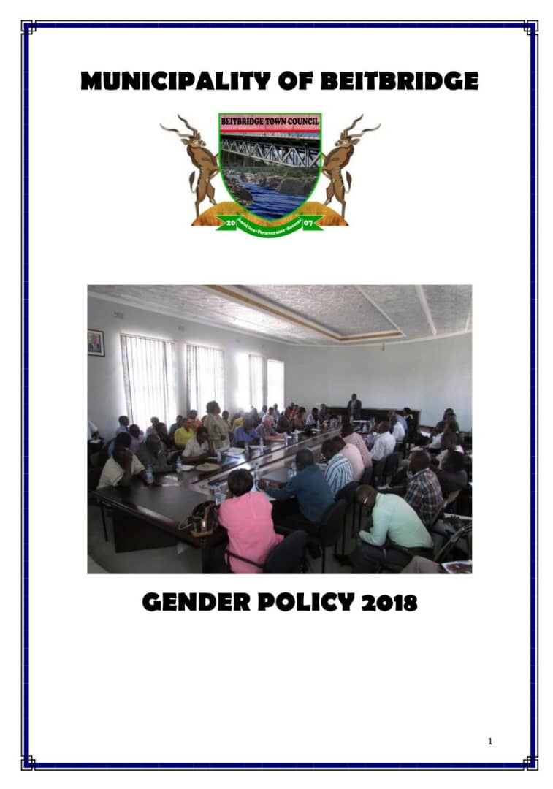
  I. GENDER POLICY, ACTION PLAN, HUB AND SPOKE
Gender policy was adopted by council in 2018. A gender Action plan is also in existence and is renewed every year
It is well known and has a high profile champion within the council.

Slide 4
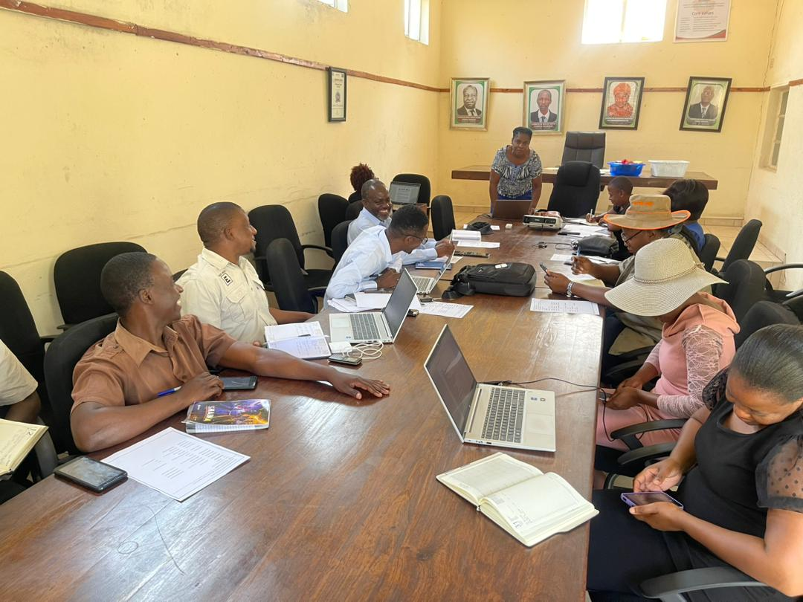
  I. GENDER POLICY, ACTION PLAN, HUB AND SPOKE
Council is a Hub council of Matabeleland South Province.
We conducted one provincial strategy meeting on gender responsive budgeting (GRB) and Preparations for the SADC protocol@ work summit
Mentee councils were assisted on completing the summit.
Matabeleland South Provincial Hub and Spoke Meeting
Hub and Spoke strategic meeting at Plumtree Town Council

Slide 5
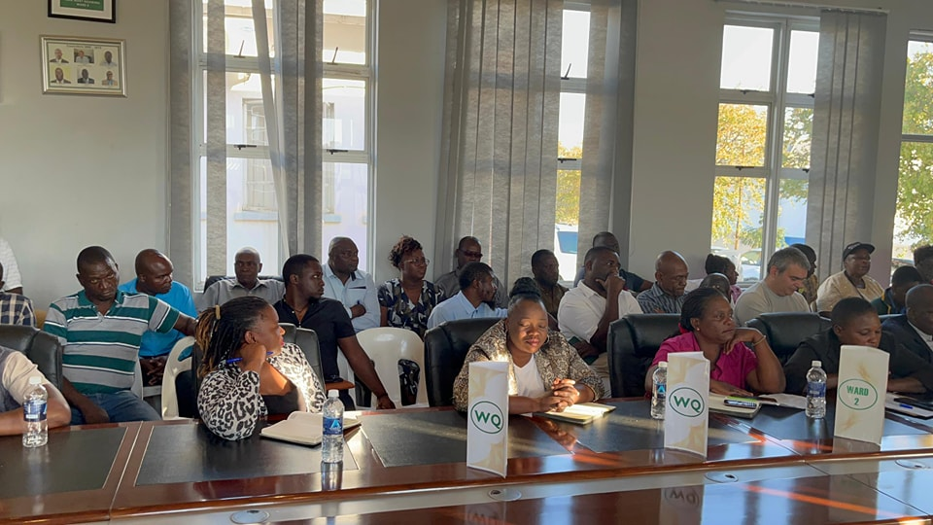
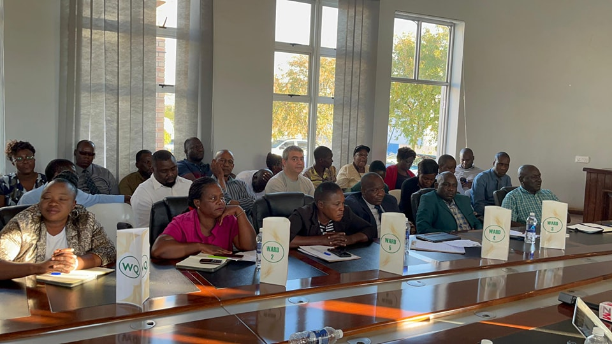
II. GOVERNANCE
Detail
Evidence
4 councillors are female. ¼ women chairs the health and housing committee
Council established a Junior Council. The Junior Mayor is a male. He is deputised by a female. Junior Town Clerk is a female
4 females
3 Males

Slide 6
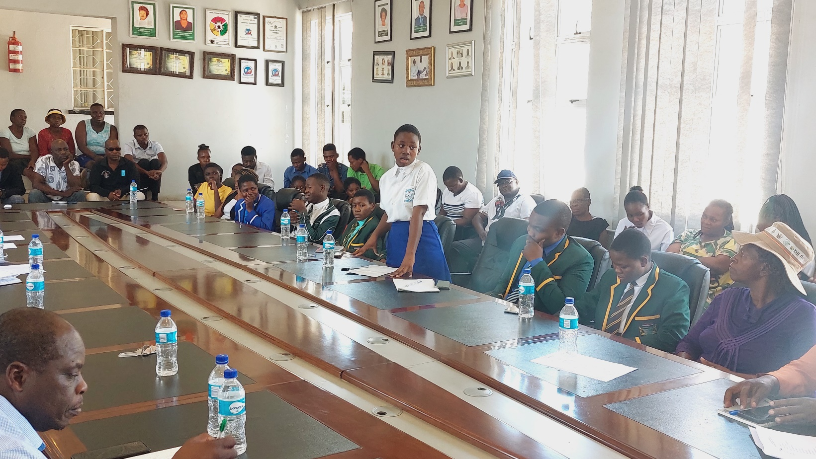
II. GOVERNANCE
Detail
Meetings attended by residents
include
Ward meetings
Budget consultations
Master Plan formulation
Water provision update
Planning and review meetings of council events eg fundraising, marathon, vendors meeting
Budget consultation for Junior Councillors, women and Youth

Slide 7
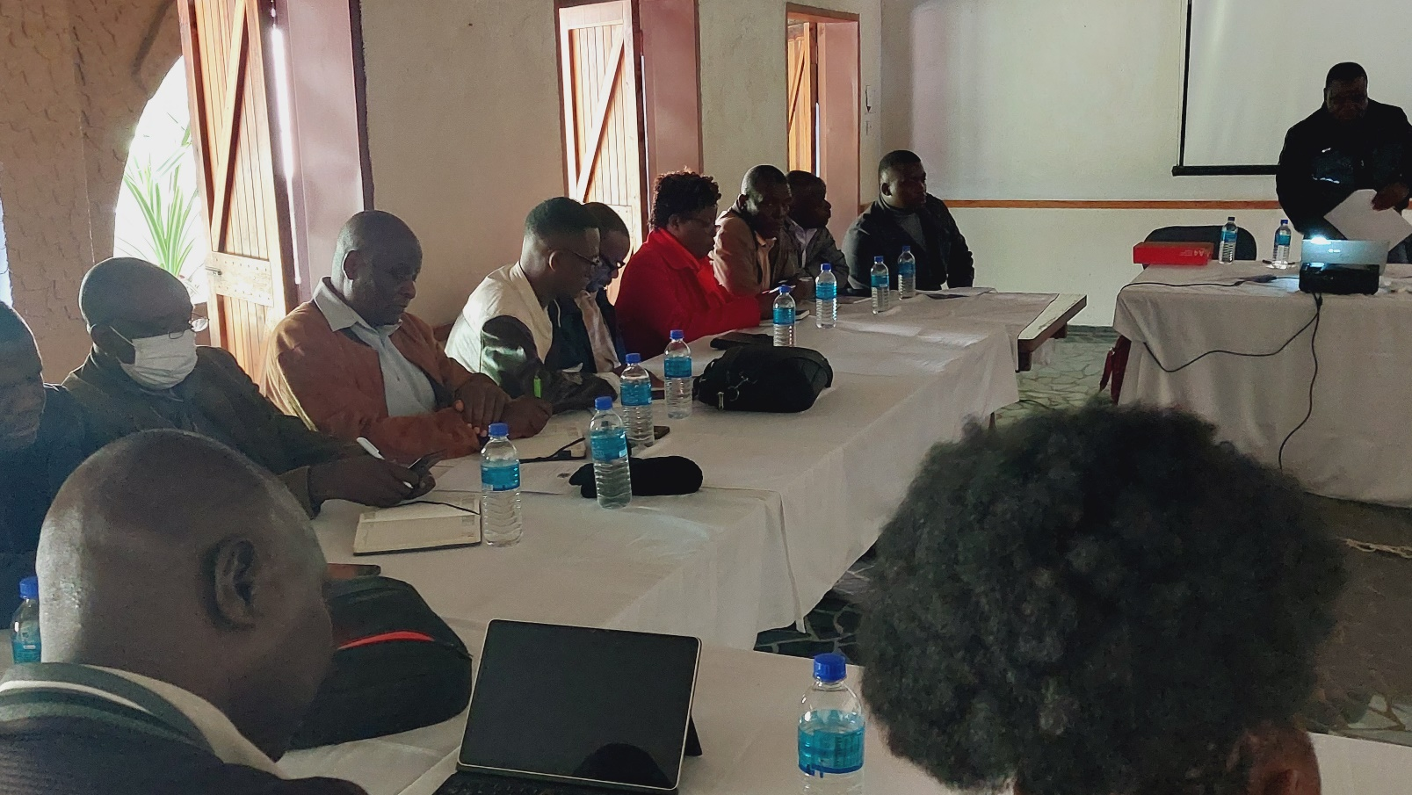
III. WORK PLACE POLICY AND PRACTICE
Council conducted training on customer care and team building for management and shop floor workers
Council reviewed the conditions of service, sexual harassment, dress code and policies
Council invited a motivational speaker to have a session with management.
Council conducted a conflict management workshop with management and councillors.
Council Policies Review at Bubi Hotel

Slide 8
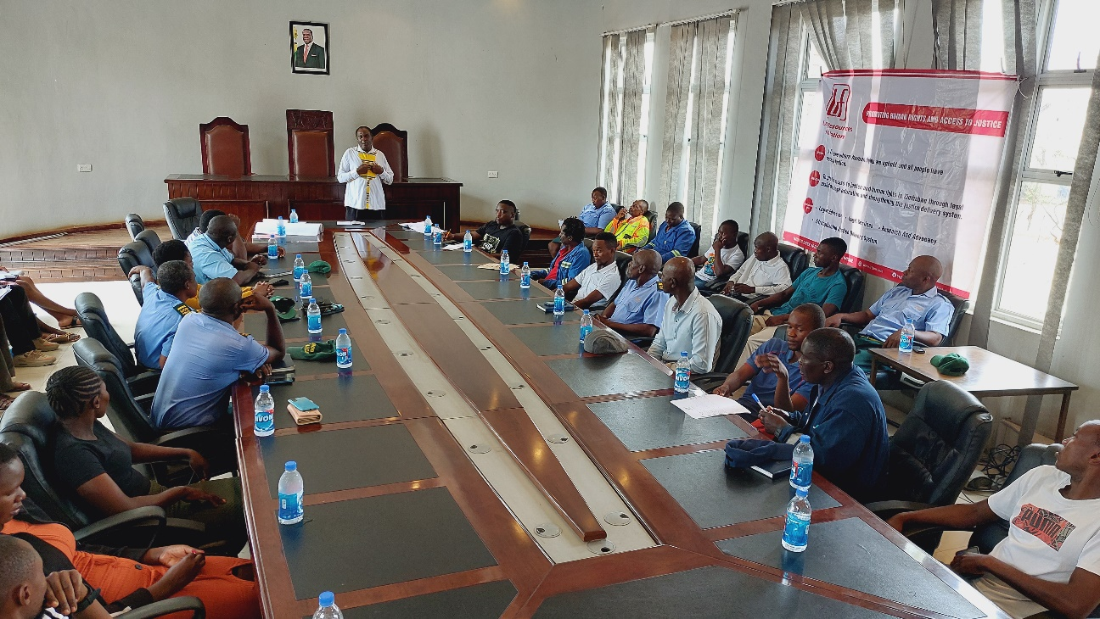
III. WORK PLACE POLICY AND PRACTICE
Gender training was conducted for workers. An officer from Legal Resources Foundation was the facilitator. The workshop was on Domestic Violence
Gender Training for council workers

Slide 9
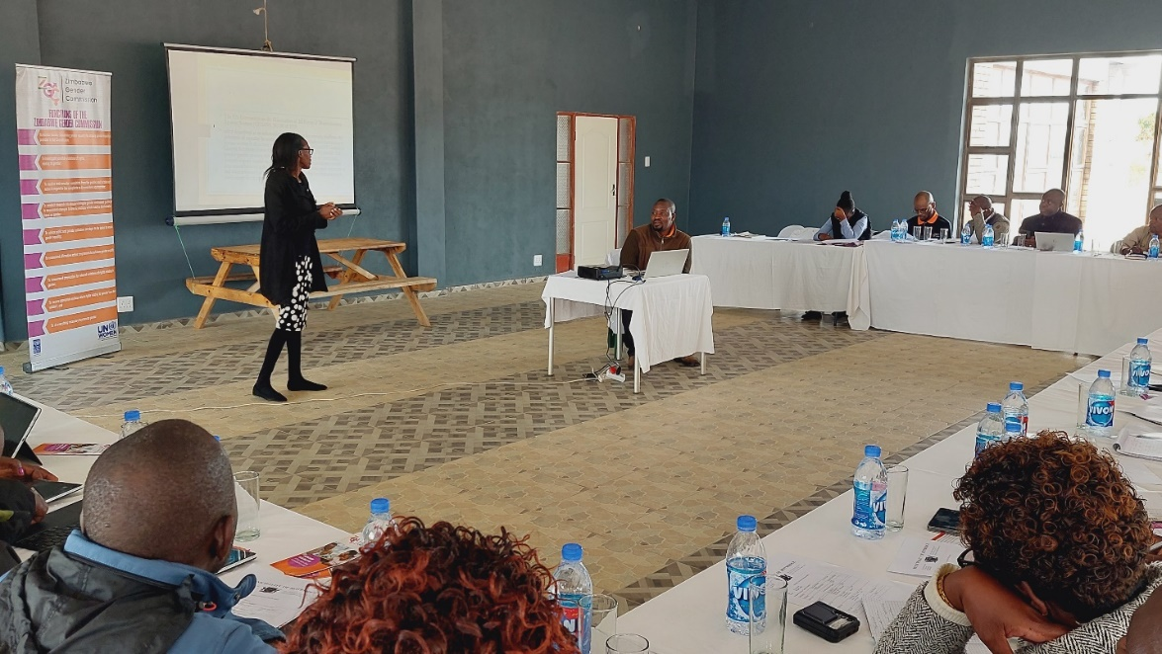
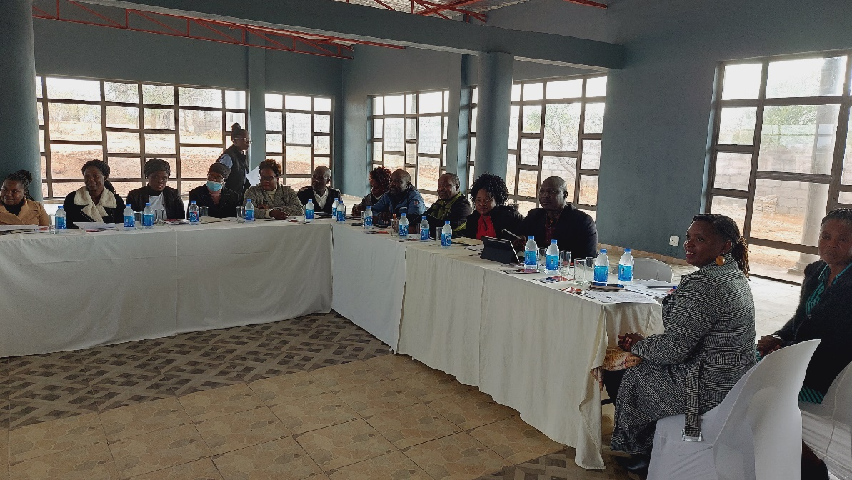
III. WORK PLACE POLICY AND PRACTICE
Gender Training for Councillors and Management in partnership with Zimbabwe Gender Commission. Topics covered included
The Role of the Gender Commission
Understanding Gender
Gender Commission
GBV
Legal frameworks
Councillors, Management and Supervisors

Slide 10
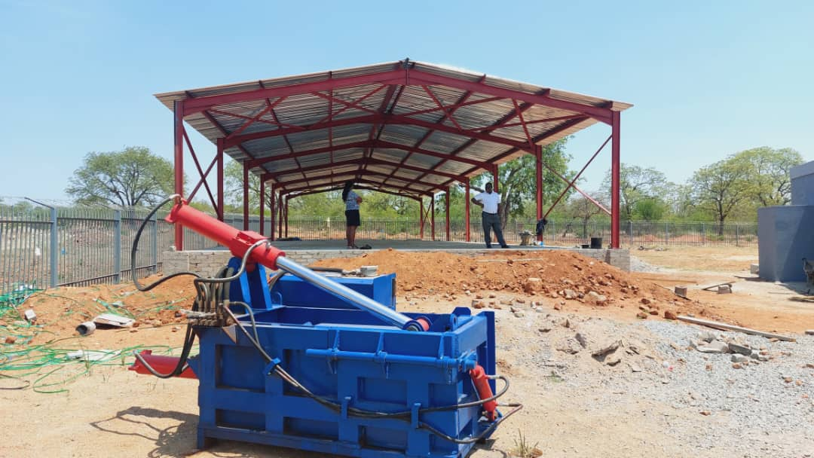
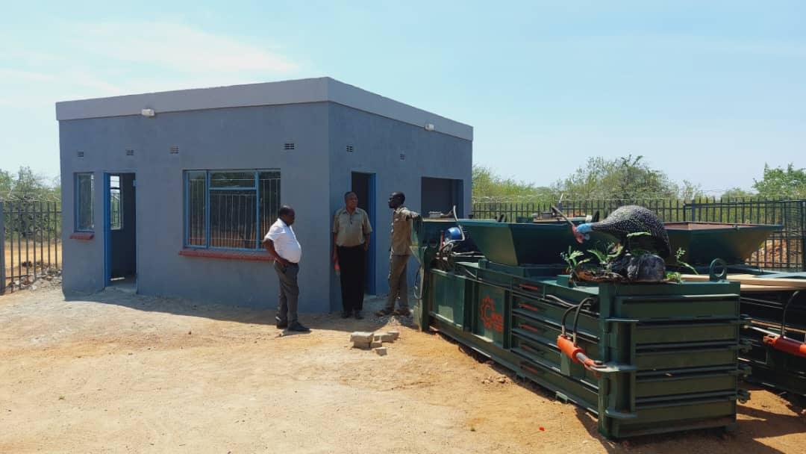
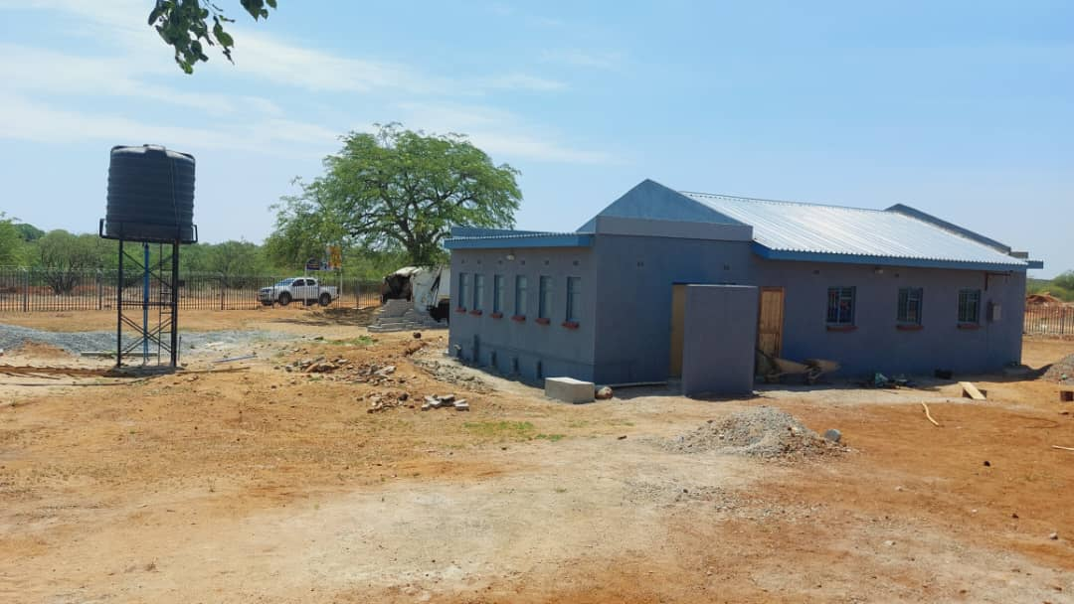
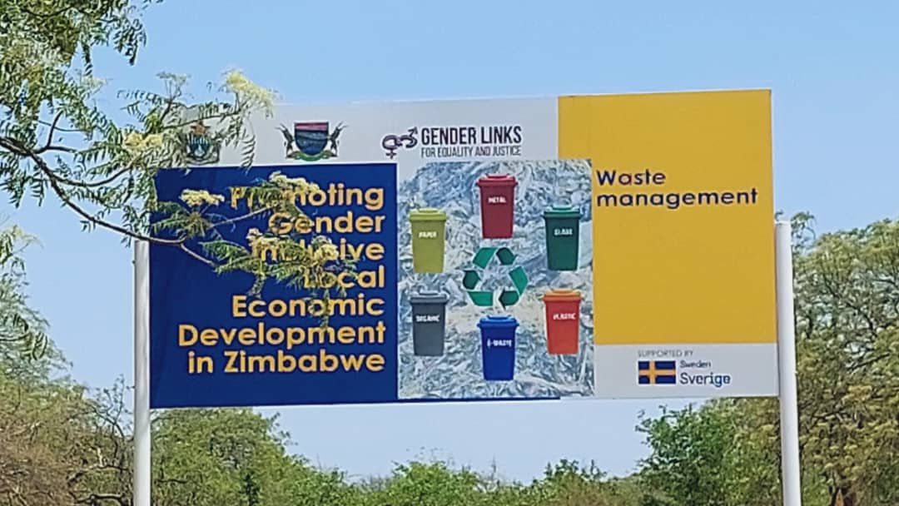
IV. LOCAL ECONOMIC DEVELOPMENT
Council in partnership with Gender links has embarked on 'The promoting gender Inclusive local economic development project: waste management project". The project aims at improving the livelihoods of women, youths and members of the community through empowering individual entrepreneurs to manage and control their enterprises as well as the flagship enterprise. The project entails the baling of collected waste plastics and crushing the same for value addition. The project site has been constructed in partnership with Gender links.
Waste Management Recycling plant

Slide 11
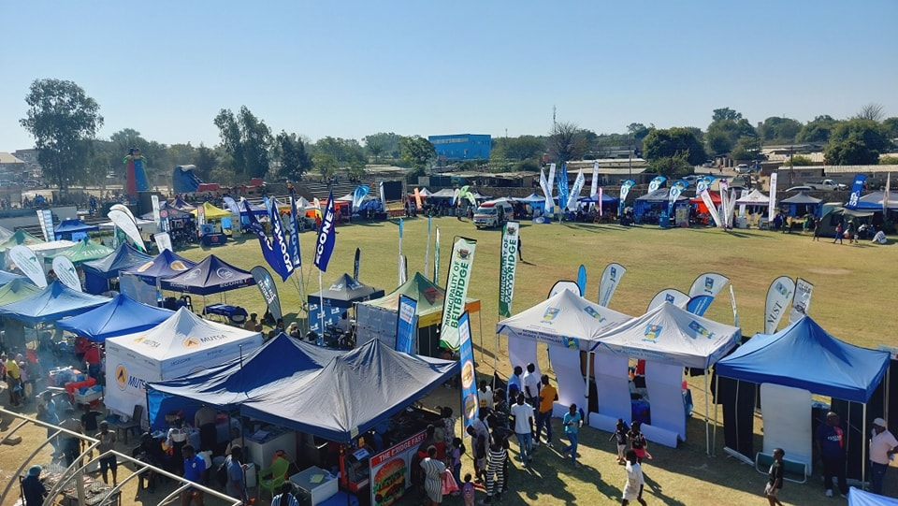
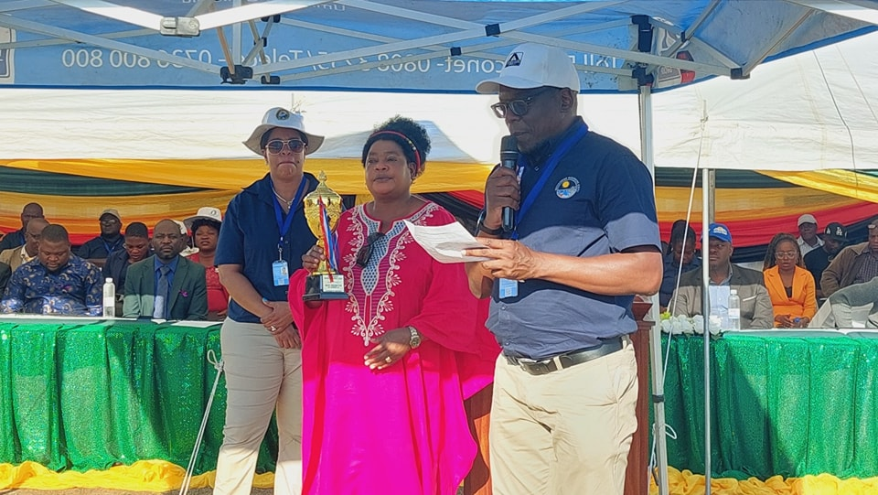
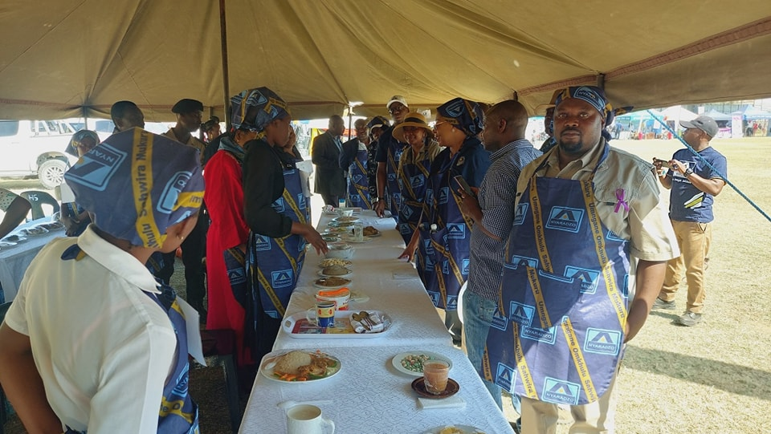
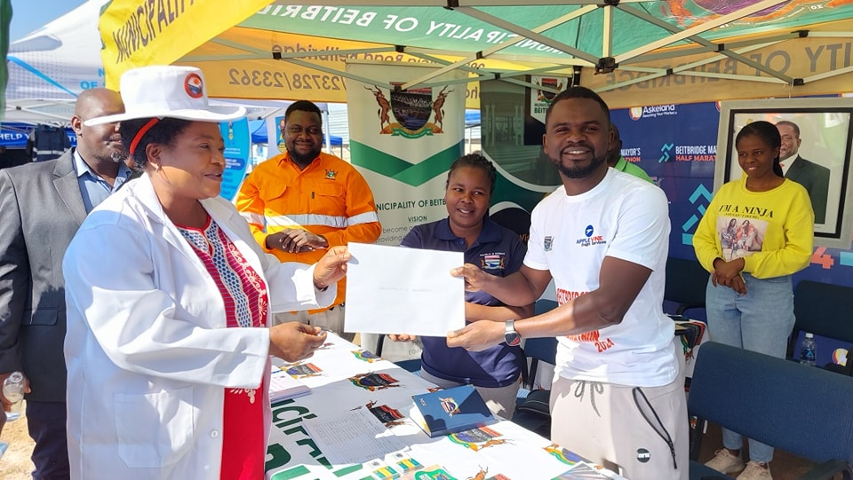
IV. LOCAL ECONOMIC DEVELOPMENT
To improve business opportunities, Council organised a Beitbridge business exhibition show in partnership with the business community, to give local business people an opportunity to market their businesses, products, personalities and services. The committee is chaired by a local business women.
Council has allocated land for the business show ground
Beitbridge Business Expo

Slide 12
V. INFRASTRUCTURE AND SOCIAL DEVELOPMENT
Land and housing
Council allocated stands and two houses to the to elderly women.
Water and sanitation
Borehole committees are in existence. 48% of the Secretariat are women
In the Municipality there are 5 public toilets. One is a private facility (at Mashakada BC) whose director is a elderly female.
The 4 public toilets run by MOB have 11 women out of 12 employees
Council public toilets have ramps and disability water closets to improve accessibility by PWDs.
.
Housing Allocations | Number | Proportion (%)
Women | 110 | 44%
Men | 141 | 56%
Total | 251
Water Committees | Number | Chairpersons of Water Committees | Vice Chairpersons of water committees
Women | 105 | 12 | 8
Men | 34 | 9 | 13
Total | 139 | 21 | 21

Slide 13
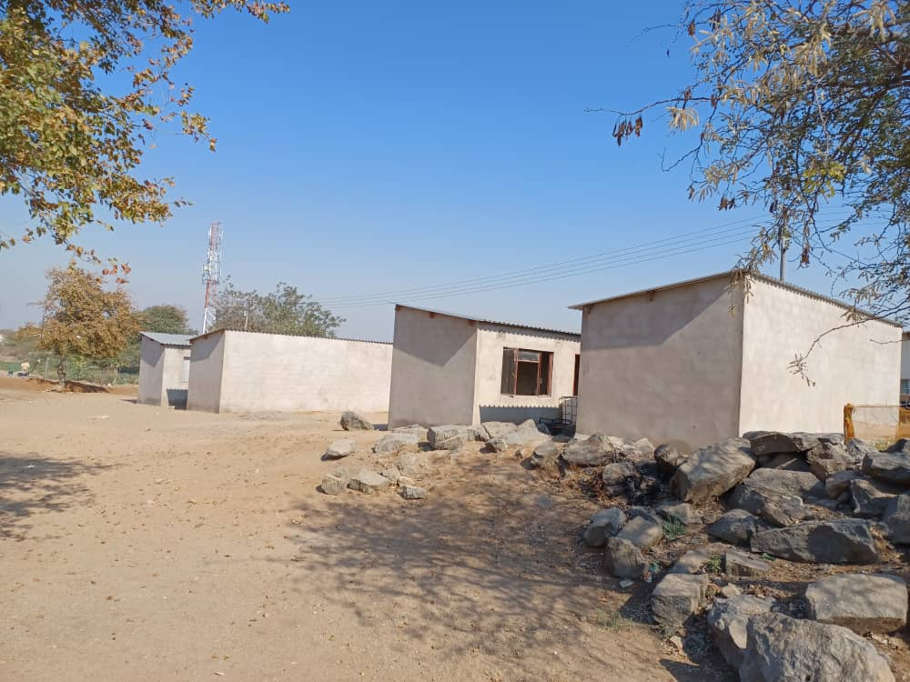
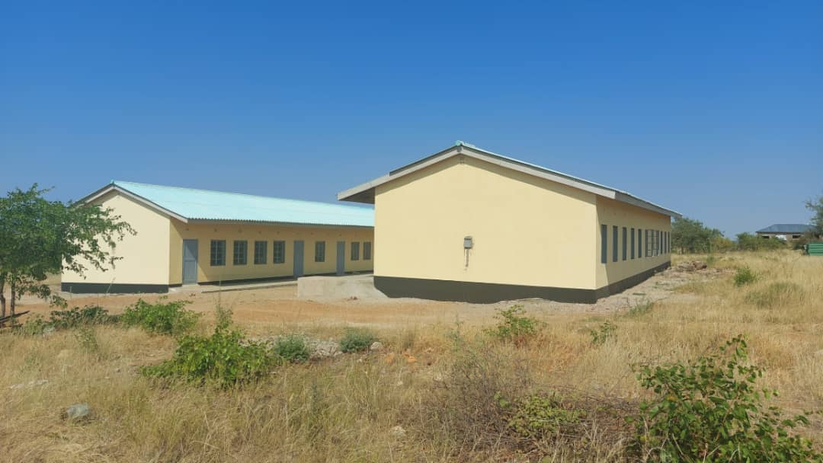
V. INFRASTRUCTURE AND SOCIAL DEVELOPMENT cont..
5 Residential houses built by council
Primary School built by council

Slide 14
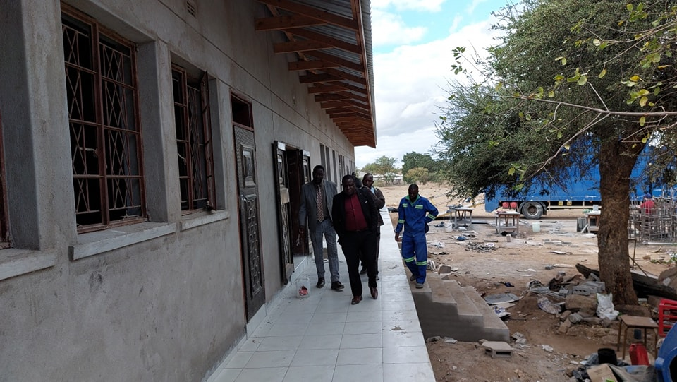
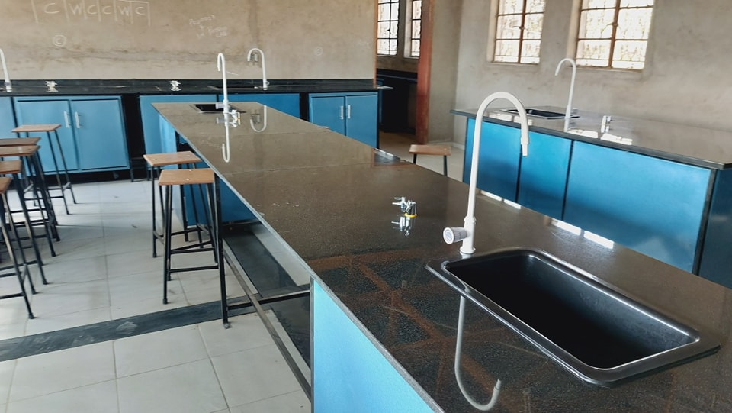
V. INFRASTRUCTURE AND SOCIAL DEVELOPMENT cont..
Equiping of the Vhembe high school science lab

Slide 15
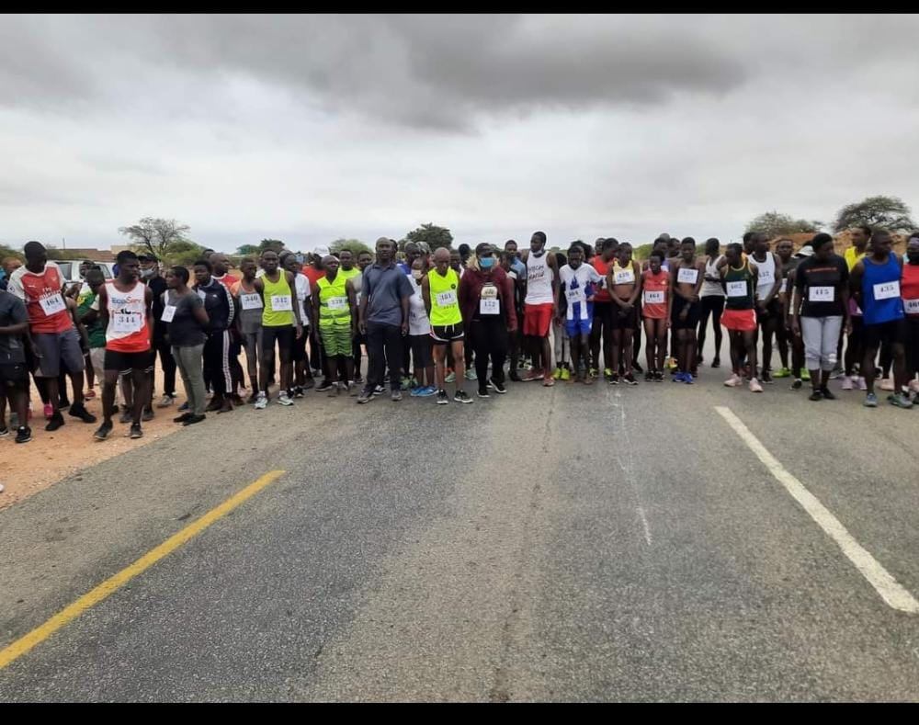
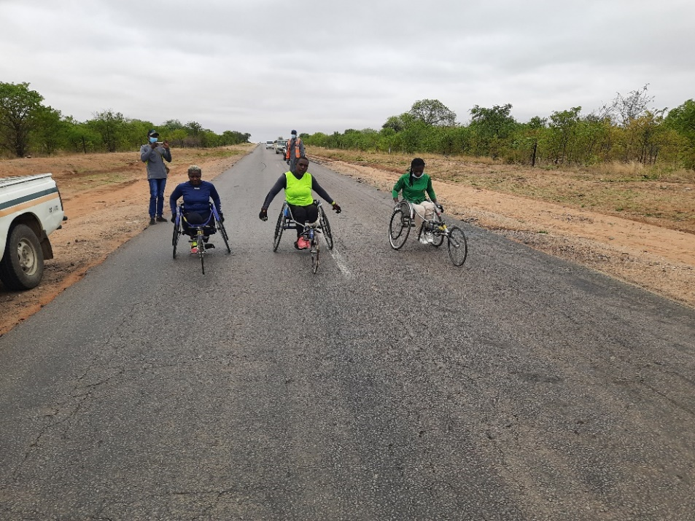
V. INFRASTRUCTURE AND SOCIAL DEVELOPMENT cont..
Equal opportunities for in all council activities
Athletes at Mayor’s Half Marathon event
People with disabilities at Mayor’s Half marathon event

Slide 16
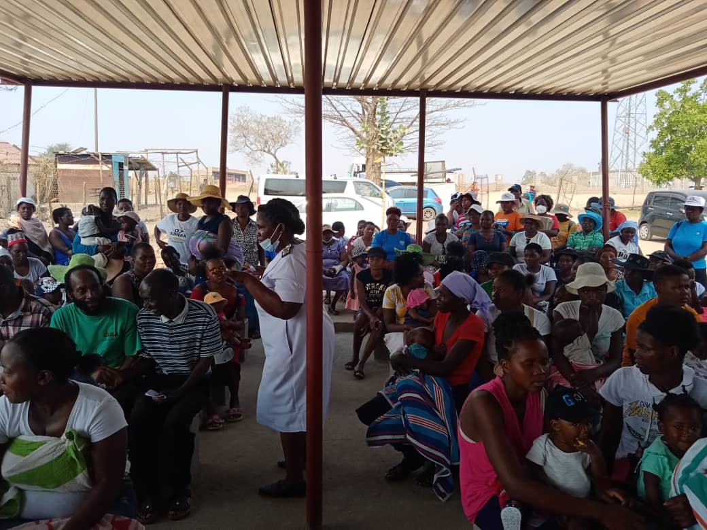
VI. SEXUAL AND REPRODUCTIVE HEALTH, HIV AND AIDS
Health education on HIV and Aids infection is given every morning at the clinics.
A maternity wing has been constructed.
Council had beerhall visits in partnership with CESSAHR
The average distance to the nearest clinic in 1.6km through the establishment of a satellite clinic
Council through Health promoters, encourage early reporting of pregnancies at health facilities.
Health education at council clinics

Slide 17
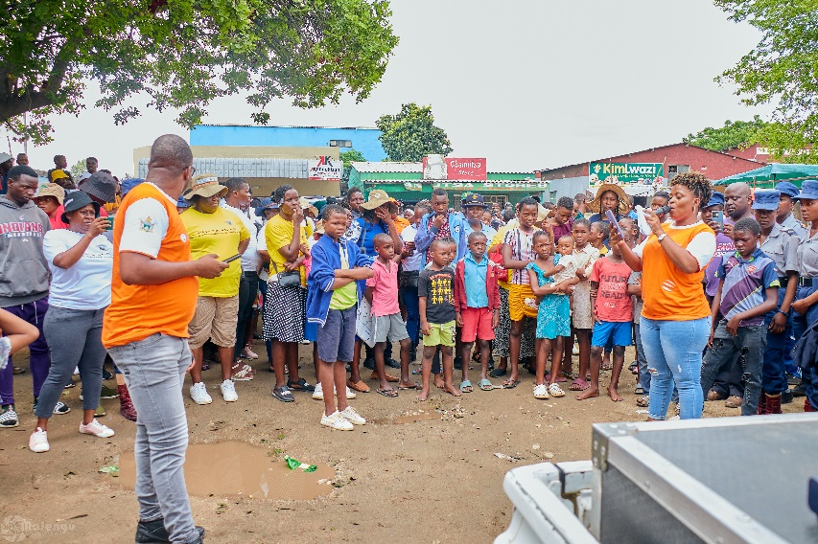
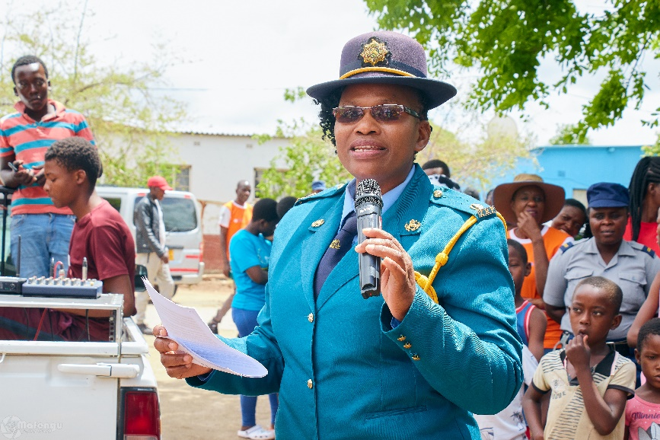
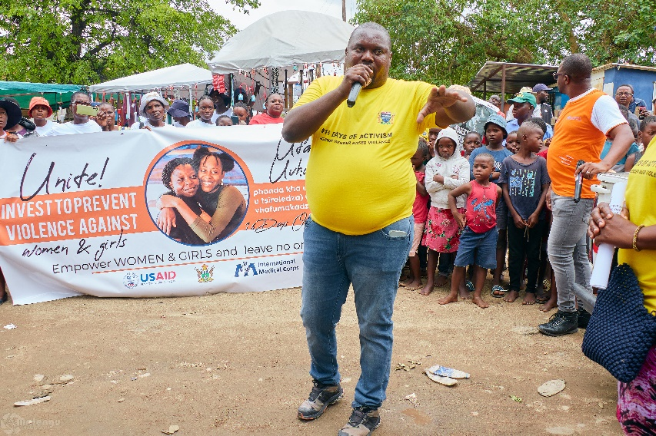
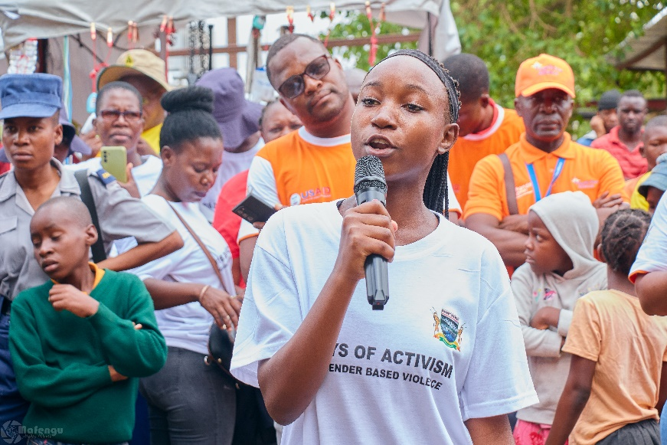
VII. GENDER BASED VIOLENCE
To improve citizen safety, Council set up solar powered tower lights to reduce the occurrence of muggings.
Council observes the sixteen days of activism against GBV
Council conducts training on gender to its employees annually.
Council refers cases of GBV to victim friendly unit(VFU). Victims of GBV are examined before referral to victim friendly unit. Council works with VFU in all GBV activities and events.
Commemoration of the 16 days of Activism

Slide 18
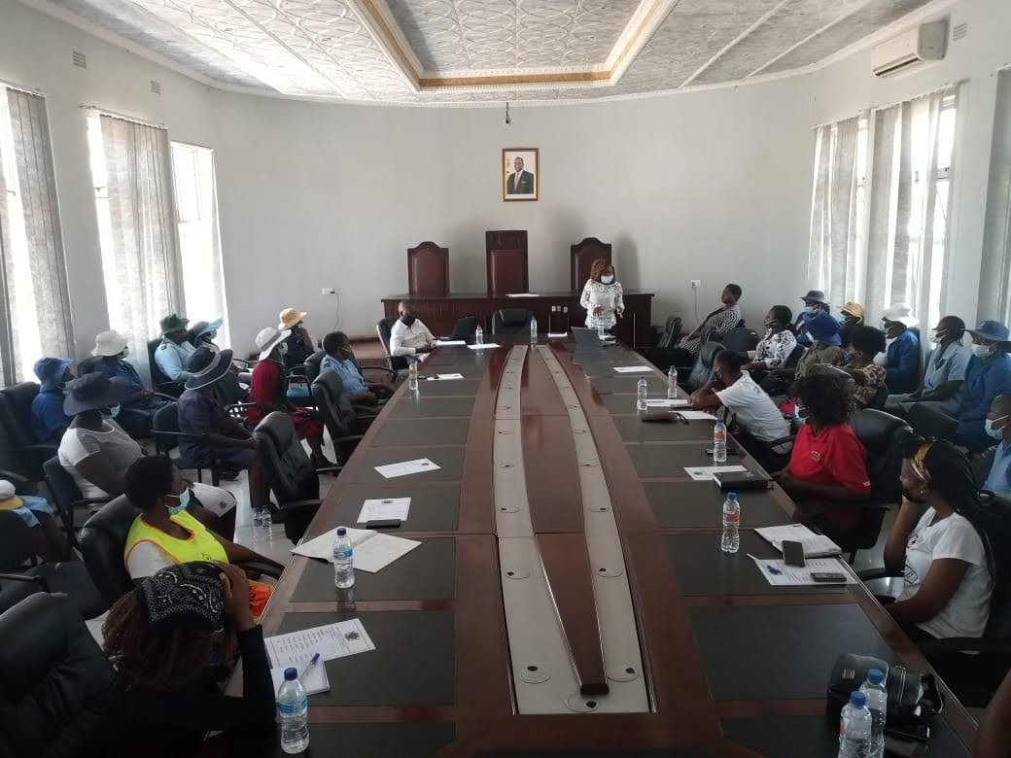
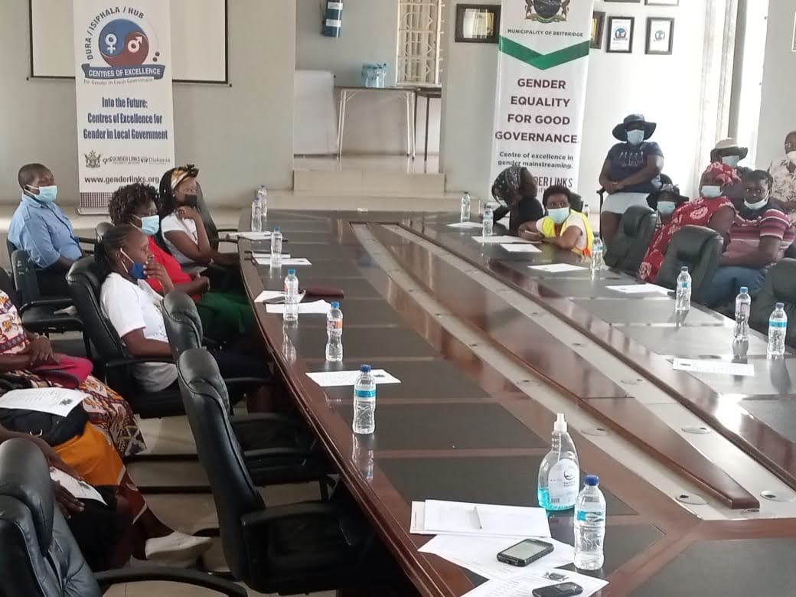
VII. GENDER BASED VIOLENCE
Training for women employees during the 16Days of Activism

Slide 19
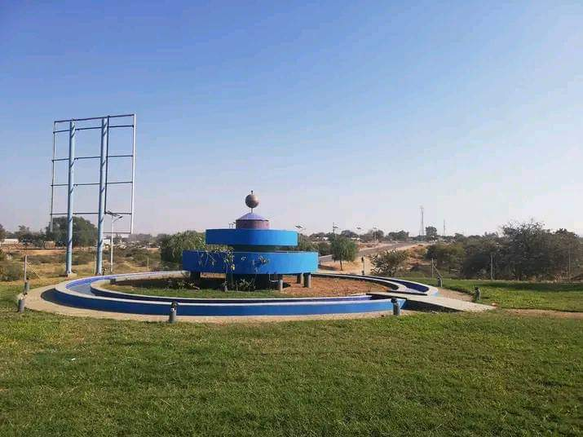
Climate Justice
Projects for climate change include
Recreational Parks- Council is entering into partnerships for recreational parks
landscaping
storm water drainage construction on floodplain
Recreational Park

Slide 20
IX. GENDER MANAGEMENT SYSTEM
Gender Champion is the chairperson of Environmental works and Management committee.
Gender focal person who is in a middle management position.
Council has established a gender desk committee that consists of focal persons from all the departments of council

Slide 21
X. GENDER RESPONSIVE BUDGETING
Council has drawn up a Budget Statement in response to the Ministry of Finance ‘s Budget directive
Key Highlights
Council ensured that the needs of women, men, youth, the elderly, persons with disabilities (PWDs) and other groups are fully taken into account at budget crafting stage.
The age group 36-49 years attended consultation meetings more than the other age groups.
Stakeholder participation implies that the public’s contribution will influence the decision arrived through participatory budgeting
Internal sources of funding contributed 79% while external sources contributed 21%. Property Tax contributed most of the revenue.
The Gender wage gap of 2.59% indicates that there are more men in management positions than women. There are also very few women in some departments especially technical. This has a bearing on the overall employment statistics

Slide 22
X. GENDER RESPONSIVE BUDGETING

Slide 23
CHALLENGES
Decision making positions are still dominated by men. However our council is an equal opportunity employer and job adverts have an inscription that encourages women to apply.
Hub and Spoke meetings could not be conducted due to limitations of movements caused by the pandemic
Competing priorities

Slide 24
LESSON LEARNED AND INNOVATION
Council has to make use of more social media and digital platforms to broaden its reach to community.
Most Women and the Youth within the community showed lack of understanding of council processes and therefore there a need to educate them.
The municipality has to continue to learn and share good practices with other local authorities.
Council should involve stakeholders in working with Junior Council to conduct campaigns and other activities that enhance the advancement and protection of children’s rights.
Fundraising activities can assist to finance capital projects for example in the construction of Vhembe Lab

Slide 25
SUSTAINABILITY AND REPLICATION
Council has a gender desk with representatives from all the sections.
All members of management need training on gender responsive budgeting
Council has a gender policy in place to ensure continuity of the processes.
There is buy in by senior management.
More trainings of council employees to ensure they understand the gender related policies in place
The gender desk does an annual review the gender action plan

