Slide 1




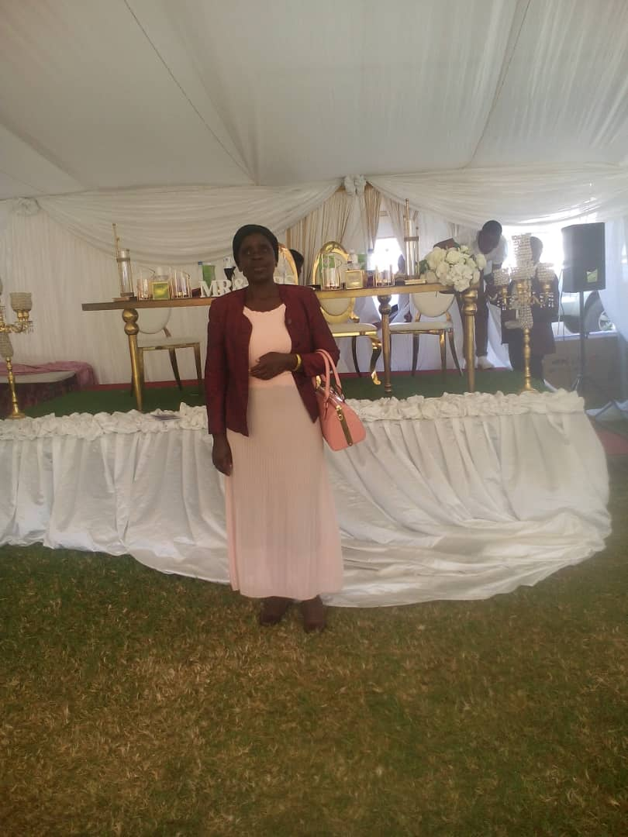
PROMOTING GENDER-INCLUSIVEE LOCAL ECONOMIC DEVELOPMENT IN ZIMBABWE
Business name: Kimbxoxo Butchery
Participant name: Nyarai Kaseke
Council: Murewa Rural District Council

Slide 2
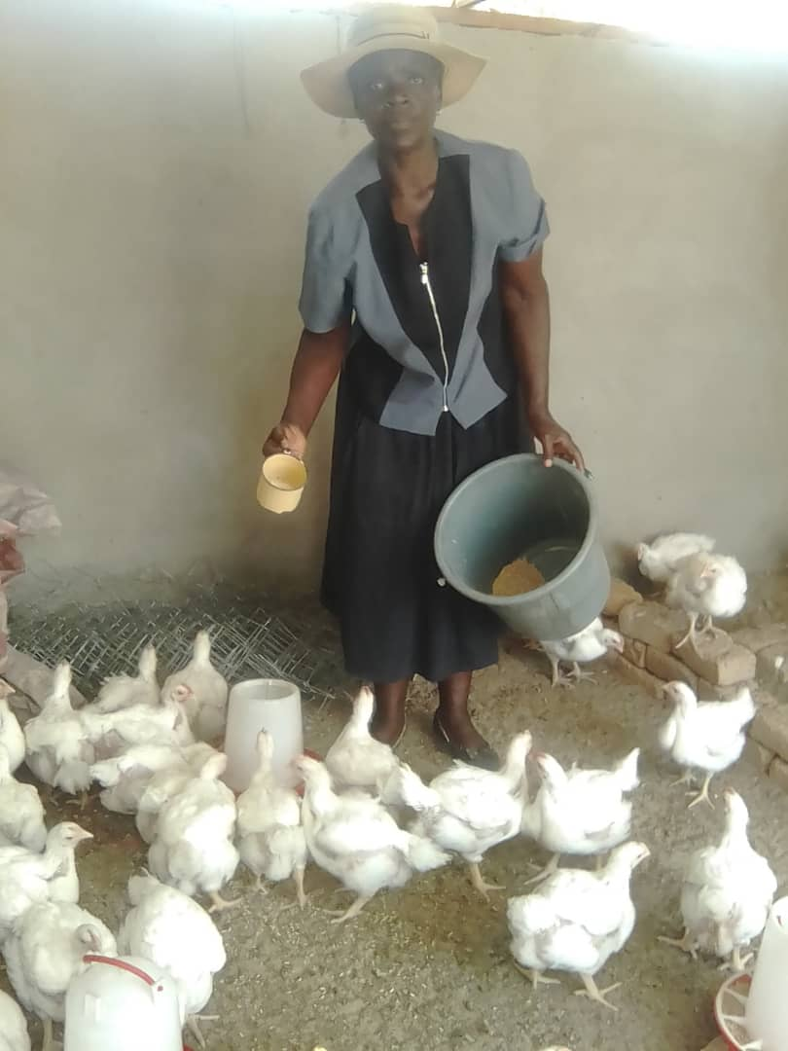
PLEASE DESCRIBE THE BUSINESS
Kimbxoxo Butchery is a Poultry business.
I keep chickens for meat and sell at my butchery.
The business focuses on chicken products and mainly targets the apostolic sect.

Slide 3
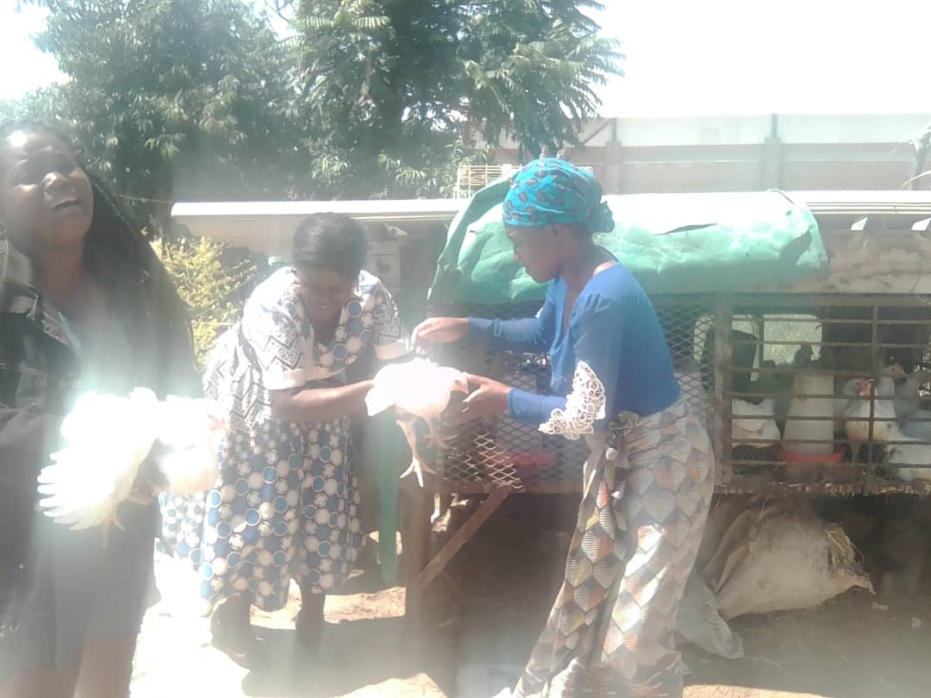
CUSTOMER BASE?
My customers are mainly those from the Apostolic sects who do not take pork because I do not sell pork products.
The business also target walk in individuals and Civil servants.
Customers have increases since I started the business.
I managed to do this through selling off cuts and which became affordable for some customers who do not want to buy full chicken.

Slide 4
COMPETITION
My business survive in a middle of competitors.
My competitors are all other butcheries in Murewa.
How I handle competition in my business
I ensure that there is constant supply of meat.
I focus on poultry products targeting apostolic sects who are many in Murewa.
I feed my chickens properly to ensure high quality meat.

Slide 5
NEW PRODUCTS OR SERVICES?
These are not new products as such but I am now packing specific products e.g. gizzards, livers, drum sticks, wings etc which the customers are running for instead of full chicken.
I advertise my products on social media.

Slide 6
QUALITY AND PACKAGING
My customers are happy with the quality of my products.
Some love baby chickens and some love the big chickens so I ensure that I have all the types which my customers love. I also ensure that there is constant supply.

Slide 7
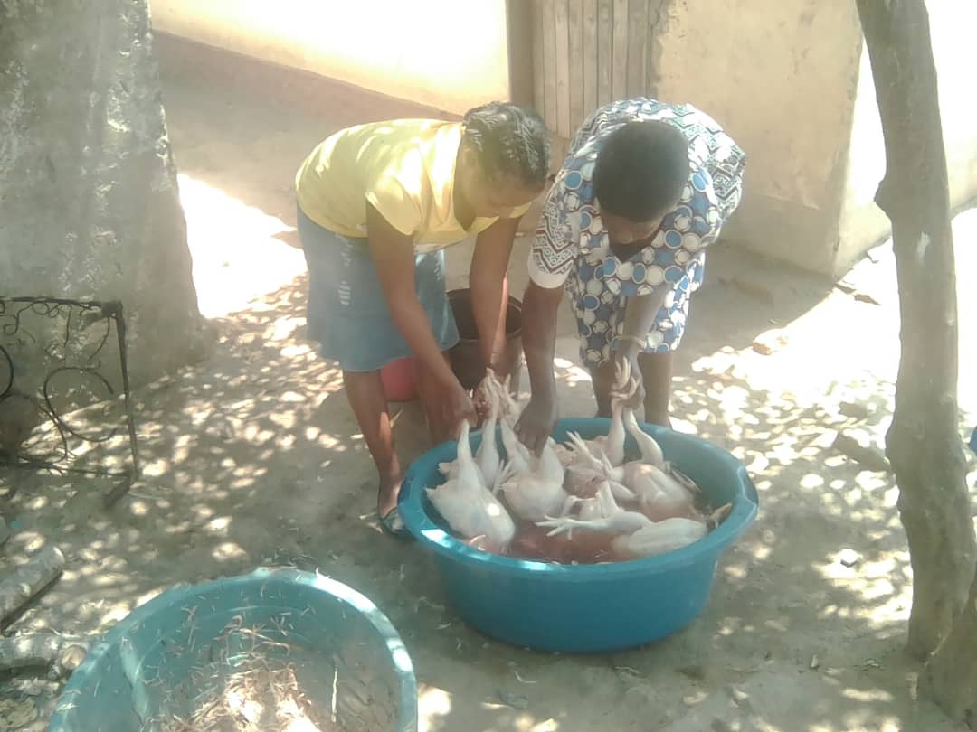
BUSINESS MANAGEMENT
As for stock management I ensure that I have 3 batches of chickens which I order after every 2 weeks so my stock levels are always satisfactory.
I charge my products in such a way that I get profit, for example if cost of keeping 100 broiler chicks is US$300, I usually get around US$600. I

Slide 8
FINANCIAL MANAGEMENT
I have a record keeping system i.e. my stock book, my credit record book and my cash receipt.
This helps me to keep track of my customers.
Yes I have a bank account for my business.

Slide 9
SAVINGS AND SELF SUFFICIENCY
Yes I am a member of a savings group. I contribute $20 per month through this saving and another one at the Waste management of $12 per month.
Through my business, I have managed to increase my household income.

Slide 10
INCOME AND EXPENSES FOR THE BUSINESS FOR THE PAST SIX MONTHS
Income
Expenses
ITEM | AMOUNT
Feeds 21 bags starter, grower and finisher | 900
Vaccines | 50
Transport | 30
Packaging | 20
Electricity | 30
Allowance | 300
TOTAL | 1330
ITEM | AMOUNT
360 Full dressed chickens @ $6 | 2160
Chicken cuts | 384
TOTAL | 2544

Slide 11
INCOME AND EXPENSES FOR THE BUSINESS FOR
NEXT SIX MONTHS
Income
Expenses
ITEM | AMOUNT
410 full chickens (dressed) | 2460
Chicken cuts | 600
TOTAL | 3060
ITEM | AMOUNT
25 bags of feed | 971
Vaccines | 100
Transport | 60
Packaging | 40
Electricity | 40
Wages | 360
Allowances | 400
TOTAL | 1970

Slide 12
WHAT PLANS HAVE YOU MADE TO GROW YOUR BUSINESS IN THE NEXT 6 MONTHS?
1. Continue with savings
2. Opening a shop in Murewa Centre to widen the customer base.
3,. To register the business so that I will be able to borrow a loan to boost capital.

Slide 13
CHALLENGES
Chicken disease outbreak- Buy medicines and I am working Vet for technical advise.
Electricity power cuts- To buy a solar powered refredgerators.

Slide 14
SUSTAINABILITY
To buy a delivery truck for ease of deliveries.
Devise marketing strategies and market linkages.

Slide 15
THANK YOU

