Slide 1




SADC PROTOCOL@WORK SUMMIT 2024
Youth Leadership
Zimbabwe, Kadoma
11-13 November 2024
Tadiwanashe Jiri

Slide 2
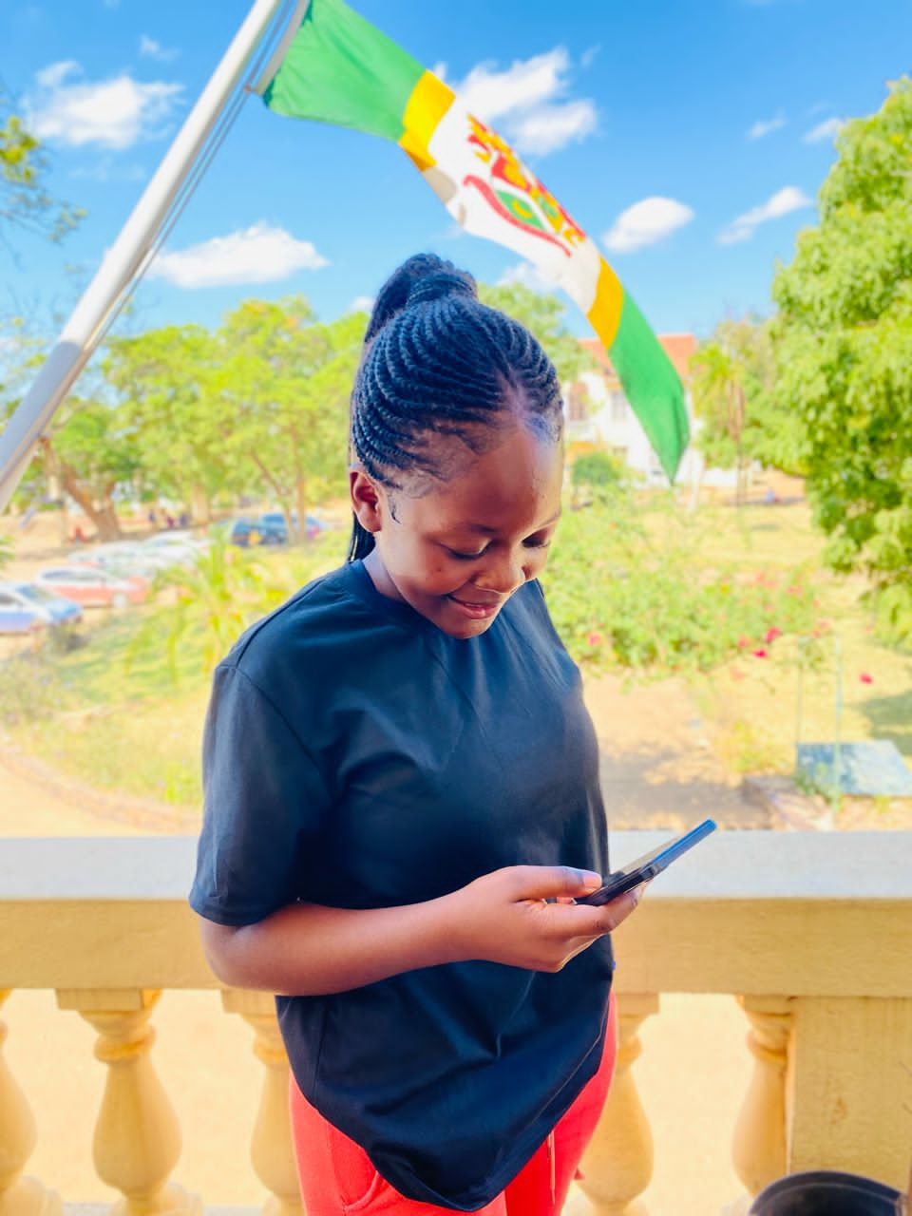
Quotable Quotes
Amplifying young voices, the time is now
Amplifying young voices, the time is now serves as a guiding principle.

Slide 3
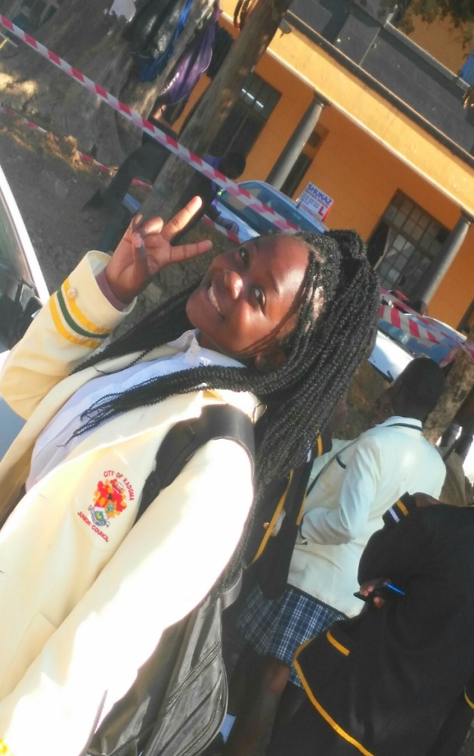
Experience as a leader
I witnessed first hand the inequalities in opportunities.
This sparked my passion for advocacy.
Effective leadership requires empathy and resilience.
I have heard mentors to guide me..

Slide 4
WHAT MAKES YOU UNIQUE
My leadership skills, training and experience.
My dedication drive me to effectively bring positive change.
I have a resilient attitude.

Slide 5

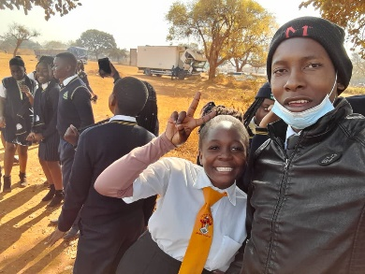
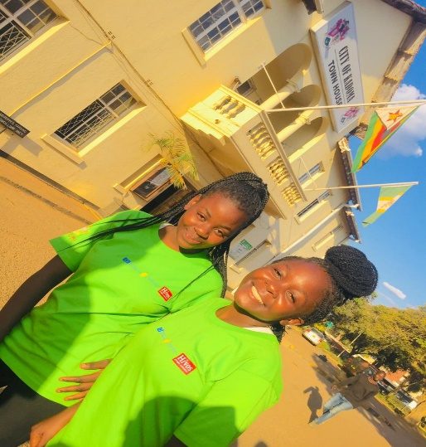
WHO IS THIS YOUTH CHAMPION?
I am Tadiwanashe G Jiri, a passionate young leader.
Committed to amplifying voices of marginalized youth.
I hail from Kadoma.
My roots in Kadoma inform my passion.
My ability to never give up.
I refuse to be shaken up.
No matter the trial or situation.
.

Slide 6
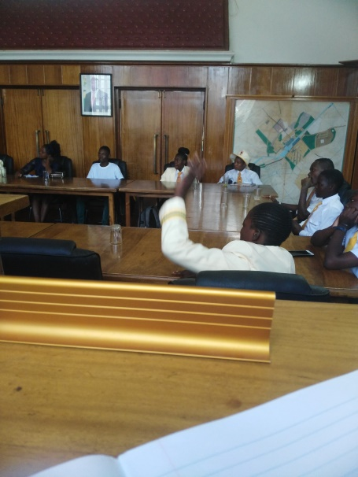
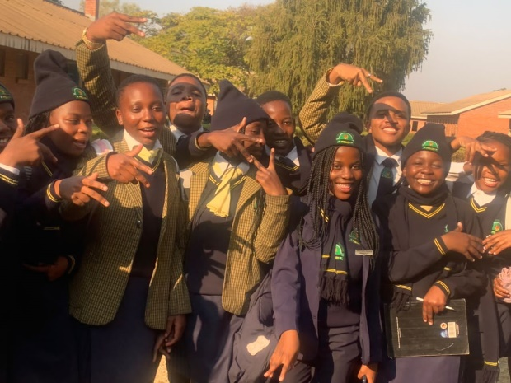
WHAT DRIVES YOU?
.
I am driven by my desire to empower.
My commitment to social justice.
My passion for community transformation.
I aim to create an environment which is friendly.
Where discrimination is totally unacceptable. Where being a girl is pride.
Where being a boy is not a burden.
I am dedicated to amplifying.
Committed to youth engagement.
Striving for a gender equality society.

Slide 7
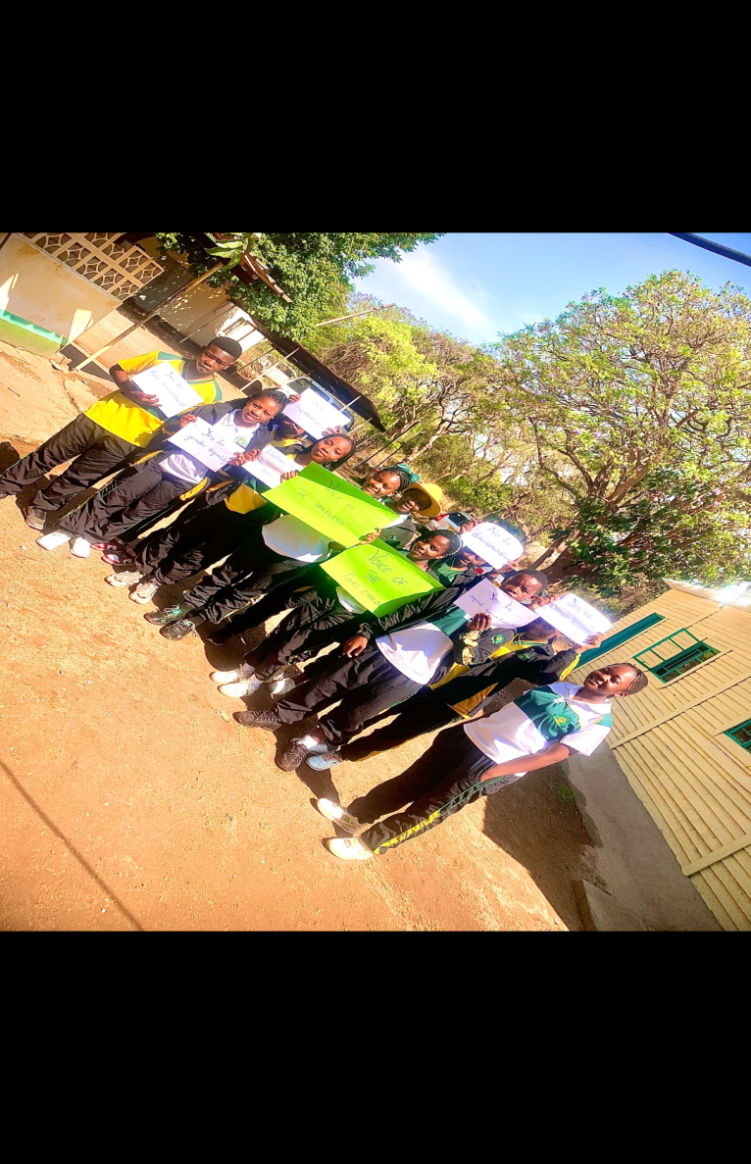
WHAT DO YOU DO?
.
My work focuses on promoting gender equality.
I have contributed to advancing gender equality.
I did it in the following ways:
I conducted a debate session.
I had a boy and girl talk.
I partnered with the Voice of the girl child organisation.

Slide 8

CHALLENGES
Social and Cultural Barriers.
The boy child is either afraid or intimidated.
Limited resources and funds to expand my work.
Stigma and discrimination.
I interviewed a few individuals.
I discovered there is need for workshops.
Guide and Counseling.
In an attempt to help the girl child the boy child has been sidelined.

Slide 9
What has changed in your life?
I have improved my emotional intelligence.
I have built strong relationships.
The following have driven this transformation:
My mother who has been encouraging me.
My Patron Nyasha who has taught me.
The Kadoma City Junior Council.
My fellow members for sharing the experience.
My determination to create positive change.

Slide 10
What Capacity Building Initiatives Have You Initiated?
I have prioritized empowering marginalized youth.
I have built capacity through mentoring.
I have coached emerging gender equality advocates.
I engaged with students at my school.
I collaborated with Voice of the Girl Child.

Slide 11
Lessons Learnt
I have learned collaboration is key.
Effective partnership are crucial.
Gender equality benefits everyone.
It takes a nation to bring change.
Everyone is equally important.

Slide 12
NEXT STEPS
Scale up gender equality initiatives.
Collaborate with policy makers.
Network with national and international organisation.
Pursue further knowledge on gender equality.
Mentor emerging leaders.
To eradicate discrimination and stigma.

Slide 13
THANK U

