Slide 1





SADC PROTOCOL@WORK SUMMITS 2024
SRHR, GBV, and Climate Change Categories Template
ZIMBABWE, MHONDORO NGEZI RURAL DISTRICT COUNCIL, NOVEMBER 2024, MAVIS MHLANGA
Zimbabwe, Mhondoro Ngezi District, 30/10/24 M. Mhlanga

Slide 2
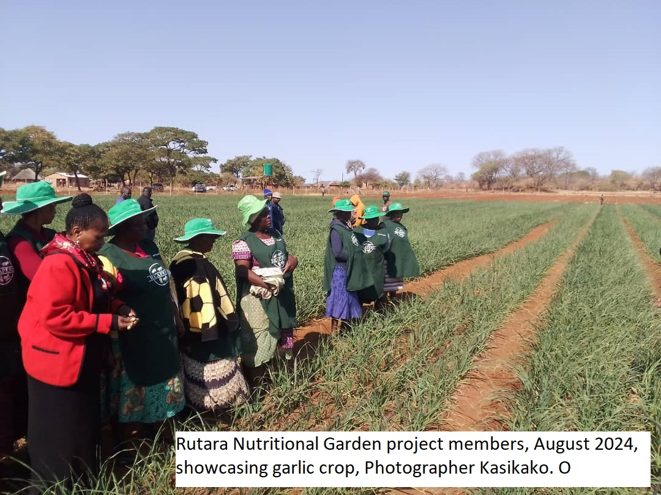
BACKGROUND
Rutara Nutrition Garden Ward 10
2 Solarised boreholes, drip irrigation, 2,5ha
Organic horticulture- Garlic, Ginger, Tumeric.
Goal
Climate Change and sustainable development
Women empowerment
Strategies
Use of clean energy-solarised boreholes
Water efficiency- drip irrigation
Biodiversity conservation-organic horticulture.

Slide 3
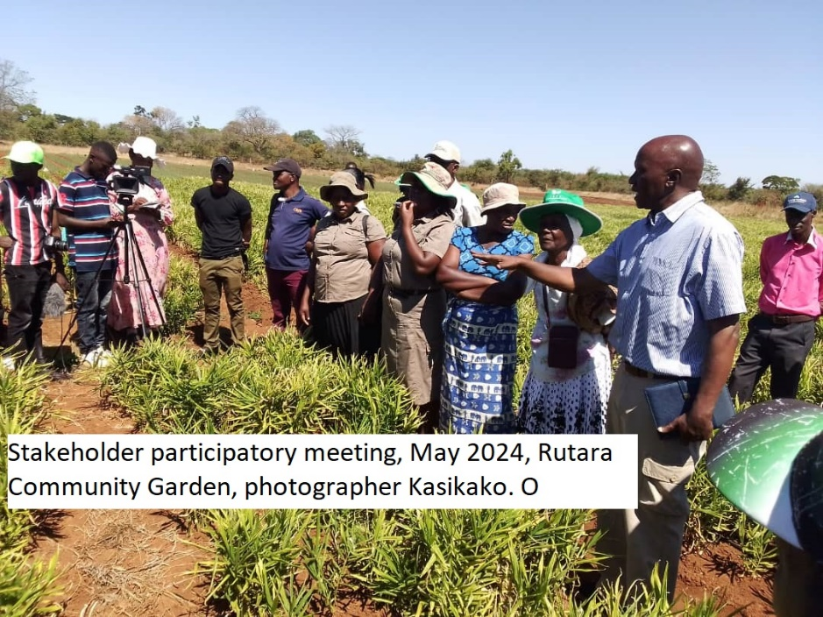
OBJECTIVES
The project is meant to mitigate the impacts of climate change through
Women economic Empowerment
Environmental protection,
Carbon Markets and Certification
Women advocacy for environmental policies,
Clean energy
Sustainable Agricultural practices.

Slide 4
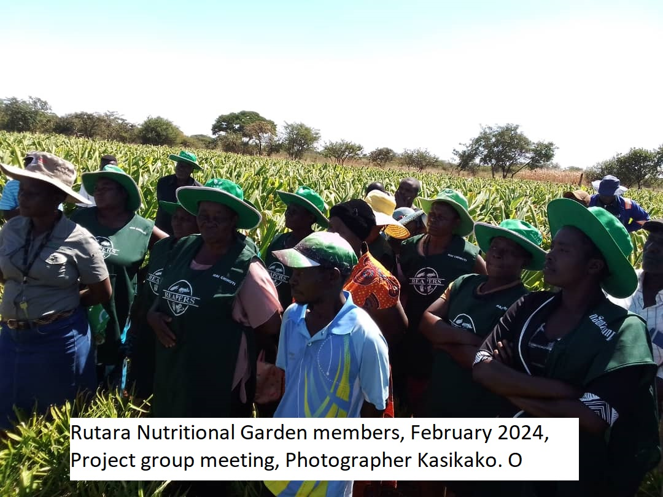
TARGET GROUPS
Women, Men, Youths, PWD (Rutara Farming Community)
To ensure full participation of all vulnerable groups of Rutara Community and foster sustainable agriculture while enhancing climate resilience.

Slide 5
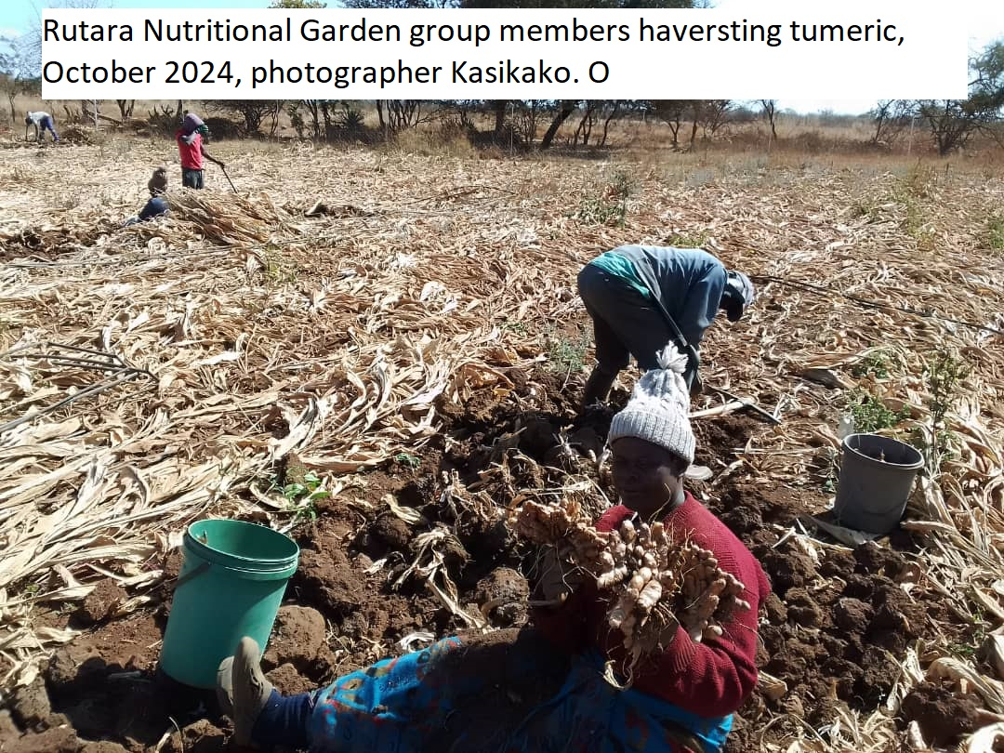
ACTIVITIES
Crop selection/Rotation
Water and Soil health management
Implement IPM
Organic Certification
Awareness and Trainings
Diverse Farming
Monitoring and Evaluation

Slide 6
STRATEGIES EMPLOYED BY THE PROJECT
Community engagement
Participatory approach
Entrepreneurship approach
Success:
Project buy in
Financial empowerment
Improved farming practices
Access to export market
Networking with foreign nationals

Slide 7
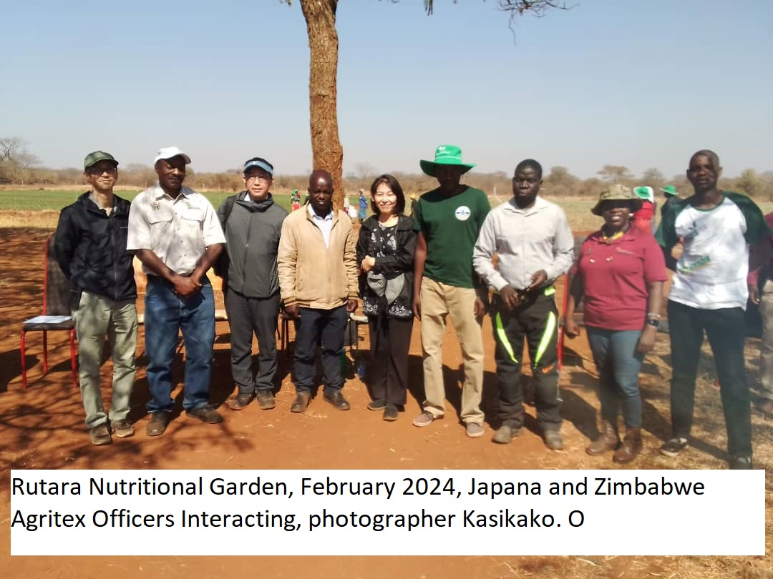
PARTNERS
Government departments
Local Authority
Private partners – Palmline/ Zimplats
New partners welcomed.

Slide 8
BUDGET
 | Amount in $
Gender specific allocation | 2 500
Gender in mainstream projects (please specify) | 2 500
Amount contributed in cash or in kind by partner organisations (please specify) | 40 000
Other sources (please specify) | - - -
Total | 45 000

Slide 9
PARTICIPANTS
Category | Women | Men | Total | % Women
Direct participants | 24 | 6 | 30 | 80
Indirect participants (e.g. through other networks) | 300 | 120 | 420 | 71
Online participants (e.g. website access, mailing lists, scholarly articles) | 400 | 300 | 700 | 57
Total | 724 | 426 | 1150 | 63

Slide 10
CHALLENGES
Limited access to telecommunication network
Limited access to ICT
Political interference
Change of currency

Slide 11
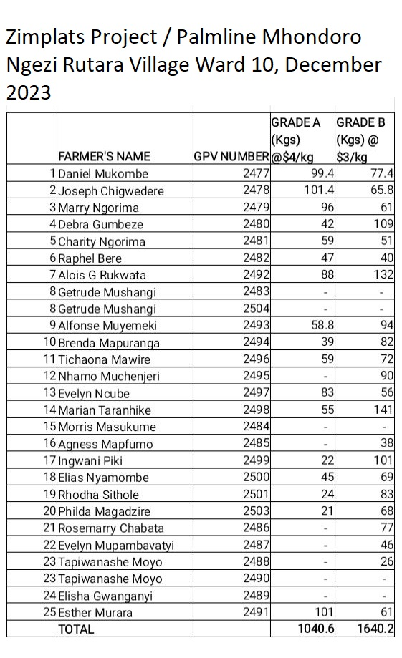
RESULTS
Carbon markets and certification programs
Women economic empowerment
Reduced GBV cases
Sustainable agricultural practices

Slide 12
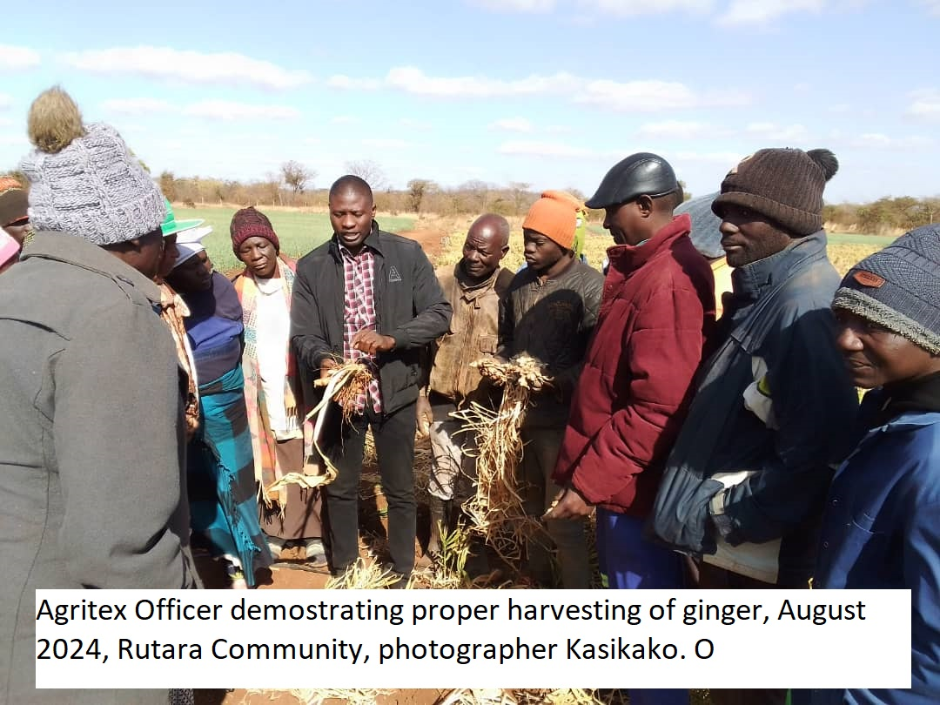
LEARNING
Resilience and adaptability
Cultural Exchange
Food security
Sustainability practices
Economic opportunities
Enhancing ICT and digital farming
Continuous training and engagement

Slide 13
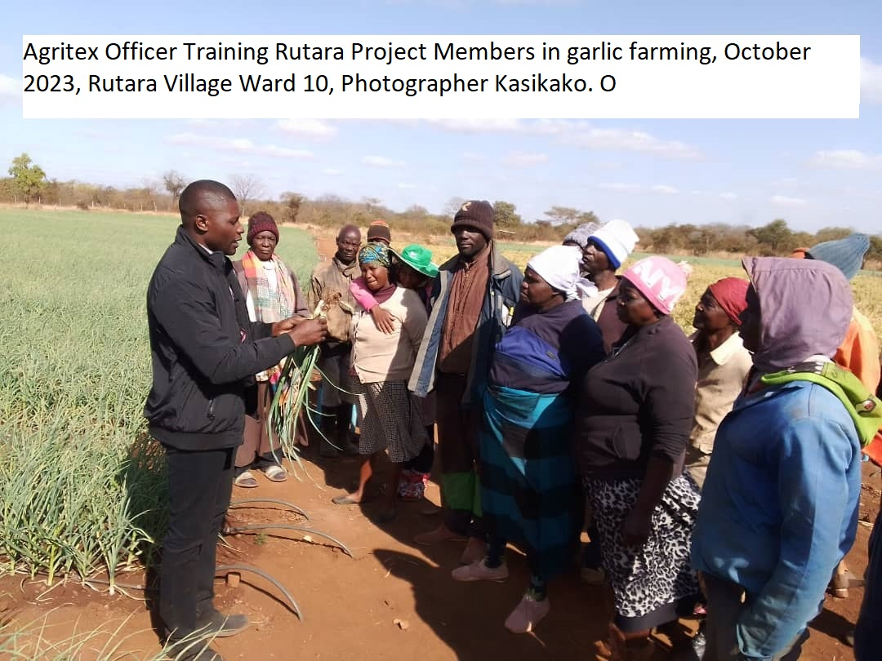
MONITORING AND EVALUATION
Reports and minutes
Suggestion box
Attendance register
Crop records
Customer satisfaction
Constitution
Project visits

Slide 14
SUSTAINABILITY AND REPLICATION
Diversified farming
Water conservation techniques
Controlling of pests and diseases
Maintenance of infrastructure
Fire Management
Adapting to change
Rutara project should allow for look and learn visits or tours of aspiring community members and other organizations.
Local authority and other institutions should facilitate for establishment of new similar projects.

Slide 15
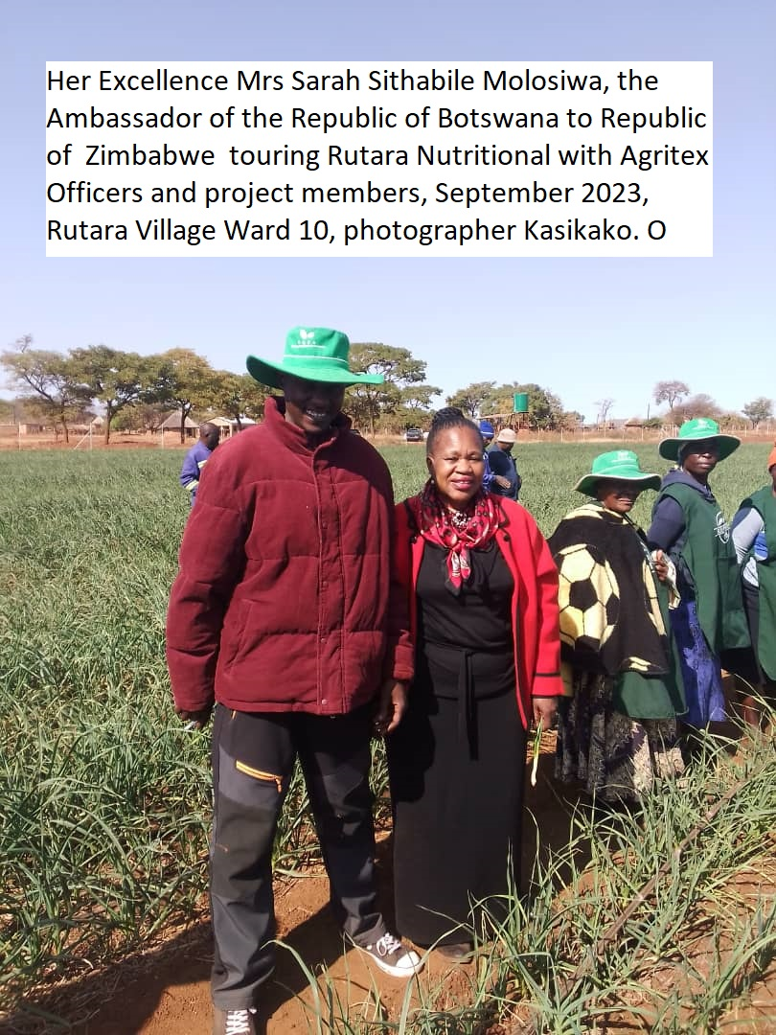
NEXT STEPS
Carbon Market accreditation – explore accreditation and certification processes.
Soil health – regular Ph tests.
Organic farming certification
Crop rotation
Collaboration
Water conservation.

