Slide 1




2024 Country Summit
PROMOTING GENDER INCLUSIVE LOCAL ECONOMIC DEVELOPMENT
NAME OF ENTERPRISE : MACHI NURSERIES
PRESENTERS’ NAME & SURNAME : MASHOKO CHIBAYA
“Promoting Gender Inclusive Local Economic Development”

Slide 2





Outline
Who is Machi Nurseries?
Current State of Business
Plans for next 6 Months
Impact of Gender Links on personal development

Slide 3
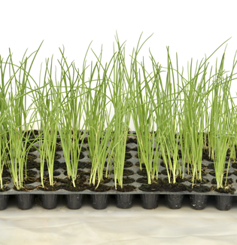

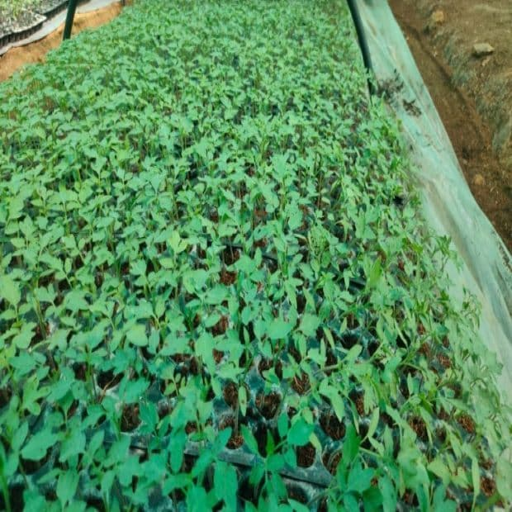
Who is Machi Nurseries?
Focus area
Horticultural nursery
  Tomato seedlings
  Onion seedlings
  Vegetables
Period in Business
  Business was started on the 28th of December 2023 to date
Area of Operation
Chivi - 68km from Masvingo CBD
Nursery covers a total area of 30 square meters
Farm covers 2800 square meters
“Promoting Gender Inclusive Local Economic Development”

Slide 4
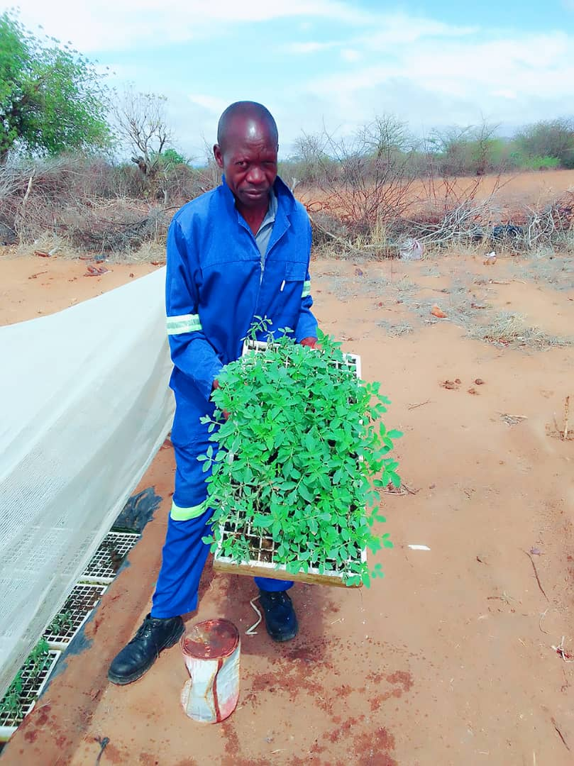
Current state of Business
Farming Method
Mixed farming method used at the plot
  Manual labour
  Organic Manure mostly used
  Fumigants used for pest and diseases control
  Manual Irrigation used -(watering cans)
Produce
  800 Tomato seedlings ready for sale
  At least 200kg dried onions on sale
  At least 5 buckets of dried vegetables on sale
Sales
  Onions seedlings USD 150 (seasonal)
  Vegetable seedlings USD 60 (seasonal)
  On average fresh vegetable sales are USD 80/month
  Target market is community in Chivi
“Promoting Gender Inclusive Local Economic Development”

Slide 5
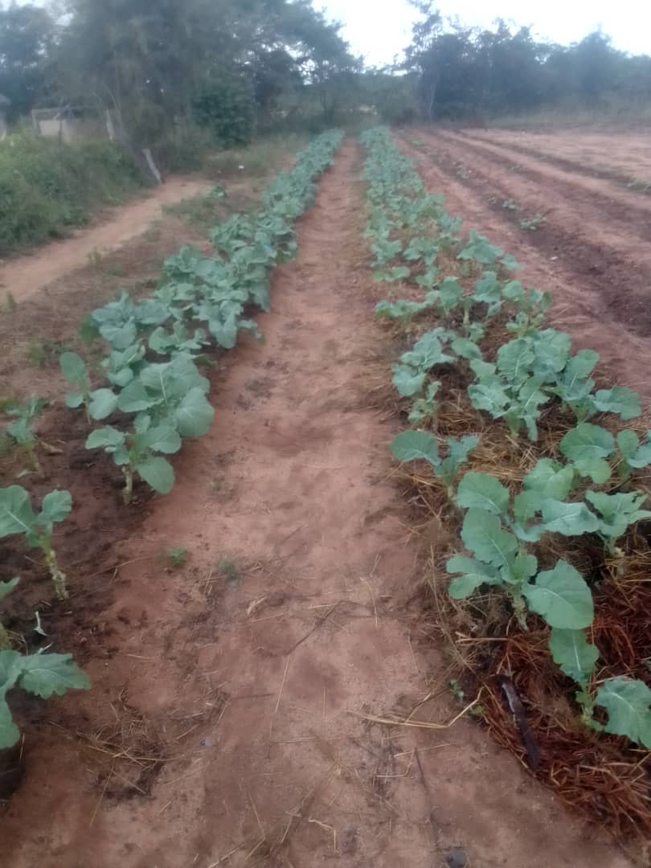
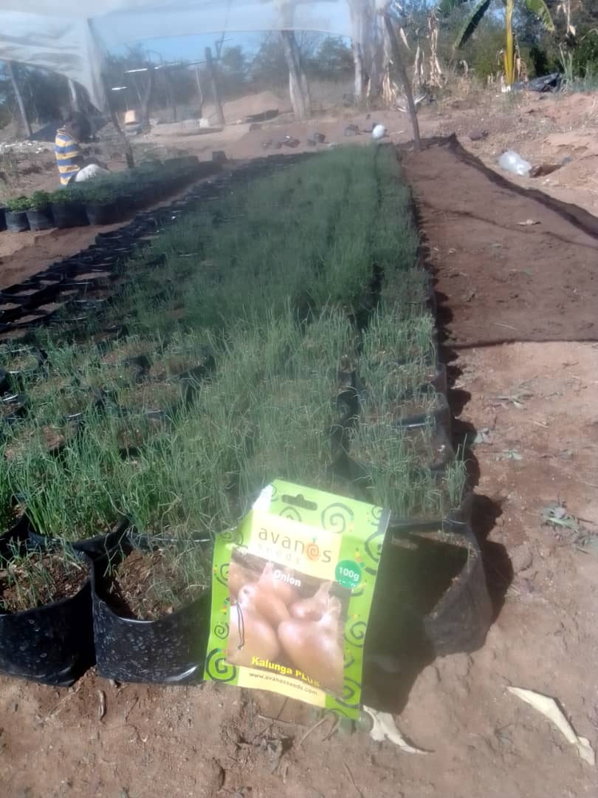
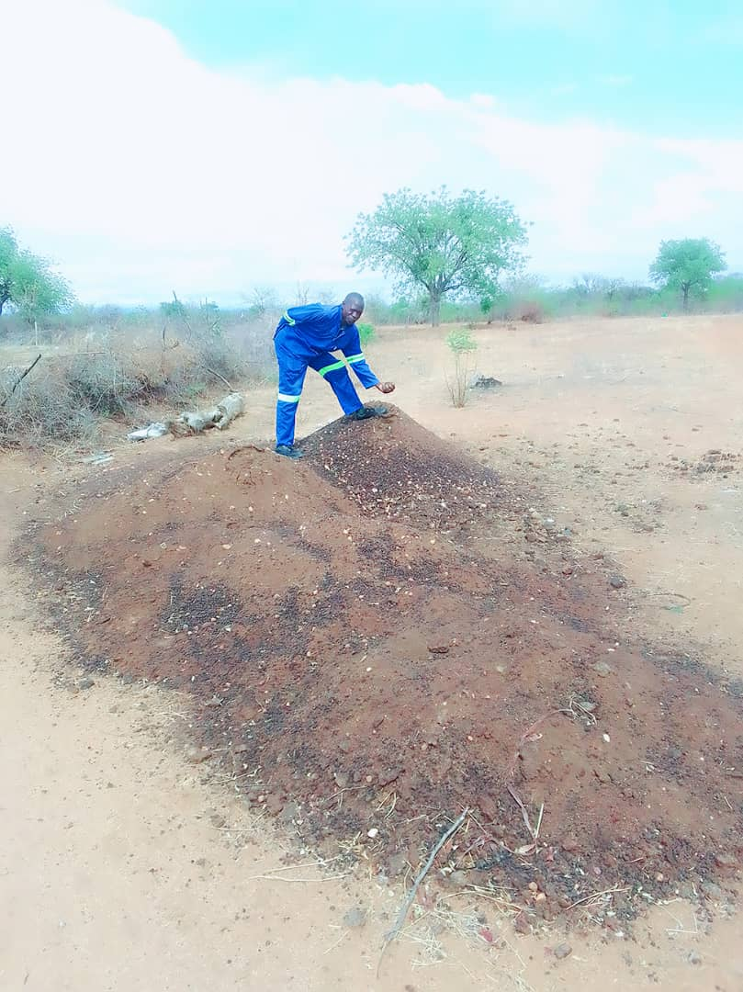
Current state of Business
“Promoting Gender Inclusive Local Economic Development”

Slide 6
Plans for the next 6 months
Operations
  To plant tomatoes and vegetables as the rains start
  Diversify by rearing broiler and road runner chickens
  Selling dried onions, tomatoes and fresh vegetables
Employment
  Employ 2 people to manage the plot full time
  Employ 3 people on part time basis to pick tomatoes
Sales
  Expand market by diversifying products
  Increase sales from USD 80 – at least USD320 per month
“Promoting Gender Inclusive Local Economic Development”

Slide 7
IMPACT OF GENDER LINKS ON PERSONAL DEVELOPMENT
 | 1 | 2 | 3 | 4 | 5 | 6 | 7 | 8 | 9 | 10
Helped to build my personal agency, confidence and self esteem |  |  |  |  |  |  |  | ✓
Gave me new skills |  |  |  |  |  |  |  | ✓
Gave me choices on access to finance |  |  |  |  |  | ✓
Gave me useful information on how to manage my personal finances |  |  |  |  |  |  |  |  |  | ✓
Helped me to develop my IT skills |  |  |  |  |  |  | ✓
Connected me to new markets |  |  |  |  |  |  |  |  | ✓
Gave me new ideas |  |  |  |  |  |  |  |  |  | ✓
Connected me to new joint ventures |  |  |  |  |  |  |  |  |  | ✓
Connected me to new enterprises |  |  |  |  |  |  |  |  |  | ✓
“Promoting Gender Inclusive Local Economic Development”

Slide 8
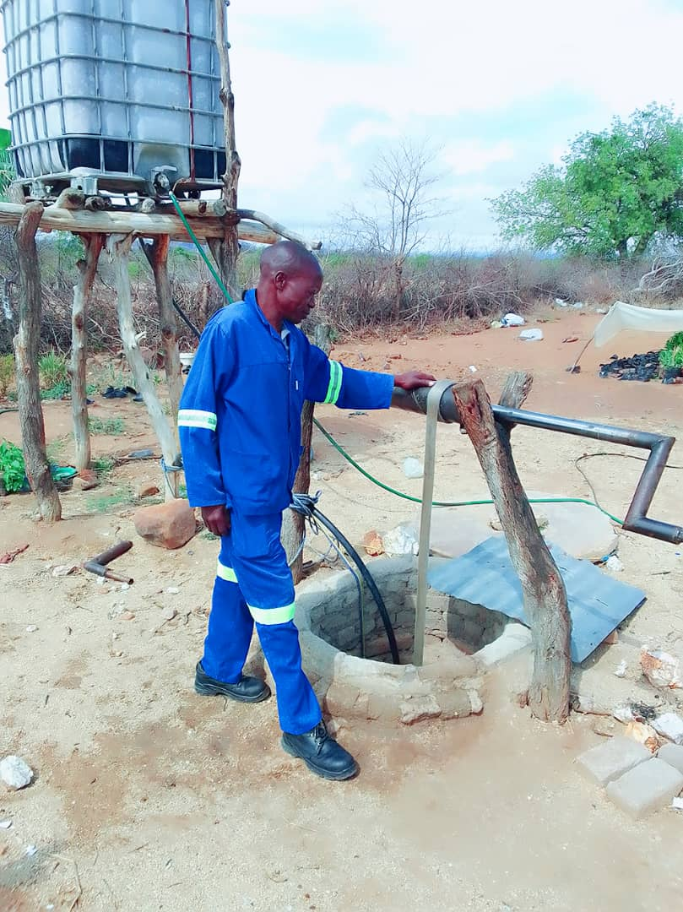
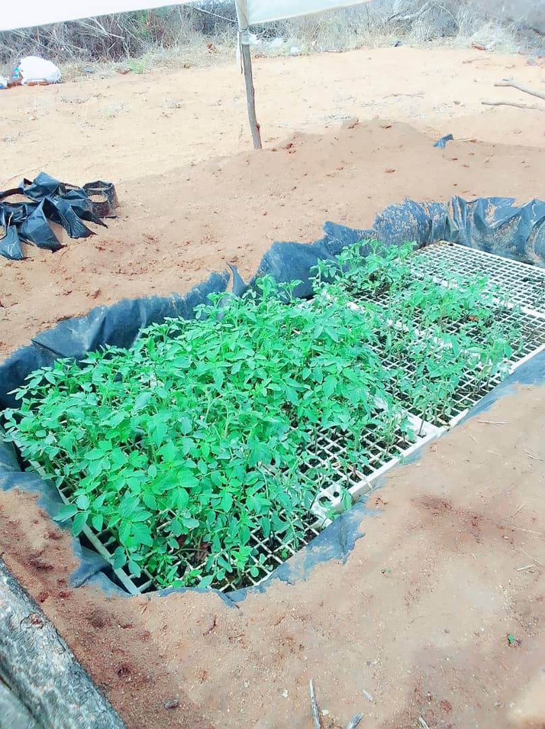
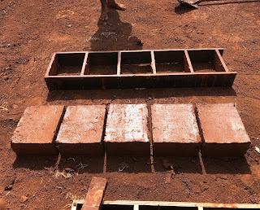
IMPACT OF GENDER LINKS ON PERSONAL DEVELOPMENT
Purchased 430W Solar, 0.25hp Submersible water pump and water tank
Purchased float trays
Purchased brick mould
“Promoting Gender Inclusive Local Economic Development”

Slide 9
CHALLENGES
Limited Water Supply
Deep well as source of water .
Destruction of farm produce
Unavailability of perimeter fence.
Limited access to finance
Lack of collateral security.
“Promoting Gender Inclusive Local Economic Development”

Slide 10

Address:
Chivi Growth point Masvingo
Thank you
Contact Numbers:
0777 488 888
0717 328 010
Email Address:
chibayamashoko88@gmail.com

