Slide 1




Promoting gender inclusive local economic development in zimbabwe
Business name : STEDWIG’S LIFESTYLE CENTRE
Participant name : CECILIA PONDE
Council : MASVINGO CITY COUNCIL
Please include photographs of the business!
“Gender-Responsive Solutions for Local Economic Development"

Slide 2
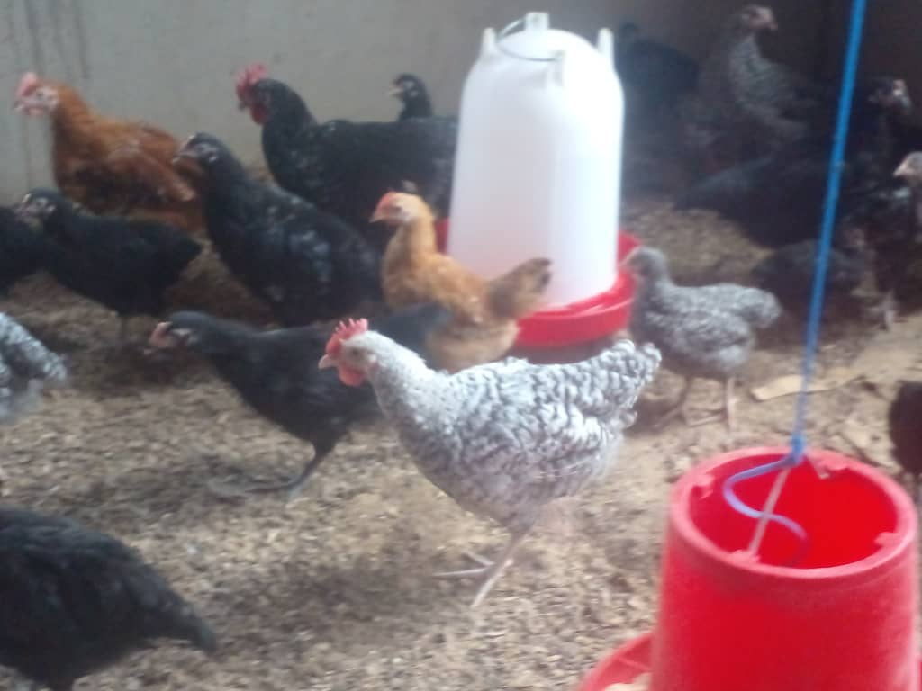
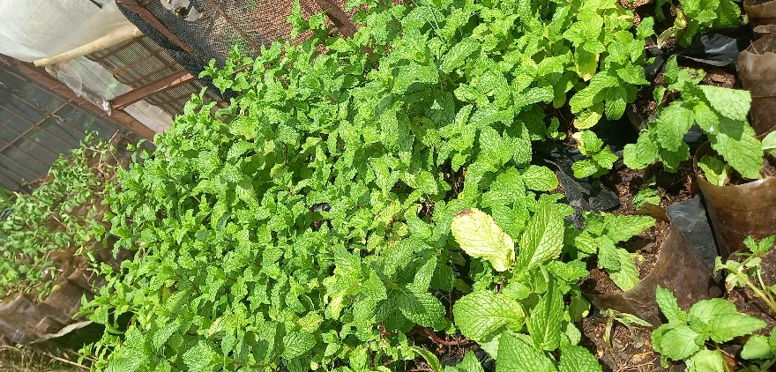
Please describe the business
Stedwig's Lifestyle Centre is a holistic natural living project situated on a semi-urban plot. The project features a vegetable garden that supplies local supermarkets and schools, a landscaping nursery and an herb garden on site. small livestock sections with Road Runner chickens for eggs and meat, and goats for meat production. Additional the project also includes fields for open-field flower production and semi-organic food security.
Photo or video

Slide 3
Please describe the business (CONTINUED)
The project was conceived after an eye-opening introduction to business facilitated by Genderlinks, Masvingo City Council, and the Embassy of Sweden. The concept is being developed in stages, with a focus on multiple income streams to ensure sustainability.
Currently, the project is in the process of expanding its vegetable garden and nursery sections, as well as diversifying into commercial flower production to increase income.

Slide 4
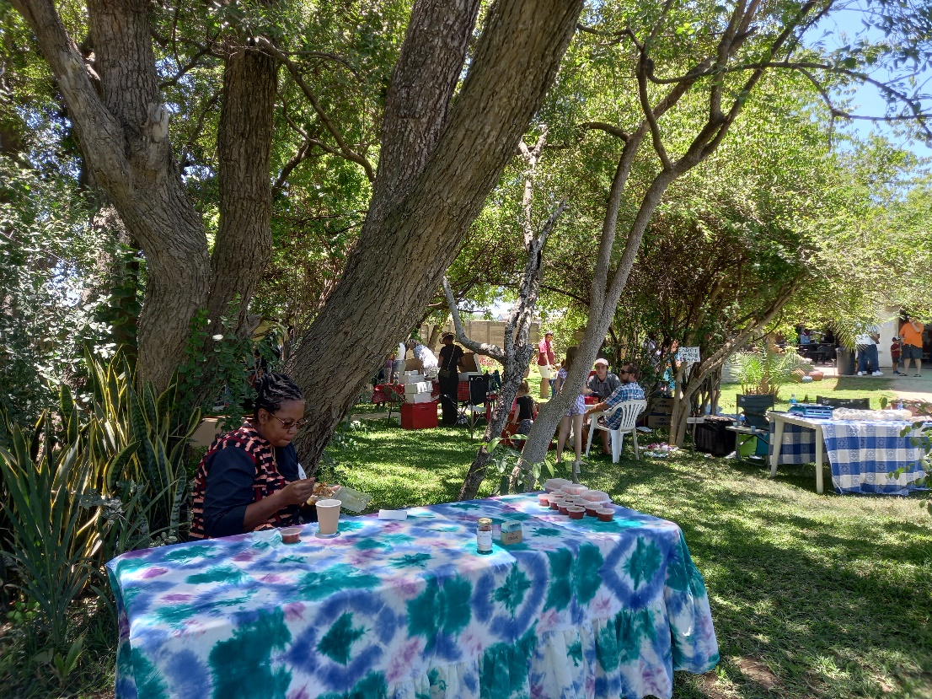
Customer base?
Who are your customers?
Local Supermarkets (for Vegetables)
Schools (For Vegetables)
Masvingo Community
Photo

Slide 5
Customer base?
Potential Customers
Visitors to the Lifestyle Centre ( for semi organic food and refreshing gate away)
Florists or wholesalers ( For Flowers)
Local Supermarkets (for flowers)
Schools (For Landscaping & Herbs)
Event planners or Individuals (for flowers and other related products)
Photo

Slide 6
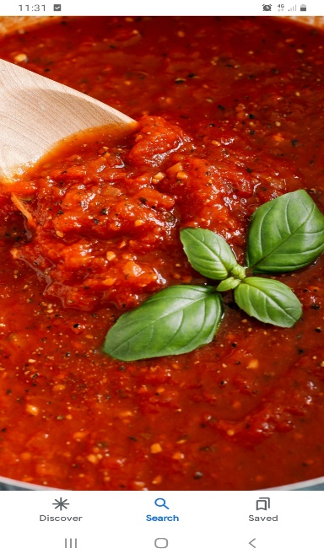
Competition AND YOUR RESPONSE
Have you increased the number of customers since starting the LED Programme? Yes
How did you do this?
We expanded our product offerings to schools, diversifying beyond the traditional Covo, Rape, and Tsunga vegetables to include more exotic options like Beetroot, Lettuce, and other table vegetables, which proved to be in demand among more affluent schools.
We developed strategic partnerships with fellow farmers within our area to guarantee a consistent and reliable supply of produce even during periods of shortfalls in our own production
Created a data base of Customers and using it for follow up.

Slide 7
new products or services?
If yes what have you introduced?
We have introduced new varieties including but not limited to Beetroot, Lettuce and carrots to our vegetable offering. (Diversified)
We also introduced: Fennel, Chamomile, Rosemary, Lavender, Oregano, Moringa and aloe to our herb nursery. (Diversified)
We have introduced preserves and condiments such as herb and garlic infused Tomato paste made from our excess tomatoes to the market. (Value Addition)

Slide 8
Quality and packaging
Are your customers happy with the quality of your products or services?
Yes.
If you have answered yes please give more information.
I turned my culinary expertise and hobby into a profitable venture by creating herb infused Tomato Paste. Customers have warmly received this new offering enjoying its fresh and exciting flavour profiles.

Slide 9
Quality and packaging
Have you changed the packaging or marketing of your business to attract more customers?
Yes
Please explain.
In response to customer suggestions and our mutual commitment to sustainability, we have replaced plastic tubs with recyclable bottles for our tomato paste packaging. This eco friendly change not only helps reduce waste but also lowers costs, creating a win-win situation for our customers and the environment.
As part of our branding, we have come up with stickers with Stedwig’s logos to enhance the appeal of our products.
By sharing recipe ideas, fun facts and highlights about our herbs and vegetables, we have significantly enhanced our social media engagement and visibility.

Slide 10
Business management
Have you hired more staff? How many full time and how many part time?
Yes additional part time staff that come in for special projects for example land preparation when expanding the gardens.
Are you keeping records of your business?
Yes. We have taken a proactive stance on Financial Management prioritising cost control and revenue enhancement to ensure long term profitability. We are still utilising manual record keeping tools e.g Receipt books and Invoice books. We are consolidating our records on Excel spread sheets that make computing of records and generating of reports easier.
Are you managing your stock and checking on a regular basis?
Yes. – Given our current small scale operations we are adopting a lean approach to inventory management to maximize input utilisation, avoiding overstocking and minimizing the risk of expired inventory,

Slide 11
Business management
Have you been able to price your products better so that you can earn a surplus from the business? Please explain.
Yes. By expanding our product range to include higher margin items like value added pastes we have been able to offset price pressures on individual items.
We have employed some cost reducing measures:
Consolidating orders to minimise transport expenses.
Stream lining Delivery routes for greater efficiency.

Slide 12
Financial management
Do you have a record-keeping system in place?
Yes
Yes If yes, how is it helping you to manage your business?
It helps me to keep track of business performance
To track debtors and collect payments
To keep track of expenditure
To produce monthly financial statements
Do you have a bank account for your business?
Yes.
Are you a member of a savings group? Yes
Are you saving money? How much have you been able to save so far?
No. Profit is being ploughed back into the business

Slide 13
Income and expenses for the business for past three to six months
Income
Expenses
ITEM | AMOUNT
Garden Produce | $1200
Herb Nursery | $600
TOTAL | $1800
ITEM | AMOUNT
Wages – Permanent Staff | $360
Wages – Casual Staff | $120
Inputs (Agrochemicals & Seed) | $40
Irrigation & Water | $40
Marketing | $15
Fuel | $50
TOTAL | $625

Slide 14
Income and expenses for the business for next six months
Income
Expenses
ITEM | AMOUNT
Garden Produce | $2400
Herb Nursery | $3000
Landscaping Nursery | $1000
Flowers – Fillers and cut flowers | $4800
Events | $1200
TOTAL | $12400
ITEM | AMOUNT
Wages – Permanent Staff x 2 | $1440
Wages – Casual Staff | $2400
Inputs (Agrochemicals & Seed) | $800
Perimeter Fencing | $6000
Land Preparation & Field set up | $3000
Irrigation & Water | $600
Marketing | $600
Fuel | 600
TOTAL | 15440

Slide 15
What plans have you made to grow your business in the next 6 months?
We will expand our product offerings by introducing herbal Teas. Add different types of sauces to the already existing herb infused tomato paste.
Continue to build strategic partnerships. Collaborate with gardening experts and complimentary businesses.

Slide 16

What plans have you made to grow your business in the next 6 months?
Offer workshops and events – We will host gardening workshops, herbal classes with Tea tasting workshops to attract new customers, build a community and generate additional income

Slide 17
Additional information?

