Slide 1




SADC PROTOCOL@WORK SUMMITS AND AWARDS
2024
GENDER RESPONSIVE BUDGETING Template
Shurugwi Town Council,
11 November 2024
Presentation by, C. Tawonezvi

Slide 2
OVERVIEW
COUNTRY | ZIMBABWE
COUNCIL (HUB/SPOKE) | spoke
GENDER CHAMPION | Councillor Mdutswa
GENDER FOCAL PERSON | Lizzie Makohliso
Latest score (2024) | None
 | Income | Expenditure | % Gender Specific
Budget (2024) | 5617572.65 USD | 5617572.65 USD | 4.7
2025 | Women | Men | Total | % Women
Council | 5 | 12 | 17 | 42
Management | 0 | 14 | 14 | %
Council staff overall | 37 | 105 | 142 | 26
Population served | 24000
Key characteristics | Mining town with vast deposits of gold, platinum, and chrome

Slide 3
I. POLICY FRAMEWORK
Our gender provisions in the main stream budget was guided by the Constitution, NDS 1, Council Gender Policy and National Gender Policy. Attached is the Council Gender Policy.
Council has in place a Gender Policy which addresses inter alia issues of gender budgeting. (see attached Gender Policy).

Slide 4
GENDER POLICY
1.0 PREAMBLE
Council acknowledges gender equity as an essential part of good local governance where women and men have equal access to decision making, equal access to services and equal treatment in the delivery of these services.
Council recognizes gender mainstreaming in all areas of policy making and management as the most effective means of ensuring gender equity.
1.1 BASIS OF THE POLICY
The National Gender Policy of Zimbabwe is the national instrument on gender. In addressing gender issues, Council will be guided by the National Gender Policy and the International instruments to which Zimbabwe is party which are referred to in the National Gender Policy.

Slide 5
2.0 APPLICATION OF THE POLICY
All matters relating to gender equity in Council shall be guided by this Policy as reviewed from time to time. Where there is inconsistency between the Gender Policy and any other Policy, the Gender Policy will take precedence.
3.0 ORIENTATION IN GENDER CONCEPTS
The Town Secretary, Councilors and Council staff are responsible for driving gender mainstreaming activities. In order to facilitate the efficient implementation of gender mainstreaming actions, the Town Secretary and every Councillor and member of Council staff shall be trained and oriented in gender concepts within three months of joining Council. The aim of the training will be to introduce or strengthen gender awareness among both female and male Councillors, Council staff and the Town Secretary.

Slide 6
4.0 GENDER IMPACT OF COUNCIL DECISIONS
Council recognizes that every policy decision affects women and men differently. In order to ensure that the impact of all policy decisions addresses the specific interests and needs of women and men, Council will assess how every policy decision affects women and men and seek to ensure that the policy achieves gender equity.
5.0 LAND USE PLANNING
Council as the Local Planning Authority is responsible for land use planning. The resultant plans will affect people’s lives businesses and social activities. In this regard, Council will ensure that land use planning in the form of Master Plans, Local Plans, and other land use plans will be conducted through participatory processes which ensure that both women and men’s concerns and needs are taken into account.

Slide 7
6.0 ALLOCATION OF RESOURCES
Resources are essential for the implementation and attainment of policy objectives. Council will therefore seek to ensure that the allocation of resources is targeted to achieve the objectives of Council.
In this regard, the allocation of resources will be gender sensitive and necessary steps will be taken to assess the needs and concerns of women and men with a view to ensure equitable allocation of resources in all areas with particular focus on the following:
Council’s annual budget;
Lease or sale of Council land for housing, commercial or industrial purposes;
Allocation of rented accommodation;

Slide 8
6.1 ECONOMIC EMPOWERMENT
The economic empowerment of residents is key to the development of the Council. Council recognizes the need to facilitate economic empowerment programs and will ensure that polices and programmes on formal and informal economic activities and home industry activities are planned and implemented in a gender sensitive manner which seeks to achieve gender equity. The aim will be to ensure equitable economic development among the residents.
6.2 POVERTY REDUCTION
Poverty is a major inhibiting factor in the development of local authorities. Council plays a critical role in ensuring poverty reduction within the Council area.
Council will consider the gender dimensions of the poor and will undertake poverty reduction programmes in a sustainable and gender sensitive manner.

Slide 9
.3 HEALTH SERVICES AND HIV AND AIDS PROGRAMMES
A healthy local citizenry is a prerequisite for development.
Council will ensure a gender sensitive health delivery system which addresses the health concerns of both women and men.
The Council further recognizes HIV and AIDS as a major challenge to development and economic and social growth.
Council will ensure that programmes to address HIV and AIDS among councillors, staff and in the community are implemented in a gender sensitive manner.

Slide 10
7.0 STAKE HOLDER PARTICIPATION
The participation of stakeholders in all decisions which affect them is an ideal which Council seeks to attain in order to achieve good local governance. In conducting stakeholder participation. Council will seek to include both women and men in stakeholder consultations to ensure that the outcome of the consultative process reflects the concerns and needs of both women and men.
8.0 PRE-SCHOOLS AND CRECHES
Both women and men are responsible for providing child care during day time. This often affects their ability to attend to other demands on their time. Pre-schools and crèches are essential to allow women and men to attend to social and economic activities. Council will ensure the provision of adequate and affordable pre-school and crèche facilities in areas close to the residential areas and work places.

Slide 11
9.0 PUBLIC SAFETY
Council recognizes that residents have the right to protection by the law against illegal activity and the expectation of swift action in case of emergency. Council consider the public safety concerns of both women and men and ensure that policies to enhance safety address these concerns.
10.0 RECRUITMENT OF STAFF
A well qualified and efficient work force is critical for the administration of the council. Proper recruitment policies which enable Council to select suitably qualified staff from a wide spectrum will be established.
Council will develop gender sensitive recruitment policies which encourage both women and men to seek employment in Council with a view to achieve gender equity among staff of Council.

Slide 12
11.0 SEXUAL HARASSMENT
Sexual harassment in the workplace is an unfair labour practice which inhibits employees from performing their functions to their maximum ability and is a violation of their rights as employees.
Council will develop a code of conduct and the sexual harassment policy which protects both women and men against sexual harassment and other forms of unacceptable behavior at the workplace and will ensure that any such cases are handled swiftly and fairly.
12.0 STAFF DEVELOPMENT
Council will undertake staff development programmes in a manner designed to achieve gender equity in the number of staff members who are offered development opportunities in preparation for higher responsibilities.

Slide 13
13.0 SERVICE DELIVERY
The core business of Council is the efficient delivery of service which meets the standards expected by the residents. Council will ensure that service delivery and all operations of Council are carried out in a manner which takes into account the concerns of both women and men and in a gender sensitive manner.
14.0 BURSARY SCHEME
Council shall endeavor to introduce a bursary scheme towards paying school fees and related stationery for seven (7) secondary school learner. For the primary school learner, council shall pay fees and stationery from grade one to seven and for the secondary school learner, council shall pay fees and stationary from form one to four. Four girls three boys. The scholars shall be day scholars learning at day schools within our boundary.

Slide 14
SELECTION PROCESS
Selection of beneficiaries shall be gender sensitive one male and one female.
Suitable candidates shall be approved by council through a full council resolution.
Names of potential beneficiaries to the bursary scheme shall be availed through heads of schools to council through the servicing officer of the gender and disability committee.
Council shall ensure provision of the bursary scheme in its budget through housing department.
Results of the two learners to be shared to council after term end.
14.0 EVALUATION
Gender mainstreaming will be a permanent feature of Council operations. In order to assess the impact of the gender mainstreaming activities in Council, the Council will publish a gender mainstreaming status report annually to assess the impact of the programme.

Slide 15
II. THE BUDGET PROCESS
Consultations were segregated men, women, PLWD and special needs groups and their needs were addressed in the form of , workshops and trainings for Junior Councillors, PLWD, Women in Local Gvt etc.
The methodologies used in reaching special groups included; The use of Gender Champions, use of WhatsApp groups, Face to Face engagements, Use of Facebook and other media.
The visually impaired were not covered in the consultations but PLWD were adequately covered. All other groups were covered. (See attached consultation registers attached). Attendances of all groups were above normal.

Slide 16
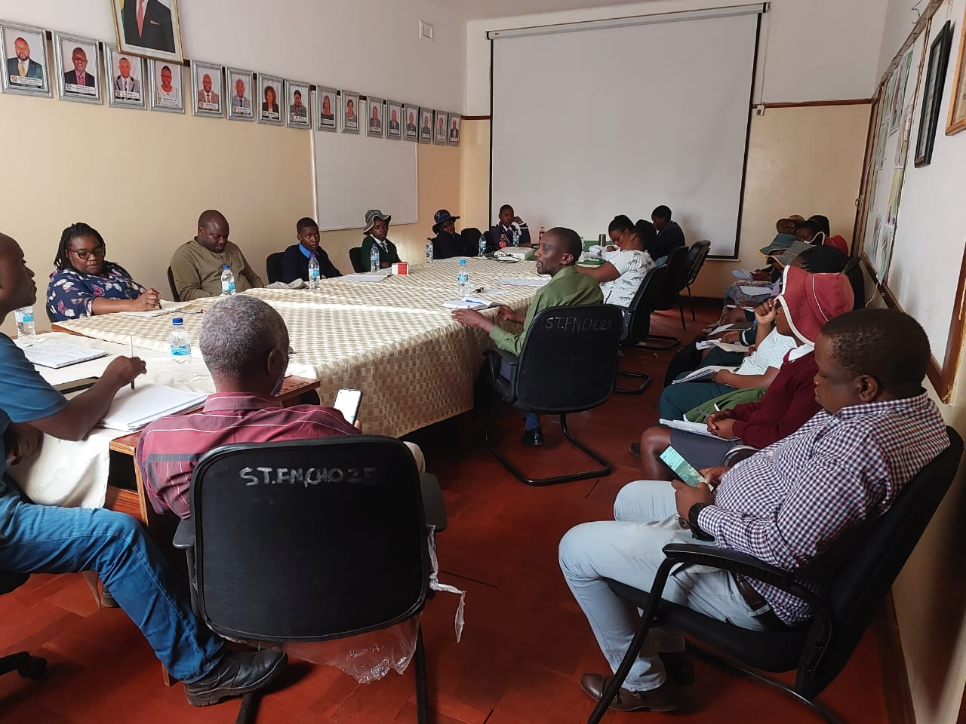
Budget Consultation Photos

Slide 17
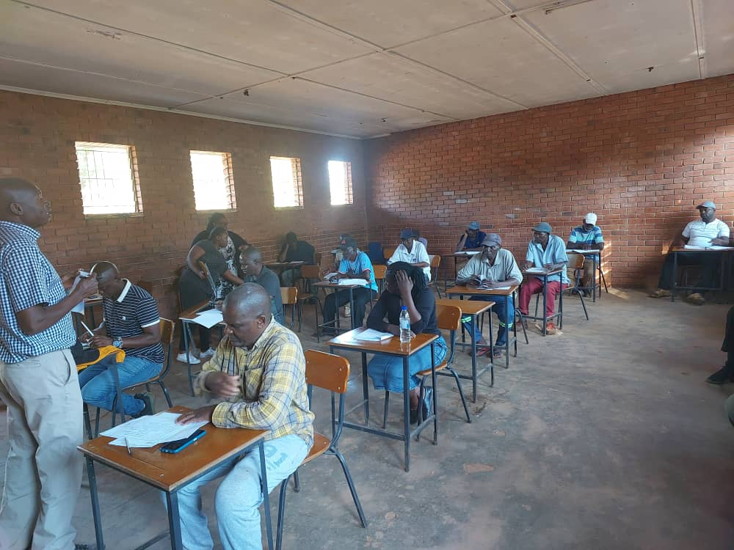
Budget Consultation Photos (Contd)

Slide 18
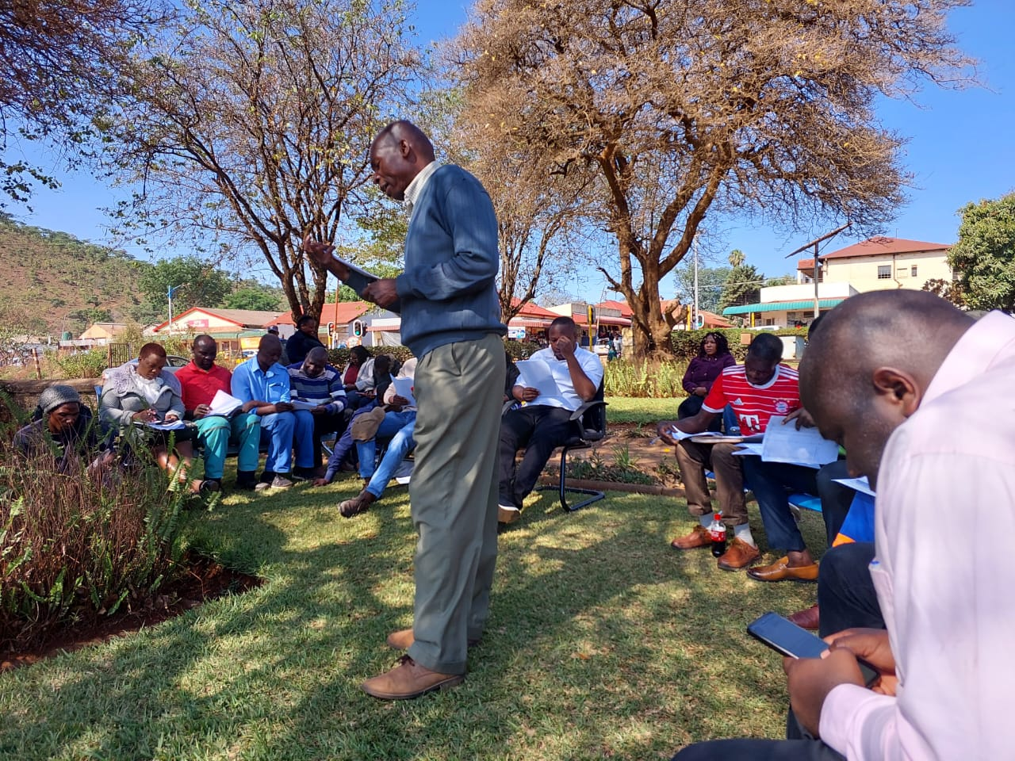
Budget Consultation Photos (Contd)

Slide 19
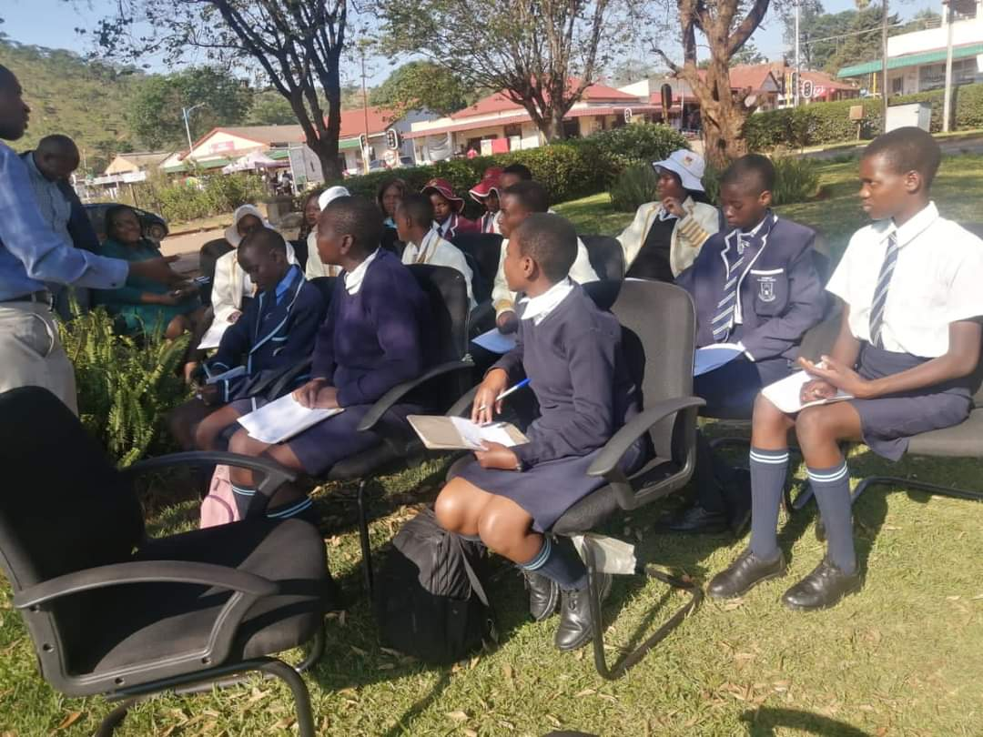
Budget Consultation Photos (Contd)

Slide 20
II. THE BUDGET PROCESS
Normally for women, all times were before 4pm to accommodates home women duties. For Vendors all times were before 2pm to avoid their peak periods.
The most effective method was face to face since it gives evidence of physical signature. WhatsApp groups were also used but the coverage was not 100% effective.

Slide 21
Budget Consultation Meetings
GROUP | DATE | TIME | VENUE
VENDORS ALL WARDS(1-13) | 17 OCTOBER 2024 | 1000HRS |  | COUNCIL CHAMBERS
BUSINESS COMMUNITY ALL WARDS(1-13) | 17 OCTOBER 2024 | 1400HRS | COUNCIL CHAMBERS
WARD 8, 9, 10 | 17 OCTOBER 2024 | 1600HRS | MAKUSHA CLINIC
GROUP | DATE | TIME | VENUE
GENDER CHAMPIONS ALL WARDS(1-13) | 18 OCTOBER 2024 | 1000HRS | COUNCIL CHAMBERS
ZIMASCO WARD 3,4,6,7. | 18 OCTOBER 2024 | 1400HRS | COUNCIL CHAMBERS
WARD 12 | 18 OCTOBER 2024 | 1600HRS | SHURUGWI NO. 2 HIGH SCHOOL
GROUP | DATE | TIME | VENUE
RESIDENTS ASSOCIATION ALL WARDS(1-13) | 19 OCTOBER 2024 | 1000HRS | COUNCIL CHAMBERS
WARD 5 | 19 OCTOBER 2024 | 1400HRS | SELUKWE PRIMARY
WARD 11 | 19 OCTOBER 2024 | 1600HRS | ZBS SHOPPING CENTRE

Slide 22
Budget Consultation Meetings (Contd)
GROUP | DATE | TIME | VENUE
PASTORS FRATENITY (CHURCH REPS) ALL WARDS(1-13) | 21 OCTOBER 2024 | 1000HRS | COUNCIL CHAMBERS
PEOPLE LIVING WITH DISABILITY.(PLWD) ALL WARDS(1-13) | 21 OCTOBER 2024 | 1400HRS | COUNCIL CHAMBERS
WARD 2, 13 | 21 OCTOBER 2024 | 1600HRS | POLY CLINIC
GROUP | DATE | TIME | VENUE
UNKI MINES | 22 OCTOBER 2024 | 1000HRS | COUNCIL CHAMBERS
JUNIOR COUNCILORS | 22 OCTOBER 2024 | 1500HRS | COUNCIL CHAMBERS

Slide 23
II. THE BUDGET PROCESS
Consultation | Women |  |  |  |  | Total | Men |  |  |  |  | Total | % Women
 | Age |  |  |  |  |  | Age
 | - 15 | 15-35 | 36-59 | 60+ | PWD |  | - 15 | 15-35 | 36-59 | 60+ | PWD
Vendors | 20 | 50 | 202 | 41 | 1 |  | 10 | 30 | 140 | 20 | 1
Gender Champion Awards | 10 | 50 | 200 | 30 | 1 |  | 10 | 30 | 140 | 20 | 1
PLWD | 20 | 51 | 207 | 33 | 3 |  | 10 | 30 | 140 | 21 | 2
Residence Association | 20 | 60 | 370 | 37 | 2 |  | 11 | 32 | 144 | 20 | 1
% | 5 | 15 | 69.5 | 10 | 0.5 | 100% | 5 | 15 | 69.6 | 10 | 0.6 | 100% | 63

Slide 24
III. REVENUE
Council resource allocation was positively skewed towards women generally.
Women occupy a higher population space hence its apparent to address their concerns.
Women views were aligned to water challenges hence allocation to wash was the highest.
80% of our Devolution funds is channelled towards water hence the element of addressing the women needs to a lager extent.

Slide 25
REVENUE SOURCES

Slide 26
IV. EXPENDITURE
Analysis of the council budget expenditure into Gender Management System; Salaries; employment equity-related expenditure; gender-specific programmes and mainstream programmes.

Slide 27
EXPENDITURE

Slide 28
IV. EXPENDITURE
Type of Expenditure | Amount | Proportion (%)
Gender Management System (GMS) | 46525.64 | 18
Employment expenditure (Human Capital Expenditure) | 87259 | 33
Employment equity related expenditure | 27669.69 | 10
Gender Specific Programming | 5374.38 | 2
Mainstream Programmes | 98000 | 37
Other | 0 | 0
Total | 264093 | 100

Slide 29
IV. EXPENDITURE- GMS
Council now has a proper functional Gender Management System (GMS), commencing from a Gender Committee which sits on a monthly basis. The Gender Focal Person is the resource person who advices the servicing officer of the committee. We have one Gender Champion who is a Councillor.
All the documents are found in the office of the Director of Finance, Gender Focal Person and the Town Secretary’s office.

Slide 30
IV. Gender Specific expenditure
Council Gender specific pragrammes includes;
Gender committee expenditure
16 days of activism against gender based violence
Commemoration of women’s day
Workplace programmes
School fees and sanitary ware for the girl child
Budget lines in line with the above are under;
Social Services
Governance and Administration.
The proportion of Council budget on Gender specific activity is 4.7%.
The programmes/projects came from the views of the participants.
Resources generally once availed should empower a civic group.
Expenditure on gender specific programmes can be measured by checking whether the project is high impact or not.

Slide 31
IV. EMPLOYMENT EXPENDITURE
 | Women |  |  | Men |  |  | Total | % women
 | Managers | Staff | Total | Managers | Staff | Total |  | Managers | Staff | Total
Full Time | 0 | 32 | 32 | 14 | 97 | 111 | 143 | 0 | 29 | 29
Part time | 0 | 3 | 3 | 0 | 8 | 8 | 11 | 0 | 27 | 27
Casual | 0 | 2 | 2 | 0 | 0 | 0 | 2 | 0 | 100 | 100
Total | 0 | 37 | 37 | 14 | 105 | 119 | 156 | 0 | 26 | 26

Slide 32
IV. EMPLOYMENT EXPENDITURE- Gender Wage Gap Analysis
 | Women | Women- Total earned | Women average earned | Men-no | Men total earned | Average earnings
Full Time | 32 | 16203.60 | 506.36 | 110 | 62220.79 | 560.54
Part Time | 3 | 230.76 | 76.92 | 8 | 593.69 | 93.44
Casual | 2 | 115.38 | 57.69 | 0 | 0 | 0
Total | 37 | 16549.74 | 640.97 | 119 | 62817.48 | 653.98
Council also encourages women to apply for managerial posts in order to address the disparity between men and women..

Slide 33
V. EXPENDITURE- GENDER IN MAINSTREAM BUDGET
Programmes | Amount | % budget
Governance & Administration | 800 071.90 | 34
Water Sanitation & Hygiene | 2 062 991.18 | 37.09
Social Services | 2 260 646.20 | 40.35
Roads | 440 163.35 | 8
Public Safety & Security | 20 650 | 0
Natural Resources & Conservation | 6 200 | 0
Total | 5 617 572.65 | 100

Slide 34
GENDER IN MAINSTREAM BUDGET

Slide 35
V. EXPENDITURE- ANALYSIS OF ONE SECTOR EG
 | Women |  |  |  |  |  | Men
 | Age |  |  |  |  |  | Age
 | Below 15 | 15-35 | 36-59 | 60+ | PLWD | Total | Below 15 | 15-35 | 36-59 | 60+ | PLWD | Total
Education | 0 | 0 | 0 | 0 | 0 | 0 | 0 | 0 | 0 | 0 | 0 | 0
Housing | 0 | 0 | 0 | 0 | 0 | 0 | 0 | 0 | 0 | 0 | 0 | 0
Social amenities | 0 | 0 | 0 | 0 | 0 | 0 | 0 | 0 | 0 | 0 | 0 | 0
Total | 0 | 0 | 0 | 0 | 0 | 0 | 0 | 0 | 0 | 0 | 0 | 0

Slide 36
V. EXPENDITURE- GENDER IN MAINSTREAM BUDGET
For people to benefit equally Council have started putting in place pro women policies since they remain the disadvantaged group and encourage women to participate in Council activities predominantly led by men.

Slide 37
V. EXPENDITURE- GENDER IN MAINSTREAM BUDGET – EXAMPLE
 | Amount | No of beneficiaries | Percentage
Total Expenditure | 1251234 | 68 | 100
No. of Men benefiting from council allocations | 1101085 | 53 | 88
No. of Women benefiting from council allocations | 275271 | 15 | 12
Total beneficiaries | 2627590 | 68 | 100%

Slide 38
VI. BUDGET CROSS SUBSIDISATION ANALYSIS
 | Income (A) | % of total budget | Expenditure (B) | % of total budget | Surplus/Deficit
Governance & Administration | 22051.98 | 14.31 | 1082121.94 | 19.58 | 282049.64)
Water, Sanitation & Hygiene | 2083641.18 | 37.27 | 2000867.06 | 36.20 | 82774.12
Social Services | 2266846.20 | 40.55 | 2054153.73 | 37.1 | 212692.48
Roads | 440163.34 | 7.87 | 390678.58 | 7.07 | 49484.76
Public Safety and Security | 0.00 | 0.00 | 0.00 | 0.00 | 0.00
Natural Resources & Conservation Mgt | 0.00 | 0.00 | 0.00 | 0.00 | 0.00
Total | 5590722.65 | 100 | 5527820.92 | 100 | 62901.72

Slide 39
VI. BUDGET CROSS SUBSIDISATION ANALYSIS
Wash programme generates more income than expenditure.
Programme being subsidised is Roads and Public Safety.
There is no existing policy to support or guide cross subsidisation.
The gender consideration on cross subsidisation of services depends on the nature and timing of the gender specific activity.
% of allocation that have been influenced by gender considerations is less than 2%.

Slide 40
VII. CONCLUSIONS AND NEXT STEPS
Gender equality has been addressed by bringing on board under social services programme and Governance programme, gender specific programmes as mentioned earlier and making sure these programmes are resourced.
Our next step as Council is implementation and evaluation guided by the budgeted gender items/activities agreed upon.

