Slide 1






2024 Country Summit PROMOTING GENDER INCLUSIVE LOCAL ECONOMIC DEVELOPMENT Template
NAME OF ENTERPRISE : MAUNGWE GREEN HUB
PRESENTERS’ NAME & SURNAME : JOHN MARK MUGARI
“Promoting Gender Inclusive Local Economic Development”

Slide 2
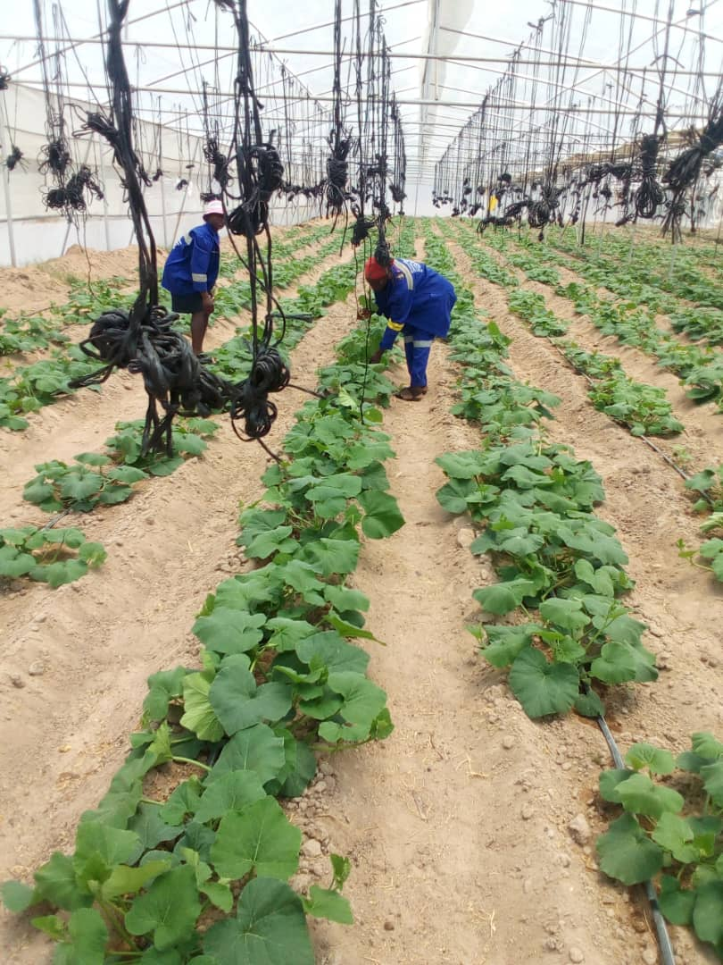
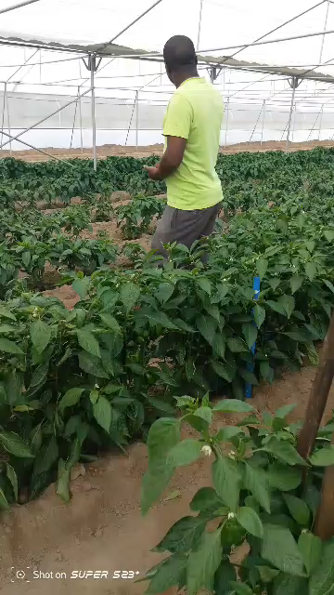
PLEASE DESCRIBE THE ENTERPRISE
Please Describe what your business is about. Horticulture Project
Number of Members in the group. 45
What is the business’s registration status? In progress
What type of registration is in place? Consultation Stage
How often does the enterprise have meetings? Every Wednesday of the week
“Promoting Gender Inclusive Local Economic Development”

Slide 3
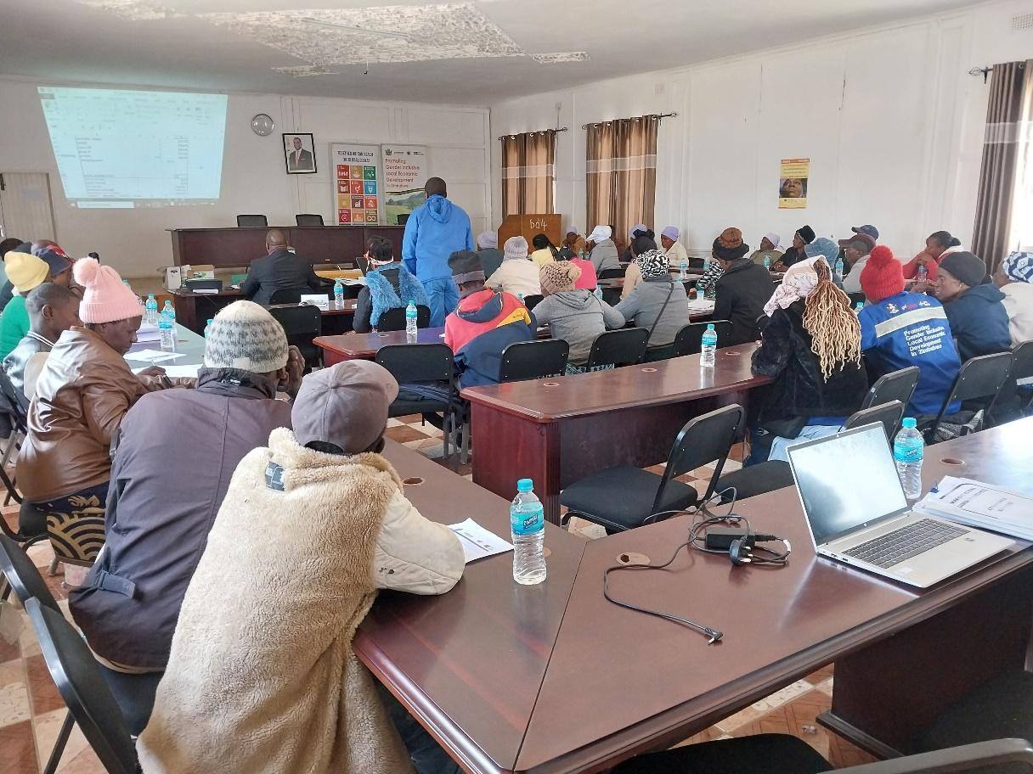
BUSINESS PLAN & MODEL?
Do you have a Business Plan in place?
Yes there is a business plan in place
Has the enterprise implemented the business plan?
Maungwe/Masvosva Green Hub is implementing its business plan
Describe the business model?
Horticulture Enterprise
What kind of support has the business received?
Financial support of USD 168 000 from Swedish Embassy through Gender Links,
Capacity Building of cooperative members by Gender Links,
Support by Council through provision of seedlings, water tank and technical support.
Monitoring and Evaluation by council through Maungwe Investments a subsidiary of Council.
Insert Photo
“Promoting Gender Inclusive Local Economic Development”

Slide 4
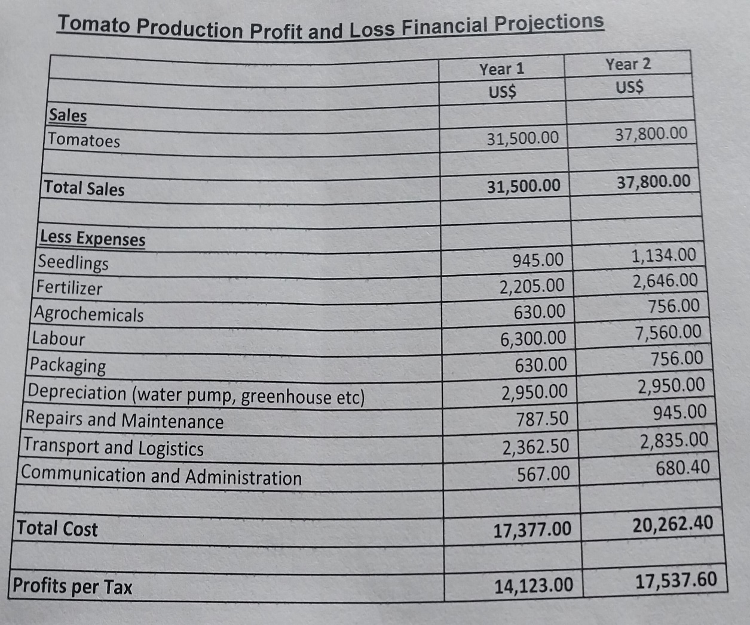
BUSINESS AND FINANCIAL MANAGEMENT?
Does the enterprise have a budget or forecasting tool for the business?
The enterprise has a budget and a business plan
Does the enterprise have a record keeping system that keeps track of expenses, sales and stock inventory?
There is a cash book and a cash record book
Does the enterprise have a bank account ?
The enterprise has an account called ………………………………….
Insert Photo
“Promoting Gender Inclusive Local Economic Development”

Slide 5
INCOME AND EXPENSES FOR THE BUSINESS FOR THE LAST SIX MONTHS
Month | Jan | Feb | Mar | Apr | May | Jun | Jul | Aug | Sept | Oct | Nov | Dec | Total
Sales (USD) |  |  |  | 520 | 511 | 323 | 124 | 300 | 356 |  |  |  | 2134
Quantity (Kgs)
Expenses |  |  |  | 120 | 96 | 221 | 56 | 84 | 71 |  |  |  | 648
“Promoting Gender Inclusive Local Economic Development”

Slide 6
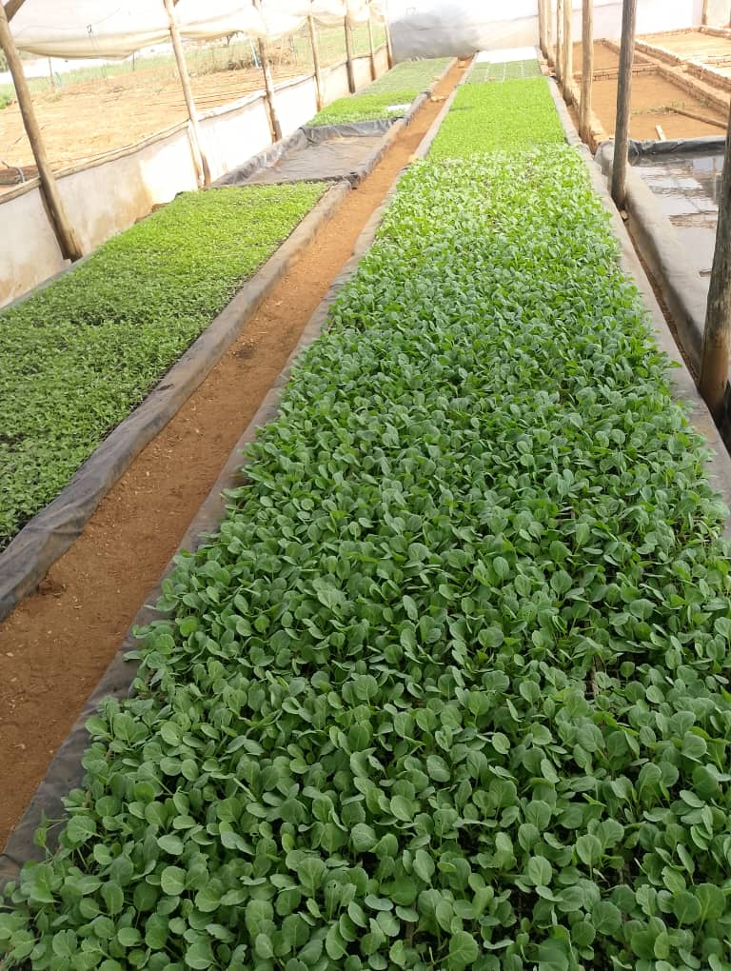
MARKETING AND SAVINGS
What/who is your main market?
Panmart Supermarket Rusape, Green Market Rusape (Musika), Mutare
What marketing strategies has your enterprise employed?
We had a meeting with suppliers, Financiers
What challenges does the enterprise face in the market? Flooding of products. Each farmers has his own price on an open market.
What opportunities do you see in the market? Production all year round and high quality products are produced.
Insert Photo
“Promoting Gender Inclusive Local Economic Development”

Slide 7
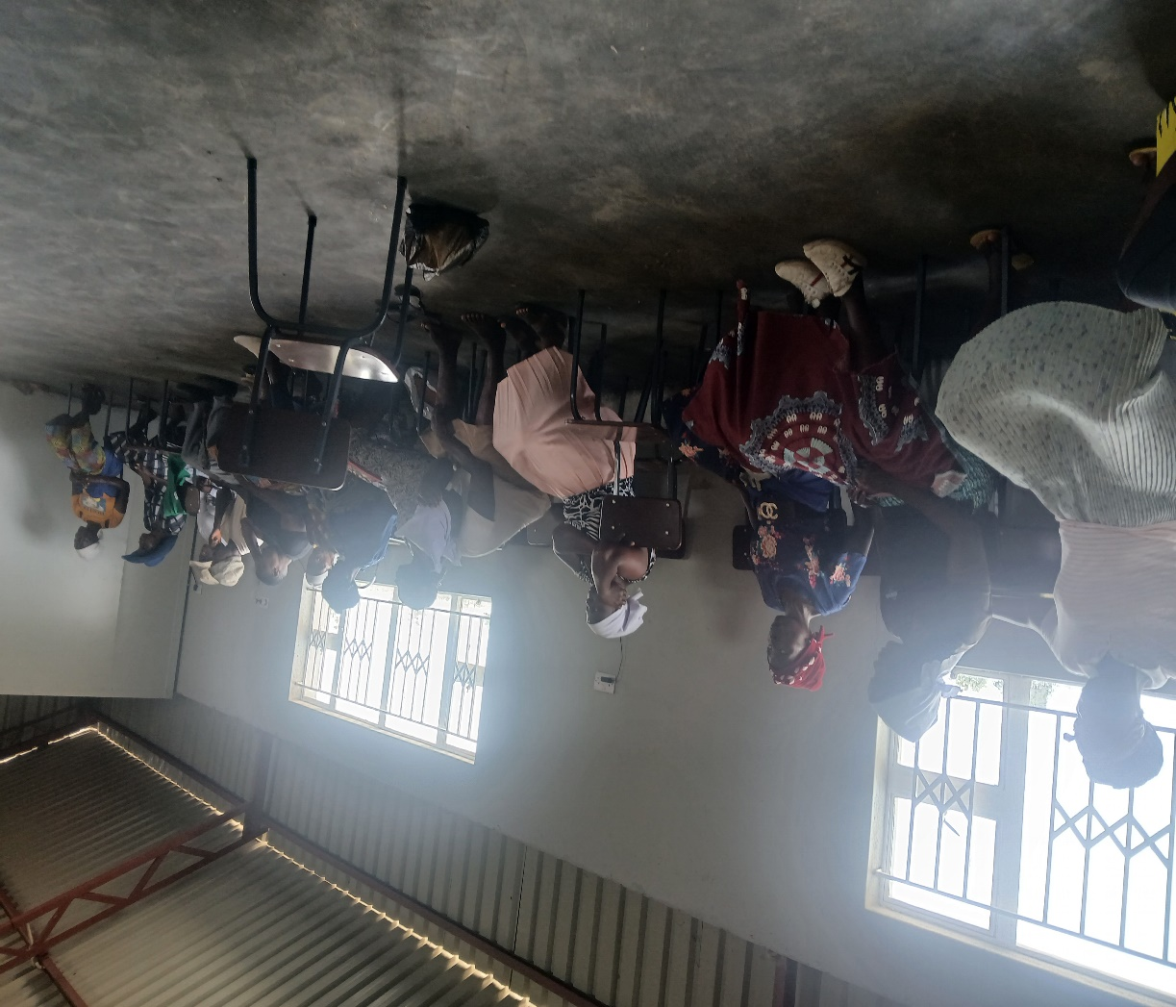
MARKETING AND SAVINGS
Does the enterprise have any savings?
Yes. ZB Bank
Are group members organised into savings groups?
Yes. (Internal Savings and Lending Groups)
How effective are the savings groups?
Very Effective. Delayed repayments attracts penalties.
What financial services has the group accessed? Nil
Insert Photo
“Promoting Gender Inclusive Local Economic Development”

Slide 8
WHAT PLANS HAVE YOU MADE TO GROW YOUR BUSINESS IN THE NEXT 6 MONTHS?
Please list your plans to grow your existing business. Explain the growth strategy of the enterprise.
Registration with Ministries: Women Affairs, Agriculture, ZIMRA and PRAZ
To open new markets
access funding
Access tenders through PRAZ.
Insert Photo
“Promoting Gender Inclusive Local Economic Development”

Slide 9
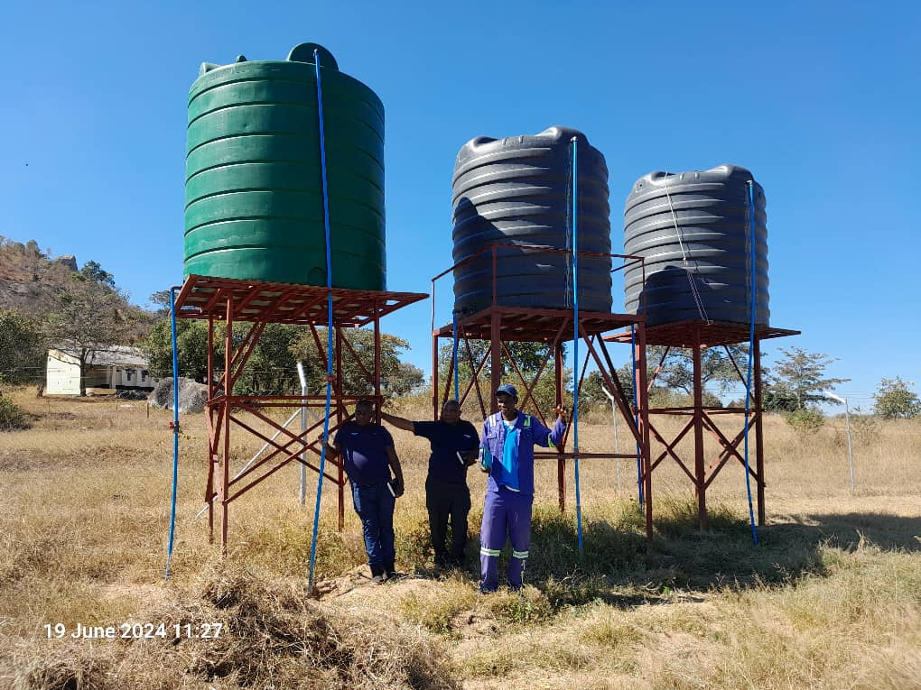
ENVIRONMENTAL PRACTICES
What environmentally friendly practices has your enterprise employed/used?
Greenhouse. High yields on small piece of land.
Footbath to prevent disease outbreak.
Water conservation.
Soil conservation.
Insert Photo
“Promoting Gender Inclusive Local Economic Development”

Slide 10
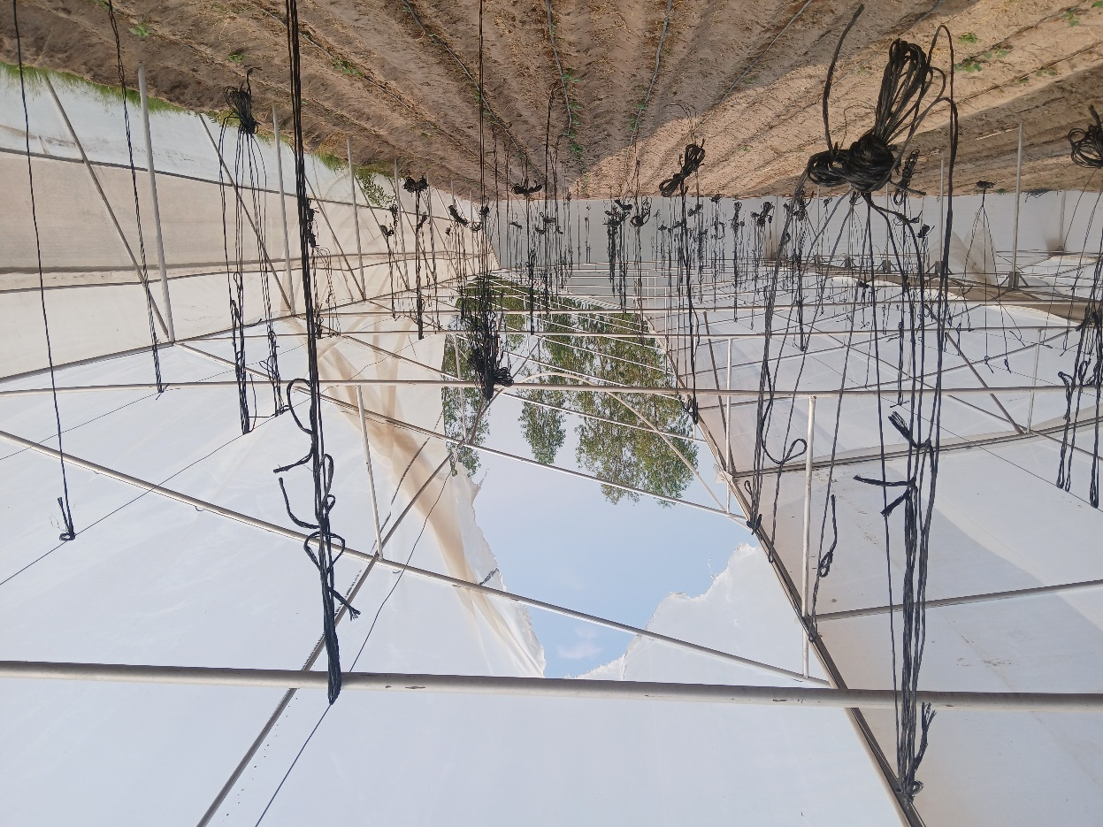
CHALLENGES LESSONS LEARNED
What challenges have you encountered with the enterprise?
Whirlwind destroying the greenhouse.
Absenteeism by members.
Crops affected by diseases.
Transportation of diseases by visitors.
No fixed price on our products.
How have you addressed / mitigated these challenges?
Wind block through growing gum trees.
Instituting a group constitution.
Scouting everyday.
Spraying weekly.
Contract farming.
“Promoting Gender Inclusive Local Economic Development”

Slide 11
LESSONS LEARNED
What lessons have been learned?
How are you/will you apply the lessons learnt?
To have greenhouse paper in stock.
To look for markets before planting.
Footbathing always.
Prohibitive policies.
Weekly meetings updates.
“Promoting Gender Inclusive Local Economic Development”

Slide 12
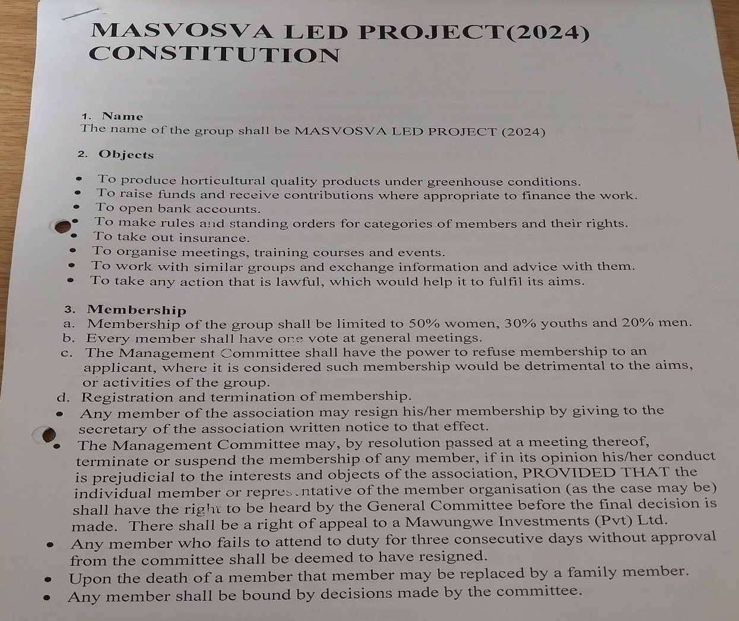
SUSTAINABILITY
What sustainability measures are in place for the enterprise?
We have a constitution to ensure that our project will last.
Project has savings.
A running management committee to control and monitor the day to day running of the project.
We have plans to insure our crops.
Insert Photo
“Promoting Gender Inclusive Local Economic Development”

Slide 13
Next Steps
What are the next steps for the Enterprise/Business?
Registration of the business.
Purchase of solar drier for conservation.
Increase membership
Add complimenting projects e.g apiary, poultry, fish farming.
“Promoting Gender Inclusive Local Economic Development”

Slide 14
Additional information?
THANK YOU!!!
“Promoting Gender Inclusive Local Economic Development”

