Slide 1





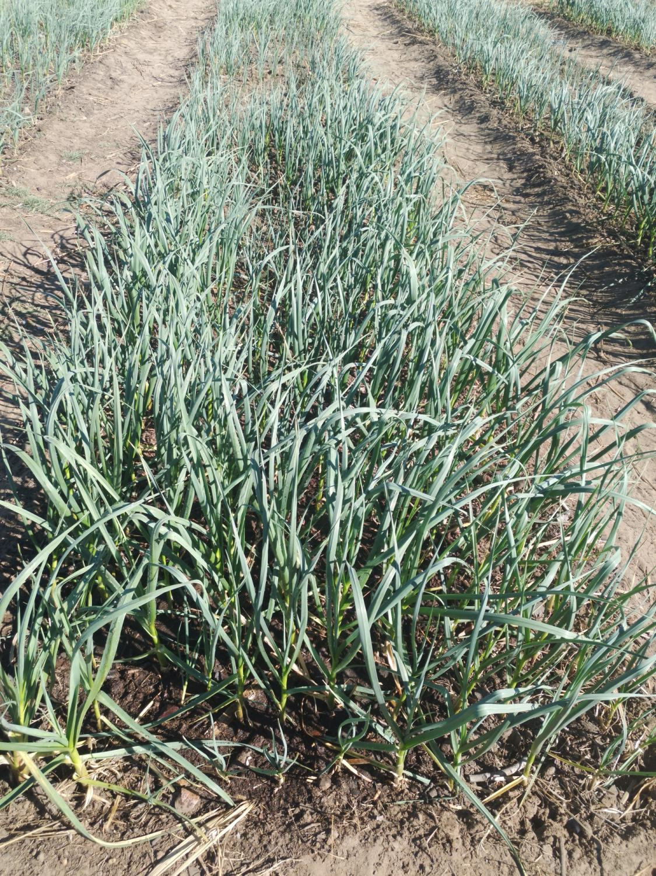
PROMOTING GENDER-INCLUSIVEE LOCAL ECONOMIC DEVELOPMENT IN ZIMBABWE
Rooted in quality farming
‘’quality that runs deep’’
Sinikiwe Zemura
Manyame RDC

Slide 2
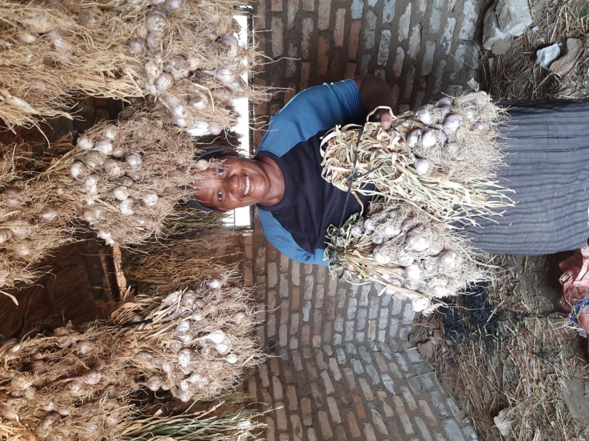
ROOTED IN QUALITY
rooted in quality is a commercial garlic farm dedicated to cultivating high-quality garlic for local and regional markets.
our mission is to provide fresh, flavorful garlic while promoting sustainable agricultural practices and supporting the local food economy.

Slide 3
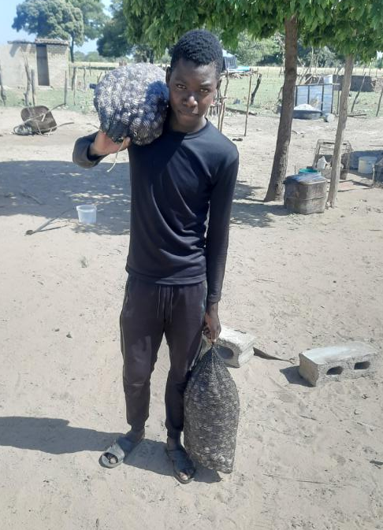
CUSTOMER BASE?
The business supplies local markets shops, local restaurants, food stores with quality products.
Since the starting of LED Programme the number of customer have increased by 50%.
this have been successful by marketing my business through social media and personal engagement, meeting.

Slide 4
COMPETITION
Garlic business faces competition from established garlic farms, garlic wholesale distributors, local farmer’s and cooperatives and other local agricultural businesses.
I handle this competition by giving discounts for bulk orders, SWOT analysis (Strength, Weaknesses, Opportunities, Threats).
different quality of product.

Slide 5
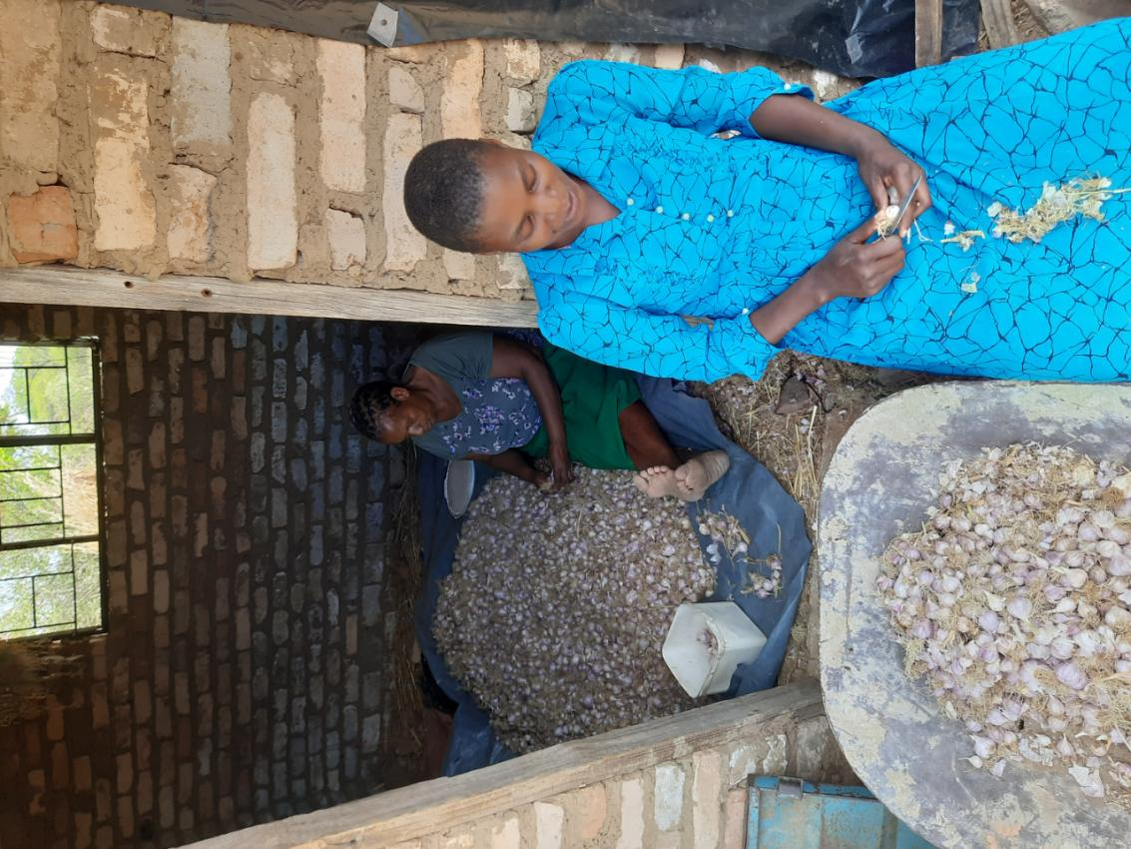
NEW PRODUCTS OR SERVICES?
I’ve new business products or services like powdered garlic and garlic teaching lessons.
some customers tend to enjoy powdered garlic because of it’s form can be used for cooking and drinking
social media advertising, gatherings and verbal communication

Slide 6
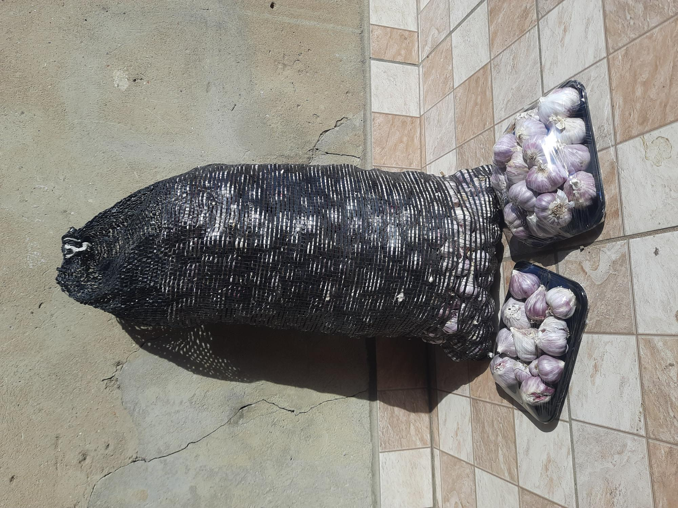
QUALITY AND PACKAGING
Are your customers happy with the quality of your products or services? yes
the customers are satisfied with my products because of good quality, packaging and delivery time.
I’ve changed the packaging and marketing of my business to attract more customers by breakdown packages into small amounts e.g. half kg, 1kg packets and giving promotion to customers.

Slide 7
BUSINESS MANAGEMENT
Have you hired more staff? How many full-time and how many part-time? yes, one full-time and 2 part-time workers.
I handle stock management by stocking packages according to weight and price this help me to manage sales and recording keeping up-to date with the product sales.
Pricing products according their quality, size and scaling so that each package will be of the right weight preventing overweight or underweight.

Slide 8
FINANCIAL MANAGEMENT
Do you have a record-keeping system in place? yes Explain.
Recording keeping it helps me running my business by keeping records of every business sale taking place every time, this helps to be aware of income and expenses
Do you have a bank account for your business? yes

Slide 9
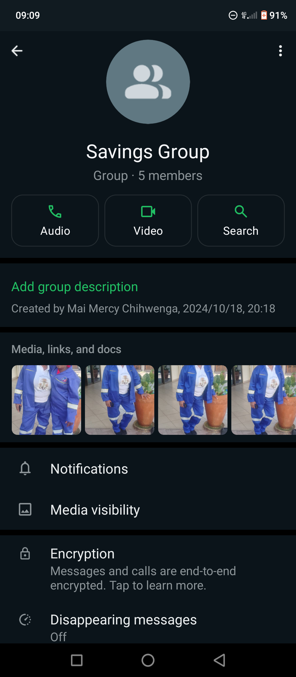
SAVINGS AND SELF SUFFICIENCY
Are you a member of a savings group? yes
we’ve managed to raise $100 in 2 months each member of 5 paying $10/month.

Slide 10
INCOME AND EXPENSES FOR THE BUSINESS FOR THE PAST SIX MONTHS
Income
Expenses
MONTHLY INCOME | AMOUNT
May | $200
June | $300
July | $350
August | $300
September | $250
October | $200
Powdered garlic | $20
Garlic lessons | $10
TOTAL | $1630
ITEM | AMOUNT
seed 40 kg ( $3/kg) | $120
compound D 50kg | $30
1L Herbicide | $15
100ml Lambda | $6
knapsack | $15
Transport | $35
Labour | $350
Electricity | $30
packaging | $5
TOTAL | $606

Slide 11
INCOME AND EXPENSES FOR THE BUSINESS FOR
NEXT SIX MONTHS
Income
Expenses
INCOME | AMOUNT
$40 training in May | $20
Garlic sales June powder | $325 $60
garlic July powder | $555 $150
garlic august | $650
powder (august) | $150
garlic September | $413
powder garlic (September) | $163
TOTAL | $2486
TOTAL
ITEM | AMOUNT
55 Kg seed ( $3x55) | $165
50 kg compound D | $30
1L herbicide | $15
200ml | $12
Transport | $35
Labour | $400
Electricity | $30
Packaging | $10
 | $
TOTAL | $697

Slide 12
WHAT PLANS HAVE YOU MADE TO GROW YOUR BUSINESS IN THE NEXT 6 MONTHS?
land expansion to to cultivate
improved irrigation system e.g. using sprinklers instead of pipe irrigation
I've registered my business with company.
I've employed two more part time personal.

Slide 13
CHALLENGES
I’ve faced some challenges like drought due to power cuts, middleman prices
I’ve addressed these challenges by buying generator for irrigation and registering my business ( able to sale to big markets).

Slide 14
SUSTAINABILITY
experiment with new garlic varieties to improve yields.
rotate garlic with other crops (e.g maize) to maintain soil fertility and reduce pests and diseases.
maintaining accurate records of planting, harvesting ,sales and finances.
allocate profits to savings, investments, or expansion plans.
grow multiple crops to reduce dependence on garlic e.g. mushroom.
consider solar power for farm operations.
support local initiatives, sponsors events (funding prize giving day) and promote agricultural education.
paying tuition fee for 3 primary and 1 secondary students.

Slide 15
ADDITIONAL INFORMATION?
I’ve experienced changes in my business like;
increased revenue and profitability,
expanded market reach and customer base,
climate change and weather variability
improved supply chain efficiency
more marketing linkages
I would also want to grow turmeric and ginger to meet customer demands for different products.

