Slide 1
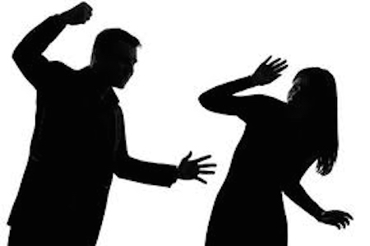
SRHR Campaign Gender Based Violence

Slide 2
Key issues
Cultural Practices – Child marriages, polygamy, FGM
Social Practices: Property grabbing, accusation of witchcraft
Human trafficking
Religious practices: Marrying out young children
Lifestyle – Alcohol abuse

Slide 3
Patriarchy
Lack of coordinated response to abuse
Laws that are not inclusive of all forms of GBV e.g. Botswana; marital rape not recognised
  Emphasis on Physical and sexual abuse and emotional abuse is not catered for in most countries

Slide 4
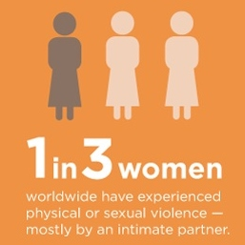
Lack of knowledge on rights and laws
Stigmatisation of GBV survivors especially survivors of sexual violence which leads to underreporting of cases

Slide 5
Key objectives
  To review laws on GBV to include other forms of GBV
  To have standardised M&E tools
  To educate traditional, religious and community leaders on abuse
  To empower women and children through education
  To economically empower women to end GBV

Slide 6
  To empower women to actively participate in politics
  Male involvement in the fight against GBV
  To foster engagement with the police
  To develop safety structures for survivors (support systems) example good practice (SA)

Slide 7
Target groups
Women and girls
Men and boys
Leaders (Religious, traditional, community)
Media
Ministries responsible for issues of GBV
Gender alias (Gender Commission)

Slide 8
Key messages
End violence against women NOW
No excuse for women and child abuse
Stand up against abuse
My body my choice
Make your voice heard
Count me in
You are part of the solution to ending GBV

Slide 9

Key messages
We are stronger together
Together we can end GBV
Yes means yes No mean NO
Ending GBV starts with me
Just like an unlocked door it does not justify theft, my short skirt does not justify rape

Slide 10

Tools – media
Radio
Television
Newspapers

Slide 11





Tools – social media
Facebooks
Twitter
Whatsapp
Instagram
Snapchat

Slide 12
Tools – Community media
Community radio stations
Community TV stations
Community newspapers
Billboards

Slide 13

Tools – other
Artists
  Drama
  Poetry
  Songs
  Comedy
Rallies and community gatherings

