Slide 1






SADC PROTOCOL@WORK SUMMIT 2024
Youth Leadership Template
(Zimbabwe, Chirundu, 29/10/2024 and Simon Mazorodze Junior Council Chairperson)

Slide 2
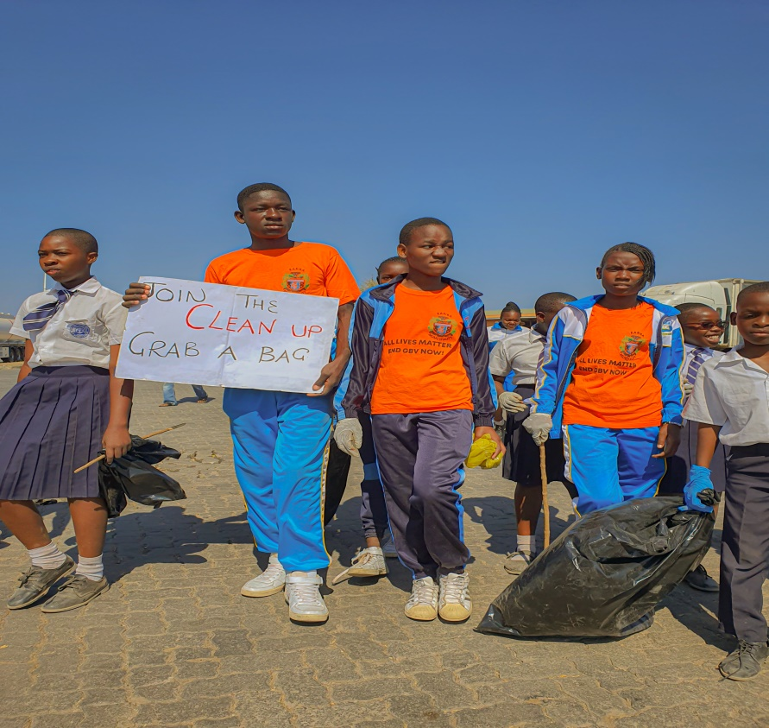
Quotable Quotes
“Leadership is the capacity to translate vision into reality”.
I break down goals into objectives and create actionable tasks.
A CLEAN-UP CAMPAIGN
Every project is done after drafting
An Action Plan (engaging stakeholders for collective impact)

Slide 3

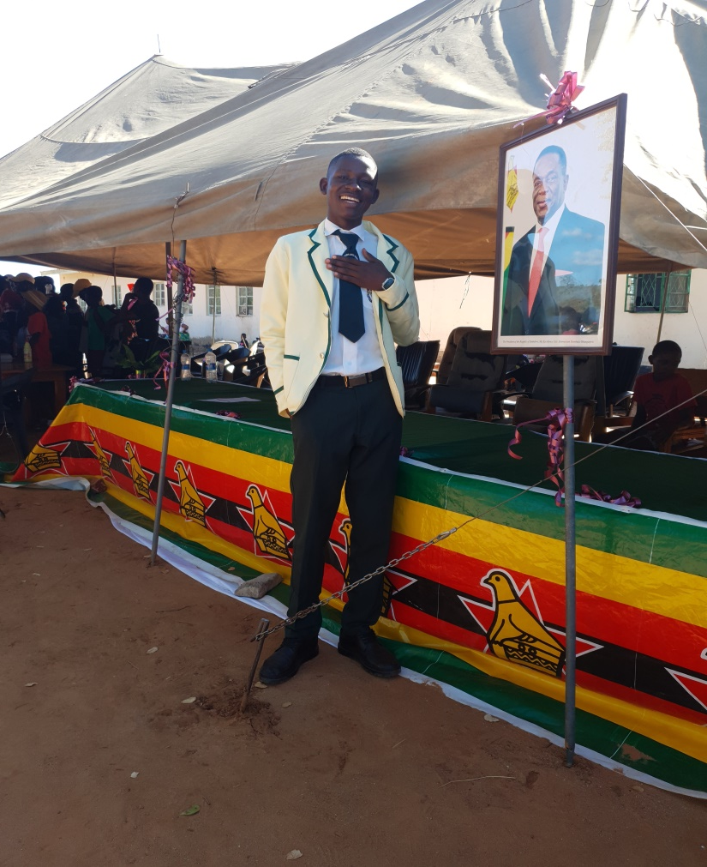
Experience as a leader
One unforgettable experience as a Junior Councilor Chairperson was leading a community developed project, “Empowering youths through education,” in Chirundu Zimbabwe.
I was nominated by people after giving my presentation and performance in several interviews.
18 /02/2024 INDEPENDENCE DAY

Slide 4
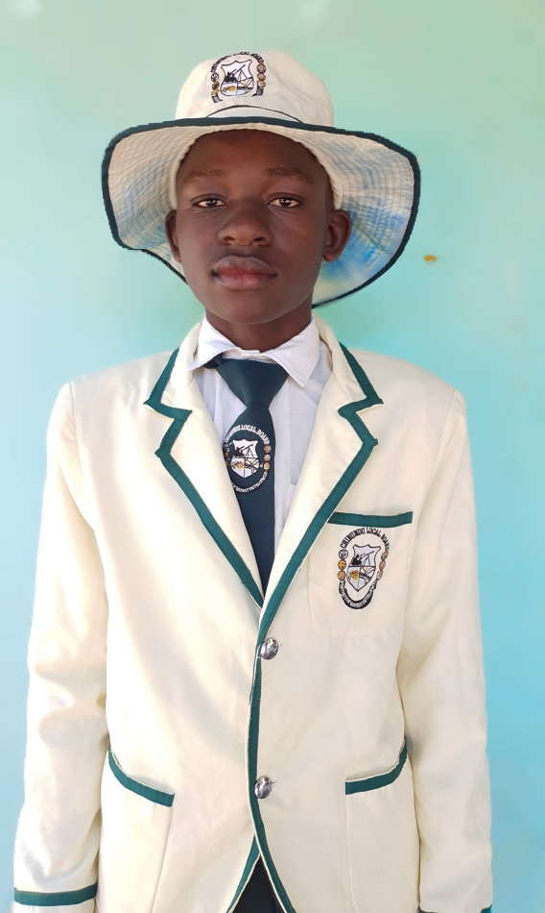
WHO IS THIS YOUTH CHAMPION?
Name : Simon Mazorodze
From : Chirundu
My commitment to integrity, transparency and fairness guides decision making , thus create my unique as a leader.
Detail

Slide 5
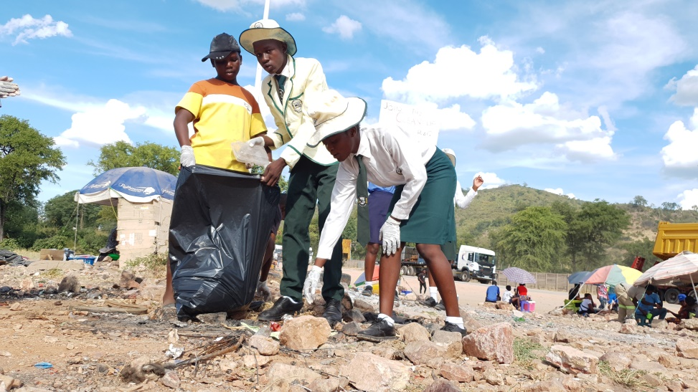
WHAT DRIVES YOU?
Detail
Vision
To transform Chirundu into a thriving and sustainable community by 2030.
Objectives
Fostering youth empowerment and advocate for gender equality.
To prevent and address drugs and substance abuse.
Commitment to gender equality : Promote equal opportunities for all, regardless of disability.
A CLEAN-UP CAMPAIGN

Slide 6
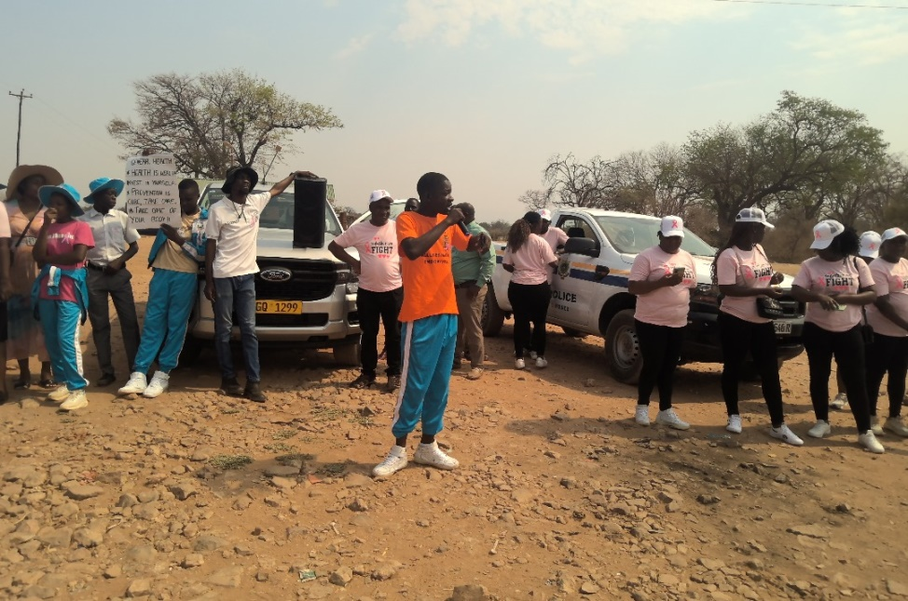
WHAT DO YOU DO?
Detail
I represent the council at events, functions and official gatherings.
I educate communities on gender issues through workshops and awareness campaings.
I establish networks for Gender Based Violence support and counseling.
GIVING A SPEECH ON A BREAST CANCER AWARENESS CAMPAIGN

Slide 7
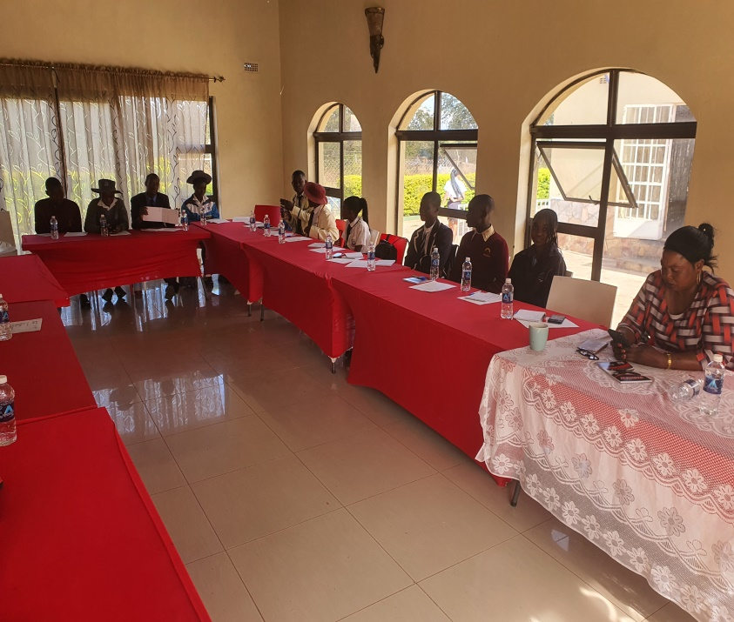
CHALLENGES
1 Limited resources
Insufficient funding of gender equality programs.
2 Resistance to change
Some council members and community leaders oppose gender equality initiatives, citing traditional reasons.
To address these challenges
1 Collaborating with community leaders, NGOs and government agencies.
A FIRST VISIT TO KARIBA WITH
KARIBA JUNIOR COUNCILORS

Slide 8
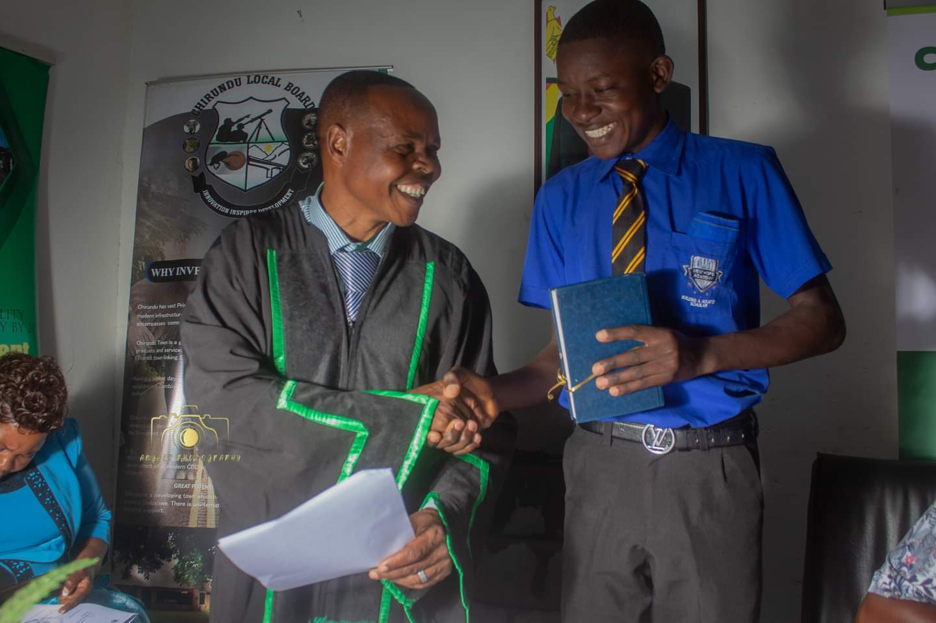
What has changed in your life?
1 Personal growth
I now understand the systemic inequalities and social injustices.
2 Relationships
I formed strong bonds with like-minded individuals.
Our Local Board and the NJCA of Zimbabwe is responsible for this change.
SWORN IN DAY

Slide 9
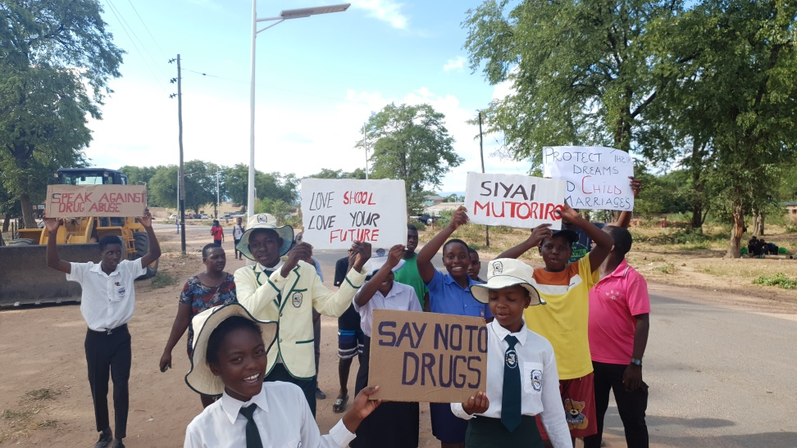
What Capacity Building Initiatives Have You Initiated?
I started an anti-drug abuse group at school.
I conducted workshops for council members, community leaders and youths groups.
A DRUG ABUSE AWARENESS CAMPAIGN

Slide 10
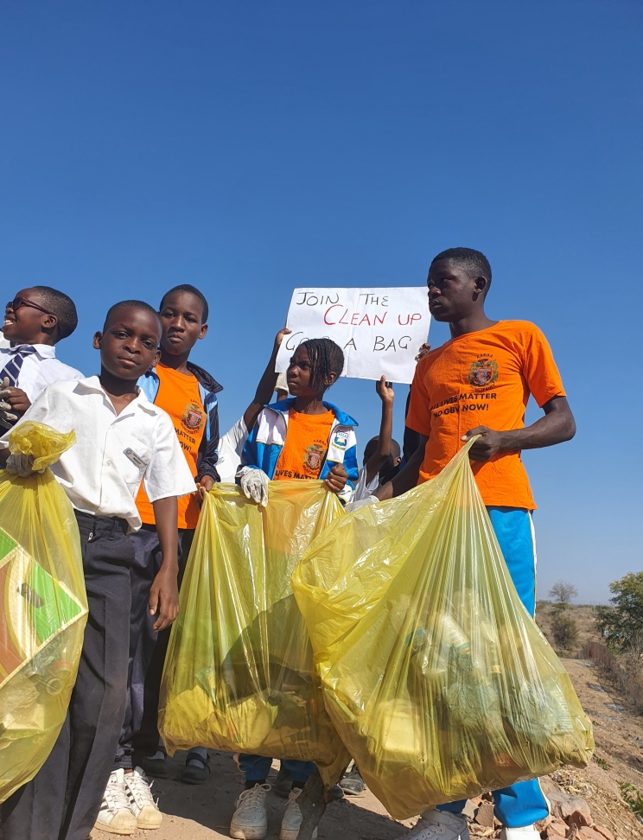
Lessons Learnt
1 Effective change requires collective effort.
2 It is important to understand community concerns.
3 Collaborations amplify impact.
4 Networking strengthens collective capacity.
A CLEAN-UP CAMPAING
WITH LOCAL SCHOOLS

Slide 11
NEXT STEPS
My future plan.
1 Enhances access to quality education, vocational training and economic opportunities.
2 Improve healthcare services, promote mental health and address gender-based violence.
Concluding thoughts
As Junior Councilor Chair person, my tenure has marked by transformative growth, resilience and purpose. Championing gender equality has reshaped governance, empowered communities and inspired collective action.

Slide 12
OBJECTIVES | ACTIVITIES | EXPECTED RESULTS | WHO | DEADLINE
Establish a Vocational Training Centre with our LA. | -Conduct needs assessment. -Establishing partners (funds) | -More job opportunities. -High small business growth | -Junior Councilors. -Community. -Government.
Setting up a Library. | -Conduct site analysis. -Plan technology infrastructure. | -High performance in education. -Enhances tech | -Junior councilors. -Ministry of education. -Community.
Establish a community-based clinic. | -Outline budget and funding. -Establish operational guidelines. | -Improved quality of life. -Better management of chronic diseases. | -Ministry of health. -Local health initiatives. -Health-care professionals.

Slide 13
THANKS
S. MAZORODZE

