Slide 1




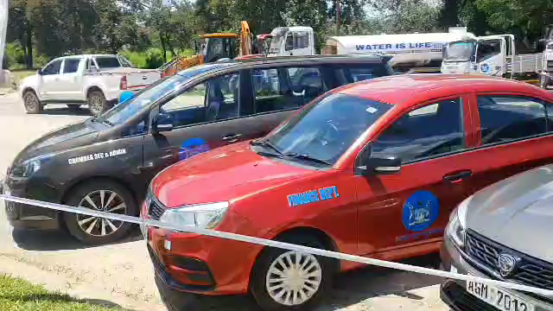
SADC PROTOCOL@WORK SUMMITS AND AWARDS
2024
INSTITUTIONAL COE
(Zimbabwe, City of Mutare, November 2024 )
Christina Mabika
City of Mutare: Zimbabwe’s gateway to the sea!
Recapitalisation For Service Delivery

Slide 2
OVERVIEW
COUNTRY | ZIMBABWE
COUNCIL | CITY OF MUTARE
GENDER CHAMPION | COUNCIL HAS ADOPTED THE MODEL THAT ALL COUNCILLORS ARE GENDER CHAMPIONS SO THAT THERE IS
GENDER FOCAL PERSON | CHRISTINA MABIKA
Latest score (year) | 88
Is the Council a Hub or Spoke Council? City of Mutare is a Hub Council mentoring Rusape and Chipinge Town Councils
 | Women | Men | Total | % Women
Council | 7 | 18 | 25 | 25
Management | 7 | 9 | 16 | 44
Council staff overall | 687 | 1367 | 2054 | 33
Population served | Total population as per 2022 census is 224 802. Council serves a day population of around 300 000- 350 000. The day population consists of people from the surrounding districts, other provinces and Mozambique who converge into the city in pursuit of different business ventures.
Key characteristics | The City of Mutare is located on the border between Zimbabwe and Mozambique. Mutare is Zimbabwe's closest city to the sea making it the most strategic location for transport sensitive import and export oriented enterprises. Mutare is also Zimbabwe's gateway to the Indian Ocean. It is the capital of Manicaland province and covers an area of approximately 16 900 hectares with at least 55 000 rateable properties (industry, commercial, residential and institutional).

Slide 3

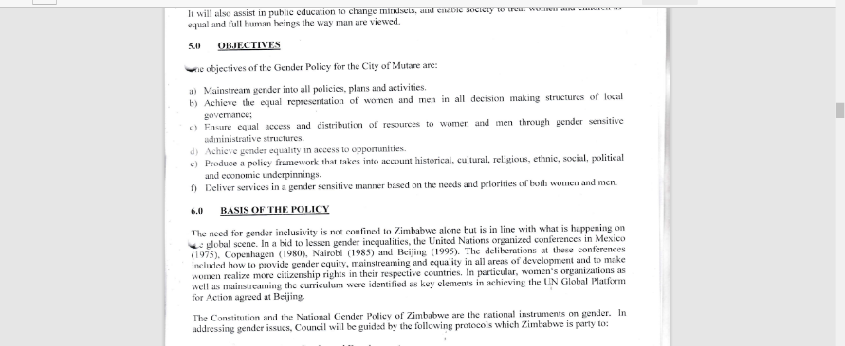
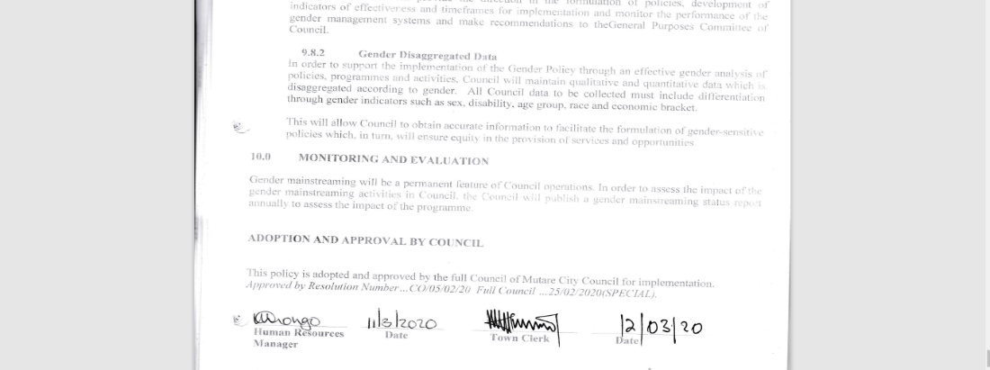
I. GENDER POLICY, ACTION PLAN, HUB AND SPOKE
Council has a Gender Policy in place that was first adopted by Council on 20 November 2015. It was then reviewed and adopted in 2020. The Gender policy is also in the process of being reviewed and will be adopted by December 2024.
Council also has a reviewed Gender Action Plan that incorporates the Post 2015 SADC Gender Protocol, SDGs and other national policies such as the Constitution of Zimbabwe and the National Gender Policy
Council is also implementing a Gender Based Violence Action Plan
Council has an SRHR Action Plan which has also been adopted by Council
Council has resolved that all Councillors and Council employees should champion gender in all spheres. This means that the gender agenda becomes a personal matter at City of Mutare for everyone.

Slide 4
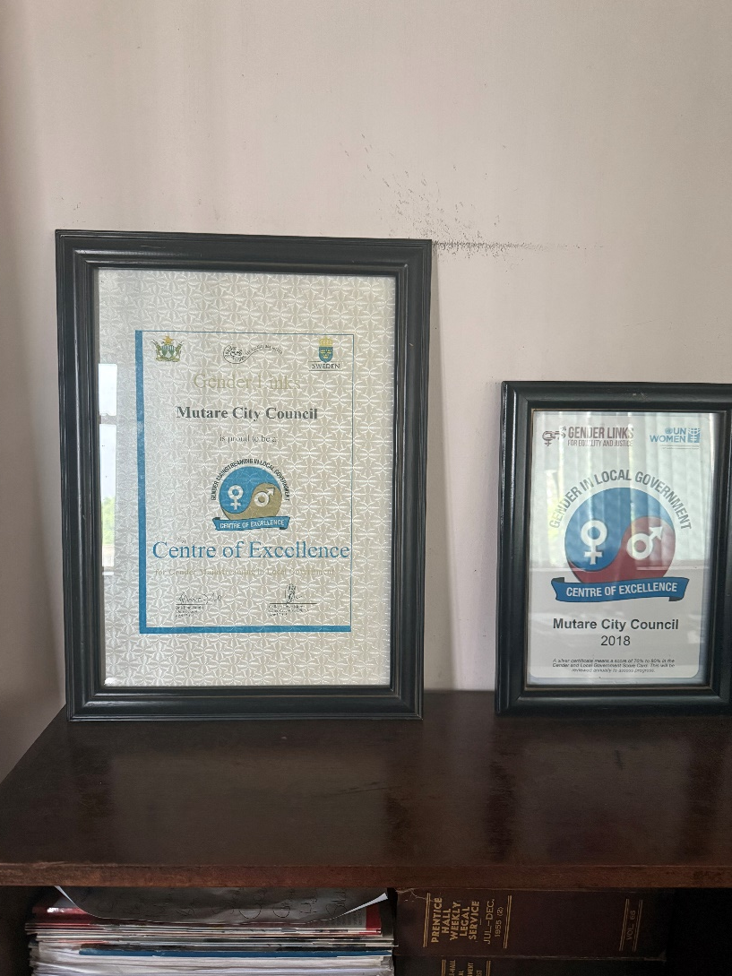
I. GENDER POLICY, ACTION PLAN, HUB AND SPOKE
Council adopted the Hub and Spoke project through a Council resolution which makes it easier to budget for the same (See resolution in evidence file)
Coodination of activities with spoke Council. It has been hard to meet but coordination is at times done online or via telephone

Slide 5
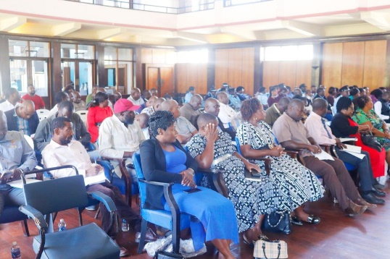
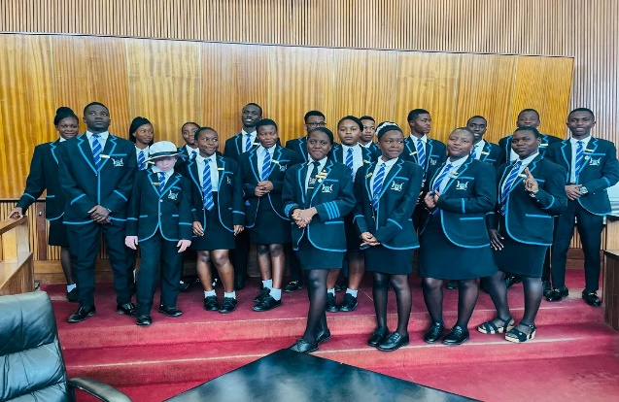
II. GOVERNANCE
Detail
Evidence
25% female Councillors and 75% male councillors. 6 out of 7 Councillors are from the 30% quota and 1 was elected.
Female Chairpersons -: 2 (Chairing the Public Works and Town Lands Committee as well as the Environmental Management Committee.)
Number of women in management is 7 ( ICT Manager Human Resources Manager, Director, Health Services, Director, Housing and Community Services, Deputy Director, Engineering and Technical Services, Chief Committee and Admin Officer, Assistant Finance Director,
Number of men in management :- 9
The Management Team is also very youthful with some of the Assistant Directors being less than 35 years
In terms of consultations, women, youths, PWD are consulted separately during planning, review and consultative meetings
Councillors, including 5 of the female Cllrs in Council waiting to sign Integrity Pledges against corruption led by ZACC
Junior Council

Slide 6
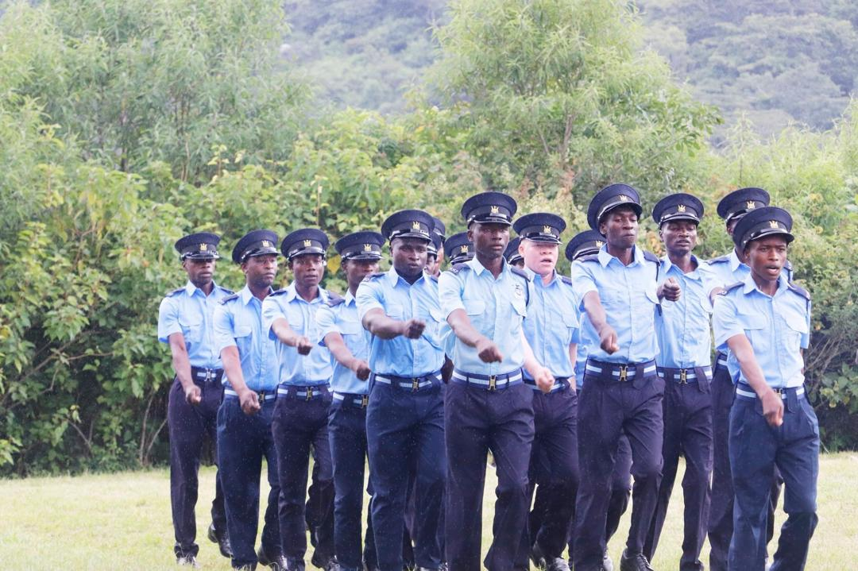
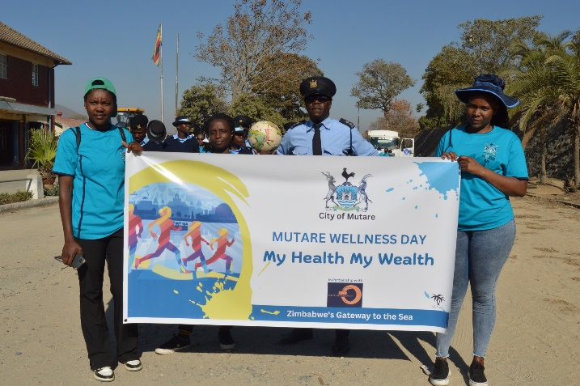
III. WORK PLACE POLICY AND PRACTICE
Women make up 33% of the total workforce for City of Mutare
27% of the workforce are youths below the age of 35 while PWD make up lass than 1% of the workforce
Council has the following policies which seek to make the work place Gender sensitive
Conditions of service, Code of Conduct and Employment Council Constitution in draft form
Safety and Health
Internship policy
Sexual Harassment Policy (under review)
Dress code policy
Recruitment Policy - Equal opportunity employment offered- (Advert cutting in evidence file)
Code of Conduct for Councillors
Sick Leave Regulation and Medical Board Procedures
Training and Development Policy (Internal training as well as funding)
Employee Wellness Policy and program (Health, Nutrition, funeral procedures, Counselling of Council employees
Standing Orders for Committee and Council meetings – to include a closure on the election of female Councillors
Grievance Resolution Policy
(Refer to evidence file Policies and Reports )
MMP Passout Parade
City of Mutare Wellness Day

Slide 7
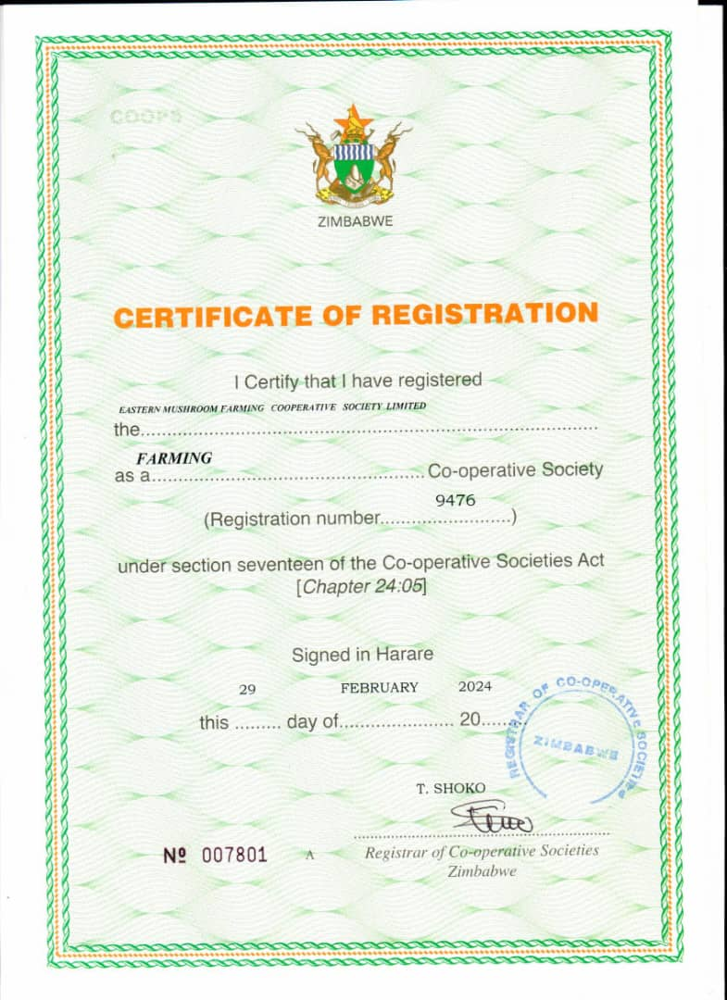
IV. LOCAL ECONOMIC DEVELOPMENT
Council has a Local Economic Development Policy in place (Refer to evidence file)
It has a number of programmes for Women in Local Economic Development and sets aside a budget annually for implementation of these programmes. Council is also part of the 12 local authorities under the “Promoting Gender Inclusive Local Economic Development” funded by Gender Links with support form the Ministry of Local Government and the Swedish Embassy
Allocation of flea markets and vending marts has been digitalized and are allocated through LADS as per the Informal Sector Policy. This has reduced abuse by men who used to take up to 4/5 flea markets and sublet to weaker groups at a higher price
Mwamuka Produce market newly refurbished with a capacity of 1705 farmers (6-11am)
Informal Sector Policy (Refer to evidence file)
Financially empowering the local people especially women – CBOs engaged to manage various Council toilets (Refer to evidence file)
Training of WLED by PRAZ and SAZ
Out of the 11 tenders allocated, 5 were allocated to women constituting about 45% of the tenders.
Group | Total | Proportion
Women | 2514 | 68
Men | 1169 | 32
Youth | 42 | 14
PWDs | 6 | 1
Total | 3683 | 100

Slide 8
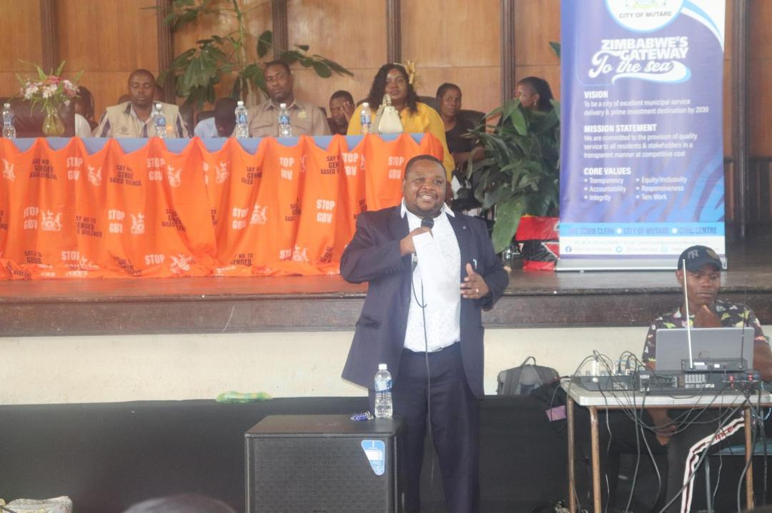
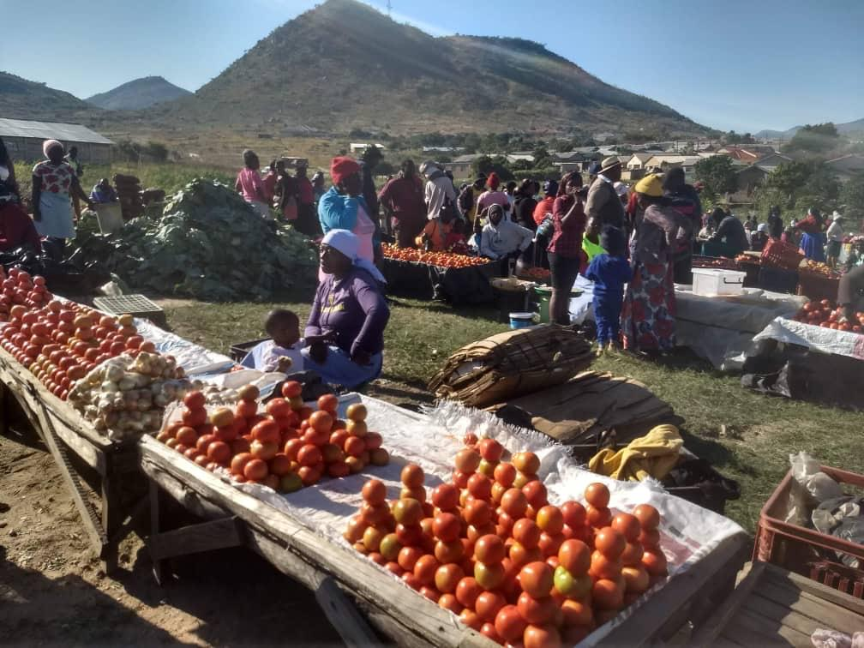
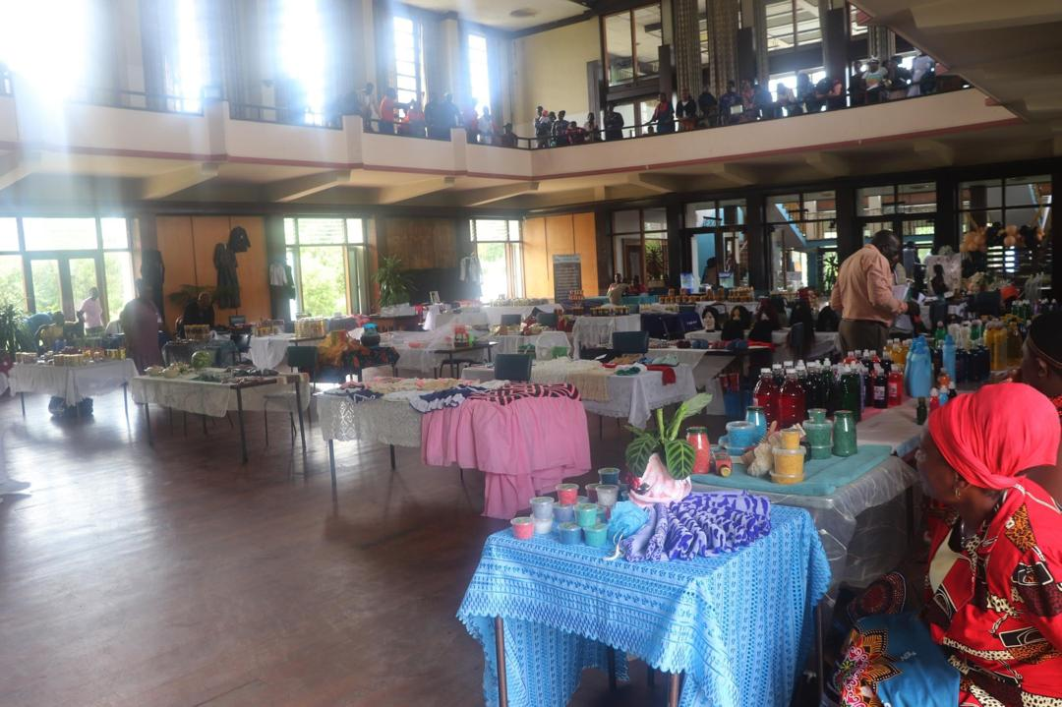
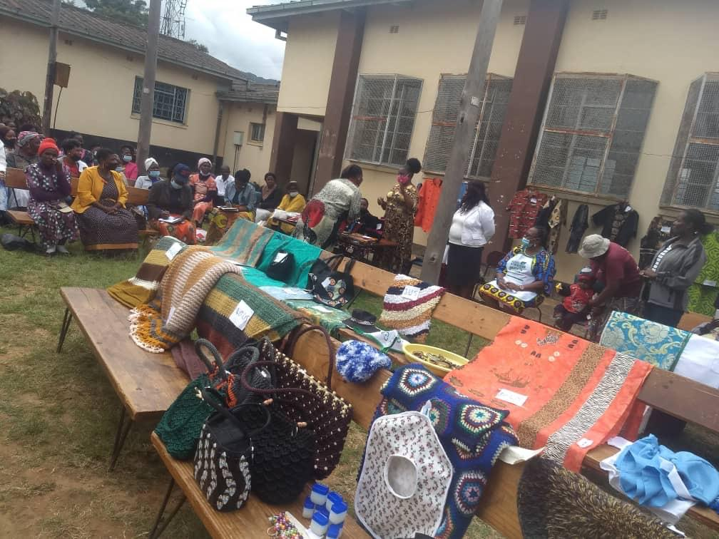
IV. LOCAL ECONOMIC DEVELOPMENT
Mwamuka Produce market
Exhibitions/Internal Tradeshows

Slide 9
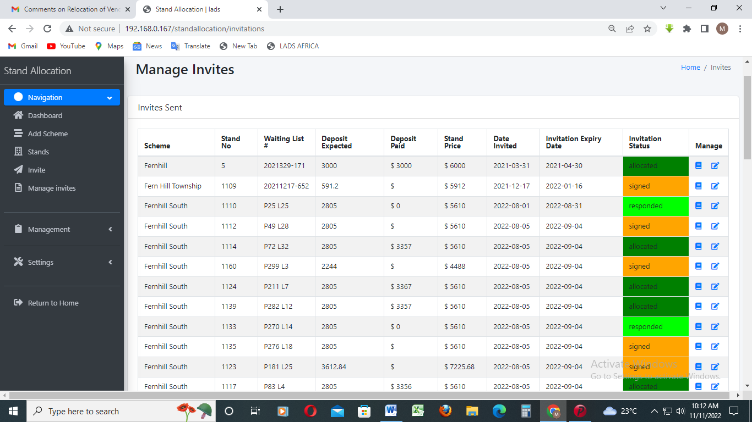
V. INFRASTRUCTURE AND SOCIAL DEVELOPMENT
Land and housing
Council keeps sex disaggregated data for both stands and housing allocations
Stands are allocated in terms of the Housing Policy which has a quota for women, youths and PWD
Modules on LADS that ensure accurate data and multiple ownership of houses especially and then subletting at higher prices e.g Waiting list module, Housing and Stands allocation
Home Ownership program at advanced stage
Disability Policy
Sex disaggregated data of land allocations for council & community beneficiaries.
Sex disaggregated data for housing allocations
.
Housing Allocations | Number | Proportion (%)
Women | 40 | 25
Men | 120 | 75
Total | 160 | 100

Slide 10
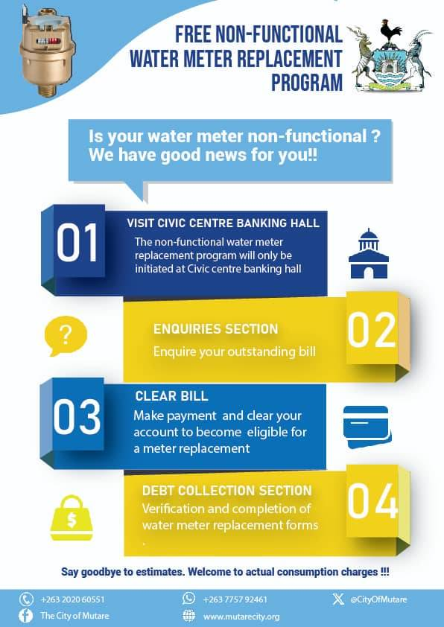
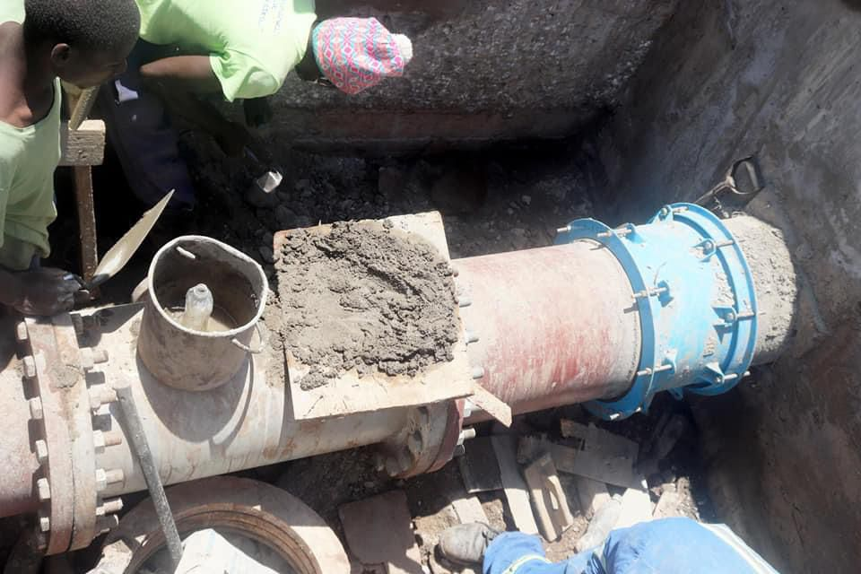
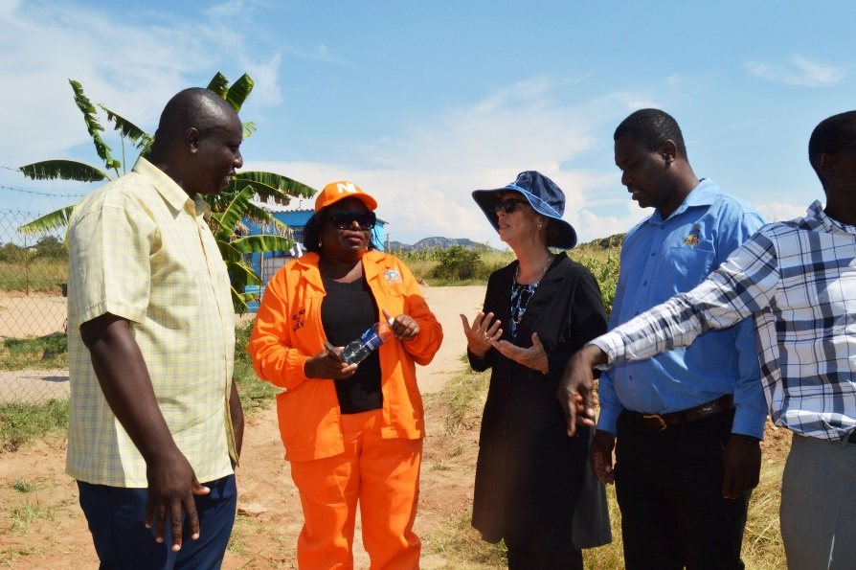
V. INFRASTRUCTURE AND SOCIAL DEVELOPMENT WATER AND SANITATION
Daily provision of water at an average of 22hrs per day (Quality water testing done daily)
Pro poor policy indicates that the first 3 kilo litres of water are free for everyone and low income households get an additional 3 kilo litres
Gimboki Water Project at 99% for 5216 households - To combat Sexual Gender Based Violence as women and girls were being raped in their quest for water.
Routine Maintenance of Odzani Water Works for production of water (165litres per capita per day)
Gimboki Sewage works were rehabilitated under ZIMFUND.
Duplication of Gimboki outfall sewer (10 km) under ZIMFUND
Reconstruction of Sewer pipeline in Dreamhouse
4000 water meters purchased for house holds to reduce non-revenue water

Slide 11
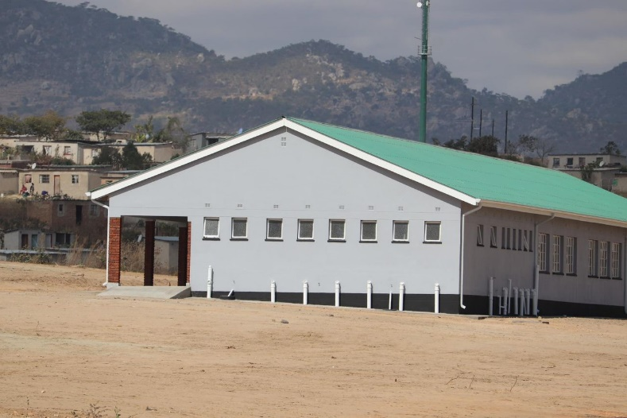
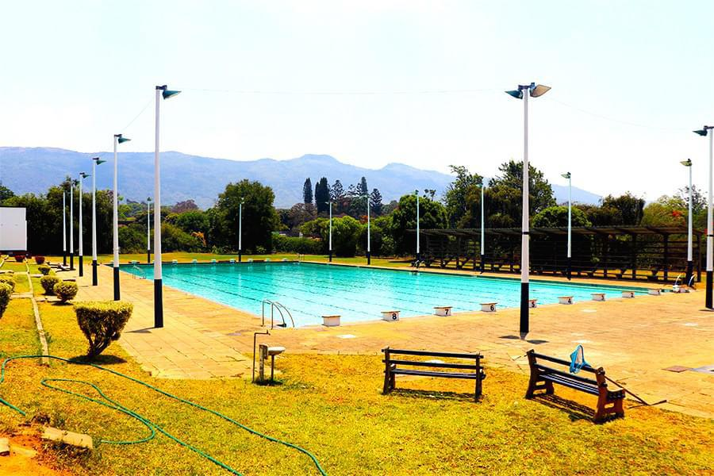
V. INFRASTRUCTURE AND SOCIAL DEVELOPMENT SOCIAL DEVELOPMENT
Refurbishment of Sakubva Stadium with brand new turf which is used for Premier Soccer League matches
Inclusion of sports for PWDs on the Council budget
Community Halls in Chikanga, Sakubva, Dangamvura, Hobhouse and Town (Renovations on Sakubva Beit Hall carried out in partnership wit the Rebuild Sakubva Programme.
Council has 4 Libraries, one of which houses the American Corner. They all offer internet services
2 Swimming pools (Sakubva and Main Bath)
Maintenance of the Council schools (Councillors sit in the SDCs as ex-officio members)
Construction of Gimboki and Chikanga Primary School through a Education Levy
Refer to Evidence File
Gimboki Primary School
Main Bath Swimming Pool

Slide 12
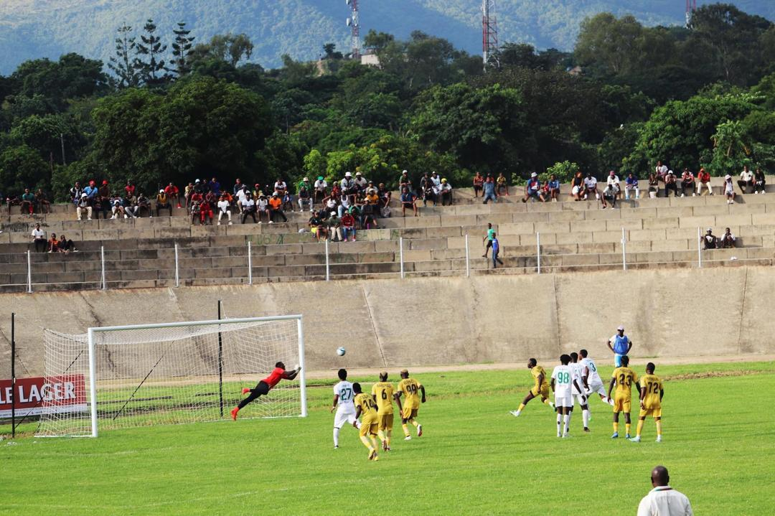
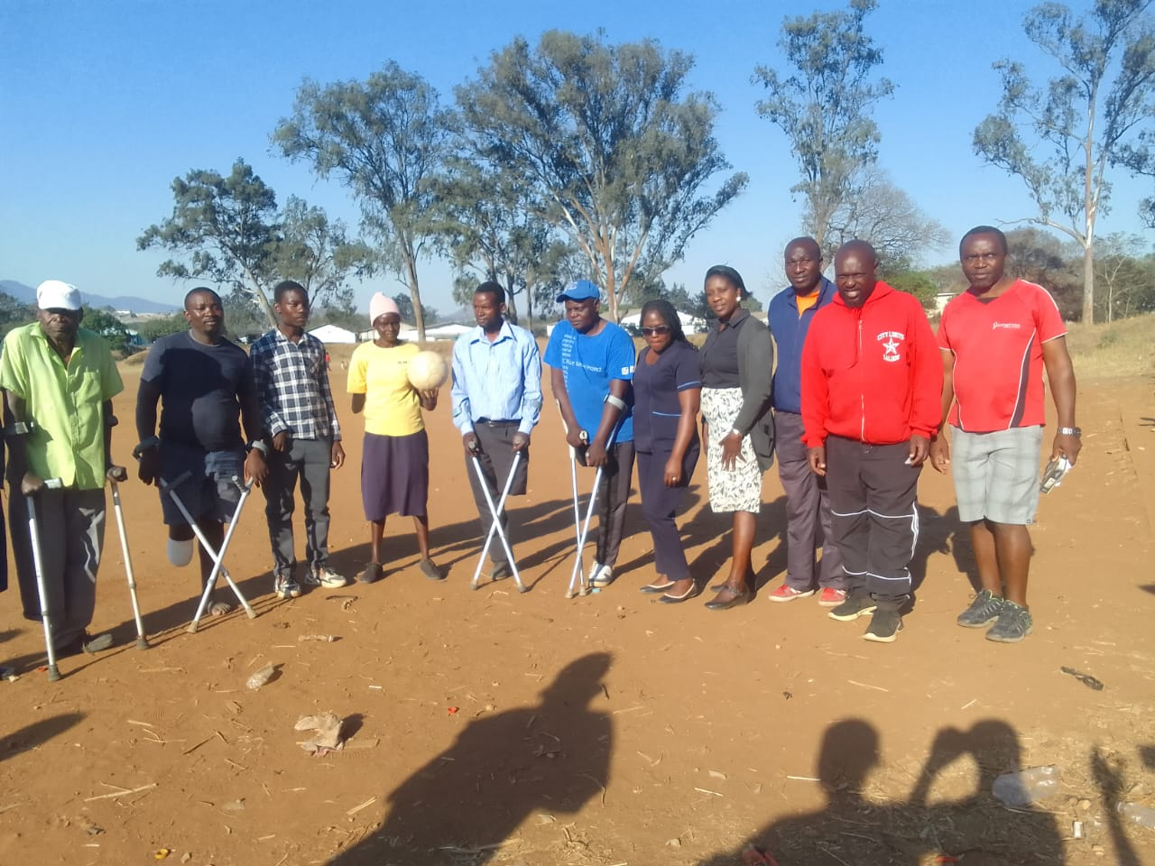
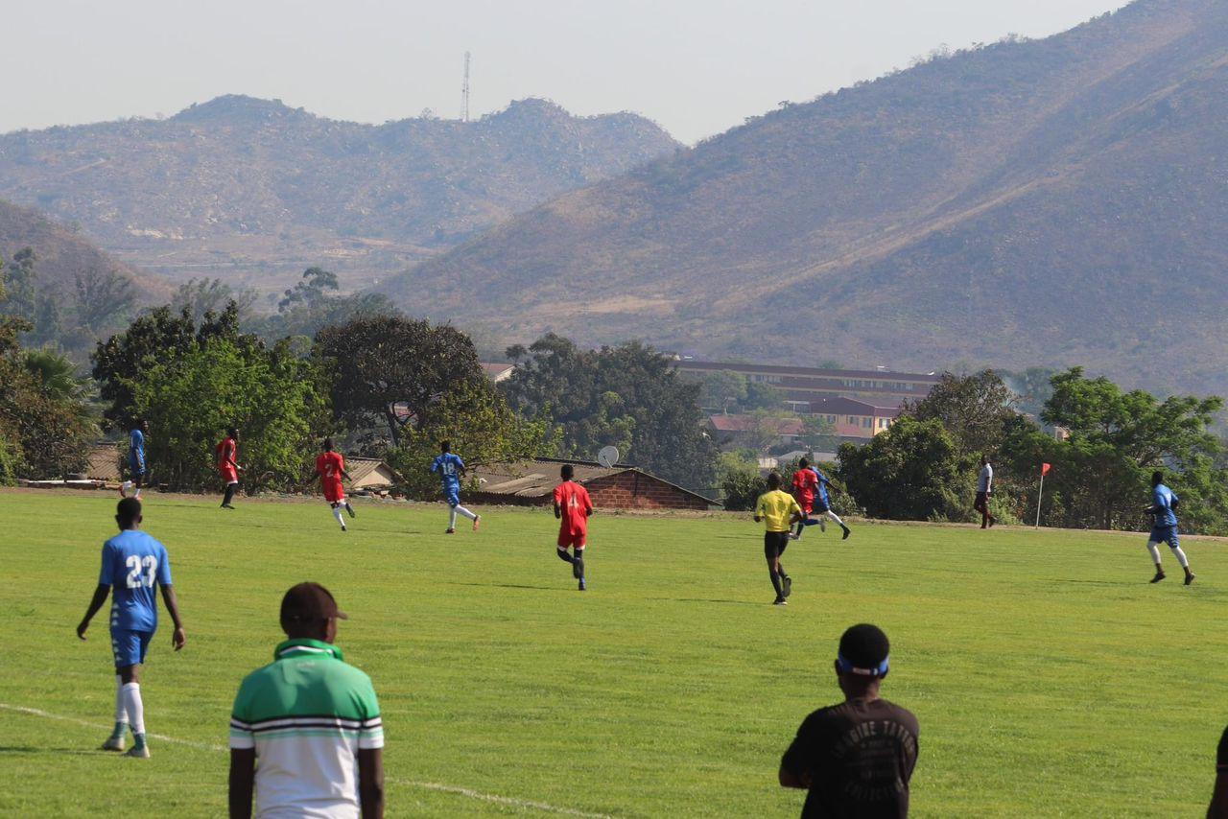
V. INFRASTRUCTURE AND SOCIAL DEVELOPMENT SOCIAL DEVELOPMENT
Sakubva Stadium for professional Soccer
Chisamba Grounds for social Soccer
Sports for PWDs

Slide 13
VI. SEXUAL AND REPRODUCTIVE HEALTH, HIV AND AIDS
To promote SRHR, Council
Runs 10 Clinics and one hospital run by Council – Council in 2023 constructed and furnished fully Gimboki Clinic
Two maternity Hospitals (Dangamvura Poly Clinic and Sakubva. The Hobhouse Clinic is being upgraded and there will be a maternity wing,
One Pharmacy which distributes medication to Council Clinics and hospital only
Council has a Voluntary Testing and Counselling Centre (New Start Centre) which is part funded by PSI.
16359 men and women were tested for HIV in 2023 and part . 4328 were men and 12301 were women)
The New Start Centre is also an ART distribution Centre
Cervical Cancer screening offered at the centre (2471 women have been screened in 2018 and part of 2019 alone)
Administering HPV Vaccines in schools to girls between 10-14years for the prevention of cervical cancer
Follow up programs on ART patients
Refer to evidence file for refurbished MIDH and the new Gimboki Clinic
Council has an Infectious disease hospital which takes people with Infectious diseases for treatment and admission. Mutare Infectious Diseases Hospital is also an ART distribution Centre
Council has 6 other clinics which are ART Distribution Centres (Over 10 898 adults were on ART, as of 2023 and part of 2024, 21 children were on ART
Council has an HIV AIDS policy which incorporates issues of Workplace peer educators
Access to PEP for rape victims at all Council Clinics and Hospital (Mutare Provincial Hospital has a one stop centre)
Condoms available in all public places
SRHR Programmes in place spearheaded by the Junior Council and the Gender Champion-tagerting the youths – Blood Transfusion program

Slide 14

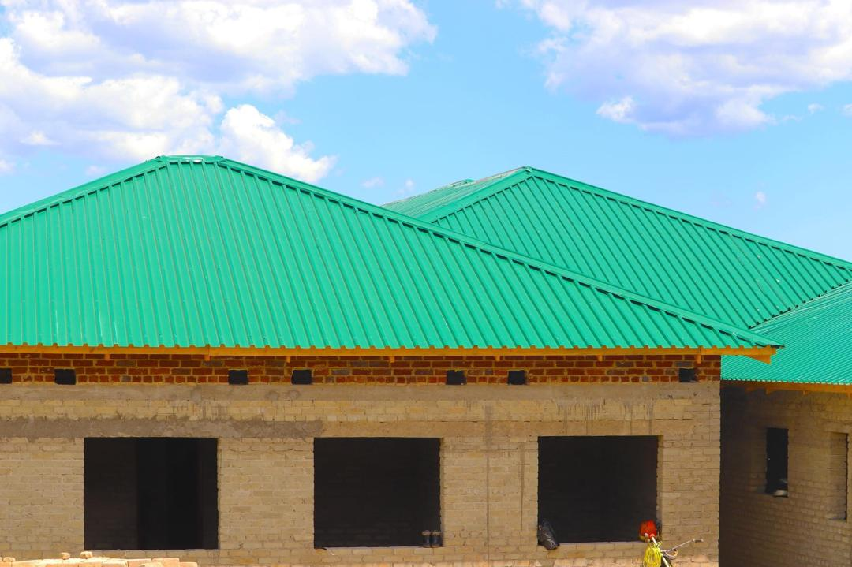
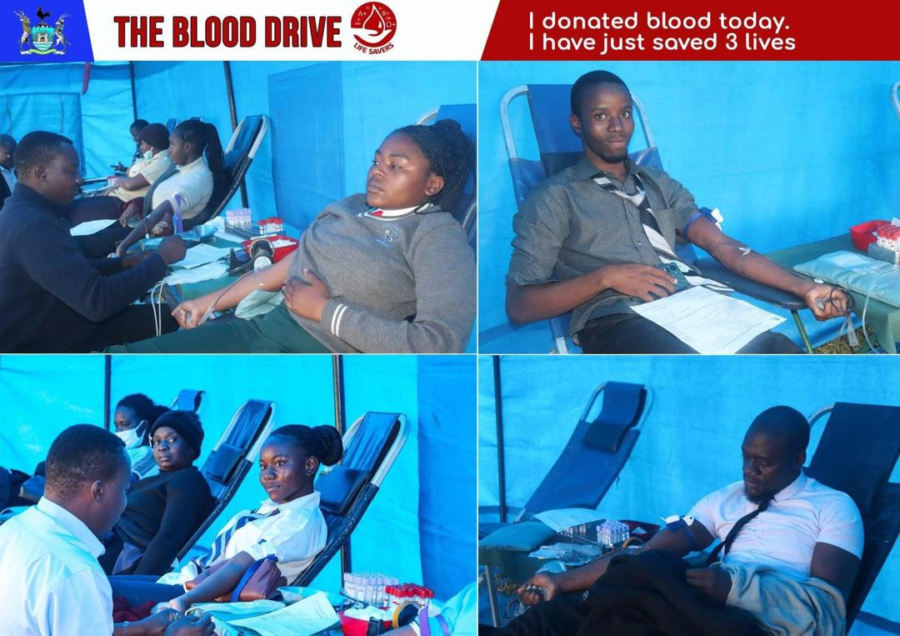
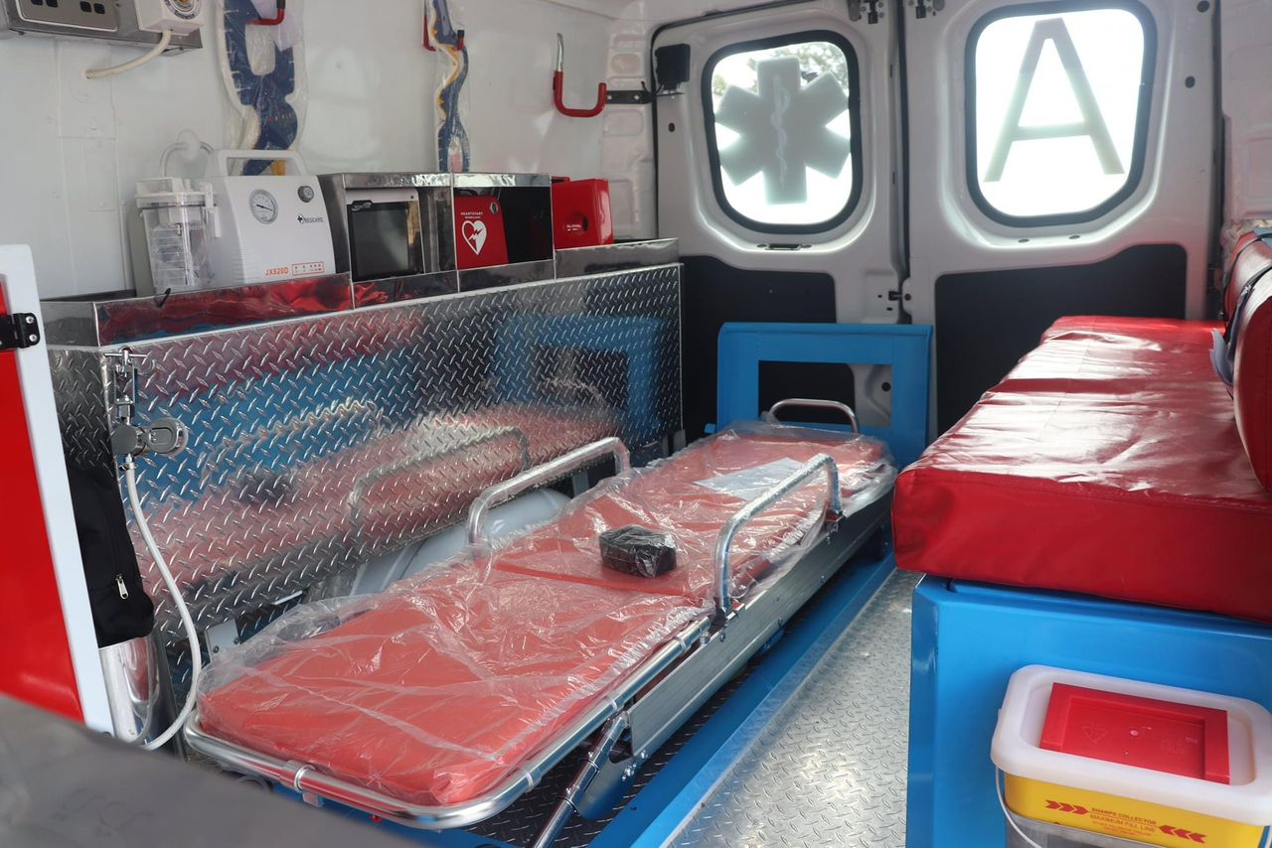
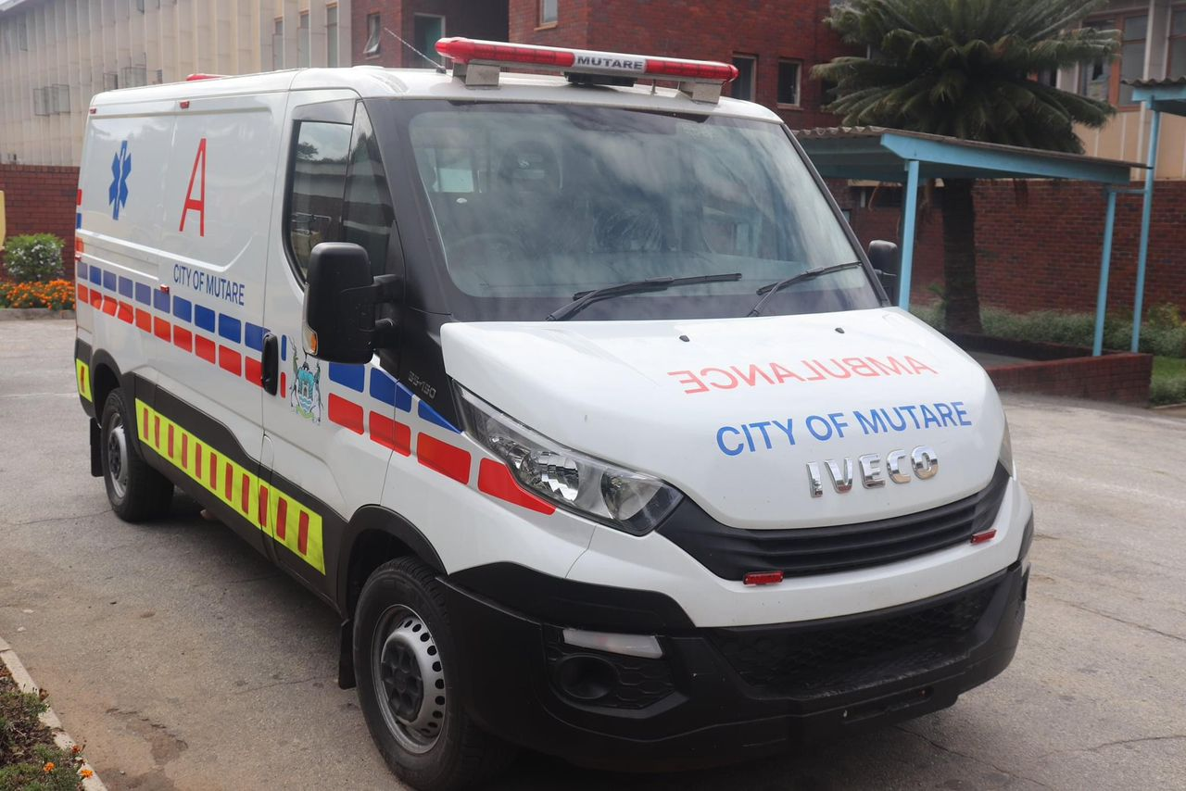
SRHR PICTURES
Breast Cancer Awareness Hobhouse Clinic
New Ambulance
Junior Council Blood Drive
New Ambulance

Slide 15
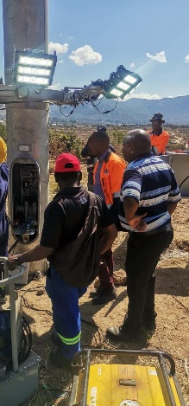
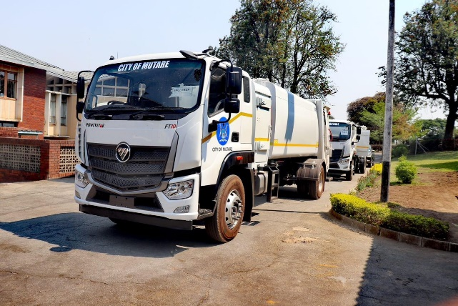
VII. GENDER BASED VIOLENCE- PREVENTION
Naming of streets continues. The Place Names Sub-Committee sat and is in the process of consulting residents for the purposes of naming all unnamed and newly established streets
Meetings with stakeholders on the referral pathway
Installation of new street and tower lights
Water provision to unorganised settlements
Streetlighting maintenance
Water Provision to Gimboki and Federation through Bowsers

Slide 16
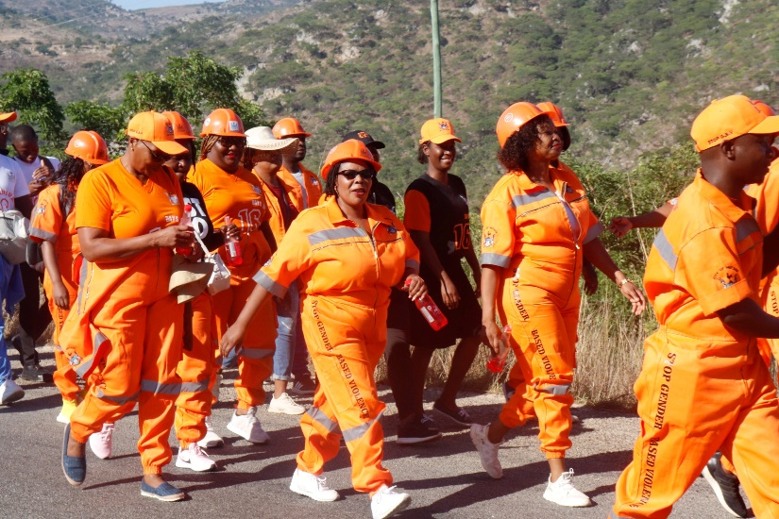
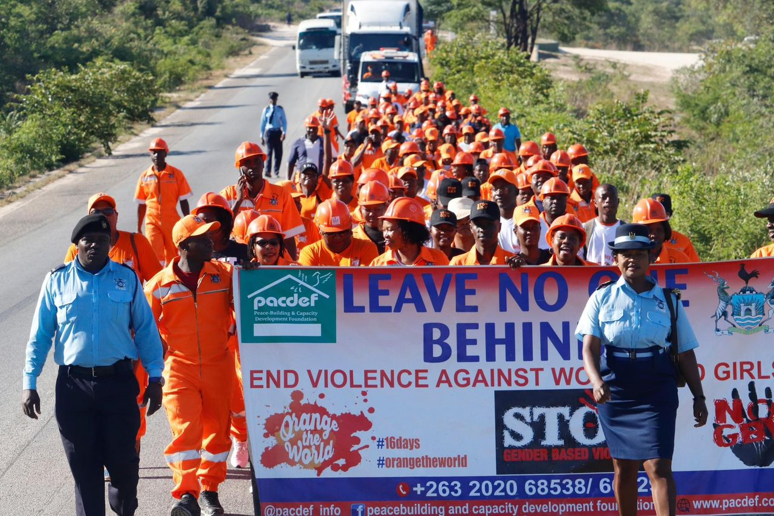
VII. GENDER BASED VIOLENCE- PUBLIC AWARENESS
Council commemorates 16 Days of Activism against Gender Based Violence with a view to raise awareness on the dangers of G.B.V.
Fliers were distributed and speeches given at the event were to raise awareness on Gender Based Violence and on ending it.
Baloon Release ceremony as a way of remembering the victims and commemorating survivors of GBV
“I have been reliably informed that this year the theme we are running with as we are commemorating is “UNITE! Invest to prevent violence against women and girls”. What I really like about the theme is its focus on the importance of financing different prevention strategies to stop violence from occurring in the first place. As you may be aware, that is Council’s primary goal when providing services – to prevent, and in this case, PREVENT GBV from happening. How will Council do it? Some may ask. The answer is simple! By making sure that we provide efficient and effective services. If streets are properly lit, someone somewhere will be saved from sexual gender based violence. If water is available, someone somewhere will not need to wake up in the middle of the night or travel long distances to get water and again, GBV will be prevented. Our Clinics will also be available to offer efficient and effective primary health care…for both prevention and to assist victims and survivors of Gender Based violence. I can go on and on trying to explain to you how we will do it as Council, but I am sure our outfits today are a clear enough commitment of how hard we will work to invest in both hard and soft infrastructure that will assist in the prevention of Gender Based violence” ATC’s speech, Nov 2023”

Slide 17
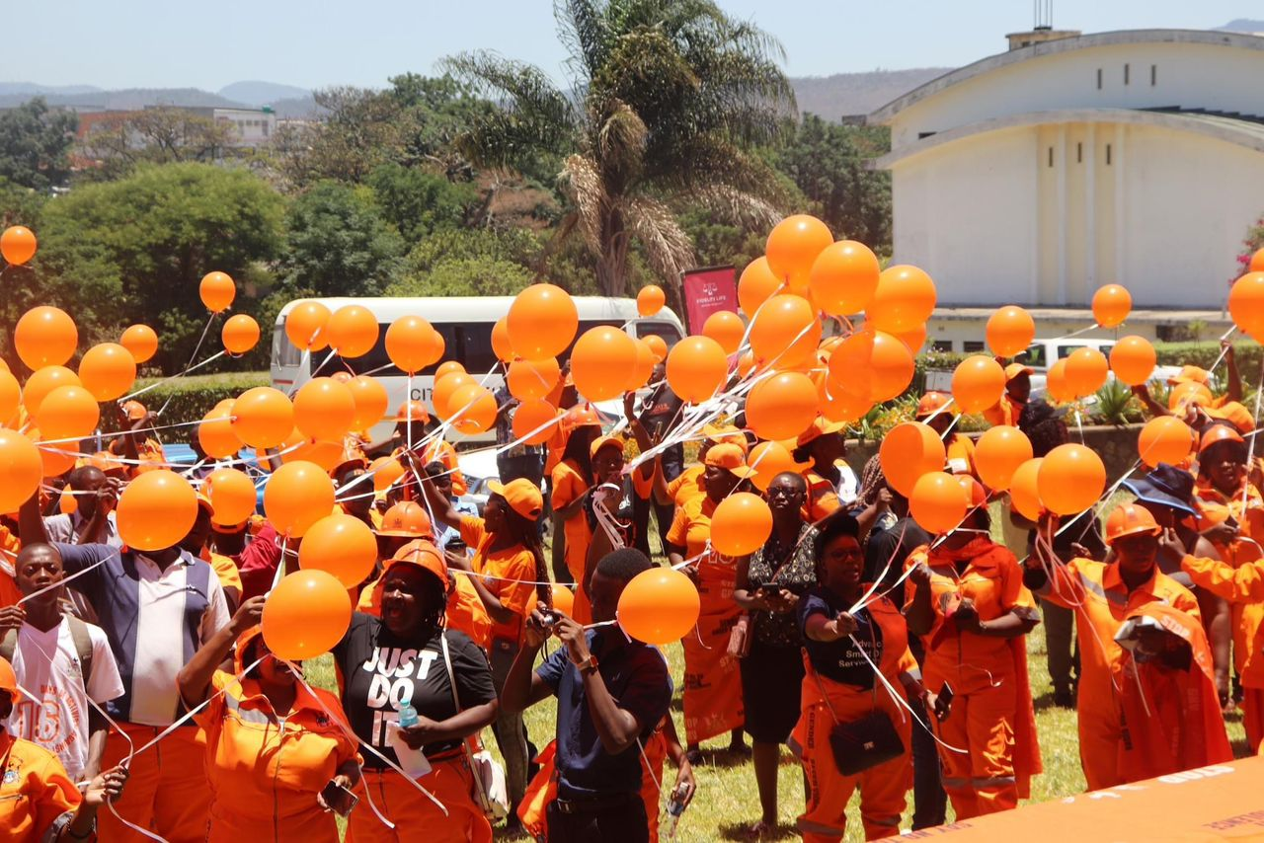
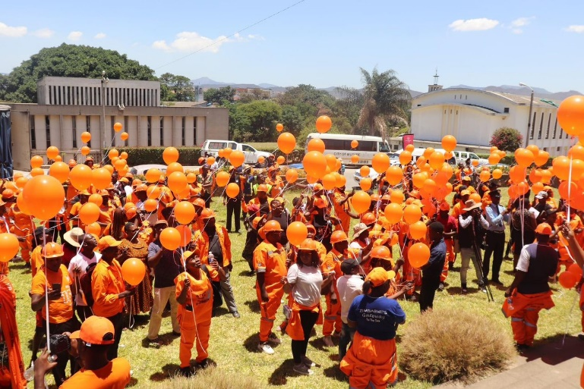

VII. GENDER BASED VIOLENCE- PUBLIC AWARENESS
Baloon release ceremony with balloons that flew away as a way of signifying the fight to completely eradicate Gender Based Violence

Slide 18
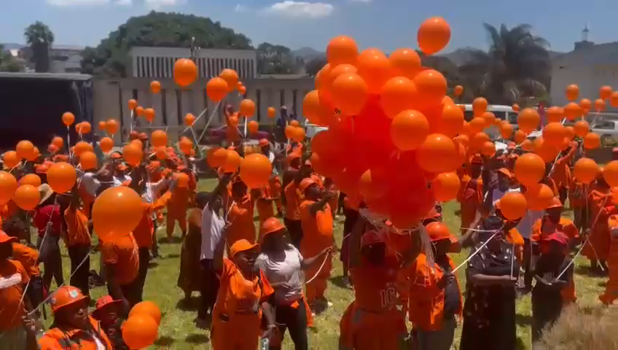
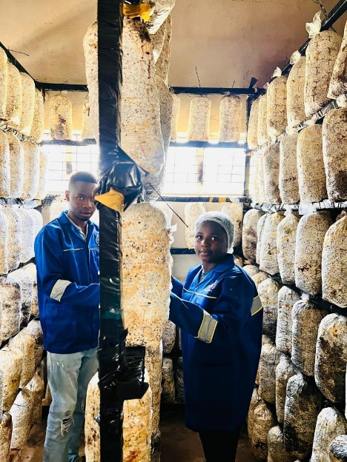
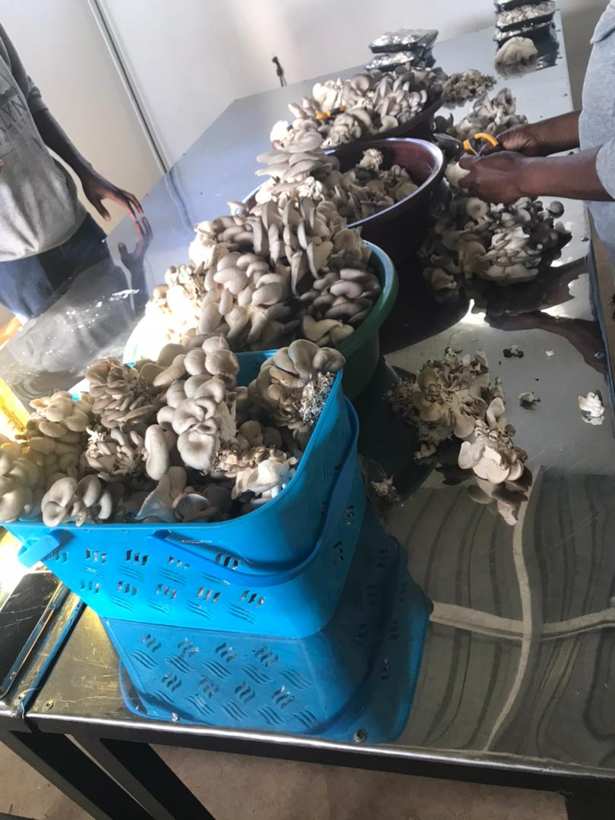
VII. GENDER BASED VIOLENCE-RESPONSE AND COORDINATIONS
Council has a one stop Centre which it runs in collaboration with the MWACSMED and other partners
Coordination of both survivors and perpetrators (were possible) for rehabilitation through Women in Local Economic Development Projects

Slide 19
GENDER BASED VIOLENCE- SUPPORT AND EMPOWERMENT
Supporting through empowerment projects done (WLED projects)
Psycho-social support for survivors
Access to Comprehensive SRHR services

Slide 20
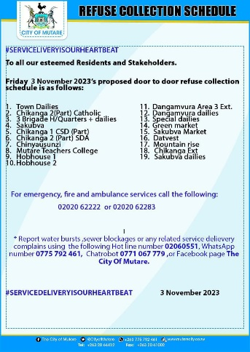
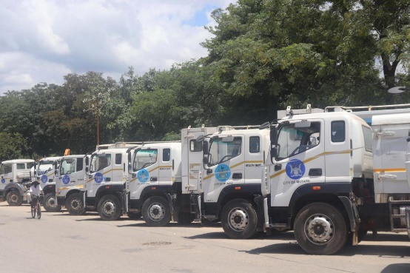
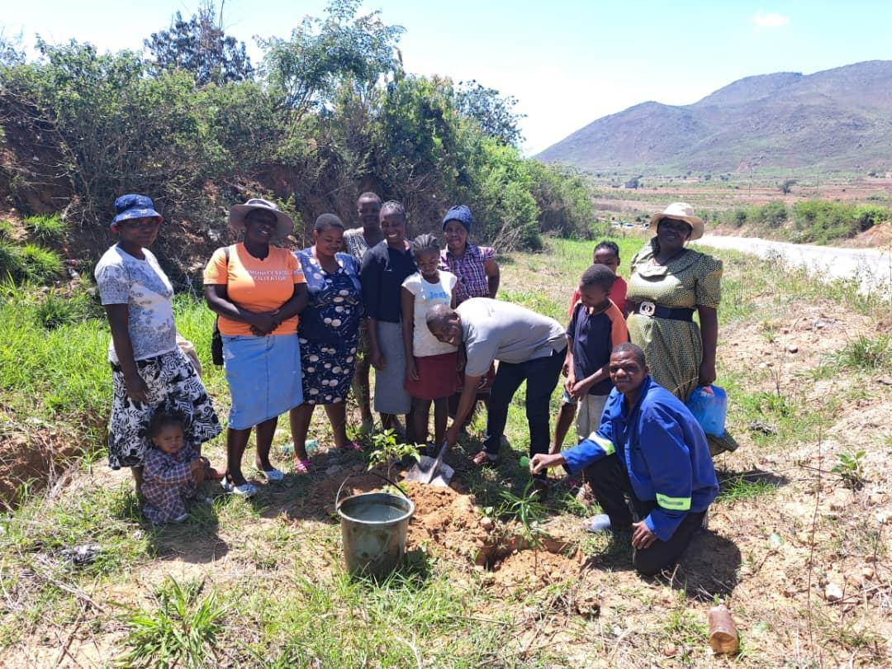
VIII. CLIMATE JUSTICE
Council has a Disaster Resilience Framework which was adopted by Council in 2020
From 2 390 tonnes of solid waste generated per month, Council collects 2280 tonnes (95% collection efficiency)
Council has 14 out of the required compliment of 12 refuse removal trucks and its refuse collection frequency is at 100%
Women Community Based Organisations engaged for street sweeping in all wards (20 people per ward)- refer to Evidence file.
Various Clean Up campaigns held with stakeholders in line with the presidential call
Tree Planting in various Wards- Partnership with Nyaradzo, MaryMount Trs College and Mega Market (Councillors planted at least 10 trees in their wards) (refer to evidence File).
Council in 2023 planted about 3 hectares of trees in Council Schools (Refer to evidence file). Target was 5ha of trees per year as per the Council Strategic Plan.
Anti- Malaria Section responsible for cleaning and clearing mosquito breeding areas
Council came up with a Climate Resilience Water Supply and Sanitation Safety Plan for the period 2025-2075. It was developed in 2023 and 2024
Refuse collection schedule
Refuse Trucks
Ward Based Tree Planting

Slide 21
IX. GENDER MANAGEMENT SYSTEM
Council has a Gender Desk Sub Committee comprising of Departmental Focal Persons from Council’s 6 Departments
The Gender Desk Sub Committee reports to a Gender Management Team which is made up of Departmental Heads.
Council has a made a deliberate decision that all Councillors and Staff are Gender Champions and are responsible for spearheading the gender agenda
The Gender Management Team provides the direction in the formulation of policies, development of indicators of effectiveness and time frames for implementation and monitors the performance of the Gender Desk Sub Committee.
The Council Gender Action Plan is aligned to the Council strategic plan as well as the Council budget (See evidence file)

Slide 22
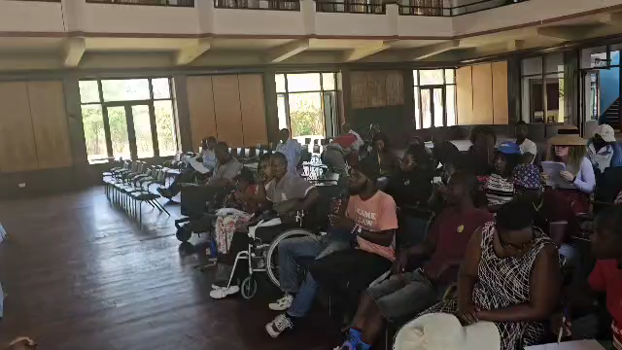
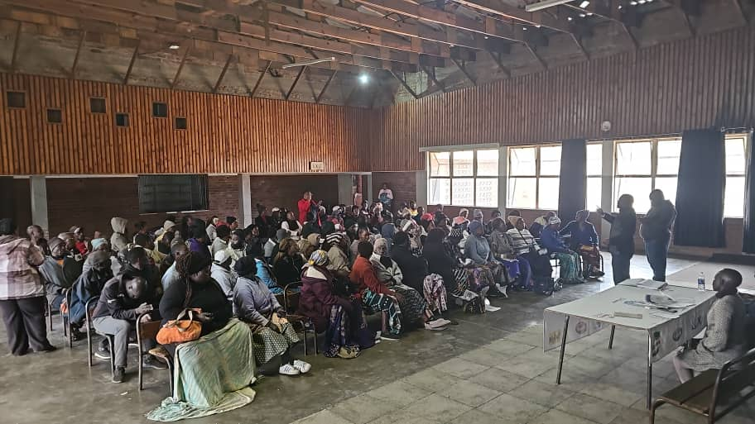
X. GENDER RESPONSIVE BUDGETING
Inclusion of PWDs during Consultations
Council submitted an entry in the GRB category
Council also drew up a GRB statement as per Ministry guidelines (see evidence file)
To address gender equality concerns Council appointed a 25 member budget committee in which all stakeholders are included which include the Youth, Women groups and People with disabilities.
Consultations through various methods such as Whatsapp Chabot, google forms
https://docs.google.com/forms/d/e/1FAIpQLSexMXtfNA0w_otD4Acsl67kcSnsQgKhz3OMhMPc79XTYmijwg/viewform
Council has also deliberately set up a Gender Specific Budget in the 2024 which was at 4 % of the total budget. Programmes such as commemorations, Sexual Reproductive health campaigns, Junior Council, Women in Local Economic Development projects fall under this budget.
Projects within the 2024 budget such as the city Gimboki water project, Construction of Gimboki and Chikanga Primary Schools, construction of a bigger Hobhouse Clinic with a maternity wing, city wide public lighting, construction of the Gimboki Primary School, and the Hobhouse clinic were included in the 2024 budget to specifically cater for social inclusion and as part of Council’s Gender Related budget. The projects will minimize the violation of women, the youth and people with disabilities

Slide 23
CHALLENGES
No control over political parties fielding women to be elected as Councillors given the 30% quota
Non Revenue Water (63.5%)
Illegal Vendors – Informal market

Slide 24
LESSON LEARNED AND INNOVATION
Collaboration with different Stakeholders for easy implementation of programmes
Training of stakeholders on COE processes
Adequate budget for gender specific activities
Record keeping and documentation of events
Continuous training for Council employees and Councillors

Slide 25
SUSTAINABILITY AND REPLICATION
Accountability and ownership by Departmental Heads for effective mainstreaming.
Reviewing of policies and procedures to ensure compliance with national policies on gender issues
Upward review of the gender budget from 1.4% in 2023 to 4% in 2024
Institutionalisation of Gender (Everyone is a Gender Champion)
Twinning with local authorities in the province
Learning and sharing with other local authorities

Slide 26
CONCLUSION
Gender equality is more than a goal in itself. It is a precondition for meeting the challenge of reducing poverty, promoting sustainable development and building good governance (Koffi Annan)

