Slide 1






SADC PROTOCOL@WORK SUMMITS 2024
Climate Change - Solarization of Boreholes in Kadoma
Zimbabwe
Kadoma
11-13 November 24
Charlot Ranganai

Slide 2
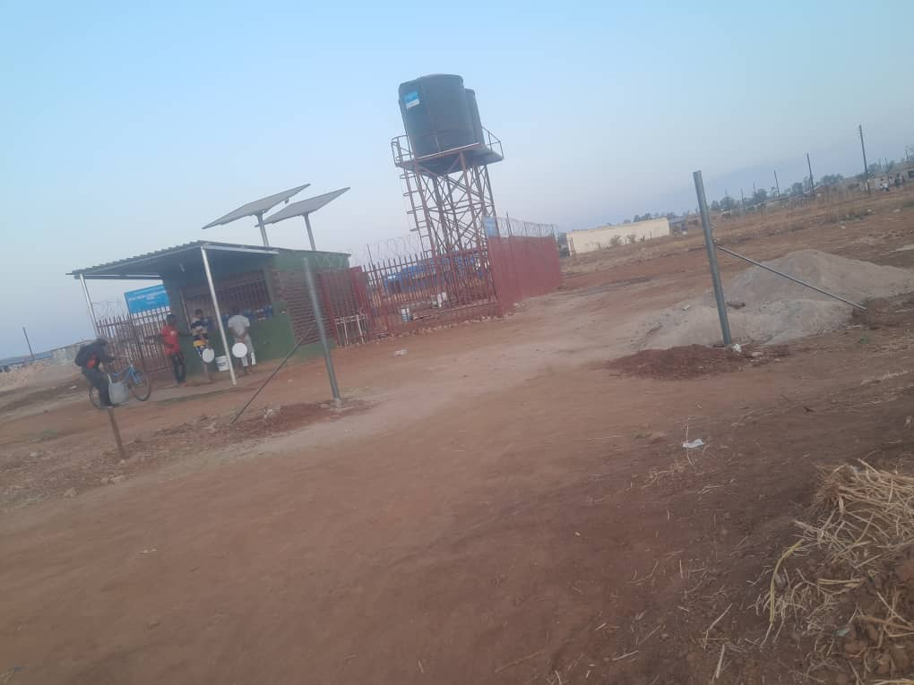
BACKGROUND
Summary
Solarization of boreholes as climate change mitigation strategy.
Problem-Water supply challenges due to power shortages.
Goal -To reduce carbon footprint and enhance water accessibility
Strategies-Technical,Financial, Social, Environment, Climate change mitigation
Strategies chosen
To access to technical expertise and resources.
To empowerment of local leaders and decision makers.
To improved community engagement and participation

Slide 3
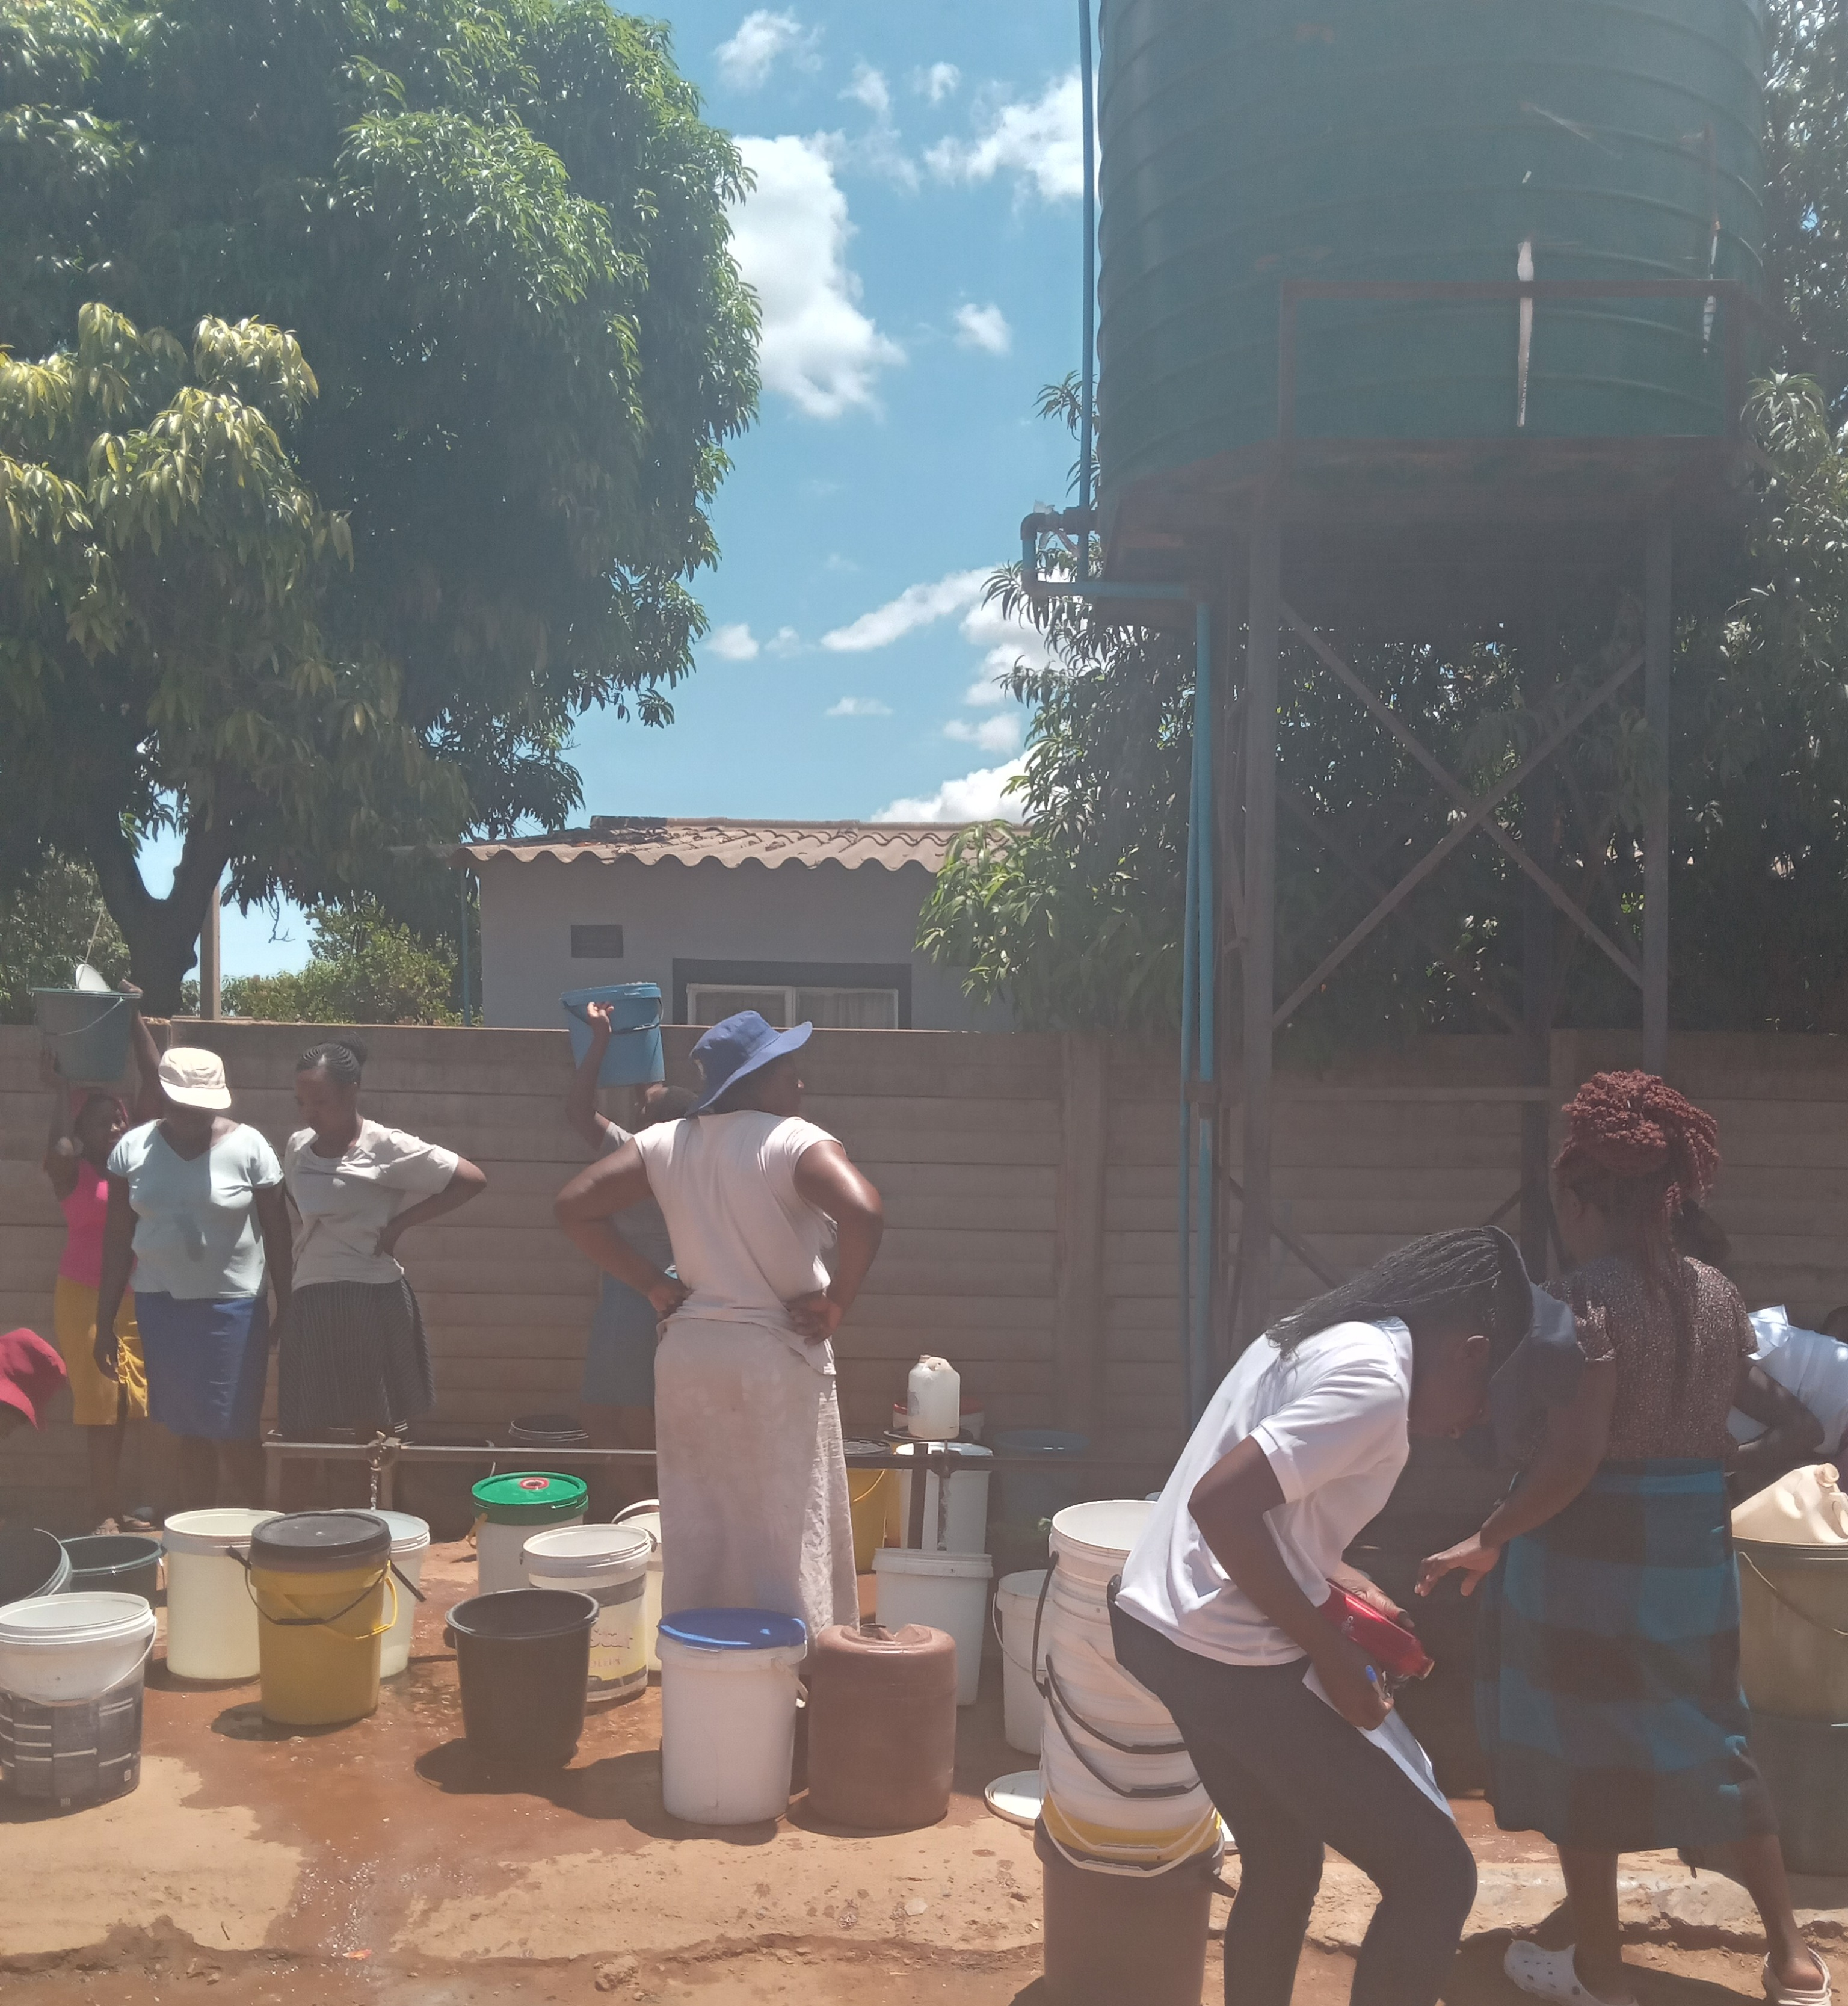
OBJECTIVES
Project Goal
To reduce carbon footprint and enhance water accessibility
Short-term- To reduce carbon footprint from water pumping Long-term- To achieve carbon neutrality in water pumping.

Slide 4
TARGET GROUPS
Targeted group- Women, youths and people living with disability.
Women plays a crucial role for the family and reduced labour burden.
People living with disability - access water without difficulties and improved health and well being.
Youths – Enhanced climate awareness and education.

Slide 5
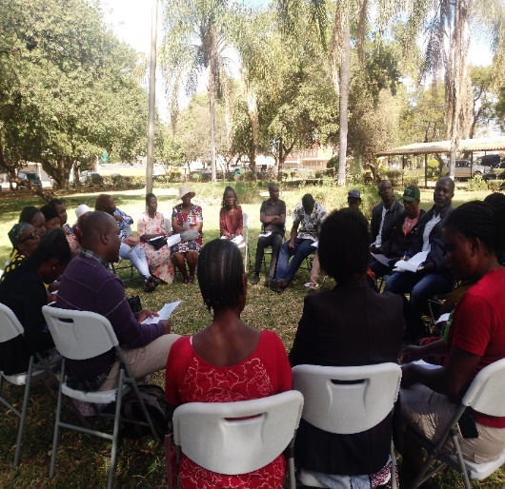
ACTIVITIES
Project activities
Community engagement, training of committee water points and funding for the participants.
Approach – Community based and climate resilient approach

Slide 6
STRATEGIES EMPLOYED BY THE PROJECT
Strategies
Community engagement and awareness campaign.
Conduct a relationship with partners, community and other stakeholders.
Mobilise funding for the participants and trainings of commitee water point and management
Strategies successful-Increased access to clean water and enhance climate resilience.

Slide 7
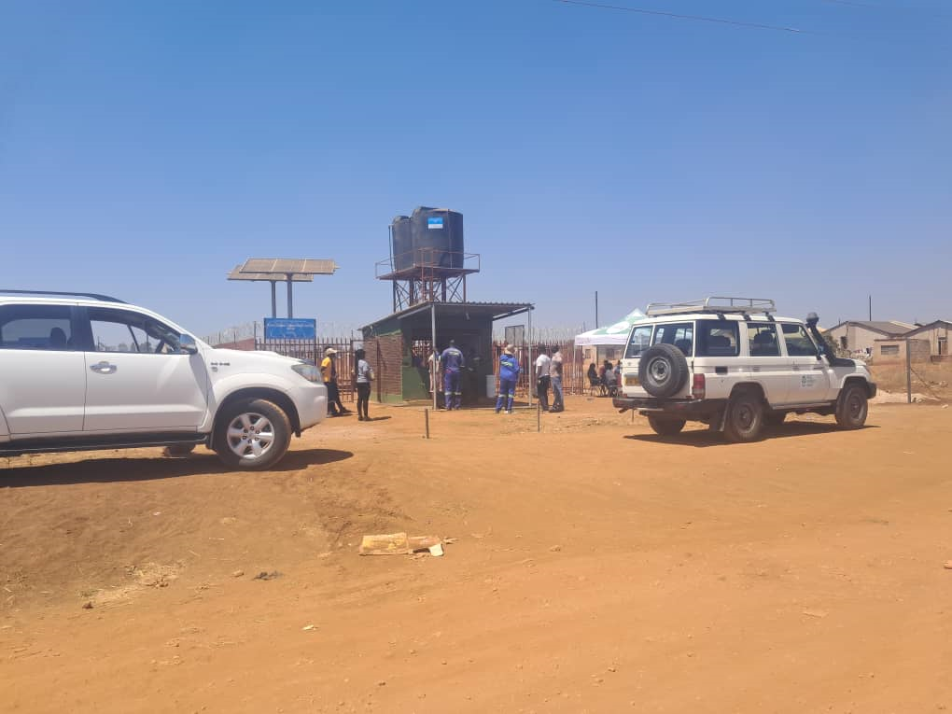
PARTNERS
Yes we work with other partners.
Role-To provided funds, equipment and formulation and training of committee water point management.
Yes partners will continued engaged

Slide 8
BUDGET
 | Amount in $
Gender specific allocation | 0
Gender in mainstream projects (please specify) | $31875
Amount contributed in cash or in kind by partner organisations (please specify) | 0
Other sources (please specify) | 0
Total | $31875

Slide 9
PARTICIPANTS
Category | Women | Men | Total | % Women
Direct participants | 8500 | 500 | 9000 | 77%
Indirect participants (e.g. through other networks) | 0 | 0 | 0 | 0
Online participants (e.g. website access, mailing lists, scholarly articles) | 0 | 0 | 0 | 0
Total | 8500 | 500 | 9000 | 77%

Slide 10
CHALLENGES
Challenges
Technical capacity constrains
Climate variability and uncertainty
Social and cultural barriers.
Lesson learned
To continue engagement with community, community leaders, partners and stakeholders.

Slide 11
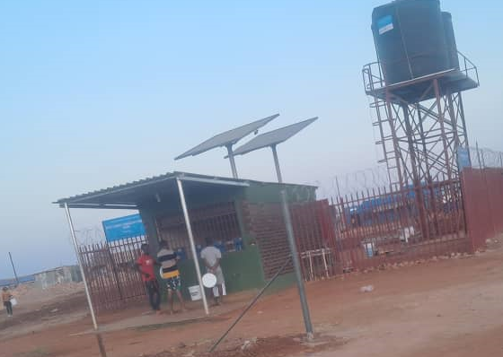
RESULTS
Short term impacts –
To reduce carbon footprint from water pumping
Improved water quality and increased access to clean water
Long term impacts
Environment
Social
Economic
Policy and regulatory impact
Project responding to:
Women’s empowerment –Increased access to clean and reduces women’s workload
Public participation-Community engagement and awareness campaign
Media coverage (including social media)-Social media campaigns
Capacity building- Training on solar-powered water pumping systems and climate change adaptation
Changes in gender attitudes
Individual level- Increase confidence and self esteem among women and to increase access to education and trainings.
Community level- Improved social cohesion and community engagement and reduce gender stereotypes and biases.

Slide 12
LEARNING
Project Key Lessons
Community engagement and participation are crucial.
Climate resilience design and construction are vital
Engagement with community and provide trainings.

Slide 13
MONITORING AND EVALUATION
Monitoring
Tracking temperature changes,
Fluid monitoring,
Geophysical monitoring,
Borehole logging
Surface monitoring and data acquisition and analysis
Types of monitoring and evaluation methods and tools
Monitoring- Water quality testing, Regular monitoring visits, Climate change resilience assessments, energy efficiency assessments.
Evaluation- Social impact assessments, Impact evaluation, Outcome evaluation, Process evaluation.
Tools- Indicators, data collection methods, remote sensing and GIS, Stakeholder engagement, Reporting and dissemination

Slide 14
SUSTAINABILITY AND REPLICATION
Work Sustainability
Funding mechanism
Climate change adaptation and resilience frameworks
To provide water management team and trainings.
Cascade to other organisation
To build relationship with partners, community groups, and engage with government agencies and ministries.

Slide 15
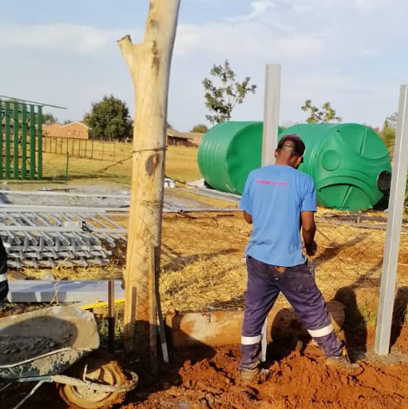
NEXT STEPS
Key priorities going forward
To continue community engagement and awareness
Monitoring and evaluation of solarised boreholes
To developing climate resilience infrastructure.

