Slide 1




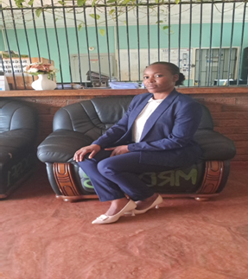
SADC PROTOCOL@WORK SUMMITS 2024
SRHR, GBV, and Climate Change Categories Template
(ZIMBABWE, MANYAME, 27/10/24 and PATRICIA TEKEDE)
Quote: “Our prime purpose in life is to help others. And if you can’t help them, at least don’t hurt them.” Dalai Lama

Slide 2
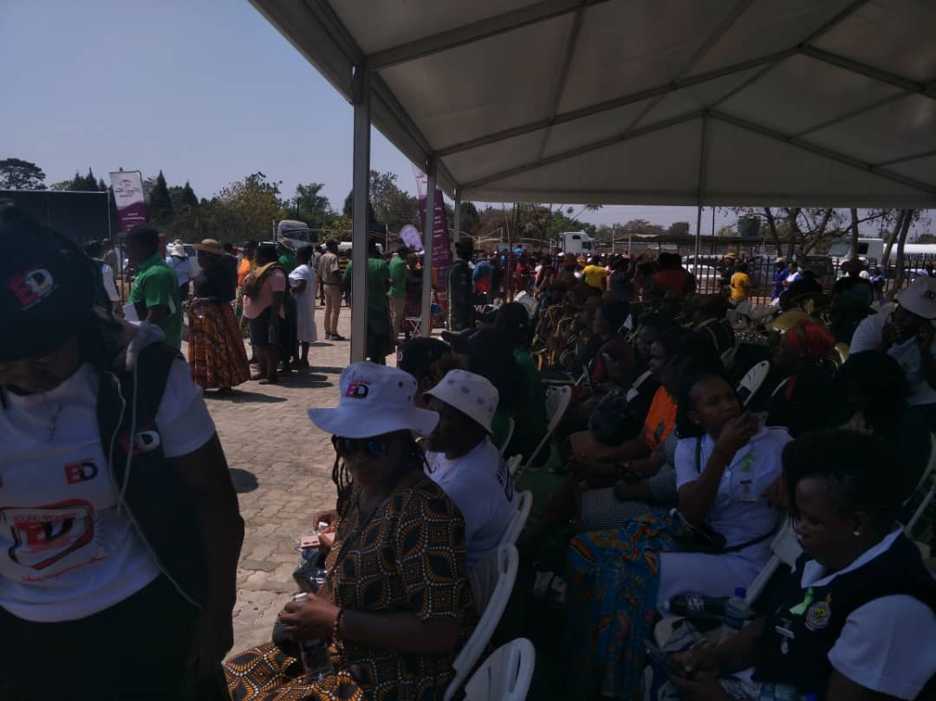
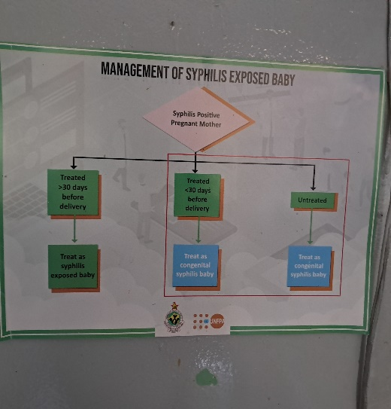
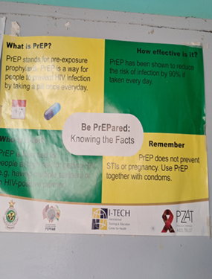
BACKGROUND
Brief summary of the project.
Sexual Reproductive Health and Rights has improved access to affordable primary health services by girls, boys, men and women in Seke district in recent years.
Necessitated by awareness campaigns, trainings and dialogues.
Results:- Clean environments and safe water, safe maternal health, healthy eating lifestyles, well informed society.
Improved access:- menstrual health, male circumcision, maternal health, diagnosis, treatment and counselling on and HIV/AIDS, and sexually transmitted diseases, immunizations, mental health
Results:- reduced severe illness and death, teenage pregnancies, child marriages, school dropouts.
What is the problem being addressed?
Lack of access to health service delivery affected maternal services. Travelling long distances to access medication, limited use of contraceptives, unwanted pregnancies.
Religious, social and cultural practices increased negative attitude medication.
Inadequate trainings on sexual health information.
Increased child marriages, menstrual stigma and discrimination, antenatal and post-natal challenges, unsafe sex, spread of diseases and increased infant mortality deaths, School dropouts
What is the goal of the project?
To improve the health and well-being of the community through provision of quality and affordable health service.

Slide 3
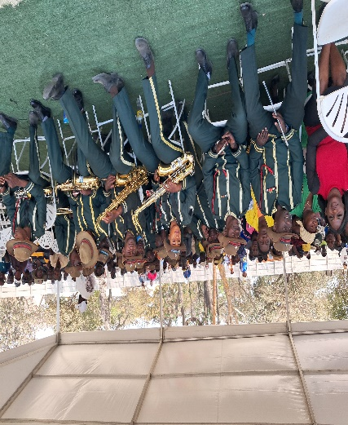
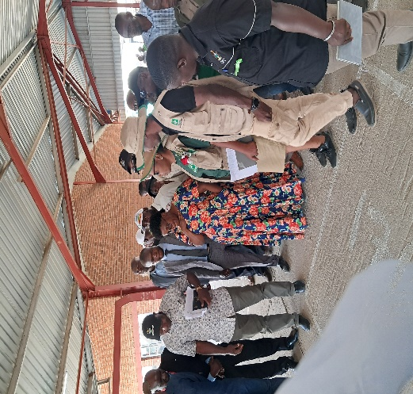
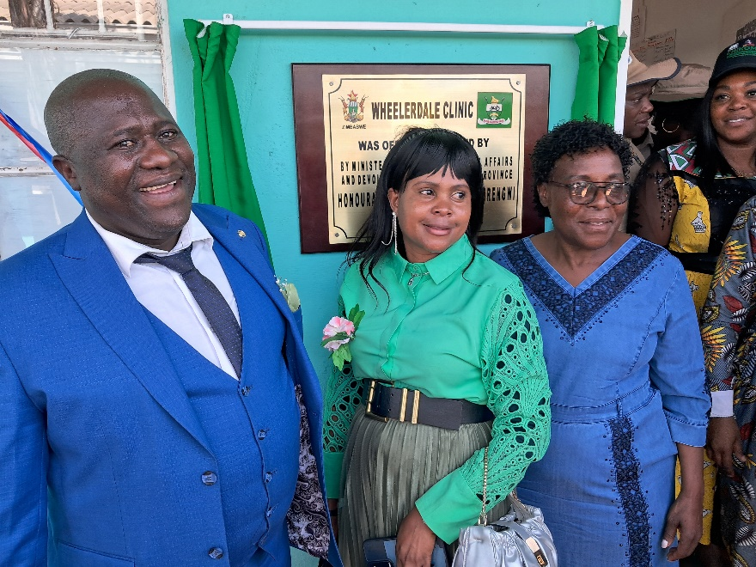
STRATEGIES
What strategies are being employed to address the problem?
Why were these strategies chosen?
Preventative, curative, palliative, rehabilitative
Community engagements – Community health workers help in educating, direct service provision, identify needs, problems, causes of teenage pregnancies, child marriages.
Educating communities- mobilising community leaders, support adolescent
Policy Advocacy- support legislation against early marriages, abortion (rape pregnancies) promotes women leadership and reporting abuse.
Education and awareness campaigns- Empower individuals to make informed choices, disseminate information, healthy relationships.
Integration of services- Outreach programmes:- peripheral patients access testing, counselling and treat, condoms and contraceptives distribution thereby reducing unwanted pregnancies and child marriages. Immunizations: measles.
Construction of clinics, mother’s shelters – Improves access to health facility, reduces pre-natal and post-natal deaths. It also helps boost breastfeeding support, addressing specific complications, promotes women empowerment and community projects ownership.
Youth friendly services- counselling, contraceptive options to reduce unintended pregnancy and sexually transmitted infections among women girls, men and boys.
Stakeholder collaboration - Enables sharing objectives, resources and maximise outcomes, improves accountability, participation and equity.
Trainings – Help manage information gaps, promote awareness, provides feedback and guidance, responsive, adapt to new ways.
Technology- telehealth improves access, information, and connection

Slide 4
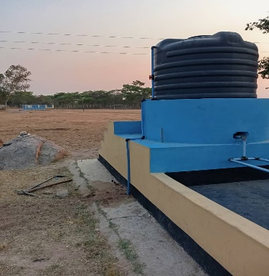
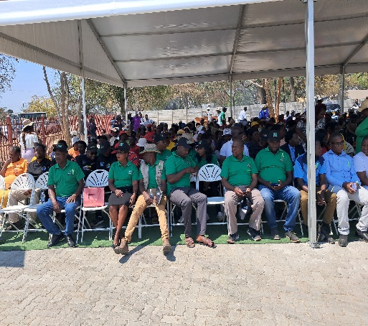
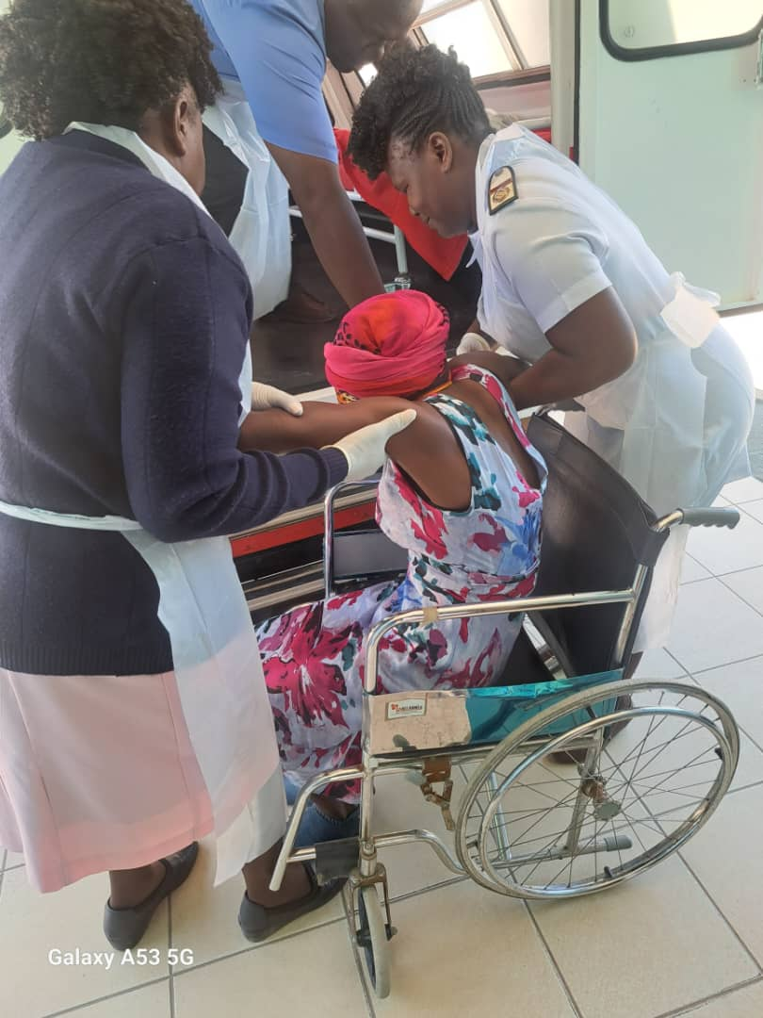
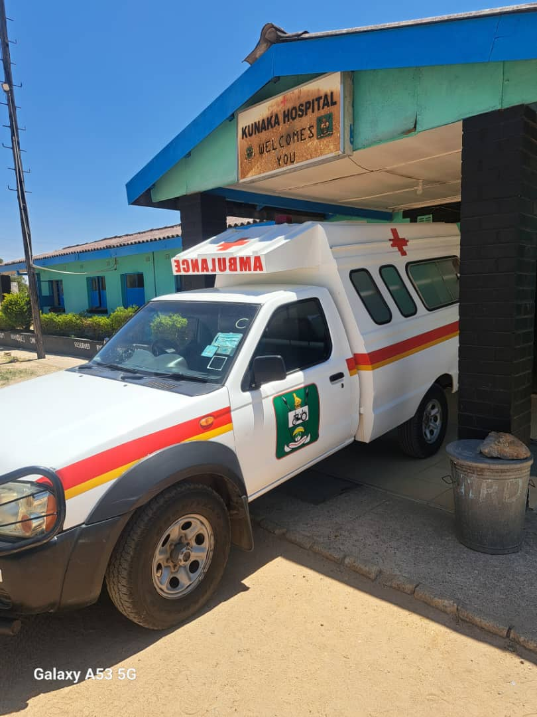
OBJECTIVES
What did the process/project set out to achieve?
Short-term and long-term objectives
Increase access to services- sexual and reproductive health services including family planning, maternal health care, safe abortion services, initiation of ART, follow up Visits, treatment of ailments, - reduce health risks and improve outcomes, Matera school pipes water scheme.
Raise awareness and education -On contraception, sexually transmitted infections like syphilis, healthy relationships, particularly targeting adolescents, drug and substance abuse
Engage communities- Build engagements and support for SRHR initiatives through mobilising leaders and stakeholders. To advocate for SRHR and services fostering a supportive environment for individuals to seek care.
Strengthen health systems: Improve the capacity of health systems to deliver quality SRHR- training health care providers such Health Centre Committee, Village Health Workers, establishing protocols for service delivery, ensuring availability of supplies, disabled. MRDC ambulance
Addressing Gender Based Violence:-Immediate efforts including preventing, responding to GBV. Providing spacing for survival and providing them with necessary health services and support.
Gender Equality: – Promote gender equality and empower women and girls through making decisions about their own bodies, as well as reproductive rights which is so fundamental to gender equality.
Collect data and Monitor: Establishing mechanisms of data collection and monitoring for effectiveness- tablets for EHTs,

Slide 5
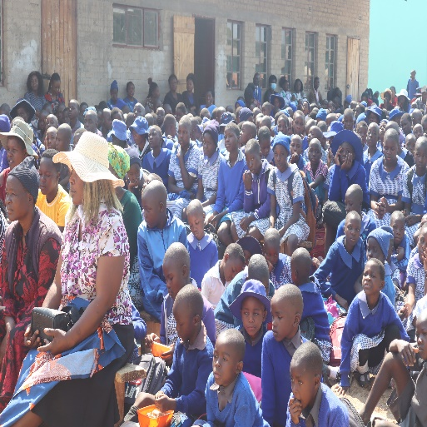
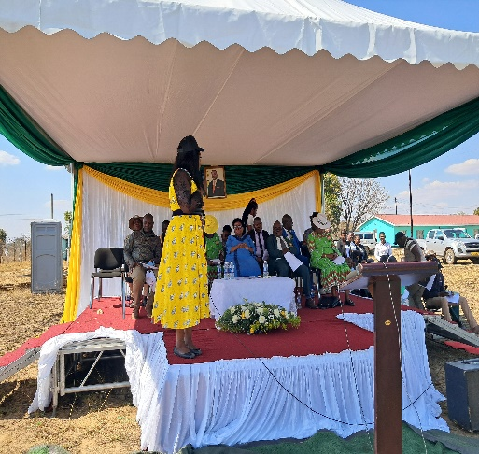
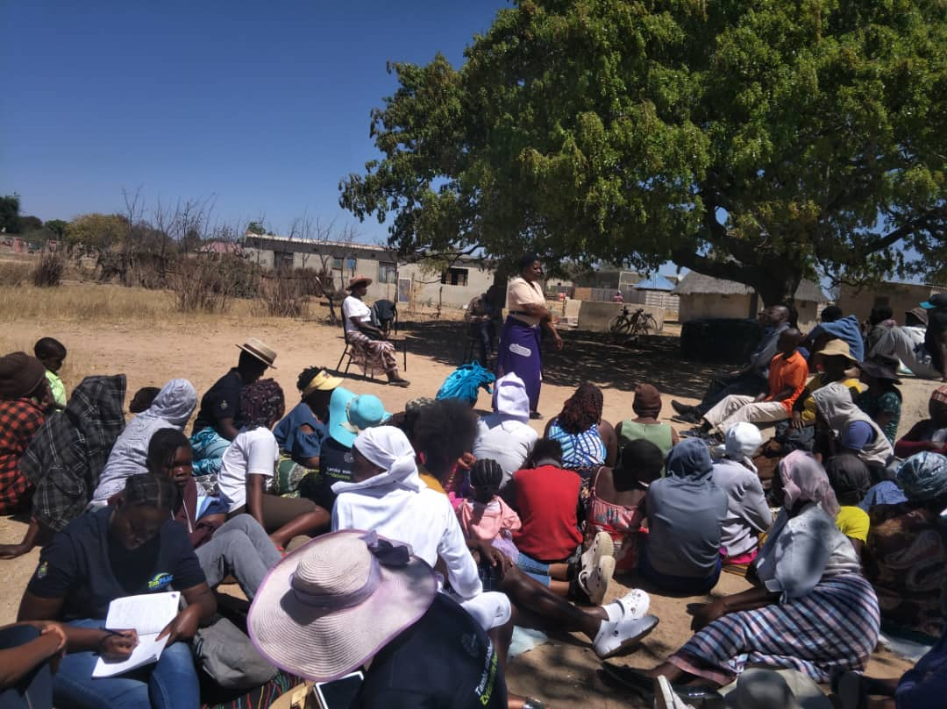
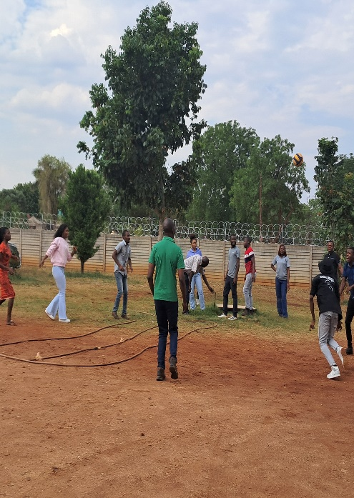
TARGET GROUPS
Who is the target group?
The target group are the youths, young women, boys, girls, young men and women
Why did you select this group?
Preventing adolescent health issues: HIV/AIDS, most do not consult family physicians for concerns about substance use, sexual health, personal or emotional problems – Kudyarawanza Primary School
Empowerment and support: through education, achieve their full potential in seeking care, support, control sexual and reproductive health, make informed decisions on their bodies –responsibility.
Addressing unique needs: Young women-Unintended pregnancies and STIs. Young men-guidance on responsible sexual guidance and consent, GBV mainstreaming, Ward 19
Comprehensive sex education: Helps understand sexuality, relationships and reproductive health, essential for overall development and well being, reduce risky behaviours and promote healthier choices. Sports day, MRDC employees
Reducing healthy disparities: School based, community based, health care for all their ages better positioned to meet the needs of young men and women, regardless of their background.

Slide 6
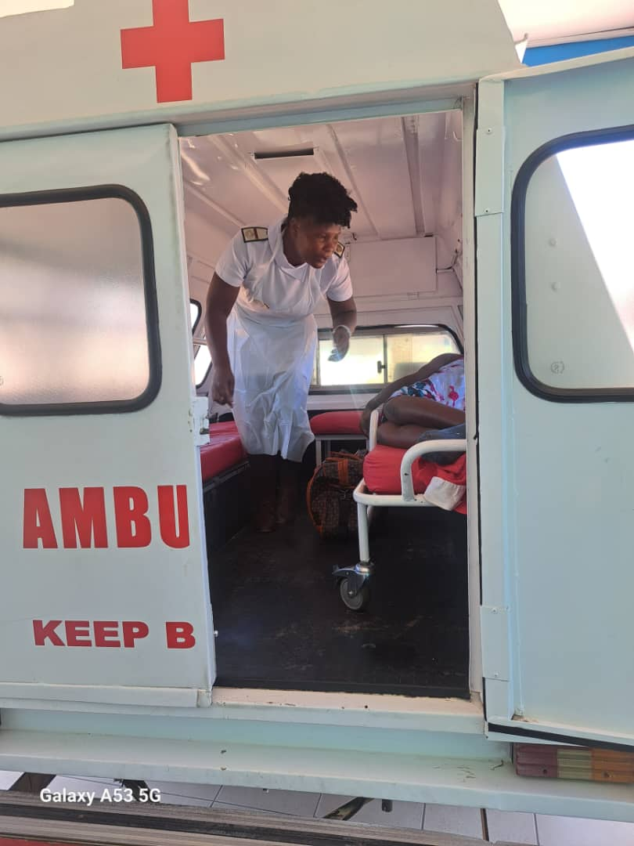
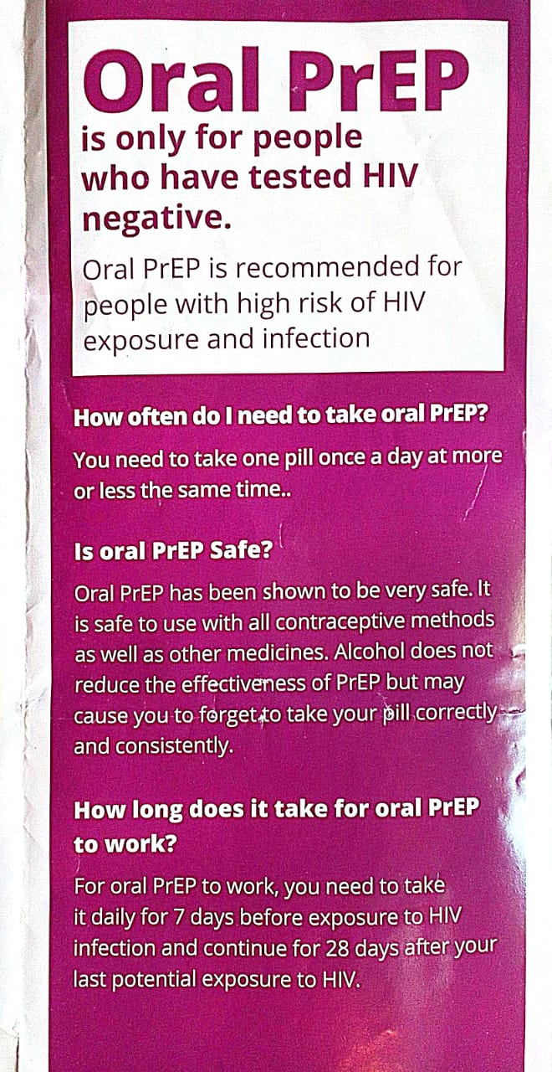
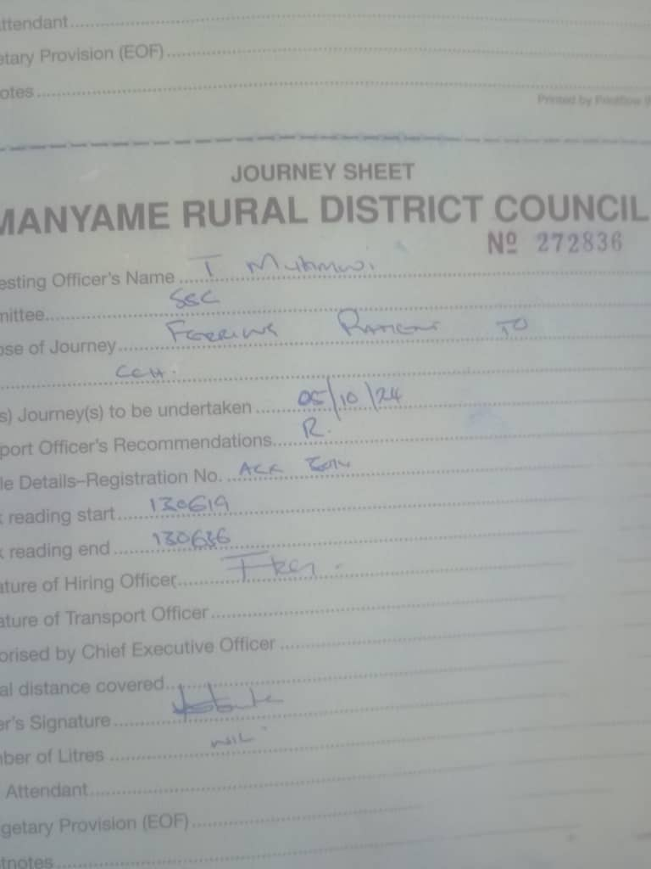
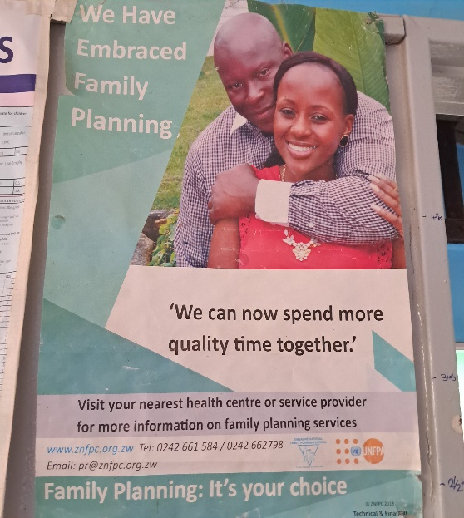
ACTIVITIES
            Describe the project activities and approach to achieve the desired results.
Whole of society approach was implemented: addresses broader determinants of health: physical, mental and social wellbeing. Designing plans tailored to specific communities for effectiveness.
Home and community-based care- Helps professionals engage directly with patients in their own environments. Enhances, accessibility and, understanding background
Telehealth Services- Reach out to patients remotely, providing consultation services and follow ups for programs such as male circumcision, breast cancer treatment, HIV and Aids. Ongoing care management improves the health outcomes.
Outreach programs- Helps to provide services to hard-to-reach areas at the periphery of the district. Prevention services such as male circumcision, voluntary Counselling and testing for HIV and Aids, thereby respecting rights to equality and non- discrimination.
Addressing Social Determinants of Health such as education and sanitation health awareness in schools helped reducing pregnancy, and spread of sexually transmitted diseases, HIV/AIDS and having pregnancy and responding to disasters or emergencies
Health Worker training - Ensures the health providers know and respect the diverse patient’s backgrounds, leading to patient satisfaction, adherence to treatment plans and incorporation of the marginalised.
Construction of clinics - provision of locally available materials increases project ownership. Engagement of health centre committees enables mobilising of funds for mothers’ shelters.
-Use of data and technology – Efficiency and effectiveness is enhanced through leveraging data analytics and technology in service delivery. Helps to keep track of trends, predict health outcomes, be able to tailor interventions.
Conducting support visits – Enhances patients’ safety, maintains standards and compliance.

Slide 7
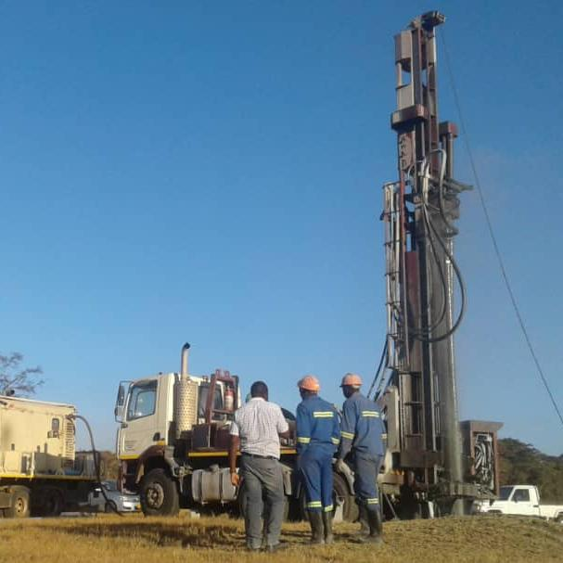
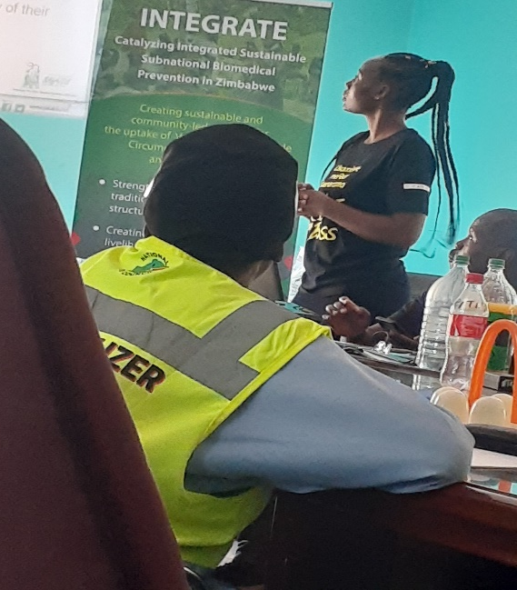
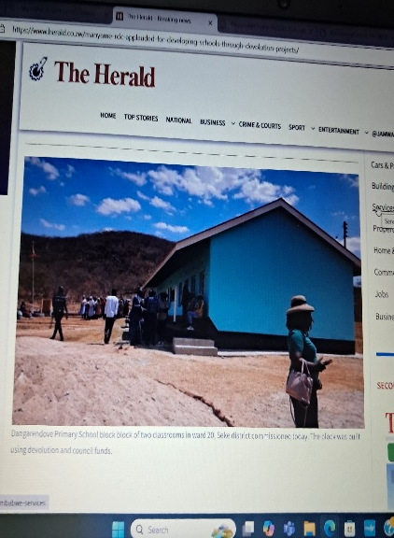
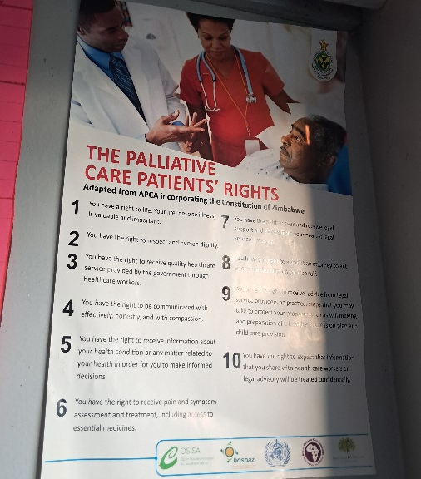
STRATEGIES EMPLOYED BY THE PROJECT
What strategies were employed by the project?
Creating an enabling environment – To promote access to services, and information. Use of local languages, sharing new policies and laws.
Conducting awareness campaigns on SRHR
Formation and activating community and school Health clubs
Conducting outreach programs - reach the periphery areas, involves tailoring messages to meet unique needs of populations.
Activating junior councillors programmes- Awareness on Sexual Reproductive Health and Rights, clean up campaigns, motivation speaking during assemblies
Infrastructural development:
Construction of classroom blocks - improve access to education. Reduce walking distances and improve girl attendance, reduce early marriages,
Construction of clinics improve access to health services, promote maternal health care
Capacity building - community and health personnel
Provision of clean and safe water and sanitation facilities - basis for a healthy community- Chief Seke Homestead Drilling
How successful were these?
Infrastructural Development – Construction of Dangarendove Primary School
Behaviour change amongst women, girls, men and women
Helps learning through peers and friends and stay away from drugs
Reaching the most peripheral communities, improving access
Testimonials on abandoning use of drugs and substance abuse
Healthy lifestyles, making choices on reproductive health
Adopting new ways of contraceptives- Jadel, loop,
Venturing in sport – implementing youth sports programs
Improved standards of living

Slide 8

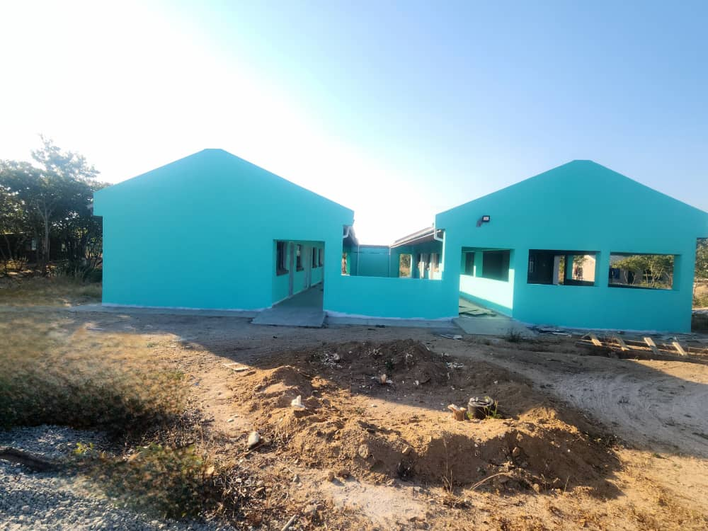
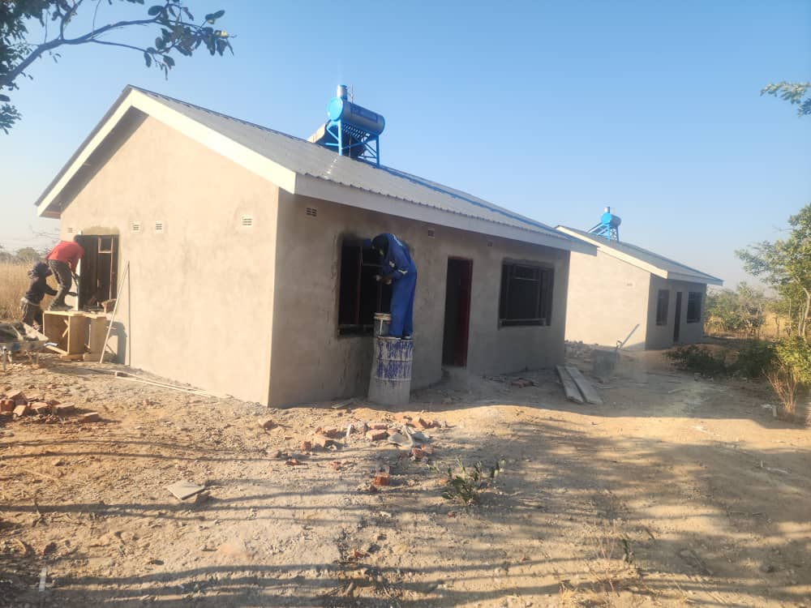
PARTNERS
            Did you work with any partners in the implementation of this programme?
            YES. We worked with Ministry of Health and Child care, Ministry OF Women Affairs, Small and Medium Enterprises Development, Zim- Tech, SAFAIDS, community
            What was their role?
            Promoting collaboration, partnerships and networking with government ministries, - Bwoni clinic and staff house construction
            Discussing sexual practices and condom use for both male and females
            HIV testing and offering counselling services
            Attending to physical and emotional GBV clients and counselling them
            Screening for sexually transmitted diseases and attending to those with positive indicators
            In school HIV AND GBV prevention sessions
            Economic strengthening activities- ISAL training
            Program coordination activities- polio campaigns, district meetings, national health related commemorations
            Mainstreaming gender, drug and substance abuse
            Will you continue engaging partners existing and or new?
            We will continue with this organization in implementing Sexual Reproductive Health and rights in the district.
            However, Council appreciated more and more

Slide 9
BUDGET
 | Amount in $
Gender specific allocation | 103 000
Gender in mainstream projects (please specify) | 70000
Amount contributed in cash or in kind by partner organisations (please specify) | 5000
Other sources (please specify) | NIL
Total | 178000

Slide 10
PARTICIPANTS
Category | Women | Men | Total | % Women
Direct participants | 3000 | 1800 | 4800 | 63
Indirect participants (e.g. through other networks) | 500 | 150 | 650 | 77
Online participants (e.g. website access, mailing lists, scholarly articles) | 800 | 400 | 1200 | 67
Total | 4300 | 2350 | 6680 | 207

Slide 11
CHALLENGES AND OVERCOMING THEM
What have been the main challenges?
Lack of adequate financial resources - Finances have not been adequate to enable completion of projects construction as planned, to train health personnel, stakeholders and the community on reproductive health. To overcome this Council would budget and fund projects and programmes. Partnerships with development partners necessitated distribution of sanitary wear and capacity building programmes. Council would drill boreholes, repair and train water point committees. Addressing this needs increased budgets on SRHR
Stigma and discrimination – Victims of Gender Based Violence have been reluctant to access health service. Women and girls have not been speaking out on Gender Based Violence. Awareness campaigns have been conducted with stakeholders such as the Zimbabwe Republic Police, Ministry of Health and Childcare, Department of Social Development. Awareness campaigns help understanding and accommodate all
Legal and Policy Barriers- Contraceptives and safe abortions have been applicable to certain age groups. In addition, this applies only to patients with specific reasons abort. Awareness campaigns, partnering with legal experts to explain to increase awareness.
Culture and Social Norms- They have influenced the attitudes towards sexual and reproductive health leading to resistance. Engagements continue to be done with community leadership to encourage use of medication. Continuous engagements with community leaders is vital.
Community apathy- Negative response including non- attendance to meetings, provision of local materials. Community engagements IS essential.
Donor Syndrome- Communities expect Council and partners to provide for all the materials then handover a complete structure to the community. Continuous engagements and education ensures that they understand their role.
Access to services- Factors such as geographical location, transportation, financial constrains limit women to attend health programs. Construction of more health centres is the way to go.
Medical mistrust- Results in reluctance to participate in health programmes. Awareness campaigns encourage active participation, adoption of new methods
Lack of tailored programs- Those that address specific preferences of women fail to attract different age groups. There is need to tailor programmes according to communities so as to zero in
Competing Priorities- There is not separate gender desk to attend to problems submitted. There is need to establish gender officers to

Slide 12
lessons, applying learning
Education is key in Sexual Reproductive Health and Rights as this ensures knowledge to prevent, seek appropriate medication, live a better lifestyle and stick to medical guidelines. Educating communities through trainings, look and learn, site visits, information sharing, workshops is ideal.
Lack of knowledge on SRHR by young women and girls - there is need to strengthen the rights and improve access through construction of more clinics in the marginal areas. There is need to use modern contraceptives, ante-natal visits to increase survival.
Women empowerment- There is need to increase commitment to deliver empowerment programmes.
Lack of reporting of Gender Based Violence - There is need to strengthen the law enforcement, legal and justice systems so as to timely address Gender Based Violence matters.
Lack of capital for businesses- There is need to encourage dual home ownership so that women can access loans to start businesses.
Weak referral pathways -Need to support the safe shelter and referral pathways to deal with perpetrators and also provision of medication to the victims
Severe impact of GBV- Reducing risk of GBV through provision of mental and psychological services.
Weak communities - There is need to improve the social determinants of health such as clean and safe water and education.
Emergency Services – Attend to in the shortest possible time.
Screening, testing and counselling- conducted for diseases such as HIV and Aids, Tuberculosis.
Increased access to maternity services- Women now access antenatal and post-natal care, screening of cervical cancer, making choices on contraceptives. Need to increase mothers shelter,
Access to information- now have important information through Wats Up, Face - book, websites
Need for more Counselling services- For Gender Based Violence survivors. There is need to provide services through skilled personnel in order to save lives and handle difficult situations. Engage partnerships in health service delivery like NGOs

Slide 13
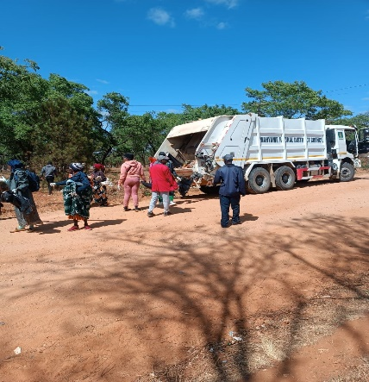
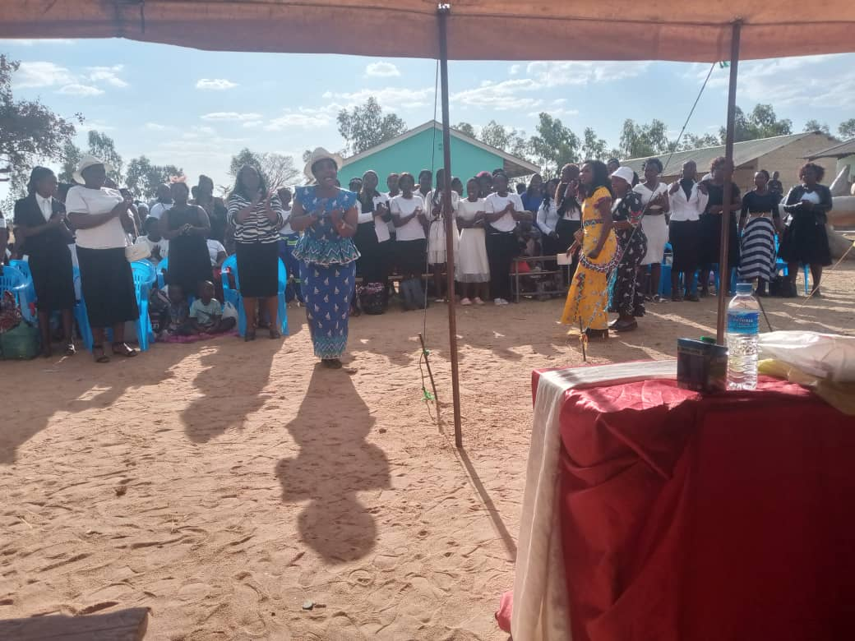
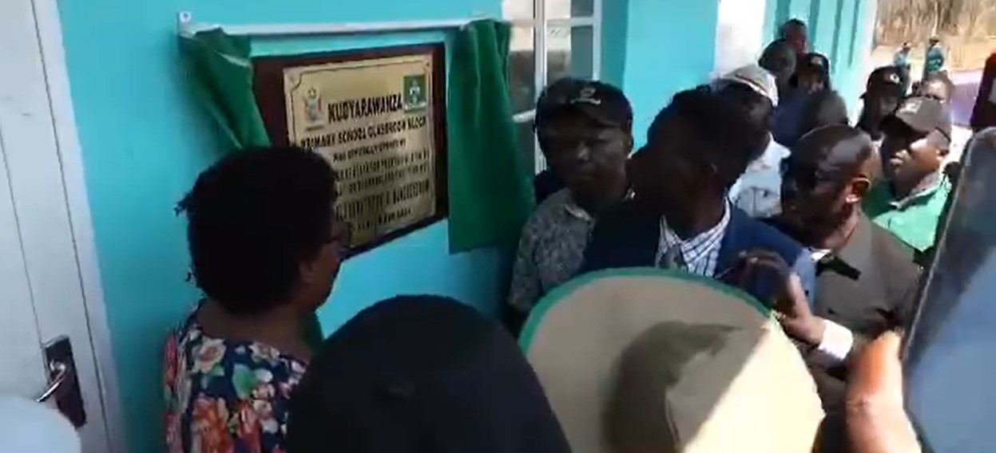
RESULTS
Please share some of your results:
What are the short-term and long-term impacts of the project?
Improved Health Outcomes- reduced morbidity & mortality rates, prevention of lifelong complications for mothers and infants, enhance workforce productivity, reduce absenteeism thereby benefitting the economy, clean up campaign, Beatrice Township, Kudyarawanza Primary school
Economic Benefits – economic stability by reducing the burden of illness, increased attendance to work
Social Determinants of health- better education achievements, skilled personnel, income opportunities
Long term care and support- nursing homes and community –based settings, appropriate support as they age.
Addressing Health Disparities –address health disparities amongst populations, related to race, status, geographic location.
How is the project responding to:
Women’s empowerment –Trainings, sharing information, making decisions.
Public participation – women, girls, now active in health services initiatives- attending meetings, financial support- family day celebrations
Media coverage (including social media) – Council gets on limelight during official openings on health and educational facilities.
Capacity building – Holding meetings, workshops with health service providers.
Changes in gender attitudes at individual and community level – boys, men, women and men have improved attitudes in a positive way to embrace SRHR in the community

Slide 14
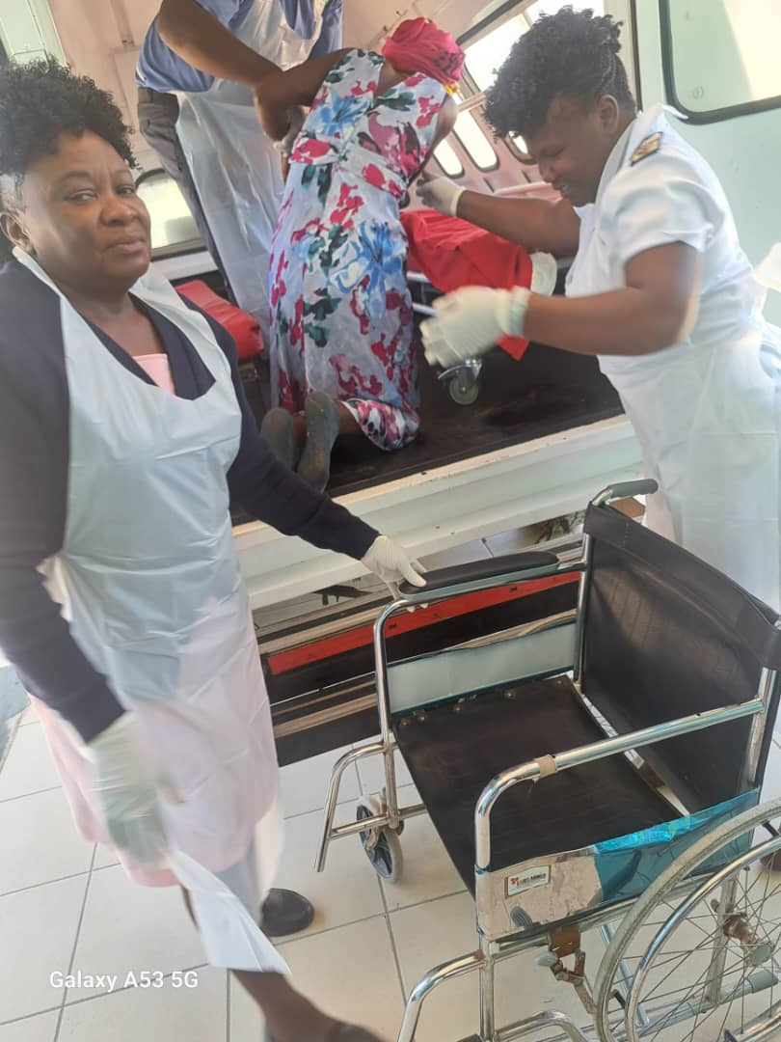

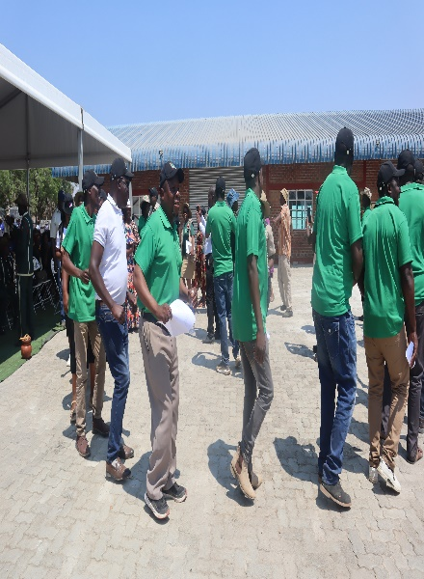
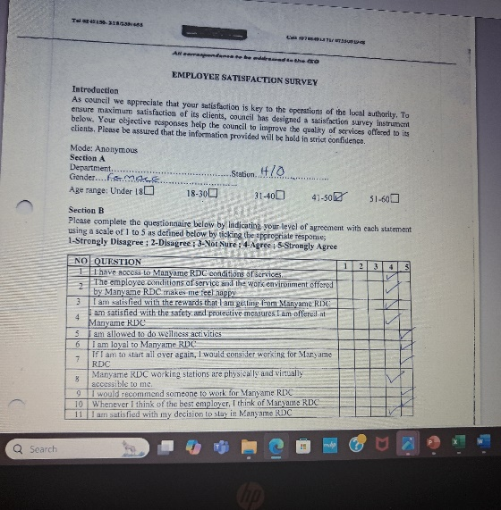
LEARNING
What are the key lessons from this project/practice?
Women and girls are the vulnerable members of society who need empowerment through work spaces, Guzha fresh market shade,
Performance based incentives for staff,
Women and girls training and mentoring on income generating projects
Data feedback, monitoring and creating and implementing standard operating procedures
How will you apply the lessons going forward?
Provision of market stalls to promote decent work places.
Providing decent accommodation to the nurses, logistical support ( fuels)
Responding promptly to their needs-construction of facilities, water, repairs,
Providing toiletries, stationery,
Training staff on ease of doing business and good customer service, Regular support visits and feedback meetings
Engagements of community leadership is essential for project completion

Slide 15
MONITORING AND EVALUATION
How do you monitor the success of the project?
Development of plans and goals - This included formulation of the annual plan and identifying all activities, partners, involved, timeframe for activities and the funding. The plan incorporates activities such as GBV sensitization campaigns, celebrating the International Women's Day, committee meetings, Activating the junior councillors, summit meetings.
Implement plans- Checking plans against planed human resources, materials, finances, partners and time frame.
Management, committee and full council meetings help track progress made through reports compiles and this provides a picture of what Council has managed to do and areas that need more efforts.
Site Visits- Taking initiatives to visit the clinics helped to monitor the state of buildings, progress on construction and repairs, situation on water and sanitation.
Participation - SRHR programs ensured getting to who what is best, where to improve.
Surveys- Conducting client satisfaction surveys ensures that the organization gets feedback from clients and work on areas that need improvements. Online surveys were conducted to ensure privacy.
Tools used to measure impact include:
Plans - Strategic, annual and monthly
Meeting minutes -Management, Committee and full council
Reports - Weekly, monthly and yearly
Surveys - Online Survey questions
Social Media - comments section and What's Up platforms

Slide 16
SUSTAINABILITY AND REPLICATION
How can the work be sustained/kept going?
Embracing policies and procedures- Gender, sexual harassment policies to guide on mainstreaming gender in the organization, focusing on processes and procedures such as recruitment and selection, promotion, allocation of resources.
Embracing Structures – establishment of Gender Champion, Gender committee, Gender Focal person and departmental focal persons.
Organizational framework- The organization should be adaptive and resilient through continuous learning through trainings and workshops, and adapt to the need to improvements in order to respond to healthy needs and environmental conditions.
Regular meetings- keeping track of the service, to monitor compliance, strict adherence to procedures, having updates, feedbacks, queries and respond to these.
Trainings/ Workshops- Provincial chapter meetings, district meetings
Exchange visits and summits- Inter districts, Provincial and International forums to learn how others are managing
Value based care- To focus on the quality of the services so as to improve healthy
Focusing on prevention- A clean environment is the cornerstone of a healthy system: clean and safe water, healthy diets, no garbage environment, drug and substance abuse,
Support Visits- To get to the grassroots and have physical awareness of how things happen at the clinic and provide fuels, repairs, electricals, stationery, toiletries, clean and safe water.
Health Staff motivation- facilitate for home ownership, repairs of dilapidated houses, facilitate repairs when needed, stands allocation
Environmental Considerations: There is need to assess and minimize the environmental impact of the healthcare operations for sustainability. These include reducing waste and energy consumption, contributing to a healthier planet and population through proper waste management strategies – proper pampers disposal, safe clean water sources, proper faecal disposal methods.
Peer Based Models – Peer based Models, which facilitate training, educating, and support peers, fostering trust among participants.

Slide 17
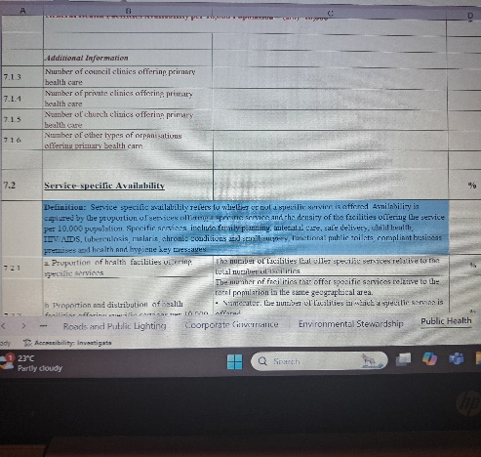
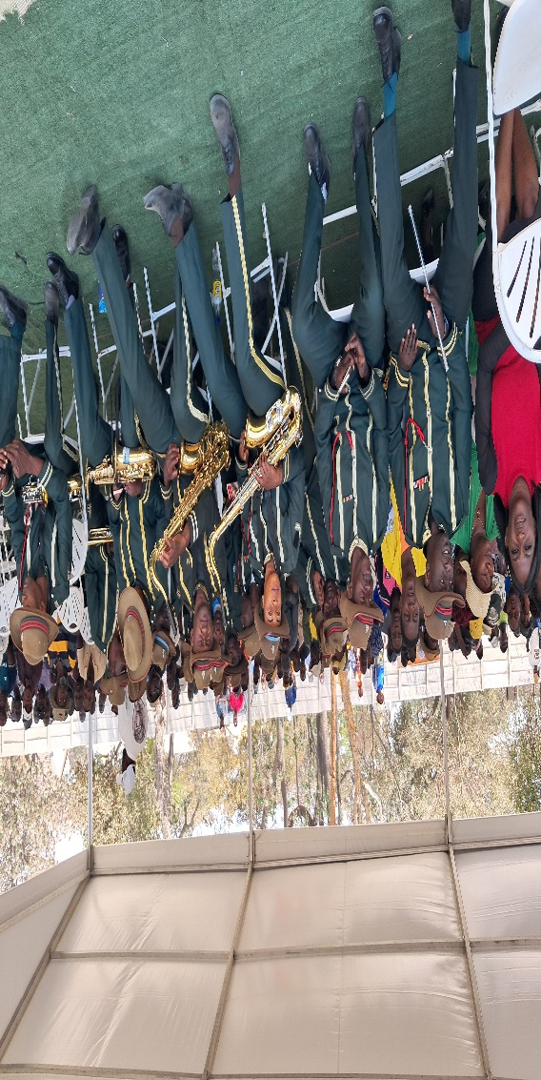
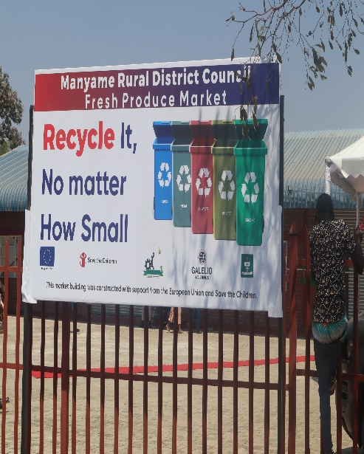
NEXT STEPS
What are the key priorities going forward?
Engagement of men and women- to encourage participation, in Reproductive Health Initiatives to improve gender equality
Climate change and SRHR- Becoming increasingly important, as impact affect sexual reproductive health, especially among vulnerable communities.
Universal access to services – SRHR to be a top priority, address stigma, discrimination.
Integrating SRHR into broader Health Frameworks –to ensure visibility and importance of SRHR within public health agendas, ensuring that the issues are prioritised along side other health concerns.
Research and Capacity building – Training of health service providers on SRHR, community and Health Centre Committees, Gender focal persons
Addressing neglected areas- adolescents, those in conflict areas
Awareness campaigns – GBV, prevention, cure, counselling
Partnerships- Building coalitions in health service delivery
Look and learn programmes – Councils, inter-districts, provincial and nations
Addressing neglected areas -
Include evidence here – photos/clippings

