Slide 1




PROMOTING GENDER-INCLUSIVEE LOCAL ECONOMIC DEVELOPMENT IN ZIMBABWE
Business name : Clothing and cosmetics
Participant name: Belindah Katambi
Council : Municipality of Kariba
Please include photographs of the business!

Slide 2
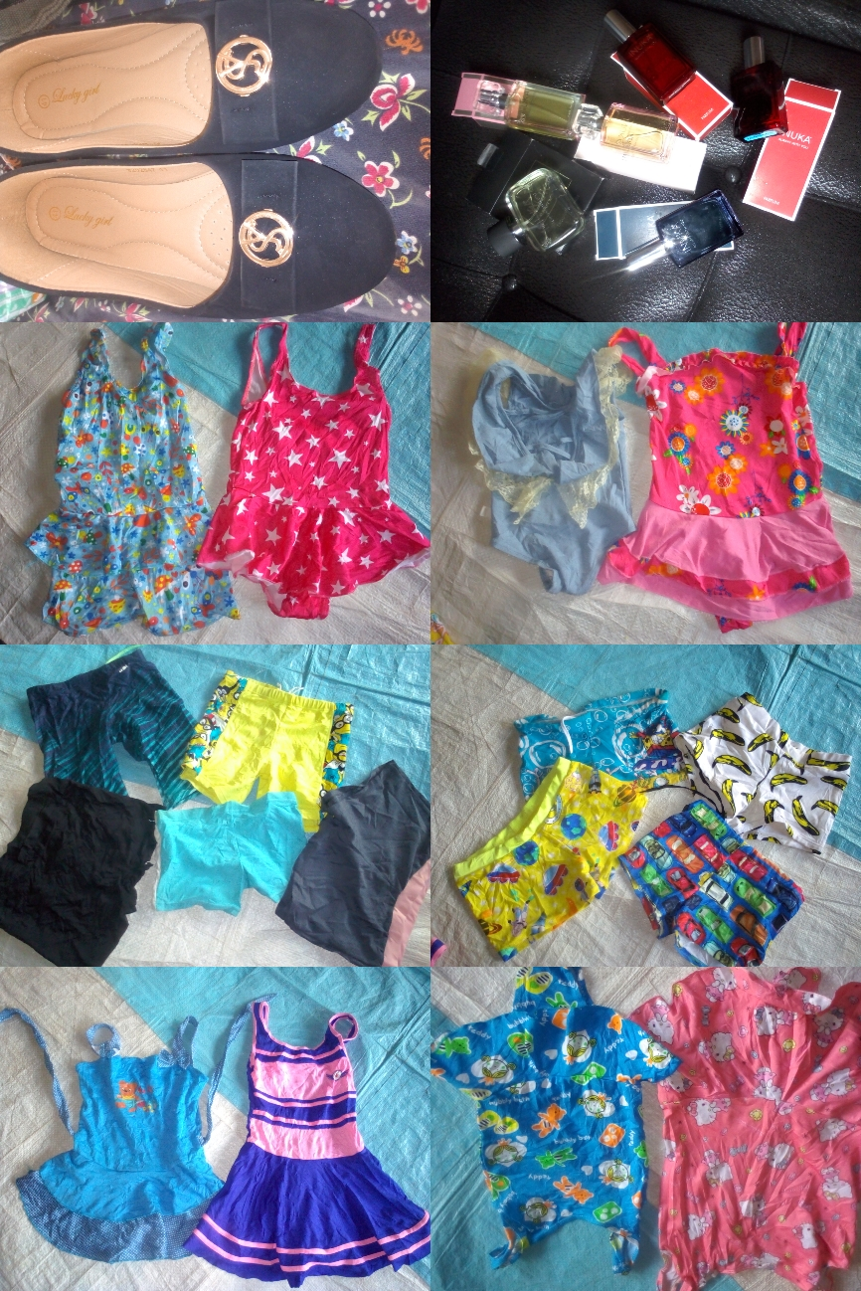
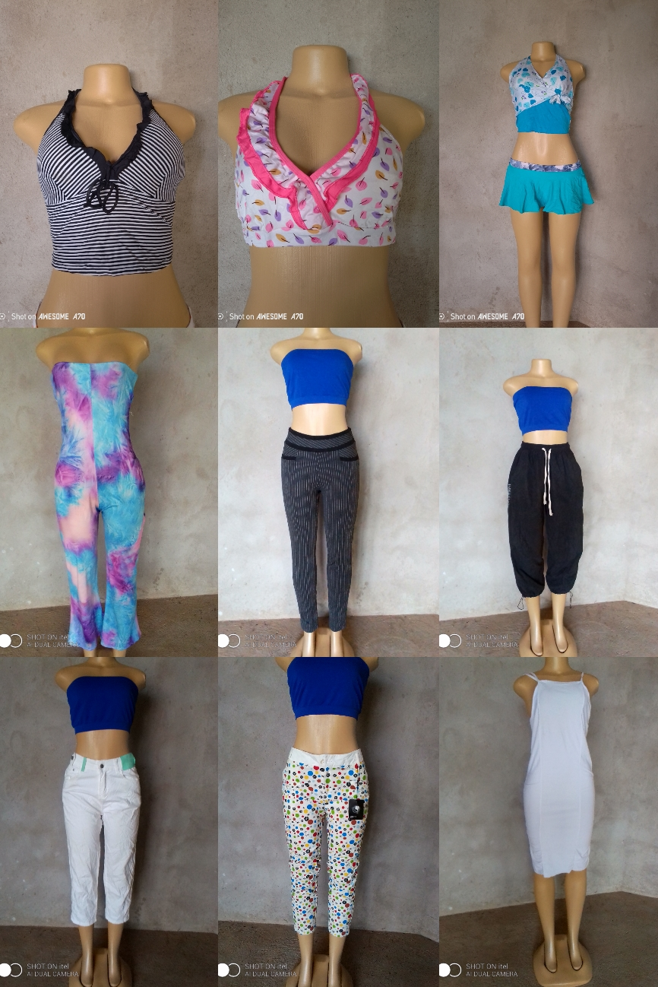
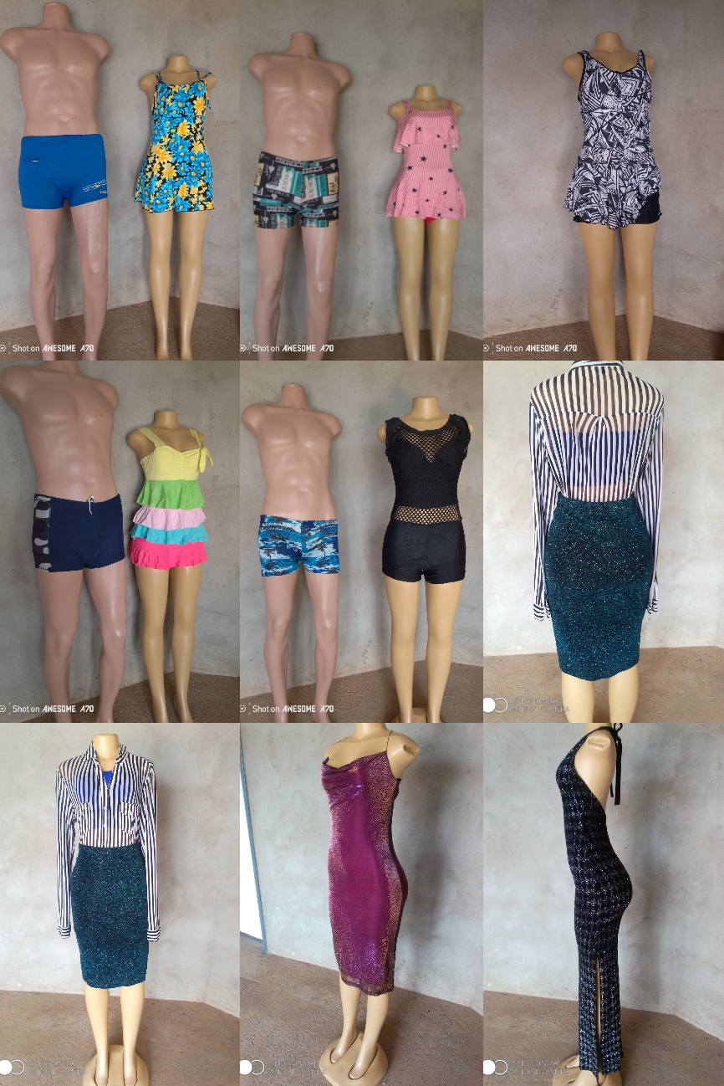
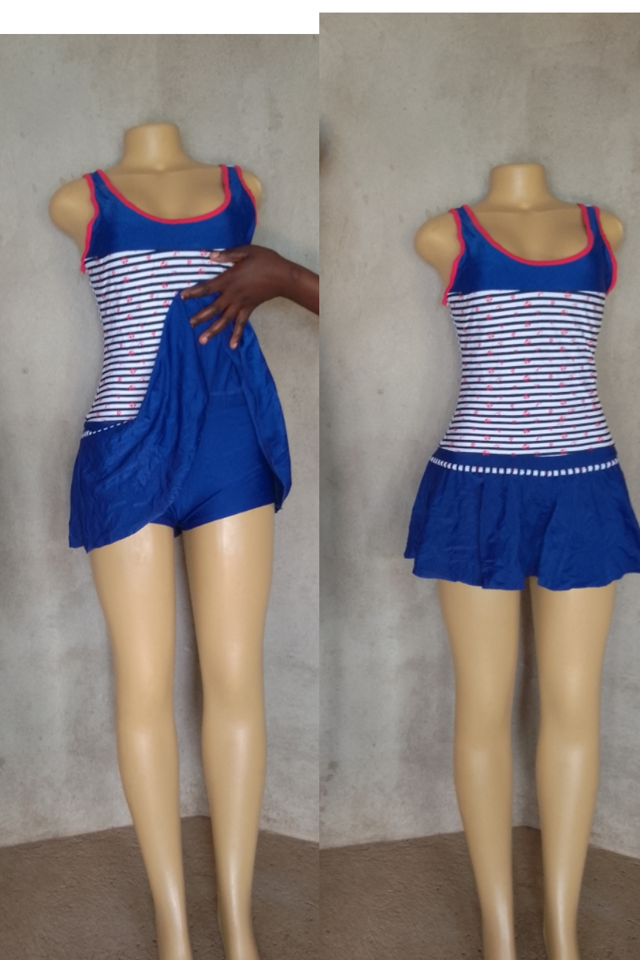
PLEASE DESCRIBE THE BUSINESS

Slide 3
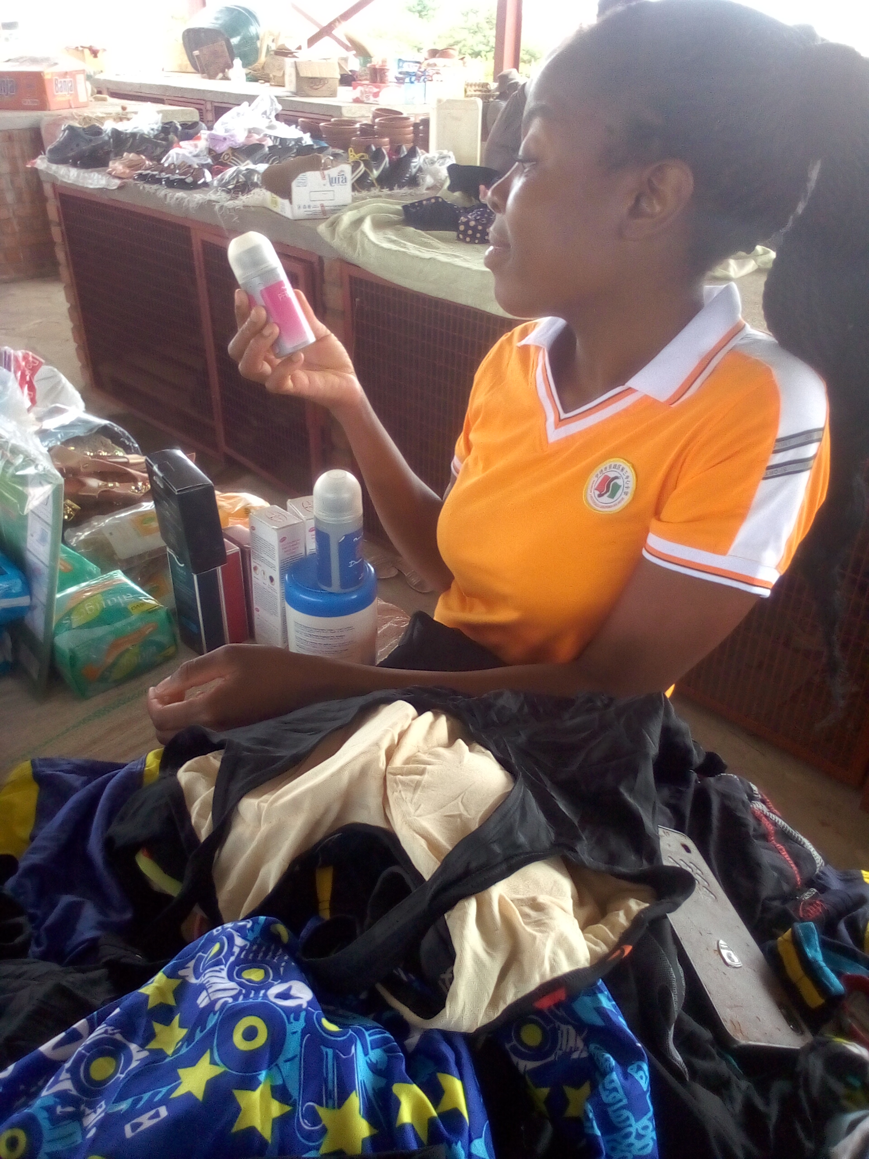
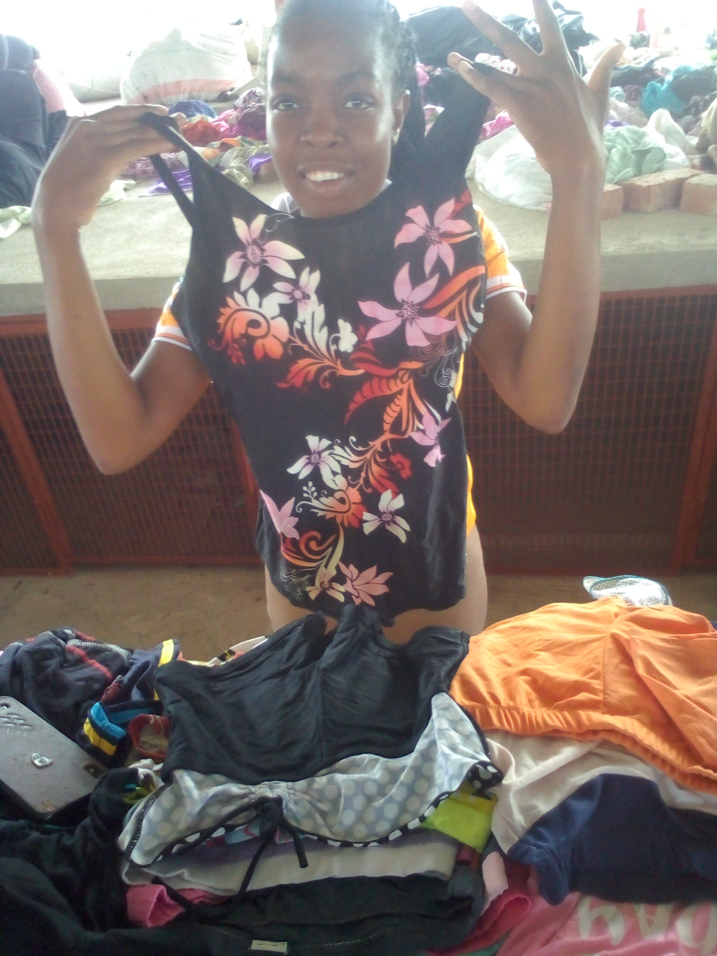
CUSTOMER BASE?
My customers as a beauty and cosmetics and clothing are the young and adults .. School children for swim wear
Ever since I started LED I have become more confident in running the business in terms of advertising that more and more customers are based on online marketing
So social media is my strength and being available at the market all the time to meet up with the customers

Slide 4
COMPETITION
The competition I have are the other boutiques and other residents around the market
Despite of having that challenge I came up with a strategy to provide good quality of goods and also affordable at the same time by having different wholesalers from which they order

Slide 5
NEW PRODUCTS OR SERVICES?
I have introduced more female products because it's on demand and some hygiene products since they are needed day by day
The products are at very high demand because these are day to day needs
I advertise my products through social that is WhatsApp group that I have created , Facebook, Instagram and by carrying some samples when I leave home

Slide 6
QUALITY AND PACKAGING
My customers are really happy with the products because they are legit and all cosmetics are clinically tested so they don't have side effects. Clothes are of good quality
I don't have any branding because I order finished goods already

Slide 7
BUSINESS MANAGEMENT
For the mean time I don't have any staff still mananging on my own
Mananging my stock has become easily because I am now writing everything down having a business plan ,so I do monthly stock take and to calculate the expenses and profits. I have been pricing up because from where I order my stuff it's very cheap and affordable that if it comes here in town the prices are still okay for customers

Slide 8
FINANCIAL MANAGEMENT
I have a record keeping book for my business of 11 months from the Capital , expenses and Income
It's really helpful to have a record keeping because it helps to plan the future,to know what is going on, for accountability and money coming in and out of the business
I don't have a bank account yet for my business

Slide 9
SAVINGS AND SELF SUFFICIENCY
I am not yet a member of any savings group but I am currently doing my own savings. I have managed to raise $300.
Now am now able to participate in monthly groceries as a family and to help to pay some bills at home

Slide 10
INCOME AND EXPENSES FOR THE BUSINESS FOR THE PAST SIX MONTHS
Income
Expenses
ITEM | AMOUNT
Clothes | $56
Shoes | $87
Bags | $22
Lips therapy gloss | $6
Hair products and braids | $52
Toiletries | $87
Herbs | $19
Perfumes and roll ons | $87
Body creams and tissue oils | $78
Rat traps | $3
TOTAL | $497
ITEM | AMOUNT
Transport | $40
Rents and bills | $102
Stationary | $5
Data and airtime | $90
TOTAL | 237

Slide 11
INCOME AND EXPENSES FOR THE BUSINESS FOR
NEXT SIX MONTHS
Income
Expenses
ITEM | AMOUNT
Clothes | $150
Shoes | $100
Bags | $80
Lip therapy gloss | $40
Hair products and braids | $300
Toiletries | $200
Herbs | $50
Perfumes and roll ons | $200
Body creams and tissue oils | $100
Rat traps | $50
TOTAL | $1270
ITEM | AMOUNT
Transport | 35
Rents and bills | $102
Stationary | $3
Data and airtime | $100
TOTAL | $240

Slide 12
WHAT PLANS HAVE YOU MADE TO GROW YOUR BUSINESS IN THE NEXT 6 MONTHS?
For my business to grow I have planned to reach the customers needs like the office workers looking for formal clothes, athletes looking for gym clothes and water bottles, children looking for books and other back to school products and young adults for clothing trends and especially women for toiletry andh hygienic products
To have a strong relationship with customers by giving good services
Providing consistent services
Meeting customers demands
Always motivate myself that I can make it
To advertise more on social medias
Lastly but not least to know my competitors in order to strategise

Slide 13
CHALLENGES
Some of my business partners copy the goods I sell and sometimes reduces the prices of the item
Also the market is far from the CBD so some of the customers wont come
So fortunately I found a solution to this problem of distance by carry some stuff to the CBD and also to market my business through social media by giving customers references to where to get the afford and good quality products

Slide 14
SUSTAINABILITY
My business needs a clean and comfortable environment for the customers to buy more , so as I will participate in every cleaning campaigns
Boost stronger public image and reputation for the environment
Renewal of the litters
Other measures are for me to dress well , smell good and always clean on my body and market stalls in order to attract more customers

Slide 15
ADDITIONAL INFORMATION?
The changes I noticed in my business is that people now know me and what I do as in the type of products hence more customers
It has been a great benefit and experience to have Gender Links because now I can feel confdent and able to call myself an Entreprenuer

