Slide 1




SADC PROTOCOL@WORK SUMMITS AND AWARDS
2024
GENDER RESPONSIVE BUDGETING Template
ZIMBABWE, UMP ZVATAIDA RDC, 10 N0VEMBER 2024, KARENJE BRANDON.

Slide 2
OVERVIEW
COUNTRY | ZIMBABWE
COUNCIL (HUB/SPOKE) | SPOKE
GENDER CHAMPION | NCUBE S
GENDER FOCAL PERSON | MRS TSIMBA S
Latest score (year) | 2022
 | Income | Expenditure | % Gender Specific
Budget 2025
 | Women | Men | Total | % Women
Council | 6 | 16 | 22 | 27%
Management | 0 | 6 | 6 | 0%
Council staff overall | 10 | 19 | 29 | 34%
Population served | 124 226
Key characteristics | THE DISTRICT IS WELL FURNISHED WITH MINERAL DEPOSIT AND WE HAVE ACTIVE PEOPLE IN: BLACK GRANITE, GOLD, GYNITES, LIMESTONE THROUGH IRRIGATION SCHEMS WE HAVE FARMERS MAINLY IN THE TOMATOES INDUSTRY ANIMAL HUSBANDRY IS ONE OF THE ACTIVITIES IN UMP

Slide 3
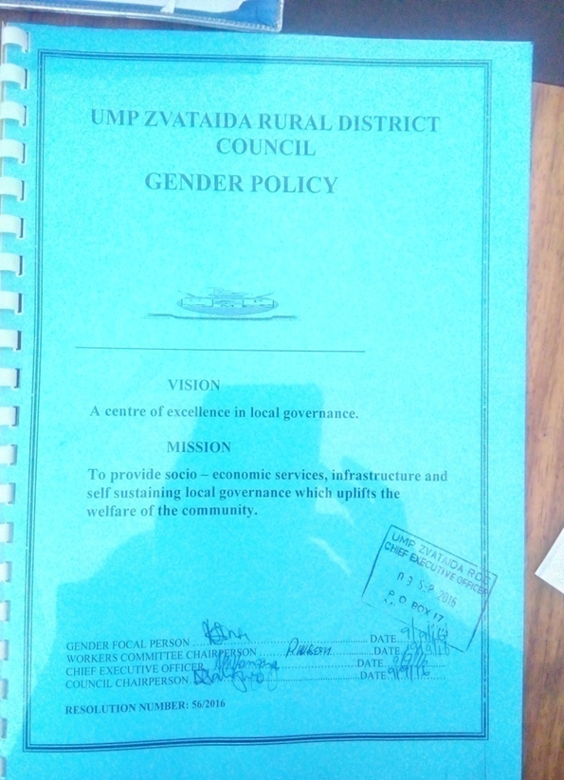
  I. POLICY FRAMEWORK
What gender provisions and policies guide the council budget?
The council has adopted the National Gender Policy, Constitution of Zimbabwe, National Development Strategy 1. The Council strategic plan is aligned with the NDS1 and Water and sanitation and our Social services programme incorporates gender projects and of recent we have incooperated the call action as our term of reference
Does the council have a gender policy and does it address issues on gender budgeting?
A gender policy is in place and operational as a guideline to the councils budget.
Photo of the Gender Policy

Slide 4
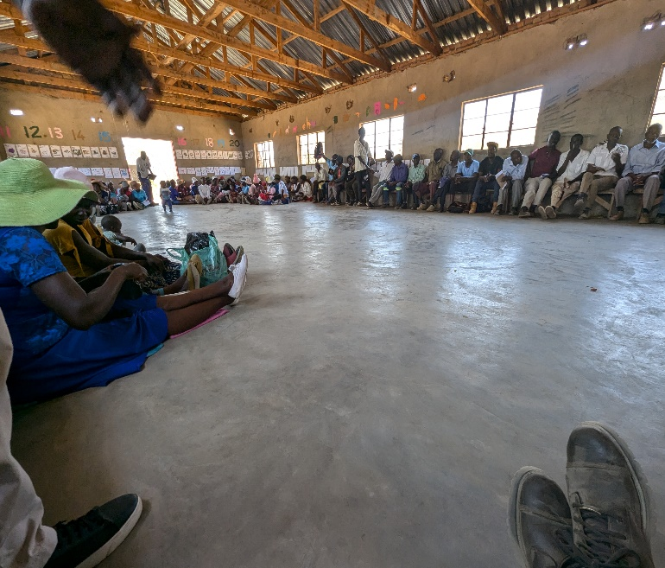
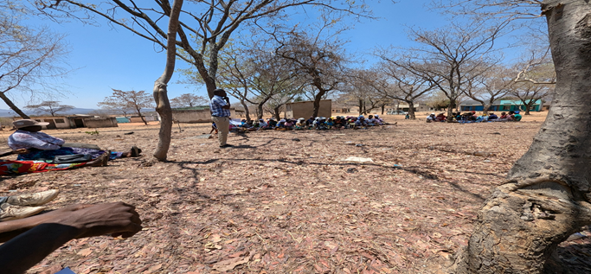
II. THE BUDGET PROCESS
Detail
Evidence
How did the council integrate gender and inclusion in budget planning?
During budget planning we formed an equal gender planning committee to analyse previous years budgets
How did the council integrate gender and inclusion into budget consultations?
We carried out budget consultations in all ward centres for civic engagements.
Special groups engagements were carried out as well
How did the council ensure that the budget consultation process was inclusive i.e., “no one is left behind
The invitations were published in the newspaper, notice boards at schools, clinics, shopping centres.
Councillors, Headmans and village committees were also carriers of information to residence of UMP
Photos or video of budget consultation

Slide 5
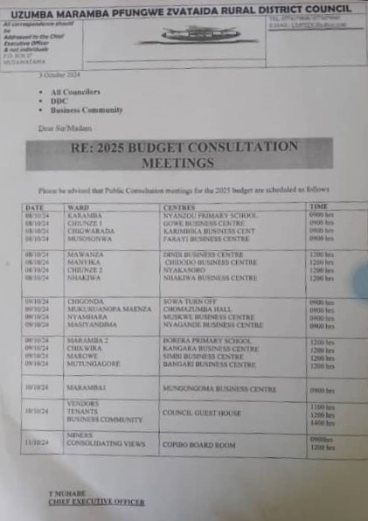
II. THE BUDGET PROCESS
Detail
Evidence
What time, venue and meeting strategies did the council use to ensure inclusion?
Meetings were held starting from 10 am, as advised by the councilors and headman after consulting the availability of their residences, we held the meetings at ward centres so as to allow everyone in the ward to participate
Did the council make use of technology to broaden your reach? How?
The council used whatsapp groups, facebook, bulk SMSs convey information
How effective was this technology?
It was effective as some of the wards that usually had low turn ups improved significantly and the whatsapp group interactions also helped before hand

Slide 6
II. THE BUDGET PROCESS
Does the council have sex/age/PLWD statistics on those who participated in the consultations? – refer to consultation registers and populate table below
Consultation | Women |  |  |  |  | Total | Men |  |  |  |  | Total | % Women
 | Age |  |  |  |  |  | Age
 | - 15 | 15-35 | 36-59 | 60+ | PWD |  | - 15 | 15-35 | 36-59 | 60+ | PWD
 |  | 160 | 277 | 96 |  | 533 |  | 88 | 238 | 59 |  | 35 | 58%
% |  | 30 | 51.97 | 18.03 |  | 100% |  | 22.86 | 61.82 | 15.32 |  | 100%

Slide 7
III. REVENUE
The councils budget consist of 64% internal funds and 36 % external funds.
How did gender considerations informed decisions concerning the budgeting of revenue?
The councils revenue is aligned to its expenditure and thus gender targeted activities have a direct effect on the budgeting of the councils revenue.
How were these decisions influenced by budget consultations
The councils expenditure is directly based on budget consultation outcomes, the consultation are what gives the council activities and projects for the following year
Is any of the external financing specifically targeted at gender?
80% of the external funds revenue is aimed at building clinics, mothers shelters, schools and drilling boreholes are targeted mainly at gender.

Slide 8
IV. EXPENDITURE
Analyze the council budget and categorise expenditure into Gender Management System; Salaries; employment equity-related expenditure; gender-specific programmes and mainstream programmes.
What proportion (%) does each constitute?
Insert Pie Chart/Table
2 | Amount | %
Gender Management System (GMS) | 92 880 | 1
Employment expenditure (Human Capital Expenditure) | 767 196.54 | 8
Employment equity related expenditure | 286 600 | 3
Gender Specific Programming | 1 280 300 | 14.6
Mainstream Programmes | 6 365 282 | 72.4
Total | 8 792 258.54 | 100

Slide 9
IV. EXPENDITURE
Type of Expenditure | Amount | Proportion (%)
Gender Management System (GMS) | 92 880 | 1
Employment expenditure (Human Capital Expenditure) | 767 196.54 | 8
Employment equity related expenditure | 286 600 | 3
Gender Specific Programming | 1 280 300 | 14.6
Mainstream Programmes | 6 365 282 | 72.4
Other
Total | 8 792 258.54 | 100

Slide 10
IV. EXPENDITURE- GMS
Does the council have a Gender Management System? (E.g., Gender Committee, Gender Focal Person, Gender Champion).
Yes the council has a stand alone Gender Committee, a Gender Focal Person and a Gender Champion
Are GMS activities budgeted for ? (E.g., Committee meetings, Hub/ spoke activities, exhibitions, Training, Policy formulation, Exchange visits, Office equipment and stationery, other activities?
Yes as a stand alone committee the Gender Committee comes up with is own budget which is then consolidated with other committee budgets
Where are these budgets found?
These budgets are found in the Gender Committee minutes and Budget documents

Slide 11
IV. Gender Specific expenditure
What gender-specific programmes does the council have?
-Trainings and workshops, Junior Councils, Payment of fees for OVCs, Entrepreneurship skills training for women, Commemorations for International days, Menstrual Health programmes, Dialogue with sex workers, Public speaking competitions, Mothers’ Shelter, Safe shelter for GBV Survivors, Wheelchair for PLWD, Women Clubs, District shows.
Where are these budget lines found? Are they visible?
These budget lines are found in the Gender Committee budget and consolidated council budget.
What proportion of the council budget is allocated for gender-specific programming?
A minimum of1% of the budget
How were these programmes/ projects informed by budget consultations?
These programmes or projects were budgeted from as per the the needs of the communities which they submitted to the council during consultations.
How are the gender-specific projects helping to promote gender equality and women’s empowerment?
By introducing women empowerment projects, the council is increasing disposable income for the gender specific groups therefore closing the gap between males and females leading to equality
How do you measure the expenditure on gender-specific programmes (outputs, outcomes and impact)?
They are measured through reports from activities carried out

Slide 12
IV. EMPLOYMENT EXPENDITURE
 | Women |  |  | Men |  |  | Total | % women
 | Managers | Staff | Total | Managers | Staff | Total |  | Managers | Staff | Total
Full Time | + | 10 | 10 | 6 | 13 | 19 | 29 | 0 | 43.5 | 34.5
Part time
Casual |  | 5 | 5 |  | 1 | 1 | 6 | 0 | 83.3 | 83.3
Total | 0 | 15 | 15 | 6 | 14 | 20 | 35 | 0 | 51.7 | 42.9
What proportion of the work force do women comprise overall? 42.9%
What is the percentage of women in management? 0%
What percentage do women comprise of the full-time 34.5%, part-time 0 and casual 83.3%, labour force?
What are the reasons for the this employee breakdown?

Slide 13
IV. EMPLOYMENT EXPENDITURE- Gender Wage Gap Analysis
 | Women | Women- Total earned | Women average earned | Men-no | Men total earned | Average earnings
Full Time | 10 | 2,407,440 | 240,744 | 19 | 6,534,480 | 343,920
Part Time | 0 | 0 | 0 | 0 | 0 | 0
Casual | 5 | 653,448 | 130,689.6 | 1 | 130,689 | 130,689
Total | 15 | 3,060,888 | 204,059.2 | 20 | 6,665,169 | 333,258.45
What is the gender wage gap?= 63.31%
What does the wage gap reflect
The gap reflects that there is still a lot work to do regarding employment of women on higher posts in Council. Most women in Council are in lower grades.
What plans does the Council have in place to close the gender wage gap?
Council to continue encouraging women to further their studies so that they can be able to fill higher grade posts and Council also on its adverts encourage women to apply

Slide 14
V. EXPENDITURE- GENDER IN MAINSTREAM BUDGET
Programmes | Amount | % budget
Governance & Administration | 90 160.00 | 14.5%
Water Sanitation & Hygiene | 620 350.00 | 100%
Social Services | 1 870 234.00 | 100%
Roads | 1 680 000.00 | 80%
Public Safety & Security | 350 000.00 | 100%
Natural Resources & Conservation | 50 140.00 | 10%
Total | 6 660 884.00
Draw Pie chart here

Slide 15
V. EXPENDITURE- ANALYSIS OF ONE SECTOR EG
 | Women |  |  |  |  |  | Men
 | Age |  |  |  |  |  | Age
 | Below 15 | 15-35 | 36-59 | 60+ | PLWD | Total | Below 15 | 15-35 | 36-59 | 60+ | PLWD | Total
Education | 800 | 135 | 0 | 0 | 15 | 950 | 640 | 200 | 0 | 0 | 10 | 850
Housing | 0 | 100 | 180 | 60 | 10 | 350 |  | 145 | 150 | 35 | 5 | 335
Social amenities | 200 | 455 | 350 | 80 | 20 | 1105 | 190 | 460 | 400 |  | 30 | 1080
Total | 1000 | 455 | 530 | 140 | 30 | 2405 | 830 | 805 | 550 | 35 | 45 | 2265

Slide 16
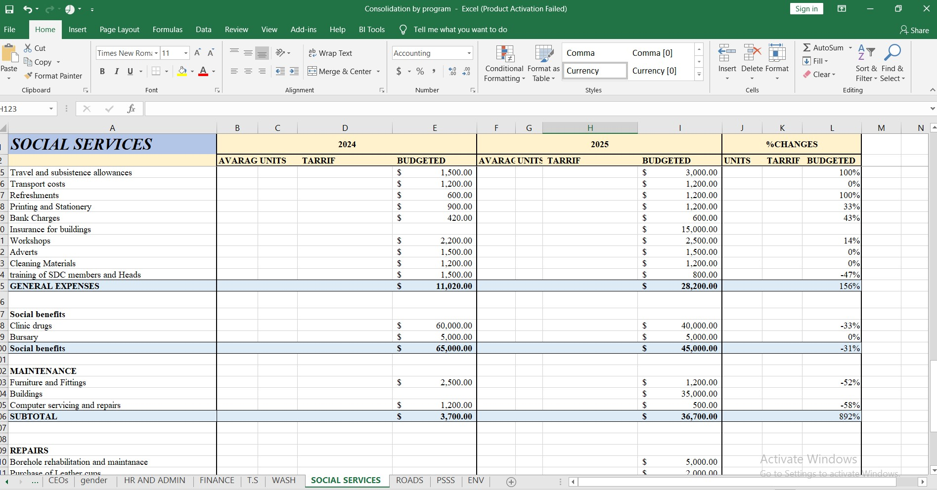
V. EXPENDITURE- GENDER IN MAINSTREAM BUDGET
Please explain how you are ensuring that women and men, boys and girls benefit equally, or that disparities are challenged through GRB
The council gives equal opportunities to everyone, projects are done to benefit each and every member of the community. When budgeting the council considers the contribution from the community thus giving an equal chance to every gender to benefit from the councils projects. GRB has aso been a too to hep combat disparities through niche targeting on issues which are legging behind on equality.
PHOTO

Slide 17
V. EXPENDITURE- GENDER IN MAINSTREAM BUDGET – EXAMPLE
 | Amount | No of beneficiaries | Percentage
Total Expenditure | 800 250
No. of Men benefiting from council allocations |  | 335 | 48.9%
No. of Women benefiting from council allocations |  | 350 | 51.1%
Total beneficiaries |  | 685 | 100%

Slide 18
VI. BUDGET CROSS SUBSIDISATION ANALYSIS
 | Income (A) | % of total budget | Expenditure (B) | % of total budget | Surplus/Deficit
Governance & Administration | 3 236 850.35 | 36.1 | 2 380 653.10 | 27 | 856 197.25
Water, Sanitation & Hygiene | 620 350 | 9.3 | 620 350 | 7 | 0
Social Services | 1 870 234.00 | 20.9 | 2 575 265.84 | 29 | (705 031.84)
Roads | 1 680 000.00 | 18.8 | 2 714 250.20 | 30 | (1 034 250.20)
Public Safety and Security | 350 000.00 | 5.3 | 350 000 | 4 | 0
Natural Resources & Conservation Mgt | 1 200 140.00 | 3.9 | 387 055.21 | 4 | 813 084 79
Total | 8 957 574.35 | 100 | 8 957 574.35 | 100 | 0

Slide 19
VI. BUDGET CROSS SUBSIDISATION ANALYSIS
Which programmes generate more income than expenditure?
Governance & Administration
Natural Resources & Conservation Mgt
Which programmes spend more than they generate (i.e. they are being subsidised). Specify nature of activities being subsidised and funding source.
SOCIAL SERVICES- CONSTRUCTION OF SCHOOLS AND CLINICS FUNDED BY INTERNAL FUNDS FROM GOVERNANCE
ROADS- CONSTRICTION AND MAINTANANCE OF ROADS FUNDED BY IINTERNAL FUNDS FROM NATURAL RESOURCES
Are there any policies to support or guide cross-subsidisation?
The council is guided by council resolutions and policies on funding expense votes that are not completely covered by their program
How have gender considerations influenced the cross-subsidisation of services?
Yes. The benefiting programms all provide services or projects that are gender focused
What percentage of allocations have been influenced by gender considerations?
60 % of allocations

Slide 20
VII. CONCLUSIONS AND NEXT STEPS
To what extent has the council budget contributed to gender equality and women’s empowerment?
The main objective of the council is to enhance service delivery, promote growth and economic expansion in UMP. The council’s budget has taken steps in empowering women to be involved in the economic expansion of UMP through various initiatives that are directed at women, boys and girls to be more visible in the economy as well as giving opportunities to men who want to venture into business and contribute to the economy, thus contributing to gender equality.
What are the next steps regards gender budgeting for the council?
In the next budget the council is going to continue engaging women on their preferences, Customer satisfaction surveys will be carried out to monitor the councils budget performance

