Slide 1
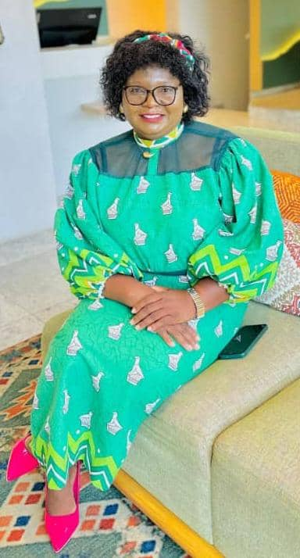



SADC PROTOCOL@WORK SUMMIT 2024
GENDER DRIVERS OF CHANGE Template
(ZIMBABWE, KWEKWE, DR I DONGO )

Slide 2
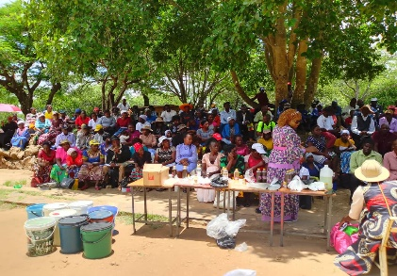
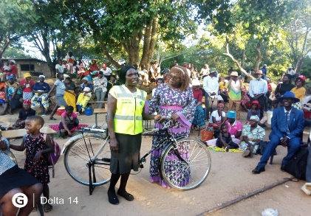
Quotable Quotes
MY QUOTE
. "Empowering women and girls to achieve economic independence is not just about breaking barriers; it's about building a future where every individual has the opportunity to thrive
reflection of my leadership capabilities/qualities? – Vision Emphasizes a clear and inspiring future for women and girls.
- Inclusion: Advocates for the participation of all individuals in economic opportunities.
- Empowerment: Focuses on enabling women and girls to achieve independence.
-Barrier Identification: Recognizes and addresses systemic obstacles.
-Collaboration: Inspires teamwork and creates a supportive environment.
-Resilience: Demonstrates commitment to overcoming challenges.
-Social Change: Drives progress toward equity and opportunity for all.
Sustainable Progress: Cultivates long-term benefits for the community.
Evidence
Fig 1 fig 2
Fig 3

Slide 3
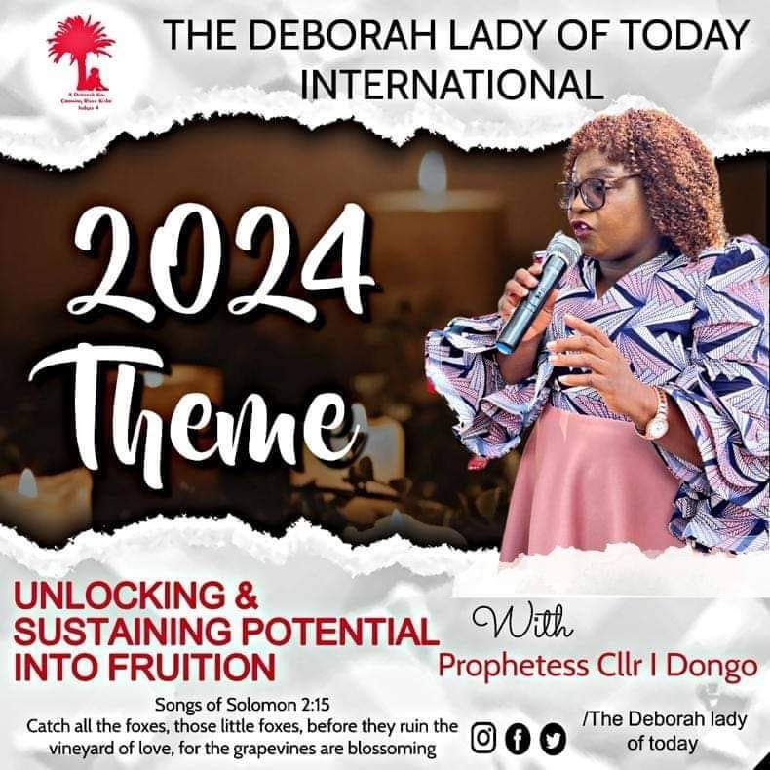
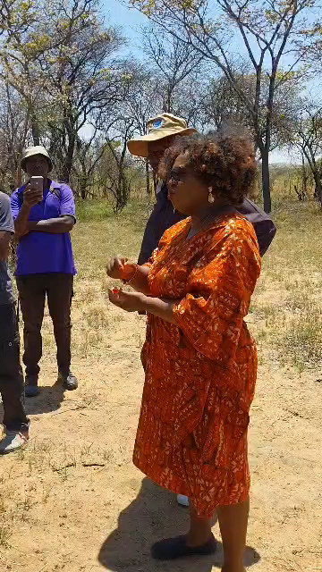

EXPERIENCE AS A LEADER
Leadership Journey
1. Early Inspiration
My leadership journey began with strong influences from women in my life, like my mother and community leaders. Their resilience in advocating for change ignited my passion for social justice and inspired me to empower others.
2. Overcoming Challenges
I faced challenges related to societal expectations limiting women's roles. Skepticism and resistance were common, but I persevered through mentorship, building a support network, and educating myself, reinforcing my commitment to gender equality and empowerment.
3. Breaking Gender Norms
I actively challenged traditional gender norms by advocating for women's leadership representation and emphasizing diverse perspectives. By participating in community discussions and highlighting women's achievements, I encouraged others to step into leadership roles, fostering a cultural shift.
4. Founding an Empowerment Ministry
Fig 1 fig 2
Fig 3 fig 4

Slide 4
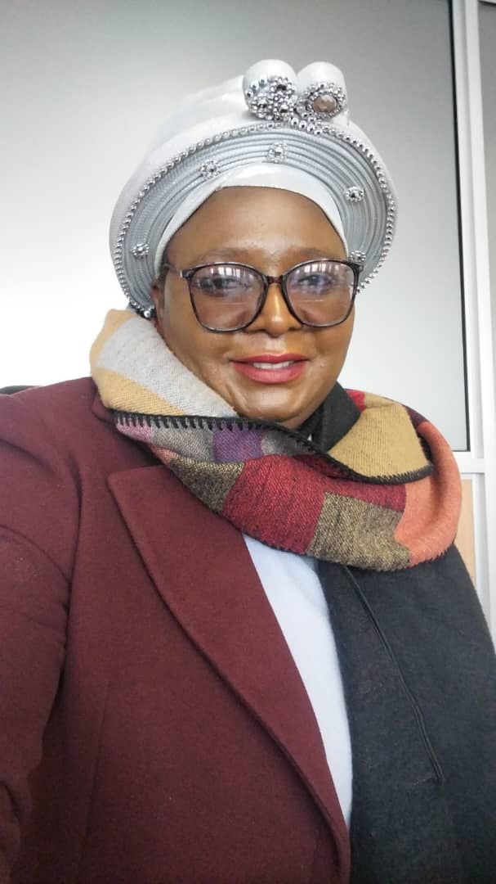
WHO IS THIS LEADER?
Detail
Who I am
Councilor Dr. Idirashe Dongo, Deputy Mayor of Zibagwe Rural District Council, a Gender Champion advocating for women's representation and addressing social issues in Zimbabwe. Founder of Deborah Lady of Today Ministries, she empowers marginalized women and leads Pastors For Economic Development,.
Origin
I am from Zibagwe Rural District Council in Kwekwe District, Midlands Province, Zimbabwe.
Sources of uniqueness
1. Shared Decision-Making
2.Increased Participation: Family members are more involved in discussions about finances, education, and health, leading to more equitable decision-making.
2.Redefined Gender Roles
Role Reversal Traditional roles are evolving, with men participating in household chores and childcare, while women engage more in economic activities outside the home.
3. Enhanced Economic Stability
Joint Income Households benefit from both partners contributing to income, improving financial security and living condition
Fig 1 Fig 2
Fig 3
n

Slide 5
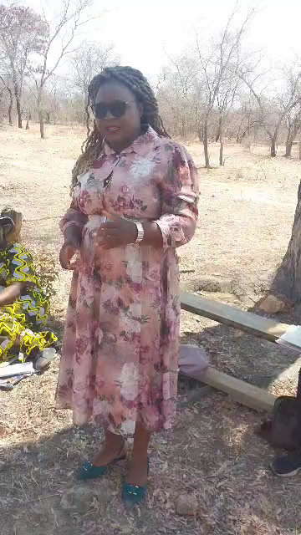
WHAT DRIVES YOU?
Detail
Vision
determined to serve so that we have a gender balanced community, where resources reach the youths, women, men, the underprivileged and marginalized of the community
Objectives
Here are the shortened objectives for promoting gender equality within the institution:
1. Integrate Gender Perspectives: Embed gender considerations in all policies and practices.
2. Establish Gender Focal Points: Assign a gender focal person in each department for better accountability.
3. Implement Gender-Responsive Budgeting: Allocate resources for programs addressing the needs of women, youth, and marginalized groups.
45. **Raise Awareness**: Foster a culture of advocacy for gender initiatives among staff and stakeholders.
Your commitment to gender equality
Include Photos or videos

Slide 6
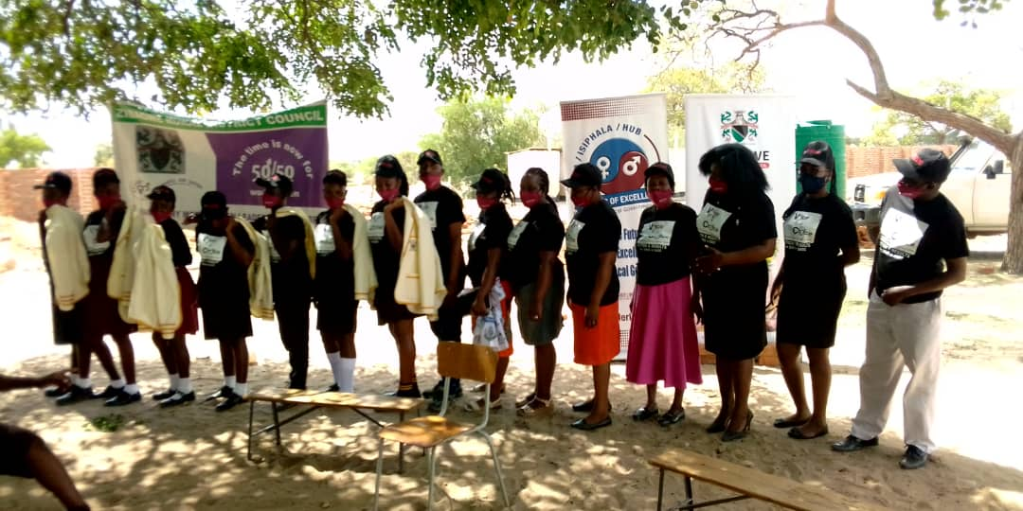
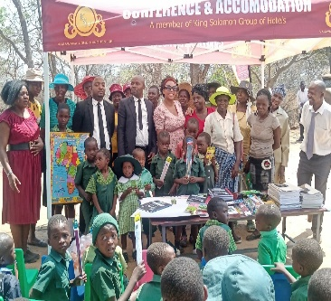
WHAT DO YOU DO?
Detail
Describe your work and how you have influenced gender equality e.g. gender mainstreaming, gender budgeting etc.
Championing gender equality has transformed my institution by establishing a Gender Standalone Committee, designating gender focal points in each department, implementing gender-responsive budgeting, and providing training. These efforts have increased awareness, improved accountability, and fostered partnerships, resulting in a more inclusive and equitable environment prioritizing gender equality in all policies.

Slide 7
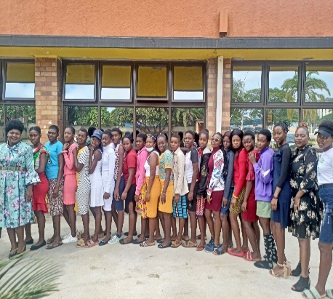
GENDER EQUALITY CHALLENGES
Resistance from Traditional Leaders
Community Disillusionment
Cultural Stigmas and Ignorance
Time-Consuming Engagement:
solution to challenges
How have you addressed the challenges?

Slide 8
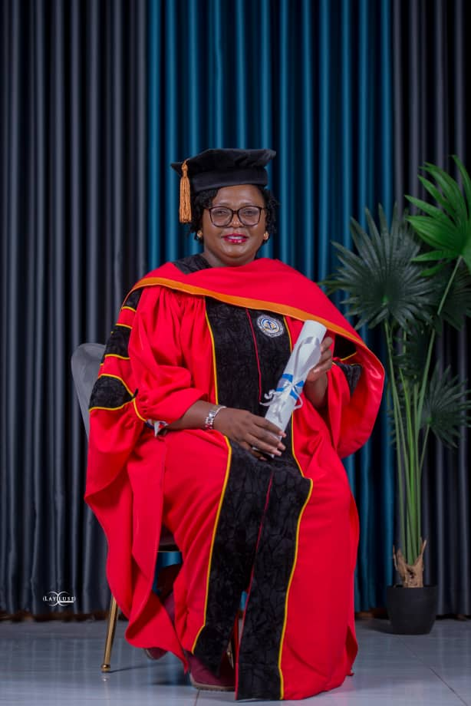
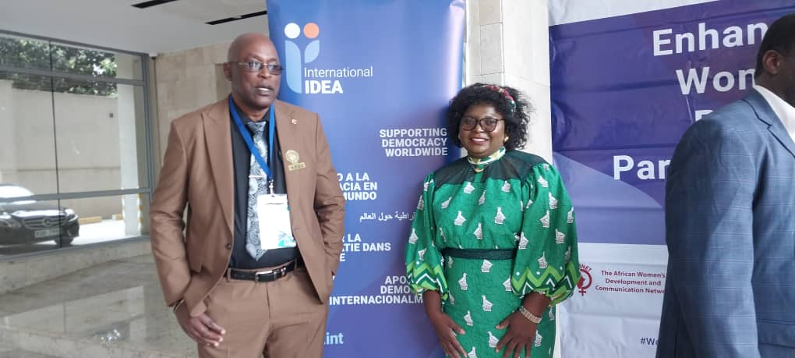
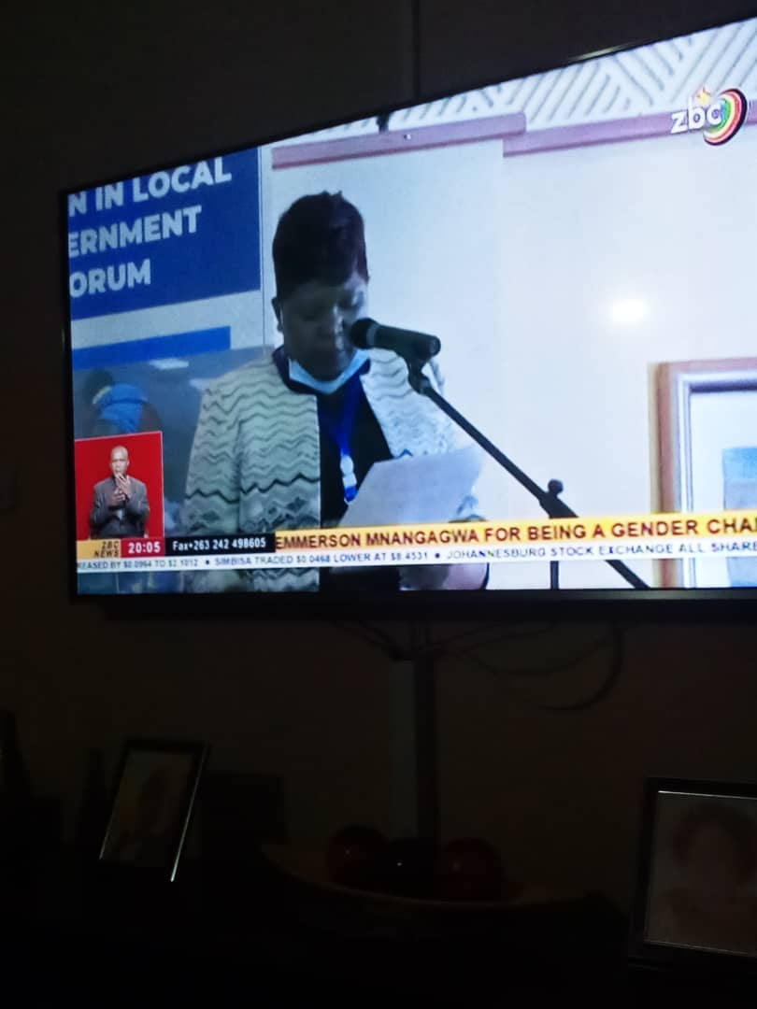
CHANGES AT INDIVIDUAL LEVEL
How has championing gender influenced your life?
Championing gender equality has profoundly influenced my life in several ways:
1. Personal Empowerment
Advocating for gender equality has given me confidence and resilience, enabling me to stand up for myself and others.
2. Enhanced Relationships
My commitment to gender equality has transformed my relationships, fostering meaningful conversations about equity and creating a supportive environment.
3. Broadened Perspective
Working on gender issues has deepened my understanding of social justice and increased my empathy for those facing systemic barriers.
equipping me to tackle challenges strategically.
Overall, advocating for gender equality has transformed my identity,
What has changed in your life?
Approach to challenges that needs a gender eye
Confidence has boosted
Engagement drive more than an activist approach especially with traditional Leadership
What/who do you attribute this/these changes to?
Capacity building
Connections build
What are your achievements?
A milestone achievement is the increase in numbers in local authorities
Due to capacity building I was motivated to attain doctorate in Theology
Include Photos or videos
Fig 1 fig 2
Fig 3
Fig 1

Slide 9
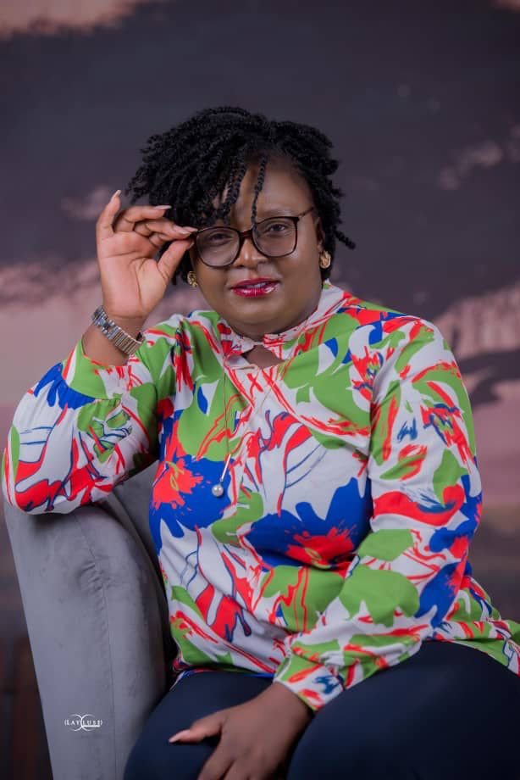
CHANGES AT THE HOUSEHOLD LEVEL
House hold level change
Active Participation
Role Reversal:
Positive Growth
Cultural ShiftChanges at the Household Level in Relation to Gender Mainstreaming and Gender-Responsive Approaches
Gender mainstreaming and gender-responsive initiatives have significantly transformed household dynamics. Traditional gender roles are shifting as men increasingly share domestic responsibilities and engage in parenting, fostering stronger family bonds. Women are gaining decision-making authority and support for their education and careers, enhancing their autonomy. Joint financial management promotes transparency and trust, while shared health responsibilities encourage collaborative well-being. Families are also becoming advocates for gender equality in their communities, challenging outdated norms. These changes contribute to a more equitable environment, redefining family dynamics and promoting broader societal transformation toward gender equality.
Include Photos or videos

Slide 10
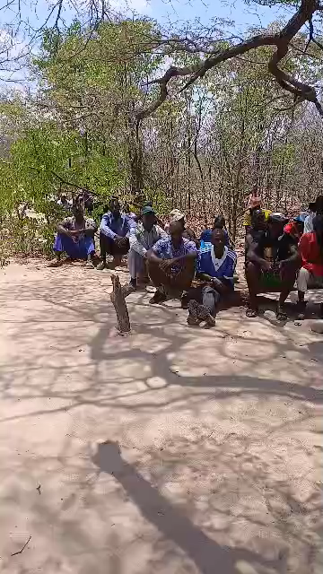
CHANGES AT THE INSTITUTIONAL LEVEL
How has championing gender equality led to changes within your institution especially in gender management systems, and gender budgeting?
Championing gender equality has led to significant changes within my institution in the following ways:
1. Strengthened Gender Management Systems: The establishment of a Gender Standalone Committee has formalized our approach to gender issues, ensuring systematic integration of gender perspectives in all institutional policies and practices.
2. Gender Focal Points: Each department now has a designated gender focal person, which enhances accountability and improves communication regarding gender initiatives and policies.
3. Gender-Responsive Budgeting: I successfully advocated for gender-responsive budgeting, resulting in financial resources being allocated specifically to programs that address the needs of women, youth, and marginalized groups.
4. Capacity Building: Regular training sessions on gender issues have been implemented, equipping staff with the necessary skills and knowledge to effectively apply gender perspectives in their work.
5. **Increased Awareness**: The focus on gender equality has raised awareness among staff and stakeholders about the importance of gender issues, fostering a supportive culture for gender initiatives.
6. **Monitoring and Evaluation: Mechanisms have been established to monitor and evaluate gender-related initiatives, ensuring accountability and continuous improvement in our gender management efforts.
7. **Collaborative Partnerships**: Collaborations with local and international organizations have aligned our policies with best practices in gender equality, enhancing our capacity to drive meaningful change.

Slide 11
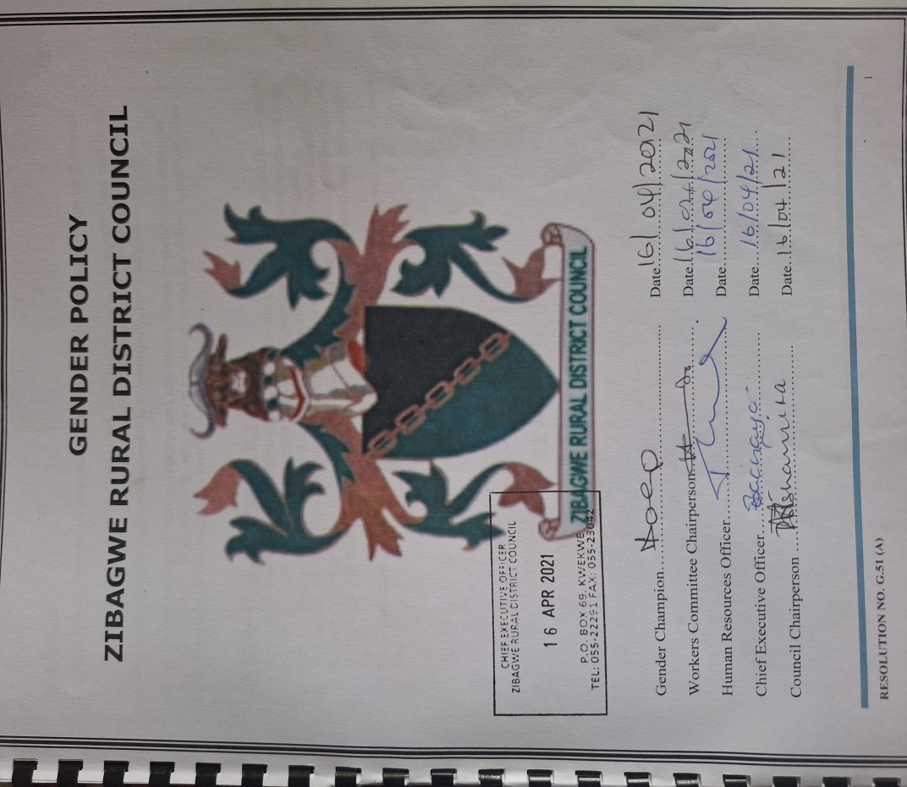
CHANGES AT POLICY LEVEL
To what extent have you contributed towards gender equality policy changes in the council?
:
- 30% of the workforce is women
employs women in fields that were traditionally occupied by men. 1 Head of Department positions, i.e. Executive Officer Planning and Assistant Head of Departments i.e. A.E.O.H.R & Admin, Civil Engineering Technician & Systems Audit.
women earn the same salaries as men for the same job status or position.
Equal opportunities and outcomes for women and men, i.e., when applying for a job both qualifying men and women are shortlisted and called for interviews.
It has clearly labelled Gender sensitive ablution facilities with urinary for men.
17% youth and 7.3% PWDs are employed by the council.
The council has an approved sexual harassment policy in place.
sexual harassment cases are dealt with using the code of conduct and its treated as a very serious dismissable offence.
Some cases would be referred to the police for example rape cases.
The Council also uses Labor Act and Constitution of Zimbabwe
.
Have you advocated or lobbied for any changes in the budget to make it more gender-responsive?
Yes, I have actively advocated for changes in the budget to make it more gender-responsive. My efforts have included:
**Training for Financial Managers, Engaging Stakeholders,3. Community Input I advocated for involving community members in the budgeting process, encouraging them to voice their needs and priorities, particularly those that affect women and marginalized groups.
I have played a major role in the implementation of the thirty percent quarter system
Include Photos or videos

Slide 12
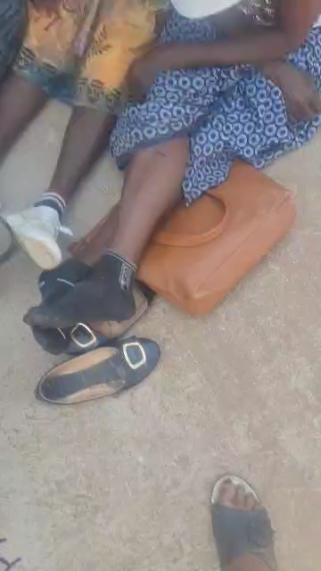
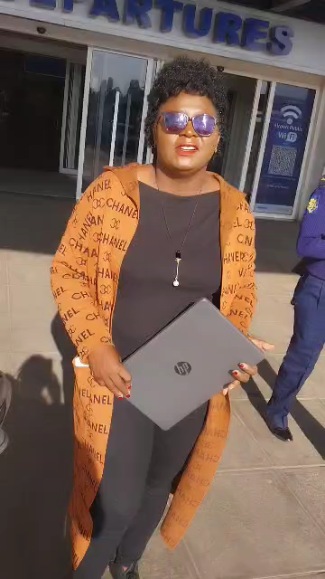
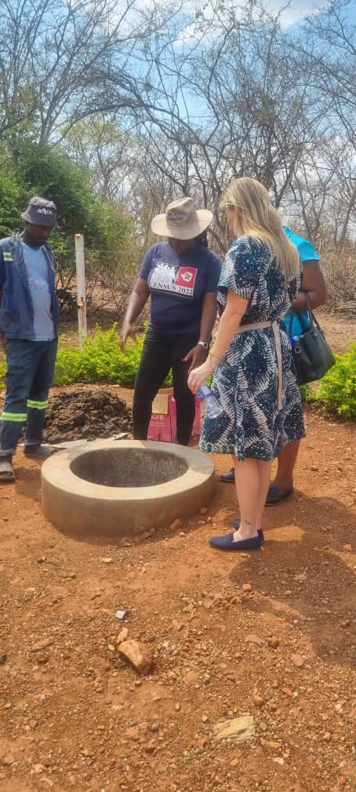
INFLUENCE AT COMMUNITY LEVEL
1.Facilitating Public Meetings I organized regular public meetings to create open forums for community members to express their concerns, share ideas, and contribute to decision-making processes. This has encouraged greater involvement in local governance.
2. Awareness Campaigns: I led campaigns to inform the community about the importance of participating in local government. These initiatives focused on issues like budget allocation and public service delivery, helping citizens understand their rights and responsibilities.
3. Gender Focal Points: By establishing gender focal persons in each department, I ensured that gender issues are consistently addressed, fostering dialogue around inclusivity and encouraging broader participation from diverse community groups.
4. Engaging Youth and Marginalized Groups: I implemented targeted outreach programs to engage youth and marginalized populations, ensuring that their voices are included in local governance discussions and decision-making processes.
5. Transparency in Budget Processes: I advocated for transparency in budget discussions,
Fig 1 fig 2
.Fig 1 Training : Sweet potatoe Project
.Fig 2Regional Tour on Women's Political Participation Peer To Peer Engagements in Botswana. 16 Countries Attended

Slide 13
LESSONS LEARNT
Lessons learnt ?
1. Importance of Youth Engagement
Engaging youth is crucial for creating lasting change. Young people bring fresh perspectives, energy, and innovative ideas. Involving them in decision-making processes not only empowers them but also ensures that initiatives reflect the needs and aspirations of future generations. By fostering leadership skills among youth, we cultivate advocates for gender equality who can drive progress within their communities.
. Skill Development Equals Opportunity
Investing in skill development is essential for opening up opportunities. Providing training and resources enables individuals, particularly women and marginalized groups, to enhance their capabilities and pursue economic independence. Skills training not only boosts confidence but also equips participants to compete effectively in the job market, leading to improved livelihoods and empowerment.
. Community Collaboration is Key
Collaboration among community members, local organizations, and government entities is vital for effective implementation of gender initiatives. Building strong partnerships fosters a sense of ownership and shared responsibility, enhancing the impact of programs. When stakeholders work together, they can leverage resources, share knowledge, and create comprehensive solutions that address complex social issues.
Tailoring Programs to Community Needs
Successful initiatives are those that are tailored to the specific needs and cultural contexts of the community. Understanding local dynamics and engaging with community members to co-create programs ensures relevance and sustainability. By incorporating feedback and adapting approaches, we can maximize the effectiveness of our efforts and foster greater community buy-in.
Tailoring Programs to Community Needs
Successful initiatives are those that are tailored to the specific needs and cultural contexts of the community. Understanding local dynamics and engaging with community members to co-create programs ensures relevance and sustainability. By incorporating feedback and adapting approaches, we can maximize the effectiveness of our efforts and foster greater community buy-in.

Slide 14
NEXT STEPS
Future plans
Here’s a concise version of the future plans related to gender equality and inclusivity:
1.Advocating for Policy Change
Engaging Stakeholders: Collaborate with government, NGOs, and community leaders to promote policies addressing gender disparities.
- **Research and Data Collection**: Gather evidence on gender issues to support advocacy efforts.
Public Awareness Campaigns*: Educate the community on the importance of gender-sensitive policies and mobilize support for change.
2.Expanding Training Programs
Workshops and Seminars: Provide regular training on gender sensitivity, leadership, and negotiation skills.
Mentorship Initiatives: Connect experienced professionals with young individuals for guidance and support.
Tailored Sector Training: Develop specialized training for sectors with notable gender disparities.
3. Collaborate on Gender-Sensitive Budgeting
- - **Monitoring and Evaluation**: Implement mechanisms to assess the impact of budget allocations on gender equality.
- **Community Involvement**: Engage community members in the budgeting process to ensure their needs are met.
4. Commitment to Inclusivity
Diversity Policies**: Implement policies promoting diversity and inclusion at all organizational levels.
Accessibility Initiatives: Ensure facilities and programs are accessible to persons with disabilities.
#5. Strengthening Youth Participation
Youth Councils: Create platforms for young people to voice their opinions on gender equality.
-Leadership Training: Offer training programs to equip youth with advocacy skills.
Collaboration with Educational Institutions: Partner with schools to integrate gender equality education into curricula.
.

