Slide 1





SADC PROTOCOL@WORK SUMMITS AND AWARDS
2024
INSTITUTIONAL COE Template
Zimbabwe,
Chiredzi Town Council
06 November 2024
Kudzai Chimusoro
Please use your background photos to make your presentation unique. Quotes and any other visuals make your presentation more engaging!
.

Slide 2
OVERVIEW
COUNTRY | ZIMBABWE
COUNCIL | CHIREDZI TOWN COUNCIL
GENDER CHAMPION | VIMBAI USHE AND SEKAI NJANJURE
GENDER FOCAL PERSON | KUDZAI CHIMUSORO
IS THE COUNCIL A HUB OR SPOKE COUNCIL? SPOKE
Latest score (year) | Between 55% - 60%
 | Women | Men | Total | % Women
Council | 2 | 8 | 10
Management | 6 | 12 | 18
Council staff overall | 65 | 167 | 232 | 39
Population served | CHIREDZI URBAN COMMUNITY – About 42 000 with reference to the last Census in 2023
Key characteristics | Chiredzi Town is located in the South Eastern corner of the country and is in Masvingo Province, lying 203km from Masvingo city, the provincial capital. It is the administrative centre of Chiredzi District, which is the sugar producing hub of Zimbabwe

Slide 3
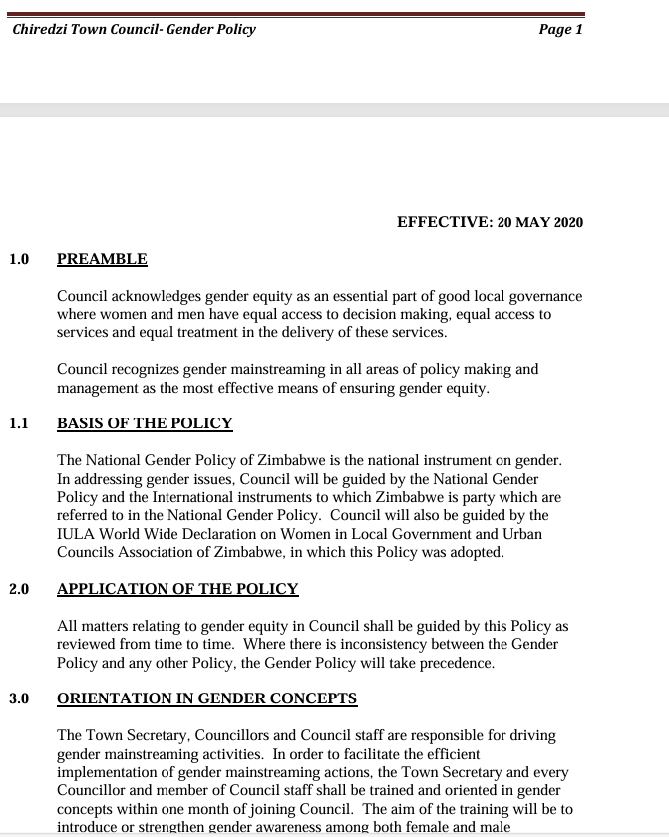
  I. GENDER POLICY, ACTION PLAN, HUB AND SPOKE
Is there a gender policy and action plan that incorporates the Post 2015 SADC Gender Protocol, SDGs and other relevant targets? YES
It is well known and has a high profile champion within the council.? 2 Female Councillors Vimbai Ushe and Sekai Njanjure

Slide 4
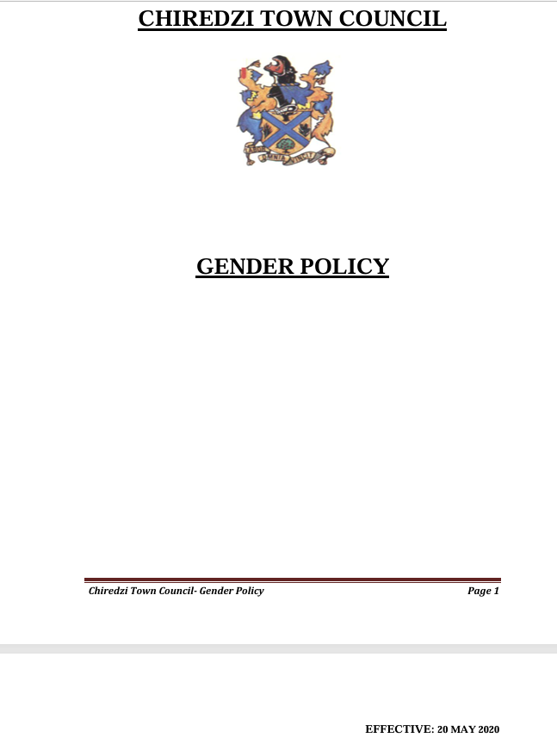
  I. GENDER POLICY, ACTION PLAN, HUB AND SPOKE
How has the council coordinated and contributed to the hub and spoke activities e.g. provincial strategy meetings? – CTC has taken part at most hub and spoke activities and even hosted one of the hub and spoke meetings
How often are hub and spoke activities conducted by the council? – As and when necessary

Slide 5
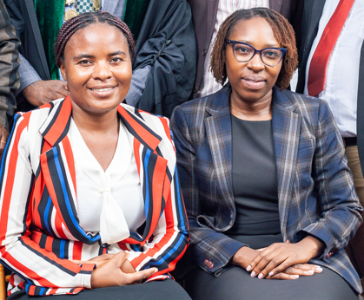
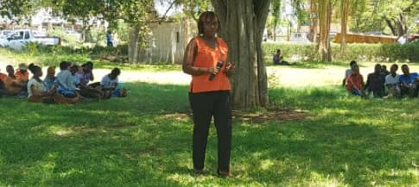
II. GOVERNANCE
Detail
Evidence
What is the proportion of women’s representation in council as councillors? (how many are elected and How many from quota) 2 Ladies from the Quota
How many committees does the council have? - 4
How many committees are chaired by women? 2
How many committees are chaired by PWD? 0
In what way do women/ youth/ PWD participate in council consultations and decision-making? Participation in public meetings and community consultations

Slide 6
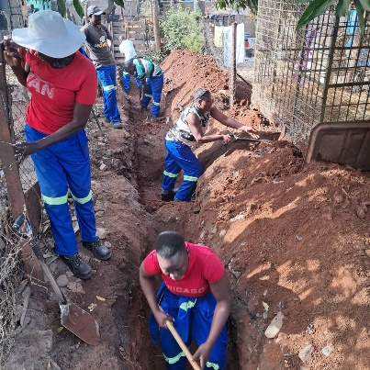
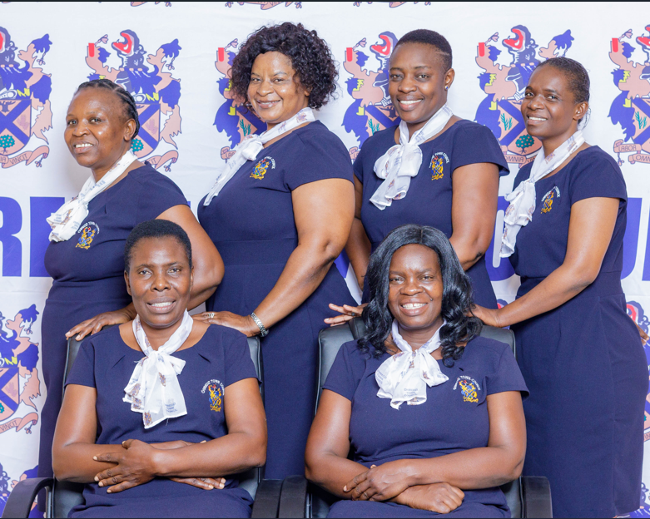
III. WORK PLACE POLICY AND PRACTICE
How gender sensitive is the workplace?
Provide examples.
What proportion of the workforce is women? 39%
How is the council supporting women in the workplace so they are better placed to work? – Equal opportunity for women in all available jobs
What is the proportion of youth and PWDs employed by the councils? Less than 5%
Does the council have a sexual harassment policy? - YES
How are sexual harassment cases dealt with? - As per code of conduct and Sexual Harassment Policy

Slide 7
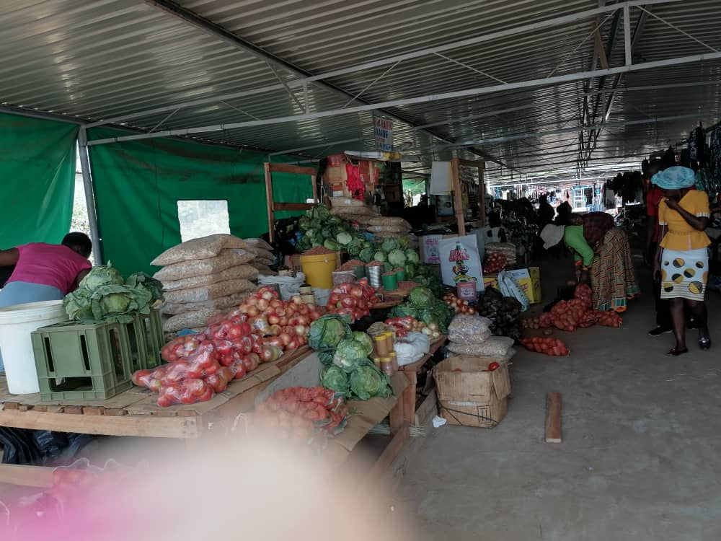
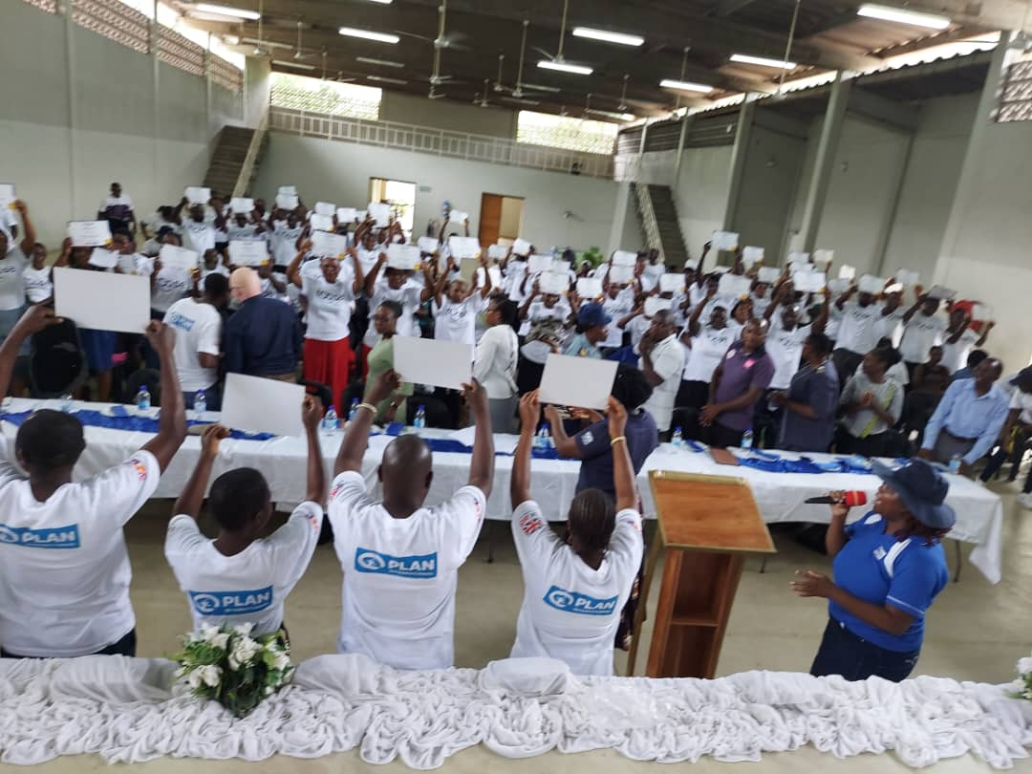
IV. LOCAL ECONOMIC DEVELOPMENT
The Council has a local economic development plan or projects that target women, PWD, and youth entrepreneurs.
Market places designed and % of stands allocated to women, men, PWD and youth on an equal opportunity basis. – W1036, M 443, PWD- 2
Existence of entrepreneurship finance schemes linked to council that benefit women, men, people living with disability, and youth – Toose and Fushai facilitated by Plan International
What arrangements have been made by the council with external sources of finance to promote access to finance for local entrepreneurs, especially women, PWD and the youth? – Trainings & market business linkages
Does the council allocate tenders to women-owned businesses? - Yes
What is the proportion of tenders allocated to women? - 30%
What proportion of the council budget is allocated to LED activities? 7%
One of our market stalls
Community Training with Plan International

Slide 8
V. INFRASTRUCTURE AND SOCIAL DEVELOPMENT
Land and housing
Sex disaggregated data of land allocations for council & community beneficiaries.
Sex disaggregated data for housing allocations
Water and sanitation
Are there water committees?
Types of water and sanitation projects.
How gender-responsive are these.
.
Housing Allocations | Number | Proportion (%)
Women | 0 | 0
Men | 0 | 0
Total | 0 | 0
Water Committees | Number | Chairpersons of Water Committees | Vice Chairpersons of water committees
Women | 16 | 3 | 2
Men | 8 | 1 | 2
Total | 24 | 4 | 4

Slide 9
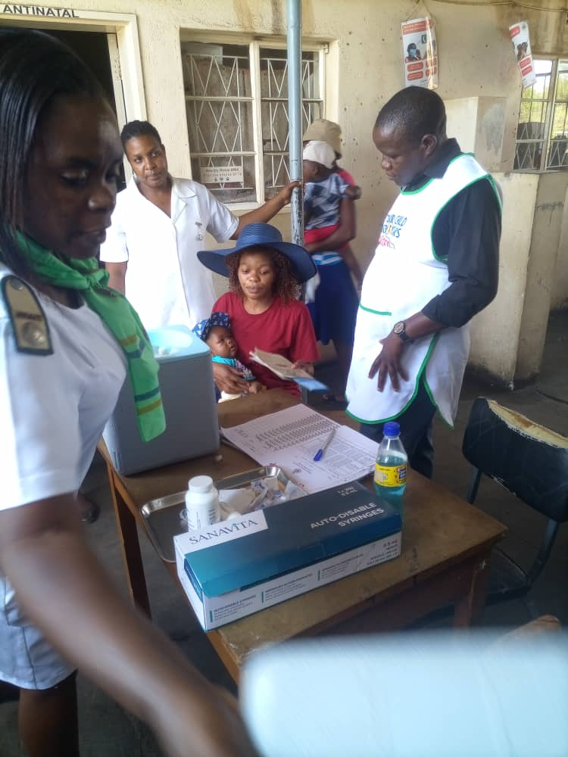
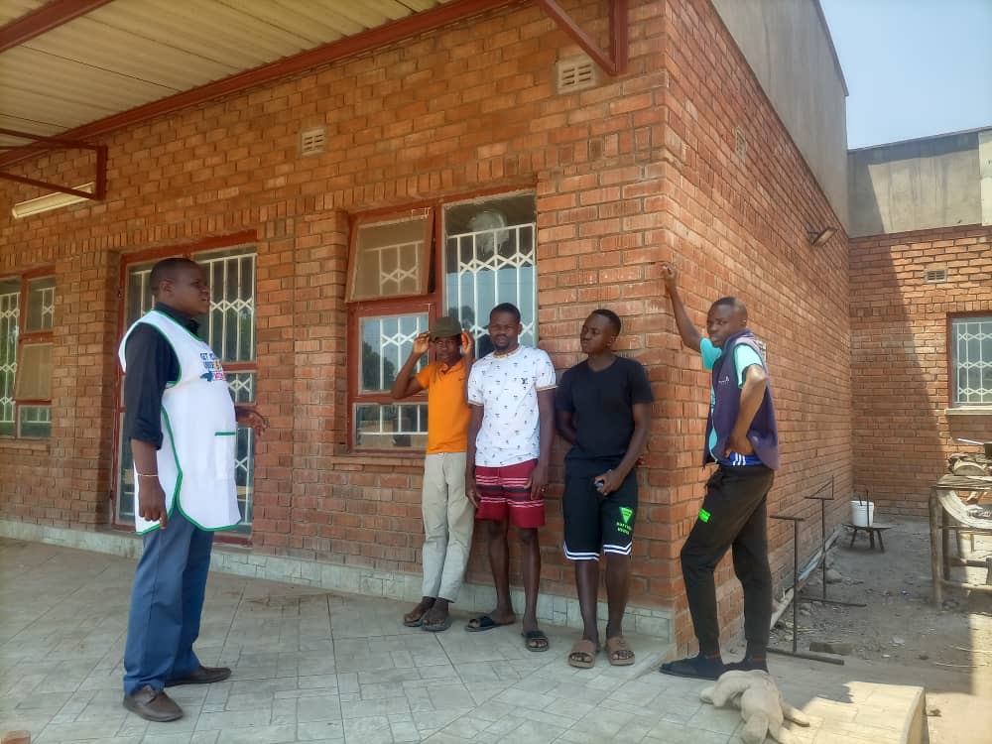
VI. SEXUAL AND REPRODUCTIVE HEALTH, HIV AND AIDS
How does the council promote SRHR? Poly Clinic has young primary care counsellors for the youth, staff training, health education talks
Do women, men, people living with disability, and youth have equal access to treatment. - Yes
How has the council ensured that health/SRHR facilities are more accessible to these groups? – Through health education talks
How does the Council encourage or support Comprehensive Sexual Education (CSE) in schools? Sex education talks in Schools

Slide 10
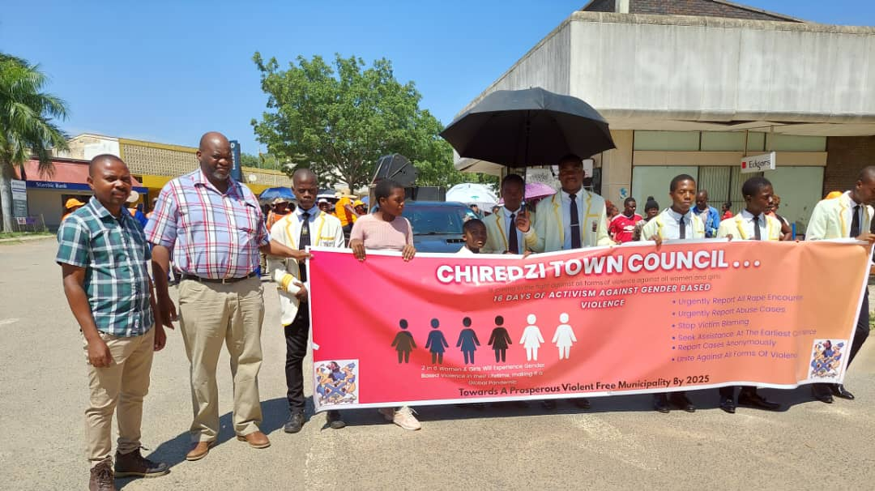

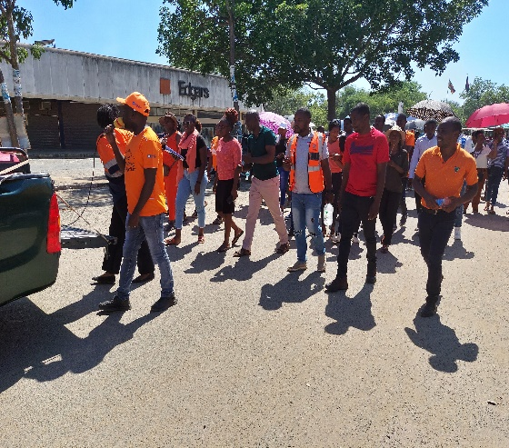
VII. GENDER BASED VIOLENCE
List key actions council has taken towards:
Prevention – Banners, Flyers and Auxeni Radio Interviews on prevention and access to assistance
Public awareness – Annual 16 Days of Activism against GBV March in Community
Response and coordination – Partnership with ZRP Victim Friendly Unit for GBV Programmes
Support and empowerment - Counselling services and Places of safety in partnership with Chiredzi General Hospital, NGO’s i.e Musasa Project

Slide 11
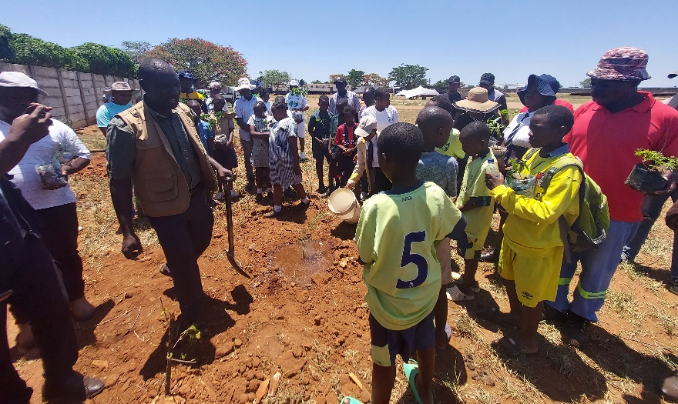
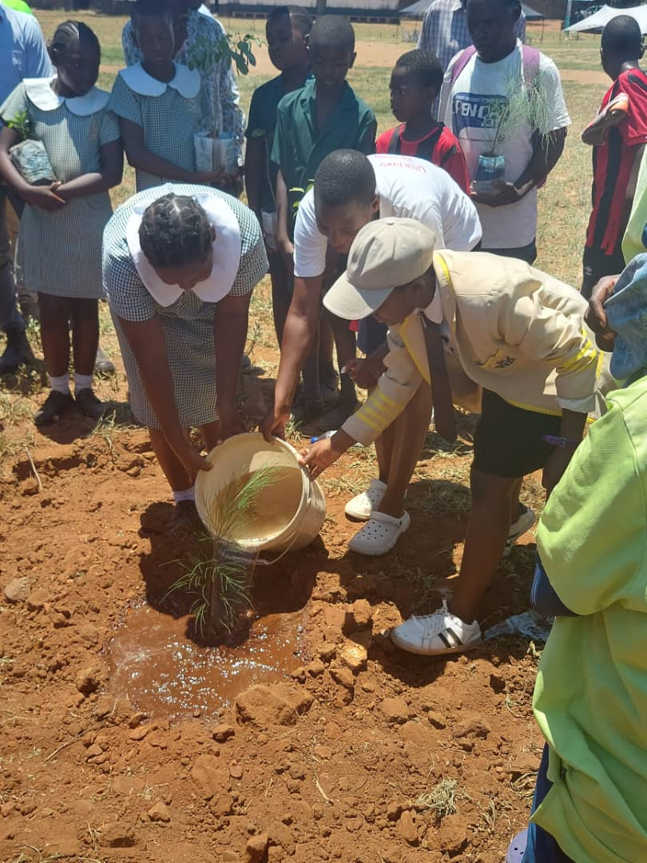
VIII. CLIMATE JUSTICE
Does council have a climate change policy? NO
Examples of women, PWD, and youth are equally involved in projects that prevent climate change such as waste management, sustainable energy and recycling and benefit from economic opportunities arising from this. - NO
How has the council adapted or mitigated against climate change? – Through programs like The Tshovani Stadium Tree Planting (See Pics to the right)
.

Slide 12

IX. GENDER MANAGEMENT SYSTEM
What Gender structures exist in council- e.g. Gender focal persons, gender committee, gender champion? - Gender champions, Focal person, Finance and General-Purpose Committee which has a mandate to discuss gender issues
Is the council Gender Action Plan aligned to the Council’s strategic plan? - Yes
Gender is written into the job descriptions of key functionaries. – Not Yet Its work in progress
How does the council monitor and evaluate gender? - Through Finance and General-Purpose Committee which has a mandate to discuss all gender issues pertaining to CTC
CTC Gender Champions Councillor Sekai Njanjure and Councillor Vimbai Ushe

Slide 13
X. GENDER RESPONSIVE BUDGETING
Photo
Did the Council submit an entry in the GRB category? - NO
Has the Council drawn up a Gender Responsive Budget statement as per Ministry Guidelines? - YES
What are the key highlights? – Incorporating aspects of gender into council operations including gender focused projects

Slide 14
CHALLENGES
What have been the main challenges? How have these been overcome? - Competing Priorities and these are being overcome by systematically incorporating gender activities into the CTC budget, programs and activities

Slide 15
LESSON LEARNED AND INNOVATION
What lessons have been learned in the COE, hub and spoke process? – Best practices on projects with gender perspective and how to continually incorporate gender in all aspects of CTC operations
How are these being applied? – Through enforcing the gender policy

Slide 16
SUSTAINABILITY AND REPLICATION
How can the COE, hub and spoke work be sustained within your organisation? – Through peer learning and hub meetings

