Slide 1




SADC PROTOCOL@WORK SUMMITS AND AWARDS
2024
GENDER RESPONSIVE BUDGETING
ZIMBABWE,CITY OF MUTARE, 11 NOVEMBER 2024
TSITSI USEYA
ZIMBABWE’S GATEWAY TO THE SEA
ACCELERATING NDS1 GAINS AND ADVANCING TOWARDS ACHIEVING ENHANCED ECONOMIC DEVELOPMENT

Slide 2
OVERVIEW
COUNTRY | ZIMBABWE
COUNCIL (HUB/SPOKE) | HUB
GENDER CHAMPION | ALL COUNCILORS AND SENIOR MANAGEMENT
GENDER FOCAL PERSON | CHRISTINA MABIKA
Latest score (year)
 | Income | Expenditure | % Gender Specific
Budget (YEAR 2024) | 67 099 595 | 67 099 595 | 4
 | Women | Men | Total | % Women
Council | 7 | 19 | 26 | 27
Management | 7 | 9 | 16 | 44
Council staff overall | 687 | 1 367 | 2 054 | 33
Population served | Total population as per 2022 census is 224 802. the day population served by Council is approximately 300 000 – 350 000
Key characteristics | Mutare City is the Capital of Manicaland province covering an area of +- 16 900 with an additional 14 00 as per approved master plan with at least 55 000 propertie.

Slide 3

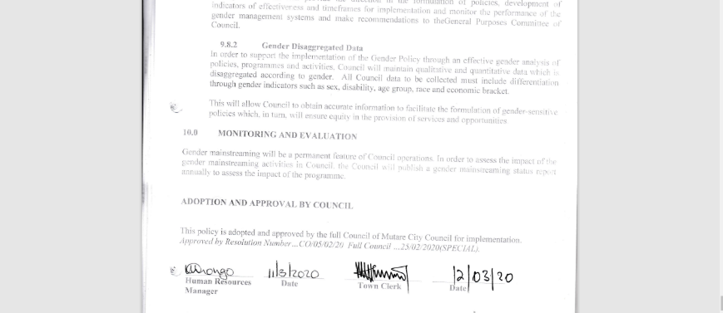
  I. POLICY FRAMEWORK
Council budget is guided by the following gender provisions and policie, National Gender Policy, Constitution of Zimbabwe, National Development Strategy 1, SADC Protocol on Gender and Development CEDAW SDGs.
Council gender policy ensures equal participation by diverse groups in public meetings and cater for their needs when budgetingon gender budgeting?

Slide 4
II. THE BUDGET PROCESS
Detail
Evidence
Council appointed a multi stakeholder committee and included new members
Apart from ward based and stakeholder physical consultations, Council also used google questionnaires (shona, English and Ndebele) whatsapp Chatbot, radio programmeand exhibition and an interpreter for the deaf.
In all consultations, the ward based and stakeholder groups, participants were involved in choosing the venue and time which is strategic and women were encouraged to participate. Notices, hailers . radio programmes and social media platforms were used to notify residents of the consultations. Council also appointed brand ambassadors to advertise council programmes.
Google form link (shona)https://docs.google.com/forms/d/e/1FAIpQLSexMXtfNA0w_otD4Acsl67kcSnsQgKhz3OMhMPc79XTYmijwg/viewform

Slide 5
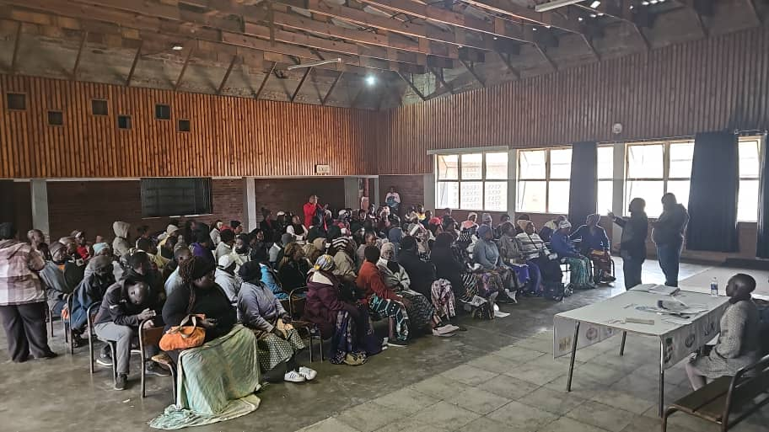
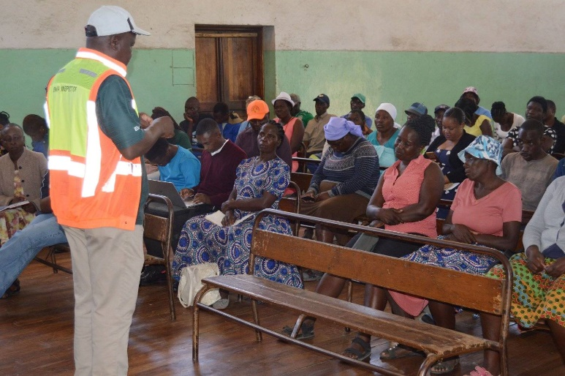
II. THE BUDGET PROCESS
Detail
Evidence
Women, the Youth and People with disabilities were consulted as a group and they are also represented in the budget Committee.
The questionnaires were distributed to residents door to door to encourage participation of women.
The questionnaires improved overall response to budget consultation from about 806 women to 1737 , ( 1500 to 4 3 42) and managed to reach out to 62

Slide 6
II. THE BUDGET PROCESS
Does the council have sex/age/PLWD statistics on those who participated in the consultations? – refer to consultation registers and populate table below
Consultation | Women |  |  |  |  | Total | Men |  |  |  |  | Total | % Women
 | Age |  |  |  |  |  | Age
 | - 15 | 15-35 | 36-59 | 60+ | PWD |  | - 15 | 15-35 | 36-59 | 60+ | PWD
 | 75 | 576 | 834 | 252 | 69 | 1737 | 110 | 878 | 1231 | 386 | 93 | 2605 | 40
% | 4 | 33 | 48 | 15 |  | 100% | 4 | 33 | 46 | 17 |  | 100%

Slide 7
III. REVENUE
Internal revenue constitutes 59% while external sources of funding constitute 41%.
Gender considerations such as rebates for water ,rates and prepaid parking in terms of the pro poor policy was considered in revenue budgeting as informed by consultations from the elderly groups and women.
The funding from devolution will be channelled to the construction of Gimboki Primary School and footbridge construction which will be mainly used by school children going to school, markets and sports complex renovations and clinic construction.

Slide 8
IV. EXPENDITURE
Gender Management System: 2%
Salaries: 22%
Employment equity-related expenditure: 2%
Gender-specific programmes:4%
Mainstream programmes: 61%
Other 9%

Slide 9
IV. EXPENDITURE
Type of Expenditure | Amount | Proportion (%)
Gender Management System (GMS) | 966 063 | 2
Employment expenditure (Human Capital Expenditure) | 14 606 047 | 22
Employment equity related expenditure | 1 485 640 | 2
Gender Specific Programming | 2 090 037 | 4
Mainstream Programmes | 41 054 390 | 61
Other | 6 097 417 | 9
Total | 67 099 595 | 100

Slide 10
IV. EXPENDITURE- GMS
Council has a Gender Management System, comprising of vibrant Gender Management Team, Gender Focal Person, Departmental Gender Focal Persons and Gender Champion. Council made a deliberate move to appoint all managers and councillors to be gender champions.
GMS activities budgeted for include Gender Committee meetings, Training, Policy formulation, Exchange visits.
The budgets are found under the Governance and Social Services programmes and during budget implementation they have their own vote

Slide 11
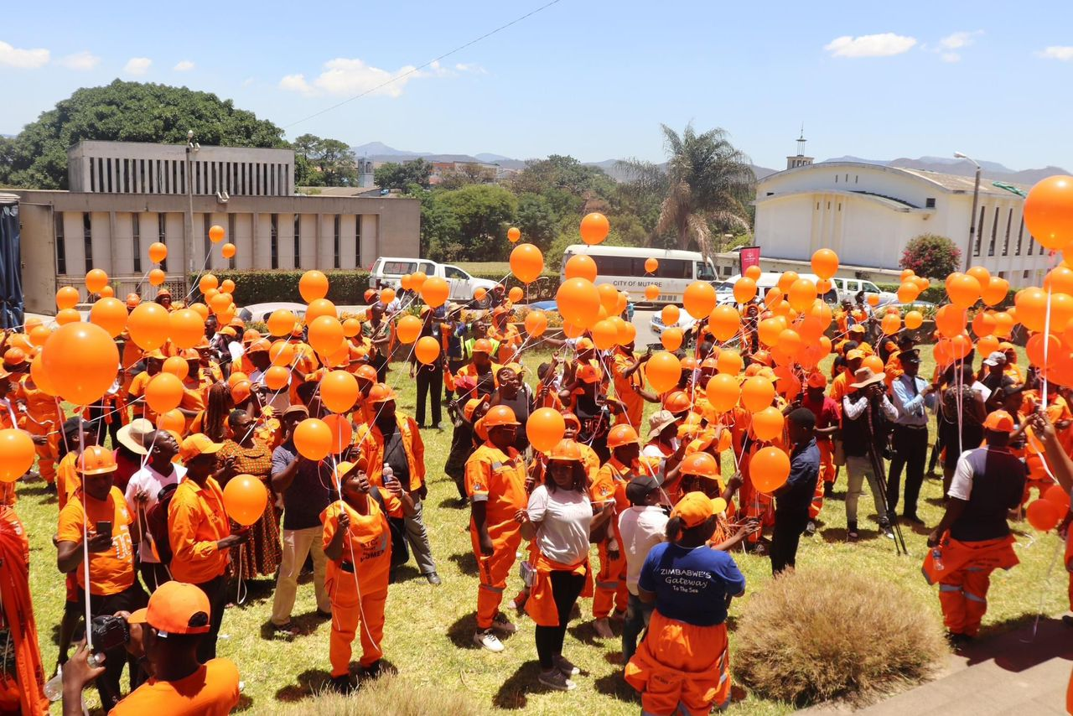
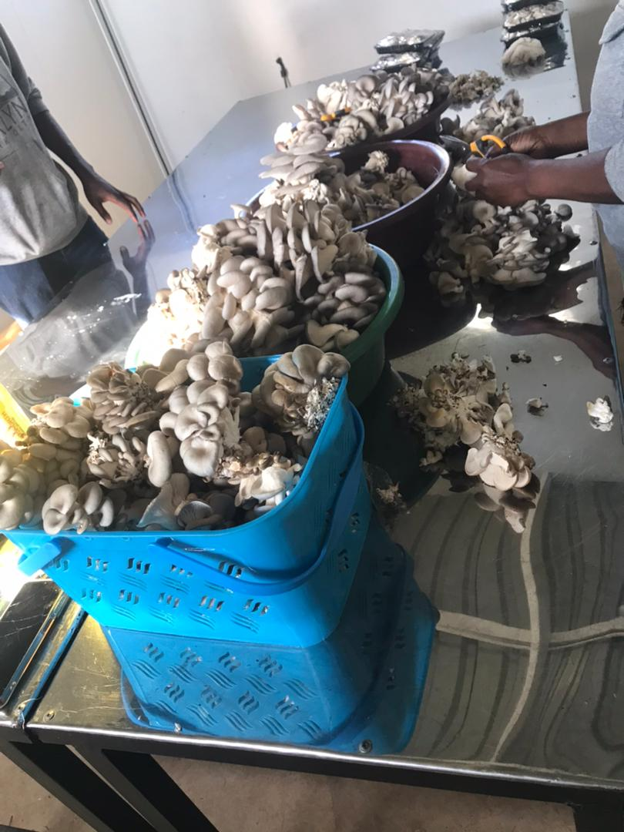
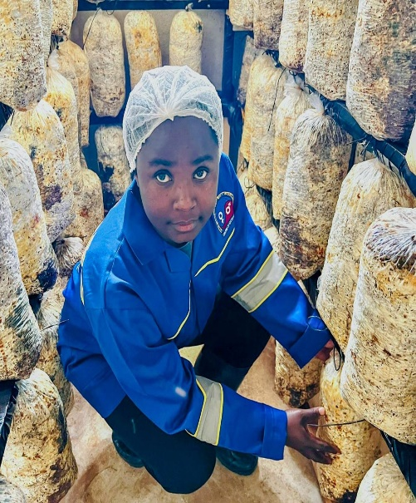
IV. Gender Specific expenditure
Council has the following gender-specific programmes:-
  Commemorations.Training,
  Junior Council,Women in Local Economic Development, Rehabilitation of Nyangombe orphanage and youth centre rehabilitation, Implementation of employee retirement plan
The budget lines are found under the Governance and Social Services , the lines are visible on the budget
4% is allocated for gender-specific programming
During budget consultations residents pointed out the need for the recognition of the elderly, the poor, PWD, youth (education grant) and for women who are under privileged or survivors of GBV.

Slide 12
IV. EMPLOYMENT EXPENDITURE
 | Women |  |  | Men |  |  | Total | % women
 | Managers | Staff | Total | Managers | Staff | Total |  | Managers | Staff | Total
Full Time | 20 | 383 | 403 | 30 | 851 | 881 | 1 284 | 40% | 31% | 32%
Part time | 0 | 284 | 284 | 0 | 486 | 486 | 770 | 0 | 37% | 37%
Casual | 0 | 0 | 0 | 0 | 0 | 0 | 0 | 0 | 0 | 0
Total | 20 | 676 | 687 | 30 | 1 337 | 1 367 | 2 054 | 40% | 34% | 33%
women comprise 33% of the workforce
The percentage of women in management 40%
Women in of the full time employment comprise 32% , and those in casual, labour force comprise 37% of the overall workforce.
What are the reasons for the this employee breakdown?

Slide 13
IV. EMPLOYMENT EXPENDITURE- Gender Wage Gap Analysis
 | Women | Women- Total earned | Women average earned | Men-no | Men total earned | Average earnings
Full Time | 403 | 3 051 978 | 7 573 | 881 | 6 187 621 | 7 023
Part Time | 284 | 2 034 652 | 7 164 | 486 | 3 331 796 | 6 856
Casual | 0 | 0 | 0 | 0 | 0 | 0
Total | 687 | 5 086 630 | 7,404 | 1367 | 9 519 417 | 6 963
The gender wage gap is (6)
The wage cap shows that women earn more than men. This is so because most women occupy higher position like nursing positions is mainly dominated by women while men occupy labour intensive jobs with lower grade.
Employees in the same grade get the same level of salary and allowances. Council will also employ more man in such positions as nursing.

Slide 14
V. EXPENDITURE- GENDER IN MAINSTREAM BUDGET
Programmes | Amount | % budget
Governance & Administration | 4 064 944 | 10
Water Sanitation & Hygiene | 7 743 038 | 19
Social Services | 2 357 806 | 6
Roads | 4 128 927 | 10
Public Safety & Security | 22 556 115 | 54
Natural Resources & Conservation | 203 558 | 1
Total | 41 054 390 | 100

Slide 15
V. EXPENDITURE- ANALYSIS SOCIAL SERVICES
 | Women |  |  |  |  |  | Men
 | Age |  |  |  |  |  | Age
 | Below 15 | 15-35 | 36-59 | 60+ | PLWD | Total | Below 15 | 15-35 | 36-59 | 60+ | PLWD | Total
Education | 4 971 |  |  |  | 2 | 4 973 | 5170 |  |  |  | 3 | 5173
Housing |  |  | 822 |  |  | 822 |  |  | 205
Social amenities | 8 893 | 28 801 | 18170 | 274 | 47 | 5 6185 | 12140 | 22190 | 14125 | 756 | 0 | 49205
Total | 13864 | 28801 | 18992 | 274 | 49 | 61240 | 17310 | 22190 | 14330 | 756 | 3 | 54583

Slide 16
V. EXPENDITURE- GENDER IN MAINSTREAM BUDGET
All programmes were been budgeted for with more resources channeled to Public Safety and security Services (37.39%) for the provision of public lighting as requested by women through consultations. In most ward budget consultations, issues of water provision and sewer maintenance and poor state of roads were topical thus the allocation of more resources. The least funded is the Natural Resources Conservation and Management (1.46%).
The allocation of more resources to Water, Sanitation and Hygiene was influenced through budget consultations were residents requested for provision of adequate and portable water, roads construction and streetlights and health services.

Slide 17
V. EXPENDITURE- GENDER IN MAINSTREAM BUDGET – HOUSING ALLOCATIONS
 | Amount | No of beneficiaries | Percentage
Total Expenditure | 375 337 | 115 823
No. of Men benefiting from council allocations |  | 49 205 | 48%
No. of Women benefiting from council allocations |  | 61 240 | 52%
Total beneficiaries |  | 115 823 | 100%

Slide 18
VI. BUDGET CROSS SUBSIDISATION ANALYSIS
 | Income (A) | % of total budget | Expenditure (B) | % of total budget | Surplus/Deficit
Governance & Administration | 5 103 435 | 8% | 16 824 003 | 25% | (11 721 568)
Water, Sanitation & Hygiene | 26 568 217 | 39% | 10 298 752 | 15% | 16 269 465
Social Services | 3 787 942 | 6% | 7 864 195 | 12% | (4 076 253)
Roads | 2 943 300 | 4% | 6 048 598 | 9% | (3 105 298)
Public Safety and Security | 28 494 214 | 42% | 25 085 914 | 37% | 3 408 300
Natural Resources & Conservation Mgt | 202 487 | 1% | 978 133 | 2% | (775 646)
Total | 67 099 595 | 100 | 67 099 595 | 100 | 0

Slide 19
VI. BUDGET CROSS SUBSIDISATION ANALYSIS
Programmes that generate more income than expenditure are WASH and Public safety
Governance, Social services, Roads and Natural Resources spend more than they generate. Some activities like capacity building , social amenities rehabilitation, and health services and roads maintenance are being subsidies. They are funded from rates and WASH ( administration charges).
Council is working on a policy on cross subsidisation and uses the Urban Councils Act to verament funds to support other programmes.
Council had budgeted to reseal 1.5 1km of road but after request from residents to extend the works to 1.7 km to ensure access to the vegetable market which is mainly dominated by women and the road is used by children going to school. Council had to use rates allocate to Public safety to finance the road and uplift the Mwamuka Market.
11% of the cross subsidisation has been influenced by gender considerations.

Slide 20
VII. CONCLUSIONS AND NEXT STEPS
Council budget has allocated 4% of the budget to gender specific programmes and women empowerment. The budget has allocated funding to women programmes which include training on various projects.
Council has made deliberate move to increase gender programmes focusing mainly on women empowerment, the youth activities and construction of schools and clinics.
It is anticipated that the gender specific budget will increase significantly in the furture as evidenced by an increase from 1.4% to 4%.

