Slide 1


Voice and Choice Summit 2026- Change Strategies-Strategic Litigation
Mauritius:
From Plaintiffs to Precedent – The Strategic Battle for Same-Sex Marriage
Voice and Choice Summit 2026 \ Voice and Choice Summit 2026

Slide 2
Synopsis– brief overview what this is about
Name | Dhanalakshmi Goundan (Dhana)
Designation | Vice- president
Organisation | Young Queer Alliance
Country | Mauritius
Category | Strategic Litigation
Summary | In October 2023, in the decrim cases of Ah-Seek v/s the State of Mauritius and Fokeerbux & Ors. v/s the State of Mauritius, the Supreme Court in Mauritius affirmed that there can be no discrimination on the basis of “sexual orientation”, which is included under “sex”. This precedent provided an opportunity for queer people in Mauritius to strategically litigate for same-sex marriage in terms of the judicial process, community, advocacy and the media.
Voice and Choice Summit 2026 \ Voice and Choice Summit 2026

Slide 3
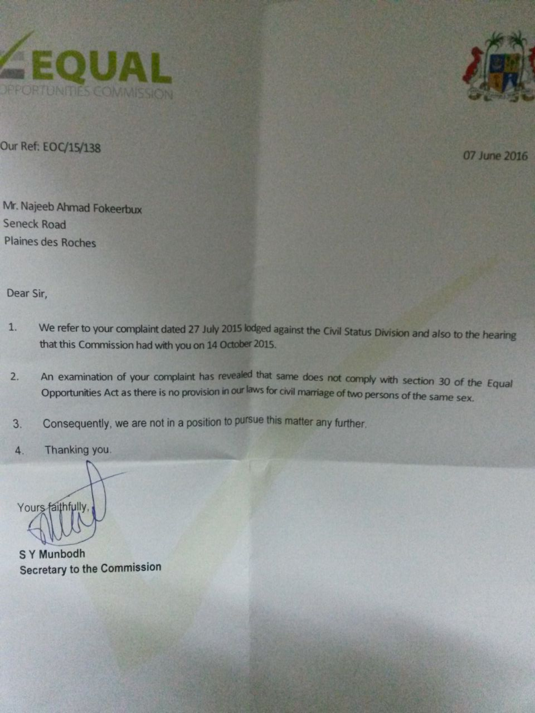
Background
In Mauritius, the number of LGBTQIA+ people reported living with their partner has doubled (5.6% in 2017 and 11.0% in 2022).
Although the Constitution prohibits discrimination on the basis of “sex” and “sexual orientation”, LGBTQIA+ people still face discrimination. One such discrimination is the Civil Status Division’s refusal to allow same-sex marriage.
In 2016, the Equal Opportunities Commission refused redress to a same-sex couple (Fokeerbux N.A. and Aubeeluck V.) after the CSD refused to register their marriage application. In 2022, another attempt (Goundan D. and Pierrot M.W.K) at the CSD to register a same-sex marriage did not succeed.
Same-sex couples face ongoing structural discrimination as they are unable to access rights associated with marriage, such as inheritance protections, spousal benefits, and legal recognition of their relationships.
Letter from EOC in 2016 refusing to provide redress
Voice and Choice Summit 2026 \ Voice and Choice Summit 2026

Slide 4
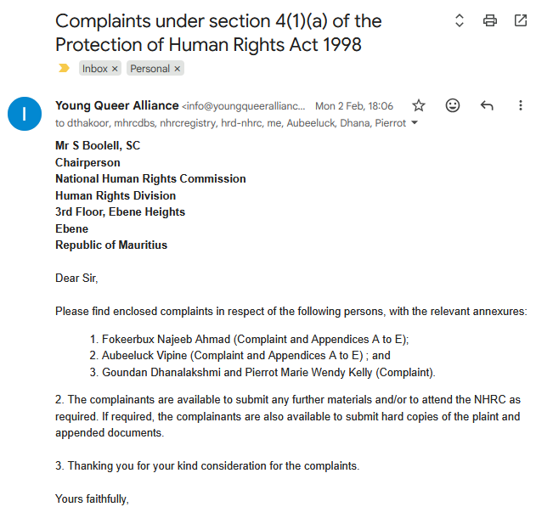
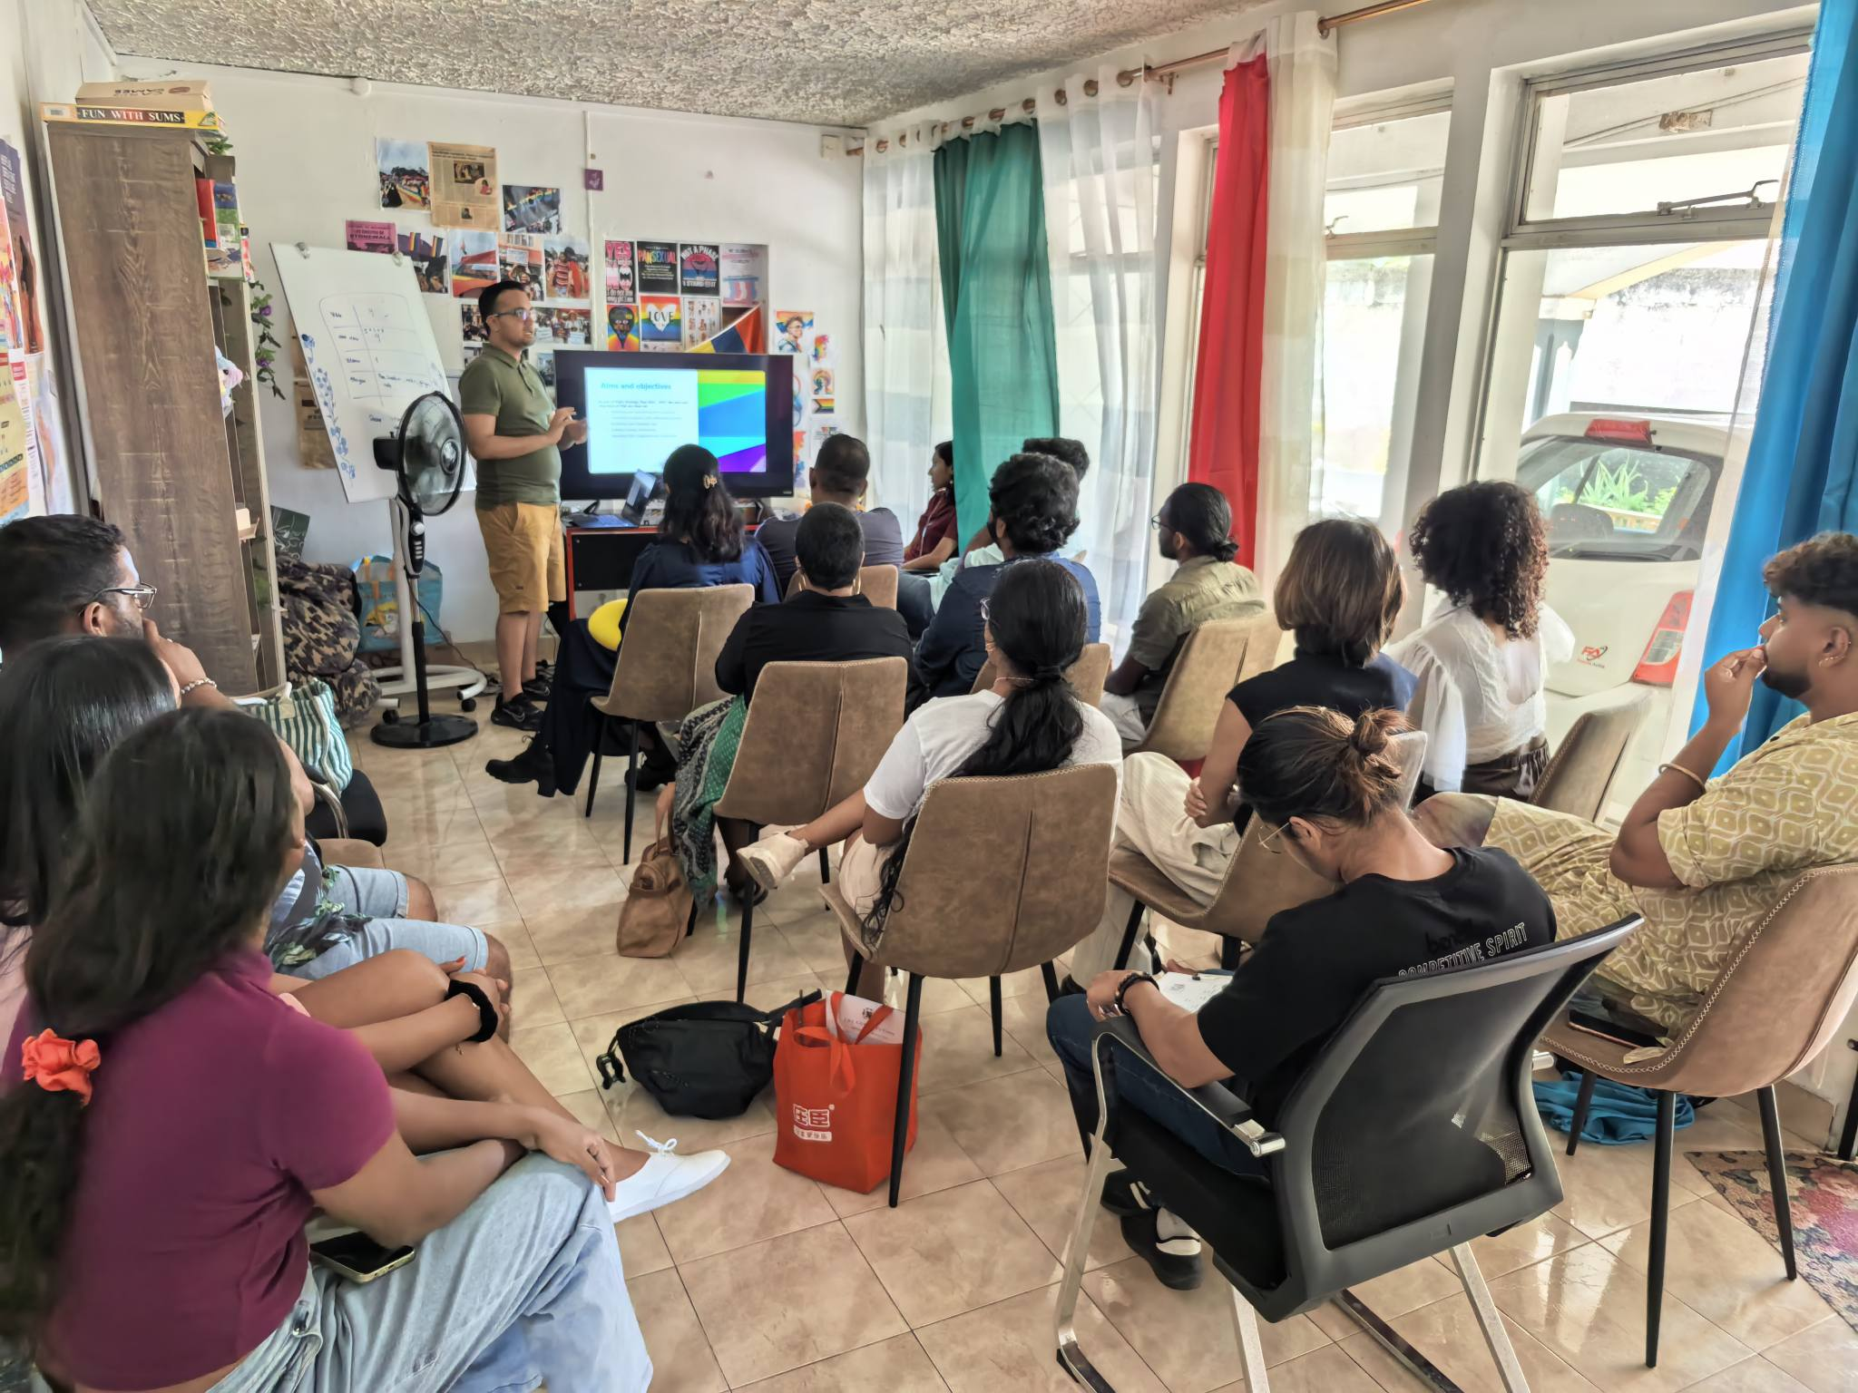
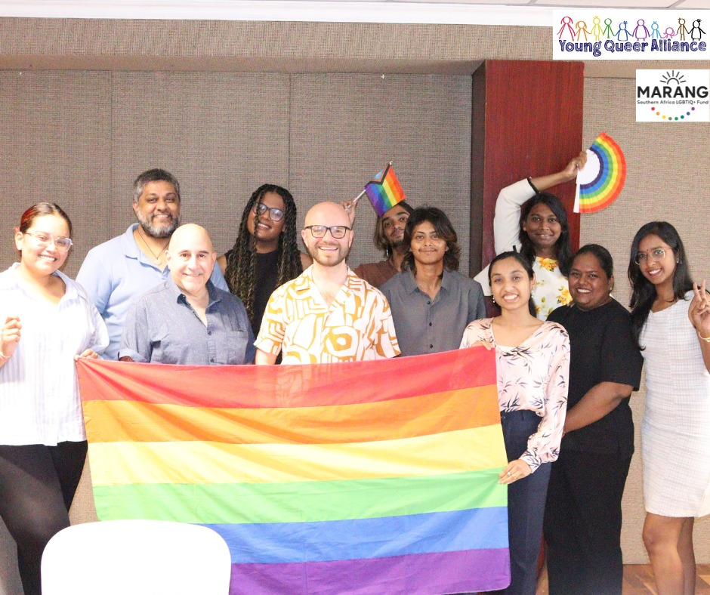
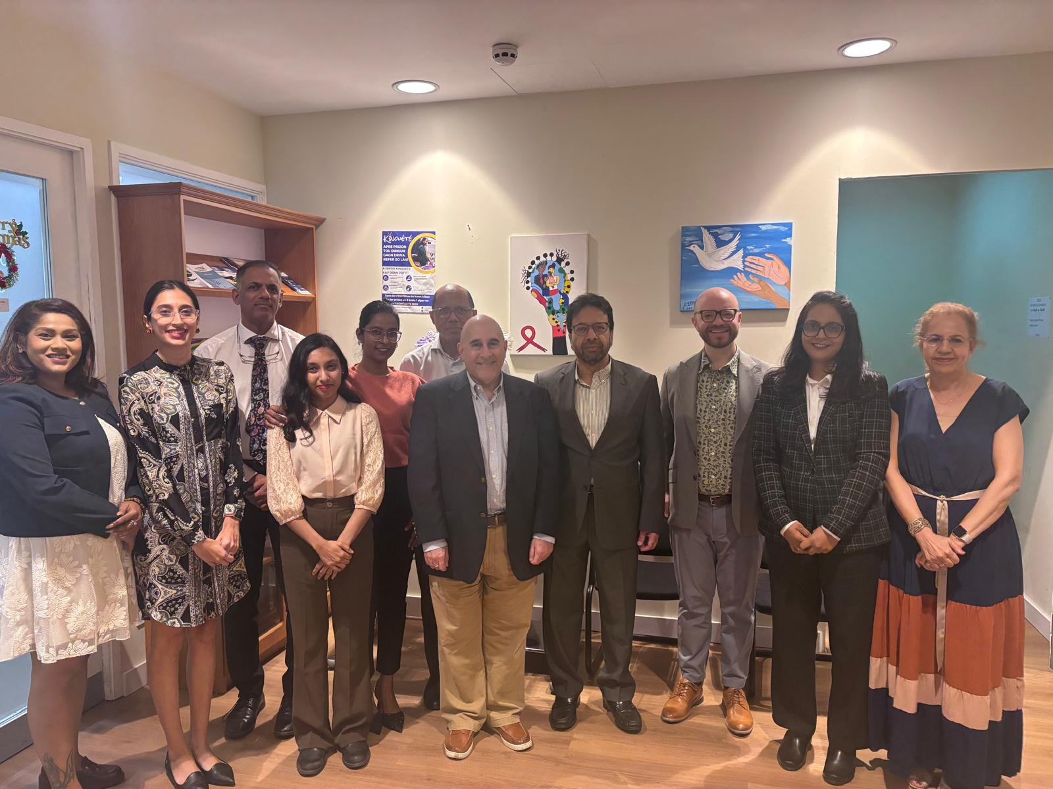
Actions
Actions Taken
There is no strategic litigation without a strategy and without litigating.
Similar to the decrim case, a four-pronged approach has been adopted:
Judicial Process: identification of plaintiffs, securing the legal teams, building the case and lodging the plaint on 02 February 2026
Community: organising the community, building the movement, and empowering LGBTQIA+ people and stakeholders
Advocacy: gathering evidence, building the arguments for change, closed door advocacy
Media: changing the hearts and minds of the population
Stakeholders Consulted
Young Queer Alliance: central to advocacy leadership, strategic coordination, community mobilisation and resource mobilisation
Legal team: Pro-Bono lawyers namely Dentons (Mauritius) LLP and the Franco-Mauritian Law Chambers LCMB et Associés
Partnership building: Freedom to Marry, local LGBTQIA+ NGOs, ally NGOs, key advisors to the State
Community: Members and volunteers at the YQA, building the momentum since 3 years
Human Rights Institutions: National Human Rights Commission, Law Reform Commission and Equal Opportunities Commission
Lodging case
Community organising
Partnership Building
Human Rights Institutions
Voice and Choice Summit 2026 \ Voice and Choice Summit 2026

Slide 5
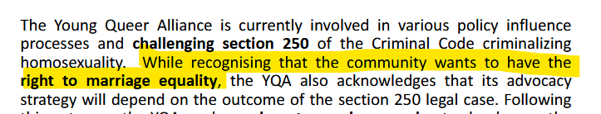
Impact
Change Achieved
Community involvement and leadership: The YQA, as an organisation, continues to empower and bring community leaders together, to lead change.
Representation: While the decrim case focused only on gay men, the litigation for same-sex marriage includes women, therefore, bringing greater community support towards the action.
Organisational sustainability: 70% of YQA funding focuses on same-sex marriage. With projects related to same-sex marriage, there has been a 50% increase in funding, with sustained project implementation lasting over the next two (02) years. Two (02) additional staff have been recruited in relation to projects on same-sex marriage.
Same-sex marriage is on the agenda: Partners and stakeholders have included same-sex marriage on their agenda.
Community narratives documented: The plaints contain the lived I-stories of the plaintiffs, bringing a human and personal approach to litigation. Additionally, legal and socio-economic evidence supporting the case for same-sex marriage is being built.
Sustainability of the Change
Capacity building for the community: The staff, community members and partners are being empowered in strategic litigation and same-sex marriage. The lessons learnt can be applied to other litigation and advocacy work.
Execution of YQA strategic plan 2022-2027: The litigation shows YQA’s commitment to implement its Strategic Plan, hence building credibility with community members, partners, stakeholders and donor agencies.
Visibility and changing of hearts: The daily lives of LGBTQIA+ persons are being demystified in the eyes of National Human Rights Institutions, creating room for policy change.
YQA 5-year strategic plan
(extract of Strategic Objective 3: Reclaiming and Changing Laws)
Extract: Narratives from plaintiffs
“However, owing to the refusal of the Civil Status Division to recognise our marriage, this cripples our freedom of expression as we are not able to show out love for each other freely. This is because, there are some instances when some people frown upon our love and emotions or other instances where, owing to the lack of recognition by the Civil Status Division, we cannot express the status of our couple life on official documents and forms .”
(Najeeb and Vipine, same-sex gay couple)
“ We are denied access to marriage excluding us from accessing safeguards of familial bonds, namely spousal and family life.”
(Dhana and Wendy, same-sex lesbian couple)
Voice and Choice Summit 2026 \ Voice and Choice Summit 2026

Slide 6
Challenges & Lessons learnt
Challenges | Mitigation
Limited knowledge of laws | Securing legal professionals to support in the case Commissioning consultancy for 2 research on same-sex marriage (legal and socio-economic aspects respectively)
Uncertainty of appetite of Human Rights Institutions | Closed door advocacy and lobbying , including through the use of domain experts (lawyers and Freedom to Marry Global)
Limited knowledge and capacity on litigating for same-sex marriage | Securing partnership with Freedom to Marry Global and building internal capacity since 2-3 years now Ongoing technical assistance from Freedom to Marry Global
Social and political sensitivities | Building strategic messages incorporating the four (04) elements: Notion of Marriage by Mauritians + Introduction of same-sex couples/gay couples + establishing national values + linking values with the end result.
Limited resources | Focused advocacy efforts and resources on a single clear objective: achieving same-sex marriage Strengthening partnerships
Lessons Learnt
Not everyone is convinced by the work – there needs to be a driver which will constantly lead the change to achieve same-sex marriage
Challenges are not only from homophobes and transphobes, but from within the community – working in coalition helps to build the momentum to reach a campaign
Setbacks are not failures but lessons learnt to be better prepared
Strategic litigation is iterative, gradual and sustainable
Voice and Choice Summit 2026 \ Voice and Choice Summit 2026

Slide 7
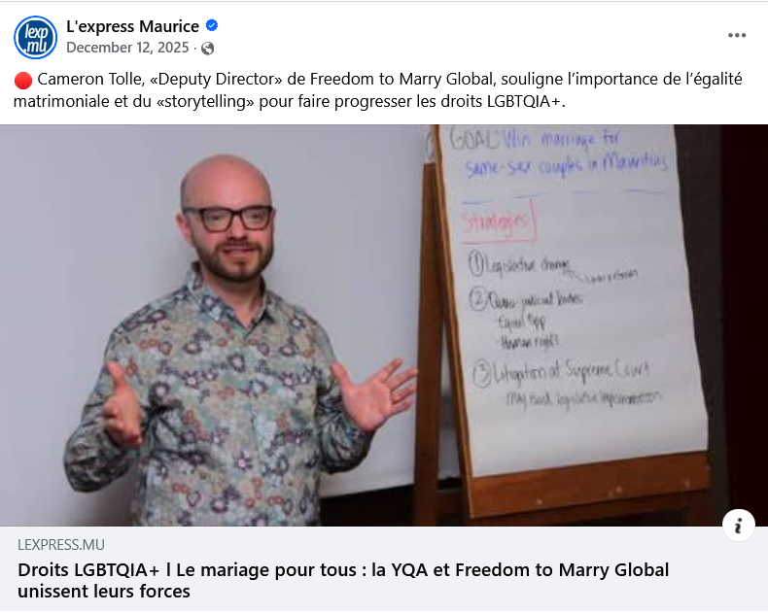
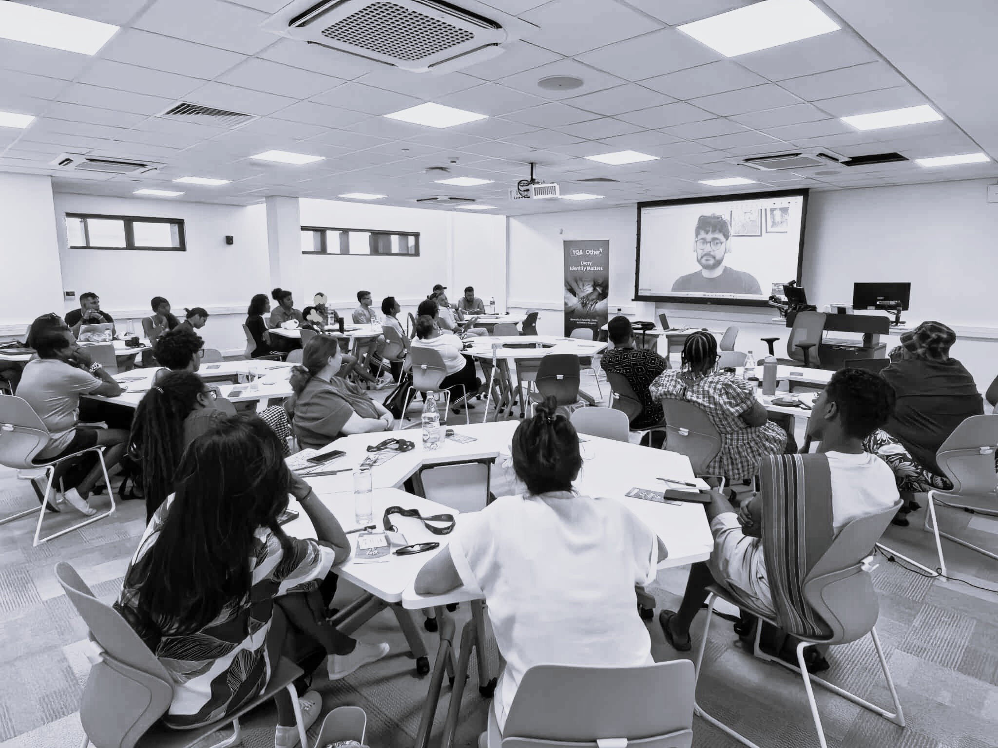
Sustainability
Sustaining Change
Building diversity in community narratives: establishing communication to share the i-stories of other same-sex couples, and their family and friends, showing support and acceptance for same-sex marriage
Generating evidence: conducting research and securing community feedbacks, narratives and community-led evidence
Multi-level advocacy: setting up advocacy meetings with other stakeholders, NGOs, foreign missions, and businesses to further the conversation on same-sex marriage
Partnering with media houses: training of media houses for proper reporting on marriage
Press article dated 12 December 2025 on the importance of “storytelling” to advance same-sex marriage
Discussions with the community on 07 February 2026 using evidence to advance same-sex marriage in Mauritius
Voice and Choice Summit 2026 \ Voice and Choice Summit 2026

Slide 8
Next Steps
Four-pronged approach to Strategic Litigation:
Judicial Process:
Attend meetings at the National Human Rights Commission in view of a conciliation and resolution
Plan for the next steps if conciliation and resolution is not reached at the NHRC
Community:
Continue strategic guidance and collaboration with organisations such as Freedom to Marry to draw on global best practices in advancing marriage equality
Develop a risk management plan to prevent and adapt in case of organised opposition and risks to plaintiffs and the community
Strengthen partnership with local LGBTQIA+ NGOs, ally NGOs, and other stakeholders
Advocacy:
Finalising the two research on “Socioeconomic analysis on same-sex marriage in Mauritius” and “Comparative legal analysis on same-sex marriage in Mauritius” by September/October 2026 followed by their dissemination
Setting up closed door advocacy meetings by the Advocacy Officer in place since February 2026 under the Marang Project
Media:
Coordinate media engagement and public education with partners to build broader understanding and support for same-sex marriage in Mauritius
Voice and Choice Summit 2026 \ Voice and Choice Summit 2026

