Slide 1


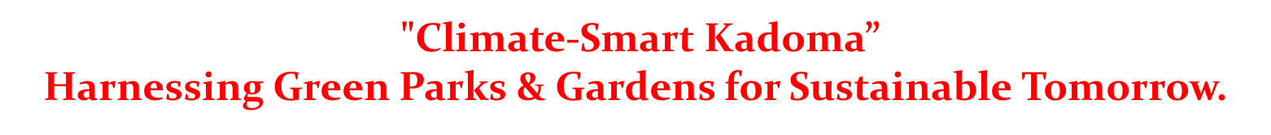
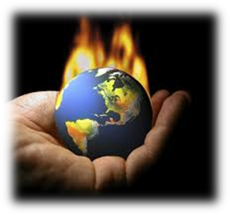
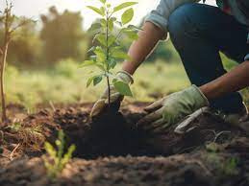
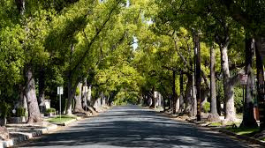


Slide 2
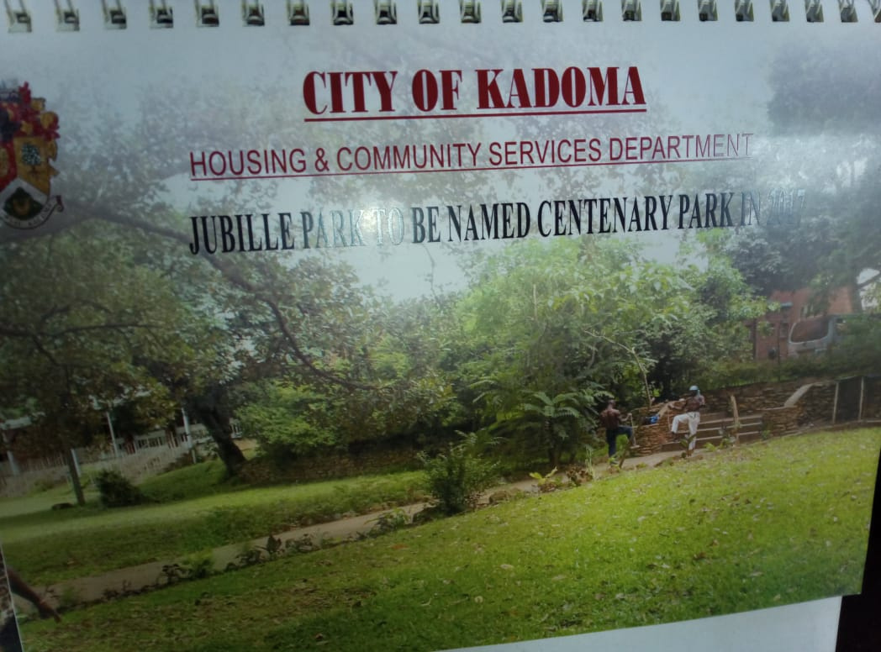
Background
"Climate-Smart Kadoma" – model green city
Led by Kadoma City Council
10 green parks covering 50 hectares
Community-driven urban planning and design
Increased green cover, reduced heat, pollution
Boosted biodiversity, jobs, and businesses

Slide 3
Objectives
Build resilience with green infrastructure planning.
Enhance community well-being through engagement.
Boost food security and economic growth.

Slide 4
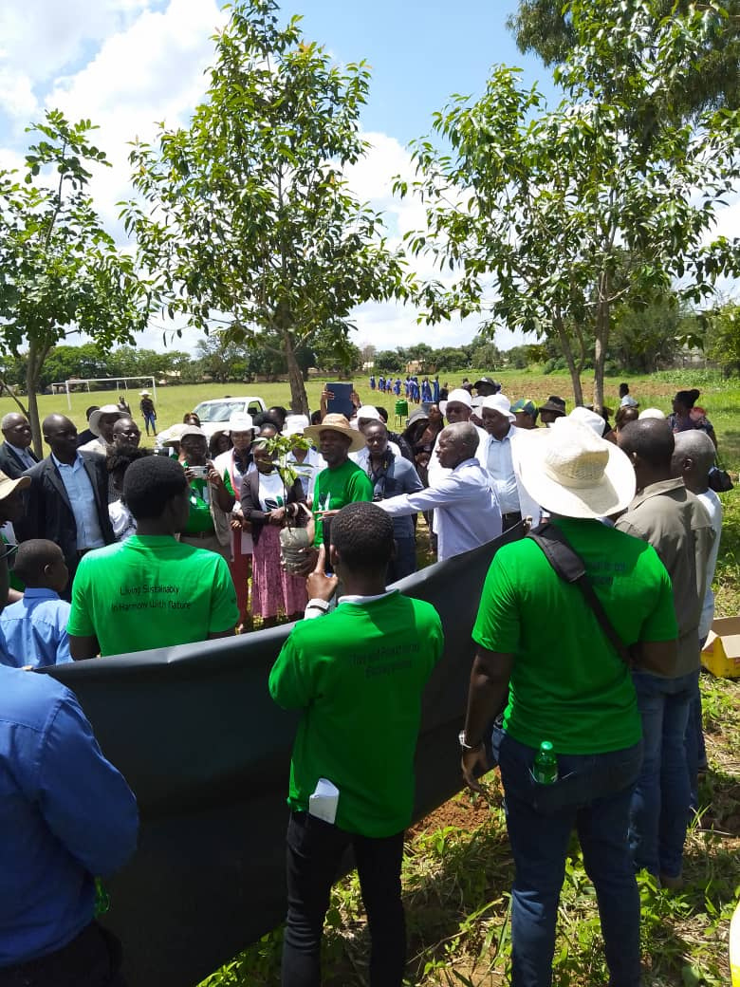
Target Groups
Community-Based Organizations (CBOs)
Women’s Groups
Local Business and Industry
Youth and Schools
Local Government and Policy Makers
Climate
Smart
Kadoma

Slide 5
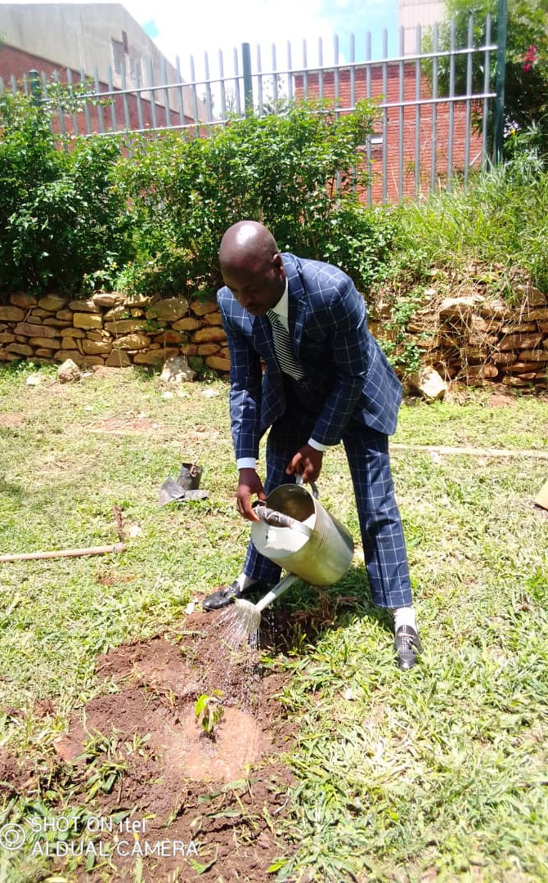
Activities
Tree Planting & Urban Forestry
Build biodiversity, improve air quality
Community Gardening Initiatives
Promote food security, community ownership
Green Infrastructure Development
Design parks for resilience, water management
Climate Education & Literacy
Empower residents with sustainable knowledge
Community Engagement Programs
Foster local stewardship and participation
Green Job Training & Opportunities
Equip residents for sustainable employment

Slide 6
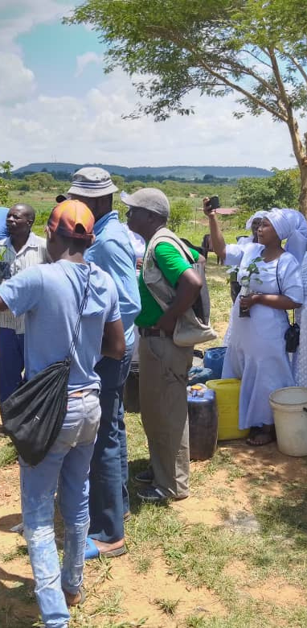
Strategies
Community Engagement
80%+ participation in workshops, sustained involvement.
Partnership and Collaboration
10+ partnerships, improved resource mobilization by 30%.
Design and Planning
40% green spaces created with resilient design.
Funding and Resource Mobilization
Secured $75,000+ through partnerships, grants.
Maintenance and Operations
90%+ of parks maintained by locals.
Capacity Building and Training
Trained 200+ stakeholders, enhanced local skills.
Advocacy and Policy Influence
3 key policies influenced, 40% increase in community support.
Monitoring and Evaluation
Quarterly assessments, 25% improvement in strategies.

Slide 7




Partners
GOVERNMENT PARTNERS
COMMUNITY
PRIVATE SECTOR PARTNERS
NON-GOVERNMENTAL ORGANISATIONS
Policy guidance, project coordination, funding support.
Park maintenance, implementation, education programs.
Park design, infrastructure development, plant supply.
Funding support, technical assistance, policy guidance. Advocacy, outreach, capacity building, research.

Slide 8
Budget
 | Amount in $
Gender specific allocation | 31 875
Gender in mainstream projects (please specify) | 31 875
Amount contributed in cash or in kind by partner organisations (please specify) | 12 500
Other sources (please specify) | 0
Total | 76 250

Slide 9
Participants
 | Female | Male | Total | % Women
Direct beneficiaries | 18 | 12 | 30 | 60%
Indirect beneficiaries (e.g. through other networks) | 61682 | 55699 | 117381 | 53%
Online beneficiaries (e.g. website access, mailing lists, scholarly articles) | 1300 | 500 | 1800 | 72%
Total | 63018 | 56211 | 119229 | 53%

Slide 10
Challenges and Solutions
Challenge | Solution
Financial Challenges | Partnered with international organizations for funding, implemented cost-saving measures, engaged local businesses for sponsorships.
Land Availability | Identified underutilized public spaces, collaborated with private landowners.
Community Engagement | Conducted outreach programs, established community-led park management committees, provided education and training on sustainable practices.
Infrastructure | Installed irrigation systems (boreholes).
Climate Change | Implemented climate-resilient design principles, used drought-resistant tree and shrub species.
Technical Expertise | Collaborated with experts, provided training and capacity building for staff.
Vandalism and Maintenance | Engaged community members in park maintenance, developed sustainable maintenance plans.
Stakeholder Conflict | Facilitated stakeholder engagement and dialogue, developed conflict resolution mechanisms, fostered partnerships and collaborations.

Slide 11
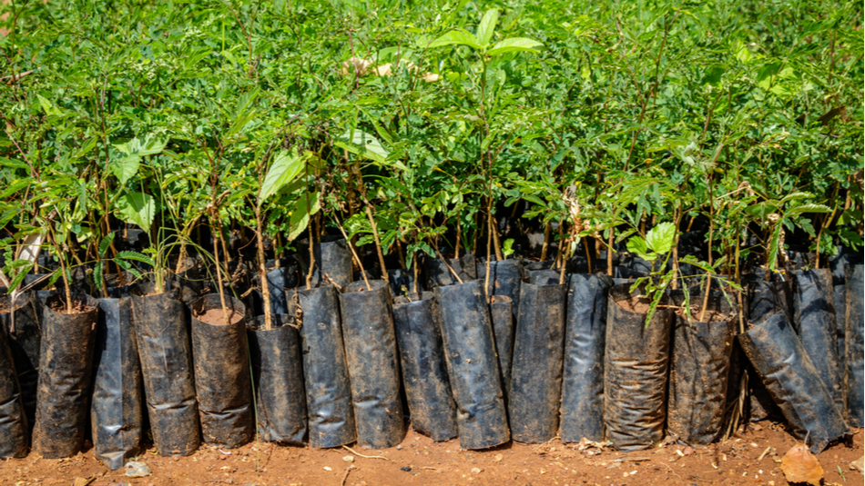
Results
Results

Slide 12
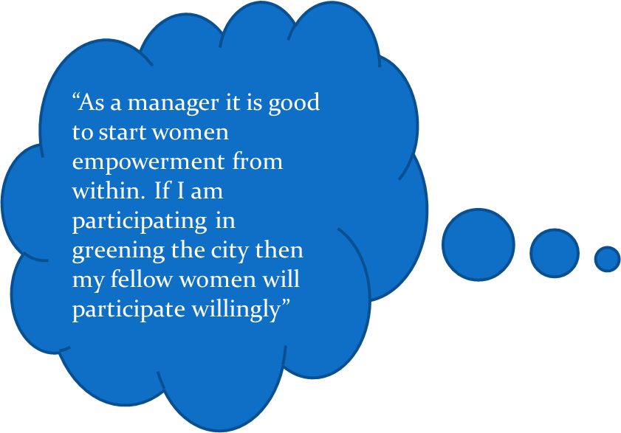
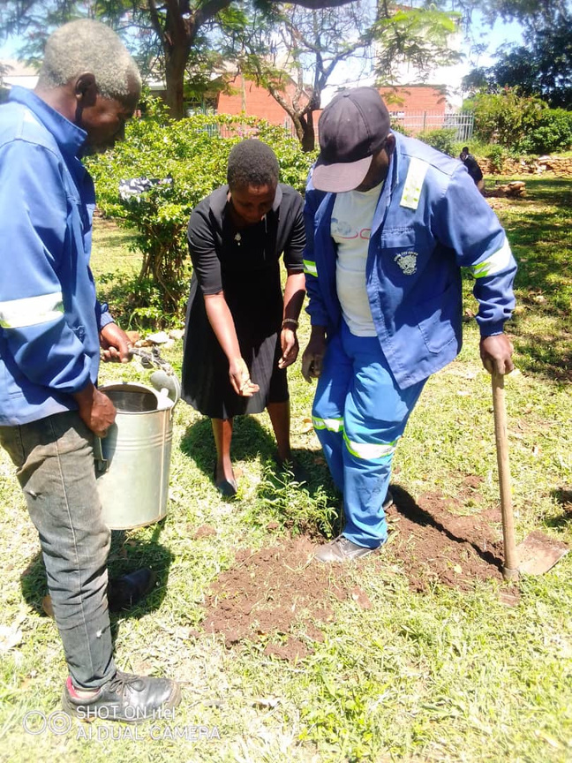
Women Empowerment
Monica Monga, Community Services Mannager 0774171958

Slide 13
Public Participation
Event: National Tree Planting Day
Purpose: Support Green Parks and Gardens initiative
Location: Tafadzwa Primary School, Kadoma, Zimbabwe
Date: December 2023

Slide 14
Media Coverage
Location: Centenary Park, Kadoma CBD
Media: A Desk Calendar was issued out
Purpose: Green Parks and Gardens initiative
Goal: Mitigate climate change with green cities
Date: February 2022, Kadoma, Zimbabwe

Slide 15
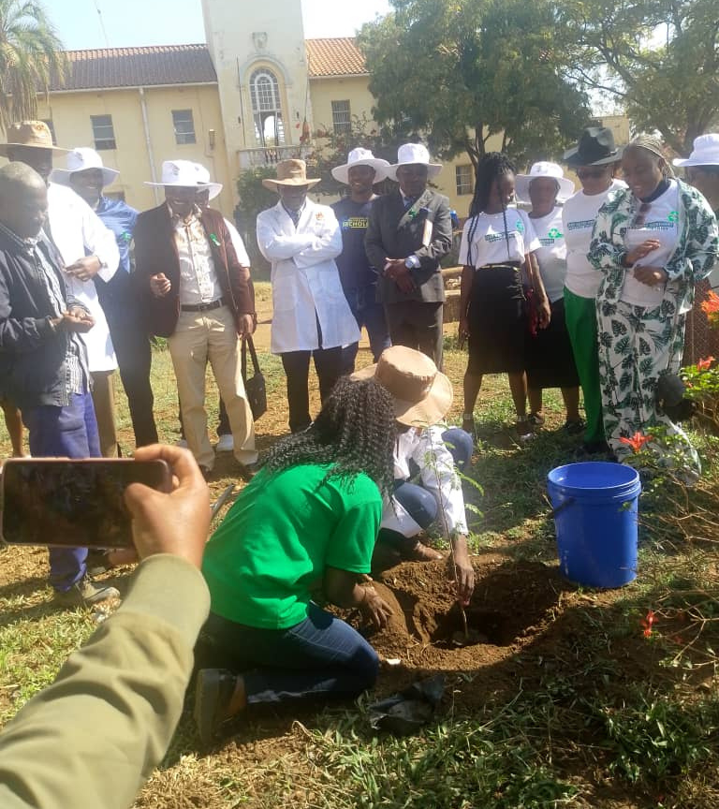
Capacity Building
Attendee: Minister of Local Government representative
Purpose: Zero Waste Movement initiative
Goal: Mitigate climate change through tree planting
Date/Location: July 2024, Civic Centre, Kadoma, Zimbabwe

Slide 16
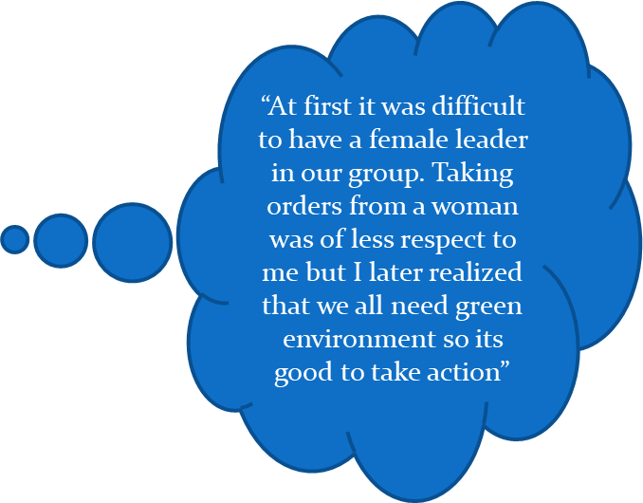
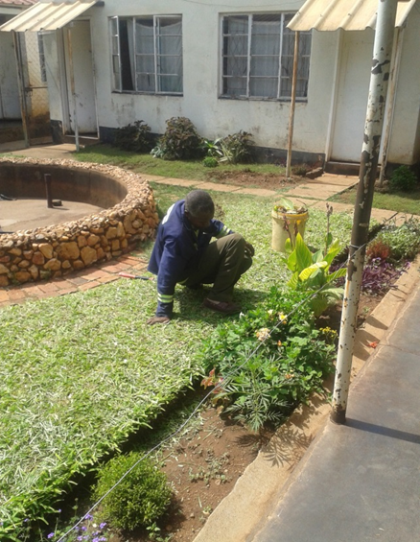
Changes in Gender Attitudes at Individual Level
Nelson Chiko, CBO member 0773532605

Slide 17
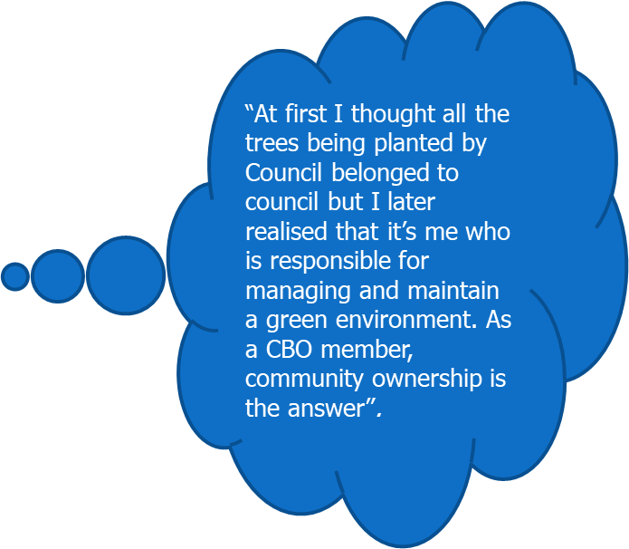
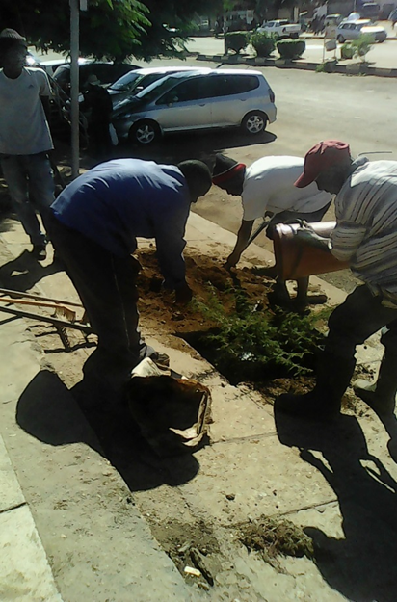
Changes in Gender Attitudes at Community level

Slide 18
Sustainability
Community-led management, public-private partnerships.
Integrated urban planning, green infrastructure.
Ongoing training, monitoring, and evaluation.
Replication
Replicate model in other cities.
Inform urban policies, green infrastructure.
Strengthen public-private partnerships, resource mobilization.
Develop climate-resilient infrastructure, sustainability guidelines.

Slide 19
Lessons Learnt
Community engagement and stakeholder collaboration drive success.
Integrated urban planning, climate resilience design essential.
Public-private partnerships leverage resources and expertise.
Capacity building, training, and adaptive management improve projects.
Application
Replicate model, share knowledge regionally, internationally.
Strengthen partnerships, mobilize resources, enhance programs.
Develop resilient infrastructure, integrate lessons learned.

Slide 20
Monitoring
Used RBME to track progress.
Measured outcomes and performance against goals.
Focused on impact and data-driven decisions.
Tools Used
Surveys and focus groups for feedback.
Photography, videography, and weather stations.
Community engagement through participatory budgets.
Evaluation Methods
Monthly reports for regular monitoring.
Focus groups and observations for insights.
Surveys and weather data for evaluation.

Slide 21
Next Step - Key Priorities
Conduct a mid term evaluation
Develop another phase of the project
Engage stakeholders and secure funding
Implement expansion plans.
Monitor and evaluate progress.

Slide 22
