Slide 1




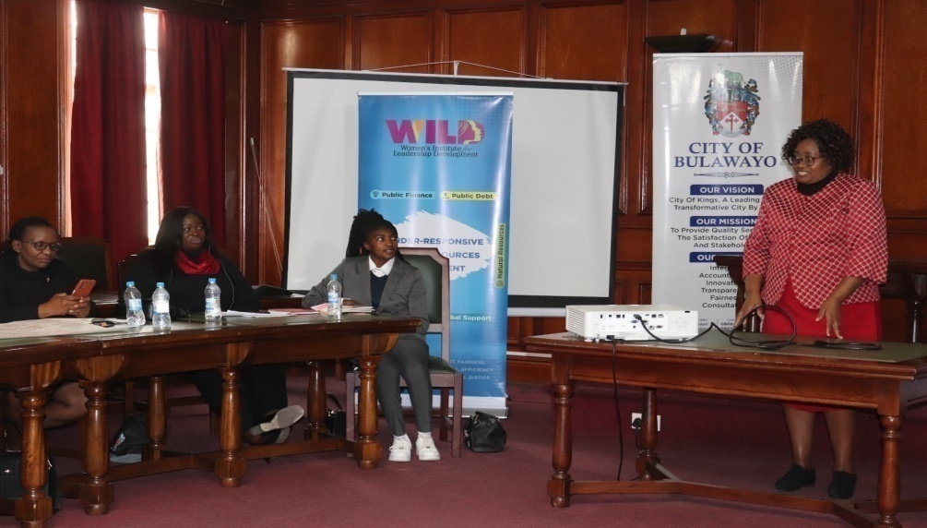

SADC PROTOCOL@WORK SUMMITS AND AWARDS
2024
INSTITUTIONAL COE
COUNTRY: ZIMBABWE
ORGANISATION: CITY OF BULAWAYO
DATE: 11-11-2024
PRESENTER: AUDREY MANYEMWE
GENDER FOCAL PERSON
Mrs A Manyemwe presenting on the importance of mental health at the Councillors Mental Health Dialogue in June 2024
“Voice and Choice! Empower Women, End Violence”

Slide 2
OVERVIEW
COUNTRY | ZIMBABWE
COUNCIL | CITY OF BULAWAYO
GENDER CHAMPION | HIS WORSHIP THE MAYOR SENATOR DAVID COLTART AND COUNCILLORS
GENDER FOCAL PERSON | AUDREY MANYEMWE
IS THE COUNCIL A HUB OR SPOKE COUNCIL?
Latest score (year) | 88
 | Women | Men | Total | % Women
Council | 17 | 21 | 38 | 45
Management | 4 | 19 | 23 | 17
Council staff overall | 1198 | 2410 | 3608 | 33
Population served | POPULATION CENSUS 2022: 665,952, COMPRISING OF 54% FEMALES AND 46% MALES
Key characteristics
“Voice and Choice! Empower Women, End Violence”

Slide 3
OVERVIEW KEY CHARACTERISTICS
Second largest city of Zimbabwe
Strategically located in the South Western part of the country linked by road, rail and air to South Africa, Botswana and Zambia. Zimbabwe International Trade Fair gate way to Bulawayo.
“Voice and Choice! Empower Women, End Violence”

Slide 4
OVERVIEW
VISION
City of Kings, A Leading Smart Transformative City By 2025.
MISSION
To provide quality services to the satisfaction of clients and stakeholders.
“Voice and Choice! Empower Women, End Violence”

Slide 5
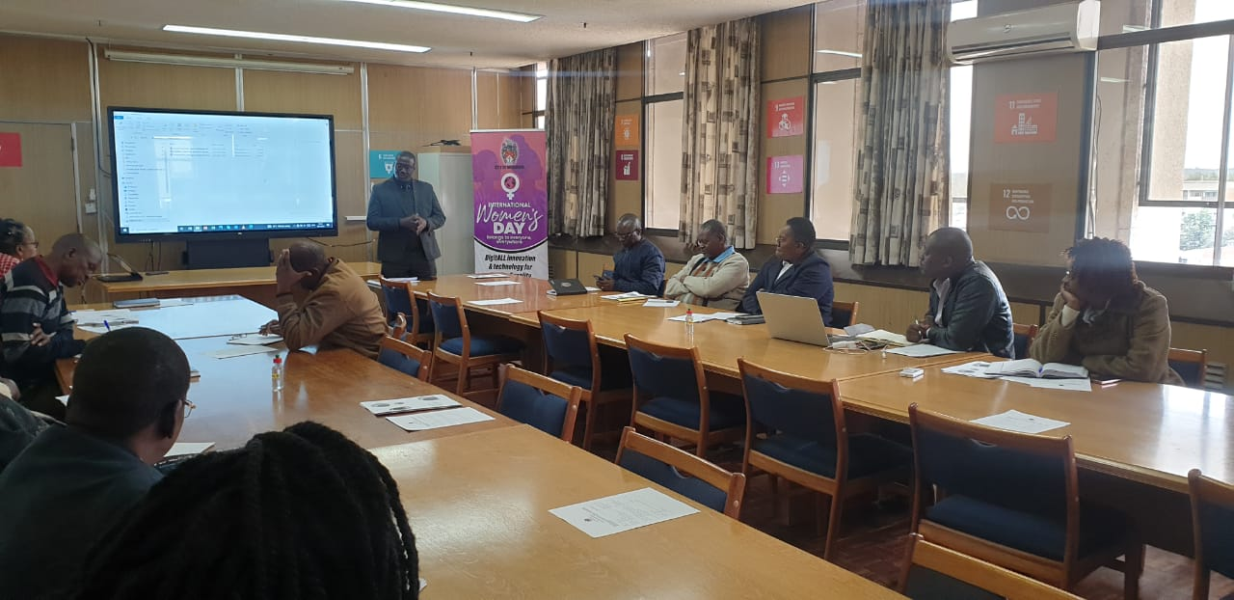
OVERVIEW
9 DEPARTMENTAL GENDER FOCAL PERSONS
Nokukhanya Ngwenya
Siphiwe Ndlovu
Charles Ndlovu
Siphiwo Moyo
Fanuel Nkawu
Linda Sibindi
Siphathisiwe Sibanda
Taught Mnkandla
Grace Chipare
Thando Sithole
Joyce S Moyo
Thandekile Tele
Siphathisiwe Dube-
Veronica Ncube
Dumoluhle Moyo
Departmental Gender Focal Persons during the Gwanda RDC Look and Learn Visit in 2023
“Voice and Choice! Empower Women, End Violence”

Slide 6
I. GENDER POLICY, ACTION PLAN, HUB AND SPOKE
“Voice and Choice! Empower Women, End Violence”

Slide 7
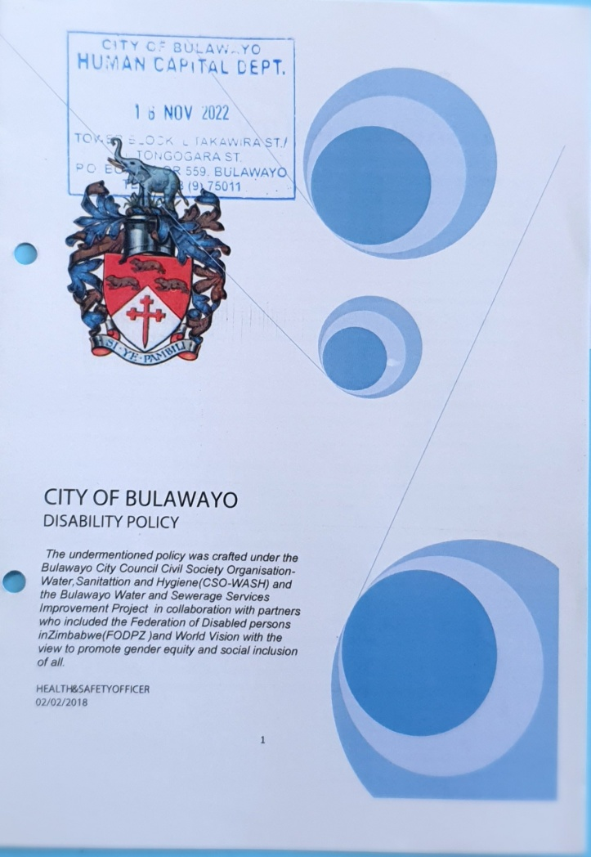
  GENDER POLICY FRAMEWORK
City of Bulawayo has a Gender Policy and Disability Policy which were adopted in 2017.
Council has other policies that address gender and social inclusion:
Recruitment and Selection Policy
Training and Development Policy
Sexual Harassment Policy
Employee wellness Policy
Youth Policy
Safety, Health & Environment
City of Bulawayo Code of Conduct
“Voice and Choice! Empower Women, End Violence”

Slide 8
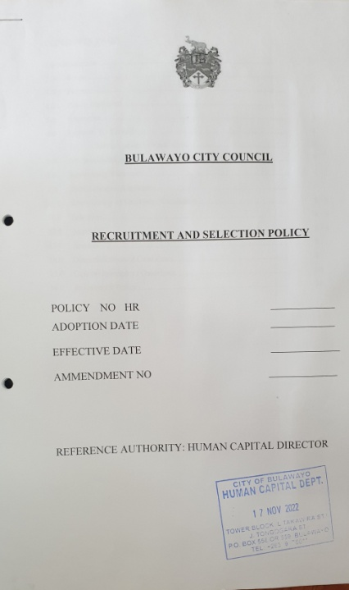

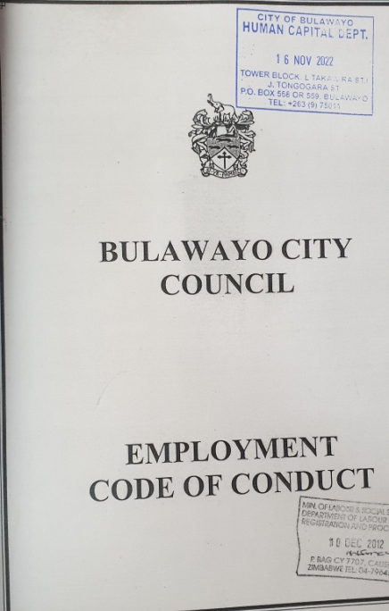
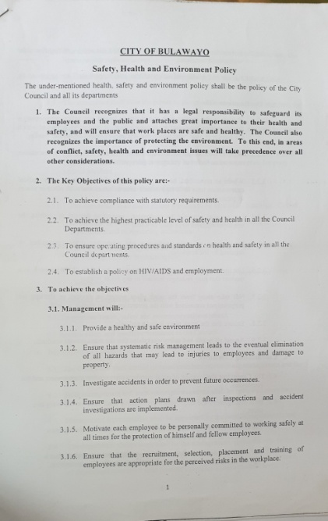
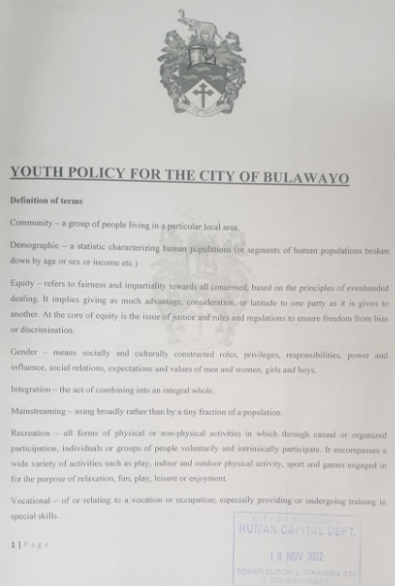
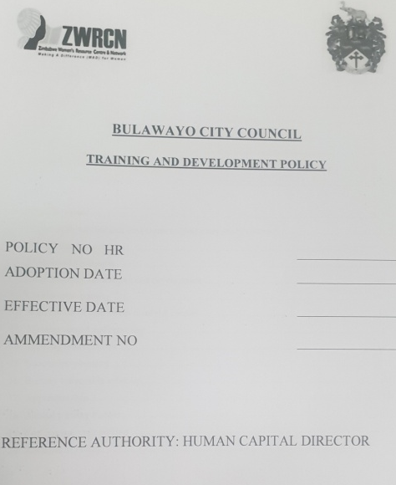
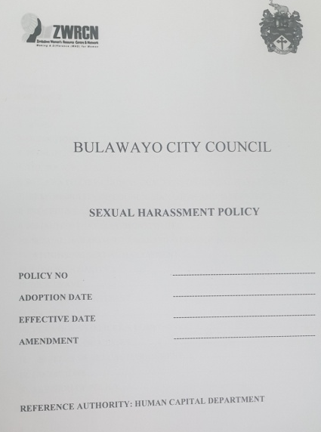
i. GENDER POLICY FRAMEWORK
“Voice and Choice! Empower Women, End Violence”

Slide 9
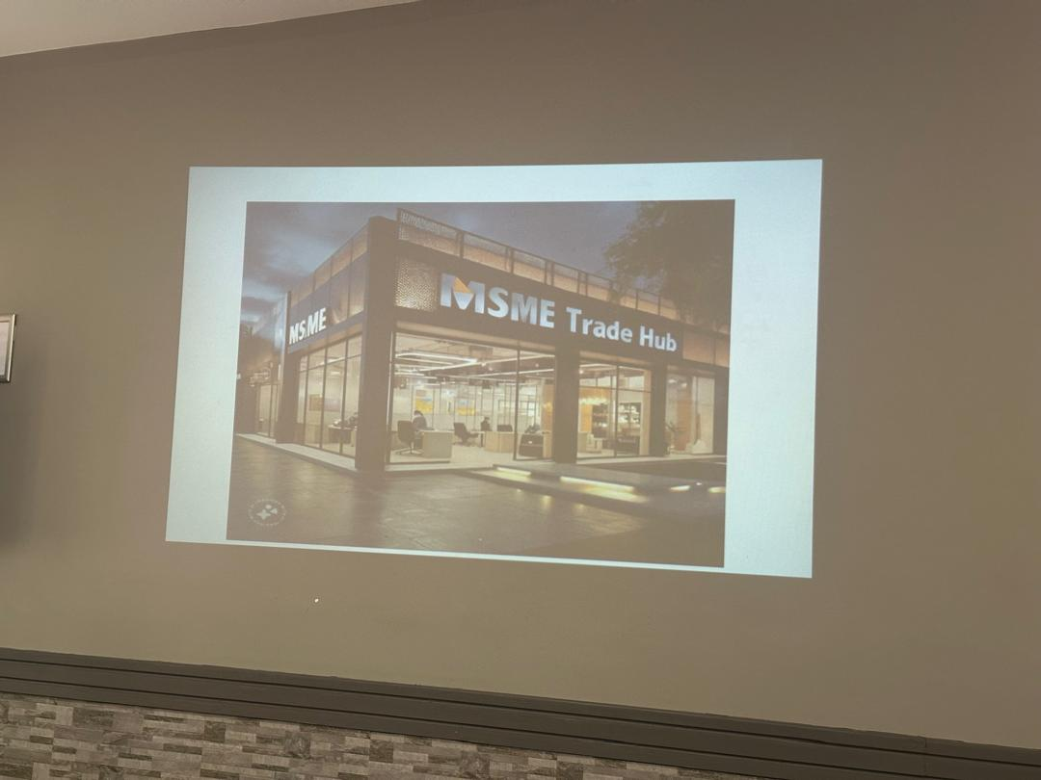
ii. ACTION PLAN
The City of Bulawayo has a Gender Action Plan which is reviewed annually.
For 2024 the emphasises was placed on the Local economic Development thematic areas
Proposed trade hub to be constructed within the Dugmore council offices
“Voice and Choice! Empower Women, End Violence”

Slide 10
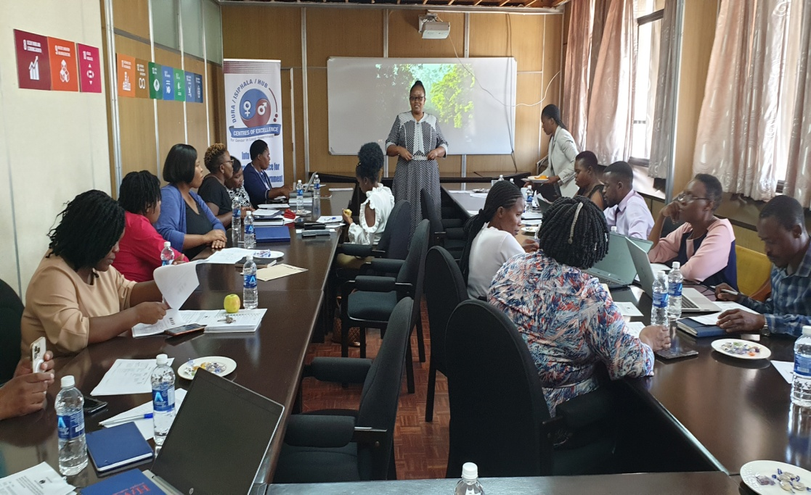
  iii. HUB AND SPOKE
The City of Bulawayo is a hub council which mentors Victoria Falls, Lupane Local Board and Hwange Local Board and other local authorities outside its Hub
The hub and spoke activities are conducted twice a year by the council though exchange visit
Victoria Falls Council, Lupane Local Board and Hwange Local Board on a Look and Learn Visit on the 26th of October 2023 at TowerBlock
“Voice and Choice! Empower Women, End Violence”

Slide 11
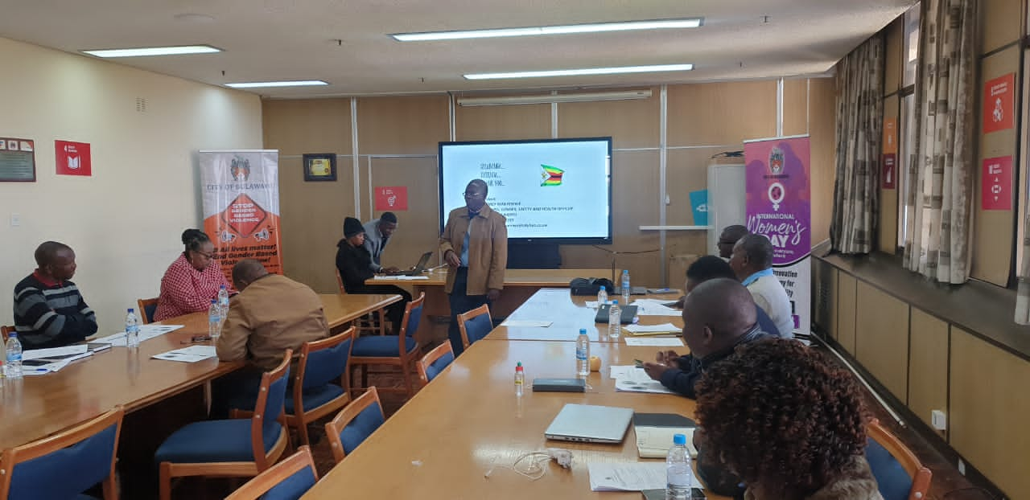
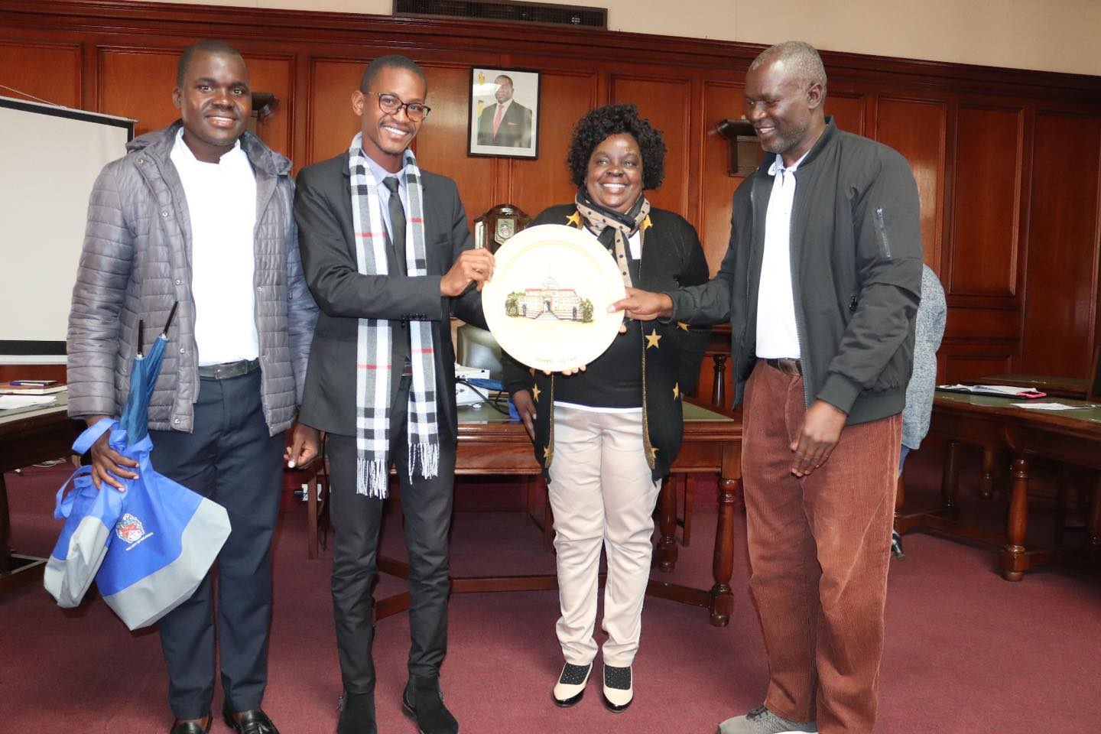
iii. HUB AND SPOKE
City of Bulawayo Finance Manager Mr Isaac Matare explaining the Gender Responsive Budget Template to Gwanda RDC Gender Committee on the 14th of June 2023 at TowerBlock
Representatives from Quelimane Municipality, Mozambique who were on a look and learn visit receiving gifts from the Chamber Secretary Mrs Zhou in May 2024
“Voice and Choice! Empower Women, End Violence”

Slide 12
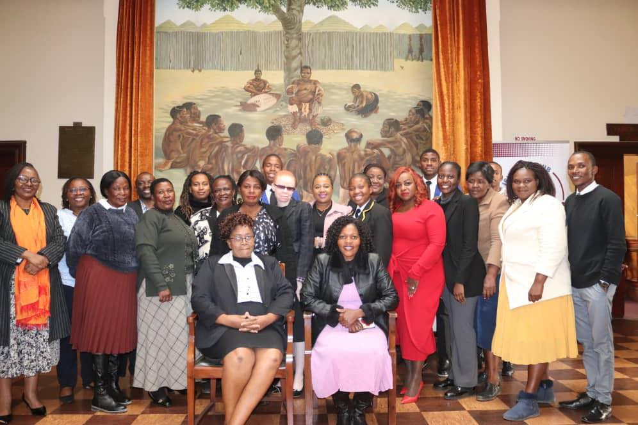
II. GOVERNANCE
Proportion
There are 17 female Councilors, with a total proportion of 45%.
8 are elected/ first past the post and 9 are proportional representation
Council has 8 committees and 2 which are Health, Housing and Education Committee and the Future Water Supplies are chaired by women.
At the moment Council does not have committees chaired by persons with disabilities
City of Bulawayo female Councillors during the European Union Monitoring Visit
“Voice and Choice! Empower Women, End Violence”

Slide 13
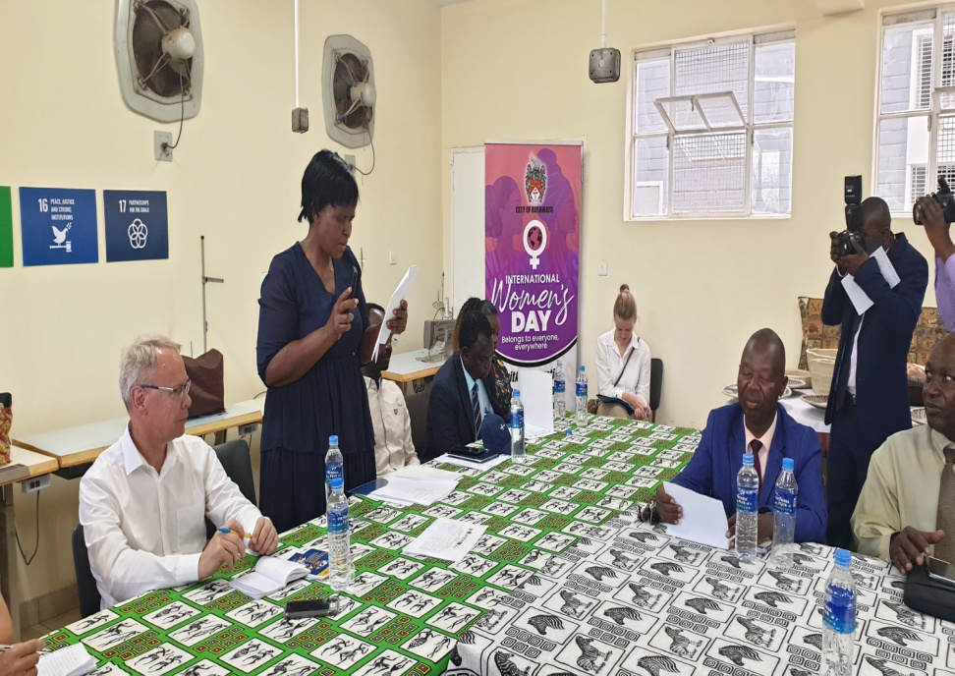
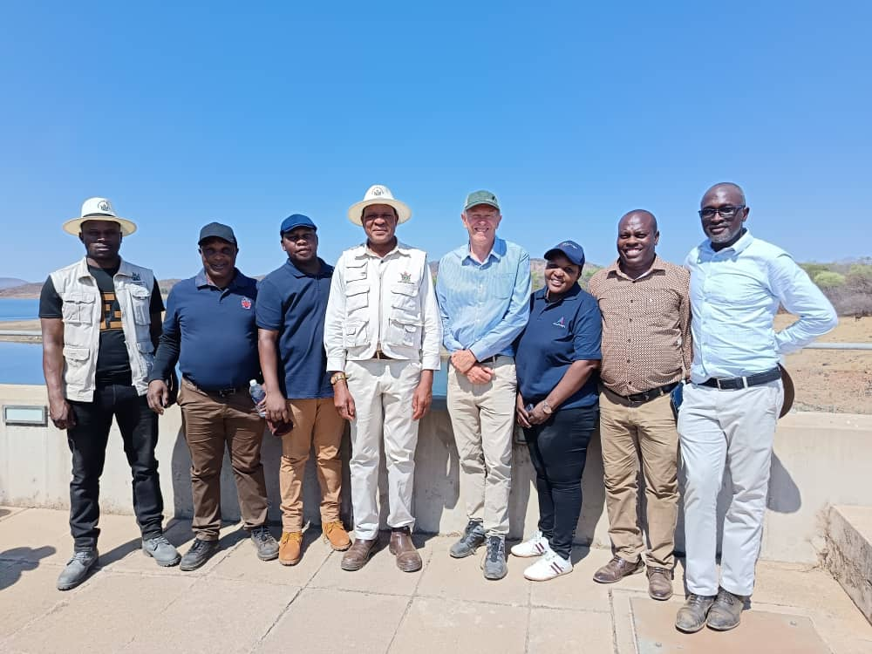
II. GOVERNANCE
Cllr Ntombizodwa Khumalo ,the Chairperson for the Health, Housing and Education Committee as the Acting Mayor during the Embassy of Sweden Field Visit at Bulawayo Home Industries
Cllr Khalazani Ndlovu, Chairperson of the Future Water Supplies on a tour to Insiza and Mtshabezi dams with the Minister of Waste
“Voice and Choice! Empower Women, End Violence”

Slide 14
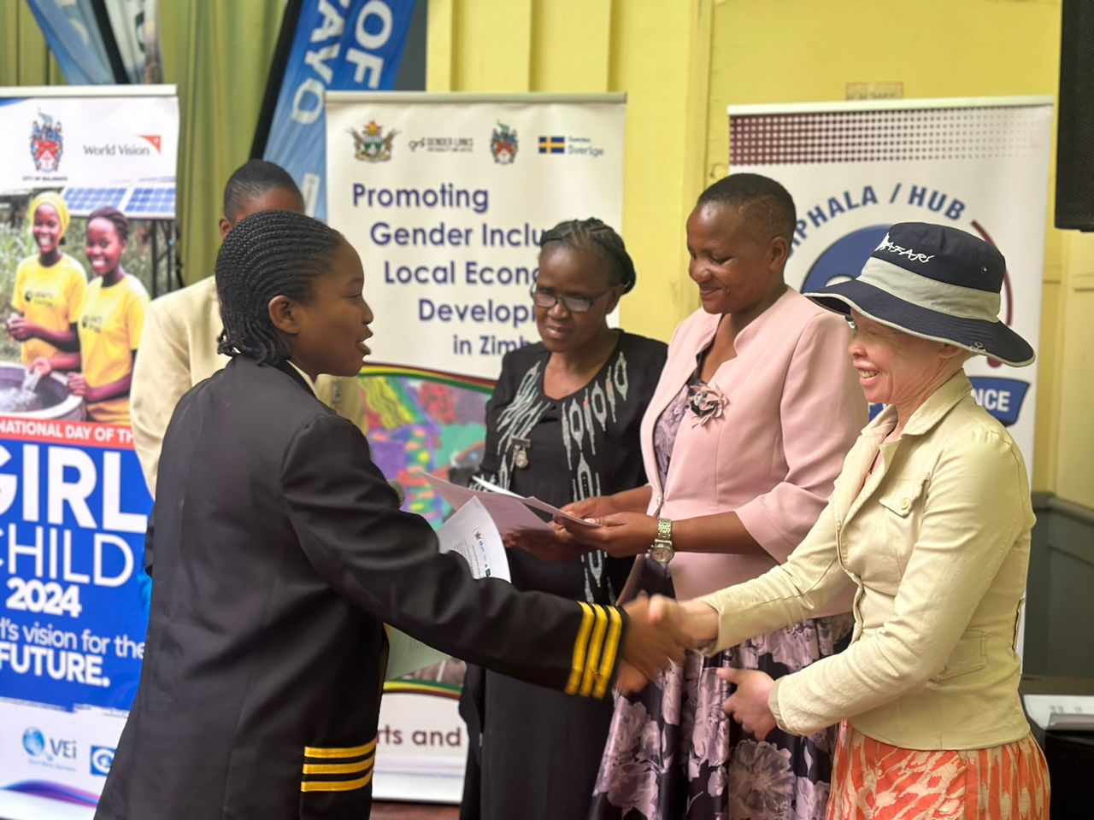
II. GOVERNANCE
Junior Mayoress, Lindokuhle Velaphi with Cllr Mercy Furanayi, Cllr Skhululekile Moyo and Cllr Ntombizodwa Khumalo at the International Day of the Girl Child on the 18th of October 2024 at the Small City Hall
“Voice and Choice! Empower Women, End Violence”

Slide 15
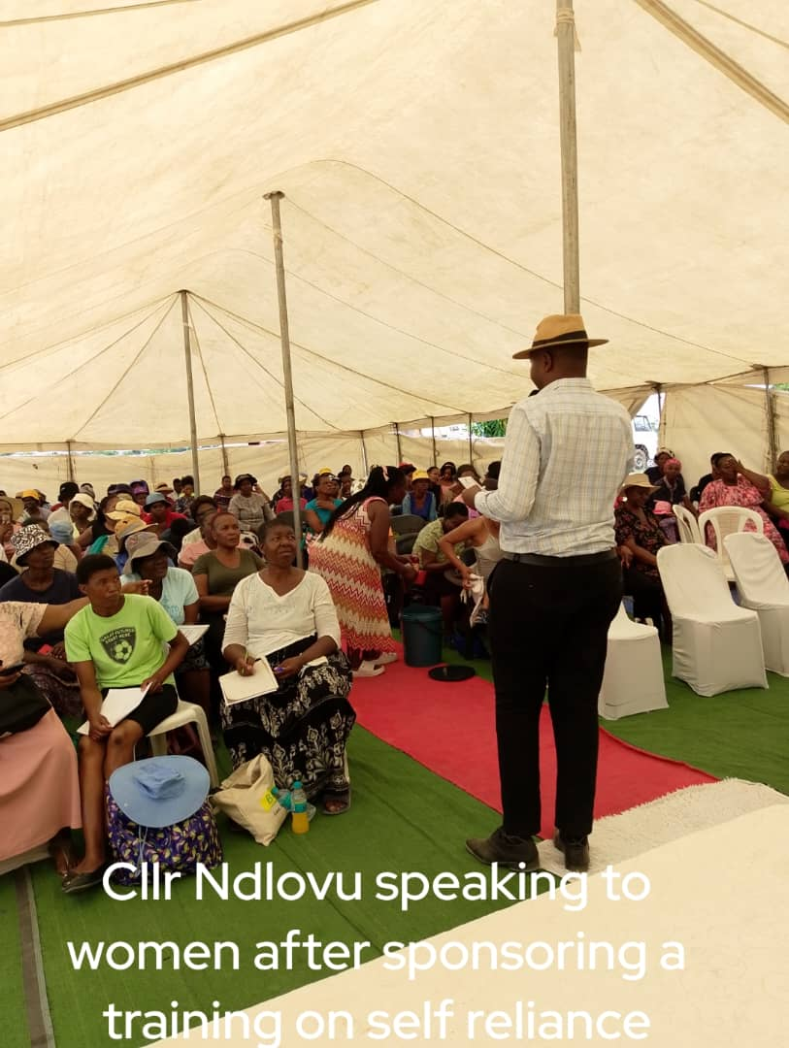
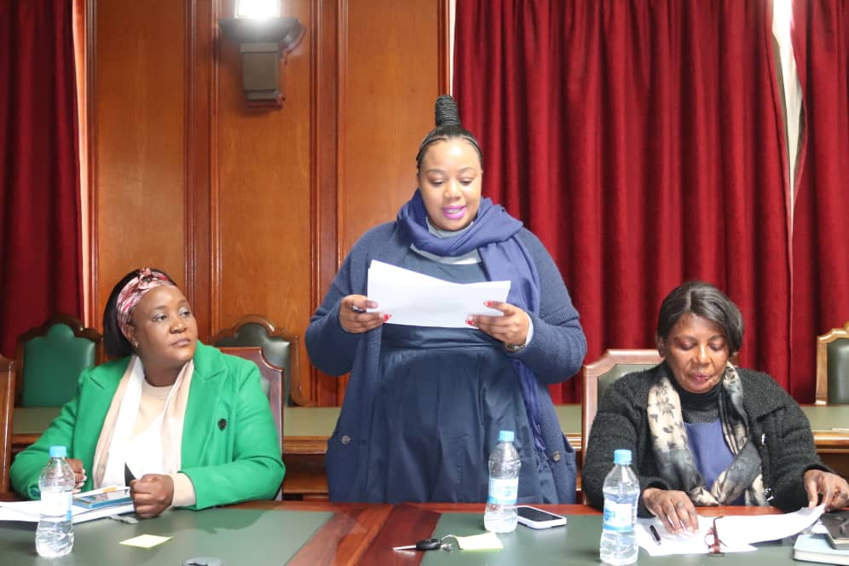
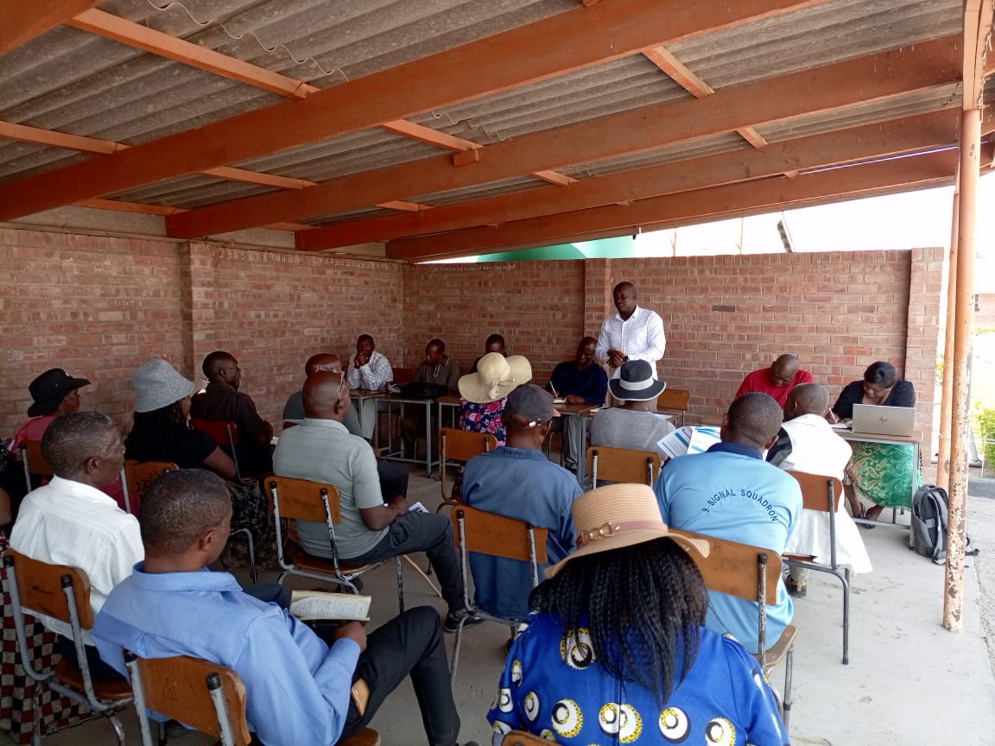
II. GOVERNANCE
Council Youth Councilors in action!!
Cllr Mellisa at the Mental Health Workshop
Cllr Ashton Mhlanga during one of the budget meetings in his ward
“Voice and Choice! Empower Women, End Violence”

Slide 16
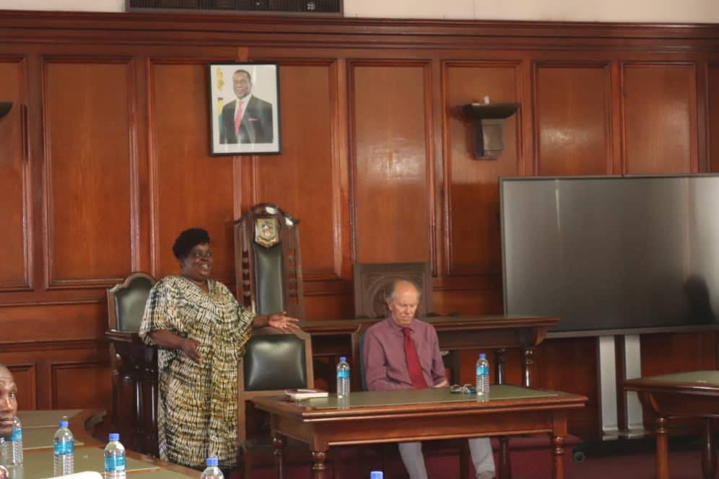
II. GOVERNANCE
PROPORTION
Council has 4 females (17%) out of 23 in decision making positions
These include 1 Head of Department, the Chamber Secretary and 3 Assistant Directors
Mrs Zhou, the Chamber Secretary addressing Acumen Group on the water crisis in the City
“Voice and Choice! Empower Women, End Violence”

Slide 17
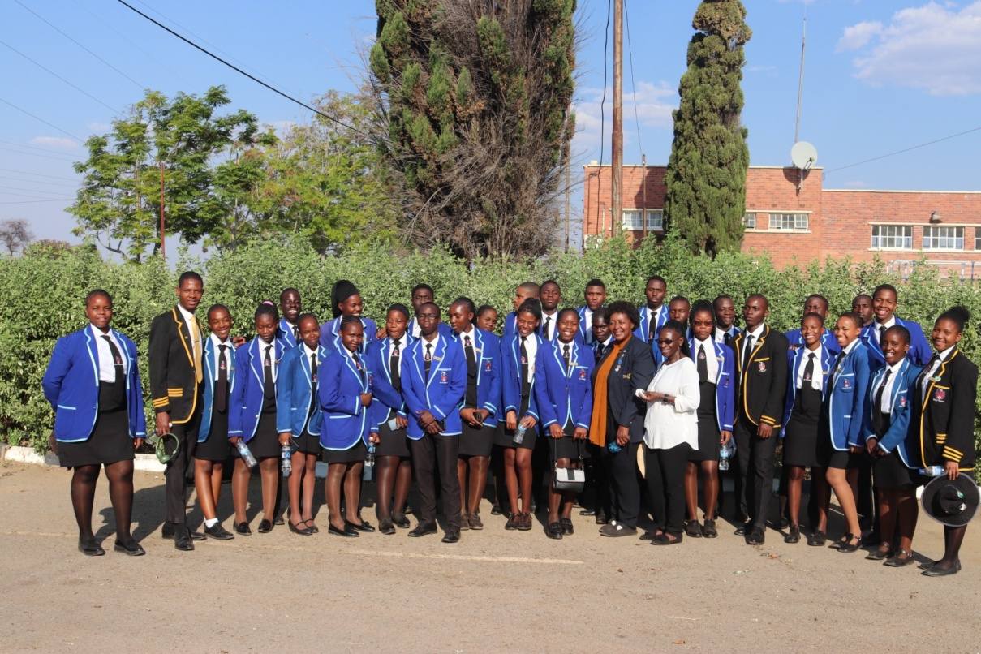
II. GOVERNANCE
PROPORTION
Council has a Junior Council comprising of 60% females and 40% males.
The Junior Council is headed by the Junior Mayor and Junior Mayoress.
City of Bulawayo Junior Councilors at Criterion Water Treatment Plant
“Voice and Choice! Empower Women, End Violence”

Slide 18
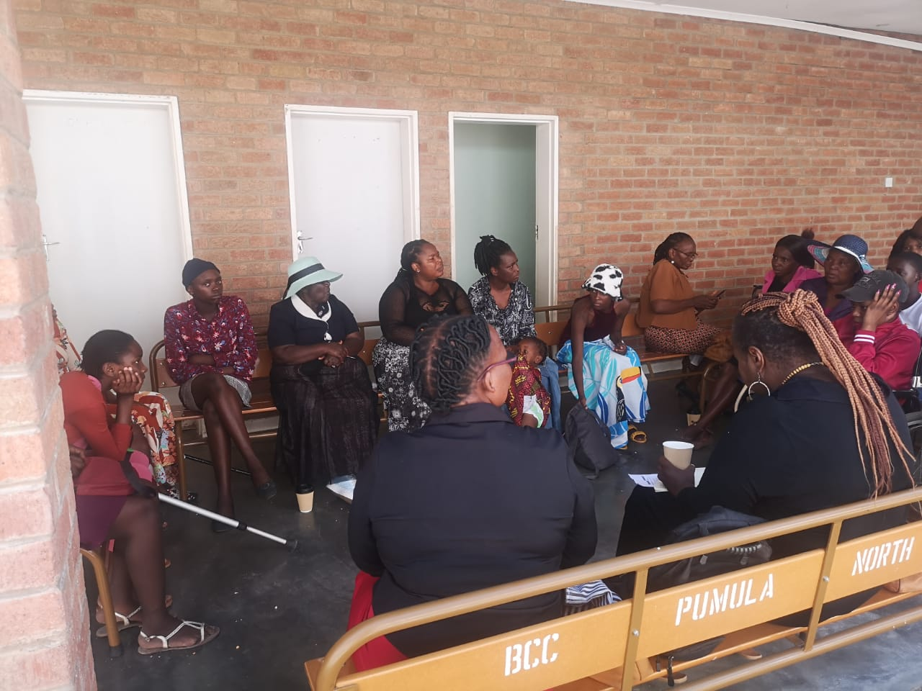
II. GOVERNANCE
Public Consultations
Evidence
Women, youths, persons with disabilities take part in council consultations
Eg. Council budget meetings, Youth Led High Tea Dialogue, Gender Based Violence Assessment with World Bank.
Eg the GBV Assessment had a representation of 74% women, 26% men with 5% PWDs
Women, youths and PWDs participating at the World Bank GBV Assessment consultation dialogue on the 3rd of April 2023.
“Voice and Choice! Empower Women, End Violence”

Slide 19
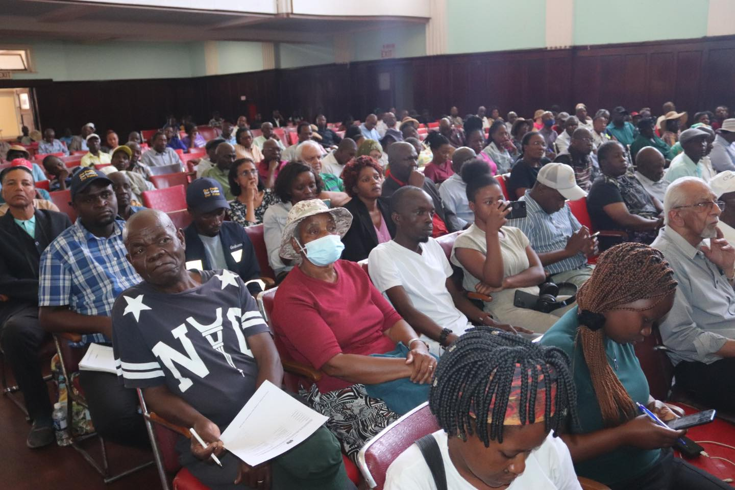
II. GOVERNANCE
Women, men, youths following proceedings during the Budget Consultation for the year 2025 at the Large City Hall
“Voice and Choice! Empower Women, End Violence”

Slide 20
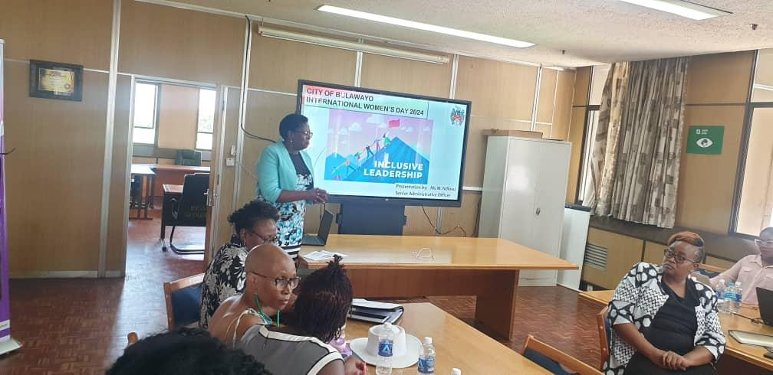
III. WORK PLACE POLICY AND PRACTICE
32% of Council’s workforce constitutes of women
Council has a total of 3608 employees, and 19% are youths and 0.1% are PWDs
4 (17%) women out of a total of 24 are in positions of decision making
.
Town Planning female Senior Administration Officer Moddie Ndlovu presenting on Inclusive Leadership during the International Women’s Day Commemoration on the 8th of March 2024 at TowerBlock. She is one of the 2 female Senior Administration Officers in Council
“Voice and Choice! Empower Women, End Violence”

Slide 21
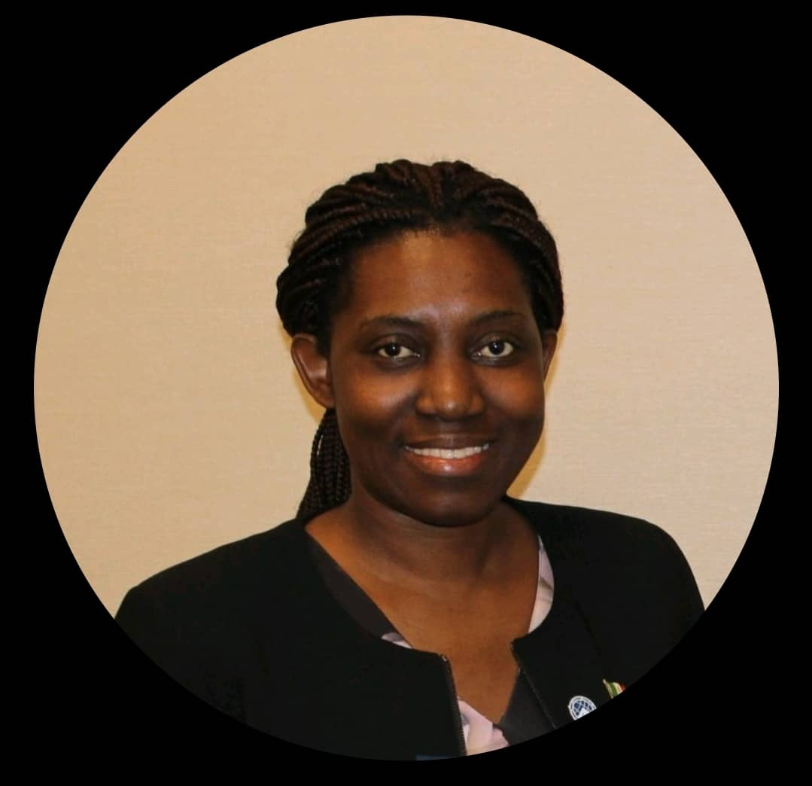
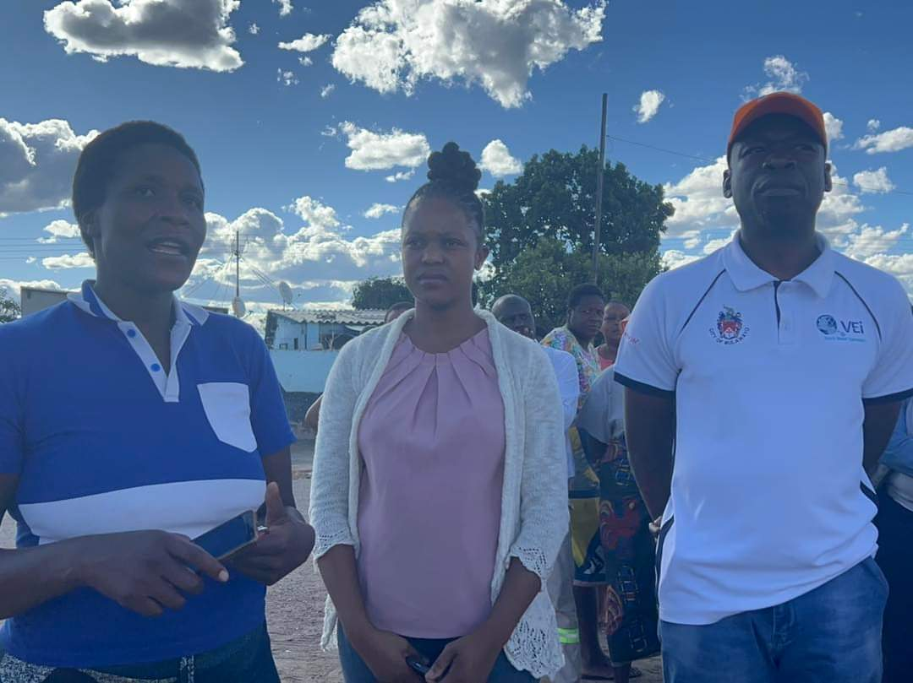
III. WORK PLACE POLICY AND PRACTICE
Council has 6 female doctors out of 10, 1 female Principal Engineer and also Assistant Director for Water and Sanitation Department, the Chamber Secretary is a woman and 7 other female engineers and technicians
A total of 219 females are in middle management positions
BCC Principal Civil Engineer Kwanele Sibanda/ Civil Engineer Sandi Sibanda
“Voice and Choice! Empower Women, End Violence”

Slide 22

III. WORK PLACE POLICY AND PRACTICE
Council has a Sexual Harassment Policy which provide guidelines on how to deal with cases of sexual harassment.
Council provides breastfeeding hour for breastfeeding mothers until the child is 6 months.
“Voice and Choice! Empower Women, End Violence”

Slide 23
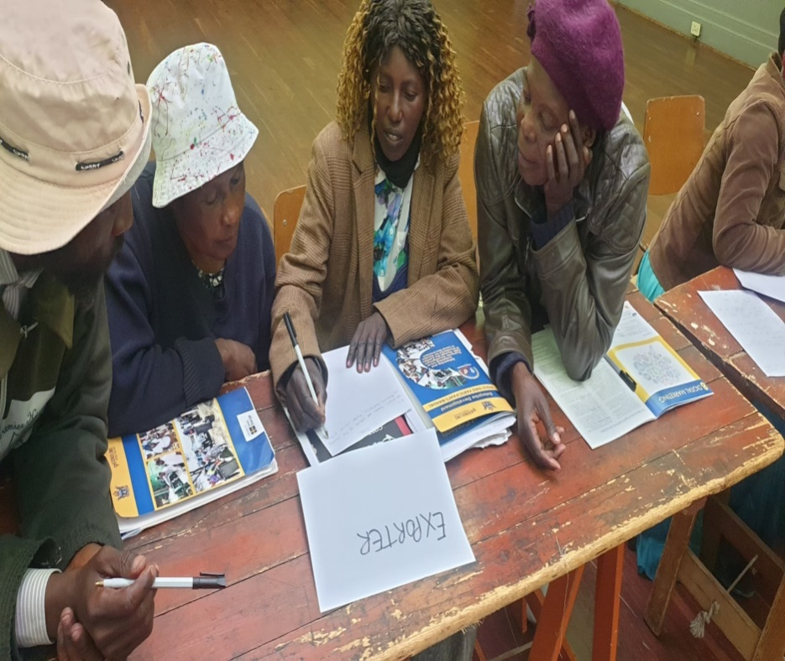
IV. LOCAL ECONOMIC DEVELOPMENT
Council has the Local Economic Action Plan
Council has designed and allocated 10744 market spaces, 54% were women, 33% men, 12% youths and 1% persons with disability.
50% Women, 30% men, 20% youths including persons with disabilities were selected to be part of the Gender Inclusive Local Economic Development programme under the Arts and Craft Value Chains
Participants during the Gender Links Local Economic Development Phase 3 training held on the 3rd- 4th July 2024
“Voice and Choice! Empower Women, End Violence”

Slide 24
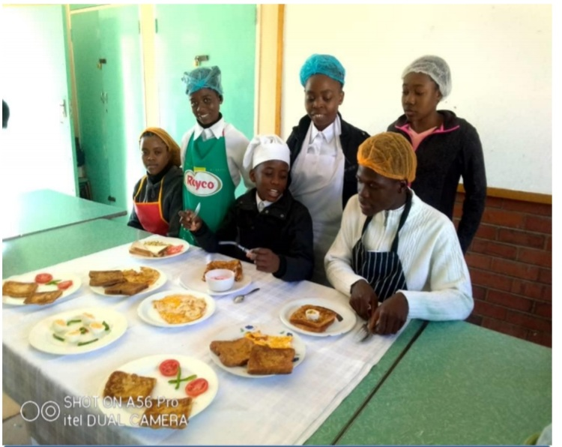
IV. LOCAL ECONOMIC DEVELOPMENT
Council runs
15 Youth Centres, 10 Vocational Training Centres and 3 Home Craft Centre
Entrepreneurship training (Sunrise Campaign expansion) workshops for women, youths, persons with disabilities
These centres have a proportion of 36% (1165) females and 64% (2100)and 1% PWDs
Hotel and Catering students at Mzilikazi Centre
“Voice and Choice! Empower Women, End Violence”

Slide 25
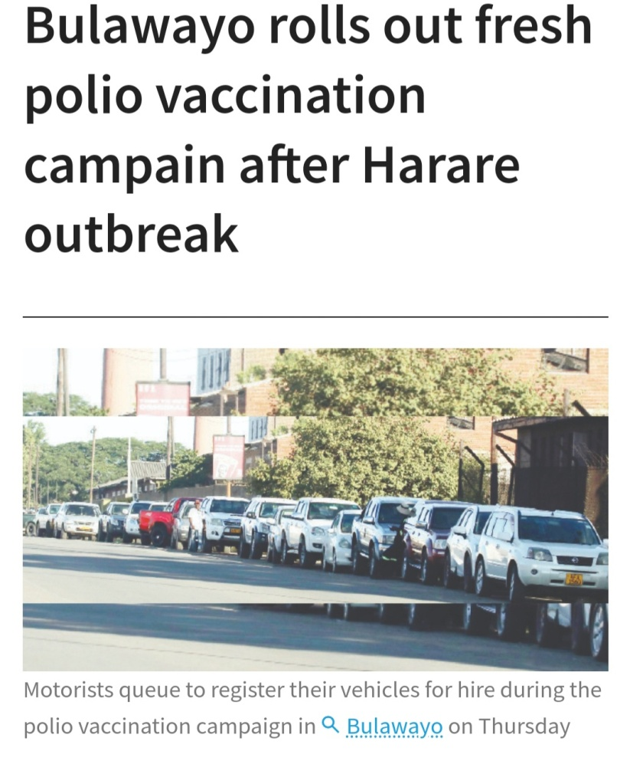
IV. LOCAL ECONOMIC DEVELOPMENT
Council allocates tenders to women-owned businesses:
85 women were awarded tenders for vehicle hire for immunisation vaccines
10 women were awarded tenders for vehicle hires for refuse removal
Women owned businesses such as Trade toppers, Privian International, Rascomy Investments, Sideline Trading, Gladevale Trading, Gladevale enterprises, Linkage trading and Water Tight Engineering were awarded contract
A newspaper article showing car queing to register after the vehicle tender had been called out in 2023
“Voice and Choice! Empower Women, End Violence”

Slide 26
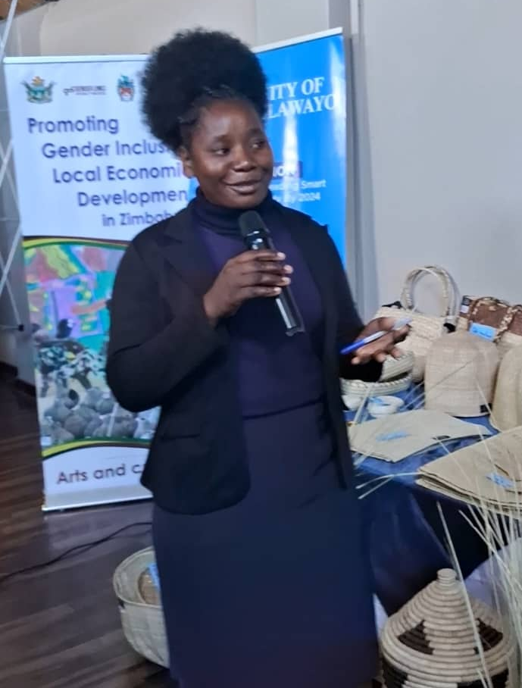
IV. LOCAL ECONOMIC DEVELOPMENT
Bulawayo Cultural Value Chains Project was commissioned by Honourable Minister Winston Chitando on the 9th of February 2024 at the Bulawayo Home Industries (BHI).
Project entrepreneurs also participated at the Gender Links Trade Show that was held in Harare
Thenjiwe Ndlovu, one of the LED entrepreneurs explaining on their products at the Trade Show on the 17th of August 2023
“Voice and Choice! Empower Women, End Violence”

Slide 27
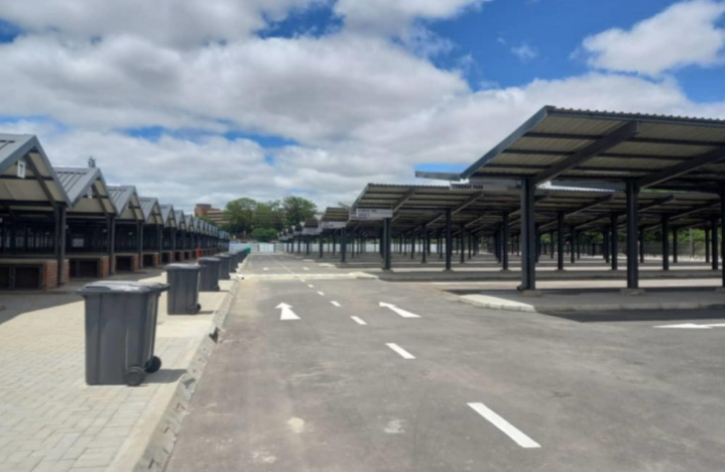
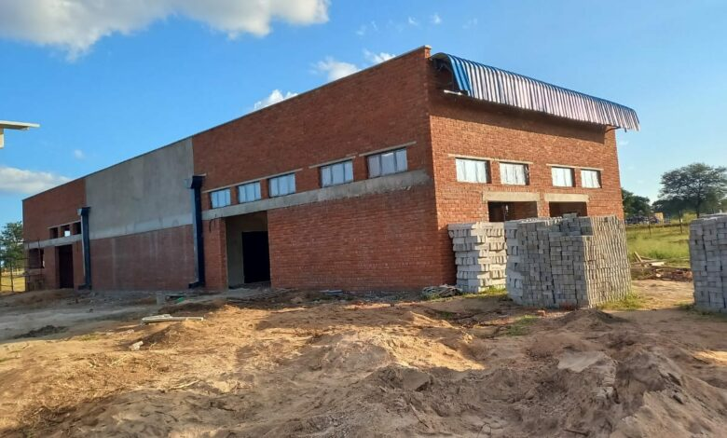
IV. LOCAL ECONOMIC DEVELOPMENT
New market stands at Egodini
Construction of the Nkulumane safe market and green solutions market in partnership with the Ministry of Local Government and Public Works, Dan Church Aid and UNDP Zimbabwe
“Voice and Choice! Empower Women, End Violence”

Slide 28
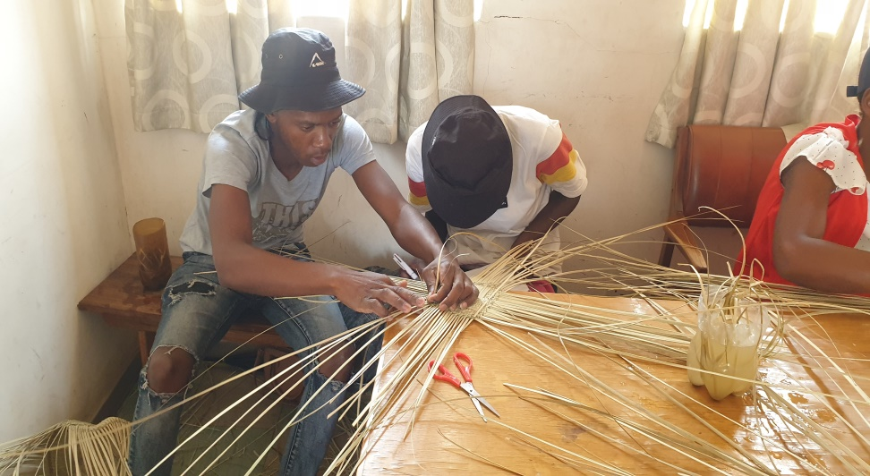
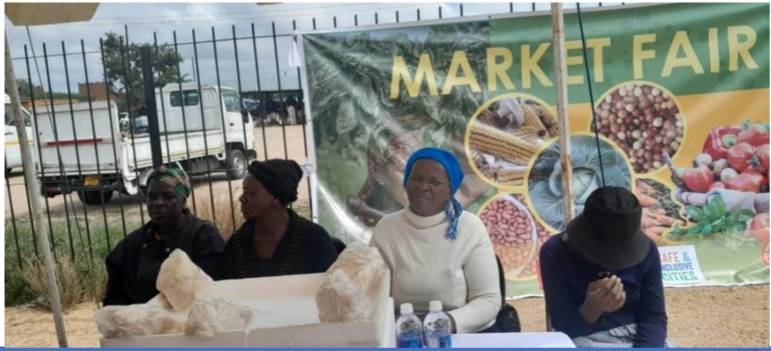
IV. LOCAL ECONOMIC DEVELOPMENT
Youths being trained on basketry weaving at Nkulumane Housing Offices
Bulawayo women at the Market Fair held earlier in 2024
“Voice and Choice! Empower Women, End Violence”

Slide 29
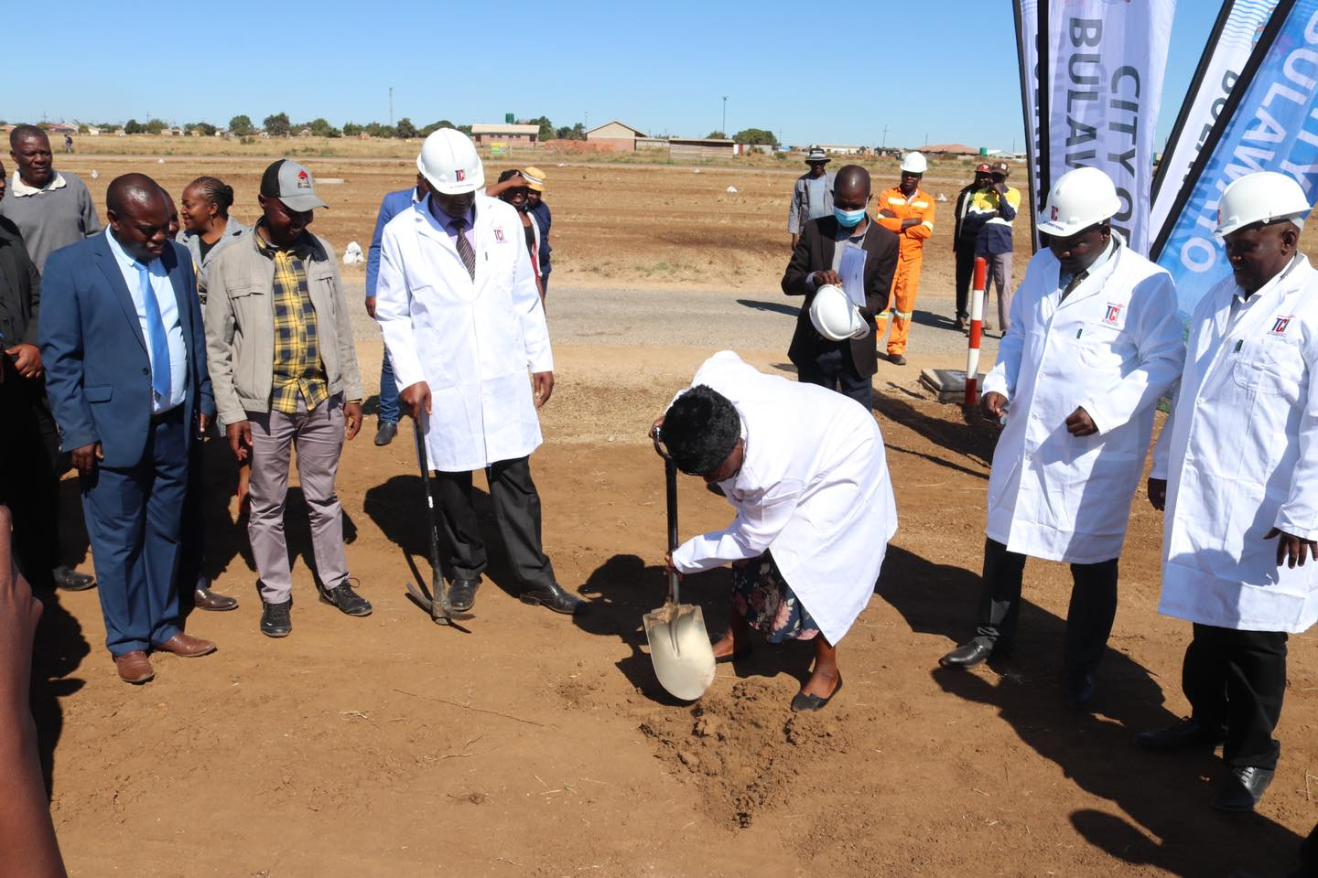
V. INFRASTRUCTURE AND SOCIAL DEVELOPMENT
LAND
.
Housing Allocations | Number | Proportion (%)
Women | 88 | 48
Men | 96 | 52
Total | 184 | 100
Council is responsible for providing housing and commercial land
Sex disaggregated data on housing stands are kept
City of Bulawayo commissioned 118 residential stands at the Emganwini Suburb in May 2023
Minister of State Hon Judith Ncube commissioning the Emgwanwini stands in 2023
“Voice and Choice! Empower Women, End Violence”

Slide 30
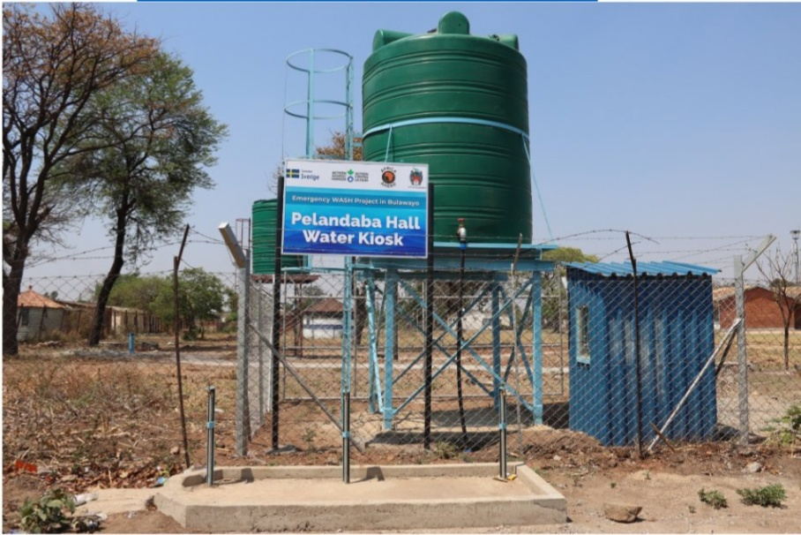
V. INFRASTRUCTURE AND SOCIAL DEVELOPMENT
WATER
Council is responsible for the provision of water
There has been rehabilitation works taking place in water stations such as Ncema and Umzingwane to ensure proper service delivery
Council has conducted 5269 household water connections and 1722 sewer connections in 2024
One of the new Water Kiosks that were installed in Pelandaba in 2023
Water Committees | Number | Chairpersons of Water Committees | Vice Chairpersons of water committees
Women | 6 | 1 | 2
Men | 6 | 1 | 6
Total | 12 | 2 | 8
“Voice and Choice! Empower Women, End Violence”

Slide 31
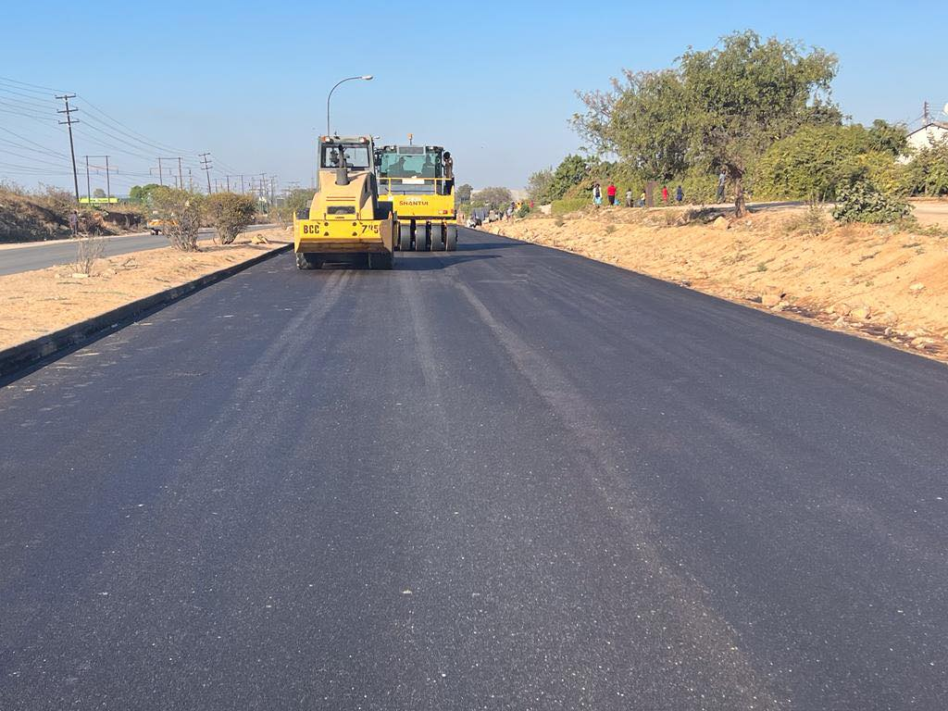
V. INFRASTRUCTURE AND SOCIAL DEVELOPMENT
ROADS AND PUBLIC LIGHTING
Council has been putting street names, signage and road markings that were no longer clear or visible.
Council has been rehabilitating roads in partnerships with the Ministry of Transport and other partners
The Council also provides public toilets for men, women and persons with disabilities at places like bus ranks, markets, stadium and community halls.
Council has also been installing solar street lights
Luveve Road rehabilitation
“Voice and Choice! Empower Women, End Violence”

Slide 32
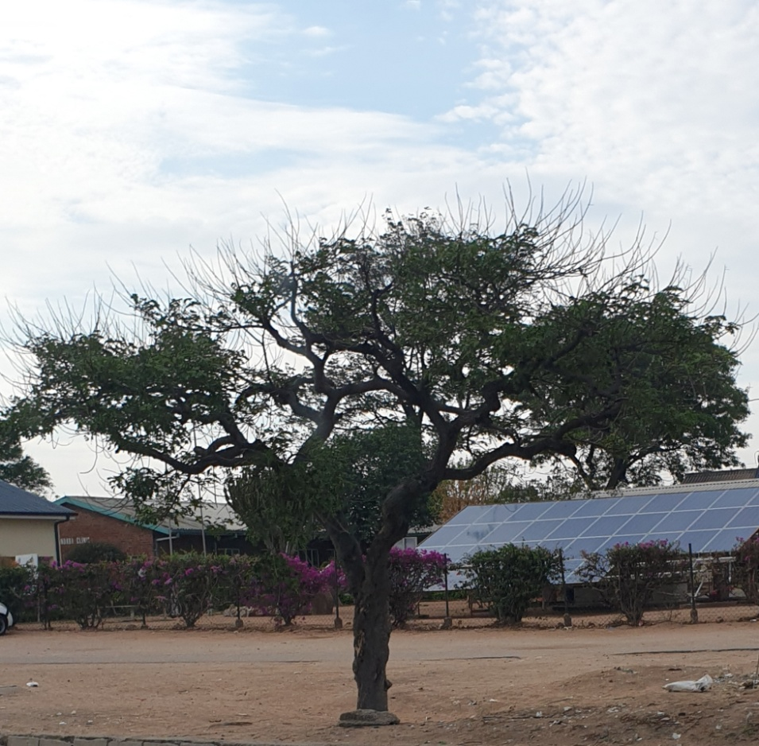
V. INFRASTRUCTURE AND SOCIAL DEVELOPMENT
Social Services
Council has social facilities such as 21 clinics, 31 schools, 15 libraries, 3 stadiums, 6 swimming pools, 16 recreation centres, 7 Vocational training centres, 20 community halls and 9 Home Craft Centres
All facilities are disability friendly, with ramps, disability ablution toilets and braille books for the visually impaired
Council installed solar at Maternal clinics for example Pelandaba Clinic
“Voice and Choice! Empower Women, End Violence”

Slide 33
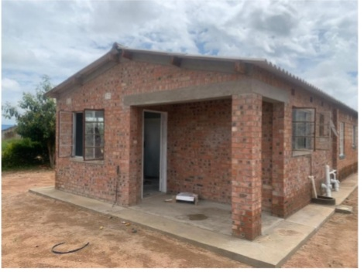
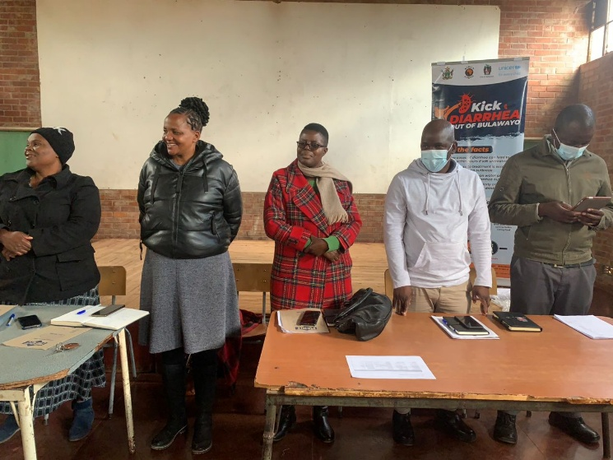
V. INFRASTRUCTURE AND SOCIAL DEVELOPMENT
Extention of temporary admin block at Vulindlela Primary school
Ward 17 water committee members and Cllr S. Moyo at one of the water point committee meetings
“Voice and Choice! Empower Women, End Violence”

Slide 34
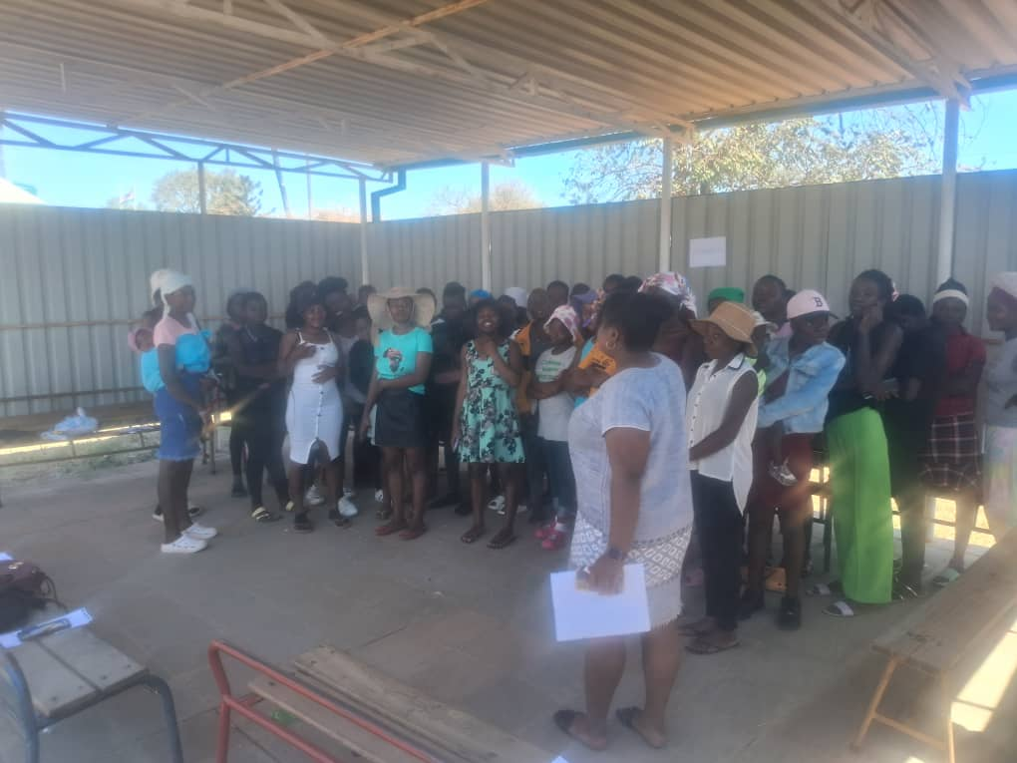
VI. SEXUAL AND REPRODUCTIVE HEALTH, HIV AND AIDS
Council has 21 clinics and 1 hospital and services provided include:
  cervical and breast cancer
  friendly family planning services
  referrals of suspected abortion to hospitals
  Provision of antenatal, basic obstetric & post-natal care services including pregnant adolescents and young girls.
Adolescent girls and young women awareness campaign on SRHR at Tshabalala Clinic in partnership with City Health Nationsl Aids Council and Plan International
“Voice and Choice! Empower Women, End Violence”

Slide 35
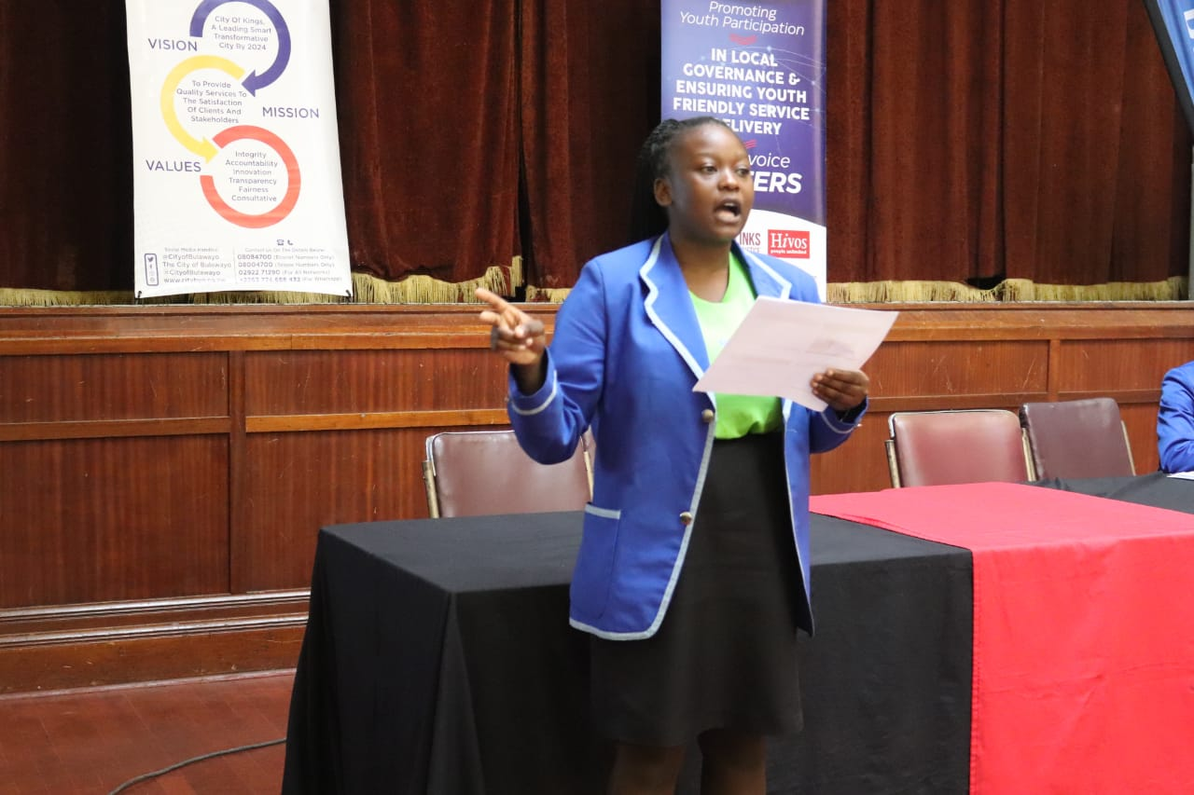
VI. SEXUAL AND REPRODUCTIVE HEALTH, HIV AND AIDS
Council conducts road show campaigns to reduce unsafe abortions and teenage pregnancies
Councils conducts awareness campaigns and dialogues on SRHR
Provision of Result Based Financing and Urban Voucher Programming in some clinics
Junior Councillor Honourable Chantele Chisiri presenting on SRHR during the Youth Led High Tea Dialogue held at Small City Hall
“Voice and Choice! Empower Women, End Violence”

Slide 36
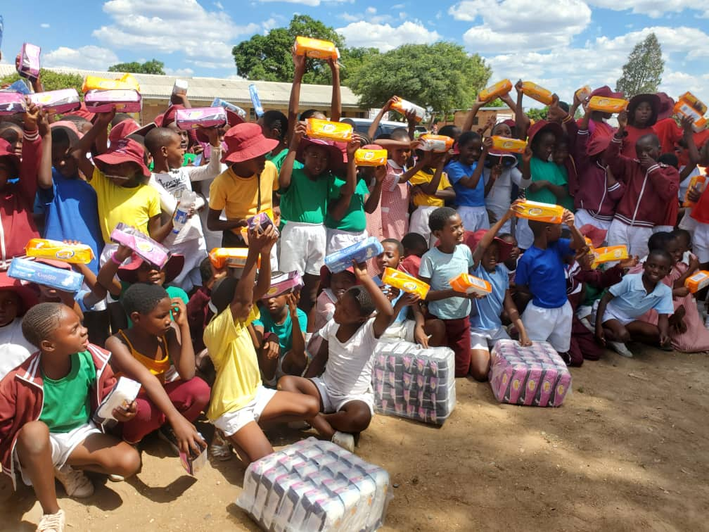
VI. SEXUAL AND REPRODUCTIVE HEALTH, HIV AND AIDS
Council has distributed Council 4477 sanitary pads to its 31 Schools in the year 2022 and 2023.
In 2024 council distributed 3783 pads in March 2024
Council seeks to provide sanitary pads to all adolescent girls in the 31 schools every term
Adolescent girls from one of the Council Primary schools receiving sanitary pads in March 2024
“Voice and Choice! Empower Women, End Violence”

Slide 37
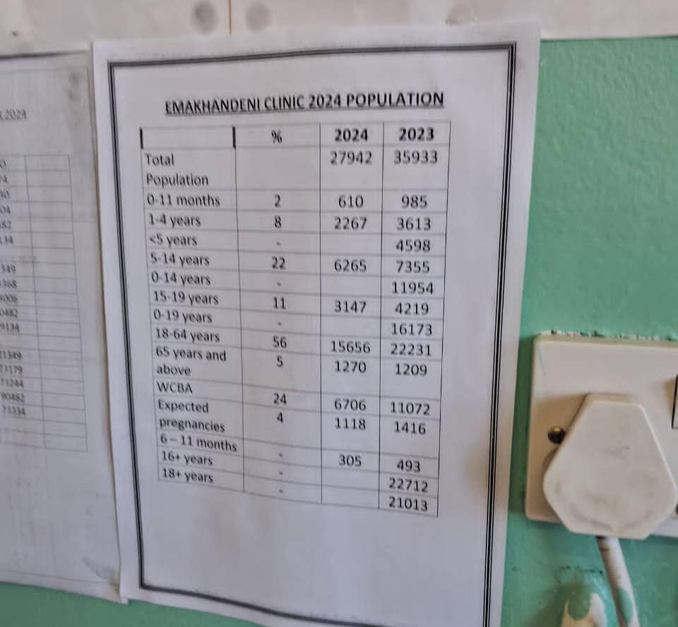
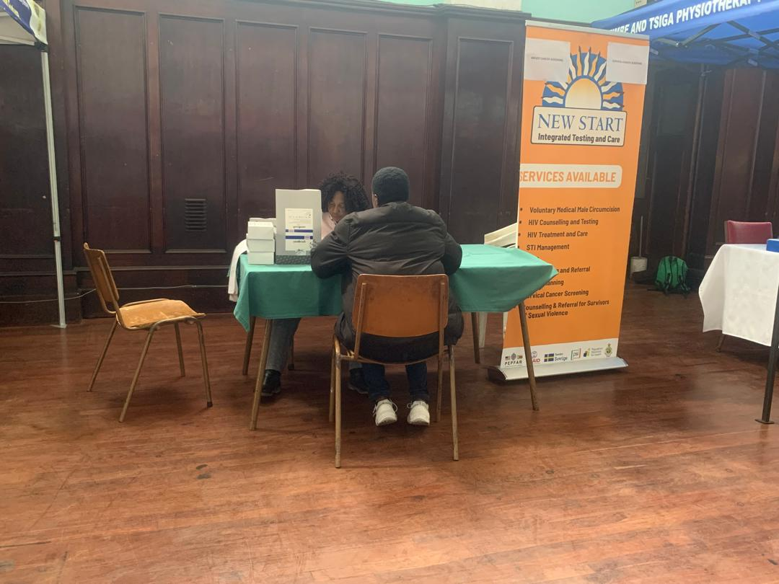
VI. SEXUAL AND REPRODUCTIVE HEALTH, HIV AND AIDS
An example of how council clinics populate their information on people offered services disaggregated by sex and age
Council employee receiving assistance on different services such as family planning, cervical cancer screening at the Employee Wellness that is done quarterly.
“Voice and Choice! Empower Women, End Violence”

Slide 38
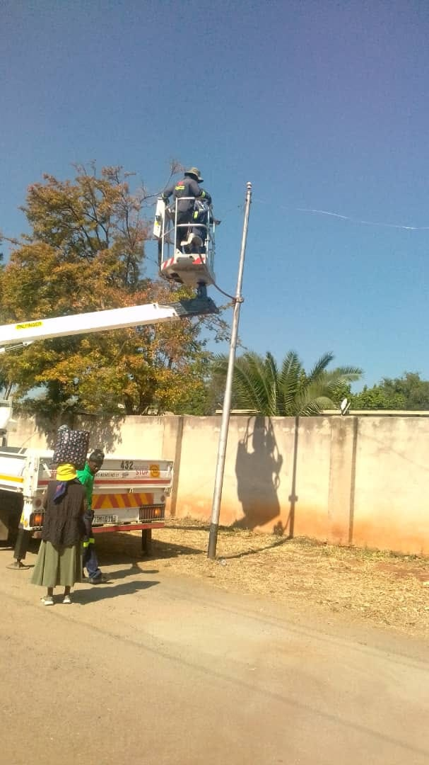
VII. ENDING GENDER BASED VIOLENCE
PREVENTION
Progress on replacement and installation is reported to Council monthly.
Council has a total of 440 tower lights,220 are functional.
In 2023 Council installed 13 new tower lights in Nkulumane 1 and Pumula South
Council has set a budget to install solar tower lights
Ward 5 Councillor, Cllr Dumisani Nkomo started a programme to repair street lights through the Ward Retention Fund
“Voice and Choice! Empower Women, End Violence”

Slide 39
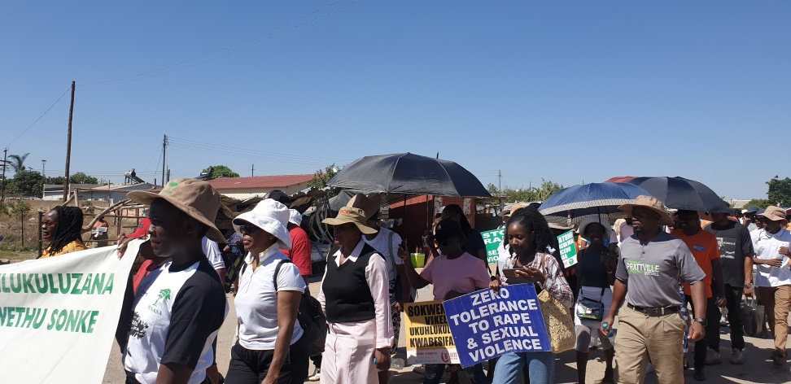
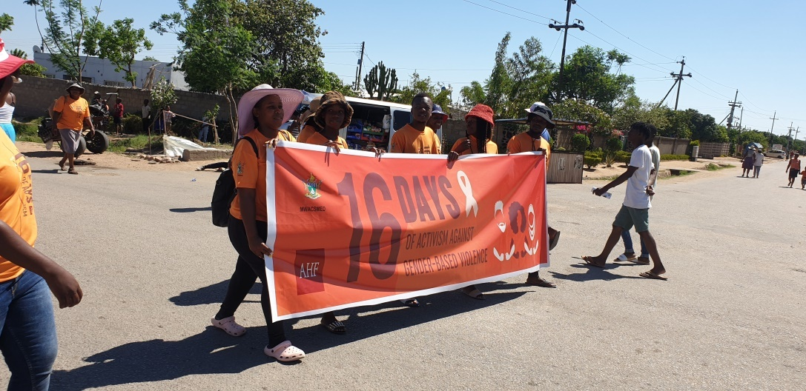
VII. ENDING GENDER BASED VIOLENCE
PUBLIC AWARENESS
Council participates in campaigns such as the 16 Days of Activism against Gender Based Violence, International Women's Day and International Day of the Girl Child
Council participates in stakeholder and community engagements, such as GESI trainings, workplace trainings on gender mainstreaming
For example CEDAW meetings, One Mobile One Stop GBV outreach held at Vurombo, GBV Assessments with World Bank, Community dialogues at Ngozi Mine
City of Bulawayo representatives during the 2023 Provincial 16 Days of Activism against GBV march
“Voice and Choice! Empower Women, End Violence”

Slide 40
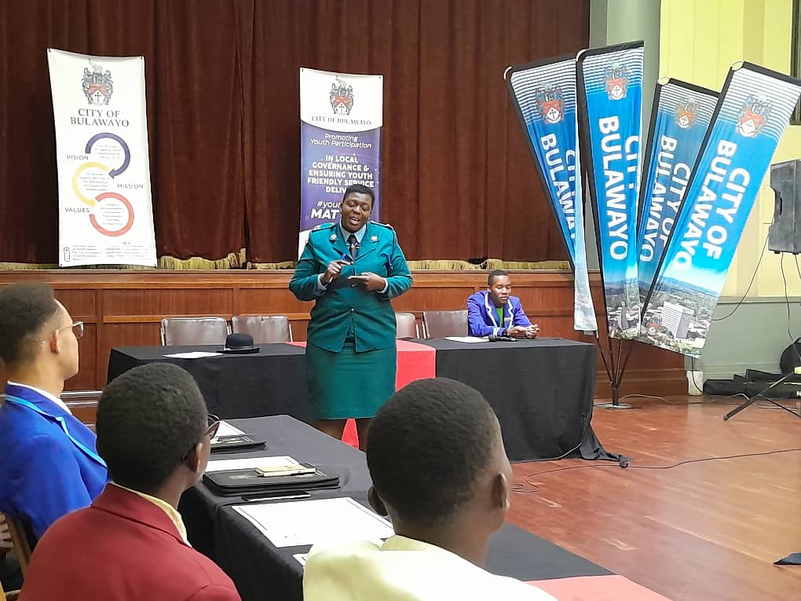
VII. ENDING GENDER BASED VIOLENCE
RESPONSE AND COORDINATION
Council collaborates with implementing partners and these include Musasa Project`s, National Aids Council, Population Solutions for Health (PSH), AFRICAID, Zimbabwe Health Interventions, Contact Counselling, Nehemiah Project, Ministry of Women Affairs, Zimbabwe Gender Commission and ZRP-VFU
Assistant Inspector Nomalanga Msebele presenting on GBV at the Youth Led High Tea Interface
“Voice and Choice! Empower Women, End Violence”

Slide 41


VII.ENDING GENDER BASED VIOLENCE
In response and coordination Council conducts mental awareness workshops to tackle issues on GBV.
Participants engaged in a meditation exercise and practical mental health activities such as personal and community mental health plans.
“Voice and Choice! Empower Women, End Violence”

Slide 42


VII. ENDING GENDER BASED VIOLENCE
Active Youth Zimbabwe offering drug abuse, morale values and human rights awareness talks to the employees
Mellisa Ncube, assistant clinical psychologist presenting during the employee mental health awareness
“Voice and Choice! Empower Women, End Violence”

Slide 43

VIII. CLIMATE JUSTICE
The Council is aware of climate change and has the following projects:
Grass Cutting programme
Youth Climate Action Fund
Ranger patrols
Tree planting
Training and information dissemination on environmental management
Clean Up Campaigns
Nutritional/Community gardens
Poultry, mushroom projects
Nursery (City of Kings)
City of Bulawayo Gender Champion, His Worship the Mayor Senator David Coltart participating in one of the City’s wide Clean Up Campaigns
“Voice and Choice! Empower Women, End Violence”

Slide 44

VIII. CLIMATE JUSTICE
106 women, 70 youths, 154 men are employed in climate change projects
Council conducted 8 environmental awareness campaigns, planted 1250 trees and cleared 85% of road verges and open spaces.
664 surveillance patrols were conducted
Community members employed waste management initiatives
“Voice and Choice! Empower Women, End Violence”

Slide 45

VIII. CLIMATE JUSTICE
Council also incorporates Climate action in its commemorations eg IDG commemorations in 2023 and 2024
IDG 2023 were done in the form of spelling bee and debate that involved climate change
IDG 2024 had high schools come up with a resolution paper on challenges young girls face due to climate change and mitigation measures
“Voice and Choice! Empower Women, End Violence”

Slide 46


VIII. CLIMATE JUSTICE
Tree planting initiatives
“Voice and Choice! Empower Women, End Violence”

Slide 47

VIII. CLIMATE JUSTICE
CITY OF BULAWAYO EMPOWERS YOUNG GIRLS AND WOMEN TO FIGHT AGAINST CLIMATE CHANGE
IDG 2024 BANNER
“Voice and Choice! Empower Women, End Violence”

Slide 48

IX. GENDER MANAGEMENT SYSTEM
His Worship the Mayor, Deputy Mayor and Councillors
Town Clerk
Human Capital Director
Principal Gender Safety and Health Officer/ Council Gender Focal Person
Gender Officer
Departmental Gender Focal Persons
His Worship the Mayor David Coltart presenting gifts to Honourable Minister Winston Chitando and Honourable Minister Judith Ncube during the LED Commissioning in February 2024
“Voice and Choice! Empower Women, End Violence”

Slide 49

IX. GENDER MANAGEMENT SYSTEM
Registers and reports on are used to gather and share disaggregated data to the management which is the General Purposes Committee every month
Council interacts with other Councils through look and learn exchange visits, commemorations, youth interface dialogues, participating at summits.
Gender is written in the Town’s Clerk performance contract
City of Bulawayo participates at all Forums eg Town Clerks Forum, Housing Director Forums
Council departmental gender focal person doing group work with Victoria Falls Council Gender Focal Persons at the Look and Learn.
“Voice and Choice! Empower Women, End Violence”

Slide 50

X. GENDER RESPONSIVE BUDGETING
City of Bulawayo submitted an entry in the GRB category
The 2024 proposed budget consultation meetings were consolidated into a single meeting in view of the elections.
The meeting had a total number of one hundred and fifty-eighty (158) participants comprised of eighty-one females (81) and seventy-seven males (77) including thirteen persons with disabilities.
Sentiments expressed were focused on the need to improve service delivery at an affordable charge
Former Mayor Cllr Solomon Mguni giving welcome remarks at the 2023 budget consultation at the Large City Hall
“Voice and Choice! Empower Women, End Violence”

Slide 51
















PARTNERSHIP FOR GENDER AND INCLUSION

Slide 52
CHALLENGES
Slow pace in writing the job descriptions that include gender mainstreaming in key positions such as Directors and assistant directors.
Staff turn over is affecting continuity in the implementation of sex disaggregated data collection for example departmental gender focal persons are frequently changed.
Poor communication and the inconsistent changes of Gender Focal Persons from other local authorities is another challenge that Council has experienced in the implementation of the hub activities.
“Voice and Choice! Empower Women, End Violence”

Slide 53
CHALLENGES
Community trainings and awareness campaigns on gender are constantly being done however men perceptions on gender issues still need to increase.
Illegal vending is increasing exposure of gender based violence to women and girls including persons with disabilities.
E-governance has not yet been fully implemented to benefit gender mainstreaming and inclusion
“Voice and Choice! Empower Women, End Violence”

Slide 54
LESSON LEARNED AND INNOVATION
Development of a Gender responsive budgeting template for Council budgets assisted in the crafting of more Gender Responsive local authority budgets.
Partnership for Goals enhanced Gender Mainstreaming In Local Authority. This has been applied by integrating gender mainstreaming in Water and Sanitation projects and has resulted in acknowledgement by funding partners such as, Vitens Waterworx, Gender Links, Embassy of Sweden, Hivos, WILD, WCOZ,FODPZ
Through the Look and Learn visits, Council has successful established a robust network of collaborations with other authorities, embassies and institutions fostering mutually beneficial relationships and knowledge for example Quelimane Municipality, Gwanda RDC, Victoria Falls Council, Hwange Board, Lupane Board and the International Municipal BRICS
“Voice and Choice! Empower Women, End Violence”

Slide 55
SUSTAINABILITY AND REPLICATION
Gender mainstreaming and inclusion is included in the Councils strategic plan , budget and there is an established office with officers who are on the organogram.
Integrating gender into e governance
Promoting peer learning and review
“Voice and Choice! Empower Women, End Violence”

Slide 56

SIYABONGA...
TATENDA...
THANK YOU...
Contact details:
AUDREY MANYEMWE
GENDER FOCAL PERSON
CITY OF BULAWAYO
CELL: 0772852283
EMAIL: amanyemwe@citybyo.co.zw
“Voice and Choice! Empower Women, End Violence”

